Slide 1

Constraining Foreground Models Using Time- and Antenna- Dependent Data
Dominic Anstey
On behalf of the REACH collaboration

Slide 2

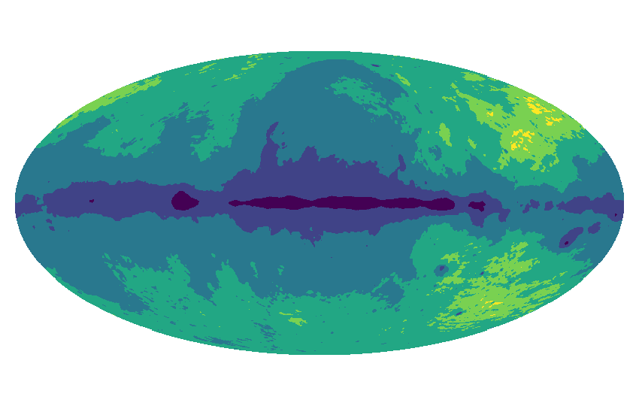
Summary of REACH Pipeline
β₆
β₅
β₄
β₃
β₂
β₁
Anstey et al. 2021

Slide 3
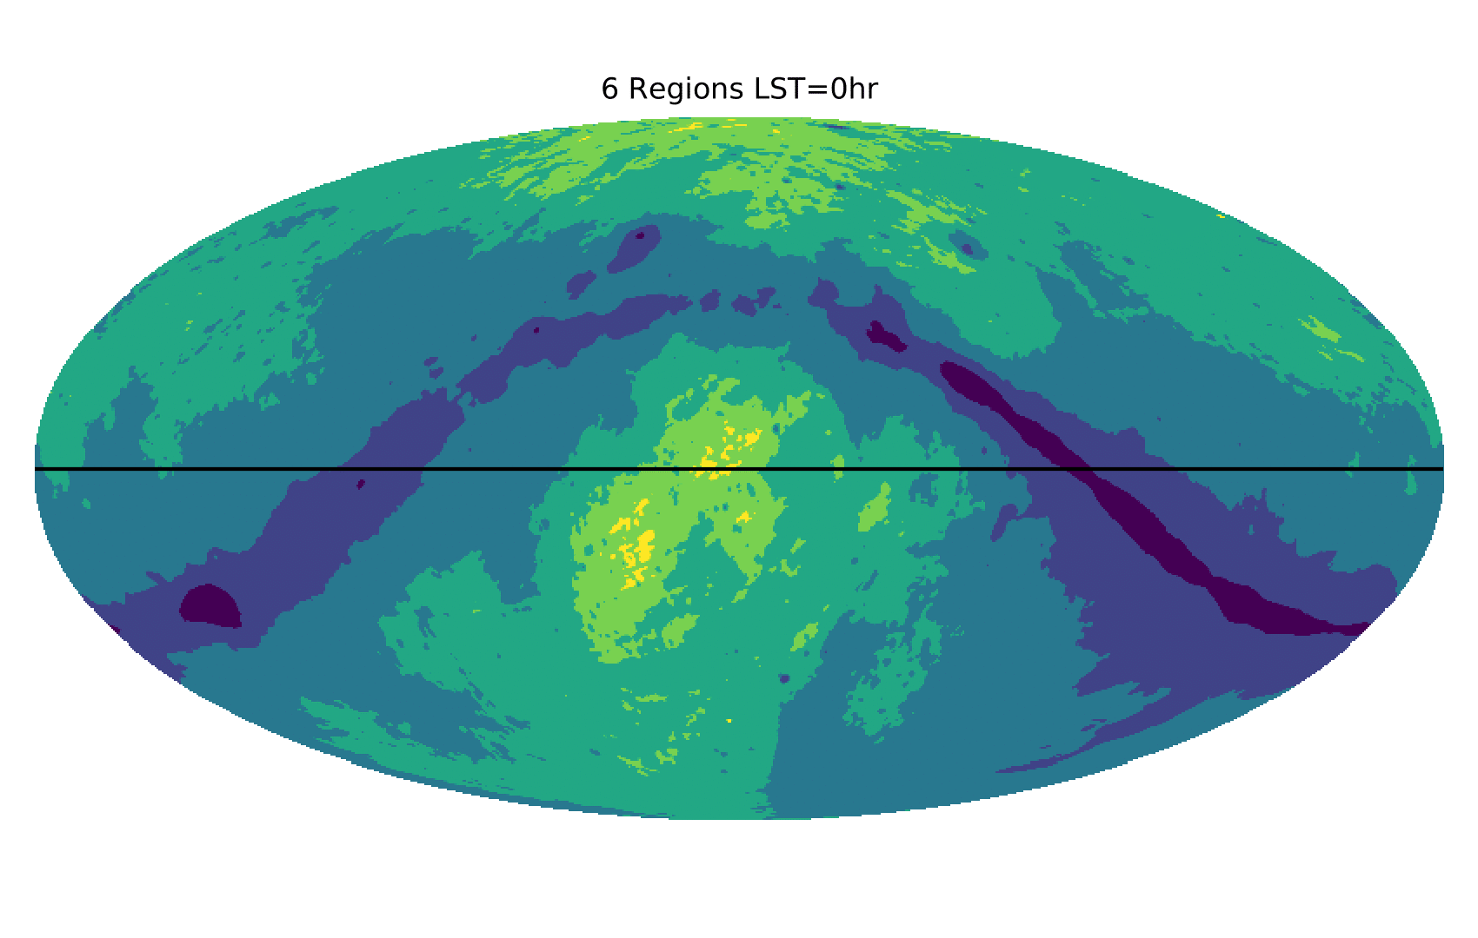
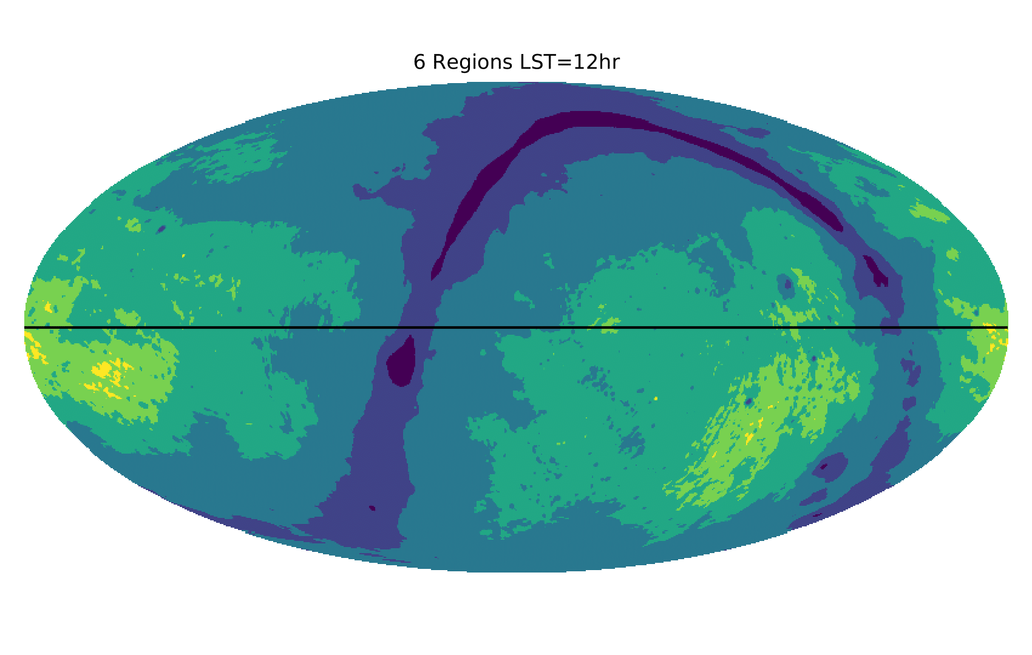
Time-Separated Fitting

Slide 4



Time-Separated Fitting
(…)

Slide 5
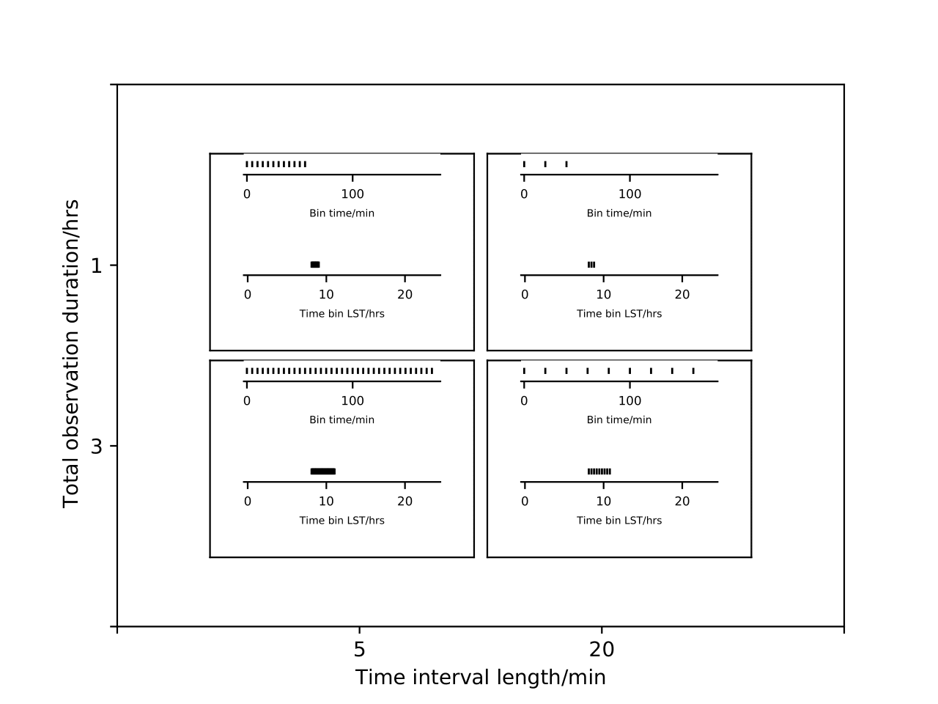
Comparison of Time-Averaged and –Separated Fitting

Slide 6
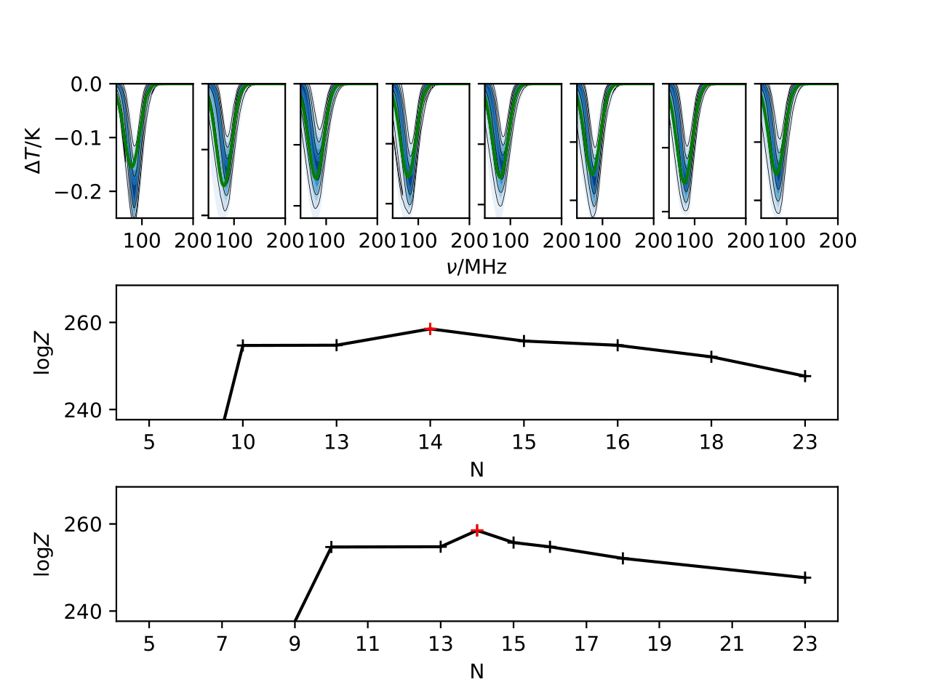
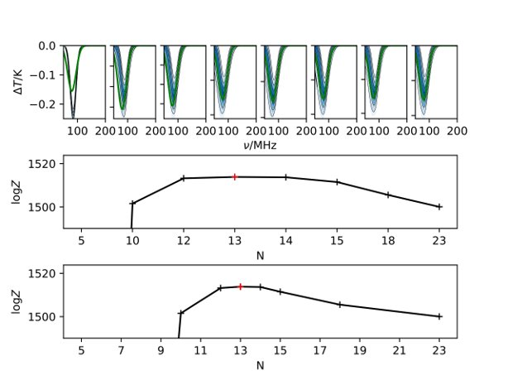
Comparison of Time-Averaged and –Separated Fitting
1 Hour
5 Minute Divisions
Time-Averaged
Time-Separated

Slide 7
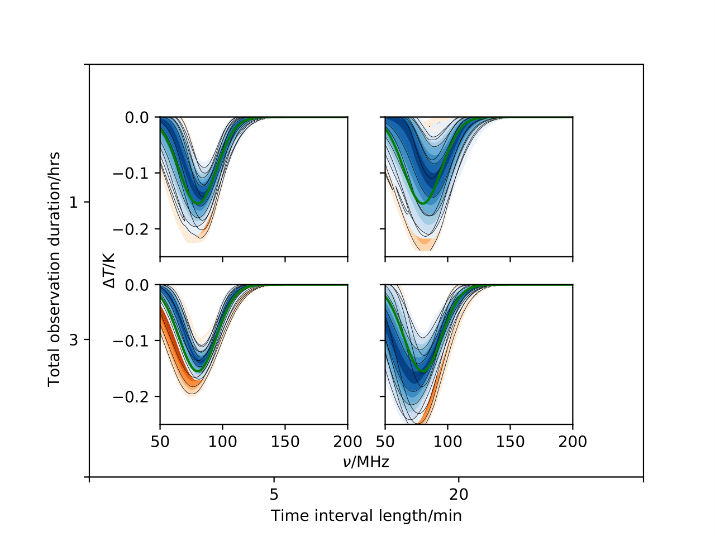
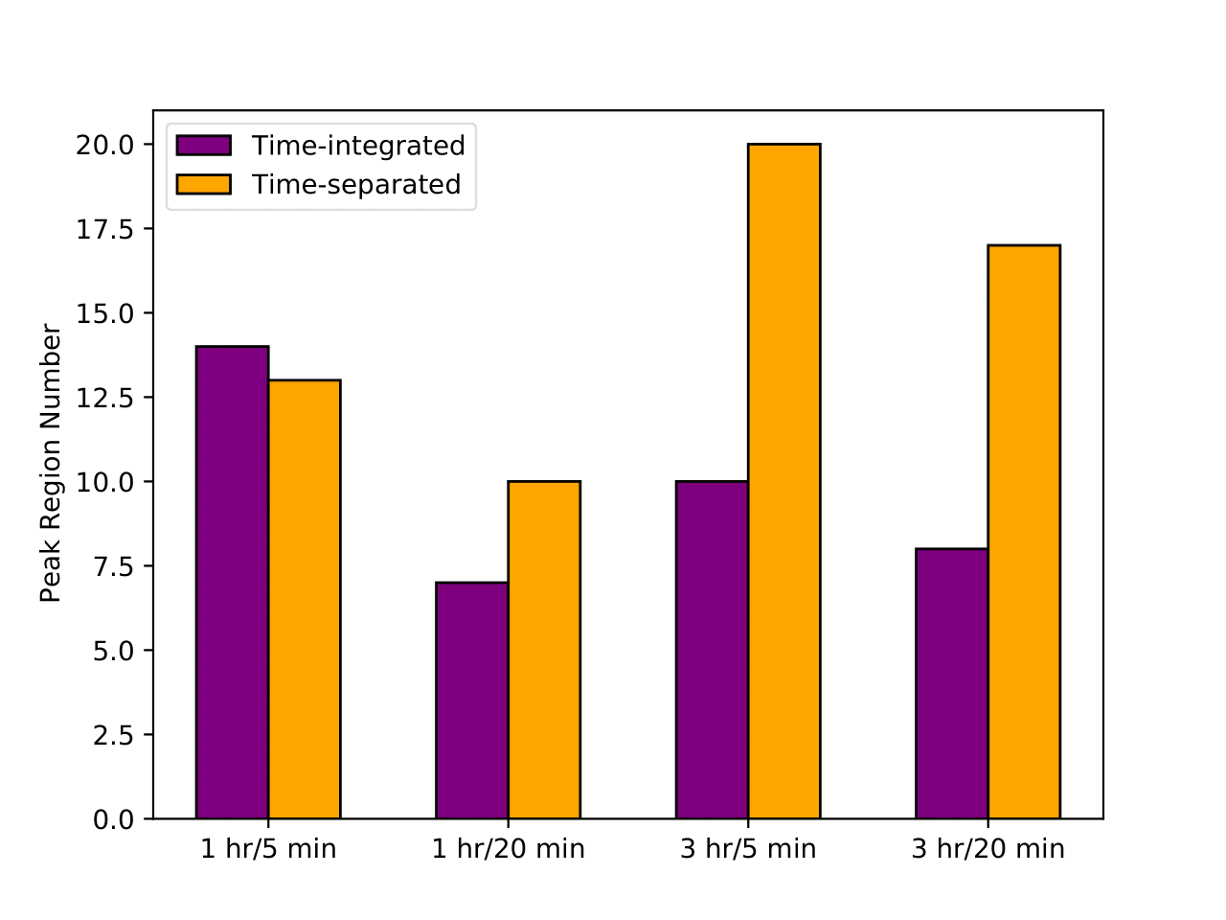
Result Comparison

Slide 8
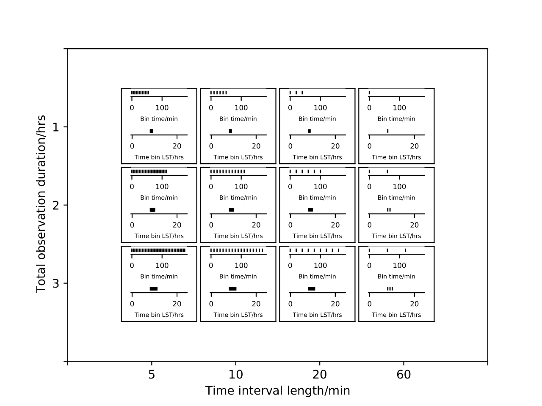
Tests of Time-Separated Analysis
Scan over observation lengths and time-bin separations

Slide 9
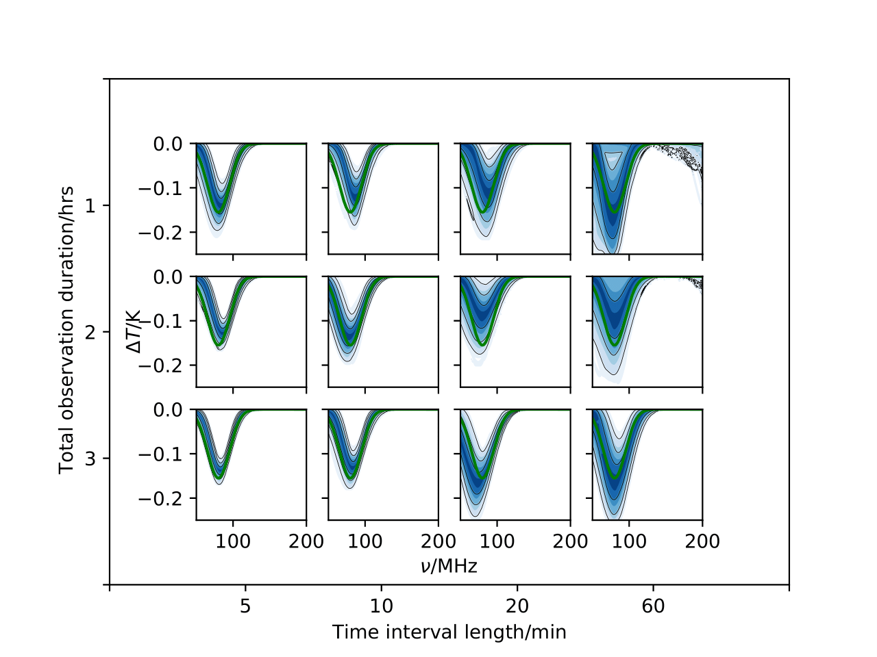
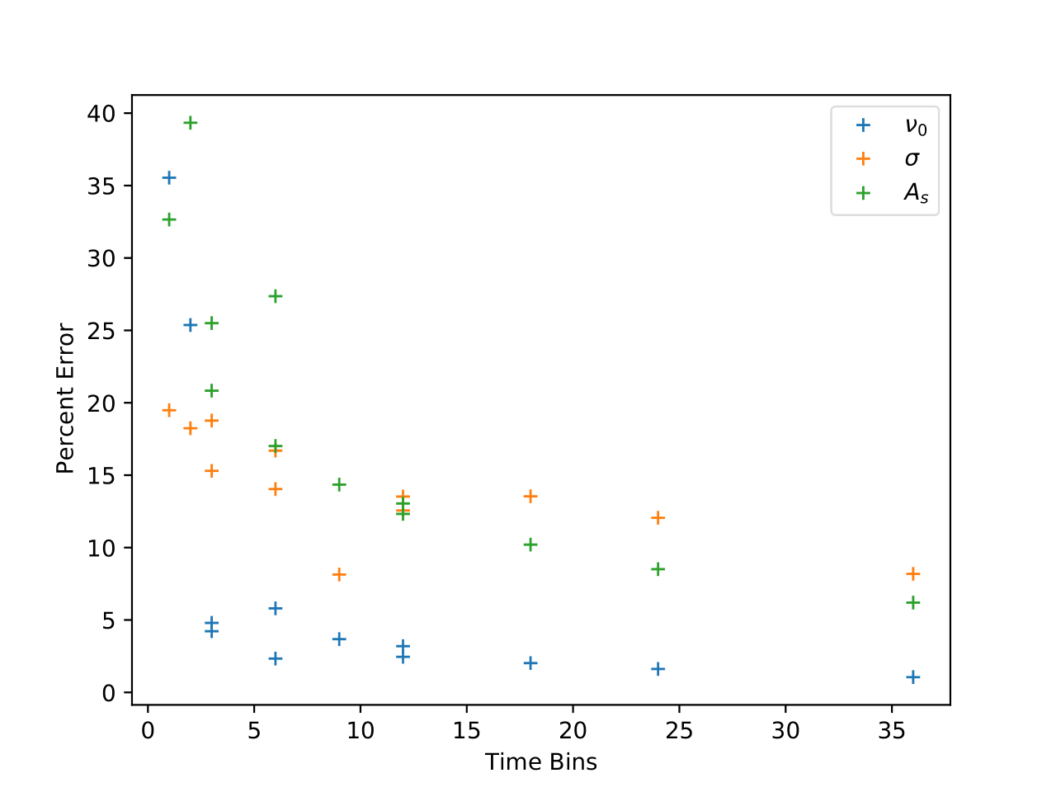
Scan Results

Slide 10
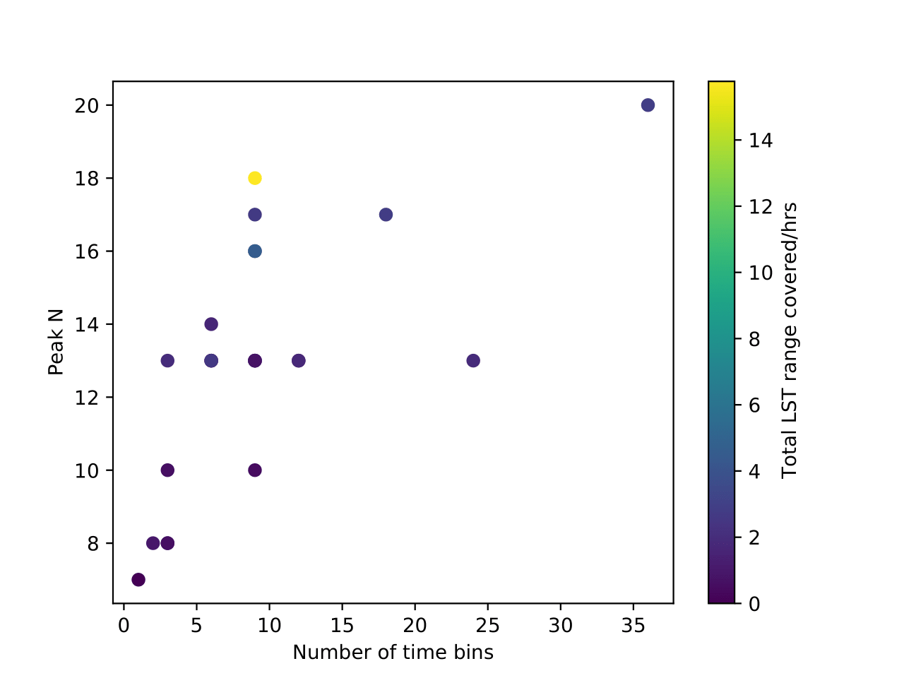
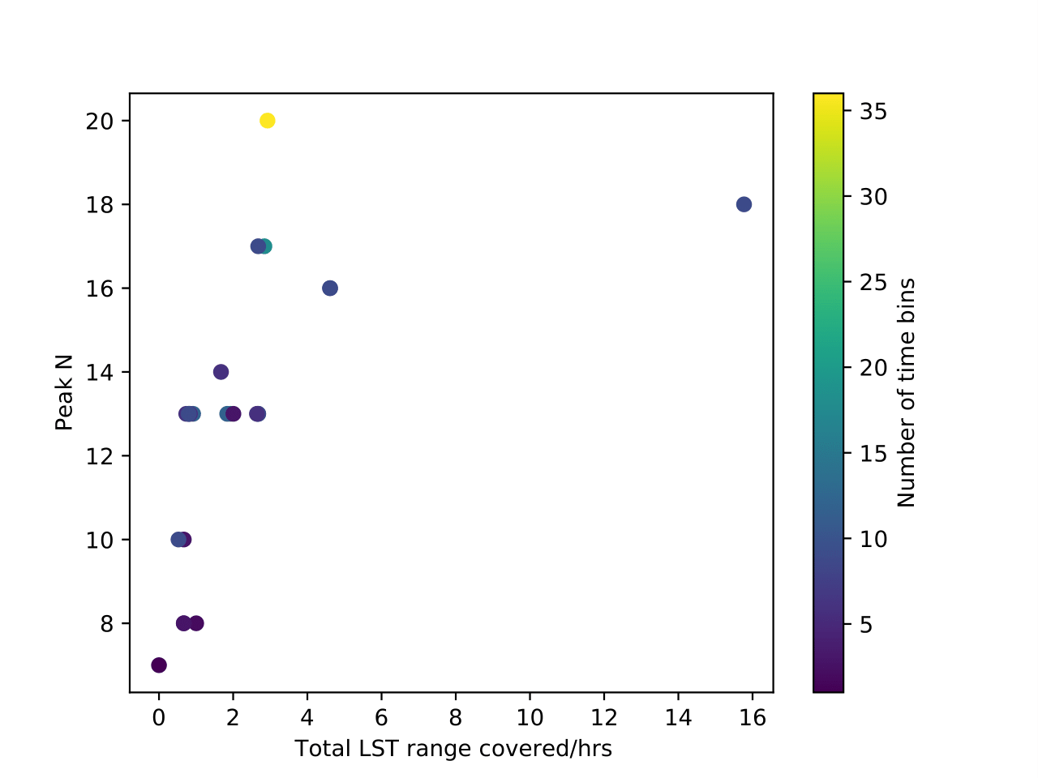
Variation in Peak Parameter Numbers

Slide 11
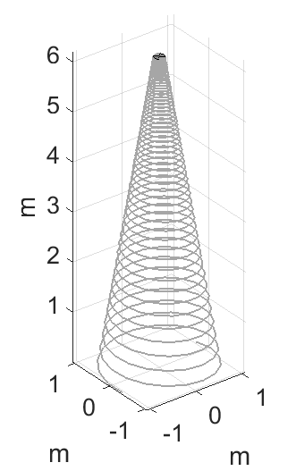
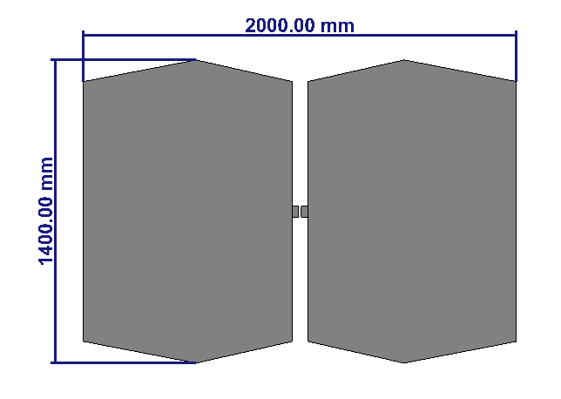
Multiple Antennae

Slide 12
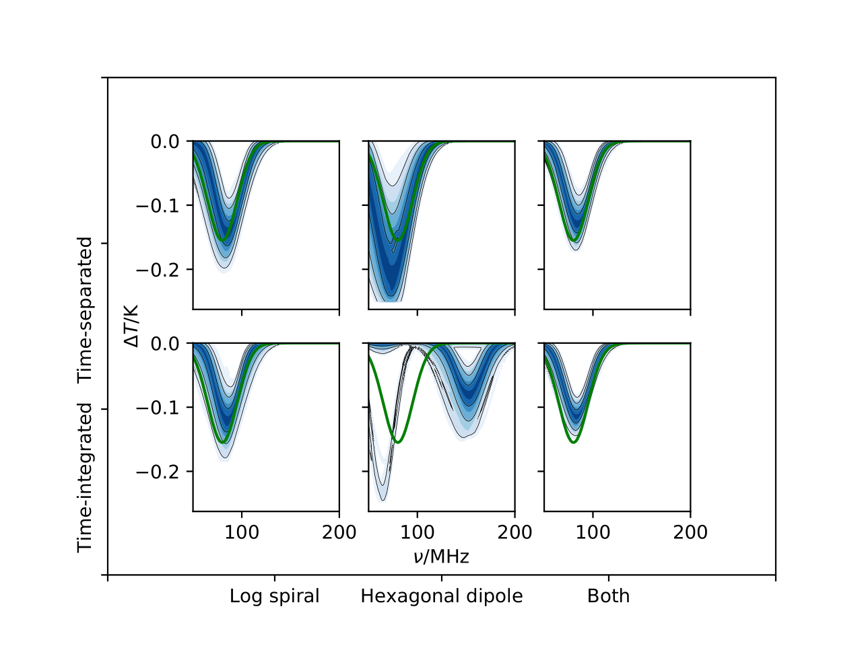
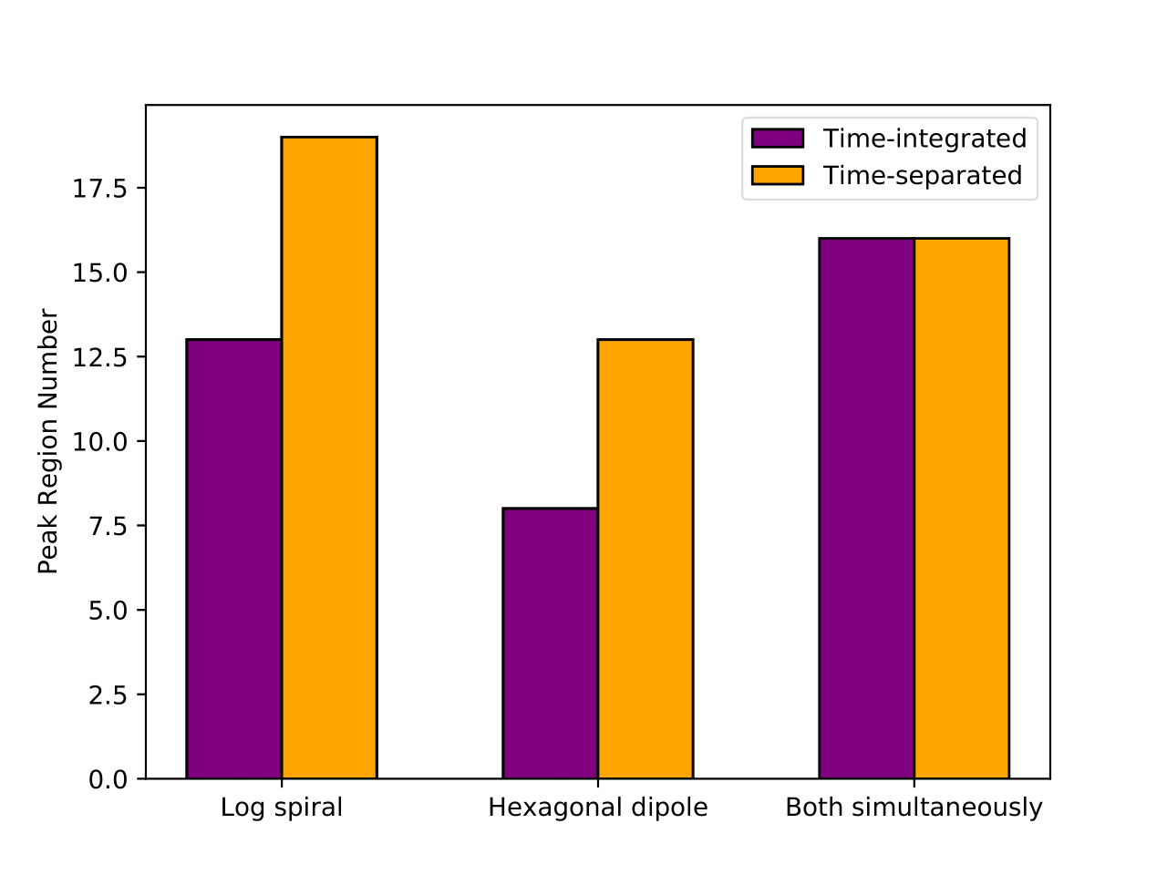
Multiple Antennae Results

Slide 13




Conclusions
Using a physical property for the foreground parameters allow multiple time-dependent data sets to be fit simultaneously
This produces a significant improvement in signal reconstuction over a single model fit to integrated data
Signal recovery accuracy improves with increasing number of time bins and increasing LST range covered by them
Number of parameters in the foreground model required to achieve an optimal model fit also increases with increasing number of time bins and increasing LST range
Method extends to allowing data from multiple antennae to be fit simultaneously, which gives further improvement in signal recovery
Antenna EM simulations provided by John Cumner and Quentin Gueuning
Plots produced using fgivenx tool: Handley, 2018

Slide 14


