Slide 1

Efficient Bayesian Modelling of Time Dependent and Transient RFI in 21cm Experiments
6th Global 21cm Workshop
Dominic Anstey
In collaboration with Sam Leeney

Slide 2
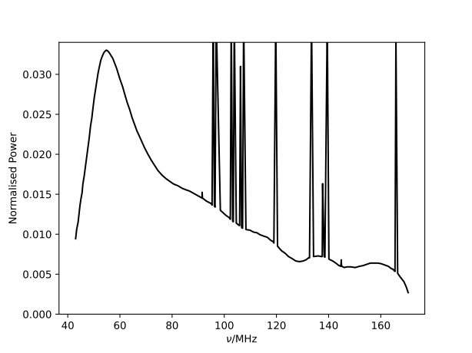
The Challenge of RFI
The 21cm signal is predicted to fall in the ~50-150MHz band. Directly over FM radio band.
- Experiments in remote locations
- RFI cleaning
Based on Leeney et al. 2023 (arXiv:2211.15448)

Slide 3
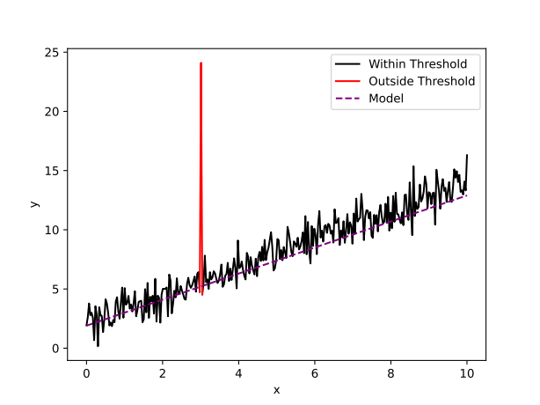
Bayesian Anomaly Flagging
Leeney et al. 2023 (arXiv:2211.15448)
- Calculate likelihoods of each point
- Compare to a threshold
- If exceeds the threshold, include the point’s likelihood, downweighted by a penalty
- If below the threshold, add a fixed penalty

Slide 4






Bayesian Anomaly Flagging
Leeney et al. 2023 (arXiv:2211.15448)
if
otherwise
Probability of a point being contaminated
Approximate scale of the contamination

Slide 5
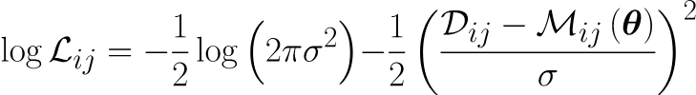


Bayesian Anomaly Flagging
if
otherwise

Slide 6
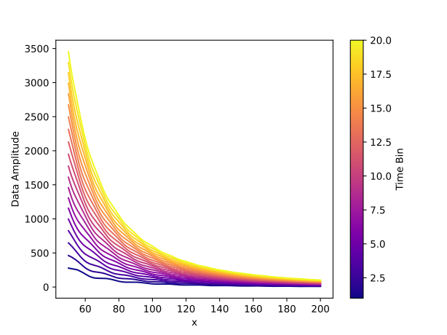
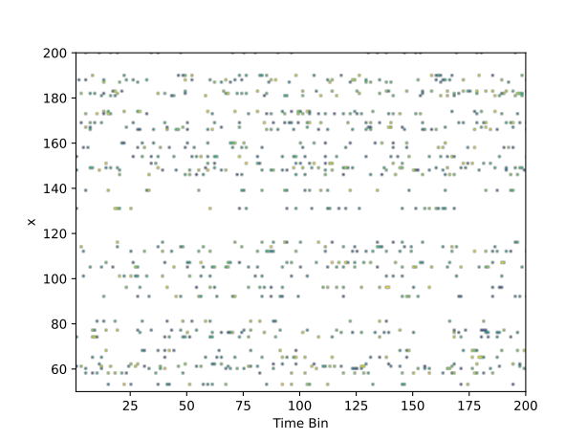

Toy Model
Sinusoid with time-varying parameters, multiplied by a power law
With randomly generated values for the sinusoid parameters

Slide 7
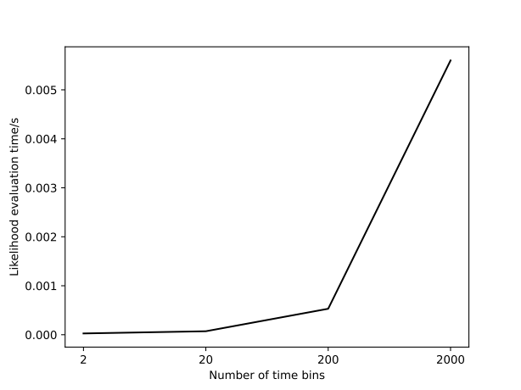
Computation Time
The term
must be evaluated and compared to the threshold for every data bin and time bin. There is no way to factorise the time summation out to speed this calculation.

Slide 8
Likelihood Reweighting
Gravitational waves
Payne et al. 2019 (arxiv:1905.05477)
Romero-Shaw et al. 2019 (arxiv:1905.05477)

Slide 9
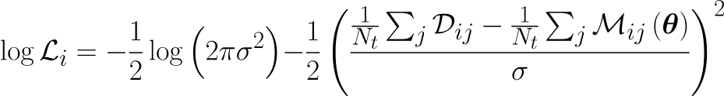
Computation Time
if
if
otherwise
otherwise
Full likelihood - Slow to evaluate
Time averaged likelihood - Fast to evaluate
Both likelihoods use the same parameters and will have comparable posteriors

Slide 10




Likelihood Reweighting

Slide 11
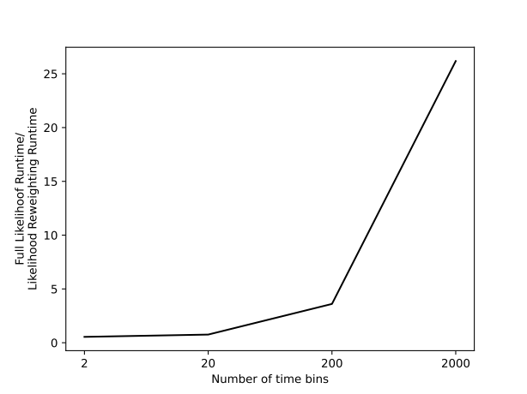
Results
Ratio of fitting data set using the flagger for
Full slow likelihood/likelihood reweighting

Slide 12
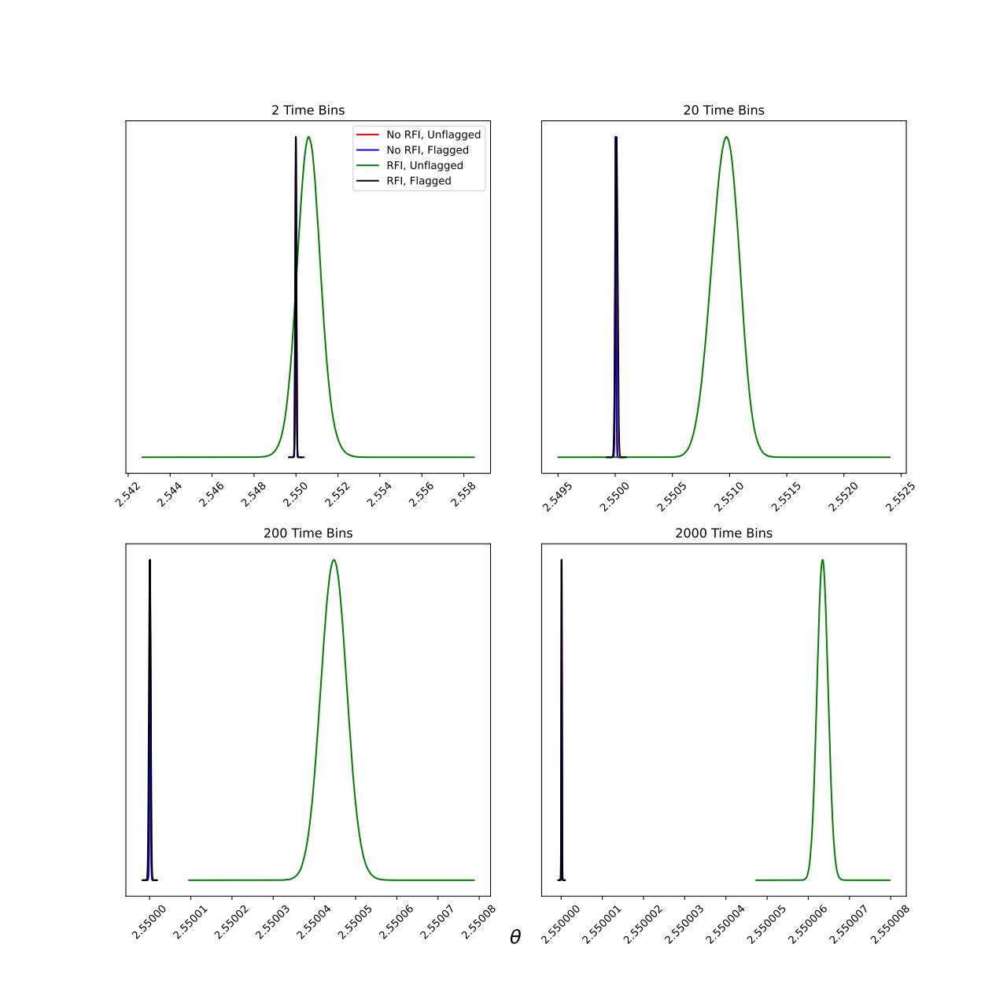
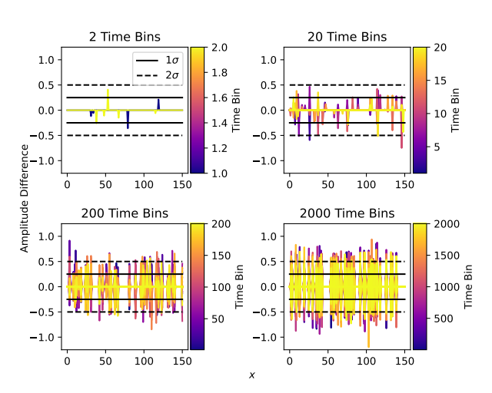
Results

Slide 13
Conclusions
In data and models with predictable time variation, that variation can be leveraged to constrain the model more accurately.
Bayesian anomaly flagging can be incorporated in this process
Issue of runtimes can be resolved with likelihood reweighting
Works effectively as both a time-sensitive Bayesian RFI compensator and an efficient Bayesian transient flagger

