Slide 1


Dominic Anstey
Modelling Beam Uncertainties in Global 21cm Experiments through Bayesian Data Analysis

Slide 2

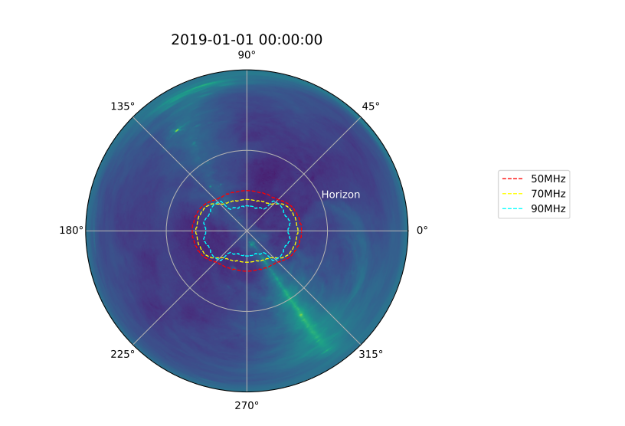
Beam Chromaticity and Uncertainties
Effects that can introduce beam errors:
- Errors in EM simulation
- Imperfections in antenna construction
- Unknown physical factors not included in the simulation
- soil permittivity
- weather effects
- material on the instrument

Slide 3
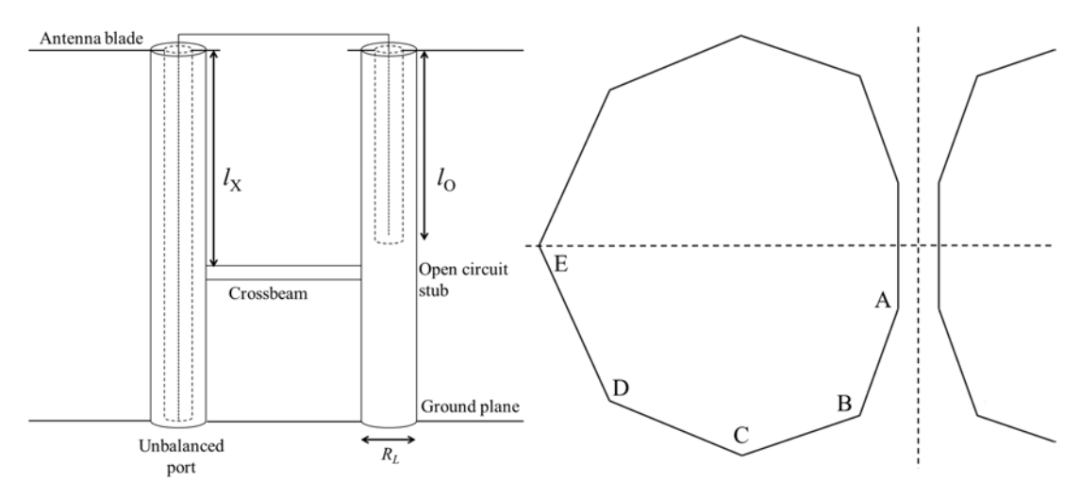
Beam Errors and Uncertainties
- Produced 2 test beams in EM simulations, A and B
- B differs from A by realistic construction errors:
- blade vertices randomly shifted by order ~ >1mm
- height above ground plane offset by ~few mm
- size of ground plane altered by ~few cm
Figure 24 from Cumner et al. 2022
Position/mm | Ax | Bx | By | Cx | Cy | Dx | Dy | Ex | gap | h | groundplane_size | R_L | l_x | l_o
Beam A | 17.956 | 78.147 | 565.57 | 271.74 | 454.42 | 724.74 | 415.64 | 894.35 | 11.208 | 694.9 | 14196 | 29.694 | 485.65 | 433.16
Beam B | 18 | 79 | 566 | 271 | 454 | 725 | 415 | 895 | 11 | 700 | 14250 | 30 | 486 | 433
Difference | 0.044 | 0.853 | 0.43 | 0.74 | 0.42 | 0.26 | 0.64 | 0.65 | 0.208 | 5.1 | 54 | 0.306 | 0.35 | 0.16

Slide 4
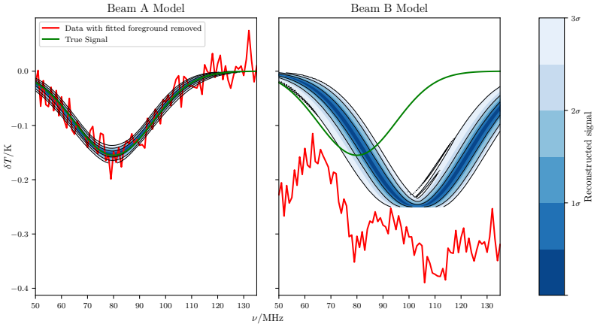
Impact of Errors
Foreground known exactly
Beam directivity variation <=0.5% (~-23dB)

Slide 5


Beam Parametrisation
Beam need to be parametrised and fit for:
Basis functions
Parametrised coefficient functions

Slide 6
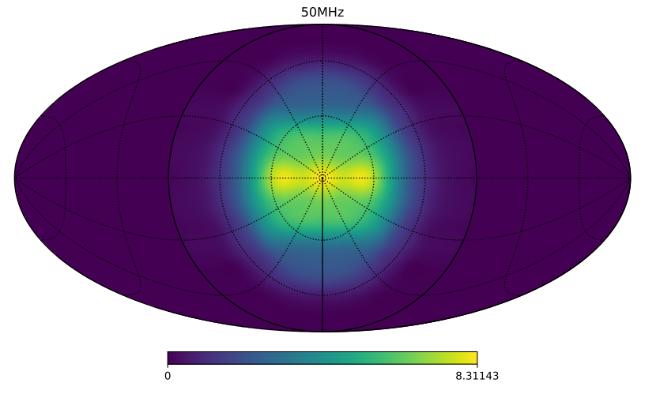
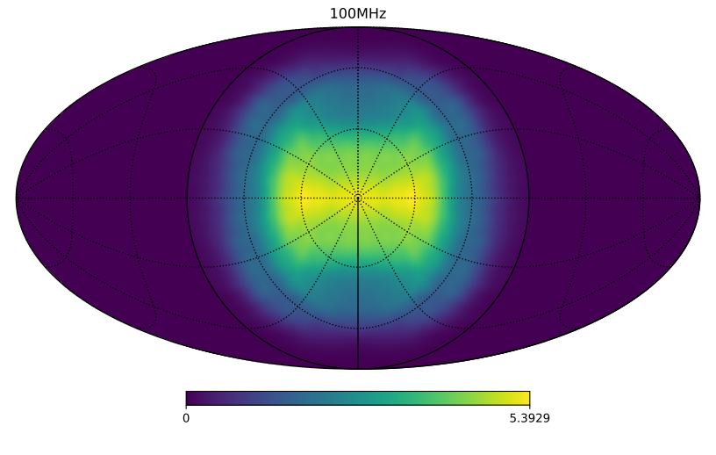
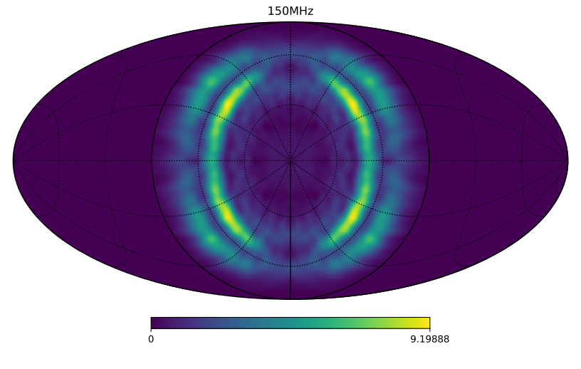
Coefficient Numbers
- Spherical Harmonics:
> 1000s of basis functions
- More sophisticated basis functions
~ 10-30
Each basis functions requires a parameterised coefficient function.
Order 5-10 parameters each.
Current best case requires of order ~50-100 parameters.
Two key Issues:
- Very slow to fit directly
- High freedom in the model

Slide 7



Nuisance Parameters

Slide 8
Analytic Marginalisation of Linear Parameters
Tauscher et al. 2021 (arXiv:2105.01672) Murray et al. 2022 (arXiv:2209.03459)
If the model is linear in some parameters:

Slide 9
Analytic Marginalisation of Linear Parameters
For uniform priors
Make the following substitutions:

Slide 10
Implementation for Beam Fitting
Require the coefficient parameters to be linear
- e.g. polynomials
Fitting a beam entirely introduces significant freedom to the model
Require basis functions specific to the antenna used
Require very tight priors
- fit variations to the coefficients

Slide 11
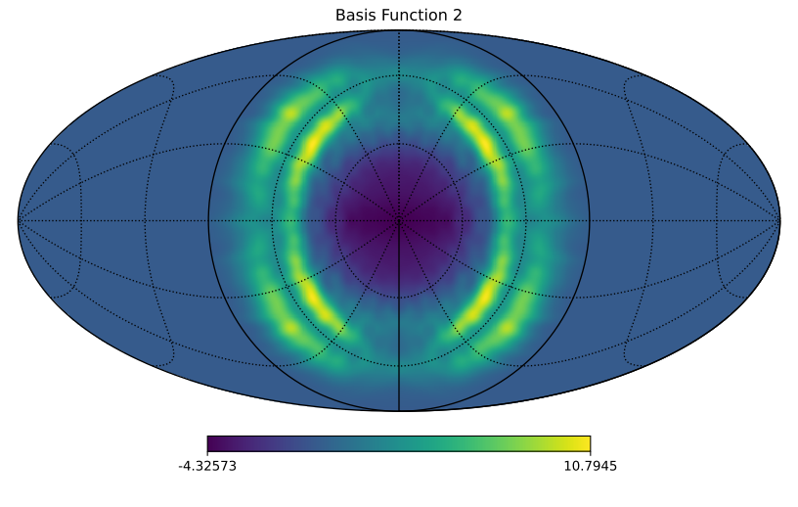
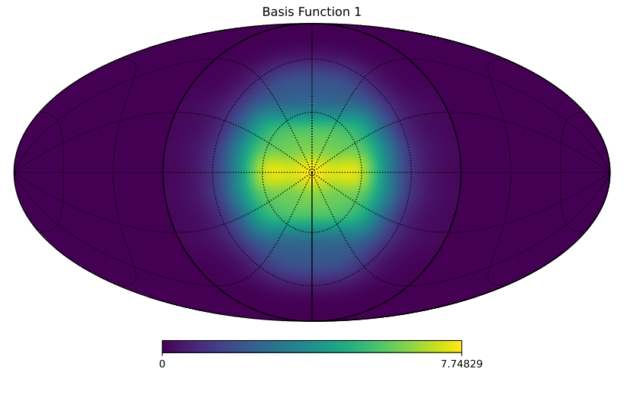
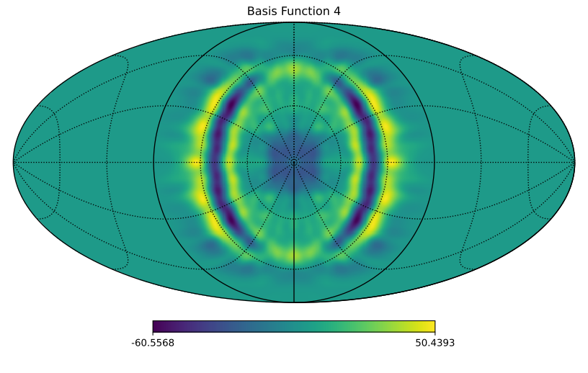
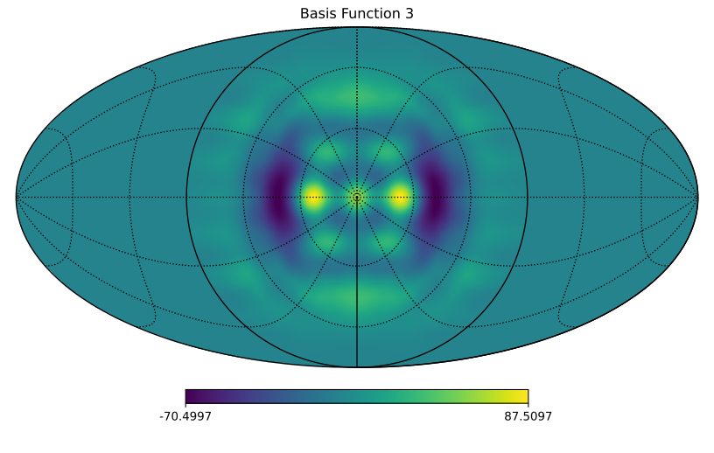
Trial Model
4 basis functions
Derived from GS decomposition of a dipole over a serrated square ground plane

Slide 12
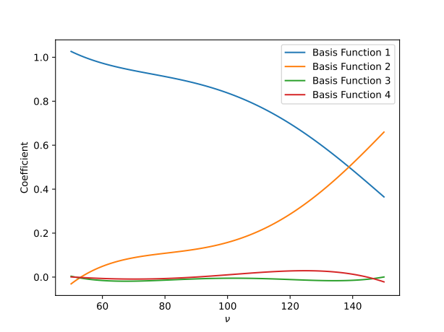

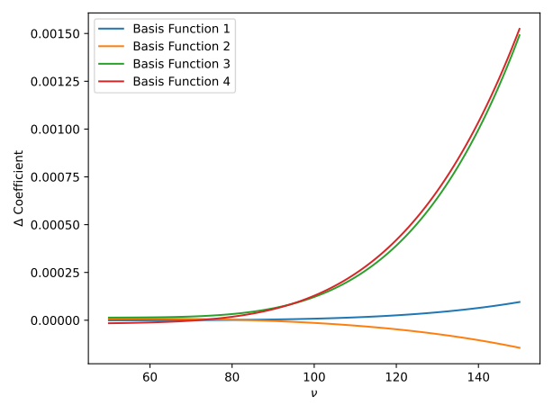
Trial Model
Beam 2
Beam 1
Changes of order 10⁻³

Slide 13
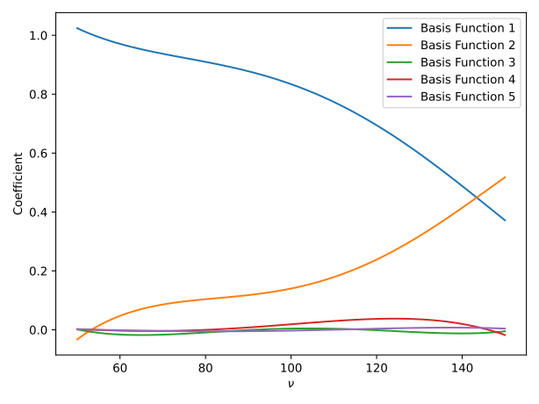
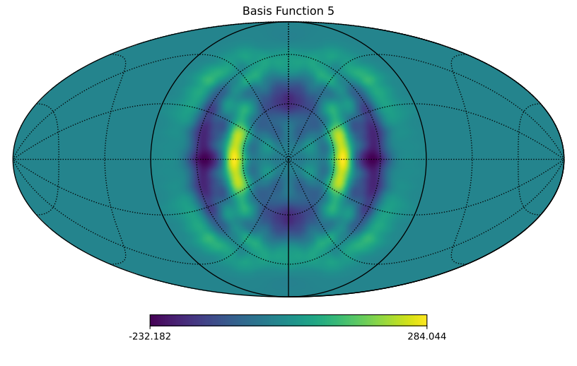
Trial Model
Beam 3

Slide 14
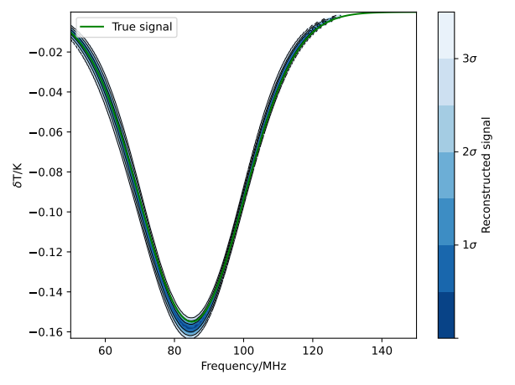
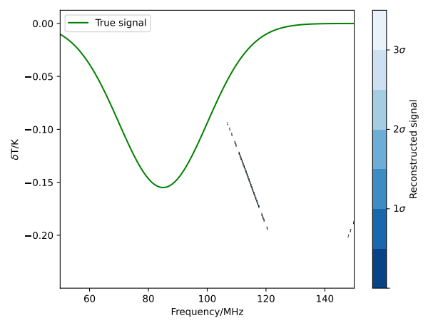
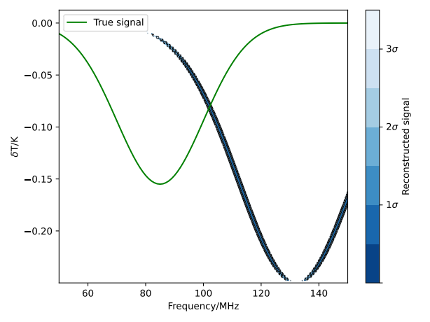
Effect of Beam Errors Without Modelling
Simulated data generated using specified test beam and a uniform power law foreground
Single spectral index foreground parameter fitted with chromaticity modelling assuming beam 1
Beam 1
Beam 2
Beam 3

Slide 15
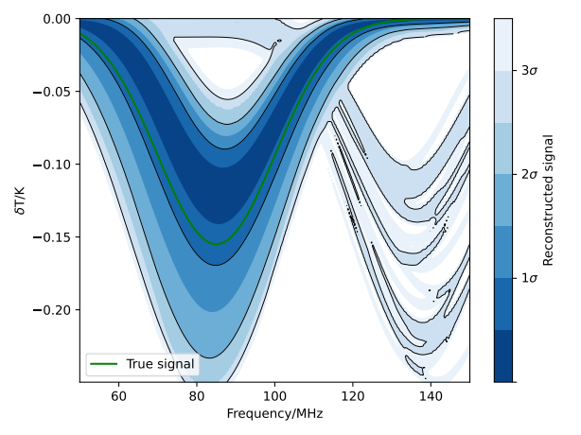
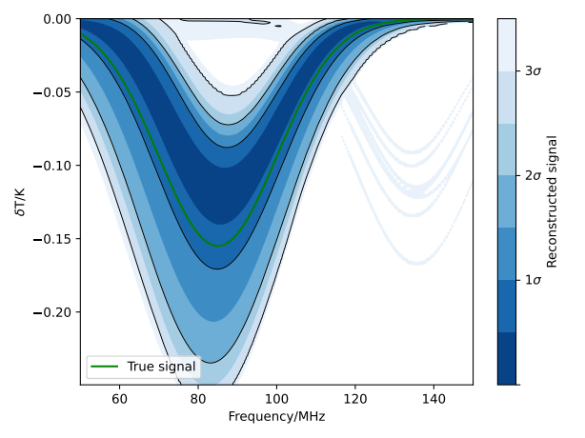
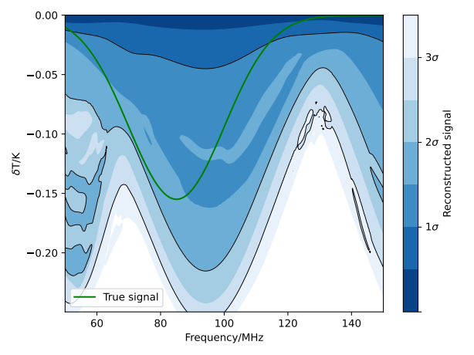
Results with AMLP Beam Modelling
Simulated data generated using specified test beam and a spatially dependant power law foreground
Full foreground with 15 spectral index parameters fitted with AMLP of 5th order polynomial variations on beam 1
Beam 1
Beam 2
Beam 3

Slide 16
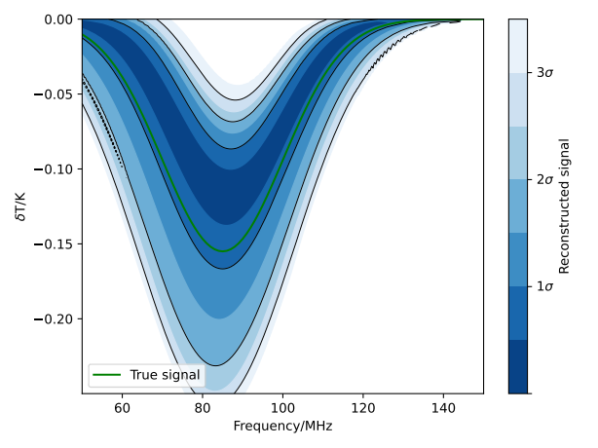
Results with AMLP Beam Modelling
Simulated data generated using specified test beam and a spatially dependant power law foreground
Full foreground with 15 spectral index parameters fitted with AMLP of 5th order polynomial variations on beam 1
Beam 1
Beam 2
Beam 3
5 basis functions

Slide 17
Correcting for Construction Errors
Simulated data generated using beam B and a spatially dependant power law foreground
Full foreground with 15 spectral index parameters fitted with AMLP of 6^{h} order polynomial variations of coefficients on beam A, for 11 basis functions derived by decomposition of beam A.

Slide 18
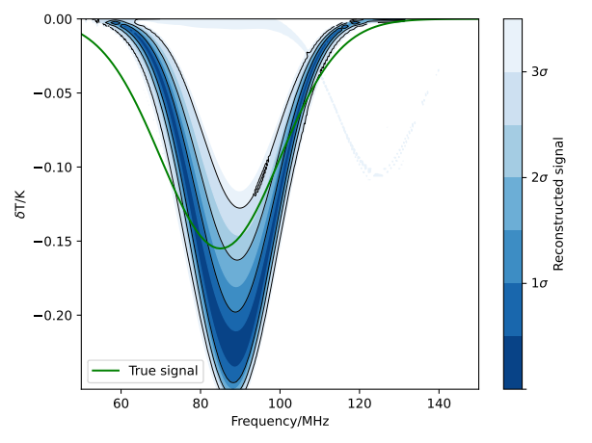
Correcting for Construction Errors
Simulated data generated using beam B and a spatially dependant power law foreground
Full foreground with 15 spectral index parameters fitted with AMLP of 6^{h} order polynomial variations of coefficients on beam A, for 11 basis functions derived by decomposition of beam A.

Slide 19
Conclusions
Inaccuracies in a beam model in 21cm experiments lead to uncorrected chromatic distortions that can mask the signal
Many realistic effects can produce sufficient beam errors to cause this issue
Parametrised beam modelling can help
Typical antenna directivities are complex enough to require more basis functions and parameters than can be practically fitted for
AMLP enables beams to be fitted for efficiently
Tight priors aid in avoiding fitting away the signal
Implementing AMLP enables beam uncertainties to be accounted for sufficiently for the 21cm signal to be recovered

Slide 20
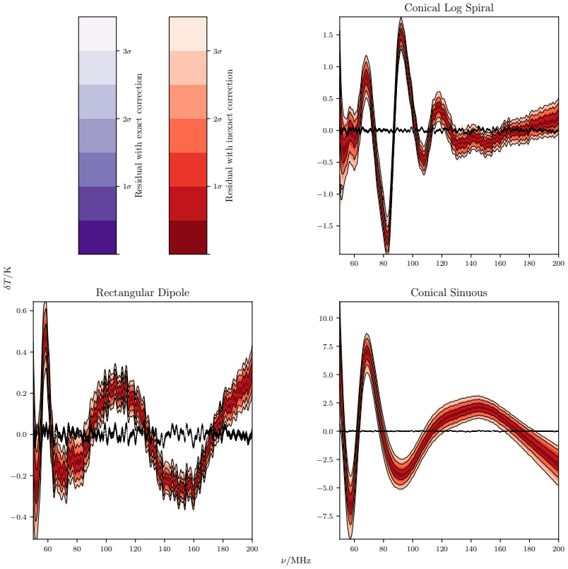
Beam Chromaticity
Slight errors in the predicted beam or foreground can produce residual chromaticity large enough to mask the 21cm signal

Slide 21

Analytic Marginalisation of Linear Parameters
For Gaussian priors
Further substitutions:

Slide 22

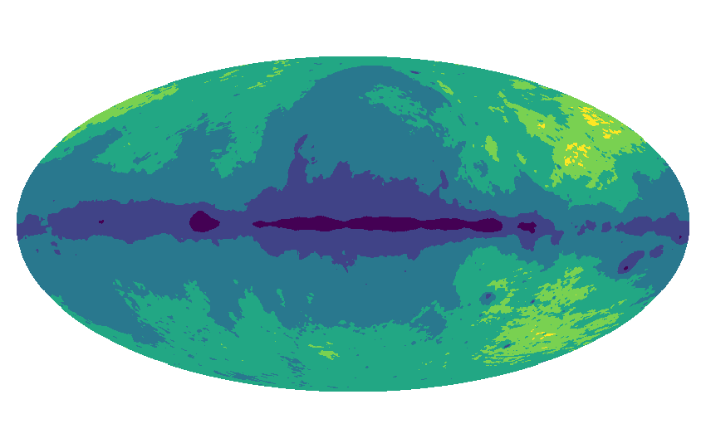
Implementation for Beam Fitting
x coefficient factor
β₆
β₅
β₄
. . . .
β₃
β₂
β₁
. . . .

Slide 23
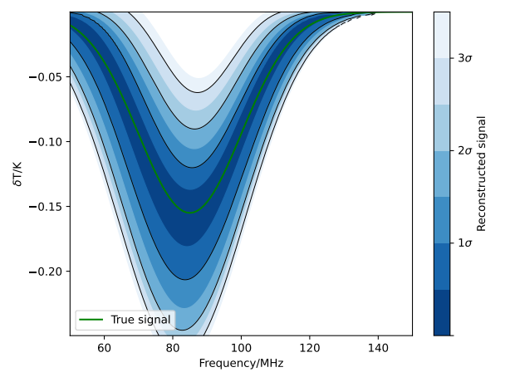
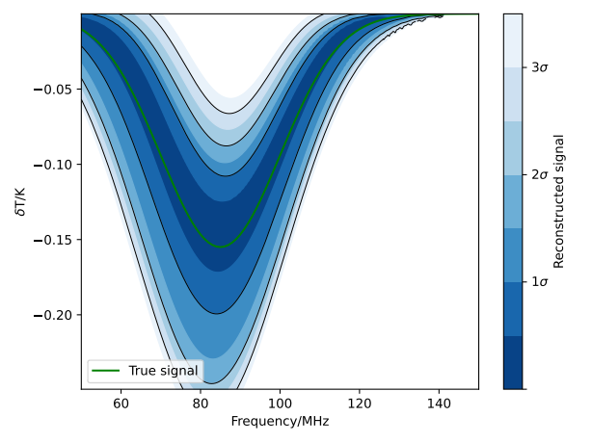
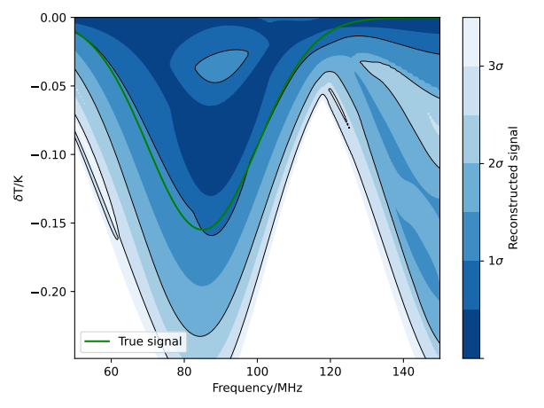
Results with AMLP Beam Modelling
Simulated data generated using specified test beam and a uniform power law foreground
Single spectral index foreground parameter fitted with AMLP of 5th order polynomial variations on beam 1
Beam 1
Beam 2
Beam 3

