Slide 1




Final Project | GroofGroof
Final Project: Fine-Tuning MentalBERT for Mental Health Text Classification Using Grid Search and Random Search Optimization
(SDG 3 Target 4.1)
Presented by
Under the Guidance of:
Almazan, Tejada, & Pajanustan, Samantha
Dr. Rodolfo C. Raga Jr.

Slide 2
INTRODUCTION
Social media, forums, and messaging platforms have become important outlets for people experiencing mental health struggles, including suicidal thoughts. The language people use often contains subtle signs of distress that automated systems can help detect. Natural Language Processing (NLP) allows large amounts of text to be analyzed quickly, but general-purpose models may miss mental health–specific cues. Transformer-based models like MentalBERT, pre-trained on mental health data, are better at identifying these patterns. Fine-tuning MentalBERT for specific tasks and optimizing its hyperparameters using Grid Search and Random Search can improve prediction accuracy and reliability. This study supports SDG 3 (Good Health and Well-Being), Target 3.4 by providing AI tools that detect signs of emotional distress early, helping healthcare professionals intervene faster and promote mental health awareness and well-being.
Almazan, Tejada, & Pajanustan, Samantha

Slide 3
PROBLEM STATEMENTS
  Suicide is a critical global health issue, with many individuals expressing distress online.
  Mental health signals in online text are often subtle, making early detection difficult for humans.
  Large volumes of posts related to self-harm or suicidal thoughts often go unnoticed.
  Automated systems are needed to identify at-risk individuals from online text.
  Fine-tuning MentalBERT for this task depends on hyperparameters; poor settings can cause misclassification of high-risk cases.
  Current studies rarely explore the effect of hyperparameter optimization on MentalBERT for suicide risk detection.
  It is unclear whether Grid Search or Random Search is more effective for optimizing MentalBERT in this context.
Almazan, Tejada, & Pajanustan, Samantha

Slide 4
OBJECTIVES
  Examine how different hyperparameter optimization strategies affect MentalBERT’s performance in detecting Normal and Suicidal expressions in social media text.
  Investigate the impact of key hyperparameters: learning rate, weight decay, and number of training epochs on model stability and effectiveness.
  Implement and compare Random Search and Grid Search to evaluate their effects on model performance, computational cost, and training efficiency.
  Evaluate fine-tuned models using classification metrics: accuracy, precision, recall, and F1-score, focusing on detecting suicidal intent.
  Identify hyperparameter configurations that consistently provide balanced and reliable classification for high-risk mental health cues.
  Provide practical insights for developing automated mental health assessment systems using transformer-based models.
Almazan, Tejada, & Pajanustan, Samantha

Slide 5
SCOPE OF WORKS
Dataset Preparation
  Use the “Sentiment Analysis for Mental Health” dataset from Kaggle.
  Focus on Normal and Suicidal categories for binary classification.
  Perform data cleaning, text preprocessing, tokenization, and label encoding.
Model Configuration and Fine-Tuning
  Fine-tune the MentalBERT model on the processed dataset.
  Vary core hyperparameters: learning rate, weight decay, and number of epochs across multiple experiments.
Hyperparameter Optimization Methods
  Apply Random Search and Grid Search to explore hyperparameter space.
  Compare both methods in terms of model performance and computational cost.
Almazan, Tejada, & Pajanustan, Samantha

Slide 6
SCOPE OF WORKS
Training and Evaluation
  Split dataset into training and testing subsets.
  Record training logs, intermediate results, and best-model checkpoints.
  Evaluate using accuracy, precision, recall, and F1-score, focusing on suicidal intent detection.
Analysis and Interpretation
  Analyze experimental results to identify trends, optimal settings, and trade-offs between search methods.
  Assess how hyperparameter choices affect sensitivity to critical mental health cues.
Documentation and Reporting
  Document all procedures, settings, and results for reproducibility.
  Present insights to guide future research and practical use of transformer-based models in mental health assessment.
Almazan, Tejada, & Pajanustan, Samantha

Slide 7
METHODOLOGY
1. Dataset Description
2. Data Preprocessing
  Used the Sentiment Analysis for Mental Health dataset from Kaggle.
  Focused only on Normal and Suicidal categories for binary classification.
  Dataset includes: ID, Status, Statement columns.
  Texts consist of real social-media mental-health expressions with informal language.
  Filtered dataset to keep only Normal and Suicidal labels.
  Applied label encoding: Normal → 0, Suicidal → 1.
Performed text cleaning:
  Lowercasing
  Removing URLs, punctuation, and special characters
  Removing stopwords
  Tokenized text using MentalBERT tokenizer (max length = 128).
Generated additional processed columns:
  statement (cleaned text)
  tokens (tokenized ids)
  number_of_characters
  number_of_sentences
Almazan, Tejada, & Pajanustan, Samantha

Slide 8
METHODOLOGY
3. Model Description
  Split data into 80% training and 20% testing.
  Loaded MentalBERT, a domain-specific model for mental-health text.
  Used Hugging Face API authentication to access model.
  Used Trainer API and DataLoader for batching, evaluation, and GPU optimization.
Adjusted key hyperparameters across experiments:
  Learning rate
  Weight decay
  Epoch count
  Logging steps
  Save strategy (epoch-based or step-based)
Almazan, Tejada, & Pajanustan, Samantha

Slide 9
METHODOLOGY
Fine-Tuning Process
Random Search Optimization
  Conducted 10 fine-tuning experiments per member.
  Kept dataset, evaluation strategy, and environment constant.
  Varied hyperparameters to observe effects on:
  Training stability
  Loss curves
  Evaluation performance
Selected best models based on:
  Accuracy
  Precision
  Recall
  F1-score
  Explored wide ranges of hyperparameters randomly.
  Tested combinations of:
    Learning rate
    Weight decay
    Epochs
    Save strategy
  Identified best-performing random trial per member using evaluation metrics.
Almazan, Tejada, & Pajanustan, Samantha

Slide 10
METHODOLOGY
Grid Search Optimization
Analysis & Interpretation
  Tested all possible combinations from fixed hyperparameter lists.
Compared systematically:
  Learning rates
  Batch sizes
  Epoch counts
  Weight decay values
  Selected most stable and accurate configuration.
  Compared performance of all models from each member.
  Analyzed trends (loss reduction, model confidence, misclassification on ambiguous texts).
Evaluated final results across:
  Base fine-tuned models
  Random Search
  Grid Search
Identified best-performing models:
  Tejada → Best base model
  Almazan → Best after hyperparameter tuning
Almazan, Tejada, & Pajanustan, Samantha

Slide 11
RESULTS | FINE-TUNING
  Tejada performed the best among the three base models.
    Lowest evaluation loss: 0.075
    High accuracy: 0.98
    Strong F1-score: 0.975 (balanced precision and recall)
  Almazan had slightly lower performance:
    Evaluation loss: 0.0796
    Accuracy and F1-score slightly lower than Tejada
  Pajanustan S. was the least reliable:
    Highest evaluation loss: 0.1463
    Lower accuracy and F1-score
Tejada is the most stable and dependable model for mental health text classification.
Almazan, Tejada, & Pajanustan, Samantha

Slide 12
RESULTS | RANDOM SEARCH
  Almazan performed best with Random Search:
    Highest accuracy: 0.9807
    Highest F1-score: 0.9807 (balanced precision and recall)
    Predictions were consistent and confident
  Tejada had slightly lower performance:
    Accuracy: 0.9804
    F1-score: 0.9803
  Pajanustan S. was the least reliable:
    Accuracy: 0.9605
    F1-score: 0.9604
Almazan is the most stable and dependable model from Random Search experiments.
Almazan, Tejada, & Pajanustan, Samantha

Slide 13
RESULTS | GRID SEARCH
  Almazan performed best with Grid Search:
    Highest accuracy: 0.9813
    Highest F1-score: 0.9813 (balanced precision and recall)
    Most consistent and confident predictions
  Tejada had slightly lower performance:
    Accuracy: 0.9724
    F1-score: 0.9724
  Pajanustan S. was the least reliable:
    Accuracy: 0.9605
    F1-score: 0.9604
Almazan is the most stable and dependable model from Grid Search experiments.
Almazan, Tejada, & Pajanustan, Samantha

Slide 14
CONCLUSION
  Different models perform differently in classifying mental health texts.
  Tejada (base model) performed best: lowest evaluation loss (0.075), high accuracy (0.98), strong F1-score (0.975).
  Almazan was slightly less precise; Pajanustan S. was the least reliable.
  Hyperparameter optimization improved model performance and stability.
  Almazan achieved the best results after tuning with Random Search and Grid Search.
  Proper model selection and hyperparameter tuning are crucial for accurate and dependable mental health classification.
Almazan, Tejada, & Pajanustan, Samantha

Slide 15
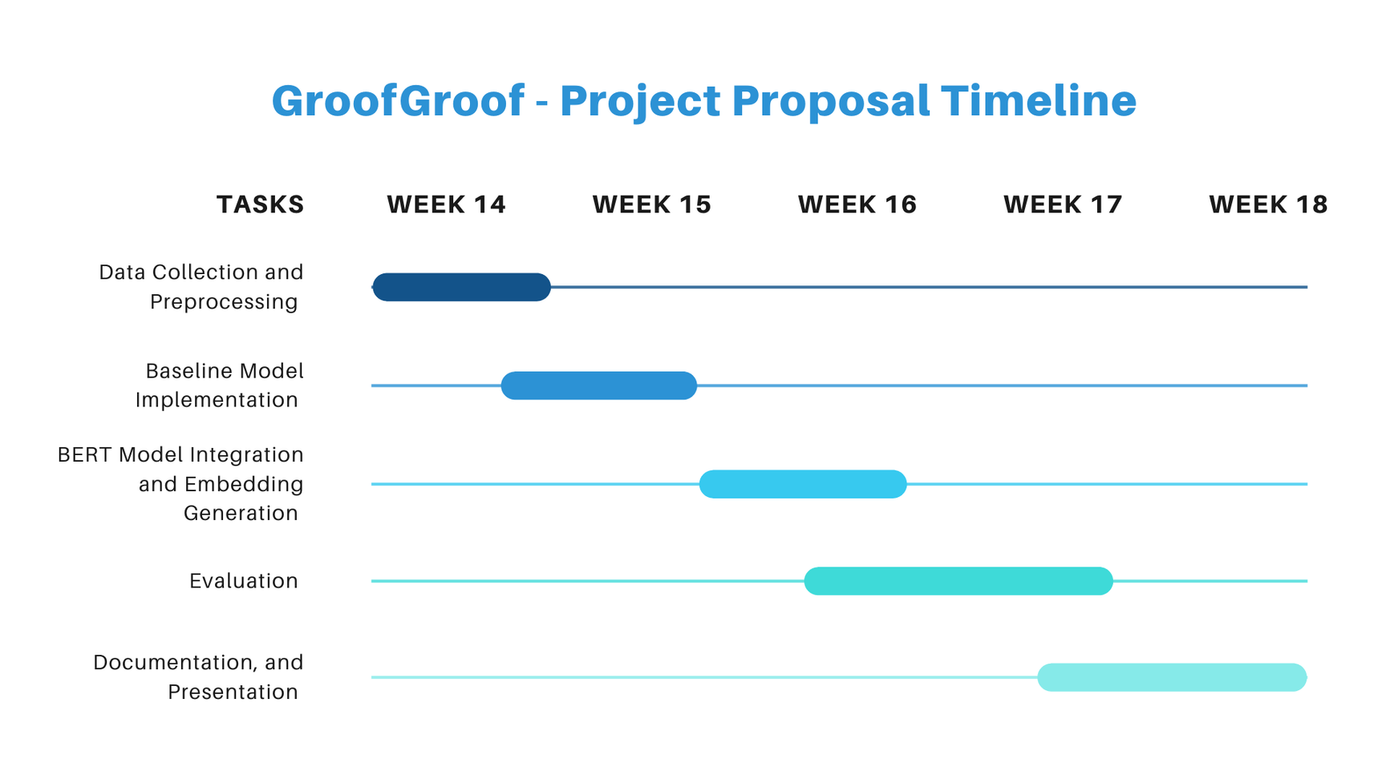
TIMELINE
Almazan, Tejada, & Pajanustan, Samantha

Slide 16
TIMELINE - Descriptions
  Week 14: Gather and review 2–3 Philippine-based academic studies on mental health (e.g., Salacut et al., 2025). Extract and clean text using PyMuPDF. Perform tokenization, sentence segmentation, and initial dataset structuring.
  Week 15: Develop and test a TF-IDF + Cosine Similarity retrieval model as the baseline. Conduct preliminary accuracy and relevance testing with a small set of question–answer pairs.
  Week 16: Embedding Generation Implement multiple BERT variants (BERT-base, BERT-large, DistilBERT, and possibly MentalBERT). Generate text embeddings and test retrieval-based response generation.
  Week 17: Perform (accuracy, precision, recall, F1-score, cosine similarity).Compare performance of all BERT models with the baseline.
  Week 18: Prepare the IEEE-formatted report, and complete the final project presentation.
Almazan, Tejada, & Pajanustan, Samantha

Slide 17
REFERENCES
[1] Ji, S., Zhang, T., Ansari, L., Fu, J., Tiwari, P., & Cambria, E. (2022). MentalBERT: Publicly available Pretrained Language Models for Mental Healthcare. https://aaltodoc.aalto.fi/items/a5d3341d-7ad5-479b-87ce-b70faf81015c
[2] Purnima. (2025, February 16). Hyperparameter Tuning in Machine Learning: Grid Search vs. Random Search. TechieFreak. https://techiefreak.org/index.php/blog/machine-learning/hyperparameter-tuning-in-machine-learning--grid-search-vs--random-search
[3] Wikipedia contributors. (2025, September 5). Hyperparameter optimization. Wikipedia. https://en.wikipedia.org/wiki/Hyperparameter_optimization?utm_source=chatgpt.com
[4] Grid Search vs. Random Search in Machine Learning: A Comprehensive Comparison for Hyperparameter Optimization. (n.d.). techiny.com. https://techiny.com/machine-learning/grid-search-vs-random-search
[5] S. Sarkar, “Sentiment Analysis for Mental Health,” Kaggle, 2022. Available: https://www.kaggle.com/datasets/suchintikasarkar/sentiment-analysis-for-mental-health
Almazan, Tejada, & Pajanustan, Samantha

Slide 18
Final Project | GroofGroof
Thank You So Much!
Final Project
Presented by
Under the Guidance of:
Almazan, Tejada, & Pajanustan, Samantha
Dr. Rodolfo C. Raga Jr.

