Slide 1

Customer Shopping Behavior Analysis
3,900 purchases • 18 columns • Transactional + demographic data

Slide 2
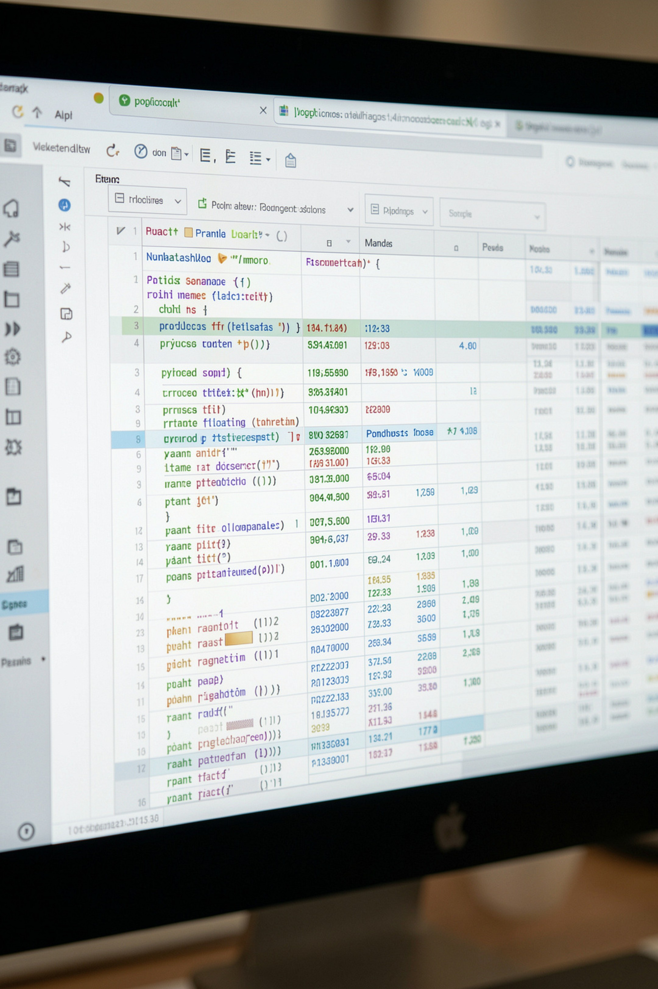
Dataset Summary
Rows & Columns
Key Features
Missing Data
Age, Gender, Item, Category, Amount, Subscription, Shipping, Rating
37 nulls in Review Rating
3,900 rows • 18 columns

Slide 3

EDA & Cleaning (Python)
01
Load & Inspect
df.info(), df.describe()
02
Impute Ratings
Median per product category
03
Standardize
Rename to snake_case
04
Feature Eng.
age_group, purchase_frequency_days

Slide 4


Database Integration
Loaded cleaned DataFrame into PostgreSQL for SQL analysis
Dropped redundant promo_code_used; kept discount_applied

Slide 5
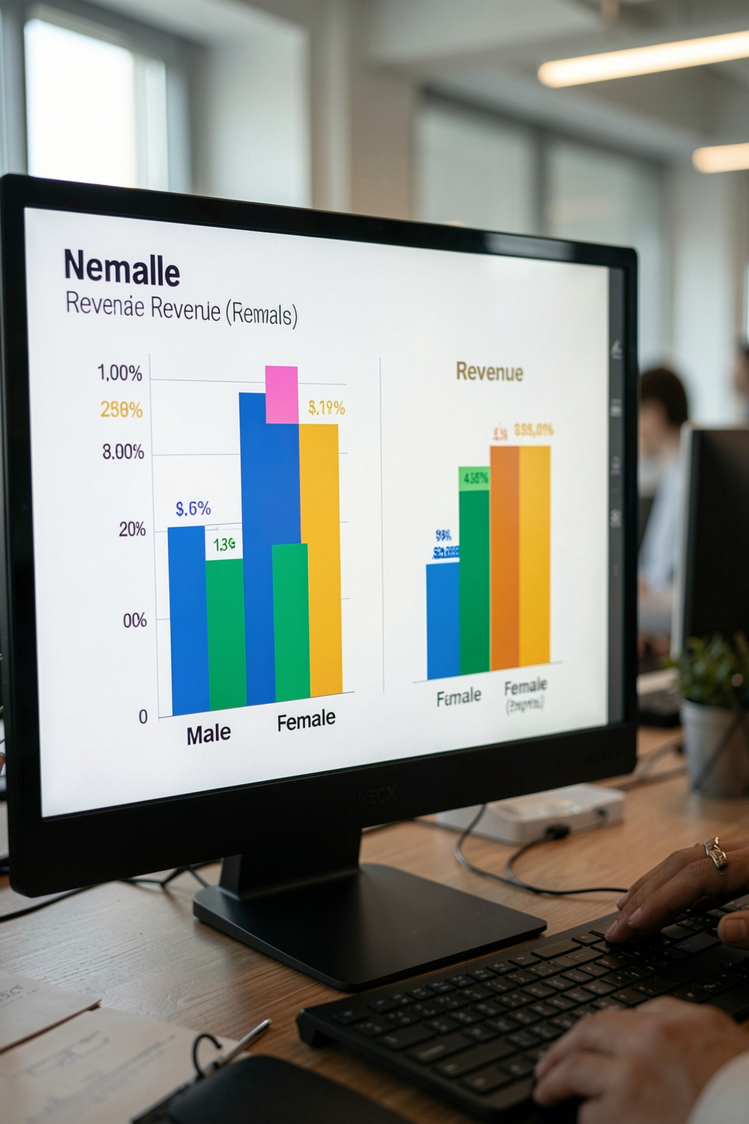
Revenue by Gender
Female
$75,191
Male
$157,890

Slide 6
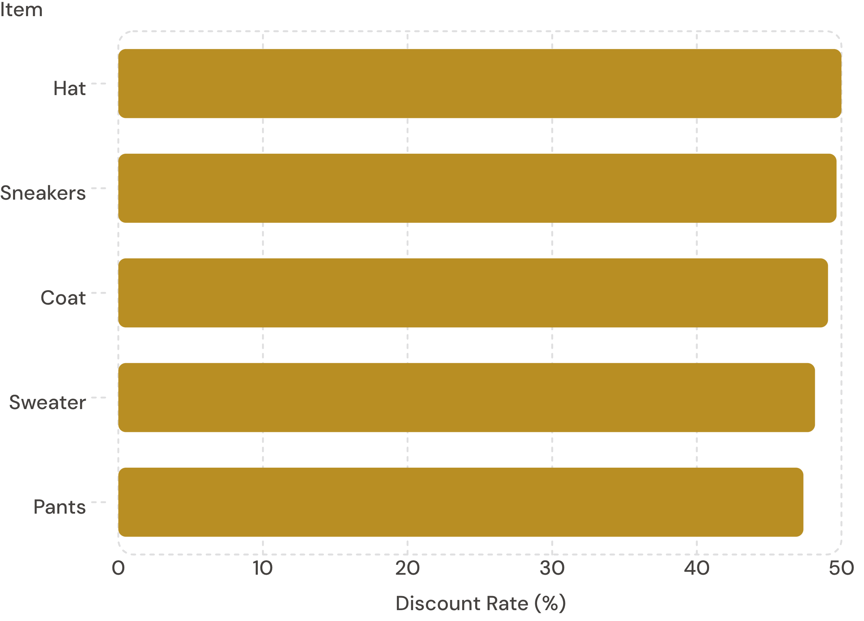
Discount-Dependent Products
Top 5 items with highest % of discounted purchases
Review discount policy to balance margin vs. sales

Slide 7
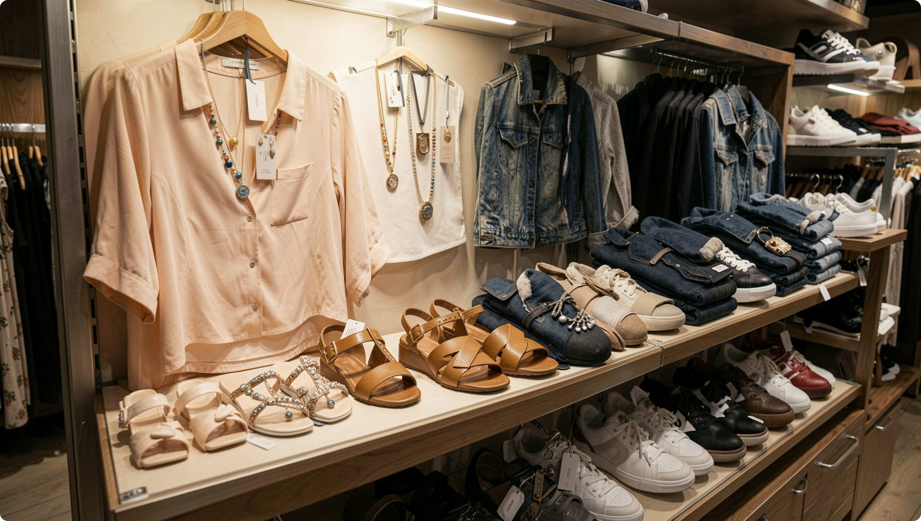

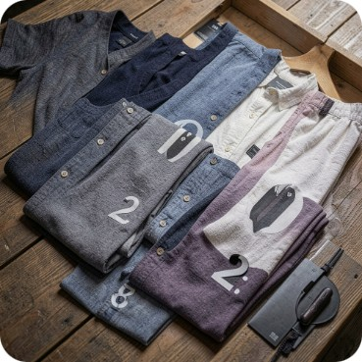
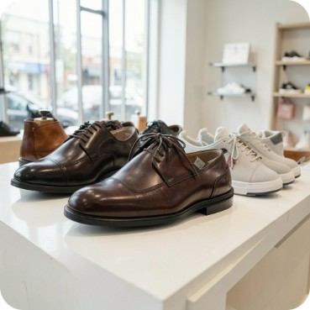
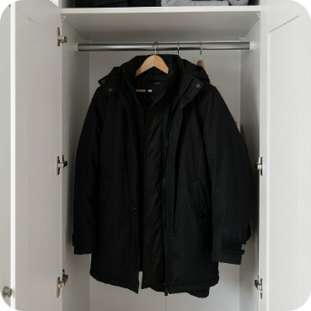
Top Products & Categories
Accessories
Top: Jewelry (171), Sunglasses (161), Belt (161)
Clothing
Top: Blouse (171), Pants (171), Shirt (169)
Footwear
Top: Sandals (160), Shoes (150), Sneakers (145)
Outerwear
Top: Jacket (163), Coat (161)

Slide 8
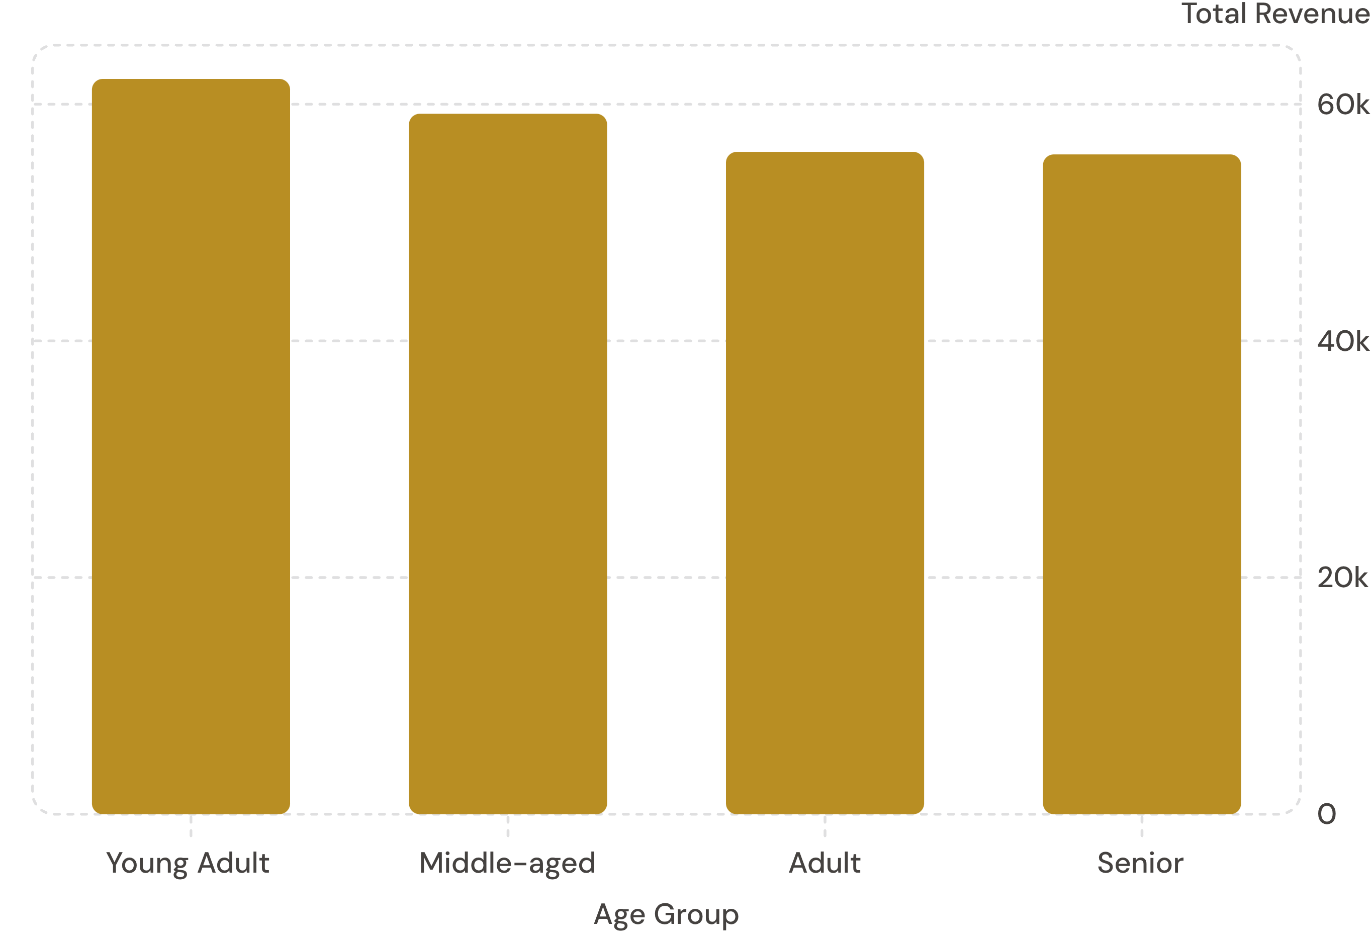
Revenue by Age Group
Focus marketing on top revenue groups
Subscribers vs Non-Subscribers
Yes: 1,053 customers • avg $59.49 • total $62,645
No: 2,847 customers • avg $59.87 • total $170,436

Slide 9
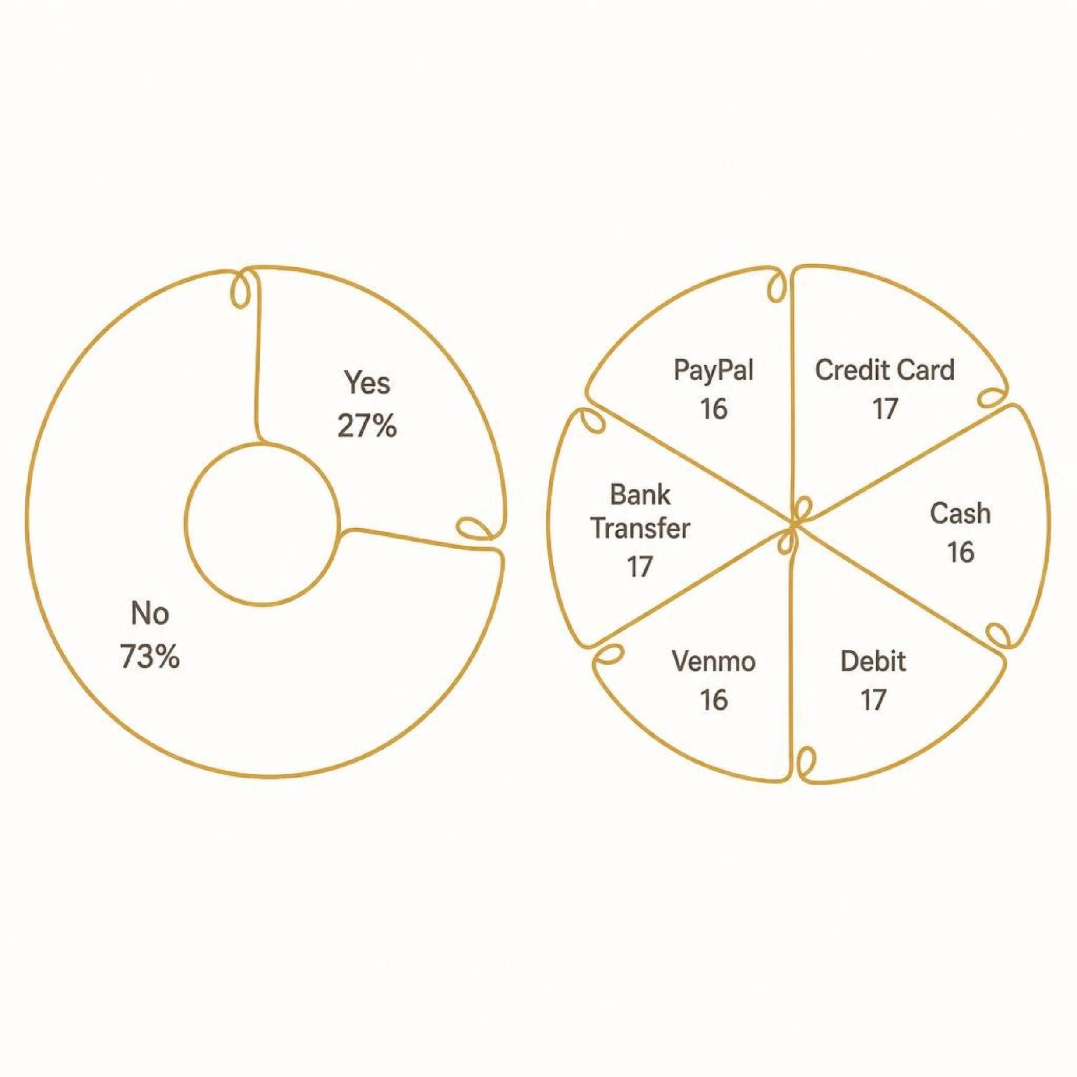
Subscriptions & Payments
Subscribers: 27% • Non-subscribers: 73%
Payment mix nearly even across PayPal, Credit, Debit, Bank, Venmo, Cash
Promote subscription benefits to boost conversion

Slide 10

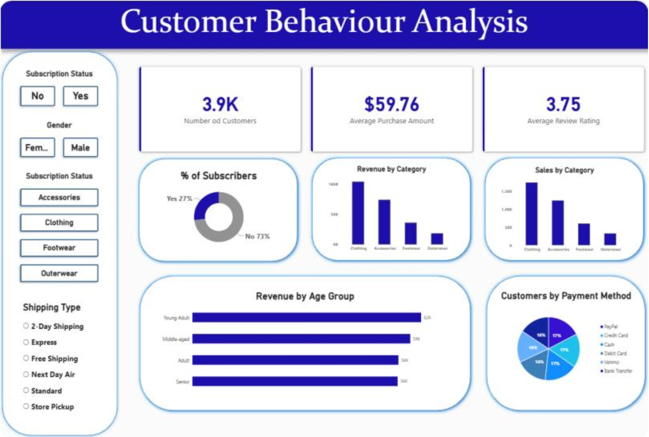


Recommendations
Boost Subscriptions
Loyalty Programs
Promote exclusive benefits
Reward repeat buyers
Discount Policy
Product Positioning
Balance sales with margins
Highlight top-rated, best-selling items
Targeted Marketing
Focus on high-revenue age groups & express-shipping users

