Slide 1

This is not what you think!

Slide 2
OUR TEAM
Place image here
Bewaji Adetola
Bewaji Adetola has a track record of commendable projects on data analysis. he presently works as a software trainer at CodeLagos. He is passionate junior data scientist, seasoned python programmer and researcher with an HND in Statistics from Benue State Polytechnic.

Slide 3

MUYIDE, Deborah is an accounting and finance professional, skilled in financial analysis. A Chartered Accountant with robust eight years cognate experience in the corporate world.
she has BSc in economics from University of Ado Ekiti. Debbie recently developed interest in data science and she is passionate about charging her world using data science with special focus in FINTECH

Slide 4

Place image here
David is a graduate of systems engineering with special interest data science and machine learning

Slide 5
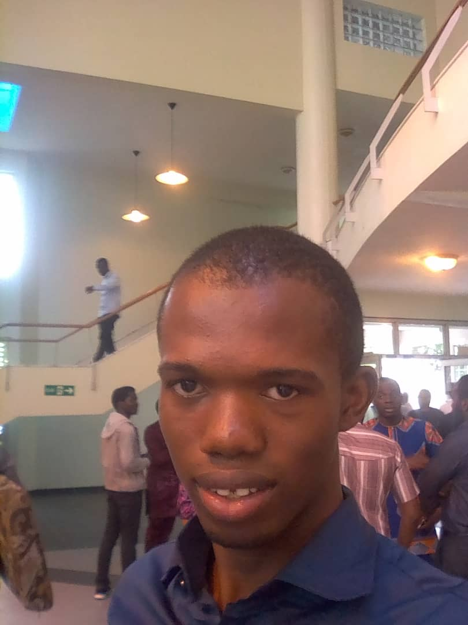
Place image here
Nweke Chinedu is a Logistics/data officer at Joza Global Logistics. Master of Process Engineering from the University of Lagos.

Slide 6
Place image here
Abisola Adegbie is a graduate of Lagos State University, works as consultant at Ritas & Associates
.

Slide 7
So, what is this?

Slide 8

Employment prospect of the Nigerian graduate
STARTUP SOUTHWEST
By:
Team Berry

Slide 9
BACKGROUND/PROBLEM STATEMENT
According to the Nigeria Bureau of Statistics, the unemployment rate rose from 14.2% to 18.8% in 2017. It also said that Nigeria’s labour population increased from 83.9 million in the second quarter to 85.1 million in the third quarter of 2017.
The challenge facing Nigeria's youth today particularly those in higher education is the hope of employment after graduate.
The future doesn't look particularly bright. This is the reason why young people will need all the guidance and support they can get in making their decisions amid Nigeria's unemployment chaos

Slide 10

OBJECTIVE
To study to trend and determine what the future holds for Nigeria's army of graduates including current university students AND also to help stakeholders know factors that determine employability of Nigeria graduate

Slide 11

Data Source
National Bureau of Statistics
Survey from about 5000 graduates who completed youth service not earlier than 2013 and across different parts of the country. Questions asked had a lot to do about their career both past and present. The data was generated by stutern Nigeria

Slide 12
Methodology
Data Collection and Cleaning
Pandas
Numpy
matplotlib
Data Analysis- Python

Slide 13
DATA ANALYSIS
The data was analyzed using Python tool. The data was first was cleaned and all incomplete and duplicate responses was eliminated. Different functions and library with the Python tool was used to obtain an insightful information

Slide 14
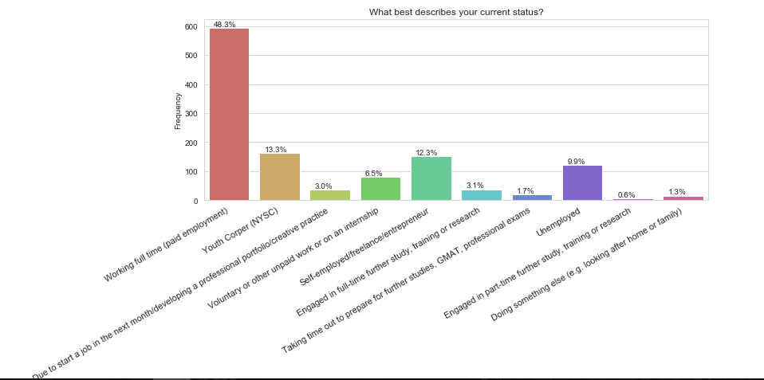
Status of Nigerian Graduates?

Slide 15
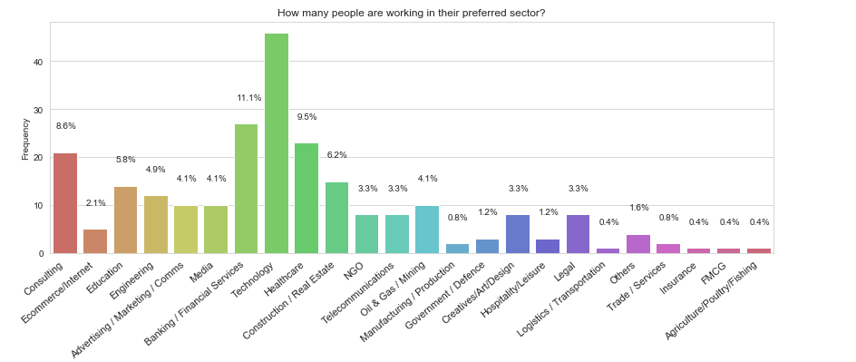
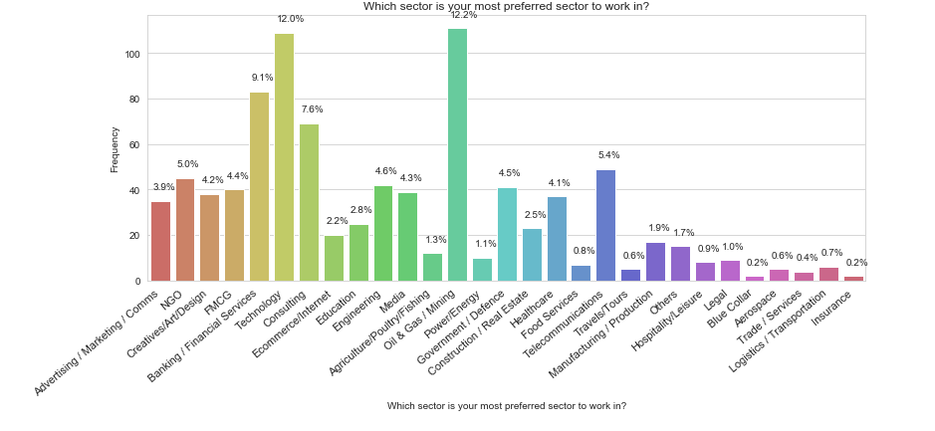
Does Nigerian graduates actually work in their preferred sector ?

Slide 16
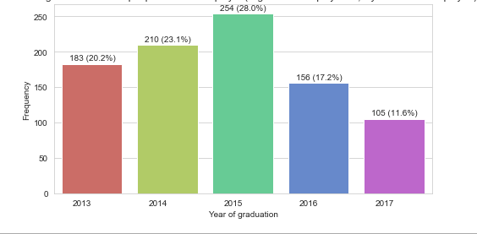
From the year 2013 to 2017, which year of graduation has the highest number of employed graduates ?
Place VISUALS HERE

Slide 17
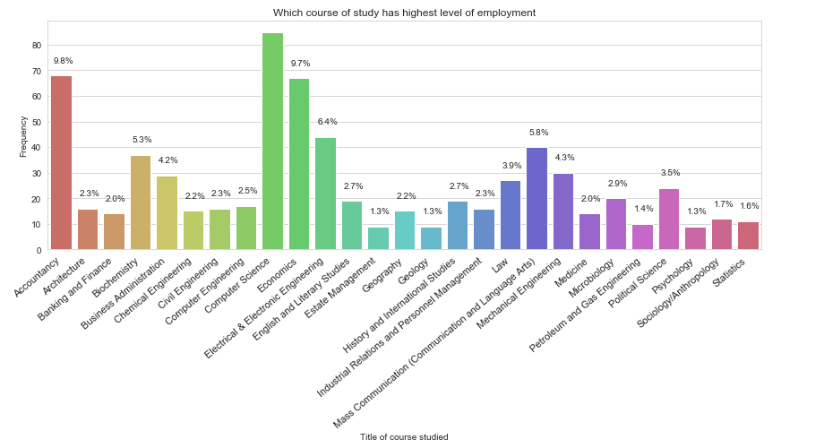
Employability by course of study

Slide 18
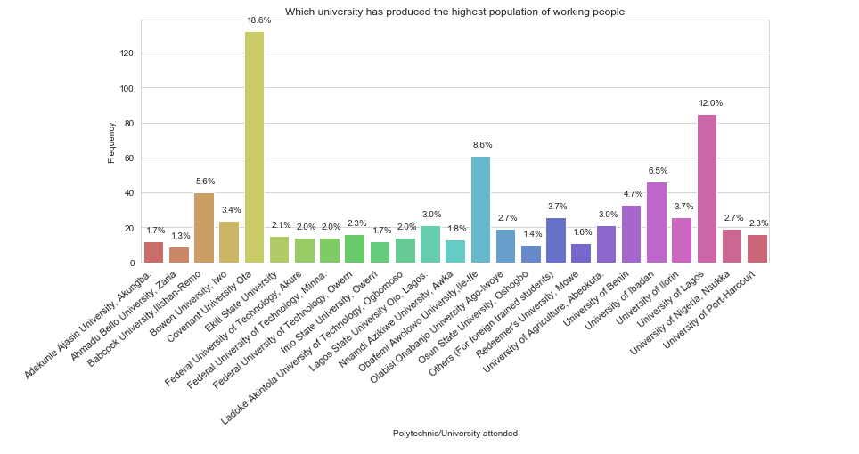
Employability by school attended
Place VISUALS HERE

Slide 19
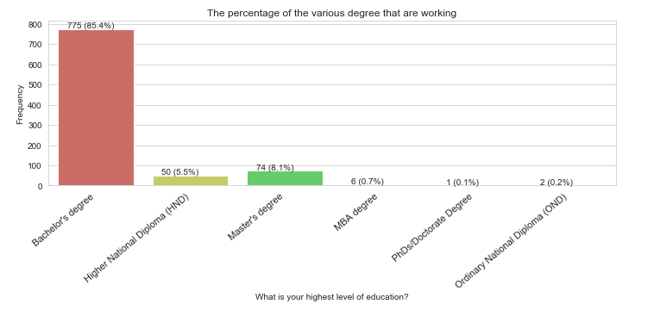
The percentage of the various degree that are working ?

Slide 20
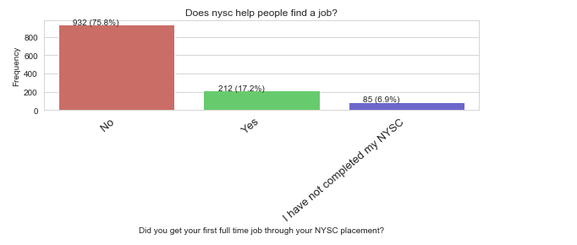
Does nysc help people find a job?

Slide 21
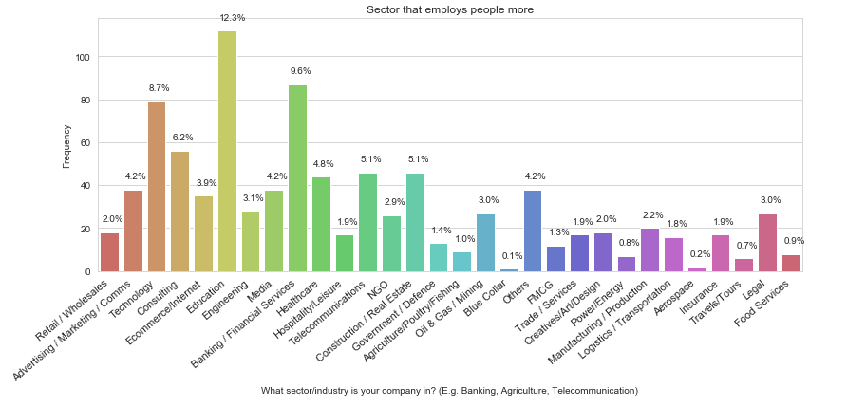
Employability by sector/industry

Slide 22
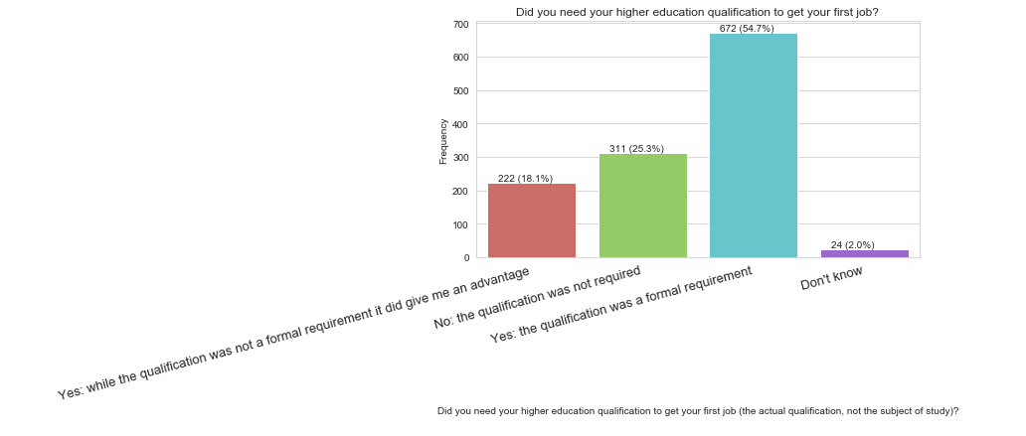
Is higher education qualification really important to get a job?

Slide 23
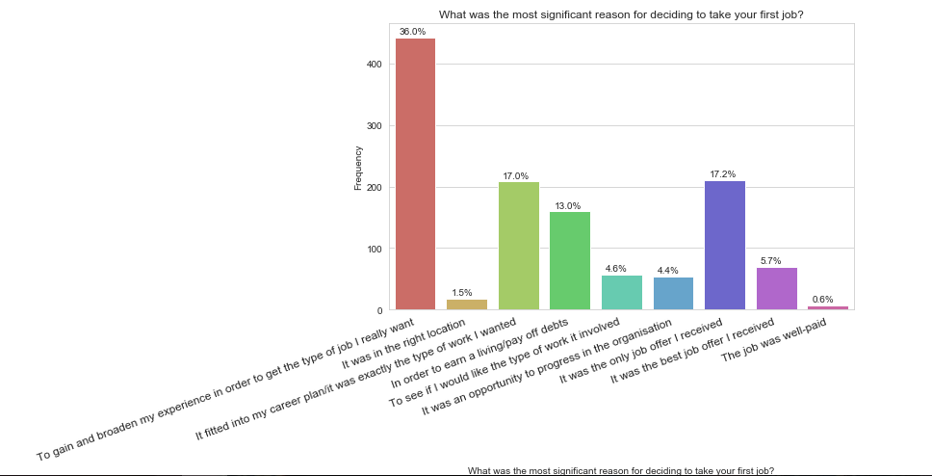
Top reason’s why young graduates take a particular job

Slide 24
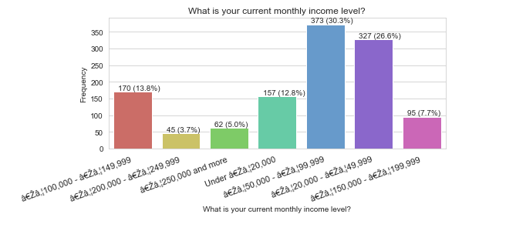
How much are Nigerian graduates actually paid ?

Slide 25
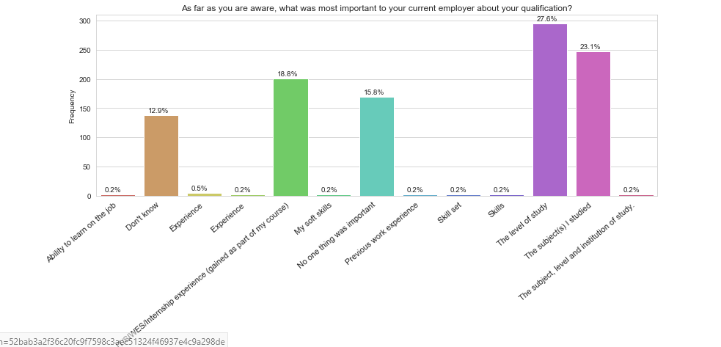
What are employers actually looking for in a young graduate ?

Slide 26
Summary
Graduates from 2015 were the highest employed in the survey from 2013 to 2017
Computer science, Accountancy and economics recorded the highest level of employment while, psychology, Estate management and Geology recorded the least level of employment.
Covenant, university of Lagos and OAU tops the list in terms of employment status while Osun state university, Redemeers and Ahmadu Bello has the worst record of employment.

Slide 27
It was also learnt that one only requires a B.sc to find a job
B.sc holders actually has the highest employment rate while those with a doctorate degree has the lowest employment rate
Most graduate earn between 50,000 to 100,000 naira
Most Nigerian graduates don’t actually work in their preferred sector
NYSC also does not help people to find a job

Slide 28
Recommendations
Young graduates should not expect to find jobs in their preferred sector and should not expect to get their first job with a salary above 100,000 naira.
There is no point going for a a higher degree qualification above a B.sc as such cannot guarantee finding a job
The government may consider scrapping NYSC as it doesn’t help a Nigerian graduate to find employment

Slide 29
Recommendation-cont-
University students should study Courses like Computer science, Accountancy and Economics and neglect Psychology, Estate management and Geology as they are not good for the Nigerian job market
Admission seekers to focus on securing admission into Covenant, university of Lagos and OAU and ignore Osun state university, Redemeers and Ahmadu Bello as they have the worst record of employment

Slide 30

Thank You for Listening

