Slide 1
Sous × NOVA
A rehearsal for your next restaurant shift
Hackathon prototype
01
Notes:
0:00–0:20
What if you could play tomorrow’s restaurant shift before it costs you? This is Sous NOVA, a restaurant simulator that lets an owner test an operational change, watch the day unfold, and compare the financial result.
Source: Sous × NOVA local MVP and src/lib simulation, staffing, menu-pricing and scenario-optimizer code. All restaurant data and behavioral assumptions are synthetic. No live DoorDash integration or external LLM is connected.

Slide 2
The cost of a restaurant decision
“Should I add a cook
or run a BOGO deal?”
Both can change how many orders you fulfill.
Both can change the queue and the margin.
An owner needs to see how the whole shift changes.
02
Notes:
0:20–0:45
Imagine an owner deciding whether to add a cook or run a buy-one-get-one offer on Friday. More orders sound good, but every order shares a kitchen. A deal also uses ingredients on the free food. The useful question is whether that change improves the shift once service capacity and costs come into the picture. That is the decision our prototype helps explore.
Source: Sous × NOVA local MVP and src/lib simulation, staffing, menu-pricing and scenario-optimizer code. All restaurant data and behavioral assumptions are synthetic. No live DoorDash integration or external LLM is connected.

Slide 3
A restaurant setup owners can complete
01
Load the restaurant profile
Menu, hours and order volume appear in the demo import.
02
Fill the operating gaps
Enter or upload inventory, staff shifts, pay and supplier costs.
03
Choose a day and test a change
Set staffing, dining hours, prices or a holiday demand spike.
Today: synthetic profile data. DoorDash connection is planned.
03
Notes:
0:45–1:10
The workflow starts with a restaurant profile. Today we use fictional data and simulate the import. An owner then fills the information a delivery platform would not provide, including inventory and staff costs. They can type it in or upload supported operating documents. Then they choose a day and opening time. Seats and kitchen stations define the physical capacity. The intended future integration would reduce setup work, but we have not connected DoorDash.
Source: Sous × NOVA local MVP and src/lib simulation, staffing, menu-pricing and scenario-optimizer code. All restaurant data and behavioral assumptions are synthetic. No live DoorDash integration or external LLM is connected.

Slide 4
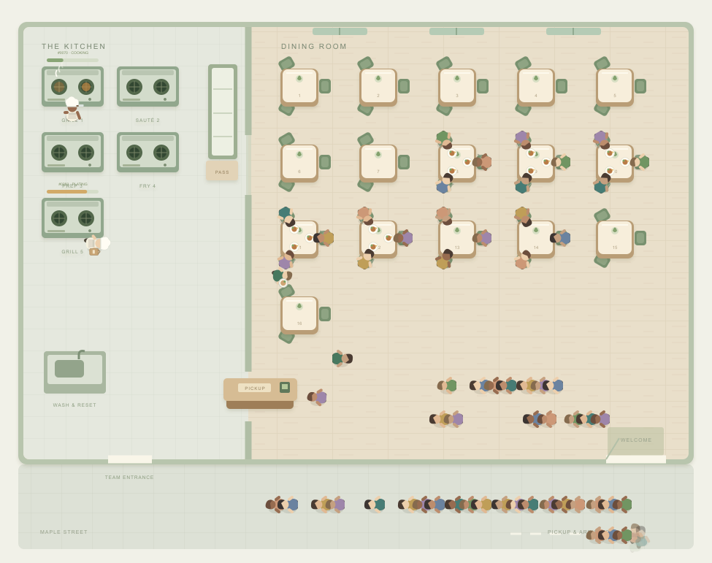
A shift you can watch and change
Live demo
Add a cook.
Change a deal.
Replay the day.
Compare profit, wait time
and customer happiness.
04
Prototype replay
Notes:
1:10–1:55, including approximately 30 seconds in the app
This is where the simulator becomes understandable. Chefs work through preparation, parties occupy real tables, and delivery drivers collect orders. The activity follows the queue model. [Switch to the app. Start with a prepared baseline in Scenario lab. Add one cook in Staff, run the scenario, and show the profit and waiting-time comparison. If time allows, show a BOGO in Menu and explain that free items still consume stock. Return to slide 5.] The image shows an earlier captured prototype replay. Use the running app for the latest seating and tabbed controls.
Source: Sous × NOVA local MVP and src/lib simulation, staffing, menu-pricing and scenario-optimizer code. All restaurant data and behavioral assumptions are synthetic. No live DoorDash integration or external LLM is connected.
Image: locally captured product rendering, outputs/sous-operations-polished.png. No external image source.

Slide 5
Ask Sous tests the tradeoff
1,584
staffing and price combinations
The most profitable tested option comes first.
Shorter waits break profit ties.
A separate shortest-wait option preserves baseline fulfilled orders.
05
Notes:
1:55–2:25
Ask Sous searches a finite set of staffing and global price combinations. Our default benchmark tested 1,584 combinations. It applies the most profitable tested option, with shorter waits breaking equal-profit ties. It also offers a shortest-wait alternative that fulfills at least as many orders as the starting draft. Owners can see that tradeoff and choose. This is deterministic scenario optimization. We do not rely on a language model to invent operational outcomes.
Source: Sous × NOVA local MVP and src/lib simulation, staffing, menu-pricing and scenario-optimizer code. All restaurant data and behavioral assumptions are synthetic. No live DoorDash integration or external LLM is connected.
Evidence: work/benchmark-settings.cjs completed 1,584 combinations in 10.74 seconds in this development environment. Runtime varies. This slide claims search coverage, not real business impact.

Slide 6
Sous × NOVA
Owners can try a decision
before a real shift depends on it.
Today
Working simulator with visible costs and queues
Next
An operator pilot to calibrate the model with real shifts
06
Notes:
2:25–3:00
We have a working local prototype with a queue engine, animated operations, document extraction, promotions, and scenario comparisons. The model uses synthetic assumptions, so the next step is an operator pilot: compare simulated days against recorded shifts, calibrate demand and service times, and measure whether owners make better staffing and promotion decisions. Sous NOVA makes those decisions visible and testable. We would love to put one real restaurant’s next shift into the model.
Source: Sous × NOVA local MVP and src/lib simulation, staffing, menu-pricing and scenario-optimizer code. All restaurant data and behavioral assumptions are synthetic. No live DoorDash integration or external LLM is connected.

