Slide 1
  The Heilbronn Triangle Problem
  Rockville Science Center
  Math Club Colloquium
  Dominic Dotterrer, Ph.D.
  15 September 2022

Slide 2
Step 1: Placing Points
Each player will take a blank card and draw some dots on it. (I will tell you how many)
Your objective is to arrange the points so that there is no triple of points that form a triangle of small area.
Try to make all the triangles as collectively big as you can.

Slide 3
Step 1: Placing Points
Each player will take a blank card and draw some dots on it. (I will tell you how many)
Your objective is to arrange the points so that there is no triple of points that form a triangle of small area.
Try to make all the triangles as collectively big as you can.

Slide 4
Step 2: Grading your partner’s work
Now pass your card to your partner, who is going to grade it.

Slide 5
Step 2: Grading your partner’s work
Now pass your card to your partner, who is going to grade it.
They will look at it very carefully and mark what they think is the smallest area triangle.

Slide 6
Tips!
Keep in mind that three points in a line form a triangle of ZERO area.
Three points that are ALMOST in a line form a very small triangle

Slide 7
Okay, let’s play!
?
Let’s do it!
The number of points you must place is 10

Slide 8
Pass to your partner for grading
?
Verify that your partner made 10 dots.
Look carefully and find the smallest triangle.

Slide 9
Why was this hard?
Which of you had the bigger triangle?
Why was this hard?

Slide 10
Should we try it again?
?
Would you like another try?
Okay, but this time we must each draw 15 dots instead of 10!
Graders, take your time. There are a lot of triangles.

Slide 11
Why was this hard?
Did 15 points seem harder than 10? Why?
Is it true that your best score can only go down if we add more points?
Discuss strategies for large numbers of points.

Slide 12
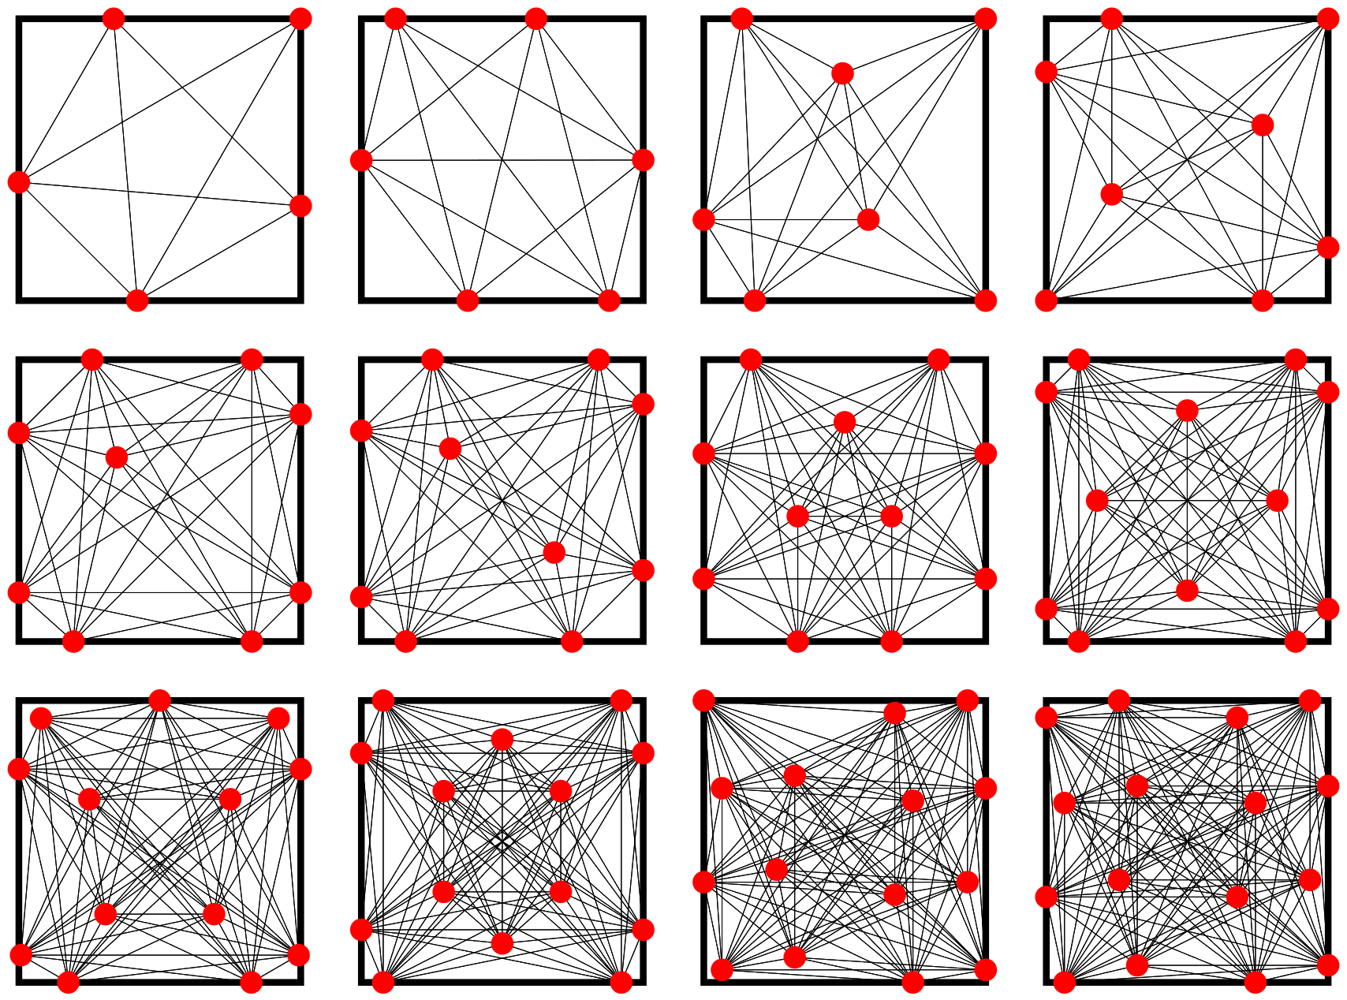
Optimal configurations for small numbers of points
For small numbers of points, the optimal configurations can be computed algorithmically.
For reasonably large numbers of points, it becomes infeasible to compute the optimal configuration.
Source: Friedman, E. "The Heilbronn Problem for Squares."

Slide 13
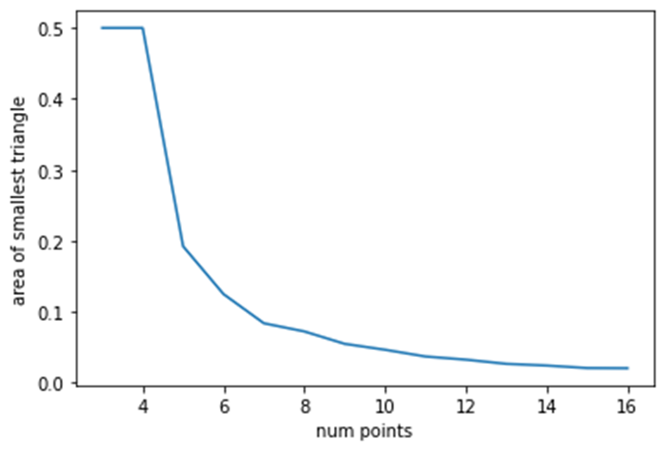
Optimal configurations for small numbers of points
If we look at the area of the smallest triangle for optimal configurations of a small number of points, it seems to be decreasing.

Slide 14
Optimal configurations for small numbers of points
How fast is it decreasing?
This is a still unsolved question in the field of mathematics called Discrepancy Theory.

Slide 15
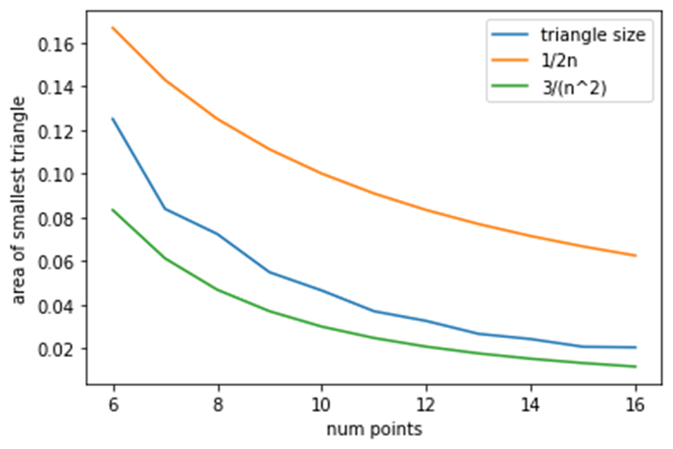
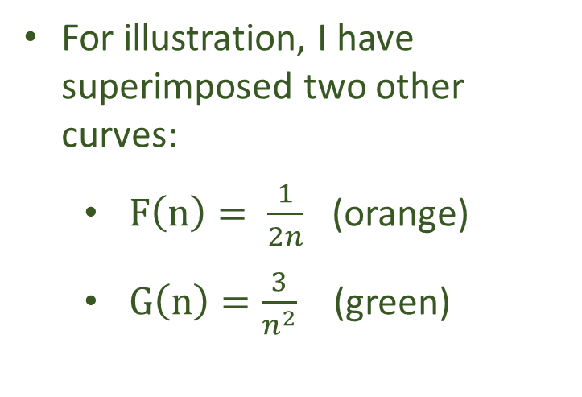
Optimal configurations for small numbers of points
For illustration, I have superimposed two other curves:
  $F\left(n\right)= \frac{1}{2n}$ (orange)
  $G\left(n\right)=\frac{3}{n^{2}}$ (green)

Slide 16
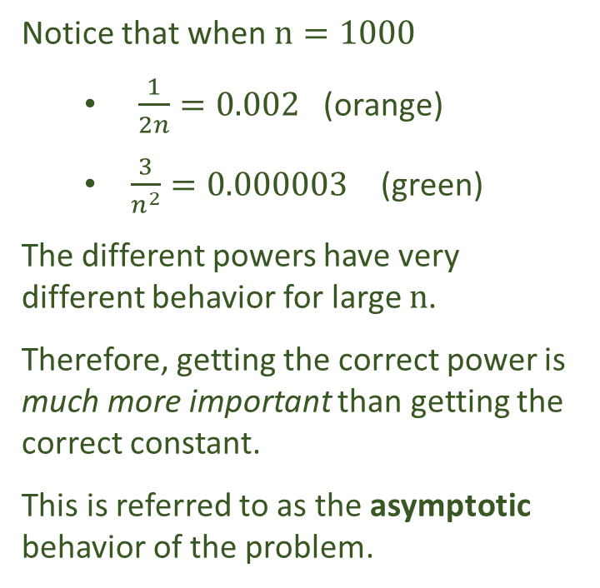
Optimal configurations for small numbers of points
Notice that when $n=1000$
  $\frac{1}{2n}=0.002$ (orange)
  $\frac{3}{n^{2}}=0.000003$ (green)
The different powers have very different behavior for large n.
Therefore, getting the correct power is much more important than getting the correct constant.
This is referred to as the asymptotic behavior of the problem.

Slide 17
Proving an upper bound
Can we prove that any arrangement of n points must have a small triangle?

Slide 18
Proving an upper bound
Can we prove that any arrangement of n points must have a small triangle?
What if we just look at one coordinate?

Slide 19
Proving an upper bound
Can we prove that any arrangement of n points must have a small triangle?
What if I draw a star around one point?

Slide 20
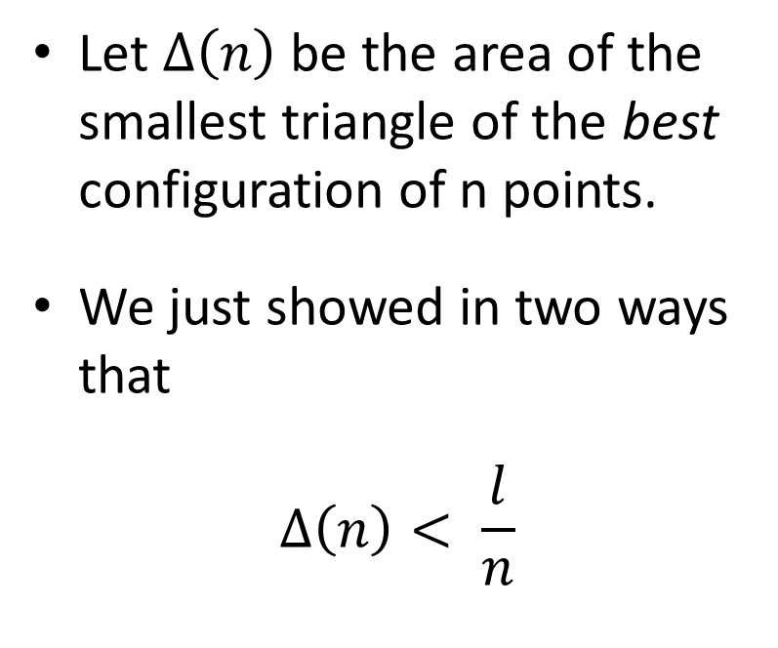
Proving an upper bound
Let $∆\left(n\right)$ be the area of the smallest triangle of the best configuration of n points.
We just showed in two ways that
$$∆\left(n\right)< \frac{l}{n}$$

Slide 21
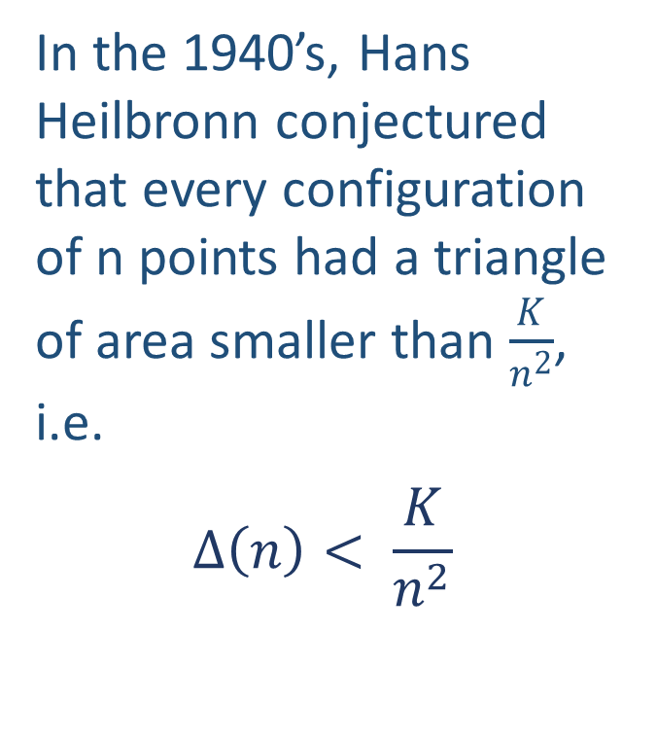
Strategies for large n
In the 1940’s, Hans Heilbronn conjectured that every configuration of n points had a triangle of area smaller than $\frac{K}{n^{2}}$, i.e.
$$∆\left(n\right)< \frac{K}{n^{2}}$$

Slide 22
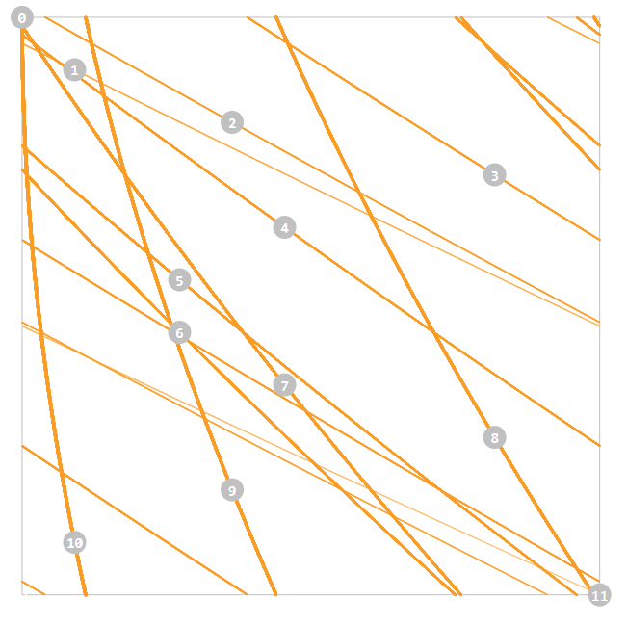
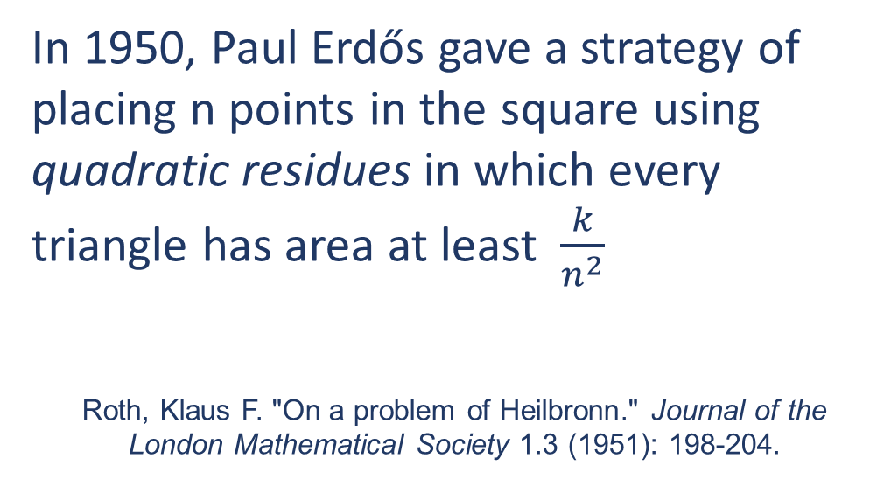
Strategies for large n
In 1950, Paul Erdős gave a strategy of placing n points in the square using quadratic residues in which every triangle has area at least $\frac{k}{n^{2}}$
Roth, Klaus F. "On a problem of Heilbronn." Journal of the London Mathematical Society 1.3 (1951): 198-204.

Slide 23
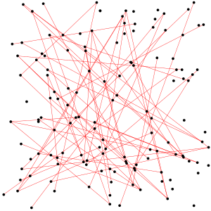
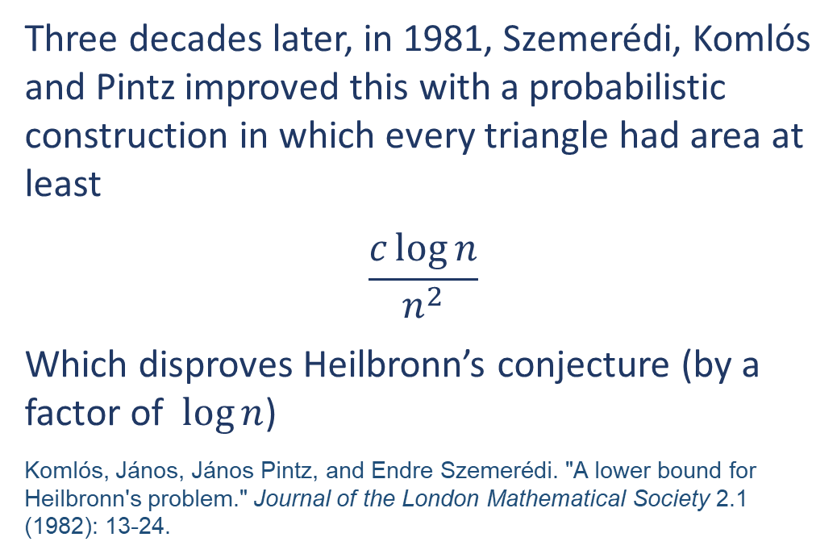
Best known strategy for large n
Three decades later, in 1981, Szemerédi, Komlós and Pintz improved this with a probabilistic construction in which every triangle had area at least
$$\frac{c\log{n}}{n^{2}}$$
Which disproves Heilbronn’s conjecture (by a factor of $\log{n}$)
Komlós, János, János Pintz, and Endre Szemerédi. "A lower bound for Heilbronn's problem." Journal of the London Mathematical Society 2.1 (1982): 13-24.

Slide 24
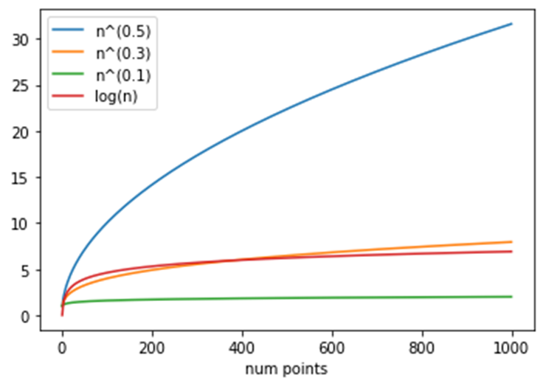
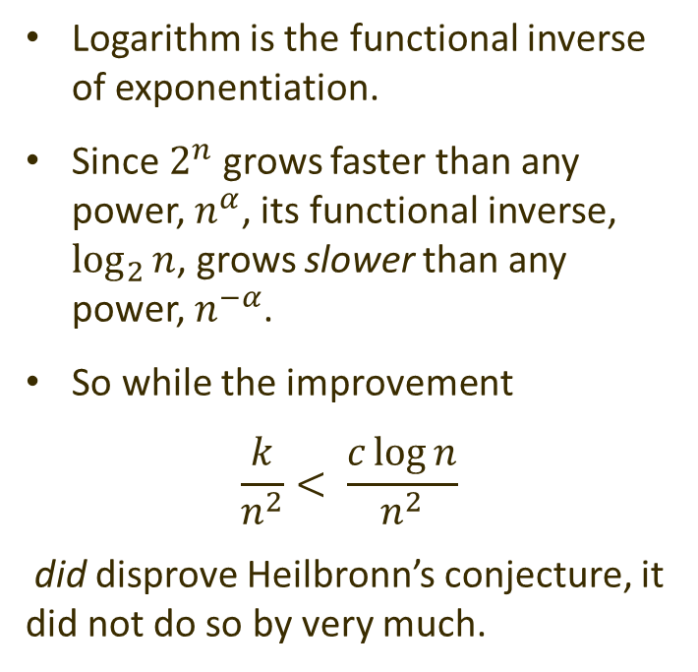
Reminder on logarithms
Logarithm is the functional inverse of exponentiation.
Since $2^{n}$ grows faster than any power, $n^{α}$, its functional inverse, $\log_{2}{n}$, grows slower than any power, $n^{−α}$.
So while the improvement
$$\frac{k}{n^{2}}< \frac{c\log{n}}{n^{2}}$$
did disprove Heilbronn’s conjecture, it did not do so by very much.

Slide 25
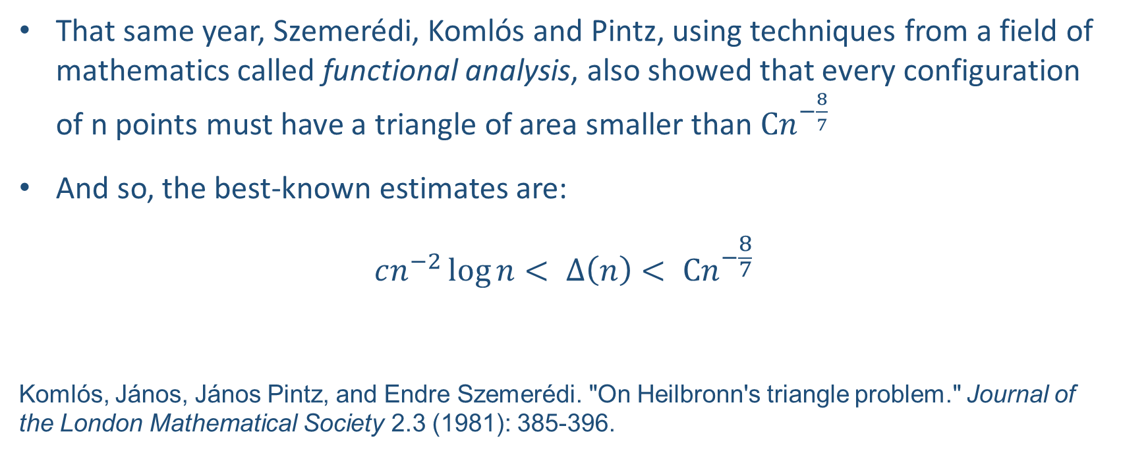
The current state of the art
That same year, Szemerédi, Komlós and Pintz, using techniques from a field of mathematics called functional analysis, also showed that every configuration of n points must have a triangle of area smaller than $Cn^{−\frac{8}{7}}$
And so, the best-known estimates are:
$$cn^{−2}\log{n}< ∆\left(n\right)< Cn^{−\frac{8}{7}}$$
Komlós, János, János Pintz, and Endre Szemerédi. "On Heilbronn's triangle problem." Journal of the London Mathematical Society 2.3 (1981): 385-396.

Slide 26
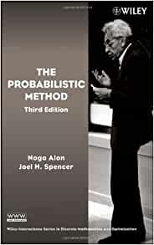
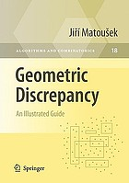
Further reading
These are two excellent books if you are interested in learning more about these kinds of problems.

