Slide 1
Privacy Protected Synthetic Data Fabrication
Commercial Applications and Technical Challenges
Dominic Dotterrer, Ph.D.
20 July 2022

Slide 2
The need for automated test data fabrication
Enterprise software utilization requires test data for
Vendor integrations testing
Internal non-production systems testing
Ideal test data for this purpose meets several specification:
Structural coherence to meet the testing requirements (e.g. relational integrity).
Automatically generated, requiring little analytical knowledge of the data.
Meets data governance requirements (i.e. privacy constraints).
Refs: Generating Synthetic Data in Finance: Opportunities, Challenges and Pitfalls, JPMorgan Research

Slide 3
The impact of privacy-protected synthetic data fabrication
Increase development velocity
Avoid recurring compliance certifications
No “pre-analysis” of the data needed
Standardize data sharing
Algorithmically applied privacy controls
Minimize both explicit and statistical exfiltration risk
Achieve stronger controls than simple anonymization
Minimize exposure to consumer data privacy regulation (GDPR or CCPA)

Slide 4
The trouble with simple de-identification
Techniques in de-identification:
Masking – hash a string or masking “Dominic” with “Nancy”
Batching – replace “aged 38” with “aged 35-40”
Pruning outliers – There is only one regional manager in Duluth.
None of these protect against leaking statistical data.
Refs:
Robust de-anonymization of large datasets (how to break anonymity of the Netflix prize dataset)
Simple demographics often identify people uniquely
Broken promises of privacy: Responding to the surprising failure of anonymization

Slide 5
Approaches to synthetic data fabrication
Generative Adversarial Networks
Privacy Preserving Synthetic Health Data
Synthesizing Tabular Data Using Wasserstein Conditional GANs
Autoencoders
Differential Privacy Preservation for Deep Autoencoders
Differentially Private Mixture of Generative Neural Networks
Bayes Nets
PrivBayes: Private Data Release via Bayesian Networks

Slide 6
Technical challenges
Time series – continuity or autocorrelation of samples
Relation integrity – preserving foreign keys when fabricating a DB with complex relations.
Interpreting numerical values – from what distribution should you sample a SKU#?
Natural language – how to protect privacy in language models is still an active field of research
Differential privacy in natural language processing: The story so far

Slide 7
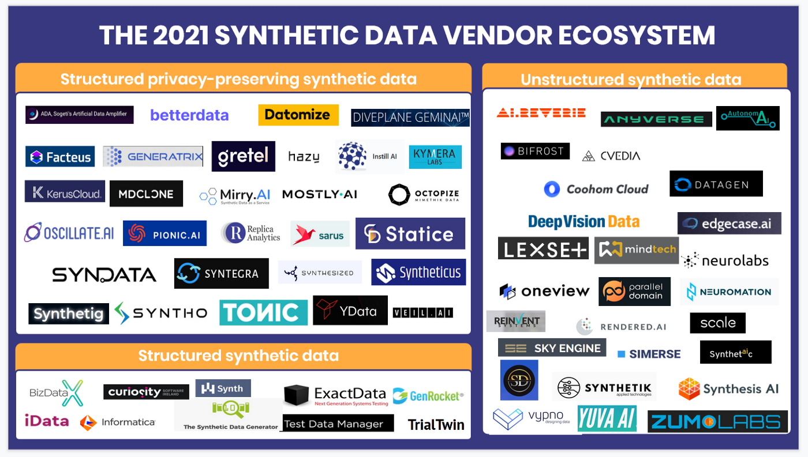
Commercial products
Leapyear.io
Mostly.ai
Diveplane
DataFleets
Privitar
IBM Optim
Gretel.ai
Tonic.ai
MDClone
Medium.com

