Slide 1

Capstone project
Personal Finance Management Tracking
Divergence Academy 2022

Slide 2
Agenda
ABOUT ME
THE PROJECT OVERVIEW
ASSESSMENT AND ANALYSIS
THE PROCESS.
THE DATASET USED.
VISUALIZATIONS

Slide 3

About me:
Ghana Laxmi Bhattarai, a Veteran still in the process of transitioning into the civilian World. I chose Data Science Immersive program because I was always interested in learning big data, ETL process and other data related tools such as SQL and Power BI.
I have pretty good experience working with routers, switches, firewalls, VMware , LANs, WANs, and VLANS through the work experience associated with 11th Signal Brigade, Fort Worth, Texas.

Slide 4
Project Overview
This mini project primarily focuses on using Power BI as the data analytics tool to track personal finances
In our daily life, It is also a useful to use it as the financial literacy.
Power BI here is used to detect data types, transform columns using custom functions.
Power BI is used to clean up and transform data.
DAX Function is used to create some measures and calculations .
.

Slide 5

Assessment and analysis:
The following are done.
Calculated the Net Worth in the bank account.
Total Spending per month is calculated.
Total income per month .
Visualizing the months that are financially good or bad.
Tracking the expense and savings.

Slide 6

Process :
Getting the data.
Data Transformation.
Data Cleansing
Visualization

Slide 7
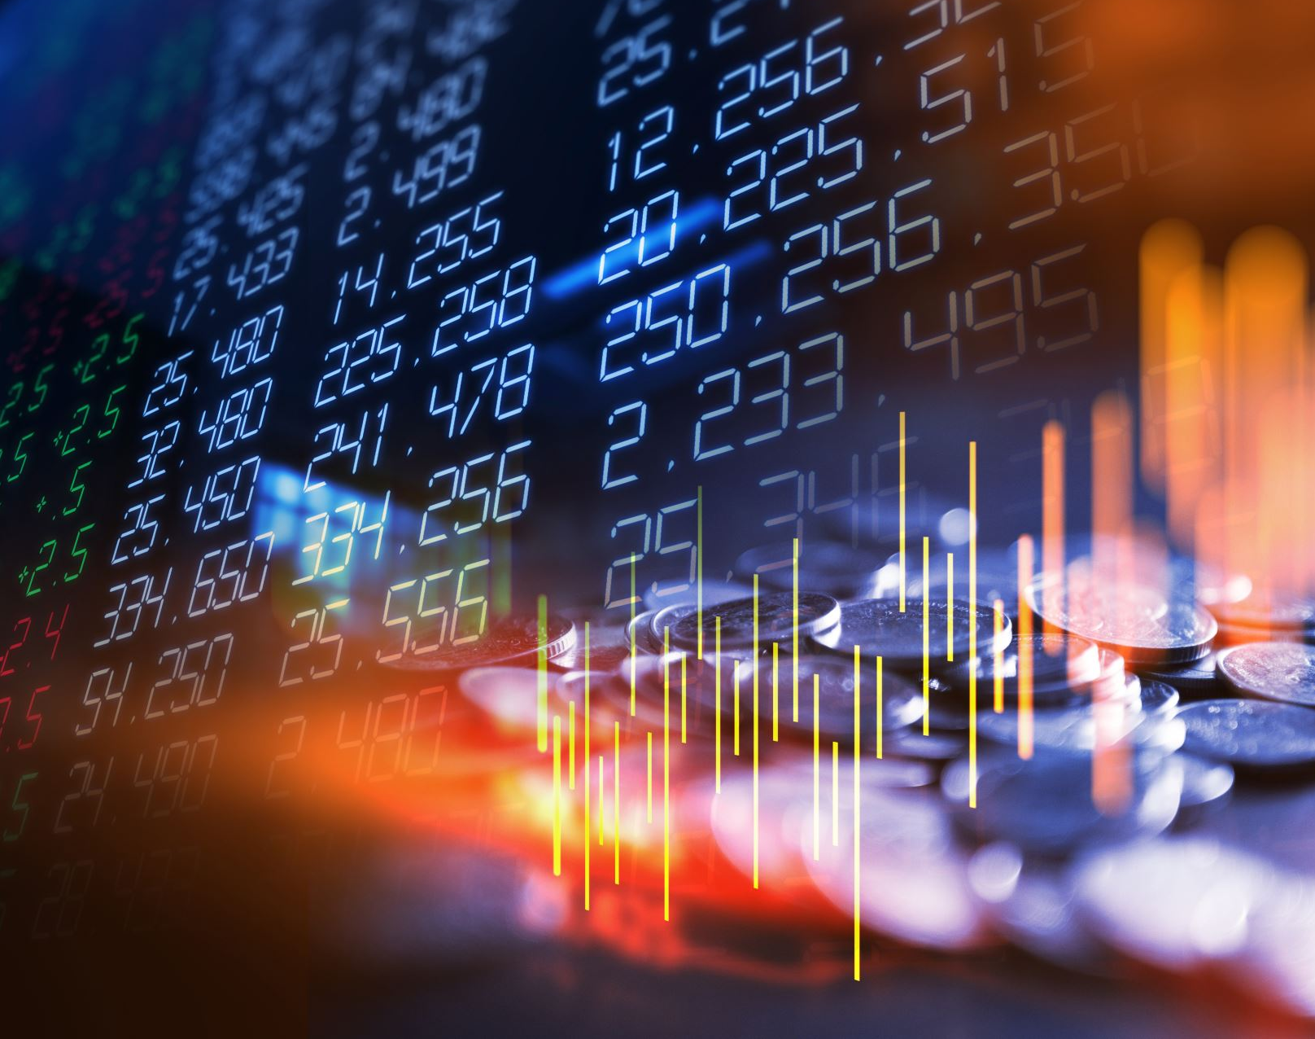
Dataset used
Personal Banking transaction from the year 2020 to 2022.

Slide 8
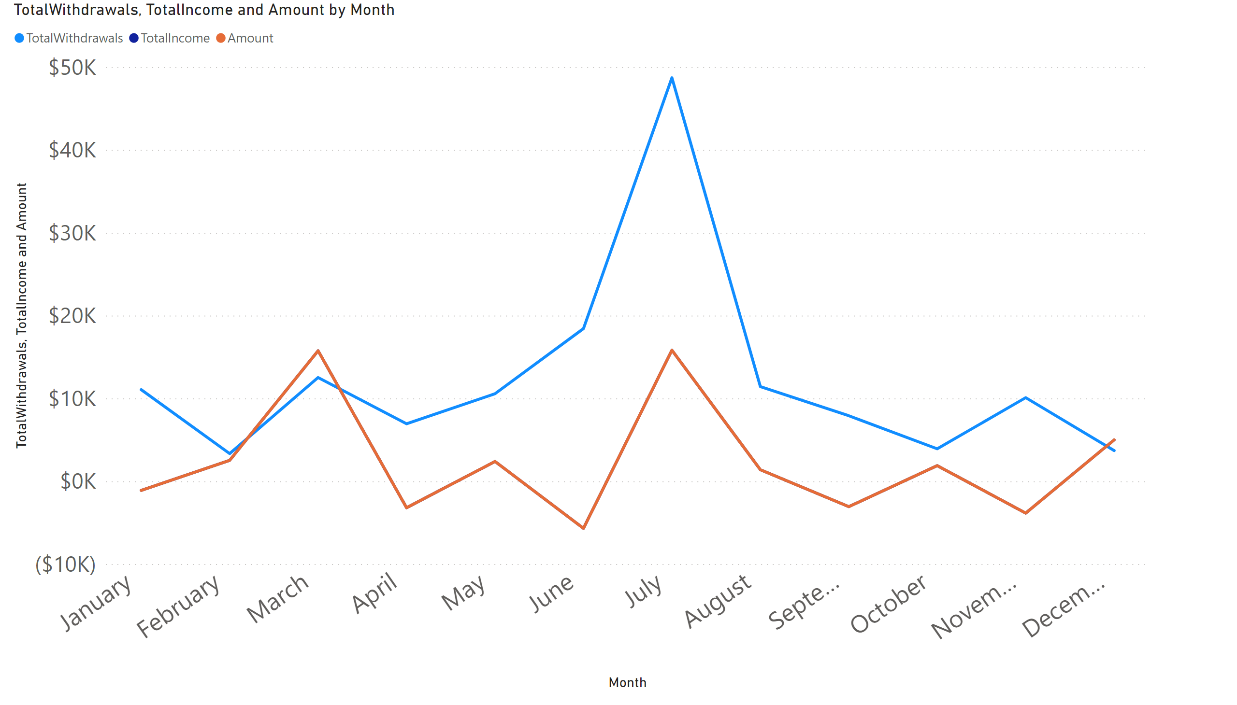
Page 1
Visualization I
Notes:
lineChart
No alt text provided

Slide 9
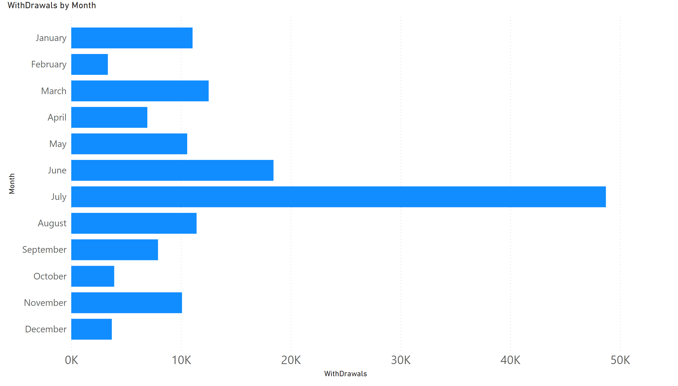
Page 1
VISUALIZATION II
Notes:
clusteredBarChart
No alt text provided

Slide 10

QUESTIONS ?
COMMENTS !

