Slide 1
Squat Assistant
YOUR HOME-GYM SUPPORTER
Group 10
Domenico D’Orsi, Matteo Manni, Lorenzo Mazzei, Denny Meini
Mobile And Social Sensing System
A.A 2023/24

Slide 2


No support during the exercises
Problem: Home-gym has no personal trainers
No prevention of injuries

Slide 3


Solution: A mobile app that does it for you!
Repetition and series count
Form assessment and BPM monitoring

Slide 4
Application main components
Landmark detection model
FitBit and FitBit app
The core part of the system relies in the landmark detection model, used both for form assessment and repetition count
The other fundamental component of the system is the FitBit smartwatch, along with its native app, which are used to provide the BPM real time measure

Slide 5
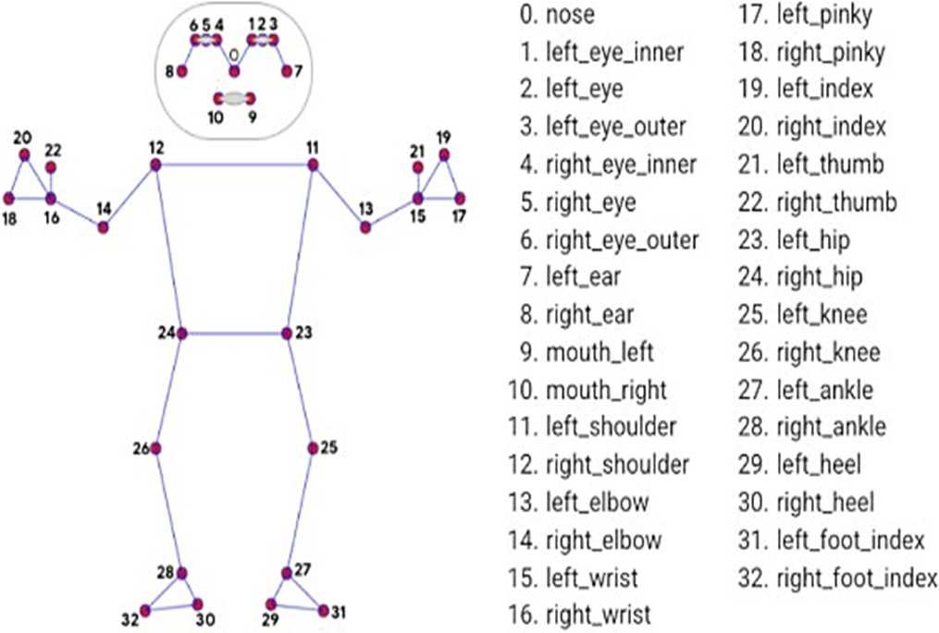

The model: MediaPipe Pose Landmarker
Able to detect the pose of a person from a camera stream
33 landmarks for 33 body parts
3 coordinates for each landmark
Landmarks considered: 12, 24, 25, 26, 28

Slide 6
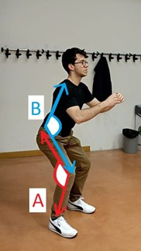
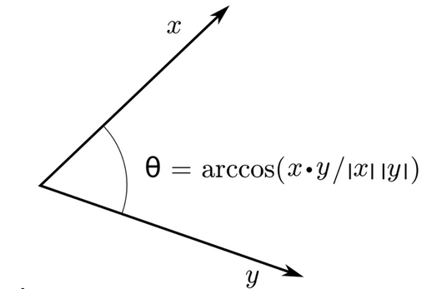

Measured Angles
Angle Knee (A)
Angle Hip (B)
Also measured:
Knee Distance
Ankle Distance

Slide 7
The Phases of a Squat
Phase 0
Phase 1
Phase 2
Repetition Count:
Angle knee: (145,160)
Form Assessment:
Angle hip < 140
Knee distance < 4*Ankle distance
or
Knee distance > 8*Ankle distance
Repetition Count:
Angle knee: (90,145]
Form Assessment:
Angle hip <= 90
Knee distance < 3*Ankle distance
or
Knee distance > 8 Ankle distance
Repetition Count:
Angle knee <= 90
Form Assessment:
Knee distance < 4*Ankle distance
or
Knee distance < 8*Ankle distance

Slide 8
Repetition Count
Implementation of a Finite State Machine
Exercise
State
0
Exercise
State
2
Exercise
State
4
Exercise
State
1
Exercise
State
3
Repetition
counter +=1

Slide 9

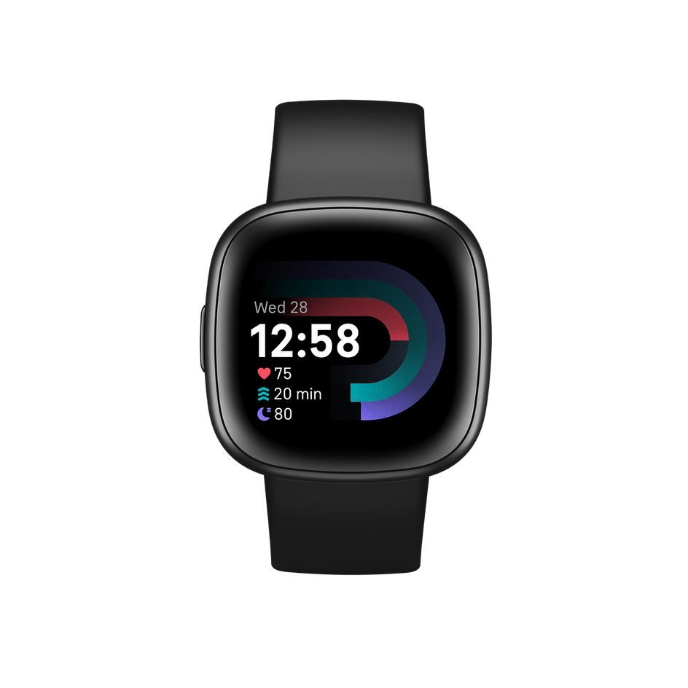

FitBit and FitBit App
Smartwatch connection with the application

Slide 10
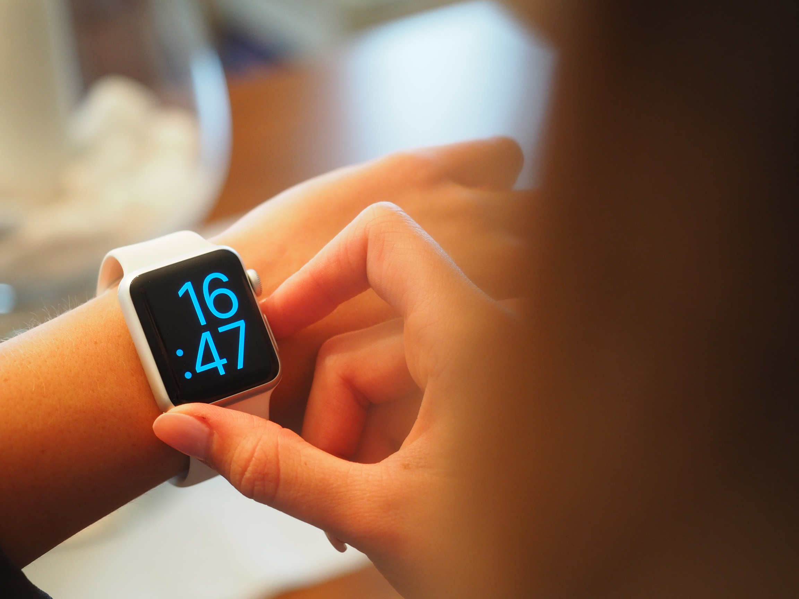
MAIN ISSUES
No API Available
No bluetooth communication with external app

Slide 11
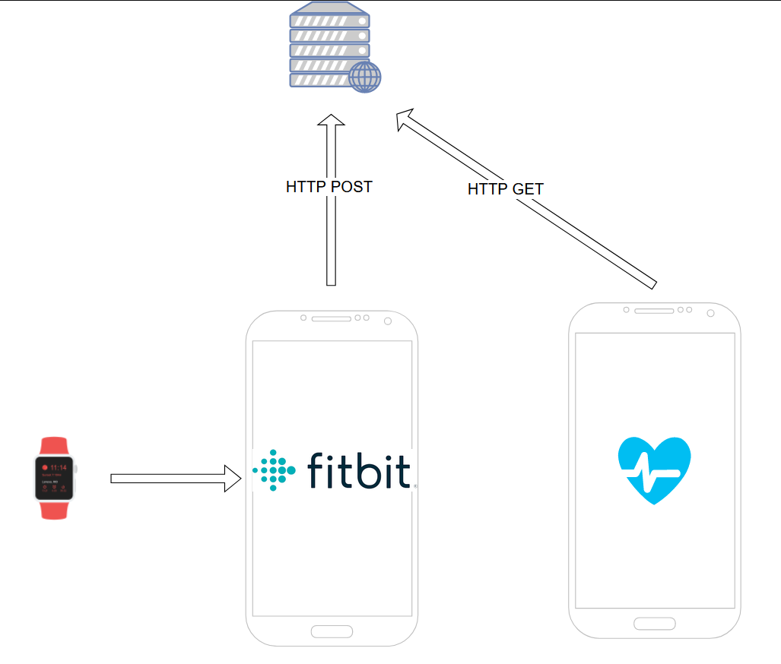
Smartwatch workflow

Slide 12
Overall application
pipeline

Slide 13
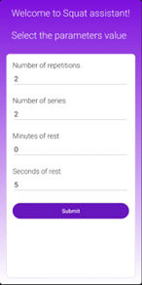
Parameters setup
Choosing our workout configuration

Slide 14
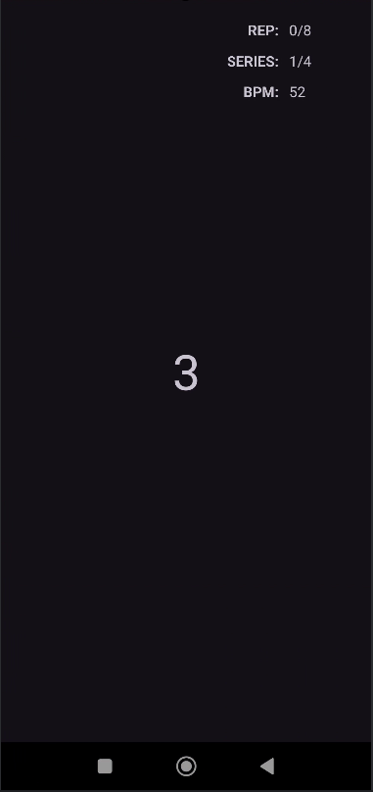
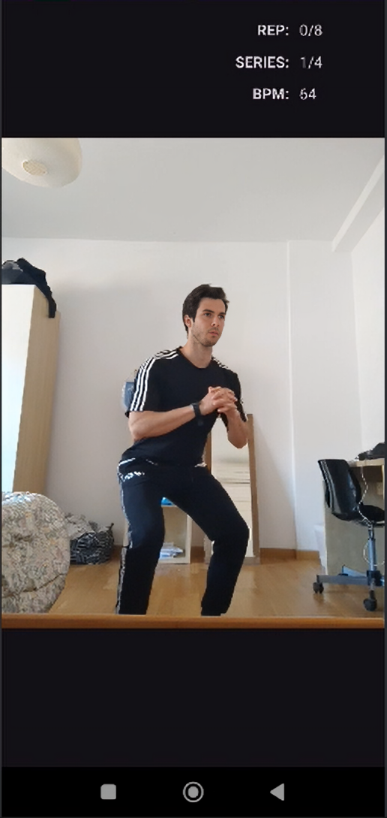
Exercise execution

Slide 15
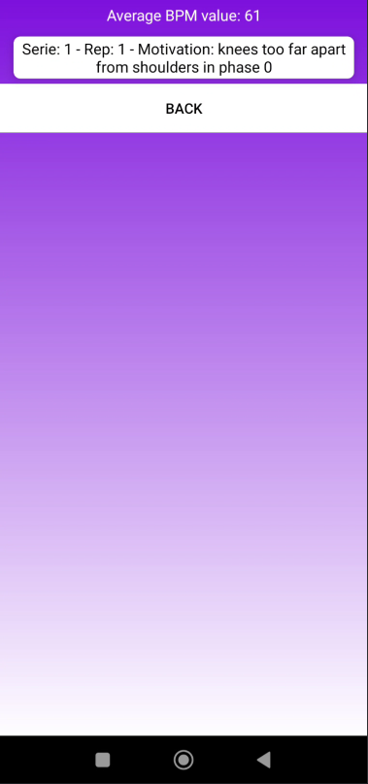
Workout report
Wrong repetitions and average BPM value are reported in this fragment

Slide 16
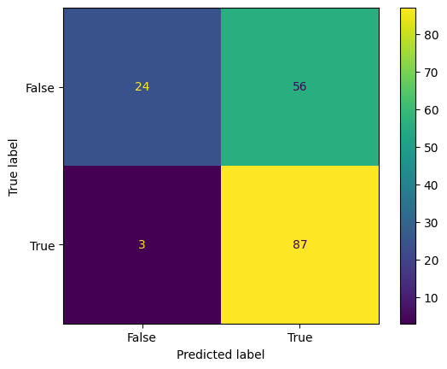
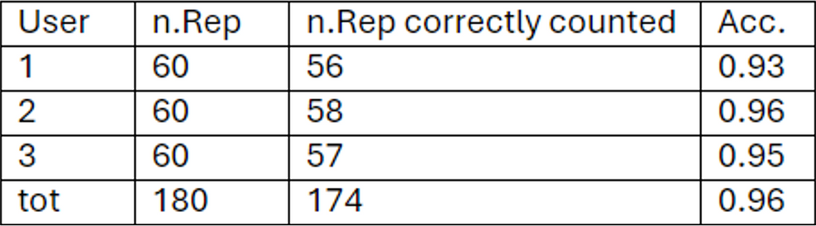
Results
Repetition Count
Form Assessment
F1 Score: 0.86
Accuracy: 0.75

Slide 17
Conclusions
In this work we presented our application which is capable, through a pose estimating model, to perform both form assessment and repetitions count
The model obtained really good performances even though it’s based on simple heuristics, thus making it a really useful and lightweight application for fitness enjoyers
In the future, we may implement other exercises inside of the application and try to use a combination of different models for the form assessment

Slide 18
Thanks for your attention
We are open to your questions

