Slide 1
WARDEN
An AI co-scientist that decides what to compute next
for area-selective ALD: SiO₂ on SiO₂, nitride passivated
Notes:
This is WARDEN, an AI co-scientist for area-selective atomic layer deposition. I'll cover the problem, why it is hard, how WARDEN works, what it has shown so far, and where it goes next.

Slide 2
The problem: oxide on oxide, not on the nitride
3D NAND needs SiO₂ grown on SiO₂ while the adjacent SiN stays bare, to isolate charge-trap cells
Route: an inhibitor that caps nitride N–H groups but leaves oxide O–H groups free to grow
Hard because both surfaces are amorphous, with many different reactive sites
90 %
selectivity at 10 nm of oxide: the target
3D NAND
the application: oxide-on-oxide next to charge-trap nitride
Notes:
The challenge comes from 3D NAND: grow silicon oxide on oxide, but not on the silicon nitride right next to it, with 90 percent selectivity at 10 nanometres. The usual route is an inhibitor molecule that caps the nitride's N-H groups and leaves the oxide's O-H groups free. That is hard because both surfaces are amorphous, with many different reactive sites.

Slide 3
Why an AI co-scientist helps
Today
With WARDEN
Molecules picked by intuition
One idealised surface
Adsorption energy as a proxy
Failed calculations dropped or misread
Compute spread evenly
Molecules from sourced literature and analogs
Validated amorphous surfaces, site by site
Reaction kinetics judged by a real dose window
Numerical failures retried, never read as chemistry
Each calculation chosen for its value
Notes:
Today, inhibitors are picked by intuition and judged by adsorption on one idealised surface, failed calculations are dropped or misread, and compute is spread evenly. WARDEN sources every molecule in the literature, works site by site on validated amorphous surfaces, judges kinetics against a real dose window, and spends each calculation where it can change the decision.

Slide 4
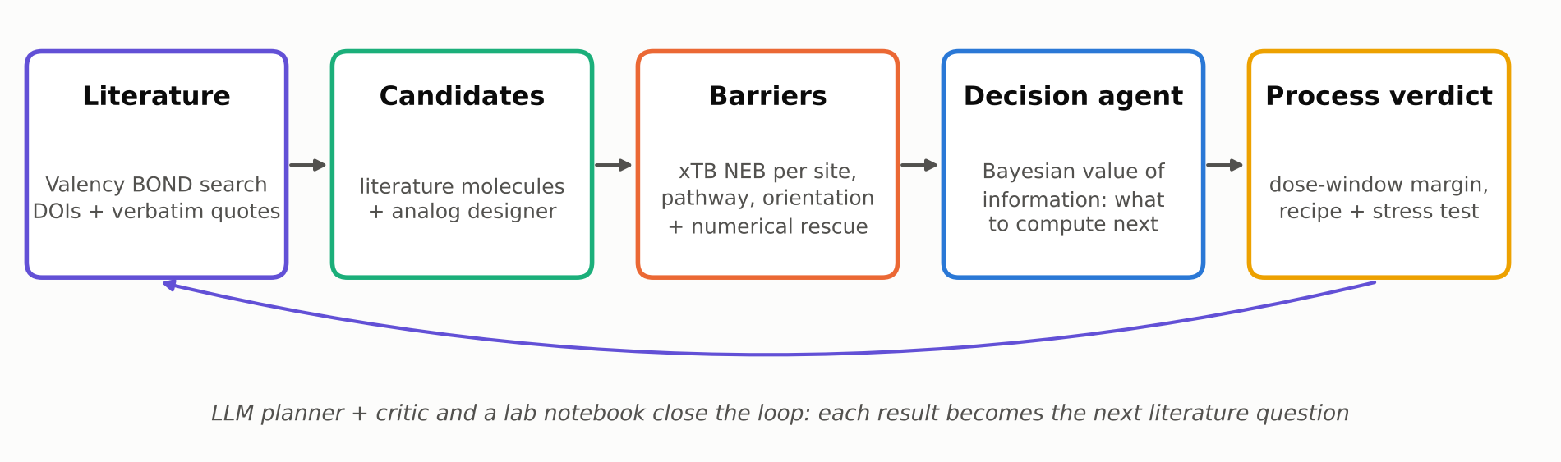
How WARDEN works
Every literature claim quotes a retrieved source verbatim; an independent critic reviews each proposal
Amorphous slabs pass admission gates before any energy is computed; hypotheses are scored by code, not by the LLM
Notes:
Here is the loop. WARDEN searches the literature through Valency BOND and keeps only what it can quote. It turns papers into candidate molecules and designs analogs, computes reaction barriers with xTB on validated surfaces, and a decision agent picks the next calculation. A process model gives the verdict, and an LLM planner, a critic and a lab notebook turn each result into the next question.

Slide 5
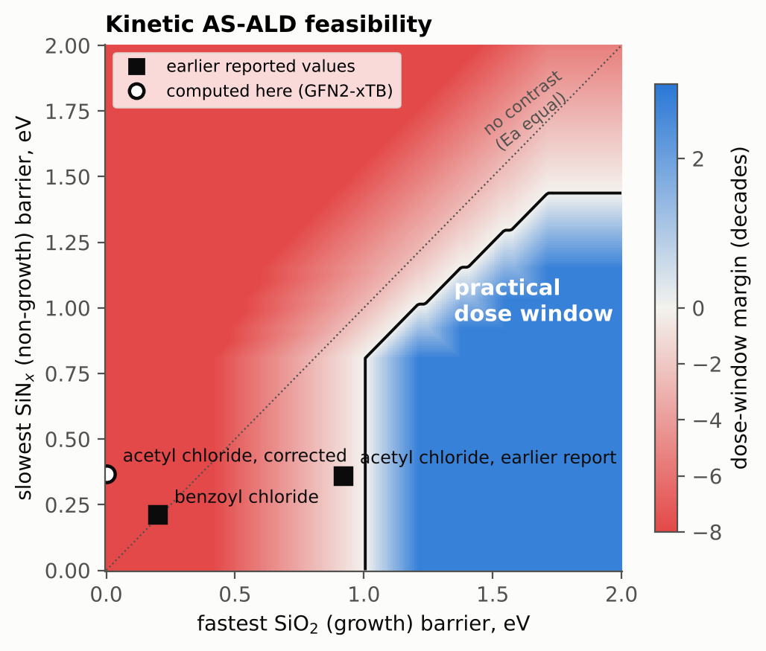
One criterion: can a dose separate the surfaces?
Each barrier gives a capping rate: k = (k_B T / h) · exp(−Ea / k_B T)
Works only if the slowest nitride site is 99 % capped before the fastest oxide site reaches 1 %, at 0.05–30 s
Margin in decades, at the best temperature: the number every component optimises
A large barrier difference alone is not enough: both barriers must sit in the blue band
Notes:
Everything optimises one physical number. Each barrier gives a capping rate. A molecule only works if a practical dose caps the slowest nitride site before it touches the fastest oxide site: the blue region, measured in decades. A big barrier difference is not enough; both barriers have to sit in the right band.

Slide 6
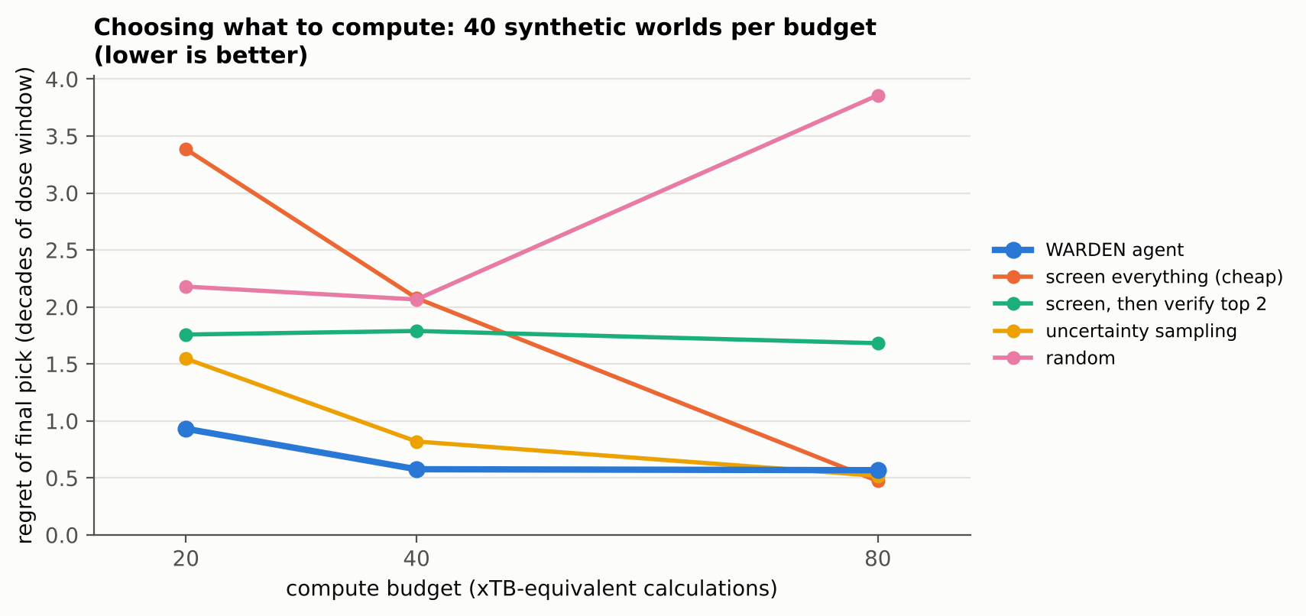
The agent chooses what to compute next
value of a calculation = expected improvement in the margin × P(success) ÷ cost
2.5 dec.
lower regret than screening everything, budget 20
16%
less compute to match exhaustive screening, budget 80
Notes:
The agent keeps a Bayesian belief over every barrier it could compute, and values each possible calculation, a new molecule, site, pathway, orientation or a better method, by how much it could change the decision per unit cost. On forty synthetic test cases per budget, it beats screening everything at tight budgets and matches it at large budgets with sixteen percent less compute.

Slide 7
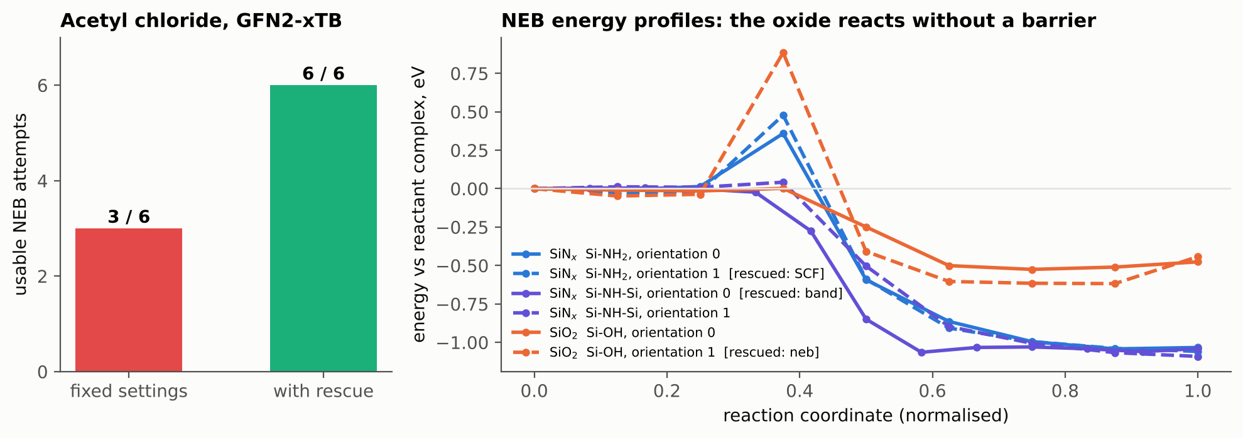
Validation: real calculations, corrected conclusions
-13.6 dec.
6 / 6
acetyl chloride: oxide reacts with no barrier, so not selective (first screen: +0.71 eV)
usable NEB attempts with targeted numerical retries (was 3 / 6)
Notes:
We validated the workflow on real calculations. Our first screen had reported acetyl chloride as nitride-selective. WARDEN showed its oxide reaction is barrierless, the orange profile, so it would cap the oxide too. And half of all barrier calculations were failing for purely numerical reasons; one targeted retry per failure type brought that to six out of six.

Slide 8
Candidate screening
Candidate (from Valency) | Agent's priority | Margin, decades | P(S ≥ 90 %)
pivaldehyde | value/cost 2.96 | [[pending]] | [[pending]]
glutaraldehyde | value/cost 2.96 | [[pending]] | [[pending]]
propanoyl chloride | value/cost 2.38 | [[pending]] | [[pending]]
BDMADMS | control (prefers SiO₂) | [[pending]] | [[pending]]
cyclic azasilane | no barrier model yet | [[pending]] | [[pending]]
Finding: [[best candidate, its margin and predicted selectivity, or why no candidate passes yet]]
Notes:
From ten papers retrieved through Valency, WARDEN built five candidates, each with a DOI and a verbatim quote. Having learned that acyl chlorides attack the oxide, it ranked the aldehydes, the class the literature calls nitride-selective, first. [[Result: name the best candidate, its margin and predicted selectivity, or explain which input limits the verdict.]]

Slide 9
A search you can audit, and improve
Every verdict is computed, sourced and reproducible, including the reason a molecule fails
Next: slab-level barriers and DFT on the leaders, calibrated against measured growth curves
Automate the literature loop: similar and citing papers, reported barriers as priors
github.com/dominicvarghese/donuman-ai-scientist
Notes:
WARDEN turns the inhibitor search into decisions you can audit: every verdict is computed, sourced and reproducible, including why a molecule fails. Even where today's candidates fall short, the model shows which input limits the prediction, and each part can be upgraded: slab-level barriers, DFT on the leaders, calibration against measured growth, and an automated literature loop. Thank you.

