Slide 1

Welcome to
[NODES 2021]
KNIME – Data Science Orchestration with Neo4j

Slide 2


Guest Speaker
Dominic KUMAR
Enterprise Data Architect

Slide 3

About Me
~ 20 years of experience in the data world.
Started with SQL Server 6.5 and Oracle 9i.
Worked as DB Developer, ETL Developer, DBA, Performance Lead, Data Modeler, Data Architect.
Expertise range from tuning, optimization to Data maturity modeling & architecture.
Domains include Oil and Gas and Airlines Transportation (IATA).
Hobbies – Learning to fly, compose music, travel.

Slide 4
Success Stories
Optimizing Airline Routes using Path finding algorithms, India-Spring ‘19
Event helped 3 major transportation clients transition to neo4j technology, leading to lowering operation cost & increase revenue
Neo4j Online Developer conference, London - Fall 2019
Data ETL using Talend for Neo4j Data Orchestration
Global Graph Celebration Day , London - Fall 2020
Application of Machine Learning with Neo4j database.

Slide 5
Safe Harbour
The following presentation is intended to outline general use of KNIME products. This presentation is not a sales or promotion effort from KNIME. This presentation is created based on using KNIME free license tool, available for free download.

Slide 6
Agenda
Data Engineering/Science – Challenges
Machine Learning – Production – Expectation Vs Reality
What is KNIME Analytics Platform?
Typical KNIME Data Pipeline Workflow
KNIME Nodes & Workflows
Neo4j Extension
Demo
KNIME Editions
References
Q & A

Slide 7
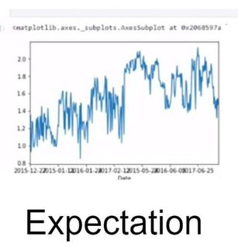
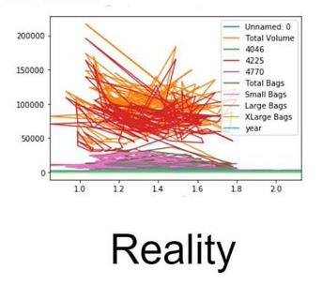
Data Engineering/Science – Challenges

Slide 8
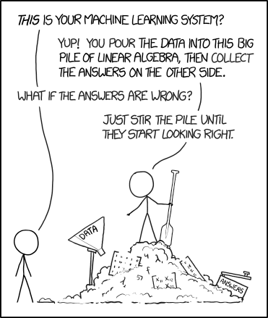
Data Science – Production
What it is
Translating Information into Knowledge.
Allowing business to make simpler & smaller improvements to an existing business process to increase revenue.
Accessing the current maturity performance and keep improving.
What it is not
Coding in Python notebooks
Data Engineers loading & manipulating data
Training and testing machine learning models.

Slide 9

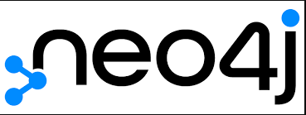

Slide 10
What is KNIME Analytics Platform ?
A Graphical IDE for Data & Tool Integrations
Data Analysis, Wrangling, Visualization and Reporting
Big Data and Cloud Components
AWS, Azure and GCP
AWS Redshift, GCP BigQuery, Azure Storage
Data Science – R, Python, H2O, Weka, TensorFlow etc.
Social Media – Twitter, Facebook
Databricks, Spark

Slide 11
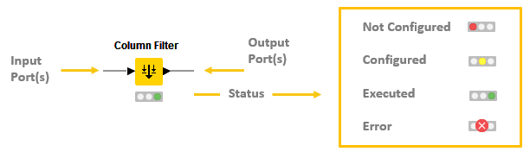
KNIME Node

Slide 12
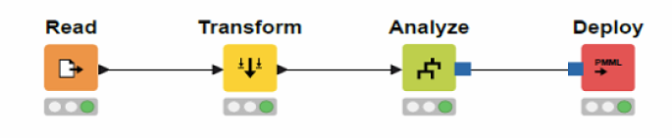
A typical KNIME Data Pipeline Workflow

Slide 13
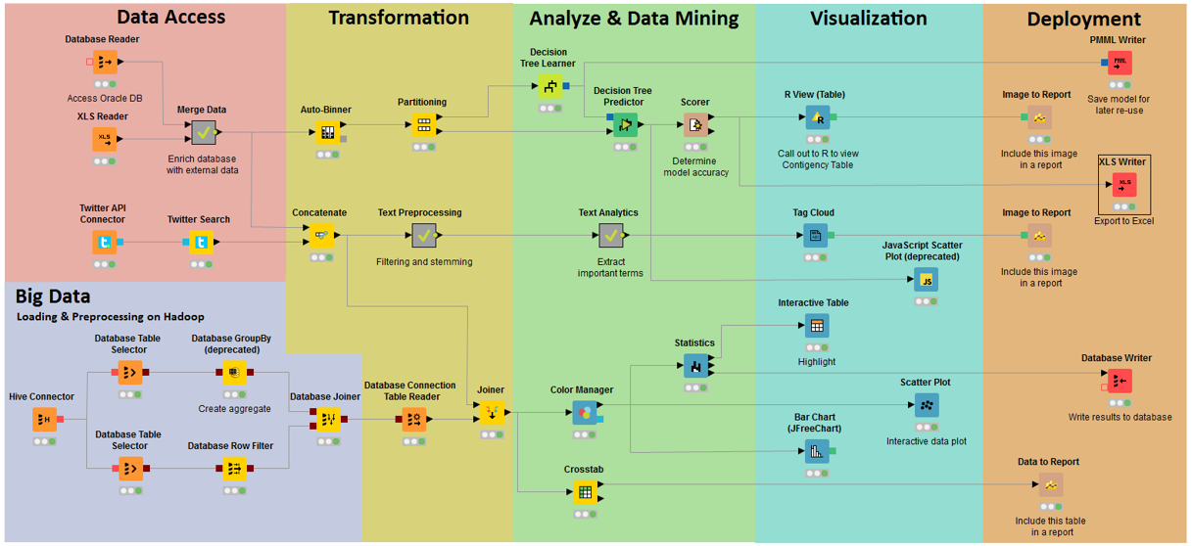
Example workflow

Slide 14
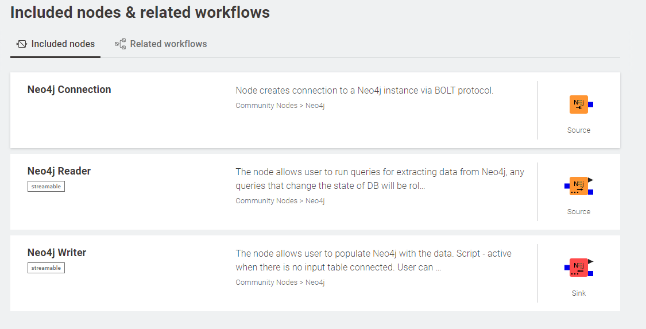
Neo4j Extensions

Slide 15
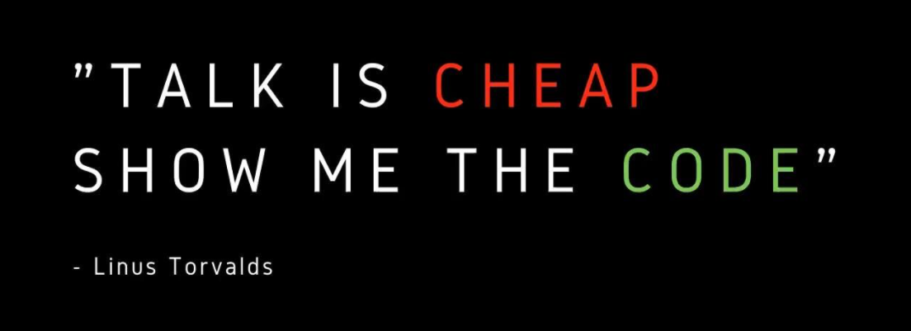


Slide 16
Demo

Slide 17
KNIME Editions
KNIME Analytics Platform
Open-source software
Learn & create intuitive, open, and continuously integrating data science workflows and reusable components accessible to everyone.
Data analytics solution on a budget
FREE
KNIME Server
Enterprise software for team-based collaboration, automation, management, and deployment of data science workflows as analytical applications and services.
Dashboards / Web Interface for reading or KPI’s.
$$

Slide 18
References
KNIME Website
https://www.knime.com/
KNIME Neo4j Extensions
https://hub.knime.com/redfield/extensions/se.redfield.knime.neo4jextension.feature/latest
KNIME NodePit
https://nodepit.com/product/nodepit
Illustrations
https://imgs.xkcd.com/comics/machine_learning.png

Slide 19
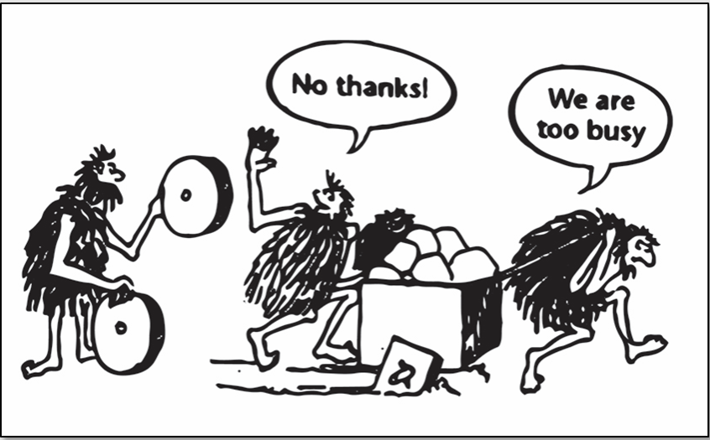
A typical day ……

Slide 20
Questions?
[NODES 2021]

