Slide 1
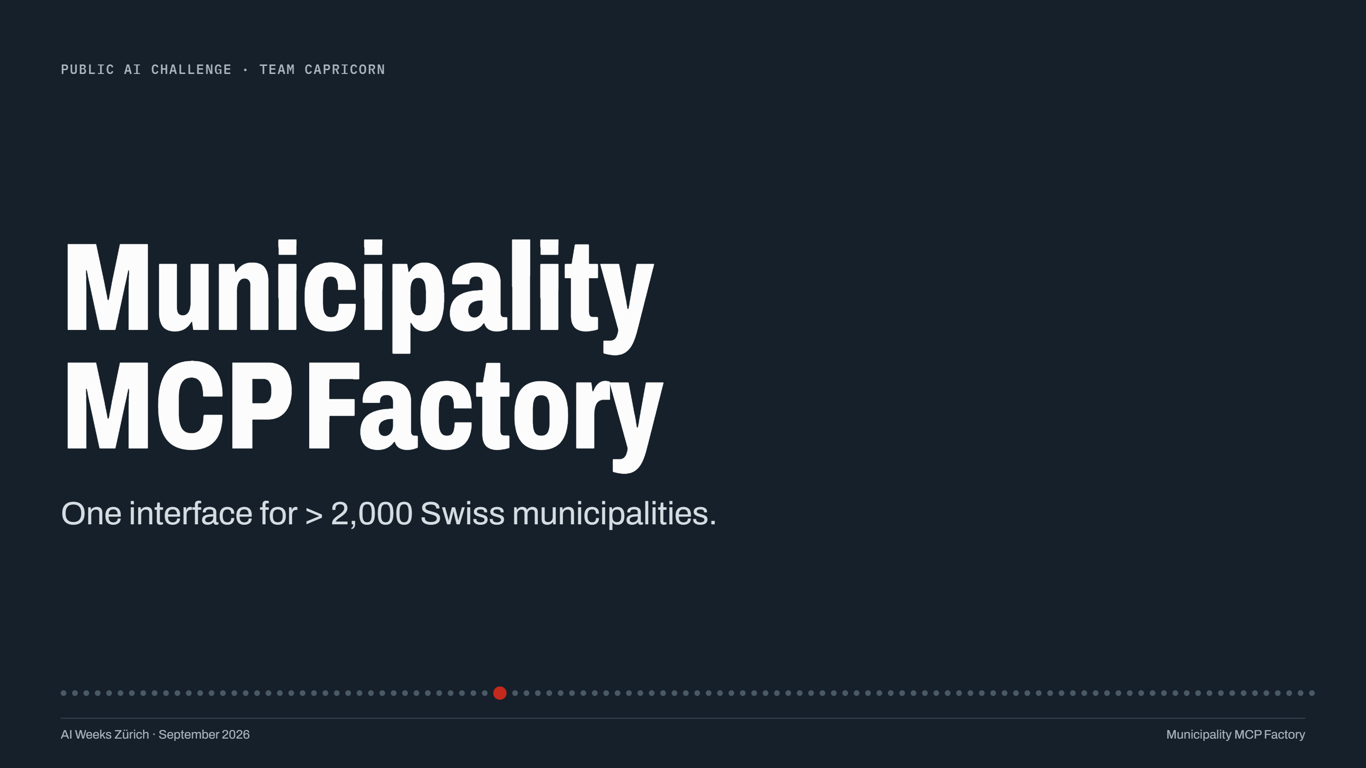

Slide 2
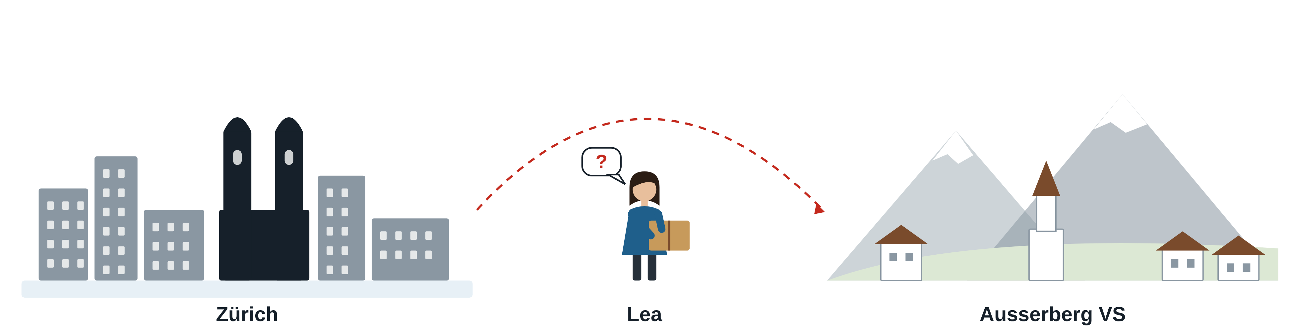
LEA
Lea is moving from Zürich to Ausserberg.
How do I register my new address?
When is the Gemeindekanzlei open?
When do I put out the paper collection?
Municipality MCP Factory
Notes:
SAY (about 15 s): Meet Lea. She is moving from Zürich to Ausserberg, a village in Valais. She has three simple questions, and like most of us, she asks her AI assistant.

Slide 3
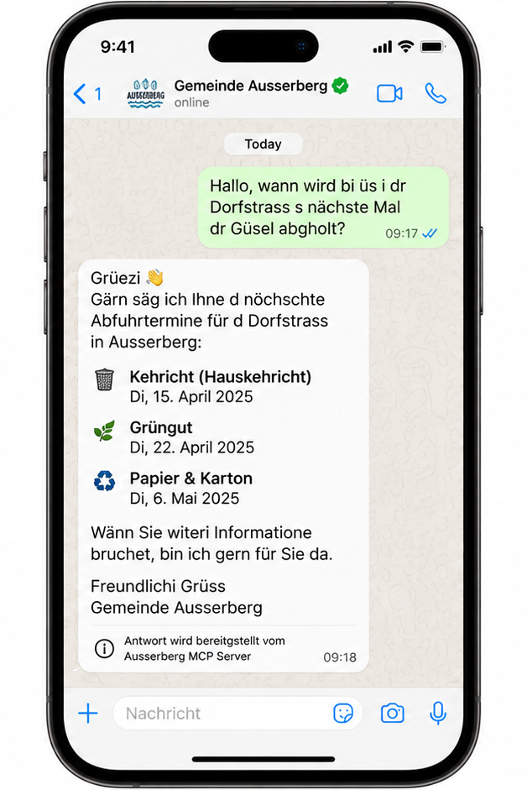
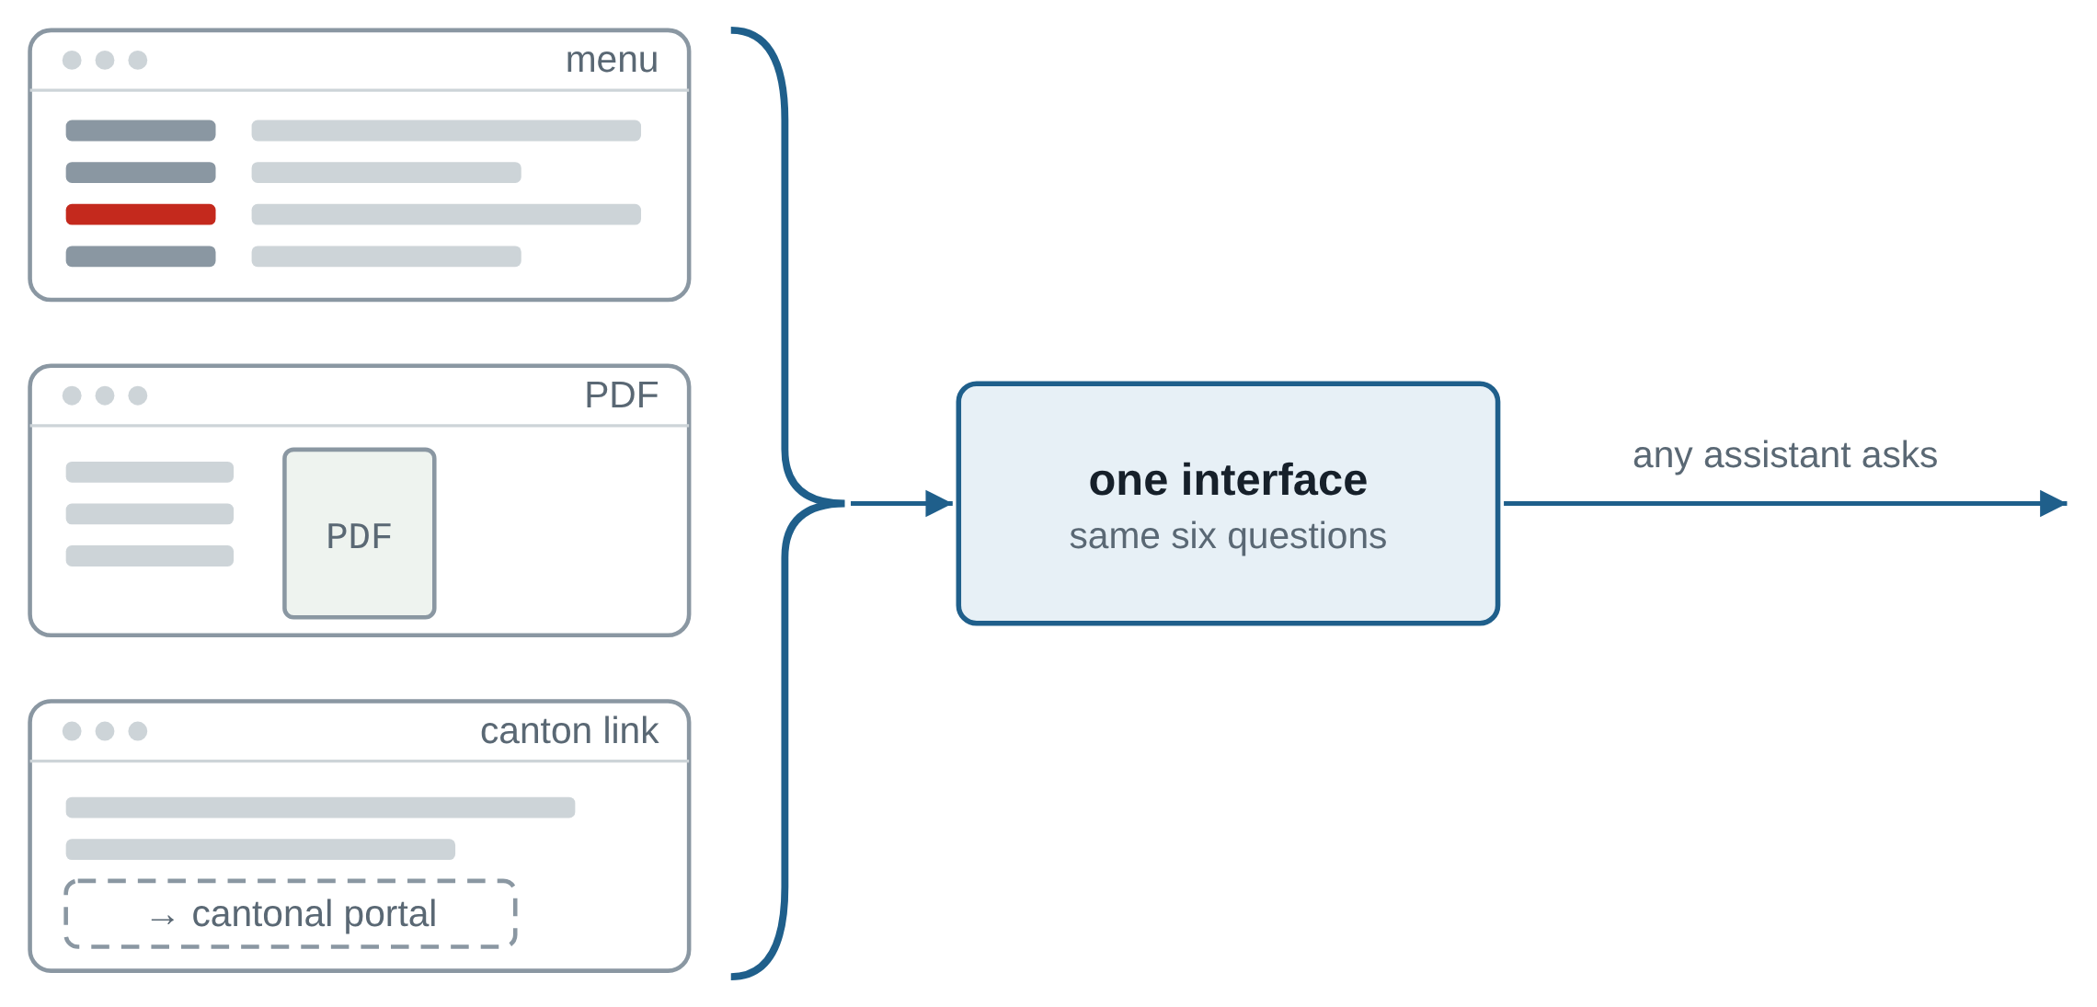
THE PROBLEM
Scattered websites, one interface: Lea gets Ausserberg's own answer.
Public AI Challenge · Team Capricorn
Municipality MCP Factory
Notes:
SAY (about 20 s): But every municipality publishes differently: a menu here, a PDF there, a link to the canton. So the assistant guesses. We bring it all together into one interface. Now Lea gets Ausserberg's own answer: the online form, the source, and an honest note about what the page does not say.

Slide 4

SOLUTION AND SCALE
AI builds and packages it. Every municipality is one more run.
Ausserberg · today
Factory
Binn
AI reads
AI checks
Common format
any assistant
Bosco/Gurin
Dübendorf
+1 Gemeinde
Ausserberg, today
next four
> 2000 municipalities
Municipality MCP Factory
Notes:
SAY (about 12 s): Behind it, AI does the work: one agent reads the pages, a second checks every fact, and it is packaged automatically. Maintenance is near zero. And every one of the 2,110 municipalities is simply one more run: Ausserberg today, the next four after.

Slide 5
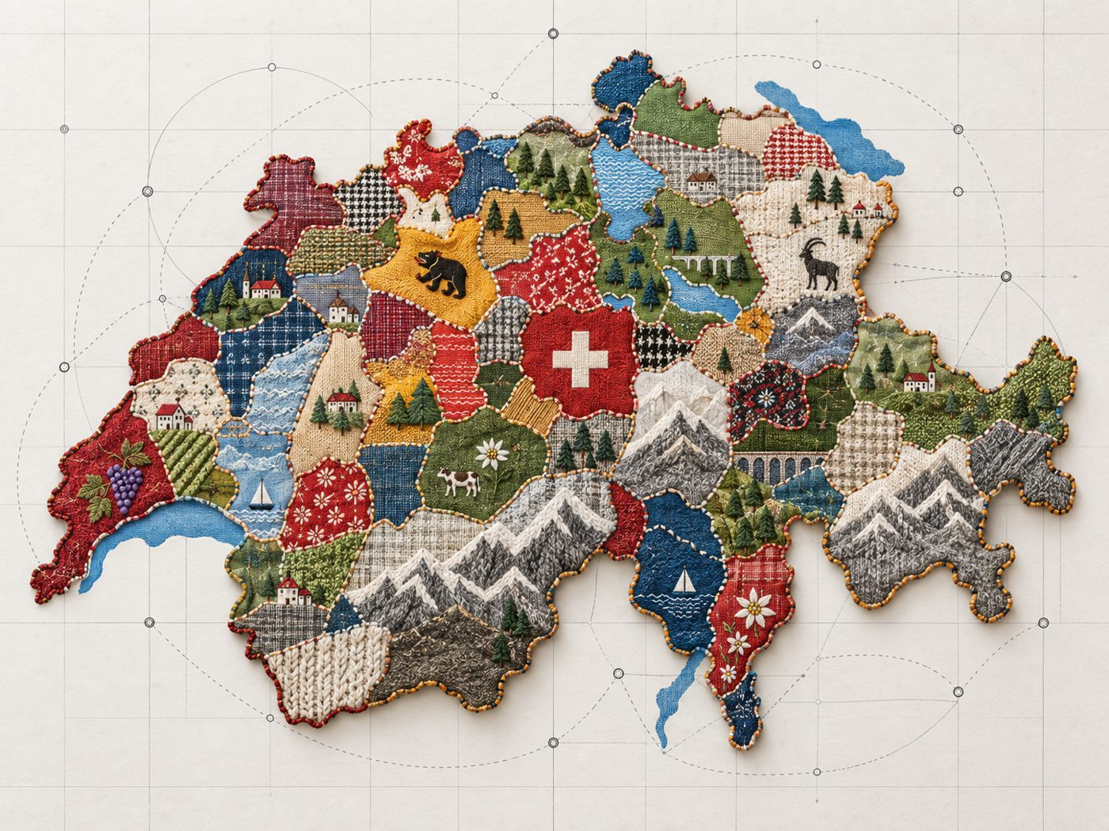
FEDERALISM
Decentralized by Design
Municipality MCP Factory
Notes:
SAY (about 13 s): Switzerland is a patchwork, and that is its strength. Every municipality has its own rules, its own website, even its own rubbish bag. We do not change a single patch. We add the seam: one common interface through the whole quilt. Lea asks once, and every municipality can answer. Thank you.

Slide 6
