Slide 1


Start
End
Activity
Sub-process
Data repository
Data flow
Sequence flow
Process Symbols (BPMN Standard)
Figure 2-3

Slide 2
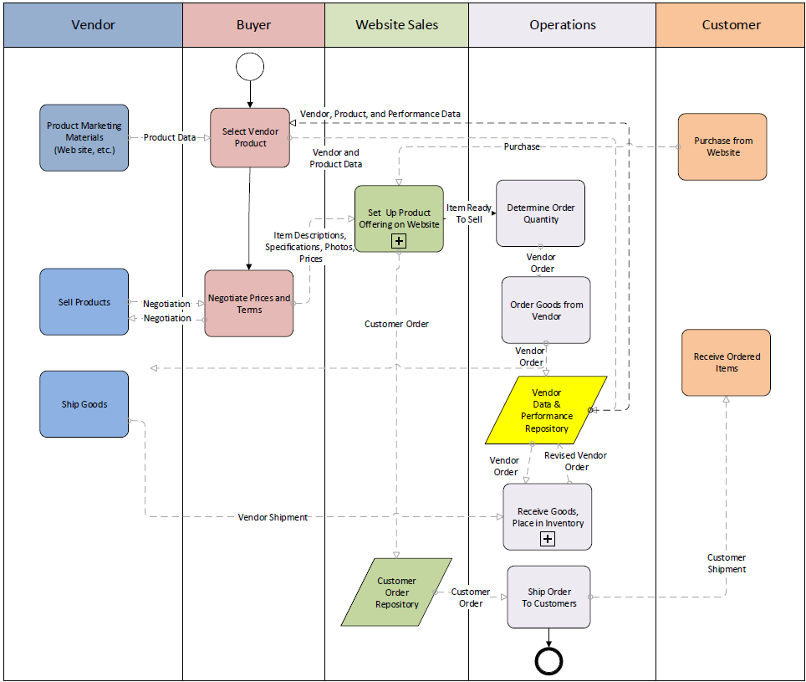
Copy of Figure 2-8

