Slide 1
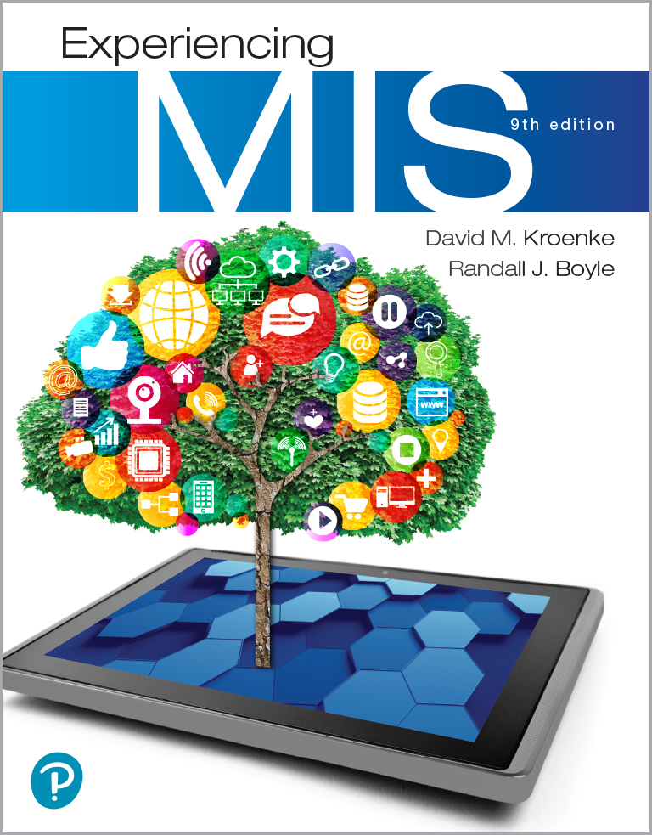
Experiencing M I S
Ninth Edition
Chapter Extension 3
Database Marketing
Slides in this presentation contain hyperlinks. JAWS users should be able to get a list of links by using INSERT+F7
Copyright © 2021, 2019, 2017 Pearson Education, Inc. All Rights Reserved
Notes:
If this PowerPoint presentation contains mathematical equations, you may need to check that your computer has the following installed:
1) MathType Plugin
2) Math Player (free versions available)
3) NVDA Reader (free versions available)

Slide 2
Study Questions
CE 3-1 What is a database marketing opportunity?
CE 3-2 How does R F M analysis classify customers?
CE 3-3 How does market-basket analysis identify cross-selling opportunities?
CE 3-4 How do decision trees identify market segments?

Slide 3
Owner of Carbon Creek Gardens Needs Database Marketing
CE 3-1 What is a database marketing opportunity?
As business grew, lost track of customers
Lost valuable customer and didn't know it
Has lot of sales data, but needs system to:
Store and track customers
Store and track services provided to customers
Store and report future scheduled services

Slide 4
Database Marketing
CE 3-1 What is a database marketing opportunity?
Application of business intelligence systems to:
Planning marketing programs
Executing marketing programs
Assessing marketing programs
Databases and data mining techniques key components
Notes:
Scenario: Mary needs to identify lost customers in a timely way. Database marketing will help classify customers in terms of how recently and how frequently they have purchased, and the size of those purchases. Customers who have not purchased recently, but purchased frequently with high value orders (such as Tootsie Swan) will be identified so Mary can attempt to gain back their business. Mary will need customer purchase records in order to perform analysis.

Slide 5
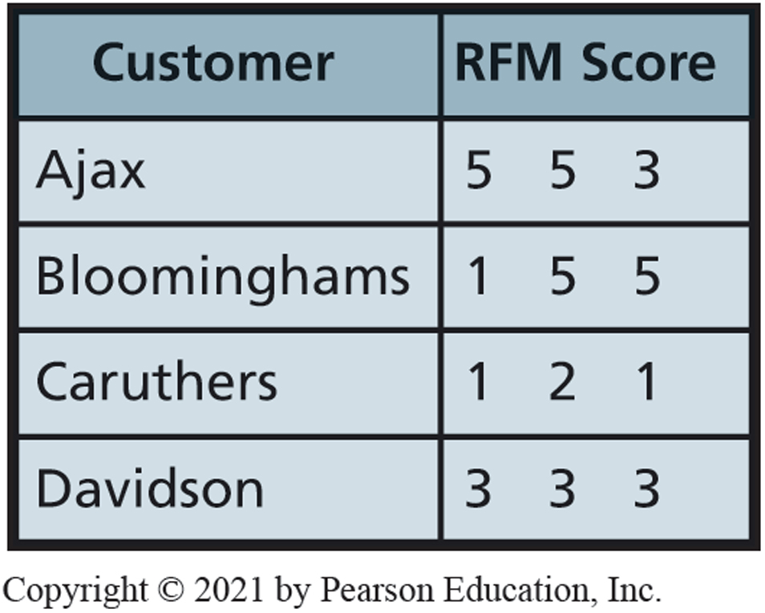
R F M Analysis: Example R F M Scores
CE 3-2 How does R F M analysis classify customers?
How recently (R) a customer has ordered
How frequently (F) a customer ordered
How much money (M) the customer has spent
Figure C E 3-1 Example of R F M Score Data
Notes:
RFM considers how recently (R) a customer has ordered, how frequently (F) a customer ordered, and how much money (M) the customer has spent.

Slide 6
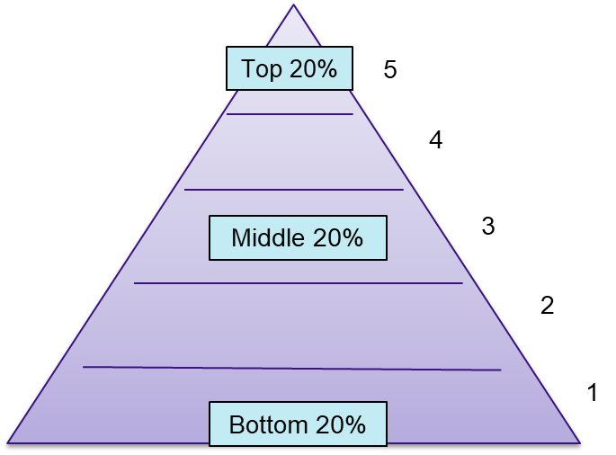
R F M Analysis Classification Scheme
CE 3-2 How does R F M analysis classify customers?
To produce an R F M score:
Sort customer purchase records by date of most recent (R) purchase.
Divide sorts into quintiles.
Give customers a score of 5 to 1.
Process is repeated for Frequently and Money.
Notes:
To produce an RFM score, a program sorts customer purchase records by date of most recent (R) purchase, divides sorts into quintiles, and gives customers a score of 5 to 1. Process is repeated for Frequently and Money.

Slide 7
Market-Basket Analysis
CE 3-3 How does market-basket analysis identify cross-selling opportunities?
Market-basket analysis
Identify sales patterns in large volumes of data.
Identify what products customers tend to buy together.
Computes probabilities of purchases.
Identify cross-selling opportunities.
Customers who bought fins also bought a mask.
How many customers bought both fins and a mask?
Notes:
Association analysis important part in shopping basket data analysis.

Slide 8
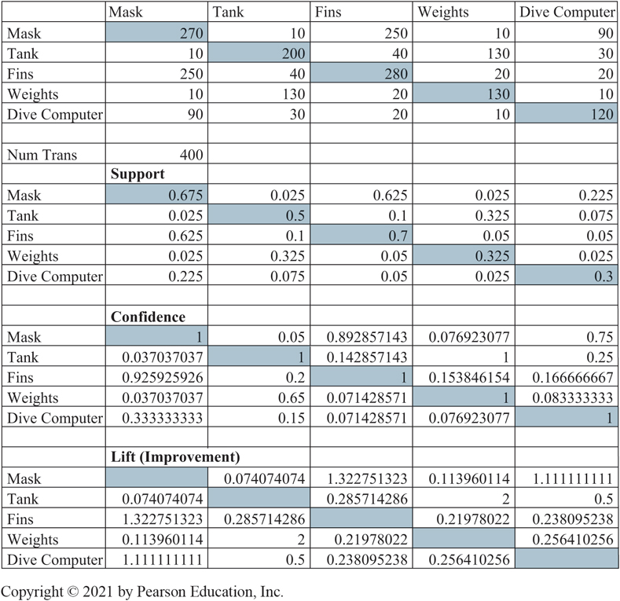
Market-Basket Example: Dive Shop Transactions = 400 (1 of 4)
CE 3-3 How does market-basket analysis identify cross-selling opportunities?
Figure C E 3-2 Market-Basket Example
Notes:
Hypothetical sales data
First row of numbers under each column is total number of times an item sold.
For example, 270 in first row under Mask column means that 270 of the 400 (.67) transactions included masks.
280 under Fins column means that 280 of 400 (.700) transactions included fins.

Slide 9
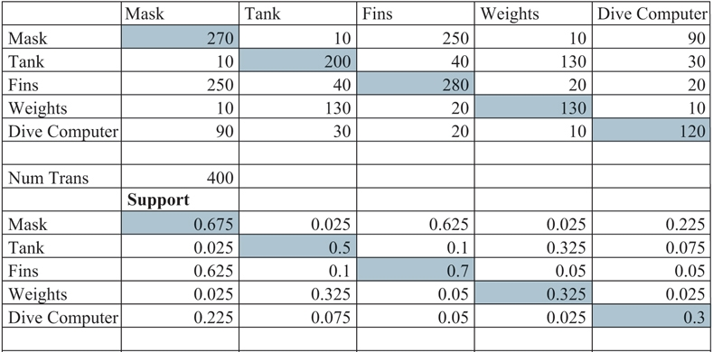
Market-Basket Example: Dive Shop Transactions = 400 (2 of 4)
CE 3-3 How does market-basket analysis identify cross-selling opportunities?
Figure C E 3-2 Market-Basket Example
Support is probability that two items will be purchased together.
Notes:
Support is probability that two items will be purchased together.
To estimate that probability, examine sales transactions and count number of times two items occurred in the same transaction. Fins and masks appeared together 250 times, and thus the support for fins and a mask is 250/400, or .625. Similarly, the support for fins and weights is 20/400, or .05.

Slide 10
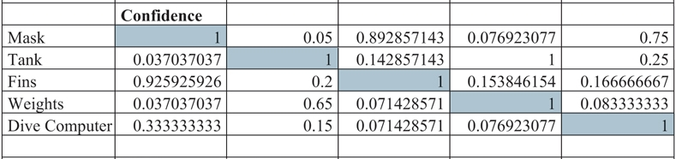
Market-Basket Example: Dive Shop Transactions = 400 (3 of 4)
CE 3-3 How does market-basket analysis identify cross-selling opportunities?
Figure C E 3-2 Market-Basket Example
Confidence is a conditional probability estimate.
Masks were purchased 270 times.
Those individuals who bought masks, 250 also bought fins.
Thus, given a customer bought a mask, we can estimate probability for buying fins to be
or 92.6%.
Notes:
Confidence is a conditional probability estimate.
Masks were purchased 270 times, and those individuals who bought masks, 250 also bought fins. Thus, given a customer bought a mask, we can estimate probability for buying fins to be 250/270, or 92.6%.

Slide 11
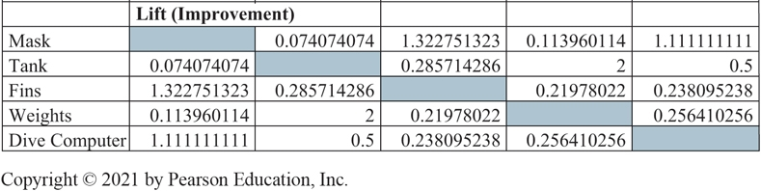
Market-Basket Example: Dive Shop Transactions = 400 (4 of 4)
CE 3-3 How does market-basket analysis identify cross-selling opportunities?
Figure C E 3-2 Market-Basket Example
Lift shows how much base probability increases or decreases when other products are purchased.
Lift of fins and a mask is confidence of fins given a mask (.926), divided by base probability of fins (.7), or 1.32.
Likelihood that people buy fins when they buy a mask increases by 32 percent.
Notes:
Lift shows how much base probability increases or decreases when other products are purchased.
Lift of fins and a mask is confidence of fins given a mask (.926), divided by base probability of fins (.625), or 1.32. Likelihood that people buy fins when they buy a mask increases by 32 percent.

Slide 12
Warning!
CE 3-3 How does market-basket analysis identify cross-selling opportunities?
Analysis only shows shopping carts with two items
Must analyze large number of shopping carts with three or more items
Know what problem you are solving before mining the data
Know what question you want to answer
Notes:
Cannot say what likelihood customers, given they bought one item, will buy both two or more other items.

Slide 13
Decision Trees
CE 3-4 How do decision trees identify market segments?
Unsupervised data mining technique.
Hierarchical arrangement of criteria to predict a value or classification.
Basic idea
Select attributes most useful for classifying “pure groups.”
Creates decision rules.
Notes:
Basic idea of a decision tree is to select attributes most useful for classifying entities.

Slide 14
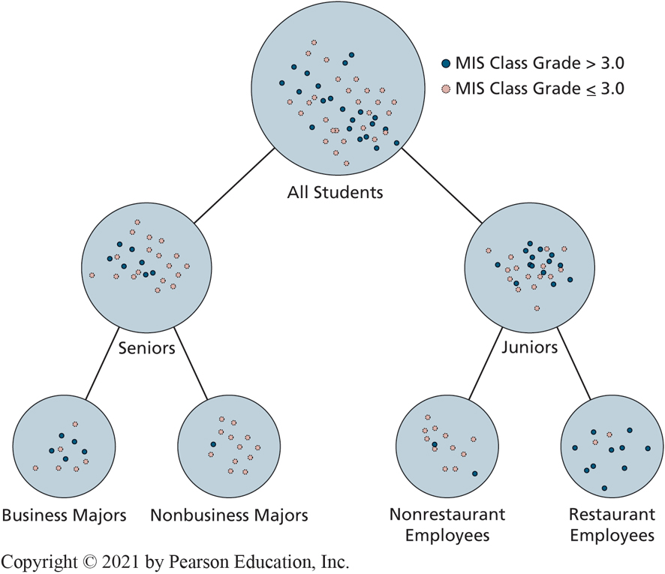
Decision Tree for Student Performance
CE 3-4 How do decision trees identify market segments?
Figure C E 3-3 G P A s of Students from Past M I S Class (Hypothetical Data)
Notes:
Classifying students on whether their GPA was greater than 3.0 or less than or equal to 3.0.
This tree examined students’ characteristics, such as class (junior or senior), major, employment, age, club affiliations, and other characteristics to create groups as different as possible on classification of GPA above or below 3.0.

Slide 15
Transforming a Set of Decision Rules
CE 3-4 How do decision trees identify market segments?
If student is a junior and works in a restaurant,
Then predict grade > 3.0
If student is a senior and is a nonbusiness major,
Then predict grade < 3.0
If student is a junior and does not work in a restaurant,
Then predict grade < 3.0
If student is a senior and is a business major,
Then make no prediction
Notes:
Do not confuse these If/Then rules with those in expert systems. These rules are developed as a result of data mining via decision tree analysis, which generally identify 10 or 12 rules. Expert system rules are created by interviewing human experts, which typically, results in hundreds or thousands of rules.

Slide 16
Decision Tree for Loan Evaluation
CE 3-4 How do decision trees identify market segments?
Classify loan applications by likelihood of default
Rules identify loans for bank approval
Identify market segment
Structure marketing campaign
Predict problems
Notes:
Common business application

Slide 17
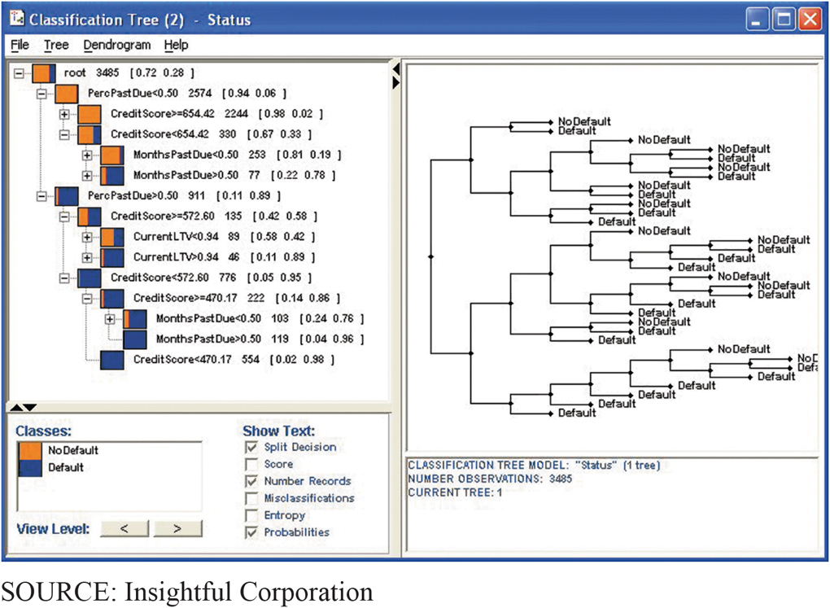
Credit Score Decision Tree
CE 3-4 How do decision trees identify market segments?
Figure C E 3-4 Credit Score Decision Tree
Notes:
An institution considering the purchase of a loan portfolio can use the results of a decision tree program to evaluate the risk of a given portfolio. Common business application of decision trees is to classify loans by likelihood of default.
This example generated by Insightful Miner. Data from 3,485 loans were examined. Of those loans, 72% had no default and 28% did default. To perform analysis, decision-tree tool examined six different loan characteristics.

Slide 18
Decision Rules for Accepting or Rejecting Offer to Purchase Loans
CE 3-4 How do decision trees identify market segments?
If percent past due is less than 50 percent, then accept loan.
If percent past due is greater than 50 percent and
If CreditScore is greater than 572.6 and
If Current L T V is less than .94, then accept loan.
Otherwise, reject loan.

Slide 19
Active Review
CE 3-1 What is a database marketing opportunity?
CE 3-2 How does R F M analysis classify customers?
CE 3-3 How does market-basket analysis identify cross-selling opportunities?
CE 3-4 How do decision trees identify market segments?

Slide 20

Copyright

