Slide 1
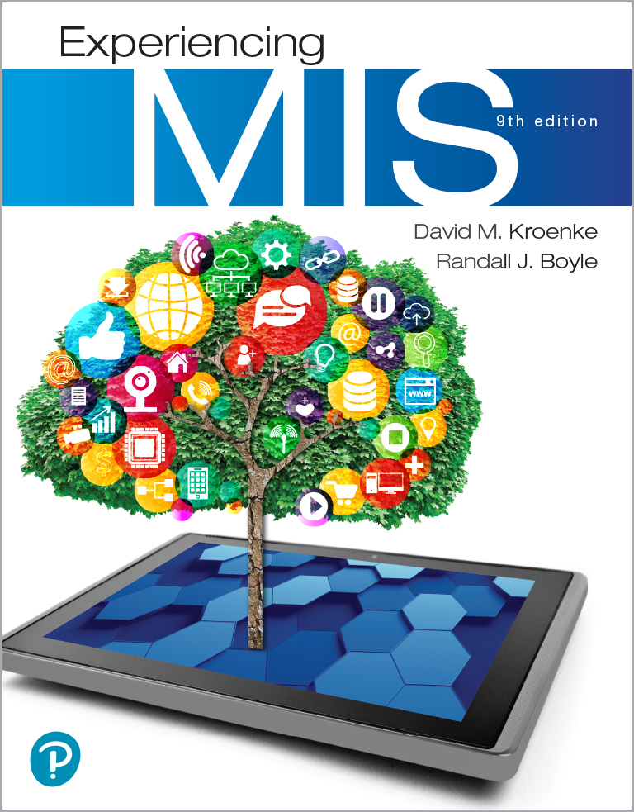
Experiencing M I S
Ninth Edition
Chapter Extension 5
Mobile Systems
Slides in this presentation contain hyperlinks. JAWS users should be able to get a list of links by using INSERT+F7
Copyright © 2021, 2019, 2017 Pearson Education, Inc. All Rights Reserved
Notes:
If this PowerPoint presentation contains mathematical equations, you may need to check that your computer has the following installed:
1) MathType Plugin
2) Math Player (free versions available)
3) NVDA Reader (free versions available)

Slide 2
Study Questions
CE 5-1 What are mobile systems?
CE 5-2 Why are mobile systems important?
CE 5-3 How do native and Web-based mobile applications compare?
CE 5-4 What characterizes quality mobile user experiences?
CE 5-5 What are the challenges of personal mobile devices at work?

Slide 3
What are Mobile Systems?
CE 5-1 What are mobile systems?
Information systems to support users in motion
Computing device
Small and lightweight
Power-conserving
Capable of wireless access
Major elements in a mobile system
Users in motion
Mobile devices
Wireless connectivity
Cloud-based resources
Notes:
Users access mobile systems from any place—at home, at work, in the car, on the bus, or the beach—using any smart device, smartphone, tablet, or PC.

Slide 4
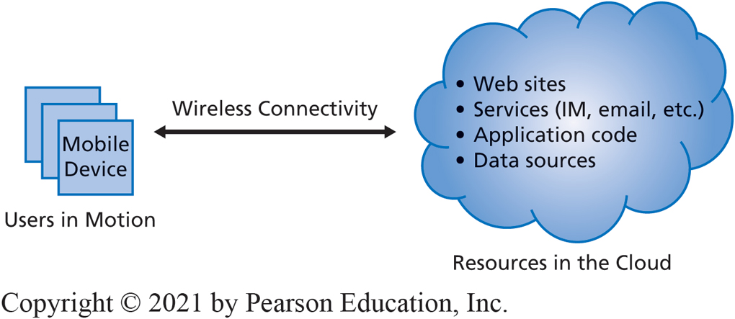
Elements of Mobile Systems
CE 5-2 Why are mobile systems important?
Figure C E 5-1 Elements of a Mobile Information System
Notes:
Major elements in a mobile system are users in motion, mobile devices, wireless connectivity, and a cloud-based resource.

Slide 5
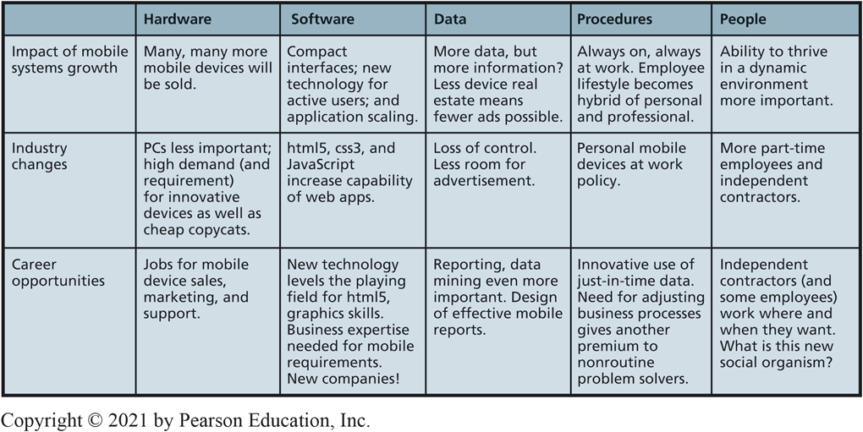
Five Components of Mobile Change and Opportunity
CE 5-2 Why are mobile systems important?
Figure C E 5-2 Five Components of Mobile Change and Opportunity
Notes:
Mobile systems have major impact on business and society today—an impact forcing industry change while creating new career opportunities for mobile-IS-savvy professionals and large numbers of new, interesting mobile-IS-related jobs.
There are billions of mobile devices worldwide generating several exabytes of traffic per month. Smartphones will account for the majority of global mobile traffic.

Slide 6
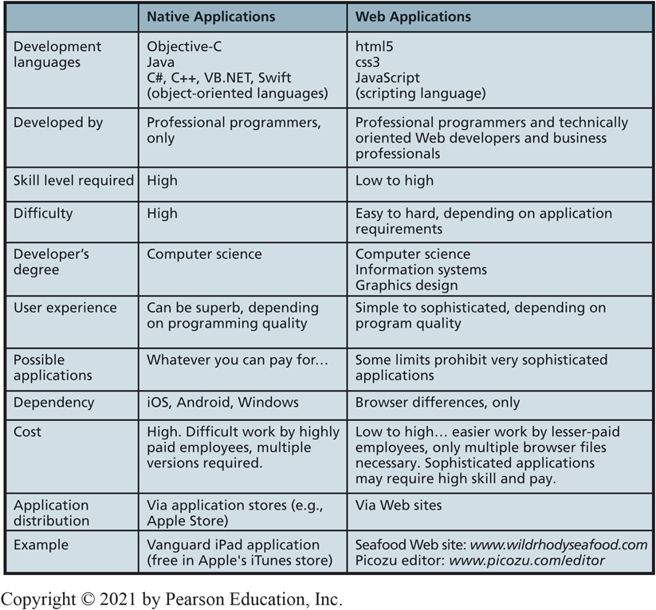
Native vs Web Applications
CE 5-3 How do native and Web-based mobile applications compare?
Figure C E 5-3 Characteristics of Native and Web Applications
Notes:
This figure contrasts native and Web applications.
Native applications run on just one operating system. Web applications run in browsers. In the latter case, the browser provides a more or less consistent environment for the application; the peculiarities of operating systems and hardware are handled by the browser’s code and hidden from the Web application.

Slide 7
Developing Native Applications (1 of 2)
CE 5-3 How do native and Web-based mobile applications compare?
Run on any operating system and device.
Serious, heavy-duty, professional programming languages.
Objective-C,
C++, Swift, Java, V B.NET, etc.
Close control over computing device, enable creation of sophisticated and complex user interfaces.
Fast and efficient use of memory.
Limited to type of operating system.
Costly development.
Notes:
All of these languages are object-oriented, which means they can be used to create difficult, complex applications and, if used properly, will result in high-performance code that is easy to alter when requirements change.

Slide 8
Developing Native Applications (2 of 2)
CE 5-3 How do native and Web-based mobile applications compare?
Web development languages: h t m l 5, c s s 3, JavaScript.
Browsers handle idiosyncrasies of operating system and underlying hardware.
h t m l 5: support for graphics, animation, 2D animations, other sophisticated user experiences.
c s s 3: used with h t m l 5 to specify appearance of h t m l coded content.
JavaScript: provides underlying logic of application.
Notes:
The benefit of such languages is that they give programmers close control over the assets of the computing device and enable the creation of sophisticated and complex user interfaces.

Slide 9
Which is Better?
CE 5-3 How do native and Web-based mobile applications compare?
Depends on:
Strategy and goals.
Application requirements.
Budget.
Schedule.
Tolerance for managing technical projects.
Need for application revenue.
Thin-client applications cheaper to develop and maintain.
May lack “Wow!” factor
Notes:
Choice depends on strategy, particular goals, requirements for your application, budget, schedule, tolerance for managing technical projects, need for application revenue, and other factors.
In general, thin-client applications are cheaper to develop and maintain, but may lack wow factor.

Slide 10
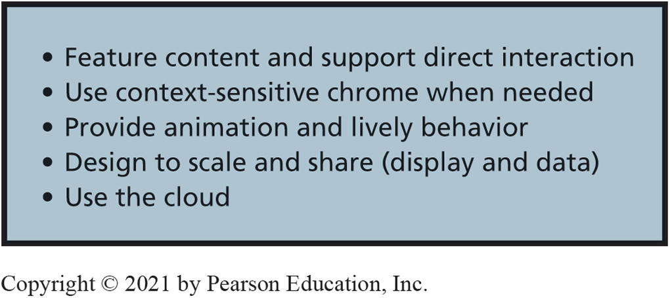
Sophisticated H T M L 5 Application (1 of 6)
CE 5-4 What characterizes quality mobile user experiences?
Figure C E 5-4 Characteristics of a Quality Mobile U X
Notes:
Primary emphasis on users’ content, giving such content as much display as possible. Rather than show menus, toolbars, and heavy window borders. Content should be shown cleanly and in center stage.
Context-sensitive chrome, pops up in the display when appropriate.

Slide 11
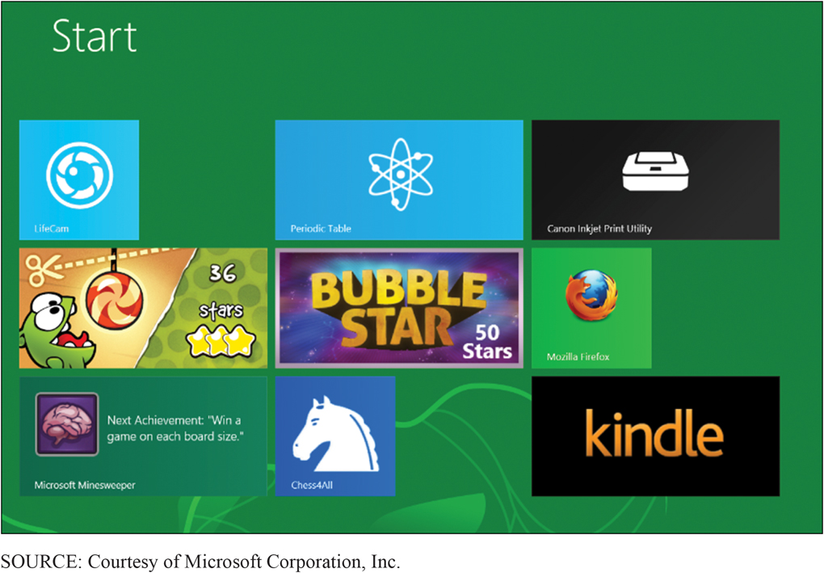
Sophisticated H T M L 5 Application (2 of 6)
CE 5-4 What characterizes quality mobile user experiences?
No toolbar (chrome) to start a program
User intuitively knows to click image to start application
Direct interaction drives application behavior
Figure C E 5-5 Chrome-less Interface
Notes:
Mobile applications need to be designed to share data. For example, Windows 8 introduces a feature called charms, which are icons that slide in from the right of the display. One of the default charms is Share, and it is used to share data from one mobile application to another.

Slide 12
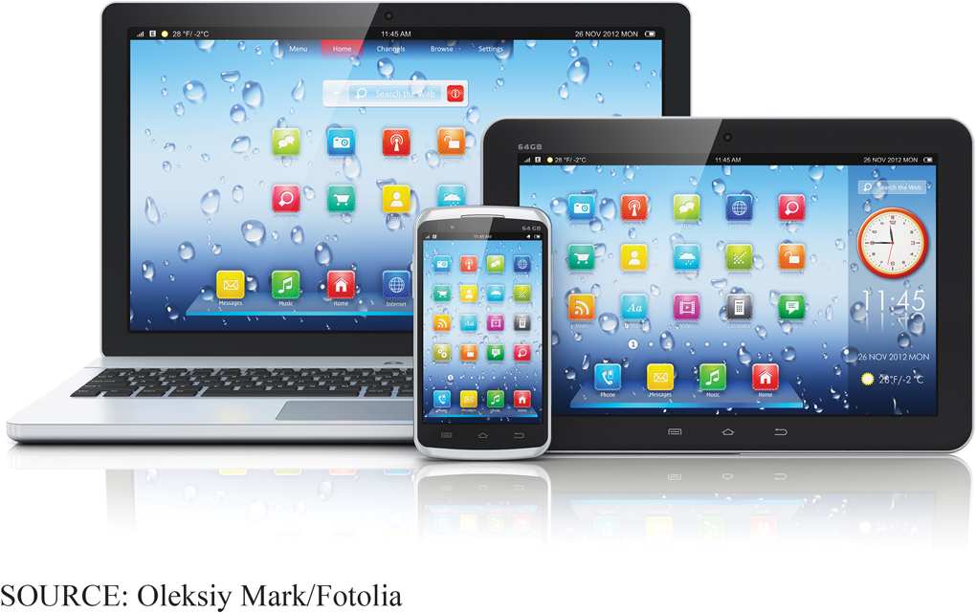
Sophisticated H T M L 5 Application (3 of 6)
CE 5-4 What characterizes quality mobile user experiences?
Figure C E 5-6 Example of Application Scaling
Notes:
Mobile applications appear on phones, tablets, PCs, and even large displays. Applications must be designed so that they can scale up and down without appearing awkward or taking over the device.

Slide 13
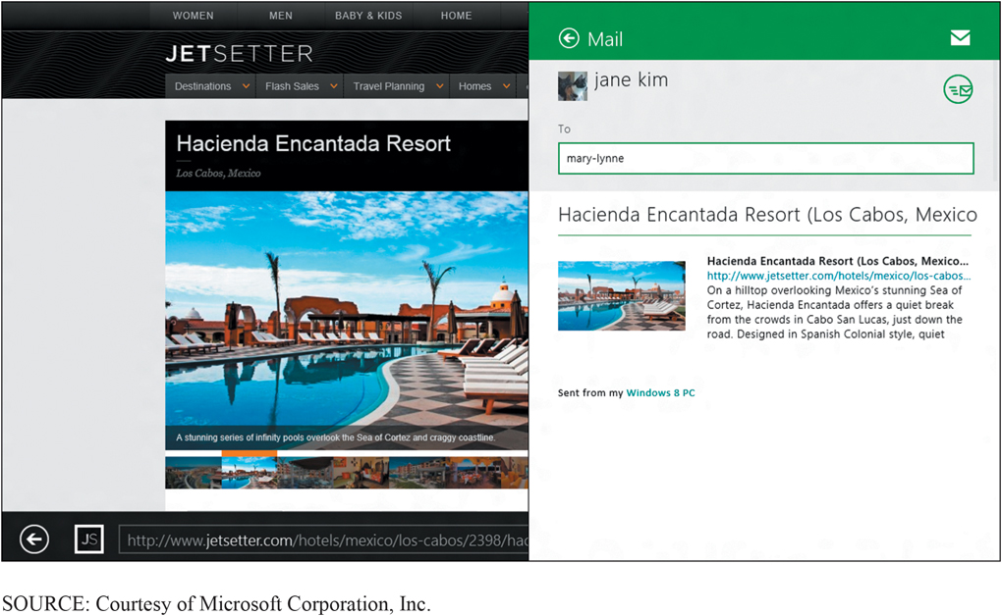
Sophisticated H T M L 5 Application (4 of 6)
CE 5-4 What characterizes quality mobile user experiences?
Figure C E 5-7 Example of Microsoft Edge Sharing

Slide 14
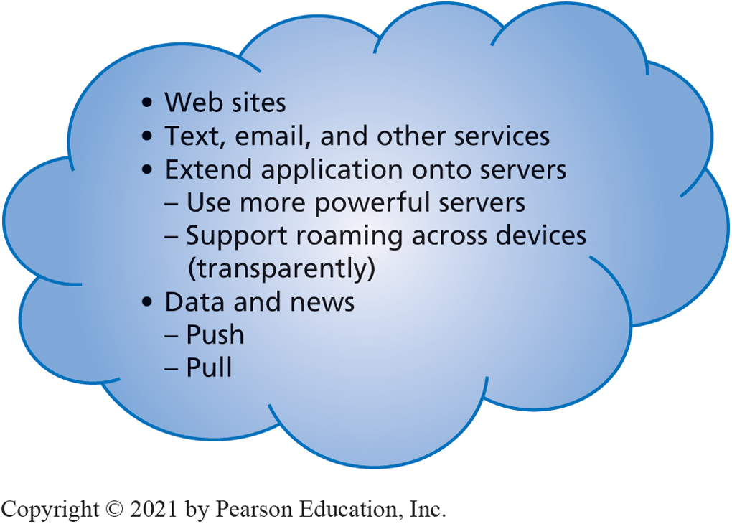
Sophisticated H T M L 5 Application (5 of 6)
CE 5-4 What characterizes quality mobile user experiences?
Figure C E 5-8 Mobile Systems Cloud Use
Notes:
Push data is data the server sends to or pushes onto the device.
Pull data is data the device requests from the server. (Notice that those terms use the server’s perspective.)
Push data is more impressive to users because they need do nothing to receive it.
On the other hand, excessive pushing is annoying.

Slide 15
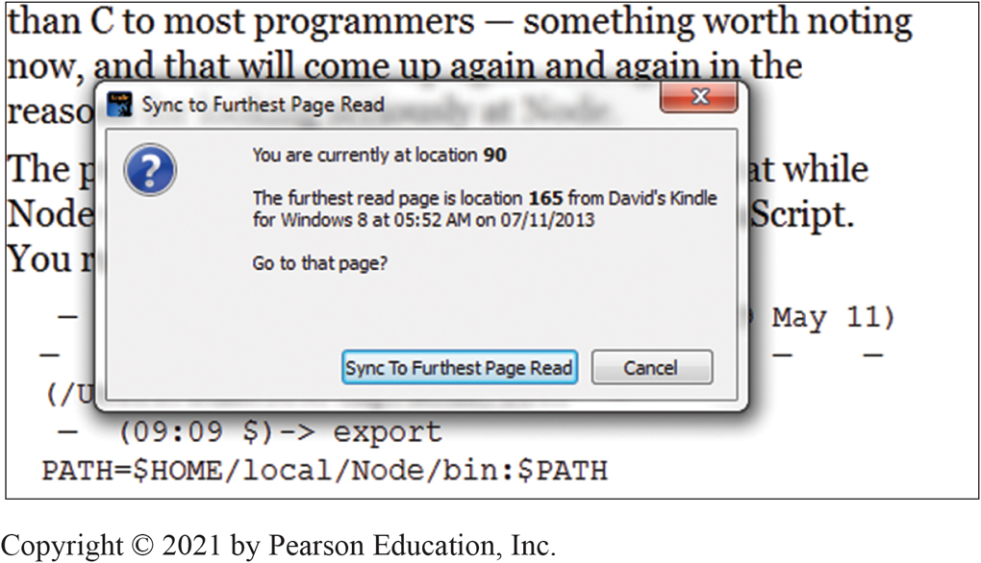
Sophisticated H T M L 5 Application (6 of 6)
CE 5-4 What characterizes quality mobile user experiences?
Figure C E 5-9 Kindle Roaming Message Displays in Front of Kindle Text
Notes:
You might point out Amazon's grammatical error—"furthest." Should be "farthest."

Slide 16
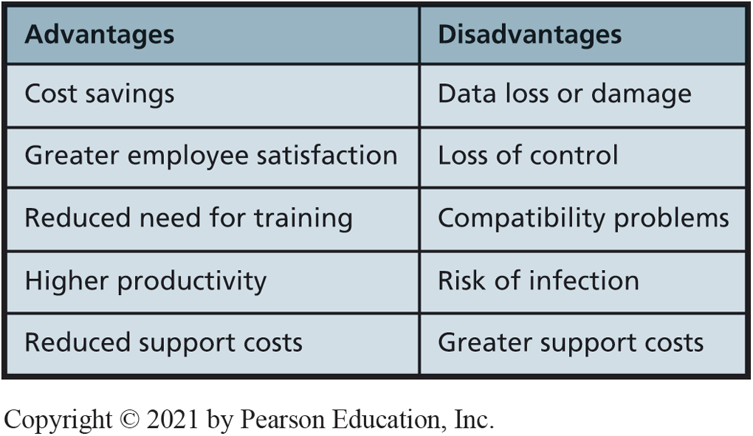
Personal Mobile Devices at Work
CE 5-5 What are the challenges of personal mobile devices at work?
Figure C E 5-10 Advantages and Disadvantages of Employee Use of Mobile Systems at Work
Notes:
Organizations have a love/hate relationship with their employees’ use of their own mobile devices at work. They love the cost-saving possibility of having employees buy their own hardware, but they hate the increased vulnerability and loss of control.
Whatever the costs and risks, employees are bringing their own devices to work. Ignoring the issue will simply make matters worse.

Slide 17
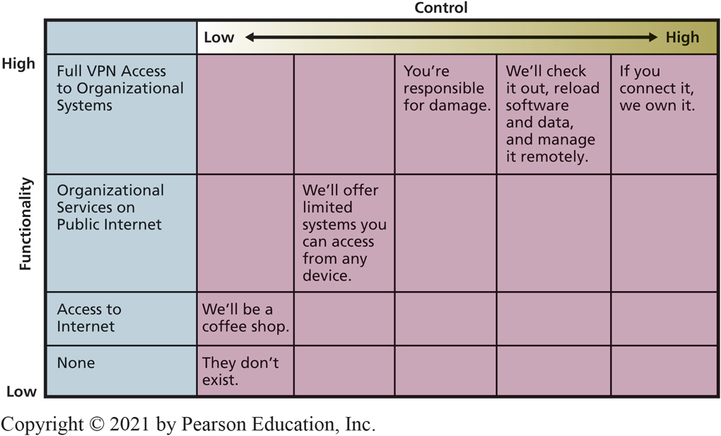
Survey of Organizational B Y O D Policy
CE 5-5 What are the challenges of personal mobile devices at work?
Figure C E 5-11 Six Common B Y O D Policies
Notes:
A BYOD policy is a statement concerning employees’ permissions and responsibilities when they use their own device for organizational business.

Slide 18
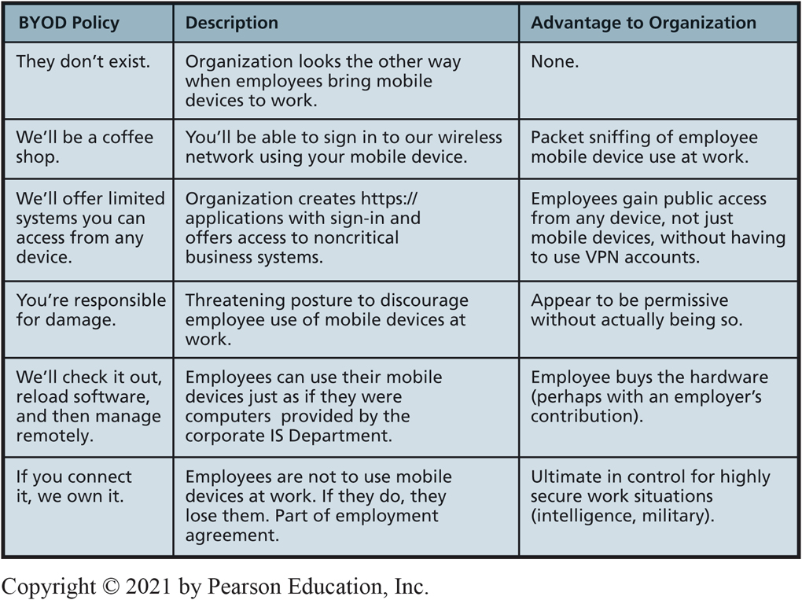
Advantages of Example B Y O D Policies
CE 5-5 What are the challenges of personal mobile devices at work?
Figure C E 5-12 Advantages of Example B Y O D Policies
Notes:
BYOD policies are rapidly evolving and many organizations have not determined what is best for them. If your employer has a committee to develop such policies, join it if you can. Doing so will provide a great way to gain exposure to the leading technology thinkers at your organization.

Slide 19
Active Review
CE 5-1 What are mobile systems?
CE 5-2 Why are mobile systems important?
CE 5-3 How do native and Web-based mobile applications compare?
CE 5-4 What characterizes quality mobile user experiences?
CE 5-5 What are the challenges of personal mobile devices at work?

Slide 20

Copyright

