Slide 1

Experiencing M I S
Ninth Edition
Chapter Extension 6
Database Design
Slides in this presentation contain hyperlinks. JAWS users should be able to get a list of links by using INSERT+F7
Copyright © 2021, 2019, 2017 Pearson Education, Inc. All Rights Reserved
Notes:
If this PowerPoint presentation contains mathematical equations, you may need to check that your computer has the following installed:
1) MathType Plugin
2) Math Player (free versions available)
3) NVDA Reader (free versions available)
Chapter 5 provides the background for this Extension.

Slide 2
Study Questions
CE 6-1 Who will volunteer?
CE 6-2 How are database application systems developed?
CE 6-3 What are the components of the entity-relationship data model?
CE 6-4 How is a data model transformed into a database design?
CE 6-5 What is the users’ role?
CE 6-6 Who will volunteer? (continued)
Notes:
This chapter discusses how database application systems are developed, components of the entity-relationship data model, how a data model is transformed into a database design, and describes the users’ role in database development.

Slide 3
Collecting Better Data
CE 6-1 Who will volunteer?
You are the manager of fund-raising for a local public television station
You want the following data, but don’t have them:
How long volunteers have been helping
Volunteer effectiveness at getting donations
You know that you can use a computer database to keep better track of prior volunteers’ service and performance
You are not sure how to proceed
Notes:
By the end of this chapter extension, when we return to this fund-raising situation, you will know what to do.

Slide 4
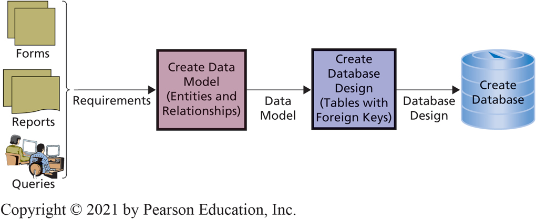
Database Application System Development Process (1 of 2)
CE 6-2 How are database application systems developed?
Figure C E 6-1 Database Development Process
Notes:
Figure summarizes database application system development process.
The design of the database depends entirely on how users view their business environment, user involvement is critical for database development.
A database must include all the data necessary for users to perform their jobs. Ideally, it contains that amount of data and no more. So, developers must rely on users to tell them what to include in the database.

Slide 5
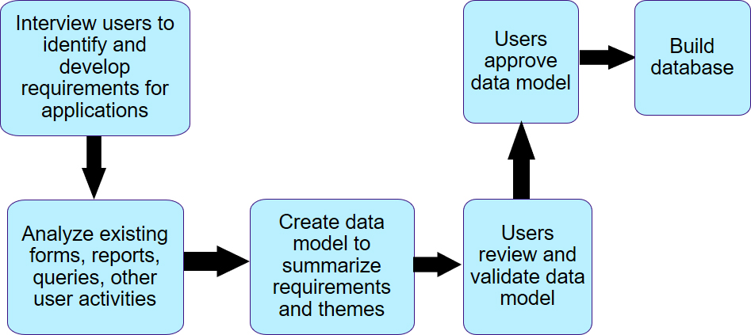
Database Application System Development Process (2 of 2)
CE 6-2 How are database application systems developed?
Notes:
Emphasize important role of users.

Slide 6
What is the Entity-Relationship Data Model?
CE 6-3 What are the components of the entity-relationship data model?
Entities
Something to track.
Order, customer, salesperson, item, volunteer, donation
Attributes
Describe characteristics of entity.
OrderNumber, CustomerNumber, VolunteerName, PhoneNumber
Identifier
Uniquely identifies one entity instance from other instances
Student_ID_Number
Notes:
Entity-relationship (E-R) data model is a tool for constructing data models.
Developers use it to describe the content of a data model by defining the things (entities) to be stored in the database and relationships among those entities.
A second, less popular tool for data modeling is the Unified Modeling Language (UML). Not discussed in chapter.

Slide 7
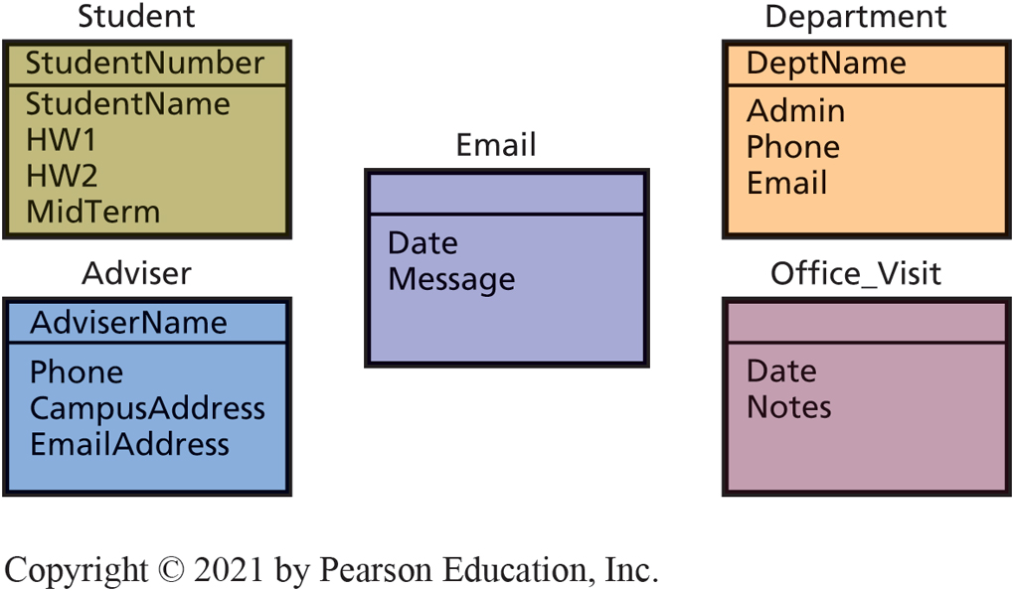
Student Data Model Entities
CE 6-3 What are the components of the entity-relationship data model?
Figure C E 6-2 Student Data Model Entities
Notes:
Notice entities Email and Office_Visit do not have an identifier (primary key). Unlike Student or Adviser, the users do not have an attribute that identifies a particular email or office visit.
Database designer will deal with missing identifiers by adding columns, possibly using hidden identifiers, to implement the users’ view.

Slide 8
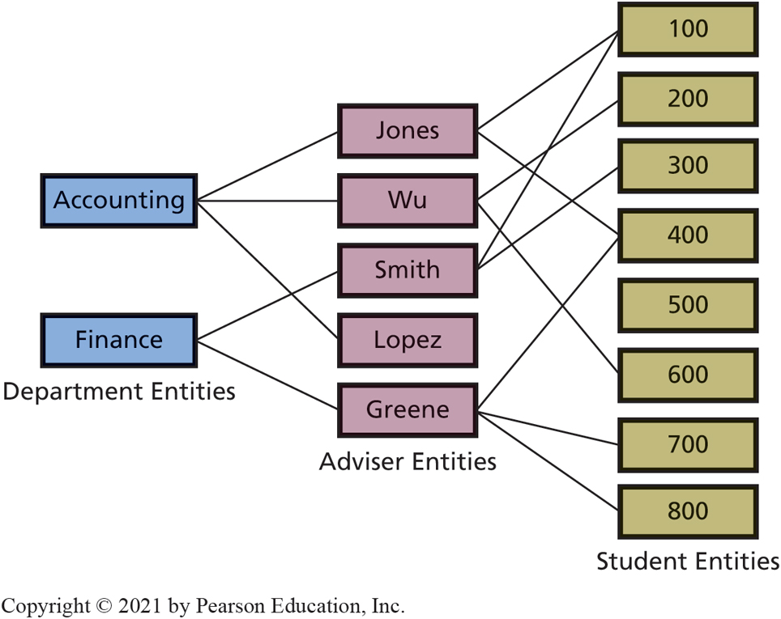
Example of Department, Adviser, and Student Entities and Relationships
CE 6-3 What are the components of the entity-relationship data model?
Figure C E 6-3 Example of Department, Adviser, and Student Entities and Relationships
Notes:
This figure depicts relationships among the entities.

Slide 9
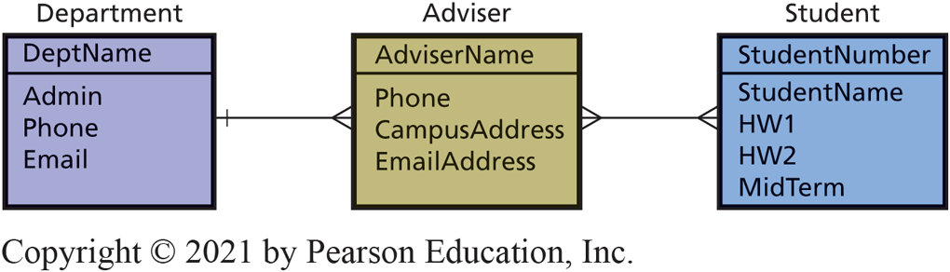
Sample Relationships Version 1
CE 6-3 What are the components of the entity-relationship data model?
Figure C E 6-4 Sample Relationships—Version 1
Notes:
Note use of crow’s foot to depict 1:N and N:M relationships between tables.

Slide 10
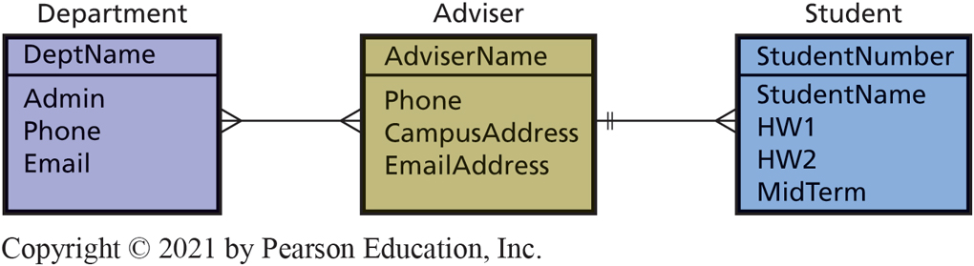
Sample Relationships Version 2
CE 6-3 What are the components of the entity-relationship data model?
Figure C E 6-5 Sample Relationships—Version 2

Slide 11
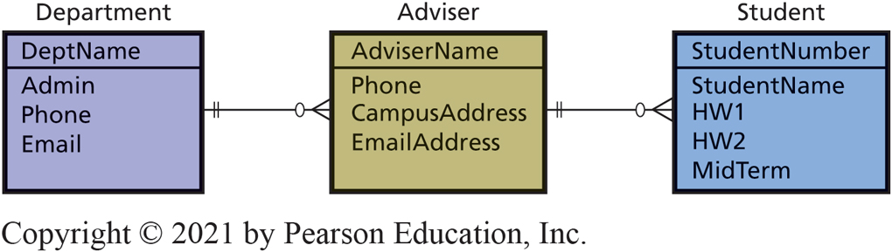
Crow’s-Foot Diagram Version
CE 6-3 What are the components of the entity-relationship data model?
Figure C E 6-6 Example Relationships Showing Both Maximum and Minimum Cardinalities
Notes:
Example of relationships showing both maximum and minimum cardinalities.

Slide 12
Normalization
CE 6-4 How is a data model transformed into a database design?
Normalization
Converting poorly structured tables into two or more well-structured tables.
Goal
Construct tables with single theme or entity.
Purpose
Minimize data integrity problems.

Slide 13
Data Integrity Problems
CE 6-4 How is a data model transformed into a database design?
Data integrity problems.
Incorrect or inconsistent information.
Users lose confidence in information.
System gets a poor reputation.
Can only occur if data are duplicated.
Notes:
Data integrity problems are serious. Information systems with poor reputations become serious burdens to the organizations that use them.

Slide 14
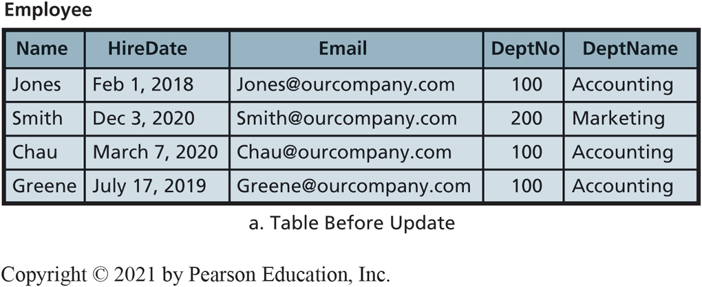
Poorly Designed Employee Table Causes Data Integrity Problem
CE 6-4 How is a data model transformed into a database design?
Figure C E 6-7a A Poorly Designed Employee Table
Notes:
Because department names are duplicated in Employee table, every row in table that has a value of “Accounting” must be changed to “Accounting and Finance.”
Problem with the table, there are two independent themes: Employee and Department.

Slide 15
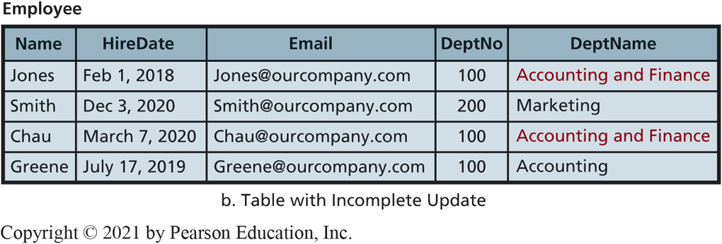
Poorly Designed Employee Table Causes Data Integrity Problem (con’t)
CE 6-4 How is a data model transformed into a database design?
Figure C E 6-7b A Poorly Designed Employee Table
Notes:
In figure CE6-7b, some rows show Dept. 100 is “Accounting and Finance,” others show Dept. 100 is “Accounting.” Which is correct?
Illustrates data integrity issues that can arise when tables are poorly structured

Slide 16
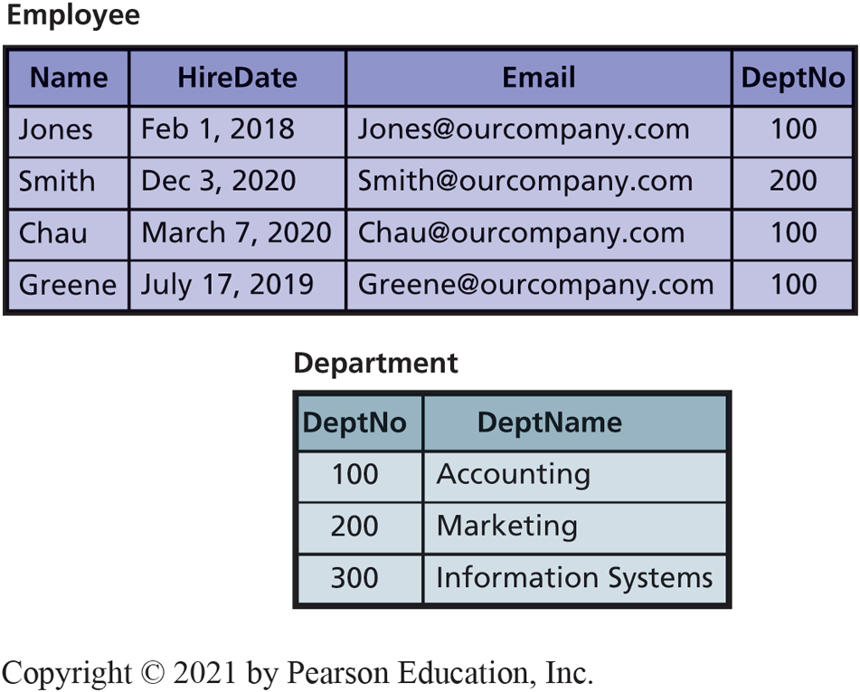
Two Normalized Tables
CE 6-4 How is a data model transformed into a database design?
Figure C E 6-8 Two Normalized Tables
Notes:
Transforming the table into two tables., department name is stored just once. Therefore no data inconsistencies can occur.

Slide 17
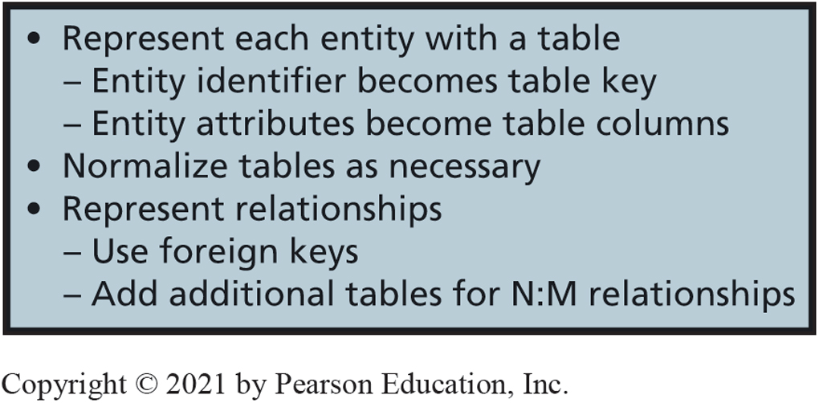
Summary of Normalization
CE 6-4 How is a data model transformed into a database design?
Figure C E 6-9 Transforming a Data Model into a Database Design
Notes:
Normalized tables eliminates data duplication, can make processing time slower. Such trade-offs are important considerations in database design.

Slide 18
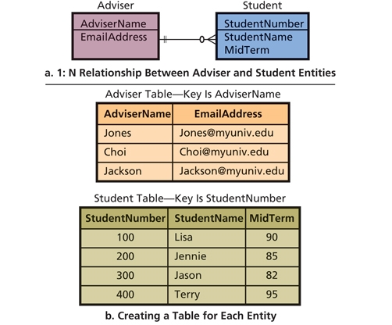
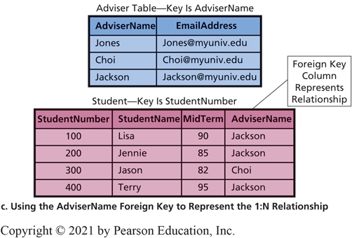
Representing a 1:N Relationship
CE 6-4 How is a data model transformed into a database design?
Figure C E 6-10 Representing a
Notes:
To represent an N:M relationship, a third table is created, as shown in two tables on the right.
Top table has two columns, AdviserName and EmailAddress. AdvisorName field in the lower right table is a foreign key that links records of top table to those of lower table by matching AdvisorName values.

Slide 19
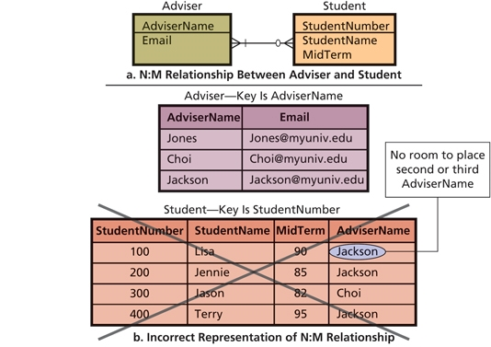
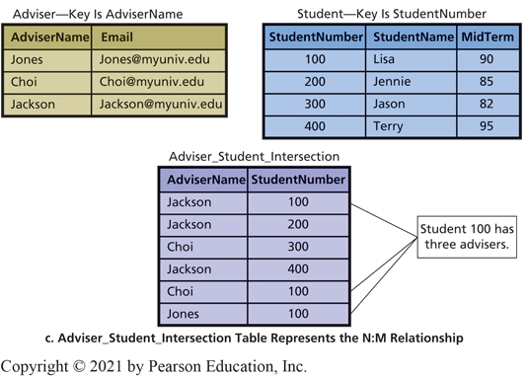
Representing an N:M Relationship: Strategy for Foreign Keys
CE 6-4 How is a data model transformed into a database design?
Figure C E 6-11 Representing an
Notes:
To represent an N:M relationship, you need to create an intersection table, as shown in figure on the right.

Slide 20
Users’ Role in the Development of Databases
CE 6-5 What is the users’ role?
Final judges.
Thorough review of data model.
Entities must contain all the data users need to do their jobs.
Must accurately reflect their view of the business.
Take it seriously.
Devote time.
Notes:
Users are the final judges as to what data the database should contain and how the records in that database should be related to one another.
User review of the data model is crucial.

Slide 21
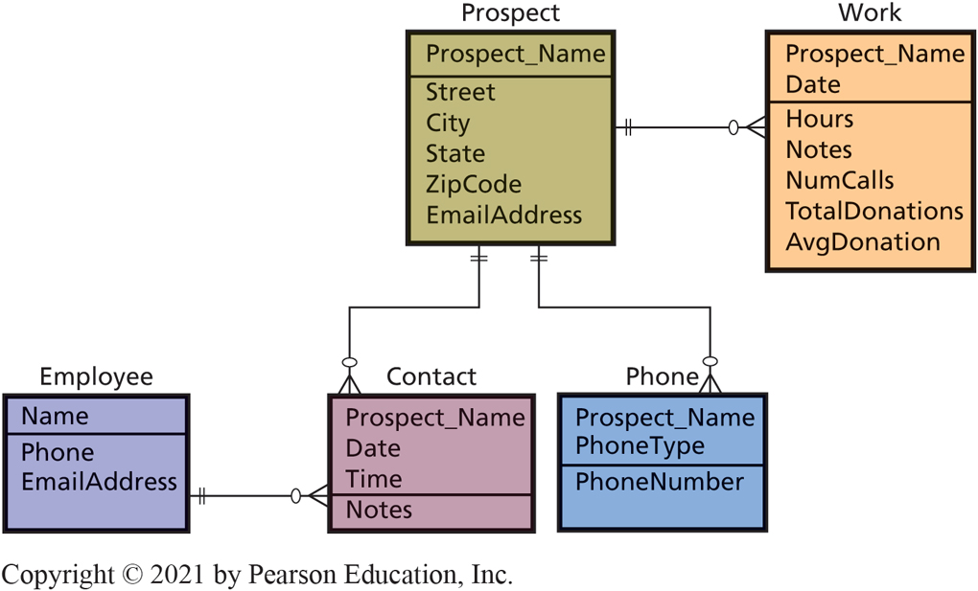
Data Model for Volunteer Database
CE 6-6 Who will volunteer? (continued)
Figure C E 6-12 Data Model for Volunteer Database
Notes:
This data model has an entity for Prospect, an entity for Employee, and three additional entities for Contact, Phone, and Work.

Slide 22
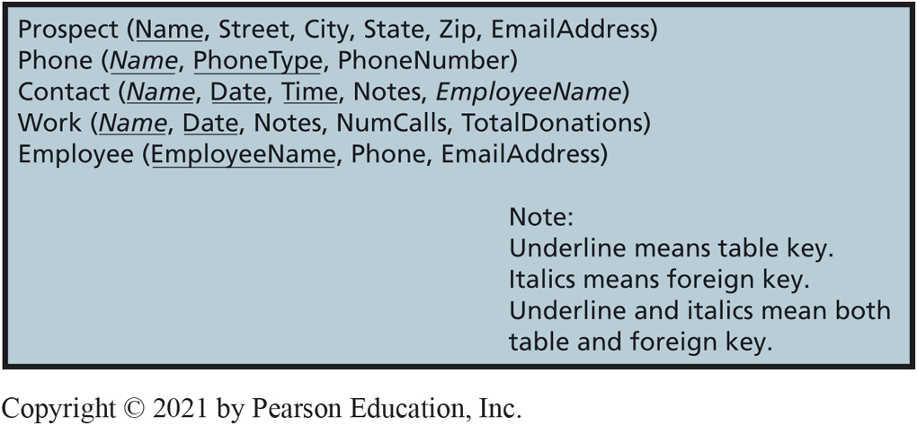
First Table Design
CE 6-6 Who will volunteer? (continued)
Figure C E 6-13 First Table Design for Volunteer Database

Slide 23
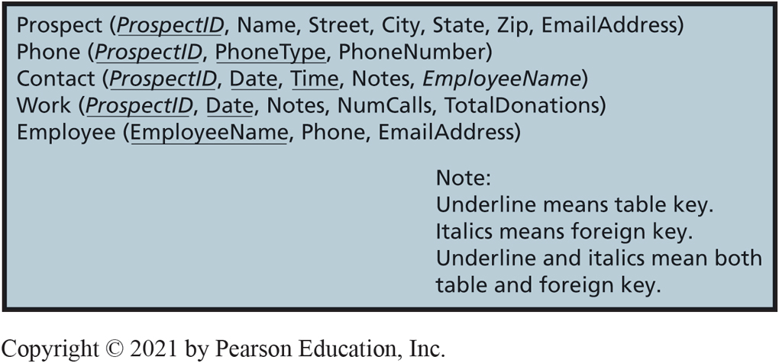
Second Table Design
CE 6-6 Who will volunteer? (continued)
Figure C E 6-14 Second Table Design for Volunteer Database

Slide 24
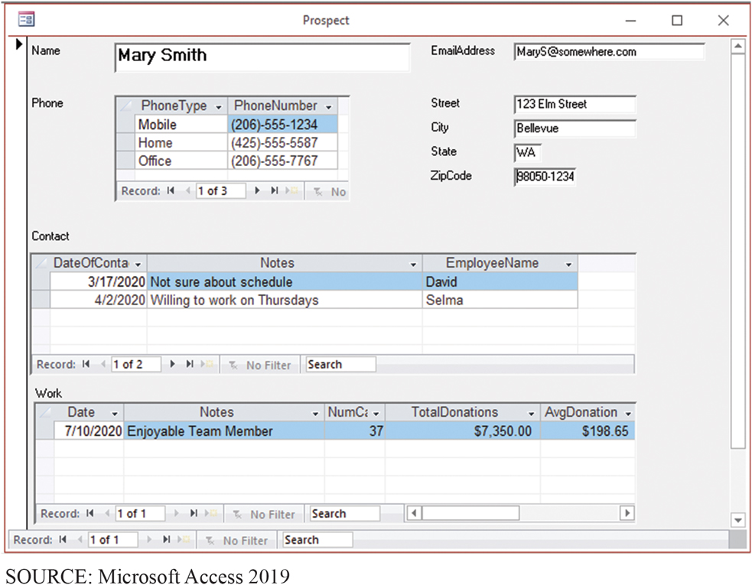
Volunteer Prospect Data Entry Form
CE 6-6 Who will volunteer? (continued)
Figure C E 6-15 Volunteer Prospect Data Entry Form

Slide 25
Active Review
CE 6-1 Who will volunteer?
CE 6-2 How are database application systems developed?
CE 6-3 What are the components of the entity-relationship data model?
CE 6-4 How is a data model transformed into a database design?
CE 6-5 What is the users’ role?
CE 6-6 Who will volunteer? (continued)
Notes:
This chapter discusses how database application systems are developed, components of the entity-relationship data model, how a data model is transformed into a database design, and describes the users’ role in database development.

Slide 26

Copyright

