Slide 1

Experiencing M I S
Ninth Edition
Chapter Extension 9
Network and Cloud Technology
Slides in this presentation contain hyperlinks. JAWS users should be able to get a list of links by using INSERT+F7
Copyright © 2021, 2019, 2017 Pearson Education, Inc. All Rights Reserved
Notes:
If this PowerPoint presentation contains mathematical equations, you may need to check that your computer has the following installed:
1) MathType Plugin
2) Math Player (free versions available)
3) NVDA Reader (free versions available)

Slide 2
Study Questions
CE 9-1 What is a computer network?
CE 9-2 What are the components of a LAN?
CE 9-3 How does the Internet work?
CE 9-4 How do Web servers support the cloud?
Notes:
This chapter discusses computer networks and the technology that underlies them.

Slide 3
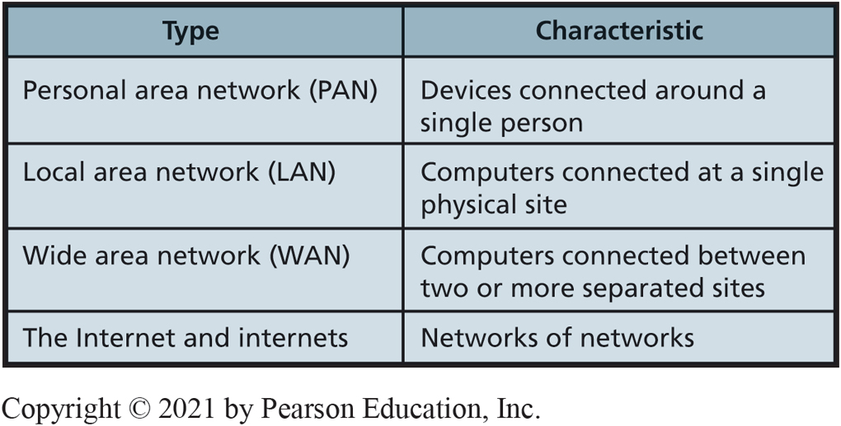
Types of Networks
CE 9-1 What is a computer network?
Figure C E 9-1 Basic Network Types
Notes:
These are the four basic network types. Networks are layered to provide seamless flow. The layers use an elaborate scheme called a layered protocol to communicate. The details of protocols are beyond the scope of this text. Just understand that a protocol is a set of rules that programs on two communicating devices follow. Computers need to use protocols so they can exchange data.

Slide 4
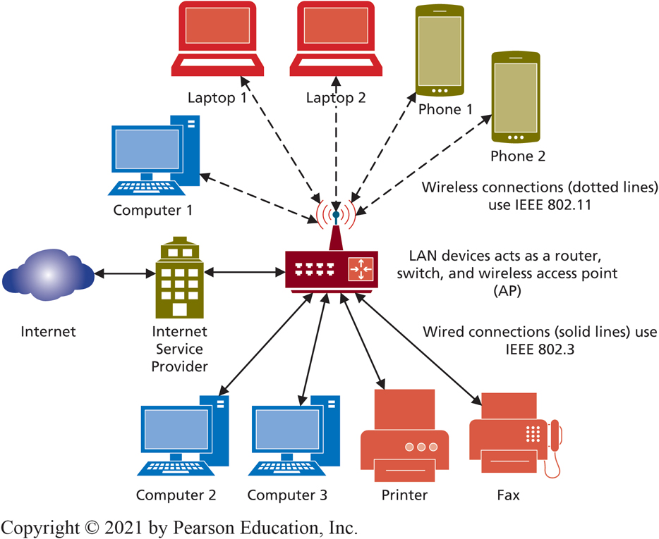
Typical Small Office/Home Office (SOHO) LAN
CE 9-2 What are the components of a LAN?
Figure C E 9-2 Typical Small Office/Home Office
Notes:
Most personal computers today support 10/100/1000 Ethernet. A LAN is a group of computers connected together on a single site.
Wired network devices communicate using the IEEE 802.3 protocol for LAN connections. This protocol standard, also called the Ethernet, specifies hardware characteristics, such as which wire carries which signals. It also describes how messages are to be packaged and processed for wired transmission over the LAN.

Slide 5
Abbreviations Used for Communications and Computer Memory Speeds
CE 9-2 What are the components of a LAN?
Communications equipment,
K(ilo) = 1,000, not 1,024 (as for memory);
M(ega) = 1,000,000, not 1,024 × 1,024;
G(iga) = 1,000,000,000, not 1,024 × 1,024 × 1,024.
100 M b p s =100,000,000 bits per second.
Communications speeds expressed in bits, memory sizes in bytes.

Slide 6
LAN Protocol
CE 9-2 What are the components of a LAN?
I E E E 802.3
Wired LAN
10/100/1000 Mbps
Ethernet
I E E E 802.11
Wireless LAN
802.11a c
Speeds up to 1.3 G b p s
Bluetooth
Transmits data short distances.
Connect computer, keyboard, mouse, printer, smartphones, smartwatches, automobiles, sports equipment, clothing.

Slide 7
Connecting Your L A N to the Internet
CE 9-2 What are the components of a L A N?
Important I S P functions:
Provide legitimate Internet address.
Provide gateway to Internet.
Pay access fees and other charges to telecoms.
WAN wireless average performance 1 M b p s, with peaks of up to 3.0 M b p s.
Typical wireless LAN 50 M b p s.
Notes:
Gateway function—ISP receives the communications from your computer and passes them on to the Internet, and receives communications from the Internet and passes them to you.
5G speeds will range from ~50Mbps to over 2 gigabit at the start, and is expected to grow to even 100Gbps, 100x faster than 4G. (https://en.wikipedia.org/wiki/5G)

Slide 8
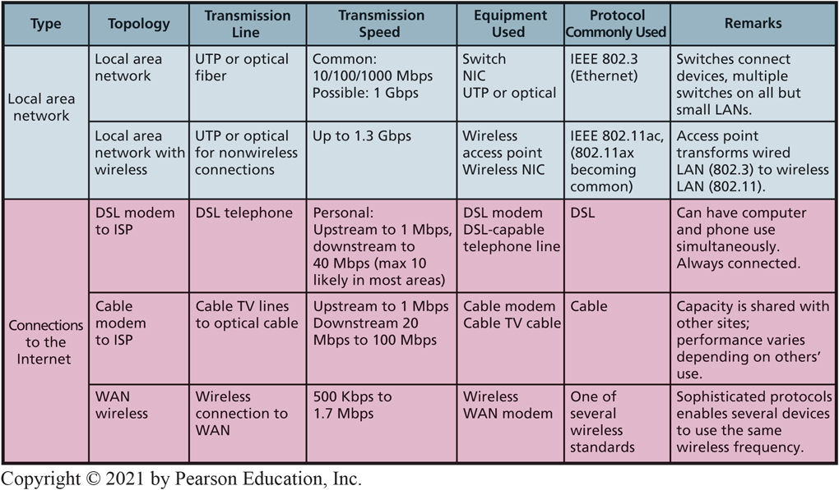
Alternative Ways of Connecting to the Internet
CE 9-2 What are the components of a LAN?
Figure C E 9-3 Office (SOHO) LAN

Slide 9
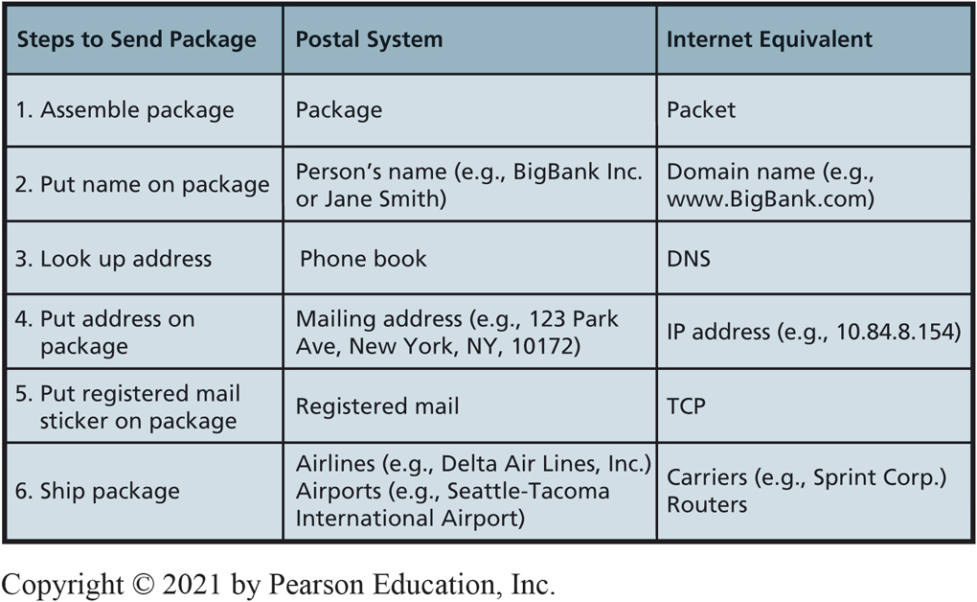
Postal System vs The Internet
CE 9-3 How does the Internet work?
Figure C E 9-4 Comparison of the Postal System and the Internet

Slide 10
Public I P Addresses
CE 9-3 How does the Internet work?
I P v 4
E.g.,137.190.8.10
Dotted decimal notation
Only about 4 billion addresses (not enough)
I P v 6
E.g., 0:0:0:0:0:f f f f:8 9 b e:8 0 a
Hexadecimal notation
340 undecillion addresses
Notes:
Most common IP addresses format is IPv4.

Slide 11
Domain Name System (D N S)
CE 9-3 How does the Internet work?
Domain name
Unique name affiliated with a public I P address.
Dynamic affiliation of domain names with I P addresses.
Multiple domain names for same I P address.
U R L (Uniform Resource Locator)
Internet address protocol, such as h t t p:// or f t p://.
Notes:
ICANN administers system for assigning names to IP addresses. Domain name a worldwide-unique name affiliated with a public IP address. Affiliation of domain names with IP addresses is dynamic. Owner of domain name can change affiliated IP addresses at its discretion.
URL consists of a protocol (like http:// or ftp://) followed by a domain name or public IP address.
What advantage does point one provide?

Slide 12
Private Versus Public I P Addresses
CE 9-3 How does the Internet work?
Public I P addresses
Identifies a unique device on Internet.
Assigned by I C A N N (Internet Corporation for Assigned Names and Numbers.)
Private I P addresses
Identifies a device on a private network, usually a LAN.
Assignment LAN controlled.
Notes:
What is purpose of the transport and internet layers?
These protocols manage traffic as it passes across an internet /Internet. Most important protocol in transport layer is TCP.

Slide 13
I P Addressing: Major Benefits
CE 9-3 How does the Internet work?
Public I P addresses conserved
One public I P address per LAN.
Using private I P addresses
Eliminates registering public I P address with I C A N N-approved agencies.
Protects against direct attack.
Notes:
Private/public IP address scheme two major benefits.
Attackers cannot send attack packets to private IP addresses.

Slide 14
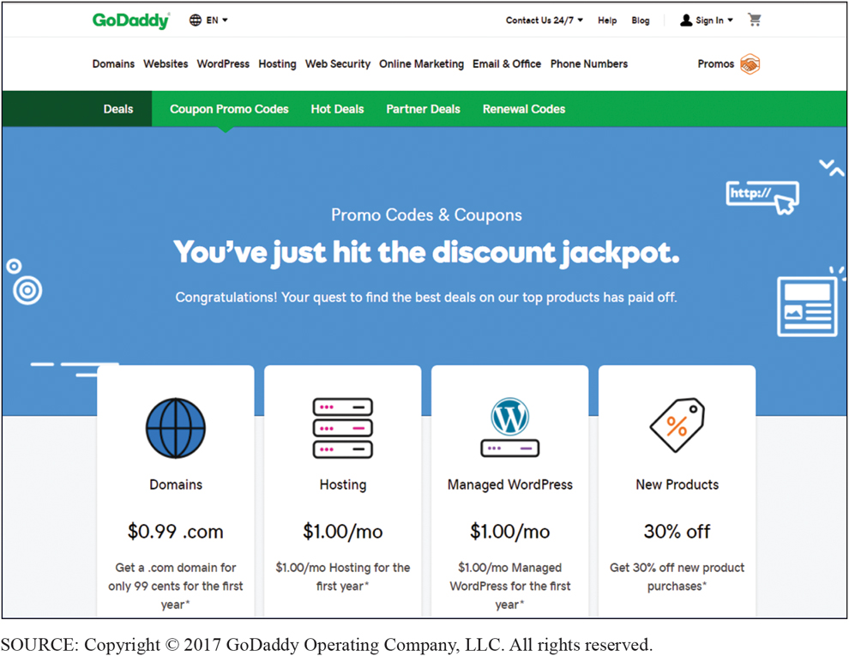
Domain Registry Company
CE 9-3 How does the Internet work?
Figure C E 9-5 Go Daddy Screenshot
Notes:
GoDaddy, or a similar agency, will first determine if desired name is unique worldwide. If so, it will apply to register that name.

Slide 15
Packets & Carriers
CE 9-3 How does the Internet work?
Messages, broken into packets.
T C P guarantees delivery of packets.
Packets move across Internet, passing through networks owned by telecom carriers.
Peering agreements—Carriers freely exchange traffic amongst themselves without paying access fees.
Notes:
Should carriers be allowed to decide which sites load quickly, which apps are allowed on a network, which content is acceptable, and charge varying access rates?

Slide 16
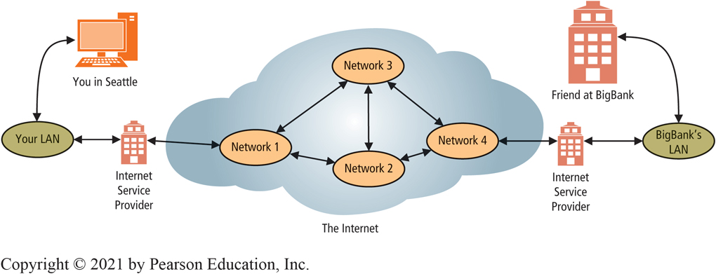
The Cloud Resides in the Internet
CE 9-3 How does the Internet work?
Figure C E 9-6 Using the Internet to Request a Web Page
Notes:
Using Internet for Hotel Reservation
Assume you send a message to a server in New Zealand hotel. Message is too big to travel in one piece, so it’s broken into packets and each packet passes along from WAN to WAN until it reaches destination. Once all packets arrive, message reconstructed, delivered to server for processing. All accomplished by computers and data communications devices that most likely have not interacted before.
Hop is movement from one network to another.

Slide 17
Net Neutrality
CE 9-3 How does the Internet work?
Net neutrality principle
All data treated equally.
Carriers should not be allowed to:
Decide which sites load quickly
Decide which apps are allowed on a network
Decide which content is acceptable
Problem: some people use more bandwidth than others.
Netflix, for example, accounts for more than 40 percent of all Internet traffic in North America during evening hours
Notes:
Should carriers be allowed to decide which sites load quickly, which apps are allowed on a network, which content is acceptable, and charge varying access rates?

Slide 18
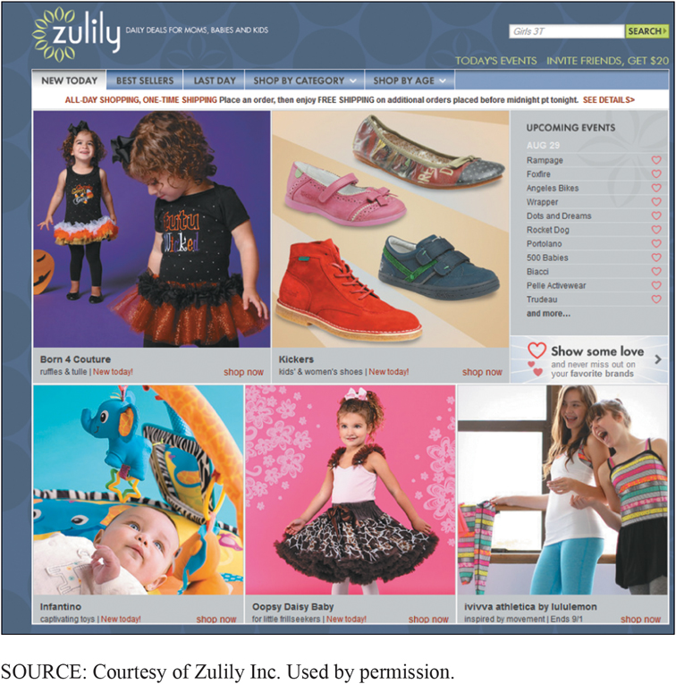
Processing on a Web Server
CE 9-4 How do Web servers support the cloud?
What happens when you visit a Web site and order something, and pay for it?
Figure C E 9-7 Sample of Commerce Server Pages; Product Offer Pages
Notes:
Sample of Commerce Server Pages; Product Offer Pages.

Slide 19
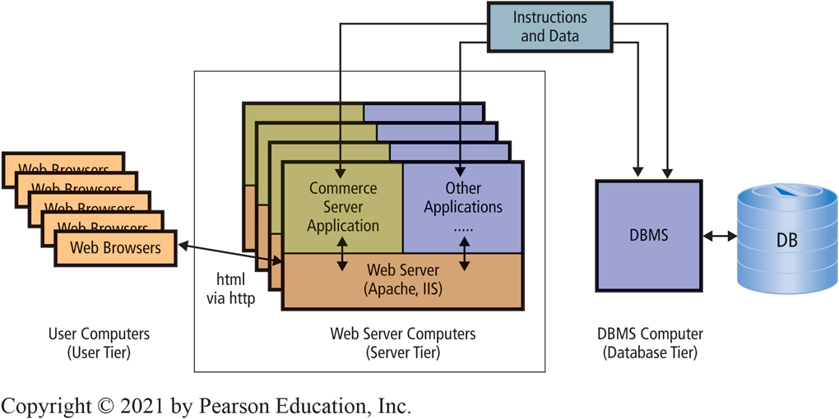
Three-Tier Architecture
CE 9-4 How do Web servers support the cloud?
Figure C E 9-8 Three-Tier Architecture
Notes:
Almost all e-commerce applications use a three-tier architecture.
User tier consists of computers, phones, other devices with browsers that request and process Web pages.
Server tier consists of computers running Web servers and application programs.
Database tier consists of computers running a DBMS that processes SQL requests to retrieve and store data.
Commerce server — application program that runs on server-tier computer. Receives requests from users via Web server, takes some action, and returns a response to users. Typical commerce server functions are to obtain product data from a database, manage items in a shopping cart, and coordinate checkout process.

Slide 20
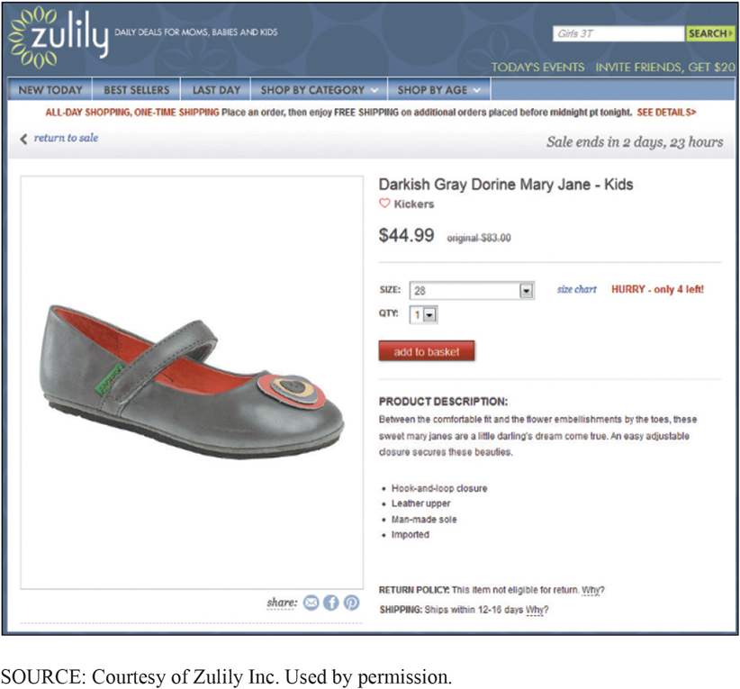
Watch the Three Tiers in Action! Sample of Commerce Server Page (1 of 2)
CE 9-4 How do Web servers support the cloud?
Commerce server requests shoe data from D B M S.
D B M S reads from database, returns data to commerce server.
Commerce server formats Web page with data and sends html version of page to user’s computer.
Customer places items in shopping cart.
Customer checks out, commerce server program processes payment, schedules inventory processing, arranges shipping, email receipt to customer.
Figure C E 9-9 Product Page

Slide 21
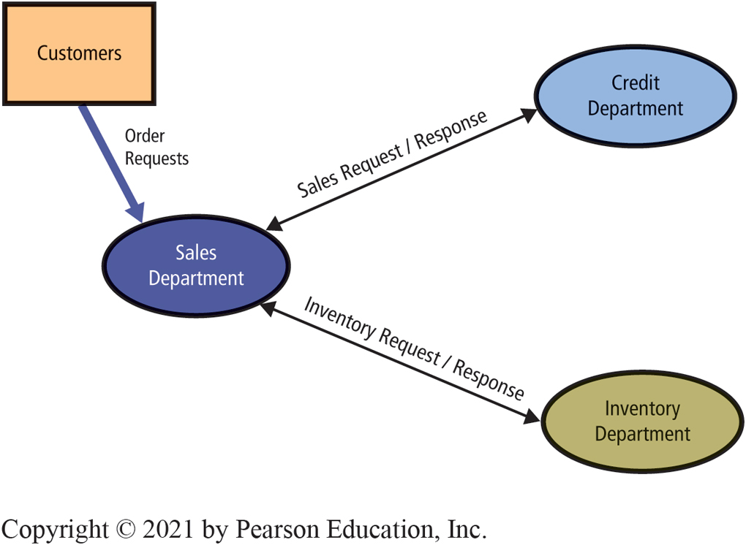
SOA Analogy: Approval Request Interactions Among Three Departments
CE 9-4 How do Web servers support the cloud?
Figure C E 9-10 Approval Request Interactions Among Three Departments
CheckCustomerCredit
ApproveCustomerCredit
VerifyInventoryAmount
AllocateInventory
ReleaseAllocatedInventory
Notes:
Each department formally states data it expects to receive with the request and data it promises to return in response.

Slide 22
Using S O A Principles, Each Department Defines Its Own Services:
CE 9-4 How do Web servers support the cloud?
Credit Department
CheckCustomerCredit
ApproveCustomerCredit
Inventory Department
VerifyInventoryAmount
AllocateInventory
ReleaseAllocatedInventory
Each department formally states data to receive with request and data promised to return in response.
Every interaction done exactly same way.
Notes:
Using SOA principles, each department formally defines the services it provides.

Slide 23
Using S O A Principles: Encapsulation
CE 9-4 How do Web servers support the cloud?
No department needs to know who works in another department, or how department accomplishes work.
Each department free to change personnel task assignments, change processes for performing services.
Best Bikes could dynamically create 1,000 Inventory Departments and Sales Department with no need to change anything it does.

Slide 24
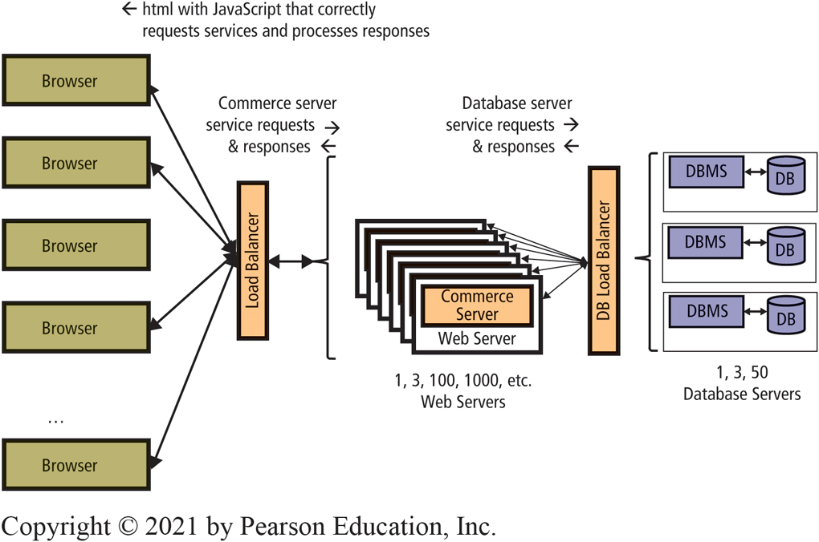
S O A Principles Applied to Three-Tier Architecture
CE 9-4 How do Web servers support the cloud?
Services
ObtainPartData
ObtainPartImages
ObtainPartQuantityOnHand
OrderPart
JavaScript written to invoke these services correctly.
Figure C E 9-11 S O A Principles Applied to Three-Tier Architecture
Notes:
Commerce server application formally defines services browsers can request, data they must provide with the request, and data each will receive in response to request.
Organization must agree on standard ways of formatting and processing service requests and data.

Slide 25
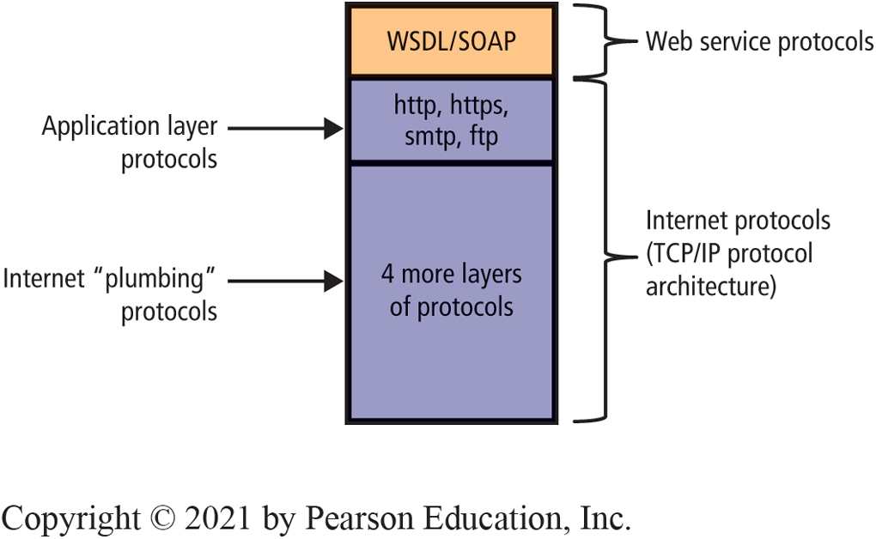
Protocols Supporting Web Services
CE 9-4 How do Web servers support the cloud?
Figure C E 9-12 Protocols That Support Web Services
Notes:
Only Internet protocols a business professional likely to encounter are at application layer.

Slide 26
W S D L, S O A P, X M L, and J S O N
CE 9-4 How do Web servers support the cloud?
W S D L (Web Services Description Language) | Standard for describing services, inputs, outputs, other data supported by a Web service. Documents coded machine readable and used by developer tools for creating programs to access the service.
SOAP (No longer an acronym) | Protocol for requesting Web services and for sending responses to Web service requests.
X M L (eXtensible Markup Language) | Used for transmitting documents. Contains metadata to validate format and completeness of a document, includes considerable overhead.
J SON (JavaScript Object Notation) | Markup language used for transmitting documents. Contains little metadata. Preferred for transmitting volumes of data between servers and browsers. While notation in format of JavaScript objects, J SON documents can be processed by any language.
Notes:
These are four standards that are used extensively for Web services and the cloud.

Slide 27
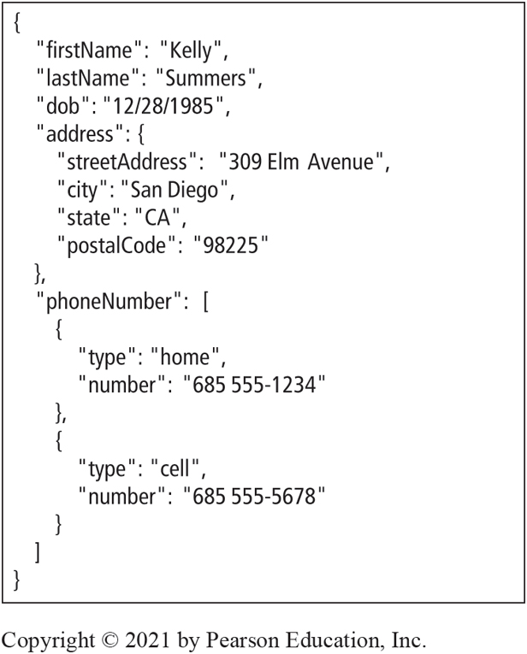
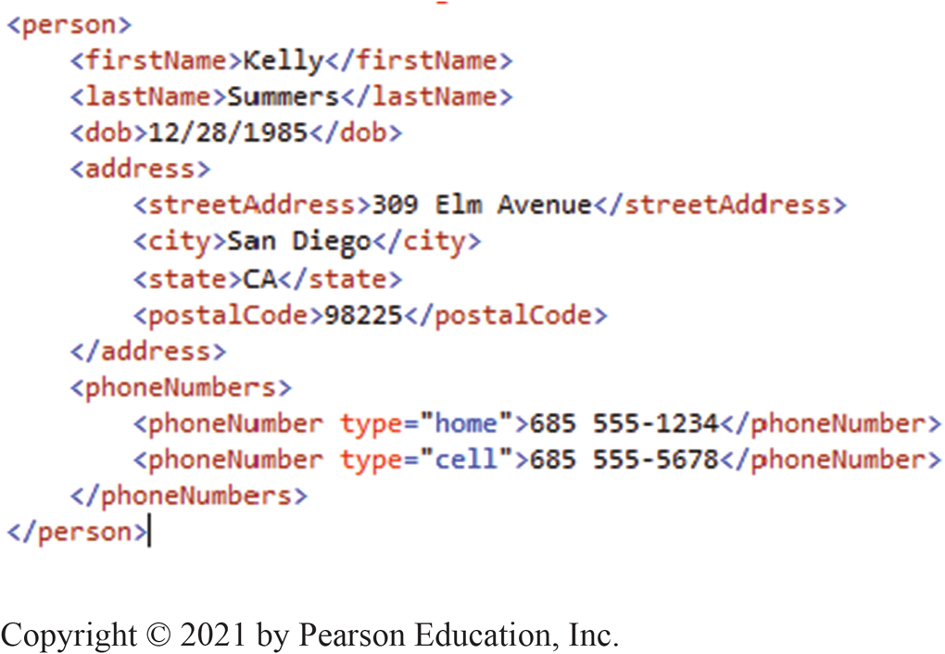
Example X M L and J S O N Documents
CE 9-4 How do Web servers support the cloud?
Figure CE9-13a Example X M L Document
Figure C E 9-13b Example J S O N Document
Notes:
XML and JSON are ways of marking up documents so that both the service requestor and the service provider know what data they’re processing. This slide shows a simple example of both. XML documents contain as much metadata as they do application data. These metadata are used to ensure the document is complete and properly formatted.
XML is used when relatively few messages are being transmitted and when ensuring a complete and correct document is crucial. Both WSDLs and SOAP messages are coded in XML.
JSON uses the notation for JavaScript objects to format data. It has much less metadata and is preferred for the transmission of voluminous application data. Web servers use JSON as their primary way of sending application data to browsers.

Slide 28
Active Review
CE 9-1 What is a computer network?
CE 9-2 What are the components of a LAN?
CE 9-3 How does the Internet work?
CE 9-4 How do Web servers support the cloud?

Slide 29

Copyright

