Slide 1

Experiencing M I S
Ninth Edition
Chapter Extension 11
Enterprise Resource Planning (E R P) Systems
Slides in this presentation contain hyperlinks. JAWS users should be able to get a list of links by using INSERT+F7
Copyright © 2021, 2019, 2017 Pearson Education, Inc. All Rights Reserved
Notes:
If this PowerPoint presentation contains mathematical equations, you may need to check that your computer has the following installed:
1) MathType Plugin
2) Math Player (free versions available)
3) NVDA Reader (free versions available)

Slide 2
Study Questions
CE 11-1 What is the purpose of E R P systems?
CE 11-2 What are the elements of an E R P solution?
CE 11-3 How are E R P systems implemented and upgraded?
CE 11-4 What types of organizations use E R P?
CE 11-5 How do the major E R P vendors compare?

Slide 3
What is an E R P System?
CE 11-1 What is the purpose of E R P systems?
Suite of modules, database, set of inherent processes for consolidating business operations into a single, consistent computing platform
Primary purpose
Integration of purchasing, human resources, production, sales, and accounting data into a single system
Allow real time global updates of transactions
Enable critical business decisions using latest data
Notes:
ERP system is an information system based on ERP technology. ERP systems integrate all of an organization’s purchasing, human resources, production, sales, and accounting data into a single system.

Slide 4
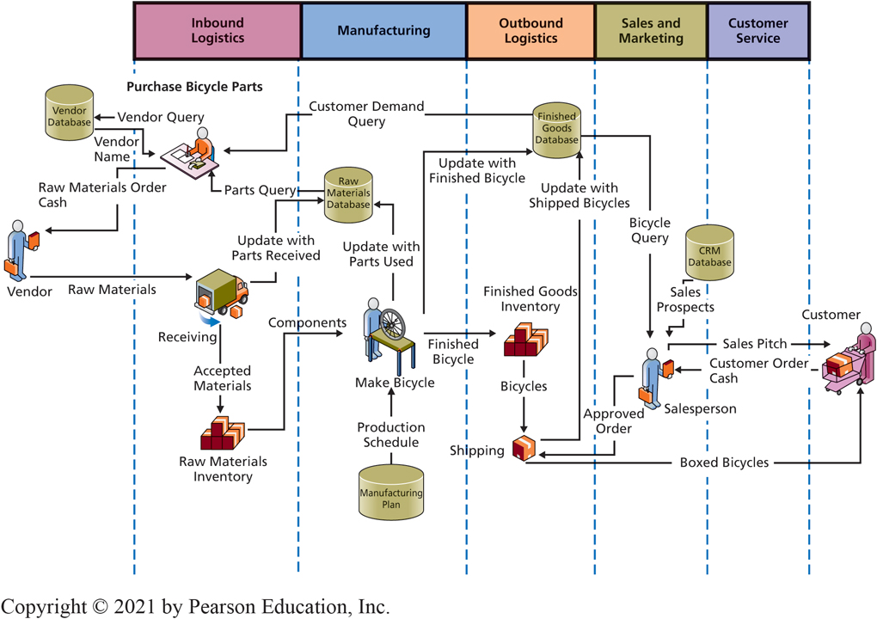
Pre-E R P Information System: Bicycle Manufacturer (5 Non-Integrated Databases)
CE 11-1 What is the purpose of E R P systems?
Figure C E 11-1 Pre-E R P Information Systems
Notes:
This diagram of the processes used by a bicycle manufacturer includes five different databases, one each for vendors, raw materials, finished goods, manufacturing plan, and CRM.
Consider the problems that appear with such separated data when the sales department closes a large order, say for 1,000 bicycles. Without integration, the remained of the organization will not easily find out about that large order.

Slide 5
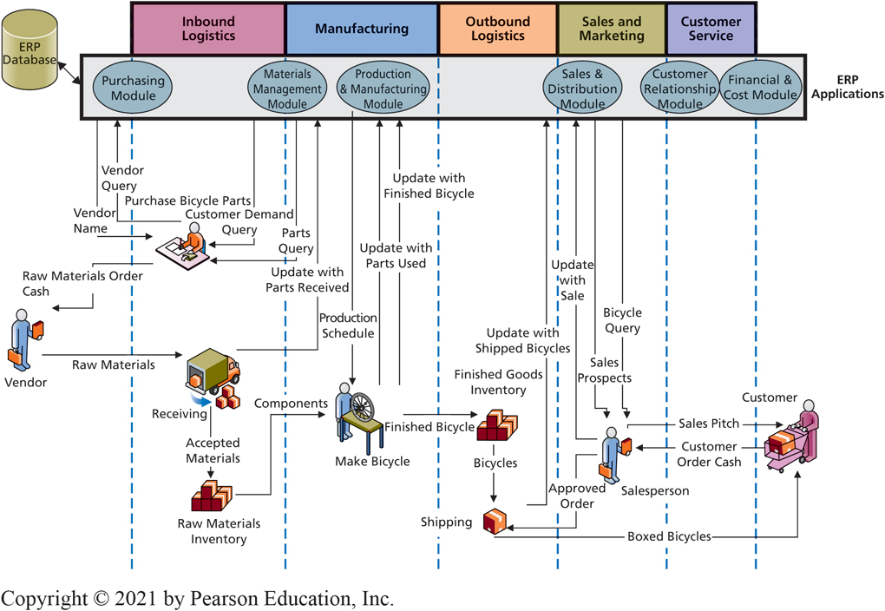
ERP Information System: Bicycle Manufacturer (Integrated Database)
CE 11-1 What is the purpose of E R P systems?
Figure C E 11-2 E R P Information Systems
Notes:
All activity is processed by ERP application programs and consolidated data are stored in a centralized ERP database.

Slide 6
Some Questions Procedures Need to Answer or Resolve
CE 11-1 What is the purpose of E R P systems?
How does sales department determine an order is “large”? By dollars? By volume?
Who approves customer credit (and how)?
Who approves production capacity (and how)?
Who approves schedule and terms (and how)?
What actions need to be taken if customer modifies an order?
How does management obtain oversight on sales activity?
Notes:
It’s easy to draw a rectangle on a chart, label it “ERP applications,” and assume data integration takes all problems away. It is far more difficult to write those application programs and design the database to store that integrated data. Even more problematic, what procedures should employees and others use to process those application programs?

Slide 7
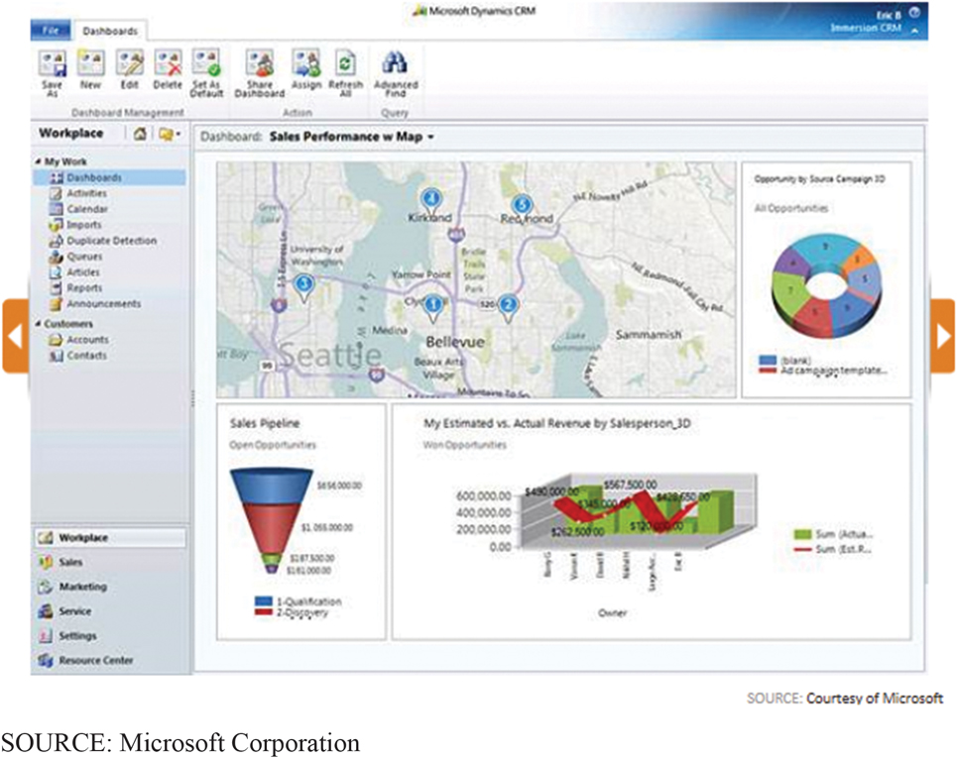
Sales Dashboard
CE 11-1 What is the purpose of E R P systems?
Figure C E 11-3 Sales Dashboard
Notes:
ERP systems can display the current status of critical business factors to managers and executives, as shown in the sales dashboard.

Slide 8
E R P Applications
CE 11-2 What are the elements of an E R P solution?
True E R P have applications that integrate:
Supply chain management
Production management
C R M
Human resources
Financial management
(http://www.erpsoftware360.com/erp-101.htm)
Notes:
Supply chain management (procurement, sales order processing, inventory management, supplier management, and related activities)
Production management (scheduling, capacity planning, quality control, bill of materials, and related activities)
CRM (sales prospecting, customer management, marketing, customer support, call center support)
Human resources (payroll, time and attendance, HR management, commission calculations, benefits administration, and related activities)
Financial management (general ledger, accounts receivable, accounts payable, cash management, fixed asset accounting)

Slide 9
Elements of E R P Systems
CE 11-2 What are the elements of an E R P solution?
Hardware
Software: E R P application programs
Data: E R P databases
Procedures: Business process procedures
People: Training and consulting
Notes:
The term ERP has been applied to a wide array of application solutions. Some vendors have attempted to catch the buzz for ERP by misapplying the term to applications that are nothing more than one or two integrated functional applications.

Slide 10
E R P Solution Components (1 of 3)
CE 11-2 What are the elements of an E R P solution?
Hardware
Cloud-based hosting
P a a S: Install E R P software and databases on leased cloud hardware
S a a S: Use E R P vendors E R P software as a service
S A P, Oracle, Microsoft, and others
Hybrid model
E R P customers store most data on cloud servers and sensitive data on self-managed servers

Slide 11
E R P Solution Components (2 of 3)
CE 11-2 What are the elements of an E R P solution?
Software: E R P Application Programs
Configurable vendor applications.
Data: E R P Databases
Trigger
Computer program within database to keep database consistent when certain conditions arise.
Stored Procedure
Enforces business rules.
Notes:
Vendor applications: Configurable, can be altered without changing program code. Set configuration parameters specifying how ERP application programs will operate: Hourly payroll application configured to specify number of hours in standard workweek, hourly wages for different job categories, wage adjustments for overtime, and holiday work, etc.
ERP Databases:
- Trigger: Database program to keep database consistent when certain conditions arise
- Stored procedure: Database program to enforce business rules

Slide 12
E R P Solution Components (3 of 3)
CE 11-2 What are the elements of an E R P solution?
Procedures: Business Processes and Procedures
Adapt to inherent processes and procedures, or design new ones?
People: Training & Consulting
Training to implement.
Top management support, preparing for change, dealing with resistance.
Training to use.
Industry-Specific Solutions
Notes:
Super Users become in-house trainers; train the trainers
Vendor and third-party consultants

Slide 13
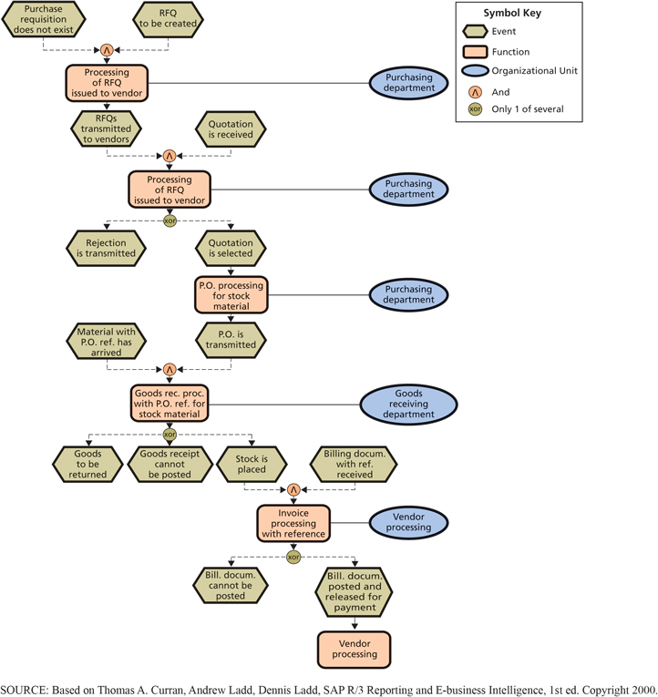
Example of SAP Ordering Business Process Blueprint
CE 11-2 What are the elements of an E R P solution?
Figure C E 11-4 Example of S A P Ordering Process
Notes:
Some ERP vendors call the inherent processes that are defined in the ERP solution process blueprints.

Slide 14
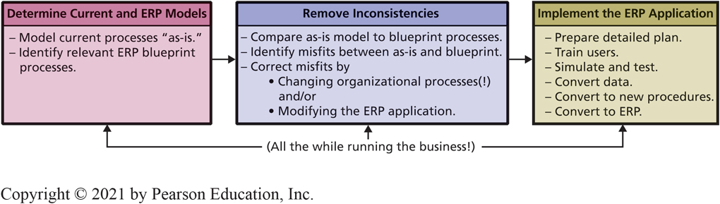
E R P Implementation
CE 11-3 How are E R P systems implemented and upgraded?
Figure C E 11-5 E R P Implementation
Notes:
To appreciate the magnitude of these tasks, consider that SAP blueprint contains over a thousand process models. Organizations that are adopting ERP must review those models and determine which ones are appropriate to them. Then, compare ERP models to models developed based on their current practices.
Inevitably, some current-practice models are incomplete, vague, or inaccurate, so the team must repeat existing process models. In some cases, it is impossible to reconcile any existing system against the blueprint model. If so, the team must adapt, cope, and define new procedures, often to the confusion of current employees.

Slide 15
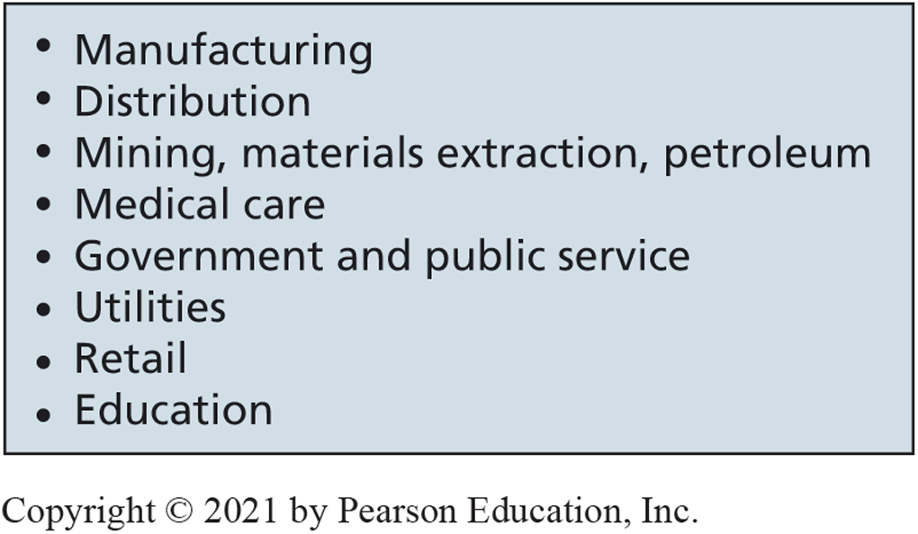
E R P Industry-Specific Solutions
CE 11-4 What types of organizations use E R P?
Figure C E 11-6 E R P Use by Industry
Notes:
Figure CE11-6 shows ERP use by industry.
Manufacturers in the aerospace, automotive, and industrial equipment industries led the way.
Over time, ERP use spread to companies and organizations in other industries, as shown in Figure CE11-6

Slide 16
E R P by Organization Size
CE 11-4 What types of organizations use E R P?
Large organizations
Have resources and skilled personnel to accomplish and manage an E R P implementation
Chief information officer (C I O)
E R P implementation part of strategic planning
Requires full backing of entire executive group

Slide 17
Midsize and Small Organizations
CE 11-4 What types of organizations use E R P?
Employ only one or two I T specialists
Medium-size organizations
Frequently small staff isolated from senior management
Isolation creates misunderstanding and distrust
First step in moving toward E R P
Obtain deep senior-level management commitment

Slide 18
International E R P
CE 11-4 What types of organizations use E R P?
Worldwide consolidation of financial statements on a timely basis
Inherent E R P procedures adaptable to many cultures
Multiple currencies and languages, manage international transfers of goods in inventories, work with international supply chains

Slide 19
E R P Market Leaders
CE 11-5 How do the major E R P vendors compare?
Size of the E R P market expected to grow from $34 billion in 2017 to $74 billion in 2026
Consolidation of vendors is likely
Top 10 vendors own 64 percent of the market share
Top 5 vendors own 55 percent of the market share (see Figure CE11-7)

Slide 20
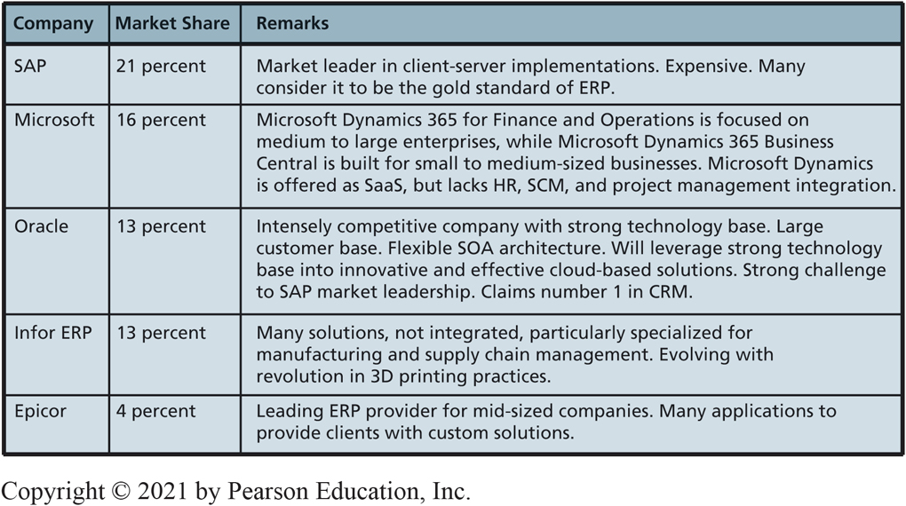
Characteristics of Top E R P Vendors
CE 11-5 How do the major E R P vendors compare?
Figure C E 11-7 Characteristics of Top E R P Vendors
Notes:
Although more than 100 different companies advertise ERP products, not all of those products meet the minimal ERP criteria. Even of those that do, the bulk of the market is held by a few vendors. This figure shows how the ERP products from each of these companies relate to the size of their customers. SAP and Oracle serve the largest organizations. Infor, Microsoft, and Epicor products primarily serve midsized to small companies.

Slide 21
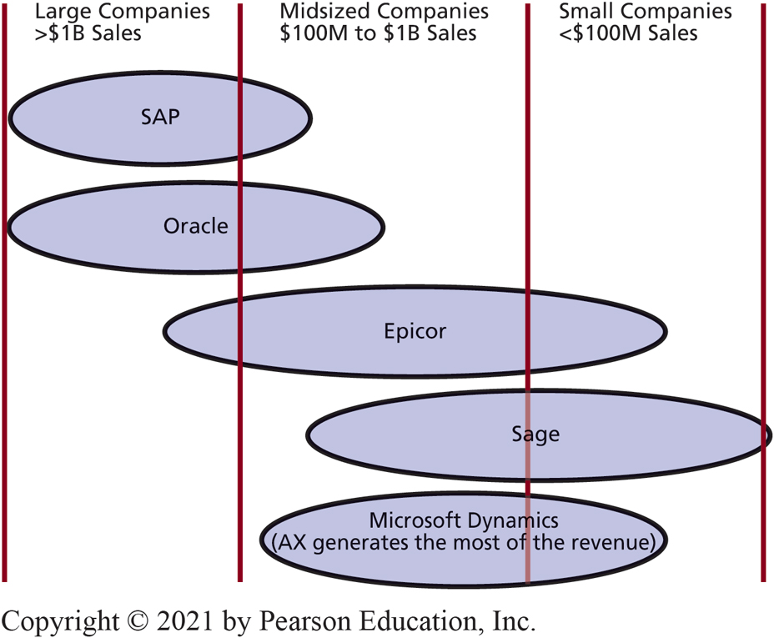
E R P Vendors and Customer Size
CE 11-5 How do the major E R P vendors compare?
Figure C E 11-8 Top E R P Vendors and Customer Size

Slide 22
S A P
CE 11-5 How do the major E R P vendors compare?
Classic S A P uses thick-client, client-server architecture
S A P HANA Enterprise Cloud
P a a S E R P provides foundation for cloud solution
Big problem—due to the size of SAP’s installed customer base
Cannot dramatically move out of classic S A P to cloud-based solutions
Must focus resources and attention on needs of current customers

Slide 23
Oracle
CE 11-5 How do the major E R P vendors compare?
Intensely competitive company with a deep base of technology and high-quality technical staff
Known for expensive fully featured products with superior performance
Oracle offers E R P Cloud Service as S a a S
E R P Services include financials, planning and budgeting, risk, and controls

Slide 24
Microsoft Dynamics
CE 11-5 How do the major E R P vendors compare?
Microsoft Dynamics 365 for Finance and Operations Enterprise Edition is for midsized to large corporations
Microsoft Dynamics 365 Business Central is for small to midsized businesses
Microsoft Dynamics will continue going forward as true ERP product for larger organizationss

Slide 25
Infor
CE 11-5 How do the major E R P vendors compare?
Grew by acquisitions
Sells many E R P products for many different industries
Products vary in purpose, scope, and quality
Serves midrange, higher-end small companies and lower-end large companies
Infor Business Cloud (S a a S) or bare-bones offered as I a a S

Slide 26
Epicor
CE 11-5 How do the major E R P vendors compare?
Epicor started off providing accounting software in the mid-1980’s
Expanded it’s capabilities through acquisition of manufacturing, supply chain, and retail software
Also provides E R P, human resources, and distribution software in cloud-based and hosted formats

Slide 27
E R P in the Future (1 of 2)
CE 11-5 How do the major E R P vendors compare?
Problems of cloud-based E R P using the hybrid model
Mobility will still present potentially serious security threat
Warehouse workers on loading dock, shipping department carry mobile devices that enable processing E R P and other enterprise applications.
Managers, decision makers, and knowledge workers will have similar applications on their own phones or other mobile devices, devices they can access from work, other offices, the street, or home.

Slide 28
E R P in the Future (2 of 2)
CE 11-5 How do the major E R P vendors compare?
Increased vulnerability to criminal hackers, malicious insiders
Potential effect of the Internet of Things
Machines will employ E R P system to schedule their own maintenance
Factory floor milling machines able to order a replacement for a dull cutter, possibly made by a 3D printer
Machines schedule routine and emergency maintenance for themselves

Slide 29
Active Review
CE 11-1 What is the purpose of E R P systems?
CE 11-2 What are the elements of an E R P solution?
CE 11-3 How are E R P systems implemented and upgraded?
CE 11-4 What types of organizations use E R P?
CE 11-5 How do the major E R P vendors compare?

Slide 30

Copyright

