Slide 1
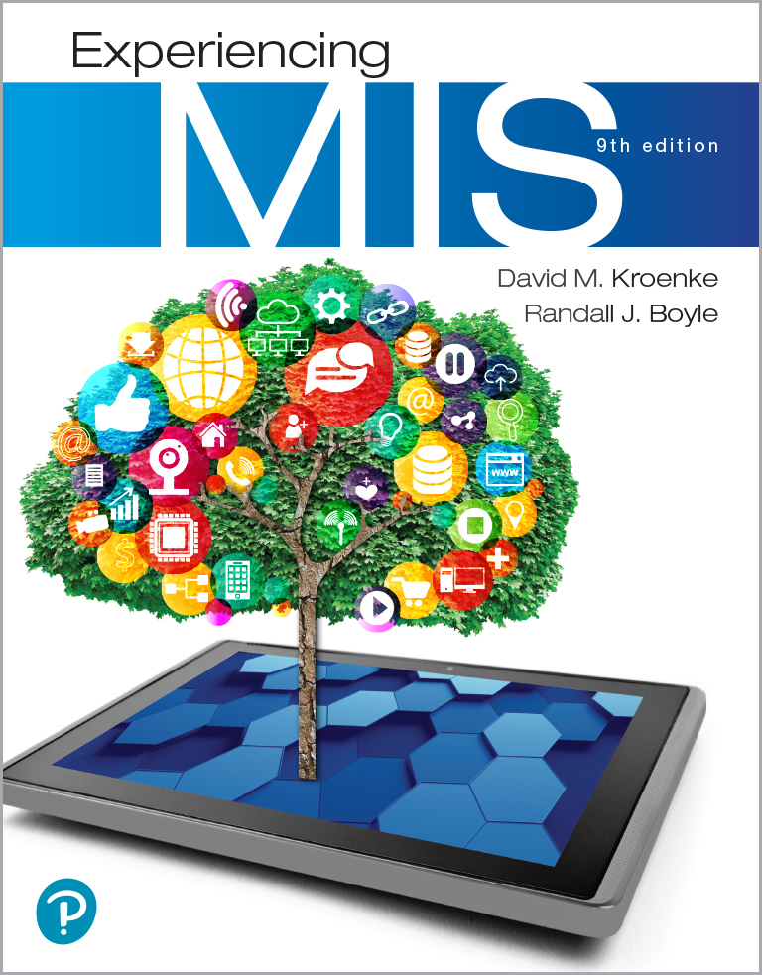
Experiencing M I S
Ninth Edition
Chapter Extension 12
Supply Chain Management
Slides in this presentation contain hyperlinks. JAWS users should be able to get a list of links by using INSERT+F7
Copyright © 2021, 2019, 2017 Pearson Education, Inc. All Rights Reserved
Notes:
If this PowerPoint presentation contains mathematical equations, you may need to check that your computer has the following installed:
1) MathType Plugin
2) Math Player (free versions available)
3) NVDA Reader (free versions available)

Slide 2
Study Questions
CE 12-1 What are typical inter-enterprise processes?
CE 12-2 What is a supply chain?
CE 12-3 What factors affect supply chain performance?
CE 12-4 How does supply chain profitability differ from organizational profitability?
CE 12-5 What is the bullwhip effect?
CE 12-6 How do information systems affect supply chain performance?
Notes:
This chapter extension considers a sample inter-enterprise IS of supply chain management among distributors and retailers. We will consider supply chain management from a generic standpoint using simple examples. Understanding the principles in this chapter extension will serve as a good basis if you work in more complicated supply chain situations during your career.

Slide 3
Inter-Enterprise Processes
CE 12-1 What are typical inter-enterprise processes?
Simple | Moderately complex | Highly complex
Small retailer credit card sales transaction process. | Standardized processing of checks among banks using Automated Clearing House (A C H) system. | Customized interorganizational processes among large companies, typically to link supply chains.

Slide 4
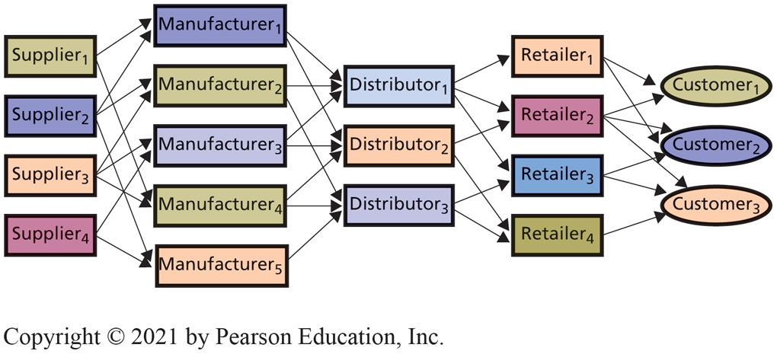
Supply Chain Relationships
CE 12-2 What is a supply chain?
Figure C E 12-1 Supply Chain Relationships
Notes:
The term chain is misleading. Chain implies that each organization is connected to just one company up (toward the supplier) and down (toward the customer) the chain. That is not the case. Instead, at each level, an organization can work with many organizations both up and down the supply chain. Thus, a supply chain and the processes that support it are networks.

Slide 5
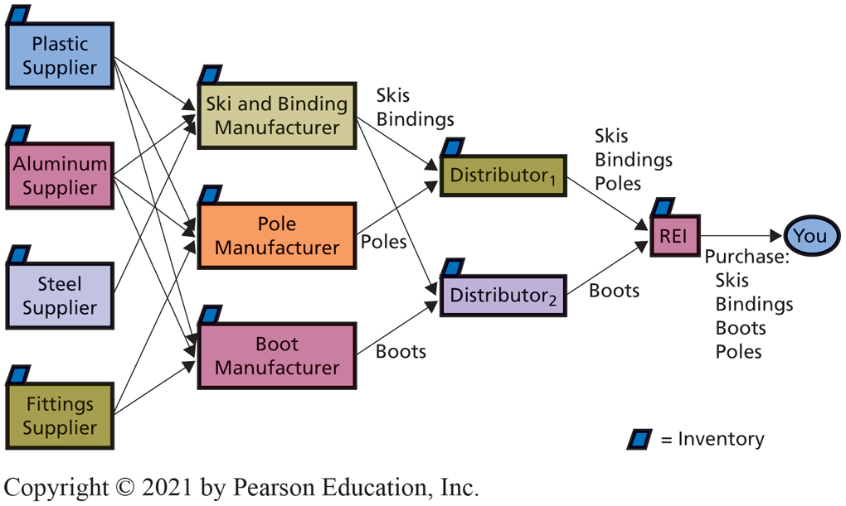
Supply Chain Example: R E I
CE 12-2 What is a supply chain?
Figure C E 12-2 Supply Chain Example
Notes:
Money is passed back up from customer through the supply chain.

Slide 6
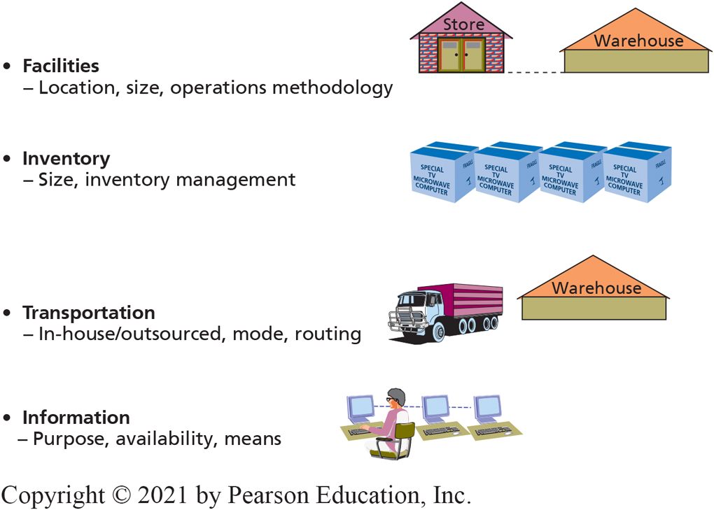
Driving Supply Chain Performance
CE 12-3 What factors affect supply chain performance?
Factors of Information
Figure C E 12-3 Drivers of Supply Chain Performance
Purpose
Availability
Means
Notes:
Information influences supply chain performance by affecting the ways that organizations in the supply chain make requests
of one another, respond to one another, and share knowledge with one another.
Purpose: can be transactional.
Availability: ways to share information; with whom, what, and when.
Means: methods for transmitting information.
Modern organizations use some version of SOA and Web services for exchanging information.

Slide 7
Supply Chain Profitability vs Organizational Profitability? (1 of 2)
CE 12-4 How does supply chain profitability differ from organizational profitability?
Profit: Total revenue generated minus total costs incurred
Maximum profit from chain
Not achieved if each organization maximizes own profits in isolation
Profitability increases when one or more operate at less than maximum profitability (e.g., carries larger than optimal inventory)
Why?
When one supplier loses sales due to out-of-stock, others in supply chain lose revenue
Notes:
Each of the organizations is an independent company, with its own goals and objectives. Each has a competitive strategy that may differ from the competitive strategies of the other organizations in the supply chain. Left alone, each organization will maximize its own profit, regardless of the consequences of its actions on the profitability of the others.

Slide 8
Supply Chain Profitability vs Organizational Profitability? (2 of 2)
CE 12-4 How does supply chain profitability differ from organizational profitability?
Some form of transfer payment induce a distributor to carry larger than optimal level inventory
Solution difficult to implement
Requires a comprehensive supply-chain-wide information system
Notes:
For higher-priced items or for items with very high volume, there can be an economic benefit for creating an information system to identify such a situation. If the dynamic is long-lasting, it might be worthwhile to negotiate the transfer-payment agreements. All of this would require a comprehensive supply-chain-wide information system.

Slide 9
The Bullwhip Effect (1 of 3)
CE 12-5 What is the bullwhip effect?
Natural dynamic of multistage supply chains
Caused by variability in size and timing of orders
Affects each stage up supply chain from customer to supplier
Not related to erratic customer demand

Slide 10
The Bullwhip Effect (2 of 3)
CE 12-5 What is the bullwhip effect?
Large demand fluctuations force distributors, manufacturers, suppliers to carry larger inventories
Reduces overall profitability of supply chain
Eliminate by giving supply chain participants access to consumer-demand information from the retailer
Notes:
Unrelated to erratic customer demand
Large fluctuations force distributors, manufacturers, and suppliers to carry larger inventories

Slide 11
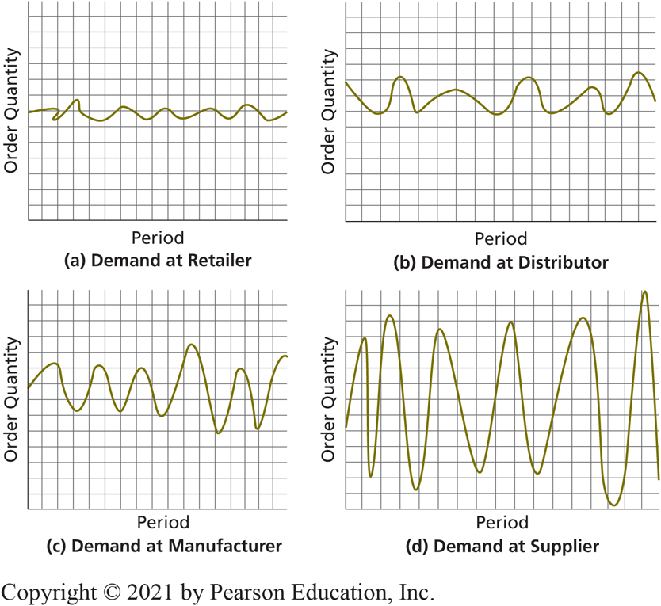
The Bullwhip Effect (3 of 3)
CE 12-5 What is the bullwhip effect?
Figure C E 12-4 The Bullwhip Effect
Notes:
Because of the nature of this process, small changes in demand at the retailer are amplified at each stage of the supply chain. As shown in Figure CE12-4, those small changes become quite large variations on the supplier end.

Slide 12
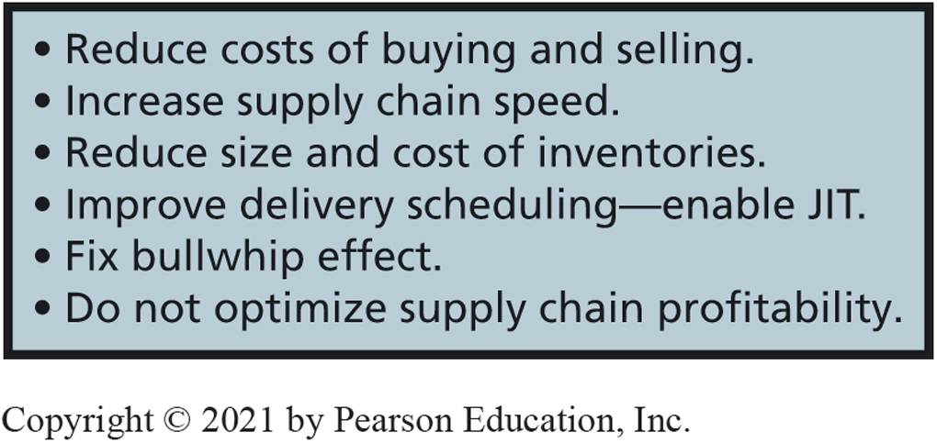
Benefits of Information Systems on Supply Chain Performance
CE 12-6 How do information systems affect supply chain performance?
Figure C E 12-5 Benefits of Information Systems on Supply Chain Performance

Slide 13
Active Review
CE 12-1 What are typical inter-enterprise processes?
CE 12-2 What is a supply chain?
CE 12-3 What factors affect supply chain performance?
CE 12-4 How does supply chain profitability differ from organizational profitability?
CE 12-5 What is the bullwhip effect?
CE 12-6 How do information systems affect supply chain performance?

Slide 14

Copyright

