Slide 1

Experiencing M I S
Ninth Edition
Chapter Extension 13
Enterprise Social Networks and Knowledge Management
Slides in this presentation contain hyperlinks. JAWS users should be able to get a list of links by using INSERT+F7
Copyright © 2021, 2019, 2017 Pearson Education, Inc. All Rights Reserved
Notes:
If this PowerPoint presentation contains mathematical equations, you may need to check that your computer has the following installed:
1) MathType Plugin
2) Math Player (free versions available)
3) NVDA Reader (free versions available)

Slide 2
Study Questions
CE 13-1 How do organizations develop an effective S M I S?
CE 13-2 What is an enterprise social network (E S N)?
CE 13-3 What are the benefits of knowledge management?
CE 13-4 What are expert systems?
CE 13-5 What are content management systems?

Slide 3
Developing an Effective S M I S
CE 13-1 How do organizations develop an effective S M I S?
Focus on being cost leader or on product differentiation.
Industry-wide or segment focus.
Premeditated alignment of S M I S with organization’s strategy.
Next slide shows process of developing a practical plan to effectively use existing social media platforms.
Notes:
Using social media in an old-style, organization-centric manner is ineffective. True value of social media can only be achieved when organizations use social media to interact with customers, employees, and partners in a more humane, relationship-oriented way.
Rather than sending messages that attempt to manage, influence, and control, hyper-social organizations create relationships in which both parties perceive and gain value.

Slide 4
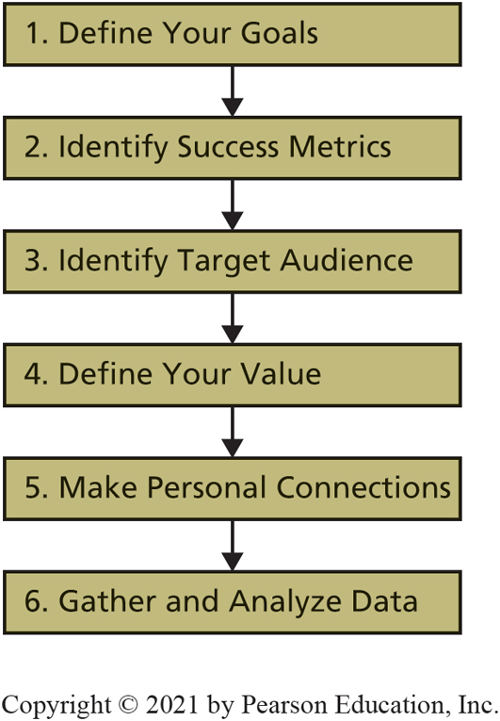
Social Media Plan Development
CE 13-1 How do organizations develop an effective S M I S?
Figure C E 13-1 Social Media Plan Development
Notes:
Figure CE13-1 walks you through the process of developing a practical plan to effectively use existing social media platform. Take a few minutes to consider each step in the process. Success metrics or key performance indicators (KPI). Metrics are simply measurements used to track performance.

Slide 5
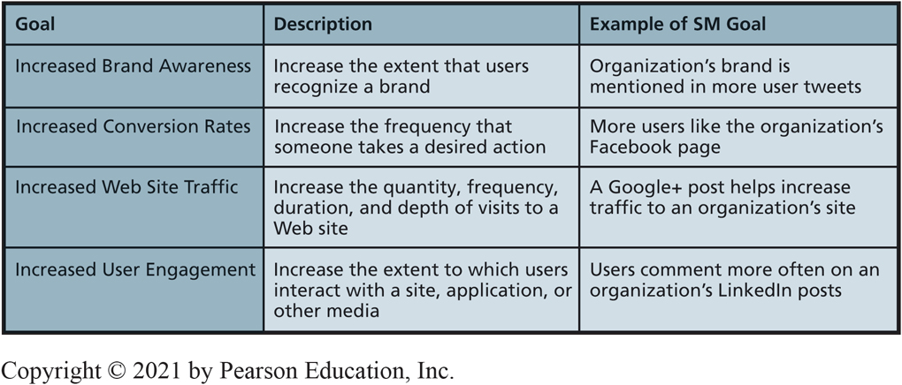
Common Social Media Strategic Goals
CE 13-1 How do organizations develop an effective S M I S?
Figure C E 13-2 Common Social Media Strategic Goals
Notes:
Metrics that don’t improve your decision making are commonly referred to as vanity metrics.
Conversion rate is the percent of people who achieve a certain result.
Bounce rate is percent of people who visit your Web site and then immediately leave.

Slide 6
Success Metrics
CE 13-1 How do organizations develop an effective S M I S?
Success metrics are measurements to track performance toward goals.
Also called key performance indicators (K P I).
Ignore vanity metrics.
Minimize bounce rate.

Slide 7
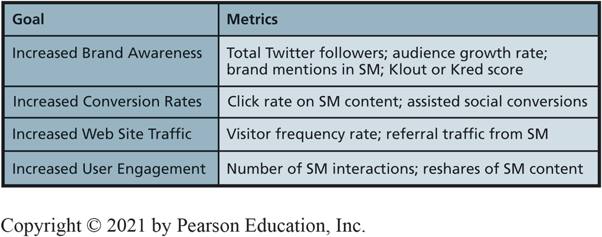
Common Social Media Metrics
CE 13-1 How do organizations develop an effective S M I S?
Figure C E 13-3 Common Social Media Metrics
Notes:
Online analytical tools like Google Analytics, Facebook Page Insights, Clicky, or KISSmetrics to measure the success metrics you defined earlier. These tools will show you statistical information such as which tweets get the most attention, which posts generate the most traffic, and which SM platform generates the most referrals.

Slide 8
Make Personal Connections (1 of 2)
CE 13-1 How do organizations develop an effective S M I S?
58% of consumers, ages 18–29, more influenced by social media chatter than by T V or Internet ads
29% of consumers over 55 thought social media chatter more influential than T V or Internet ads
Interact with customers, employees, and partners in more personal, humane, relationship-oriented way
Notes:
A CivicScience study found that 58 percent of younger consumers, ages 18 through 29, were more influenced by social media chatter than either TV ads or Internet ads. Interestingly, the study also found that only 29 percent of consumers over the age of 55 thought social media chatter was more influential than TV or Internet advertising.

Slide 9
Make Personal Connections (2 of 2)
CE 13-1 How do organizations develop an effective S M I S?
Useful interactions that help solve particular problems and satisfy unique needs
Avoid hard-selling products, overwhelming with content, and contacting too often

Slide 10
Gather and Analyze Data
CE 13-1 How do organizations develop an effective S M I S?
Gather right amount of data necessary to make most informed decision possible
Google Analytics, Facebook Page Insights, Clicky, or KISSmetrics
Allow use of social media to be flexible enough to change over time
Statistical information
Which tweets get most attention, posts generate most traffic, S M platform generates most referrals?
Senior managers see regular progress reports
Be educated about changes in social media landscape
Watch for S M success stories and inform upper management

Slide 11
Enterprise Social Networks (E S N)
CE 13-2 What is an enterprise social network (E S N)?
E S N
Software platform uses S M to facilitate cooperative work of people within an organization.
Improve communication, collaboration, knowledge sharing, problem solving, and decision making.
Enterprise 2.0
Use of emergent social software platforms within companies, or between companies, partners, or customers.

Slide 12
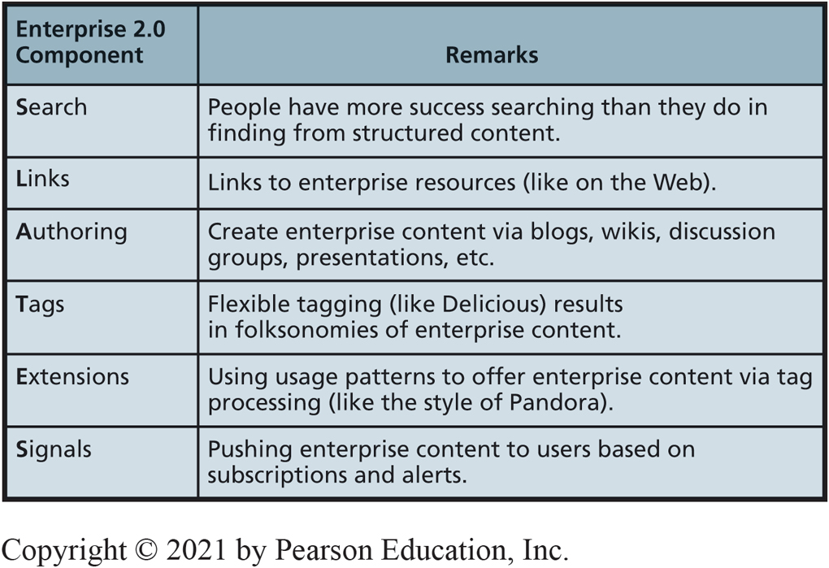
Enterprise 2.0: McAfee’s SLATES Model
CE 13-2 What is an enterprise social network (E S N)?
Figure C E 13-4 McAfee’s SLATES Model
Notes:
Enterprise 2.0: Application of social media to facilitate cooperative work of people inside organizations. Can be used to enable people to share knowledge and problem-solving techniques. ESNs employ a folksonomy, or a content structure that emerges from the processing of many user tags.

Slide 13
Changing Communication
CE 13-2 What is an enterprise social network (E S N)?
Communication channels within corporations changed in equally dramatic ways.
Using E S N s, employees can bypass managers and post ideas directly for C E O to read.
Quickly identify internal experts to solve unforeseen problems.
Notes:
Prior to 1980, communication in the United States was restricted to a few communication channels, or means of delivering messages. There were three major national TV networks and no more than a half-dozen major national newspapers.
Communication within organizations was similarly restricted. Employees could communicate with their immediate supervisor and coworkers in their vicinity. It was difficult for employees of large corporations to get private meetings with the CEO or to communicate with their counterparts in other countries. If an employee had a good idea, it was passed up through his or her boss to senior management. As a result, it was common for bosses to claim subordinates’ ideas as their own.

Slide 14
Deploying Successful Enterprise Social Networks
CE 13-2 What is an enterprise social network (E S N)?
Organizations still learning how to use and deploy E S N s.
Develop strategic plan for using S M internally via same process as used for external social media use.
Assess likelihood of employee resistance.

Slide 15
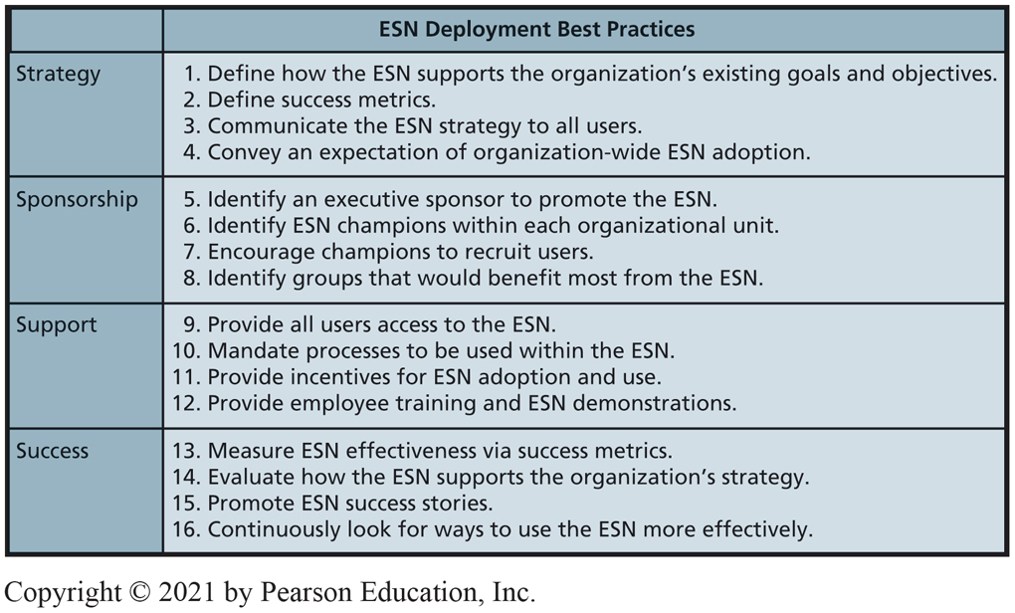
E S N Implementation Best Practices
CE 13-2 What is an enterprise social network (E S N)?
Figure C E 13-5 E S N Implementation Best Practices
Notes:
Read through the items and reflect on what you went through when you first started using SM. Think about how important your friends were in your decision to start using SM.
Having an internal champion or defender is very important.

Slide 16
Knowledge Management Systems
CE 13-3 What are the benefits of knowledge management?
Knowledge management (K M)
Creating value from intellectual capital and sharing knowledge with those who need that capital.
Preserving organizational memory
Capturing and storing lessons learned and best practices of key employees.
Scope of K M same as S M in hyper-social organizations.

Slide 17
Benefits of Knowledge Management
CE 13-3 What are the benefits of knowledge management?
Improve process quality.
Increase team strength.
Goal:
Enable employees to use organization’s collective knowledge.

Slide 18
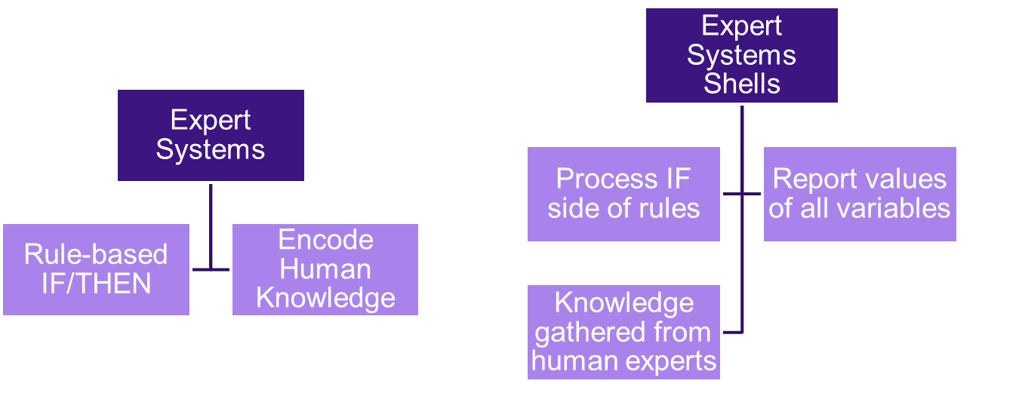
What are Expert Systems?
CE 13-4 What are expert systems?
Expert Systems
Notes:
Expert systems are rule-based systems that encode human knowledge as If/Then rules.
Expert systems shells—programs that process a set of rules.

Slide 19
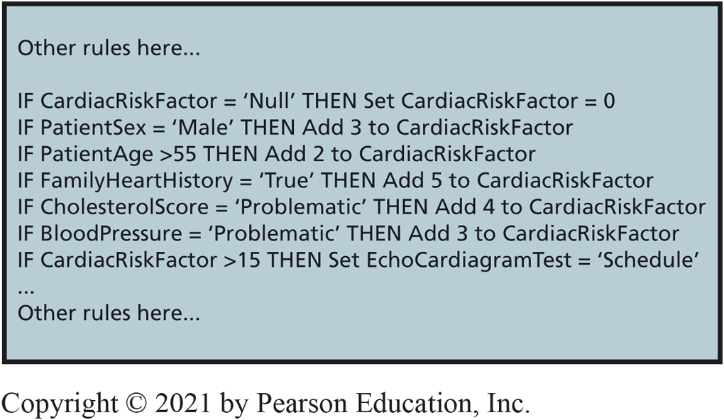
Example of If/Then Rules
CE 13-4 What are expert systems?
Figure C E 13-6 Example of If/Then Rules

Slide 20
Drawbacks of Expert Systems
CE 13-4 What are expert systems?
Difficult and expensive to develop.
Labor intensive.
Ties up domain experts.
Difficult to maintain.
Changes cause unpredictable outcomes.
Constantly need expensive changes.
Don’t live up to expectations.
Can’t duplicate diagnostic abilities of humans.
Notes:
The few expert systems that have been successful have addressed more restricted problems than duplicating a doctor’s diagnostic ability. They address problems such as checking for harmful prescription drug interactions and configuring products to meet customer specifications.
These systems require many fewer rules and are therefore more manageable to maintain.
However, unless expert systems technology gets a boost from massively parallel computing (think MapReduce and Hadoop), their problems will cause them to fade from use.

Slide 21
What are Content Management Systems (CMS)?
CE 13-5 What are content management systems?
Support management and delivery of documents, other expressions of employee knowledge.
Challenges of content management
Huge databases.
Dynamic content.
Documents refer to one another.
Perishable contents.
In many languages.
Notes:
Content management system functions are huge and complex.

Slide 22
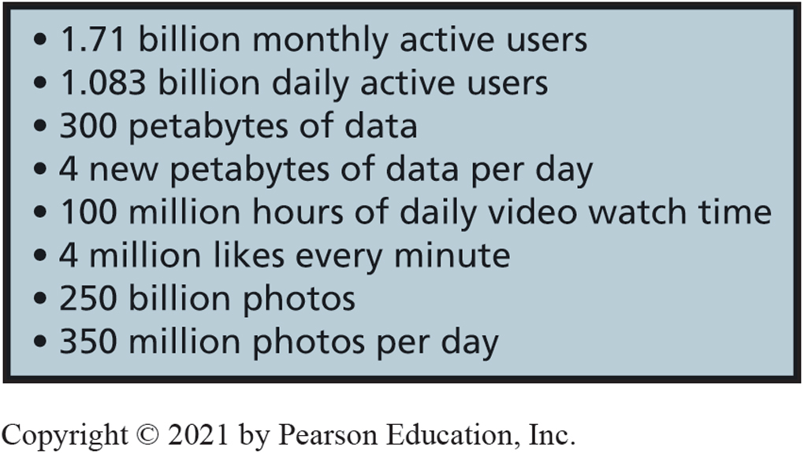
Document Management at Facebook.com
CE 13-5 What are content management systems?
Figure CE13-7 Document Management At Facebook.com
Notes:
Document management at Facebook requires extremely large amounts of storage.

Slide 23
What are C M S Application Alternatives?
CE 13-5 What are content management systems?
In-house custom development
Customer support develops in-house database applications to track customer problems.
Off-the-shelf
Horizontal market products (SharePoint).
Vertical market applications.
Public search engine
Google, Bing.
Notes:
Horizontal market: An accounting firm, for example, may license a vertical market application to manage document flow for the processing of tax returns or the management of audit documents.

Slide 24
Active Review
CE 13-1 How do organizations develop an effective S M I S?
CE 13-2 What is an enterprise social network (E S N)?
CE 13-3 What are the benefits of knowledge management?
CE 13-4 What are expert systems?
CE 13-5 What are content management systems?

Slide 25

Copyright

