Slide 1
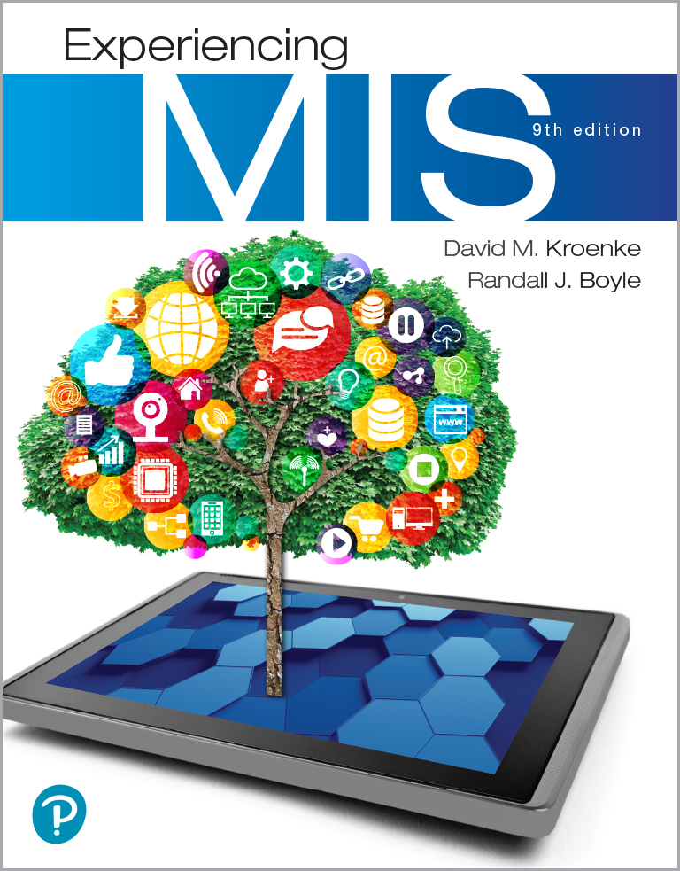
Experiencing M I S
Ninth Edition
Chapter Extension 14
Data Breaches
Copyright © 2021, 2019, 2017 Pearson Education, Inc. All Rights Reserved
Notes:
If this PowerPoint presentation contains mathematical equations, you may need to check that your computer has the following installed:
1) MathType Plugin
2) Math Player (free versions available)
3) NVDA Reader (free versions available)
Chapter 10 provides the background for this extension.

Slide 2
Study Questions
CE 14-1 What is a data breach?
CE 14-2 How do data breaches happen?
CE 14-3 How should organizations respond to data breaches?
CE 14-4 What are the legal consequences of a data breach?
CE 14-5 How can data breaches be prevented?
CE14-6 What is your role in IS Security?

Slide 3
Costs of Handling Data Breaches
CE 14-1 What is a data breach?
A data breach happens when an unauthorized person views, alters, or steals secured data
During 2018 more than 5 billion records were stolen in 6,515 data breaches
It’s likely that nearly everyone lost their records at least once in 2019
A single data breach in the U.S. costs an organization $13 million
The average cost of losing a single record is $148

Slide 4
Costs of Handling a Data Breach
CE 14-1 What is a data breach?
Direct Costs
Notification
Detection
Escalation
Remediation
Legal fees and consultation
Indirect Costs
Loss of reputation
Abnormal customer turnover
Increased customer acquisition activities
Additional $3.9 million per incident in U.S.

Slide 5
What Are the Odds?
CE 14-1 What is a data breach?
28% chance of experiencing a data breach over any given 24-month period.

Slide 6
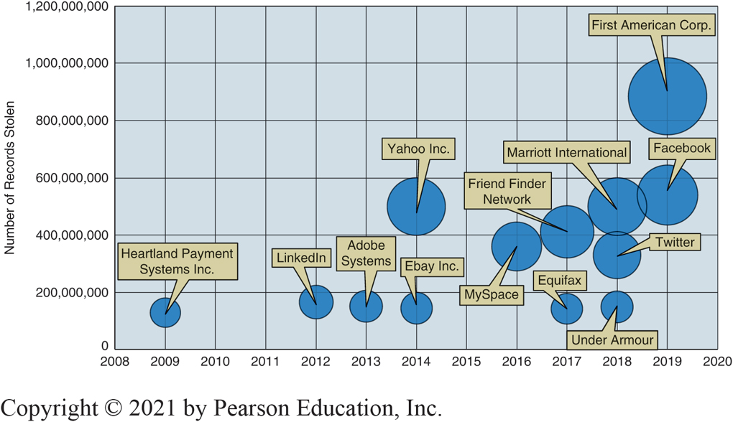
Well-Known Data Breaches
CE 14-1 What is a data breach?
Figure C E 14-1 Well-Known Data Breaches
Notes:
While Edward Snowden and Bradley Manning may have gotten more press because they stole classified documents, the data breaches shown in the figure directly affected the lives of billions of people.

Slide 7
The Largest Data Breaches
CE 14-1 What is a data breach?
Three largest data breaches are so enormous that they would have caused the other data points to be unreadable by comparison
In 2016, Yahoo! Inc. disclosed the loss of 3,000,000,000 customer records in largest ever data breach in 2013

Slide 8
Why Do Data Breaches Happen?
CE 14-1 What is a data breach?
67% are hackers trying to make money from:
Personally identifiable information (P I I)
Names, addresses, dates of birth, Social Security numbers, credit card numbers, health records, bank account numbers, PINs, email addresses
Rogue internal employees
Credit card fraud, identity theft, extortion, industrial espionage

Slide 9
Attack Vectors
CE 14-2 How do data breaches happen?
Attack vectors
Phishing scam
Trick users into donating funds for a natural disaster
Exploit new software vulnerability

Slide 10
Hitting Target
CE 14-2 How do data breaches happen?
Lost 40 million credit and debit card numbers to attackers (December. 18, 2013)
Less than a month later, announced additional 70 million customer names, emails, addresses, phone numbers stolen
Total 98 million customers affected
Stolen from point-of-sale (P O S) systems at Target retail stores

Slide 11
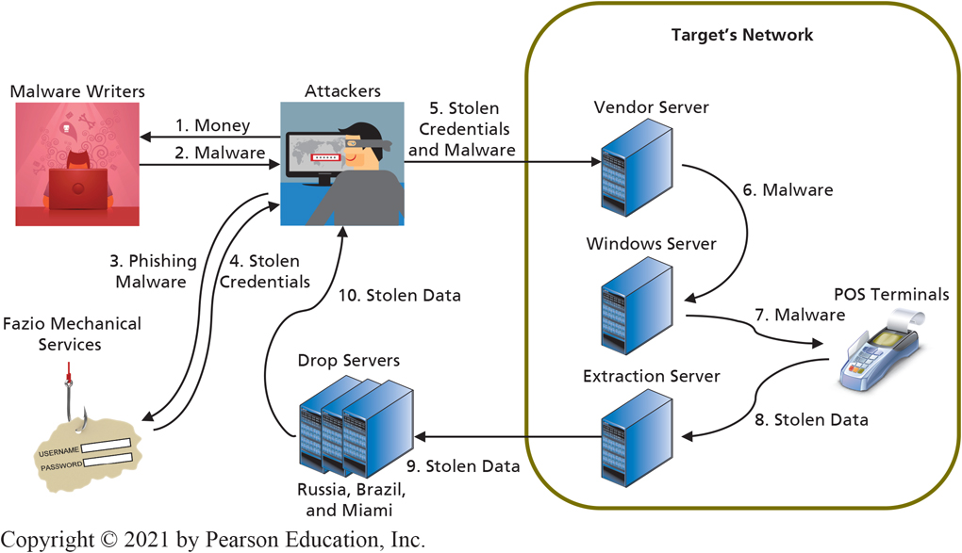
The Target Data Breach
CE 14-2 How do data breaches happen?
Figure C E 14-2 Target Data Breach
Notes:
Attackers first purchased malware designed specifically for the attacks they planned to carry out. Then, they used spear phishing, or a targeted phishing attack, to infect a Target third-party vendor named Fazio Mechanical Services. Attackers placed a piece of malware called Citadel on Fazio’s system to gather keystrokes, login credentials, and screenshots from Fazio users.
The attackers used the stolen login credentials from Fazio to access a vendor portal (or server) on Target’s network. The attackers escalated privileges on that server (i.e., took over the server) and gained access to Target’s internal network.
Attackers compromised an internal Windows file server. From this server, the attackers used malware named Trojan.POSRAM (a variant of BlackPOS) to extract customer data from POS terminals.
Customer data was continuously sent from the POS terminals to an extraction server within Target’s network. It was then funneled out of Target’s network to drop servers in Russia, Brazil, and Miami. From there, the data was collected and sold on the black market.

Slide 12
The Damage
CE 14-2 How do data breaches happen?
Attackers sold about 2 million credit card numbers and PINs for about $26.85 each (total $53.7 million)
Cost Target $450 million
Upgraded P O S terminals to support chip-and-PIN cards
Increased insurance premiums, legal fees, credit card processors settlement, pay for consumer credit monitoring, regulatory fines
Lost sales, 46% drop in next quarter revenues

Slide 13
Collateral Damage
CE 14-2 How do data breaches happen?
Payment processing industry
Shift to EMV-compliant smart cards forced replacement of 800 million payment cards and 14 million POS terminals at a cost of $7 billion
Consumers
Enrolled in credit monitoring, continually watch their credit, and fill out paperwork if fraudulent charges appear on statements
Increased insurance premiums, stricter controls, and more system auditing for organizations similar to Target

Slide 14
Responding to Data Breaches (1 of 2)
CE 14-3 How should organizations respond to data breaches?
Respond Quickly
Stop hackers from doing more damage
Exfiltration or illegally transferring data out
Immediately notify affected users
Plan for a Data Breach
Walkthroughs, business continuity planning, computer security incident response team (C S I R T)

Slide 15
Responding to Data Breaches? (2 of 2)
CE 14-3 How should organizations respond to data breaches?
Get experts to perform an effective forensic investigation
Identify additional technical and law enforcement professionals needed
Be honest about the breach

Slide 16
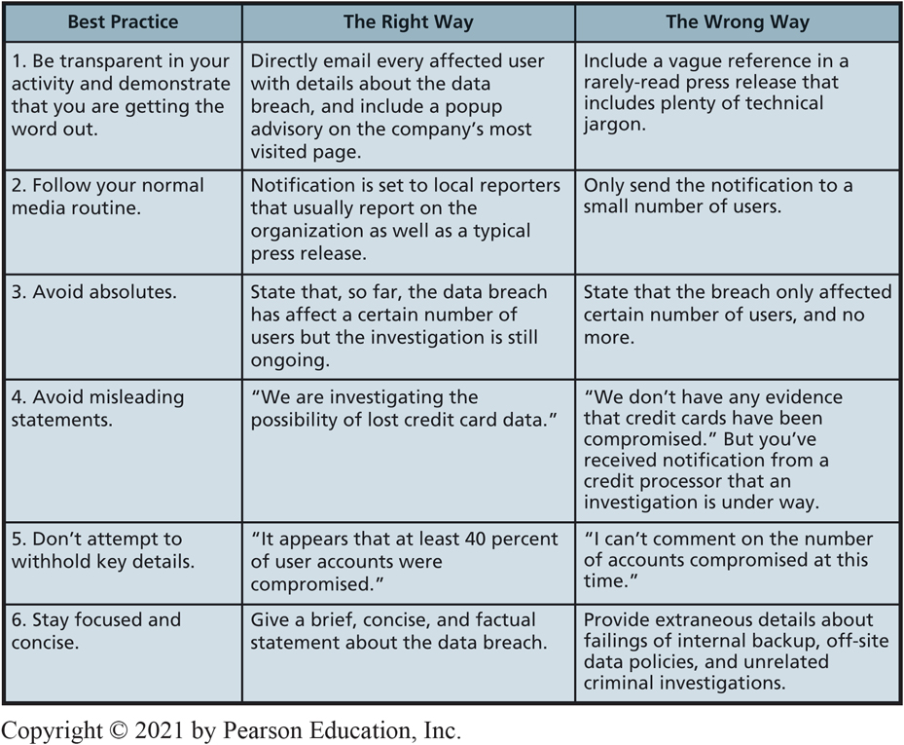
Best Practices for Notifying Users of a Data Breach
CE 14-3 How should organizations respond to data breaches?
Figure C E 14-3 Best Practices for Notifying Users of a Data Breach

Slide 17
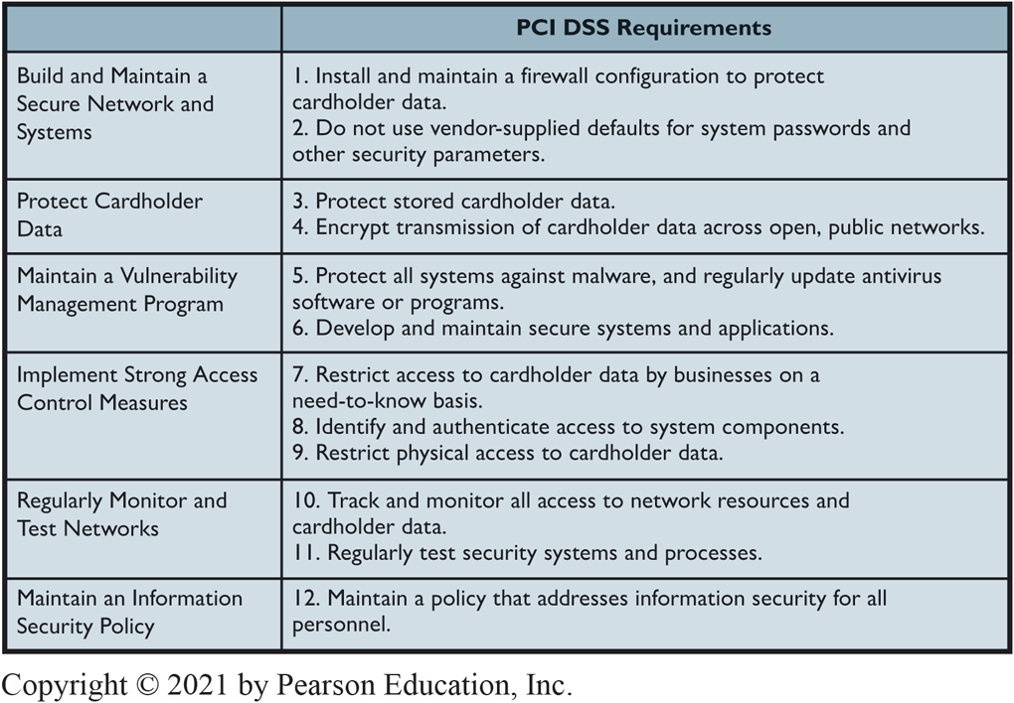
P C I D S S Standards
CE 14-4 What are the legal consequences of a data breach?
Figure C E 14-4 P C I D S S Standards

Slide 18
Regulatory Laws Govern the Secure Storage of Data in Certain Industries
CE 14-4 What are the legal consequences of a data breach?
Federal Information Security Management Act (F I S M A)
Requires security precautions for government agencies
Gramm-Leach-Bliley Act (G L B A), a.k.a., Financial Services Modernization Act
Requires data protection for financial institutions
Health Information Portability and Accountability Act (H I P A A)
Requires data protection for healthcare institutions
Payment Card Industry Data Security Standard (P C I D S S)
Governs secure storage of cardholder data
Family Educational Rights and Privacy Act (F E R P A)
Provides protection for student education records

Slide 19
Preventing Data Breaches (1 of 2)
CE 14-5 How can data breaches be prevented?
Use countermeasures software or procedures to prevent an attack
Better phishing detection software
Better authentication (i.e., multifactor authentication)
Network intrusion detection system (N I D S) to examine traffic passing through internal network
Data loss prevention systems (D L P) to prevent sensitive data from being released to unauthorized persons

Slide 20
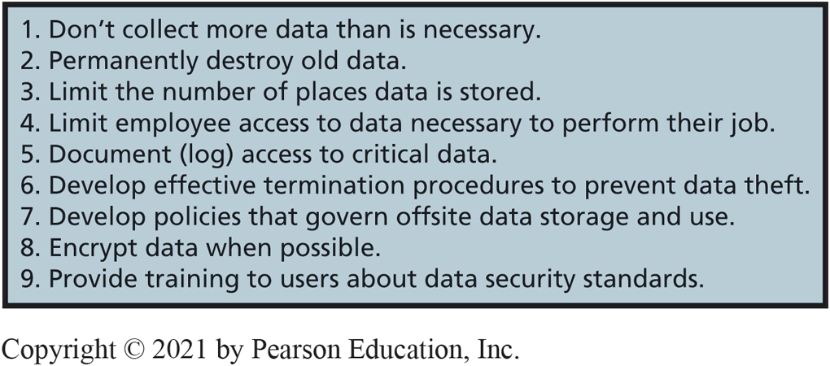
Preventing Data Breaches (2 of 2)
CE 14-5 How can data breaches be prevented?
Figure C E 14-5 Suggestions for Preventing Data Loss

Slide 21
Your Role in IS Security
14-6 What is your role in I S security?
The security of every system depends on the behavior of its users.
If the people component of an IS does not follow the security procedures component, then the quality of the HW, SW, and data security components is meaningless.
Usernames and passwords are the first line of defense for most information systems.
Proper password creation and protection measures are vital.
Notes:
One technique for creating memorable, strong passwords is to base them on the first letter of the words in a phrase.

Slide 22
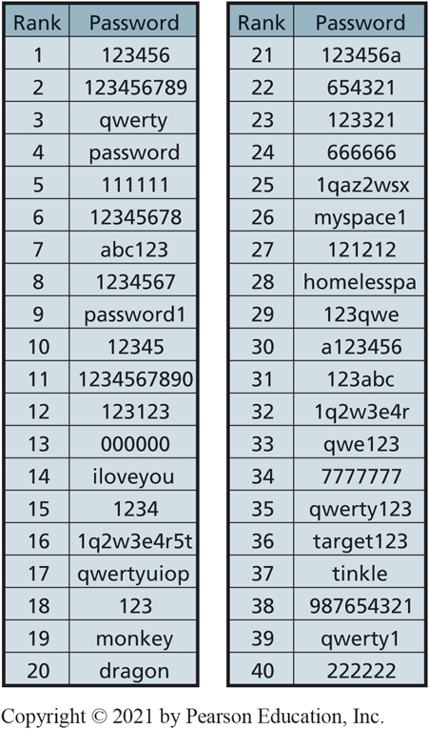
Common (Weak) Passwords
CE14-6 What is your role in I S security?
Figure C E 14-6 The Most Commonly Used Weak Passwords

Slide 23
Passwords and Password Etiquette (1 of 2)
CE14-6 What is your role in I S security?
12+ characters.
Does not contain your username, real name, or company name.
Does not contain a complete dictionary word in any language.
Different from previous passwords used.
Contains both upper- and lowercase letters, numbers, and special characters (such as ˜ ! @; # $ % ^; &; * ( ) _ +; – =; { } | [ ] \ : “ ; ’ <; >;? , . /)
Notes:
One technique for creating memorable, strong passwords is to base them on the first letter of the words in a phrase.

Slide 24
Passwords and Password Etiquette (2 of 2)
CE14-6 What is your role in I S security?
Never write down your password.
Never ask someone for their password.
Never give your password to someone.
“do-si-do” move—move away so another person can enter password privately
Common professional practice.
Notes:
You are a protector of your employer's information system, customer, supplier, and your personal data.

Slide 25
Active Review
CE 14-1 What is a data breach?
CE 14-2 How do data breaches happen?
CE 14-3 How should organizations respond to data breaches?
CE 14-4 What are the legal consequences of a data breach?
CE 14-5 How can data breaches be prevented?
CE14-6 What is your role in IS Security?

Slide 26

Copyright

