Slide 1

Experiencing M I S
Ninth Edition
Chapter Extension 15
International MIS
Slides in this presentation contain hyperlinks. JAWS users should be able to get a list of links by using INSERT+F7
Copyright © 2021, 2019, 2017 Pearson Education, Inc. All Rights Reserved
Notes:
If this PowerPoint presentation contains mathematical equations, you may need to check that your computer has the following installed:
1) MathType Plugin
2) Math Player (free versions available)
3) NVDA Reader (free versions available)
Chapter 11 provides the background for this extension.

Slide 2
Study Questions
CE 15-1 How does the global economy affect organizations and processes?
CE 15-2 What are the characteristics of international I S components?
CE 15-3 How do inter-enterprise I S facilitate globalization?
CE 15-4 What are the security challenges of international I S?
CE 15-5 What are the challenges of international I S management?

Slide 3
The Growing Global Economy
CE 15-1 How does the global economy affect organizations and processes?
After World War II, Japanese and other Asian countries increased manufacturing.
Fall of Soviet Union opened economies of Russia, Eastern Europe.
N. American and European economies integrated.
Plentiful, cheap telecommunications after dot.com bubble burst.
Booming economies: India, China.
Notes:
After World War II, Japanese and other Asian countries began to manufacture and sell goods to the West.
Rise of Japanese auto and semiconductor industries greatly expanded international trade.
Chinese economy became more open to the world.

Slide 4
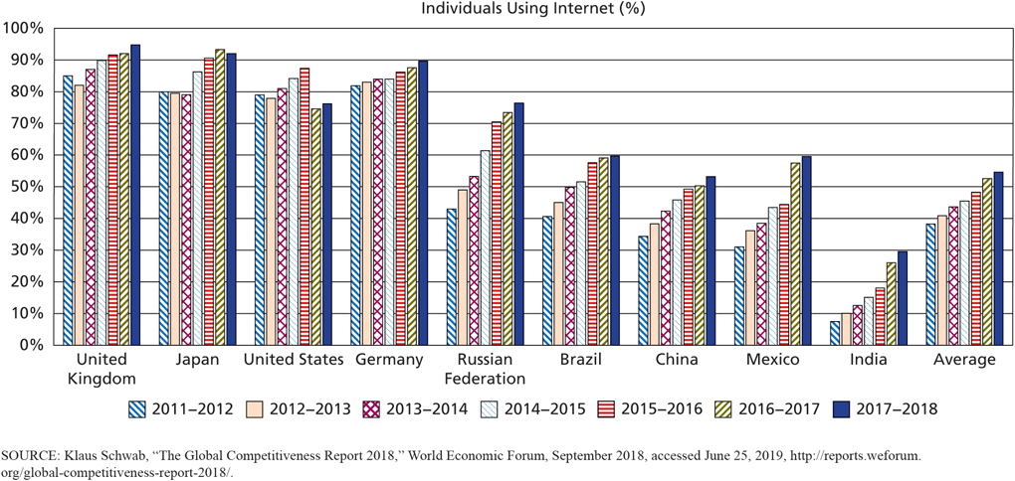
Growth in Internet Access
CE 15-1 How does the global economy affect organizations and processes?
Figure C E 15-1 Growth in Internet Access

Slide 5
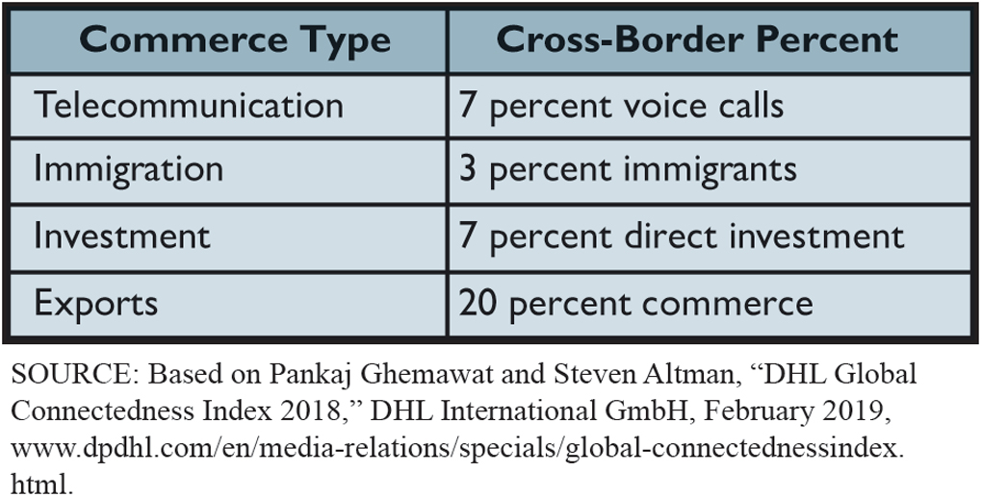
Percent of Cross‐Border Commerce: Opportunities Abounds
CE 15-1 How does the global economy affect organizations and processes?
Figure C E 15-2 Percent of Cross-Border Commerce
Notes:
As Web services become more widespread, it becomes easier to link information systems together. As mobile devices continue their exploding growth in developing countries, even more users will enter the world economy via the Internet. And as collaboration tools become more powerful, it becomes possible to provide services as well as products on the international stage.

Slide 6
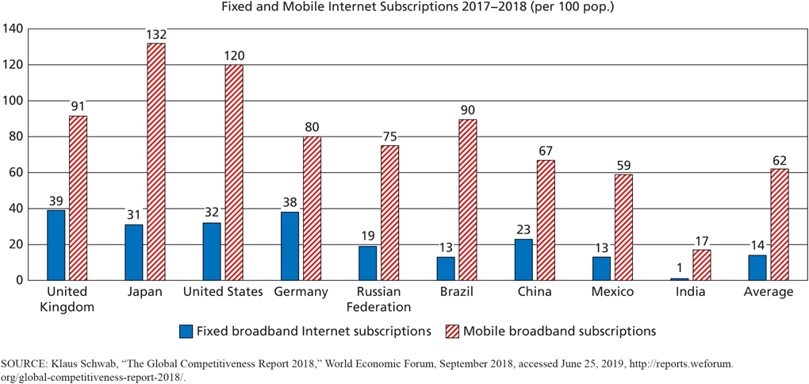
How Does the Global Economy Change the Competitive Environment?
CE 15-1 How does the global economy affect organizations and processes?
Figure C E 15-3 Fixed and Mobile Internet Subscriptions
Notes:
The enlarging Internet-supported world economy has altered every one of the five competitive forces.

Slide 7
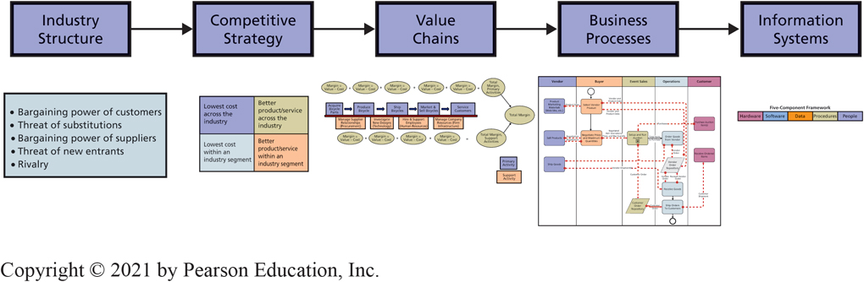
Organizational Strategy Determines Information Systems
CE 15-1 How does the global economy affect organizations and processes?
Figure C E 15-4 Organizational Strategy Determines Information Systems
Notes:
The enlarging Internet-supported world economy has altered every one of the five competitive forces.

Slide 8
Director, Asian Operations
Career Guide
Abraham Chung at Mainstream Data, Inc.
Q. What attracted you to this field?
A. “While I was working on my M B A, I took a class taught by an M I S professor with lots of charisma and a great teaching style. My undergrad major in library and information science from National Taiwan University was also closely related to the field.”
Q. What does a typical workday look like for you (duties, decisions, problems)?
A. “I communicate with people throughout the day, including customers, prospects, colleagues, and developers. My purpose is to grow our presence in Asia. I do that by learning industry trends, identifying prospects, conducting online and in-person meetings, creating proposals, and managing projects and customer relationships.”

Slide 9
How Does the Emerging Global Economy Change Competitive Strategy?
CE 15-1 How does the global economy affect organizations and processes?
Product localization and product differentiation.
Accelerates flow of data about price, product, availability, service.
Products localized to language and culture.
Internet supports unprecedented market size and product differentiation.
Notes:
Internet-supported world economy has altered every one of five competitive forces.
Suppliers can reach wider range of customers, and customers can consider wider range of vendors.
Suppliers and customers benefit from greater size of the economy and easy access to data about direct competitors, new entrants and substitute businesses.

Slide 10
How Does the Global Economy Change Value Chains and Business Processes?
CE 15-1 How does the global economy affect organizations and processes?
Value chain activities can be performed anywhere.
Final product frequently distributed throughout world.
Abundance of low-cost, well-educated, English-speaking professionals allows outsourcing service and support functions.
Ability to work 24/7 by moving work into other time zones increases productivity.

Slide 11
International I S Components
CE 15-2 What are the characteristics of international I S components?
Hardware — sold worldwide.
Emergence of the international cloud.
Software — in multiple, local languages.
Data — choosing language(s) for data descriptions and remarks.
Procedures — reflect local cultural values and norms.
People — job descriptions and reporting relationships appropriate to culture.

Slide 12
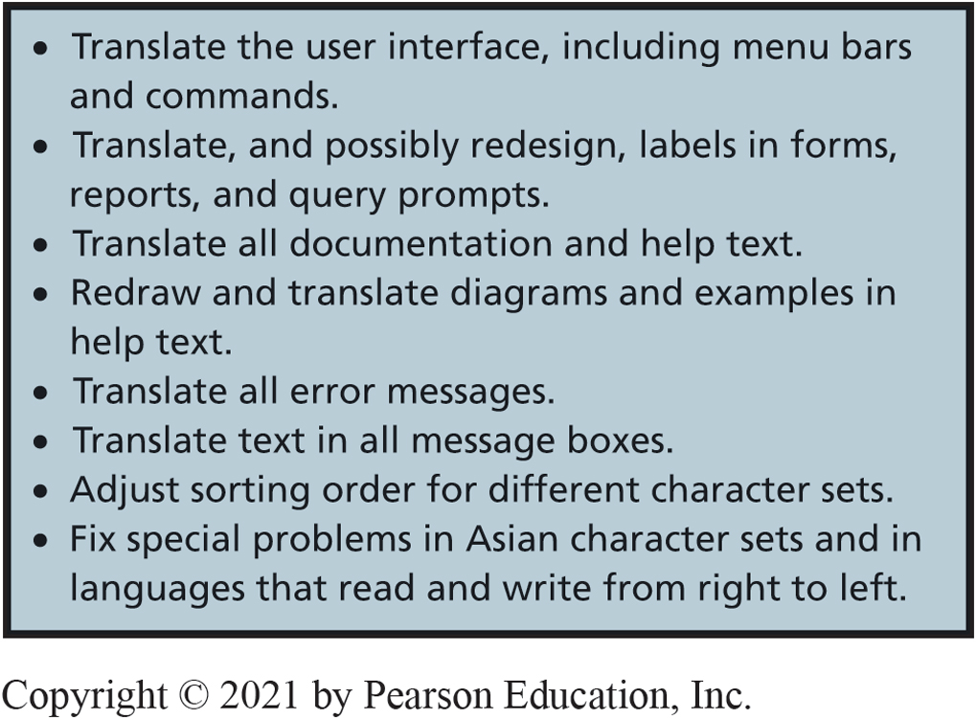
What’s Required to Localize Software? (1 of 2)
CE 15-2 What are the characteristics of international I S components?
Figure C E 15-5 Factors to Address When Localizing a Computer Program
Notes:
Localizing software is surprisingly hard to do. To localize a document or the content of a Web page, all you need to do is hire a translator to convert your document or page from one language to another. The situation is much more difficult for a computer program.

Slide 13
What’s Required to Localize Software? (2 of 2)
CE 15-2 What are the characteristics of international I S components?
Localizing programs difficult, expensive, and time consuming than translating documents.
Programming techniques can be used to simplify and reduce the cost of localization.
Design for localization, long before any code written.
Acquisition of foreign company, budget time and expense for localization of information systems.

Slide 14
I B M’s Watson Learns Korean
CE 15-2 What are the characteristics of international I S components?
Wants to use Watson to improve mobile concierge services and call center interactions.
Korean language uses different characters (Hangul) and, relative to English, can be contextually difficult to decipher.
Processes some text in Korean, gets feedback from humans who speak Korean, then processes more text until it learns to speak Korean.
Other languages to be learned.
Notes:
Good example of the inherent problems with localization can be seen in the recent partnership between IBM and the large Korean IT services provider SK Holdings C&C. SK C&C wants to use IBM’s Watson, an artificial intelligence platform able to answer questions using a person’s natural language, to improve mobile concierge services and call center interactions. In order to do this, Watson has started learning Korean.

Slide 15
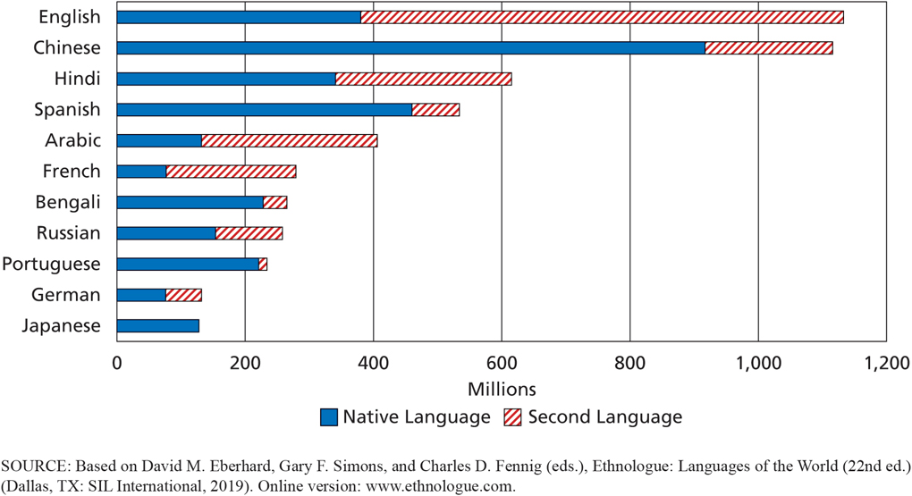
Spoken World Languages
CE 15-2 What are the characteristics of international I S components?
Figure C E 15-6 Spoken World Languages

Slide 16
What Are the Problems and Issues of Global Databases?
CE 15-2 What are the characteristics of international I S components?
Commit to single company language.
Single database not possible for companies using multiple languages.
Need applications to export and import data among separated databases.
Slow data transmission speeds may require distributed, partitioned databases and highly skilled personnel.
Notes:
Companies often decide to give up on benefits of a single database to let divisions in different countries use different databases, with data in local languages. These companies need applications to export and import data among separated databases.
Companies sometimes distribute their database in locations around world when data transmission speeds are too slow to process data from a single geographic location.

Slide 17
Types of Distributed Database Processing
CE 15-2 What are the characteristics of international I S components?
Distributed database
Single database resides in multiple locations.
Replicated database
Multiple copies of a database distributed.
Updating requires highly skilled personnel.
Partitioned database
Database divided into non-overlapping segments.
Notes:
Querying replicated and partitioned database can improve performance without too much development work.
Updating a replicated database, so changes are correctly made to all copies of the data, is full of challenges that require highly skilled personnel to solve.

Slide 18
Challenges of International Enterprise Applications
CE 15-2 What are the characteristics of international I S components?
Independent Functional Systems and Inherent Processes.
Independent Functional Systems | Inherent Processes
Unnecessary to accommodate language, business, and cultural differences | Differences in language, culture, norms, and expectations
Requires adequate data interface | Developing and evaluating “as is” models and alternative international processes incredibly challenging
Integrated, cross-functional, international system with high-level processes connected by S O A standards and the cloud
Notes:
Because of these challenges, it is likely that international business processes will be developed more like inter-enterprise business processes. A high-level process will be defined to document the service responsibilities of each international unit. The cloud and Internet standards (such as SOA) will connect those services into an integrated, enterprise, international system. The only obligation of an international unit will be to deliver its defined service.

Slide 19
Advantages of Functional Systems
CE 15-2 What are the characteristics of international I S components?
Lack of integration has advantages for international organizations and international systems.
U.S. order-processing systems operate in English, reflect practices and culture of U.S.
Taiwanese manufacturing information systems operate in Chinese and reflect business practices and culture of Taiwan.
Need adequate data interface between two systems.
Notes:
An order-processing system located in United States is independent of manufacturing systems located in other countries, it is unnecessary to accommodate language, business, and cultural differences in a single system.

Slide 20
Problems of Inherent Processes
CE 15-2 What are the characteristics of international I S components?
Some inherent processes may conflict with cultural norms.
Difficult to convince employees to follow inherent processes, more difficult in some cultures.
Future inter-enterprise business processes defined to document service responsibilities of each international unit.
The cloud and Web service standards used to connect services into an integrated, enterprise, international system.

Slide 21
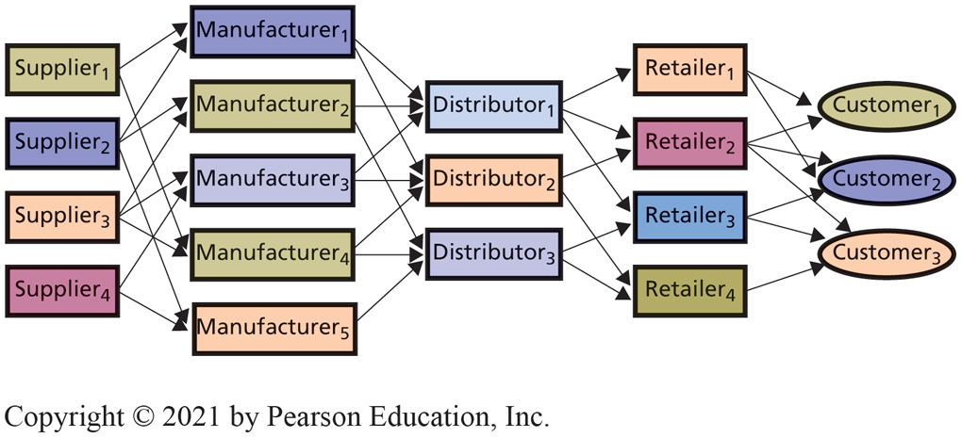
Supply Chain Relationships
CE 15-3 How do inter-enterprise I S facilitate globalization?
Supply Chain Relationships
Notes:
A supply chain is a network of organizations and facilities that transforms raw materials into products delivered to customers.
Primarily, supply chain and manufacturing systems.
At some point, social media systems may have a positive effect as well.

Slide 22
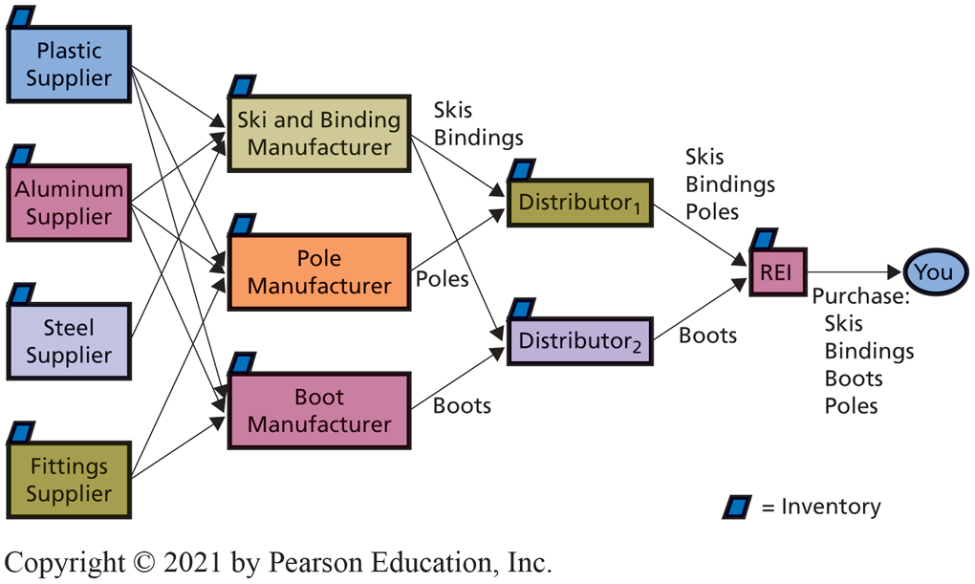
Supply Chain Example
CE 15-3 How do inter-enterprise I S facilitate globalization?
Supply Chain Example
Notes:
To appreciate the international dimension of a supply chain consider the figure above.
The only source of revenue in a supply chain is the customer. In the REI example, you spend your money on the ski equipment. From that point all the way back up the supply chain to the raw materials suppliers, there is no further injection of cash into the system.

Slide 23
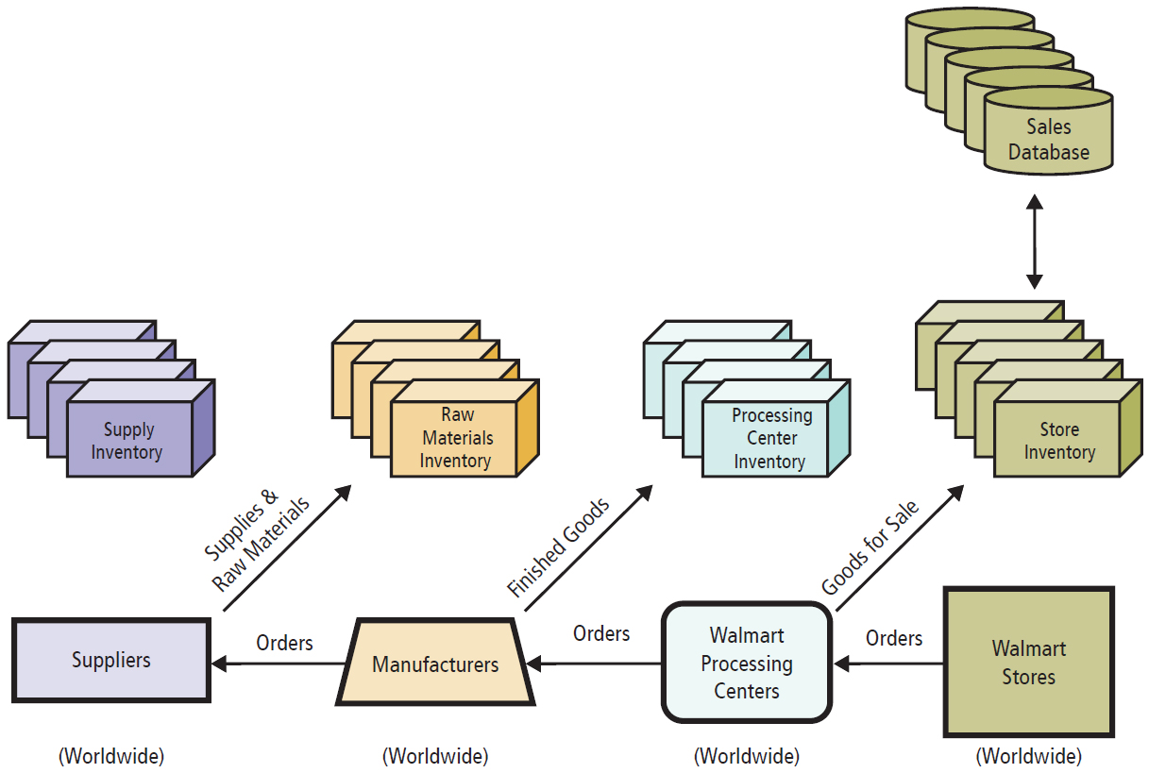
The Importance of Information in the Walmart Supply Chain (1 of 2)
CE 15-3 How do inter-enterprise I S facilitate globalization?
Example Walmart Supply Chain
Notes:
Walmart overhauled its supply chain to eliminate distributors and other intermediaries, enabling it to buy directly from manufacturers.
Also, it consolidated purchasing and warehousing into four global merchandising centers, such as the one near Mexico City that processes goods for emerging markets.

Slide 24
The Importance of Information in the Walmart Supply Chain (2 of 2)
CE 15-3 How do inter-enterprise I S facilitate globalization?
Global information systems increase supply chain profitability by:
Reducing inventories.
Reducing or eliminating bullwhip effect.
Producing comprehensive, accurate, timely information.
Choosing delivery option that optimize value.
Enabling 24/7 global shipment tracking.

Slide 25
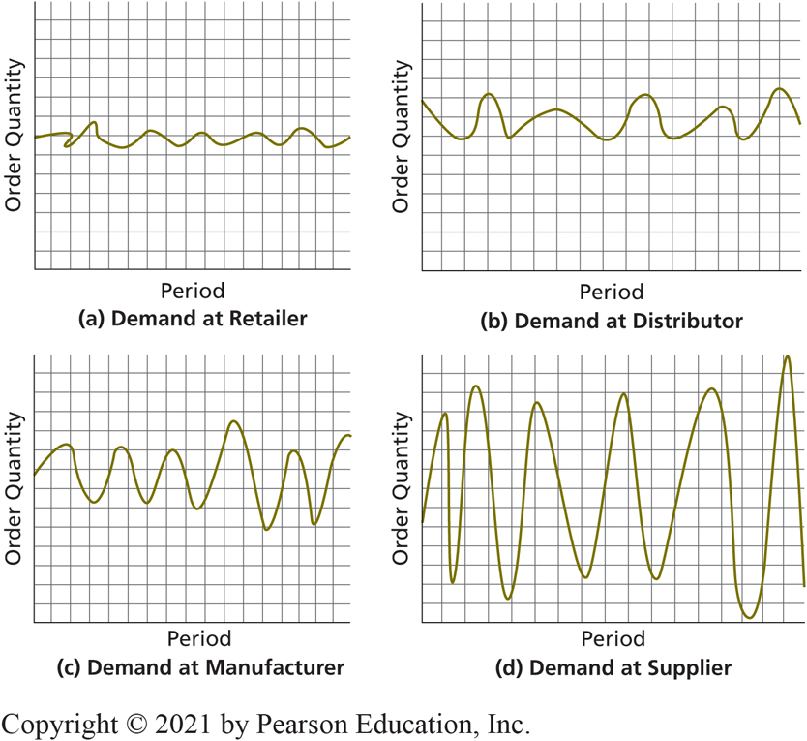
How Can Information Relieve the Bullwhip Effect?
CE 15-3 How do inter-enterprise I S facilitate globalization?
P & G supply chain for diapers
Bullwhip effect
Variability in the size and timing of orders increases at each stage up the supply chain, from customer to supplier.
The Bullwhip Effect
Notes:
The bullwhip effect is a phenomenon in which the variability in the size and timing of orders increases at each stage up the supply chain, from customer to supplier. Procter & Gamble’s supply chain for diapers.

Slide 26
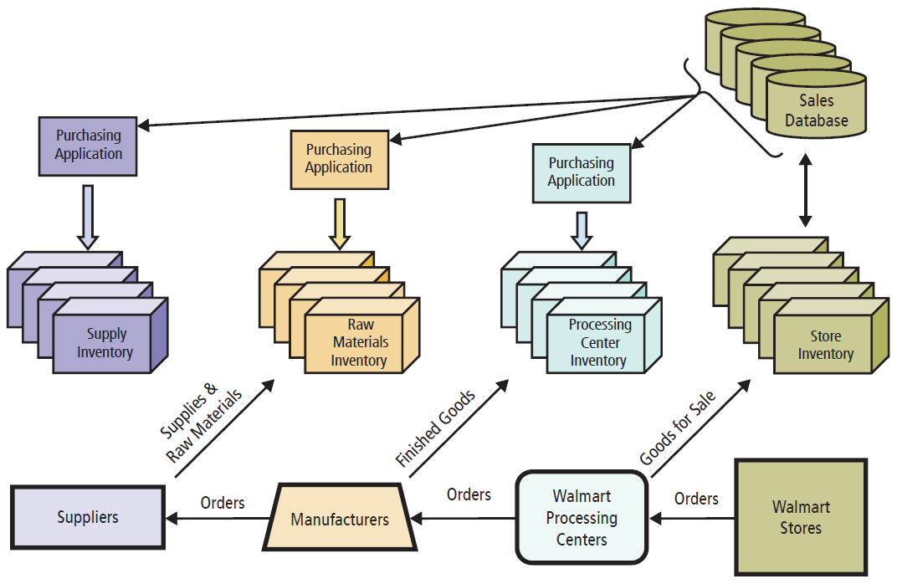
Eliminate Bullwhip Effect with True Demand Information
CE 15-3 How do inter-enterprise I S facilitate globalization?
Eliminating the Bullwhip Effect with True Demand Information
Notes:
Data about true demand will enable each entity to meet order requirements, while maintaining a smaller inventory.

Slide 27
The Legal Environment
CE 15-4 What are the security challenges of international I S?
Legal Environment
Encryption illegal or highly restricted in many countries.
Censorship problems with stored content.
Dozens of countries regularly block access to certain Internet companies.
Privacy laws vary significantly. (“Right to be forgotten.”)
General Data Protection Regulation (GDPU) passed by EU strongly impacts international companies
Intersection of international law and technology forces evaluation how information systems managed and location of data.
Notes:
Right to be forgotten: Individuals can request references of them to be removed from search results.
Consider how these laws might affect organizations that use cloud-based services to store data. Organizations could operate in a country with loose content laws and then store all of their data and applications in another country with stricter privacy laws in order to protect their users. In other words, the intersection of international law and technology is forcing organizations to carefully evaluate how they manage their information systems, in particular, the location of their data.

Slide 28
Security Challenges of International I S? (1 of 2)
CE 15-4 What are the security challenges of international I S?
Physical Security
Threats to infrastructure from natural disasters, geopolitical risks, civil unrest, terrorist attacks.
Physical infrastructure vulnerable to outright seizure.
Employees who run critical infrastructure can be targeted.
Notes:
International data centers may be more subject to typhoons, hurricanes, earthquakes, floods, volcanic eruption, mudslides, or epidemics that affect data center employees.
What is the likelihood that a computer programmer in India will insert a Trojan horse into code that she writes on an outsourcing contract?
Multitude of cultures, religions, nations, beliefs, political views, and crazy people in the world, uncertainty about risks to IS and IT infrastructure is high.
In short, risk management for both international information systems and IT infrastructure is more complicated, more difficult, and subject to greater uncertainty.

Slide 29
Security Challenges of International I S? (2 of 2)
CE 15-4 What are the security challenges of international I S?
Cultural Norms
Bribery in some countries expected.
Graft a worldwide problem.
Risks control of separation of duties and authorities.
Risk loss of valuable intellectual property.
Personal references: may be considered exceedingly rude to talk about someone when he or she is not present.

Slide 30
Challenges of International I S Management
CE 15-5 What are the challenges of international I S management?
Challenges of International I S Management
International information systems larger, more complex
International I S depts. bigger, more cultures, languages
More I S assets, risks, greater uncertainty
Complex international law, security incidents complicated to investigate
Notes:
Size and complexity make international IS management challenging.
Projects to develop them are larger and more complicated to manage.
International IS departments are bigger and composed of people from many cultures with many different native languages.
International organizations have more IS assets, and those assets are exposed to more risk and greater uncertainty. Because of the complexity of international law, security incidents are more complicated to investigate.

Slide 31
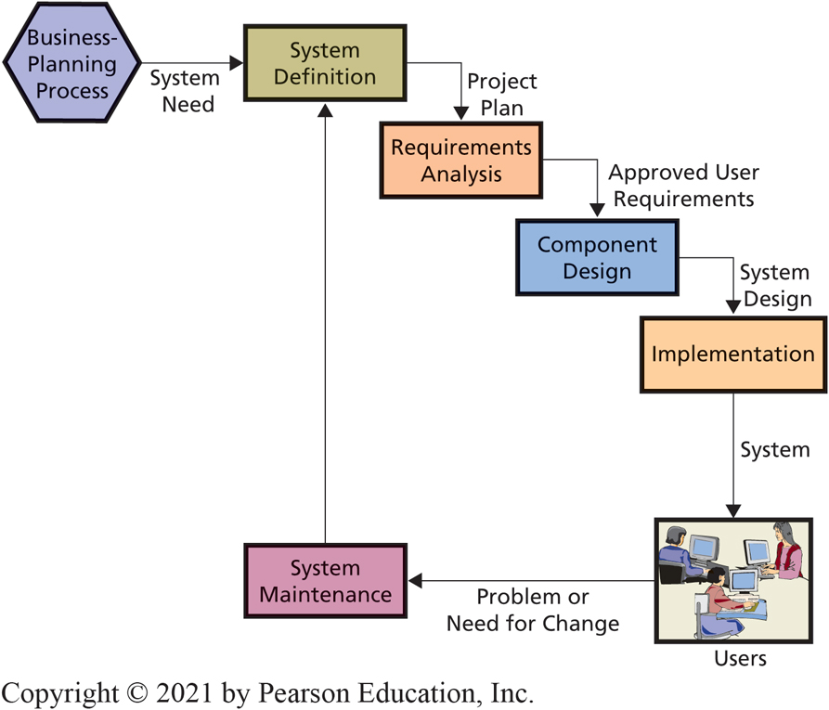
Why Is International Information Systems Development More Challenging?
CE 15-5 What are the challenges of international I S management?
Figure C E 15-7 Phases in the S D L C
Notes:
Consider the phases of the SDLC as shown in Figure CE15-7. During system definition, we are supposed to determine the purpose and scope of the system. As you know by now, information systems should facilitate the organization’s competitive strategy by supporting business processes. But what if the underlying processes differ? Again, customer support in Japan and customer support in Spain may involve completely different processes and activities.

Slide 32
Why Is International I S Development More Challenging? (1 of 3)
CE 15-5 What are the challenges of international I S management?
Hardware
Running hardware in different countries not a problem, especially using the cloud.
Software
Localizing software manageable, assuming programs designed to be localized.
If underlying business processes differ, requirements for information system will differ.
Notes:
To see why, consider the five components.
Running hardware in different countries is not a problem, and localizing software is manageable, assuming programs were designed to be localized. Databases pose more difficulties.
An international system is used by people who live and work in cultures that are vastly different from one another. The way that customers are treated in Japan differs substantially from the way that customers are treated in Spain, which differs substantially from the way that customers are treated in the United States. The procedures for using a CRM will be correspondingly different.
If the underlying business processes differ, the specific requirements for the information system will differ. Managing requirements for a system in one culture is difficult, but managing requirements for international systems can be many times more difficult.

Slide 33
Why Is International I S Development More Challenging? (2 of 3)
CE 15-5 What are the challenges of international I S management?
Data
Databases pose more difficulties.
Single database used, can it be distributed?
If so, how will updates be processed? What language, currency, and units of measure will be used to store data? If multiple databases used, how will data be transported among them?
Cloud-based databases reduces difficulties.

Slide 34
Why Is International I S Development More Challenging? (3 of 3)
CE 15-5 What are the challenges of international I S management?
Procedures
Customers in different countries treated differently than in U.S.
C R M procedures different.
Specific requirements will differ, if underlying business processes differ.
Options
Define single set of standard business processes.
Develop alternative versions of system to support different processes in different countries.

Slide 35
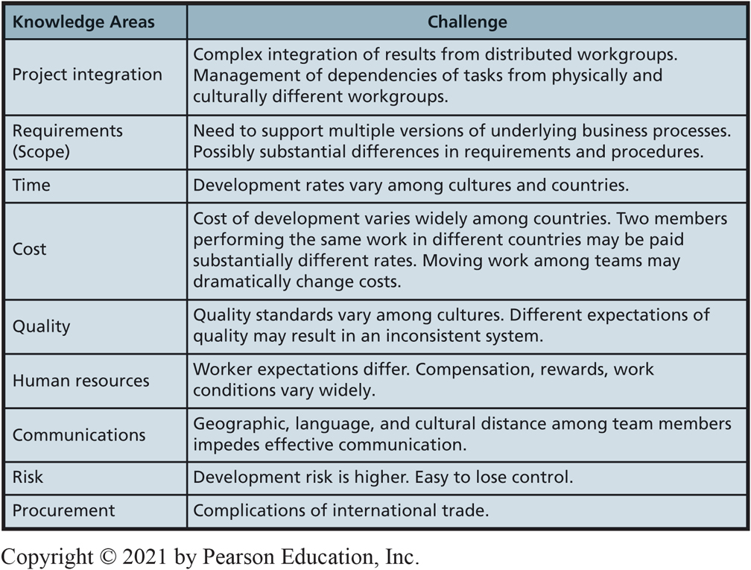
What Are the Challenges of International Project Management? (1 of 2)
CE 15-5 What are the challenges of international I S management?
Figure C E 15-8 Challenges for International I S Project Management
Notes:
This figure summarizes challenges for each knowledge area.
Many things can go wrong. Project integration is complex; requirements are difficult to determine; cost, time, and quality are difficult to manage; worker conditions vary widely; and communication is difficult. Finally, project procurement is complicated by the normal challenges of international commerce.

Slide 36
What Are the Challenges of International Project Management? (2 of 2)
CE 15-5 What are the challenges of international I S management?
Managing costs in different countries and cultures paying vastly different labor rates.
Quality and human resources more complicated for international projects. Quality standards vary.
Worker expectations vary among cultures and nations.
Compensation, rewards, and work conditions vary.
Can lead to misunderstandings, poor morale, and project delays.
Language and culture differences and geographic separation make communication more difficult and expensive.

Slide 37
What Are the Challenges of International I S Management?
CE 15-5 What are the challenges of international I S management?
Conducting operations in different countries, cultures, and languages adds complexity.
Dozens of different inventory systems used throughout the world to coordinate and integrate.
Information systems to be integrated with outsource vendors’ information systems, for different systems, all over the world.
Protecting I S and I T infrastructure.
Notes:
Chapter 11 defined the four primary responsibilities of the IT department:
Plan, operate, develop, protect information systems and IT infrastructure
Each of these responsibilities becomes more challenging for international IT organizations.

Slide 38
Active Review
CE 15-1 How does the global economy affect organizations and processes?
CE 15-2 What are the characteristics of international I S components?
CE 15-3 How do inter-enterprise I S facilitate globalization?
CE 15-4 What are the security challenges of international I S?
CE 15-5 What are the challenges of international I S management?

Slide 39

Copyright

