Slide 1

Experiencing M I S
Ninth Edition
Chapter Extension 16
Systems Development Project Management
Slides in this presentation contain hyperlinks. JAWS users should be able to get a list of links by using INSERT+F7
Copyright © 2021, 2019, 2017 Pearson Education, Inc. All Rights Reserved
Notes:
If this PowerPoint presentation contains mathematical equations, you may need to check that your computer has the following installed:
1) MathType Plugin
2) Math Player (free versions available)
3) NVDA Reader (free versions available)

Slide 2
Study Questions
CE 16-1 Why is formalized project management necessary?
CE 16-2 What are the trade-offs in requirements, cost, and time?
CE 16-3 What are the dimensions of project management?
CE 16-4 How does a work breakdown structure drive project management?
CE 16-5 What is the biggest challenge for planning a systems development project?
CE 16-6 What are the biggest challenges for managing a systems development project?
CE 16-7 What is the single most important task for users on a systems development project?
Notes:
This chapter extension addresses the major components of IS project management. It begins with a discussion of IS project management by discussing project trade-offs.

Slide 3
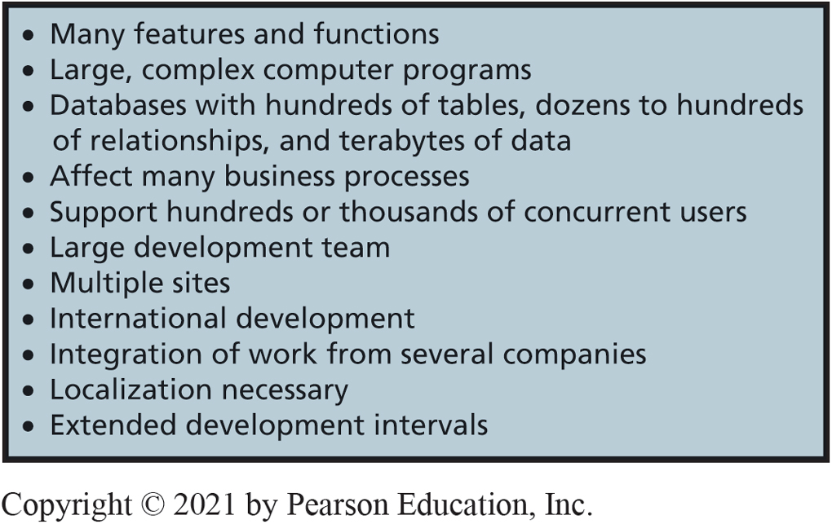
Characteristics of Large-Scale Systems Development Projects
CE 16-1 Why is formalized project management necessary?
Figure C E 16-1 Characteristics of Large-Scale Systems Development Projects
Notes:
The Internal Revenue Service provides a good example of a large-scale IS project. The IRS employs more than 115,000 people in 1,000 different sites and processes over 250 million tax returns a year. Starting in 1995, it set out to modernize the information systems for processing tax returns. Today, more than 20 years and several billion dollars later, it has not completed that project.

Slide 4
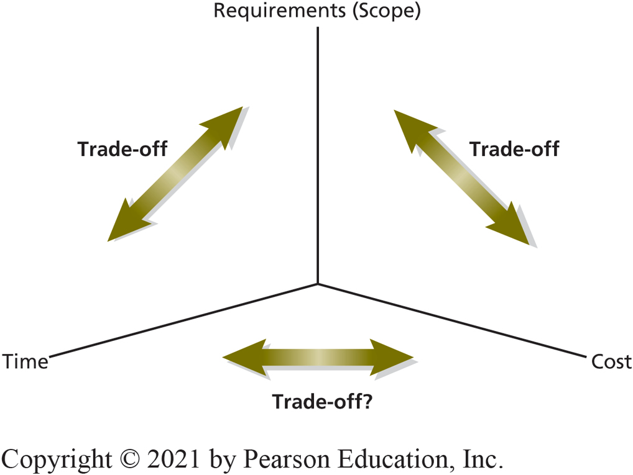
Primary Drivers of Systems Development
CE 16-2 What are the trade-offs in requirements, cost, and time?
Figure C E 16-2 Primary Drivers of Systems Development
Notes:
Systems development projects require the balancing of three critical drivers: requirements (scope), cost , and time.
We can trade off requirements against time and against cost. If we make the necklace simpler, it will take less time. If we eliminate the diamonds and gems, it will be cheaper.
Relationship between time and cost is more complicated. Normally, we can reduce time by increasing cost, but only to a point, because of diseconomies of scale.
Adding more time could decrease or increase cost.

Slide 5
Baseline Plan (1 of 2)
CE 16-2 What are the trade-offs in requirements, cost, and time?
Stipulates:
Tasks to be accomplished
Resources (human and materials) assigned to tasks
Schedule for completion of each task

Slide 6
Baseline Plan (2 of 2)
CE 16-2 What are the trade-offs in requirements, cost, and time?
Things never go according to plan
Requires trade-offs between requirements, costs, and time
Critical people leave
Hiring freezes
Natural disasters
Competitor actions
Technology changes
New management

Slide 7
Dimensions of Project Management (1 of 2)
CE 16-3 What are the dimensions of project management?
Formalized project management for large projects
Project Management Institute (P M I) best practices, processes, techniques
International organization
Endorsed by A N S I and I S O
Project Management Professional (P M P) certification
P M B O K® (Project Management Body of Knowledge) Guide for Project Management
Notes:
The process promoted by Project Management Institute (PMI) has achieved prominence.
PMI publishes project management documents and offers project management training. It offers Project Management Professional (PMP) certification. Professionals who have 4,500 hours of project work experience can earn certification by passing PMI’s examination.

Slide 8
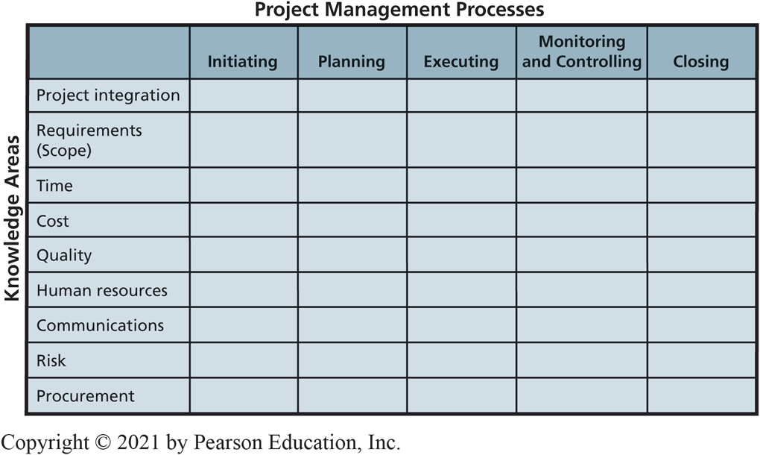
Dimensions of Project Management (2 of 2)
CE 16-3 What are the dimensions of project management?
Figure C E 16-3 Dimensions of Project Management
Notes:
PMBOK Guide is organized into five process groups and nine knowledge areas. Process groups refer to five different stages in the life of a project; nine knowledge areas refer to factors to be managed throughout life of the project.

Slide 9
Work Breakdown Structure Drives Project Management
CE 16-4 How does a work breakdown structure drive project management?
Work breakdown structure (W B S)
Hierarchy of tasks
Tasks end with deliverables
Documents, designs, prototypes, data models, database designs, working data-entry screens, etc.
Identifies task dependencies
Estimated task duration, cost, labor needed
Created with project management software, such as Microsoft Project
Notes:
Key strategy for large-scale systems development is to divide and conquer. Break up large tasks into smaller tasks and continue breaking up the tasks until they are small enough to manage, thus enabling you to estimate time and costs.

Slide 10
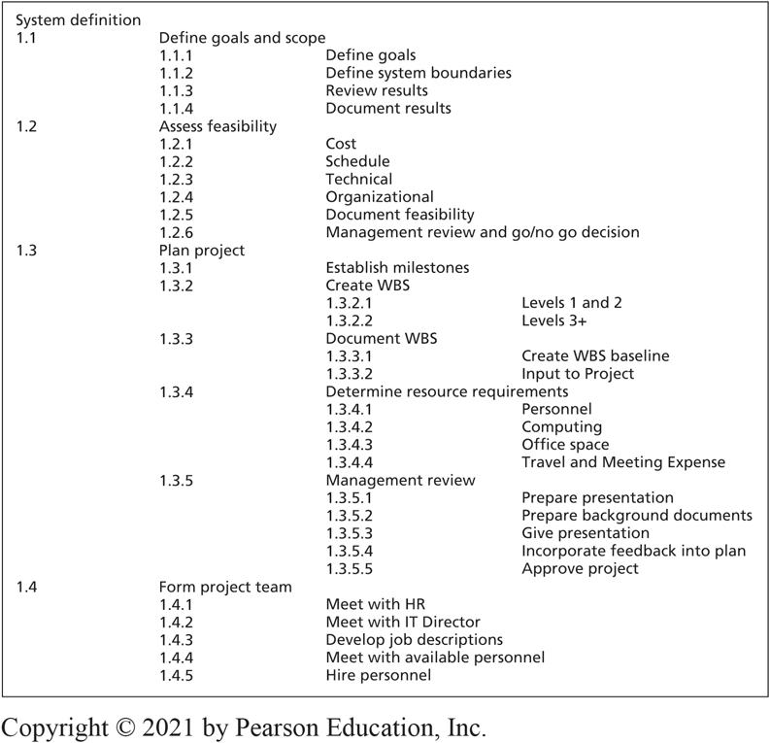
Sample Work Breakdown Structure (W B S)
CE 16-4 How does a work breakdown structure drive project management?
Figure C E 16-4 Sample Work Breakdown Structure (W B S)
Notes:
Note the term “scope” is used in two different ways. As used in this WBS example, scope means to define system boundaries, which is how it is used in SDLC. As noted in CE16-3, scope for PMBOK Guide means to define the requirements.

Slide 11
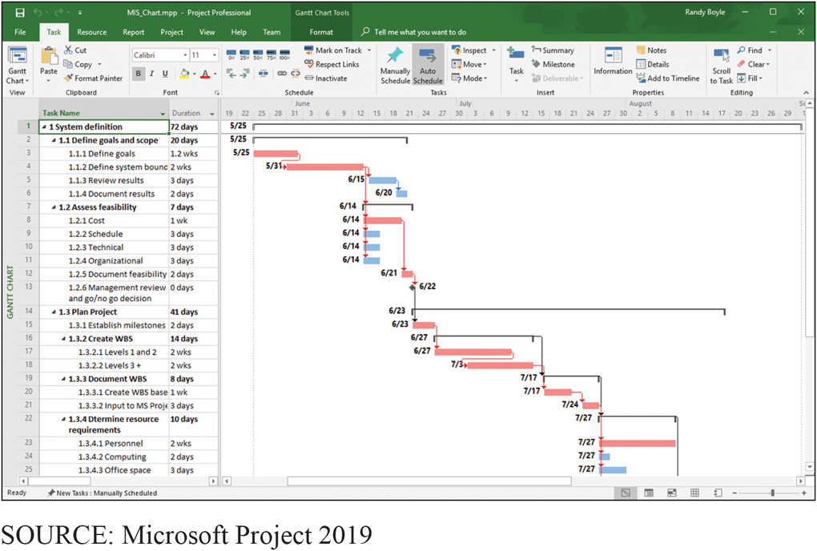
Gantt Chart of W B S for Definition Phase of a Project
CE 16-4 How does a work breakdown structure drive project management?
Figure C E 16-5 Gantt Chart of W B S for Definition Phase of a Project
Notes:
Gantt chart, shows tasks, dates, and dependencies.
Critical path is a sequence of activities that determine earliest date the project can be completed.

Slide 12
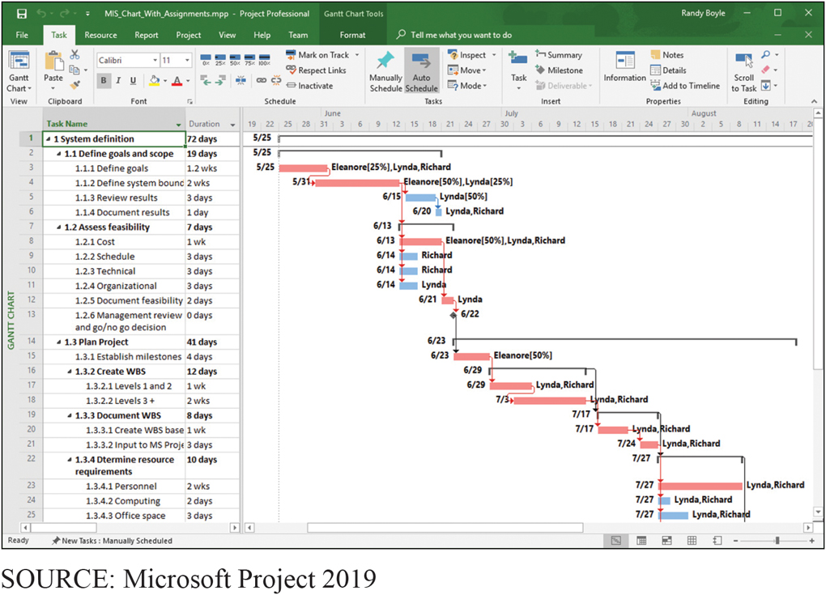
Gantt Chart with Resources Assigned
CE 16-4 How does a work breakdown structure drive project management?
Figure C E 16-6 Gantt Chart with Resources Assigned
Notes:
Using Microsoft Project or a similar product, it is possible to assign personnel to tasks and to stipulate the percentage of time that each person devotes to a task.
Final WBS plan is denoted in the baseline.
WBS is the single most important management tool for large-scale projects.

Slide 13
Challenges for Planning a Large-Scale Systems Development Project
CE 16-5 What is the biggest challenge for planning a systems development project?
Biggest challenge is scheduling
How long does it take to:
Develop a large data model?
Adapt data model to user satisfaction?
Develop a computer program?
Scheduling errors accumulate (e.g., snowball)
Difficult to do credible planning
Every task may be on critical path
Notes:
How long does it take to develop a computer program to process PRIDE privacy data on a cloud server? If no one on the team has developed a cloud-based server application before, how do you predict?

Slide 14
Three Approaches to This Challenge
CE 16-5 What is the biggest challenge for planning a systems development project?
Avoid major schedule risks and only license software from vendors
Admit impossibility of systems development scheduling and plan accordingly
Attempt to schedule development project despite difficulties

Slide 15
Estimation Techniques
CE 16-5 What is the biggest challenge for planning a systems development project?
Estimate using past projects as a guide
Estimate lines of code to be written
Use industry or company averages to estimate time required
Estimate function points in a program, determine number of lines of code, and estimate schedules
Avoid estimating techniques altogether and follow an Agile technique such as scrum.

Slide 16
Challenges in Managing Systems Development Projects
CE 16-6 What are the biggest challenges for managing a systems development project?
Coordination
Diseconomies of scale
Configuration control
Unexpected events
Critical people leave
Mergers/acquisitions disrupt organization structure
Legal environment changes
Natural disasters disrupt employees’ lives
Disputes on team over time can damage team morale
Notes:
Coordinating independent groups that might reside in different locations.
Diseconomies of scale from adding more people leads to exponential growth in interactions.
Creating effective configuration control in terms of management policies, practices, and tools to maintain control over resources.
Dealing with project disruptions due to unanticipated events.
Maintaining morale is especially difficult for long projects, for projects that require employees to make substantial sacrifices, and after a project gets behind schedule.

Slide 17
The Most Important Task for Users on a Systems Development Project
CE 16-7 What is the single most important task for users on a systems development project?
Taking responsibility for requirements
Understand systems built to support business functions, to help organization achieve goals and objectives
Managing requirements is critical
Business users and managers ensure requirements are complete and accurate
Notes:
Taking responsibility goes beyond participating in requirements meetings and stating your opinion on how things should work. Taking responsibility means understanding the information system is built for your business function and managing requirements accordingly.

Slide 18
Role of Users
CE 16-7 What is the single most important task for users on a systems development project?
Users cannot be passive
Responsible for ensuring complete and accurate requirements
Responsible for managing requirements changes, avoiding requirements creep
Define testable conditions for functions and features
Evaluate data models, provide test data and sample scenarios
Conduct user testing (beta testing)
Final approval of system

Slide 19
Active Review
CE 16-1 Why is formalized project management necessary?
CE 16-2 What are the trade-offs in requirements, cost, and time?
CE 16-3 What are the dimensions of project management?
CE 16-4 How does a work breakdown structure drive project management?
CE 16-5 What is the biggest challenge for planning a systems development project?
CE 16-6 What are the biggest challenges for managing a systems development project?
CE 16-7 What is the single most important task for users on a systems development project?
Notes:
This chapter extension addresses the major components of IS project management. It begins with a discussion of IS project management by discussing project trade-offs.

Slide 20

Copyright

