Slide 1

Experiencing M I S
Ninth Edition
Chapter Extension 17
Agile Development
Slides in this presentation contain hyperlinks. JAWS users should be able to get a list of links by using INSERT+F7
Copyright © 2021, 2019, 2017 Pearson Education, Inc. All Rights Reserved
Notes:
If this PowerPoint presentation contains mathematical equations, you may need to check that your computer has the following installed:
1) MathType Plugin
2) Math Player (free versions available)
3) NVDA Reader (free versions available)

Slide 2
Study Questions
CE 17-1 Why is the S D L C losing credibility?
CE 17-2 What are the principles of agile development methodologies?
CE 17-3 What is the scrum process?
CE 17-4 How do requirements drive the scrum process?

Slide 3
S D L C Credibility
CE 17-1 Why is the S D L C losing credibility?
Systems requirements fuzzy and always changing
Waterfall method not work well for “social” processes
Assumes linear sequence from requirements to design to implementation
Assumes requirements don’t change
Very risky—users do not see system until end
Projects often run out of money or time before completion
Notes:
Software, information systems, and business processes are not physical; they’re social.
Built for people to use to inform themselves and achieve their goals in dynamic environments.

Slide 4
Agile Development Methods
CE 17-1 Why is the S D L C losing credibility?
Rapid application development (R A D)
Unified process (U P)
Extreme programming (X P)
Scrum
and others

Slide 5
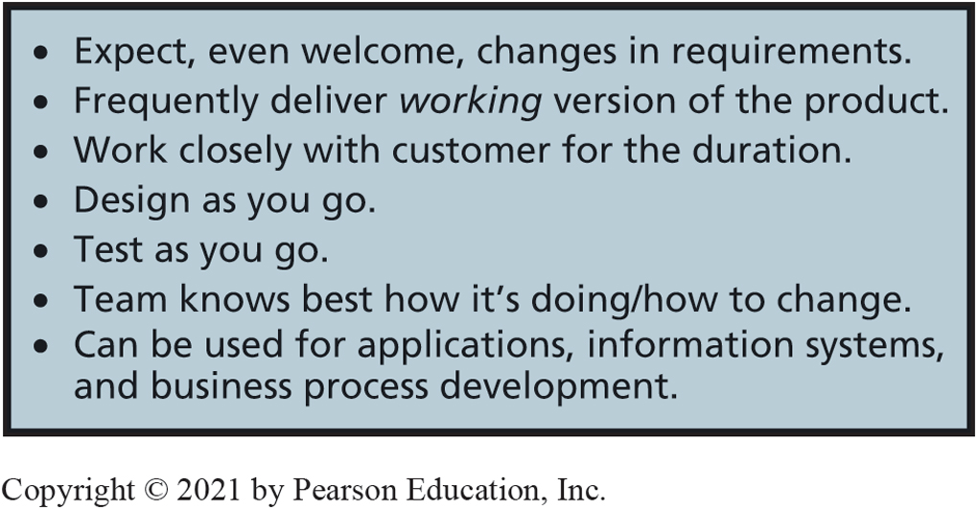
Principles of Agile Development
CE 17-2 What are the principles of agile development methodologies?
Figure C E 17-1 Principles of Agile Development
Notes:
The fourth principle is a tough one for many developers to accept. Rather than design the complete, overall system at the beginning, only those portions of the design that are needed to complete the current work are done. Sometimes this is called just-in-time design.

Slide 6
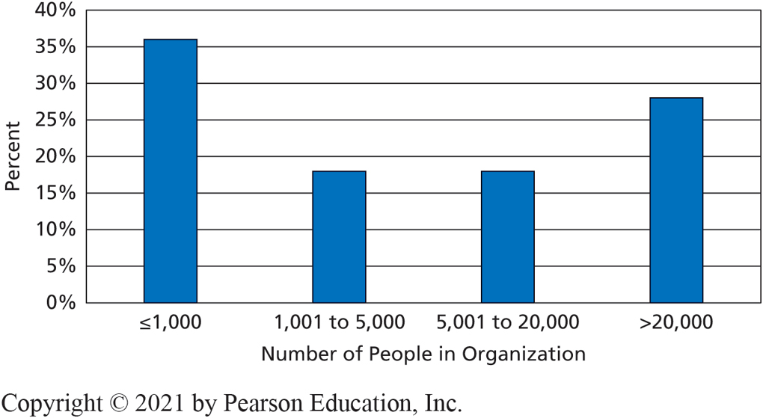
Size of Organizations Using Agile
CE 17-2 What are the principles of agile development methodologies?
Figure C E 17-2 Size of Organizations Using Agile (2018)

Slide 7
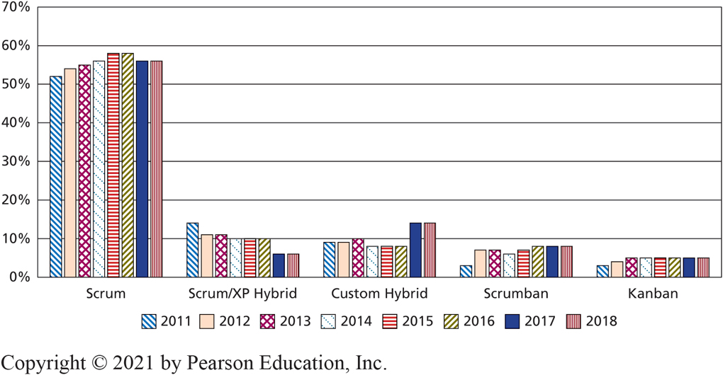
Agile Methodology Used
CE 17-2 What are the principles of agile development methodologies?
Figure C E 17-3 Agile Methodology Used

Slide 8
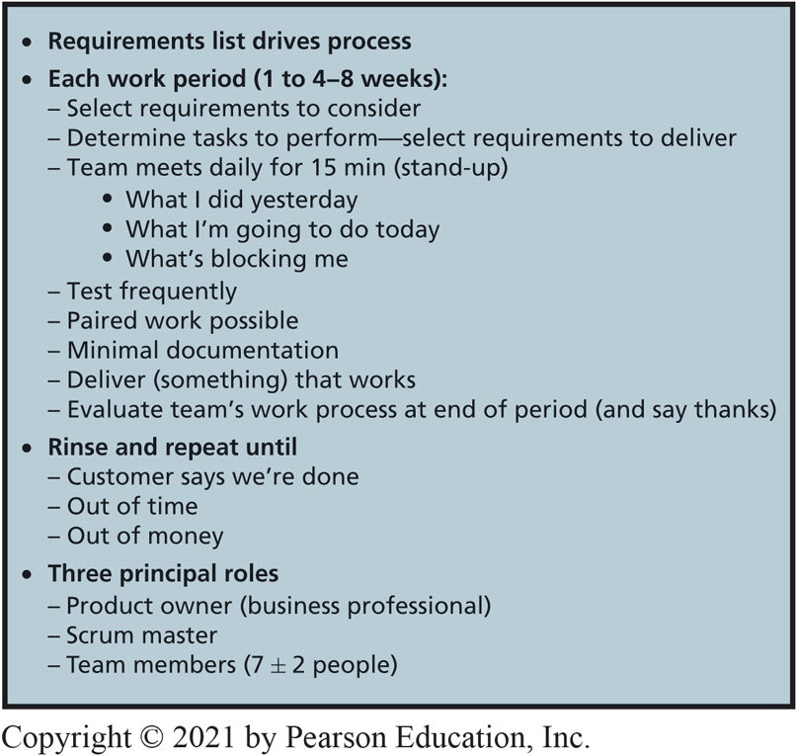
Scrum Essentials
CE 17-3 What is the scrum process?
Figure C E 17-4 Scrum Essentials
Notes:
In rugby, a scrum is a gathering of a team into a circle to restart play after a foul or other interruption.
Scrum is an agile development process that follows the principles shown in this figure.

Slide 9
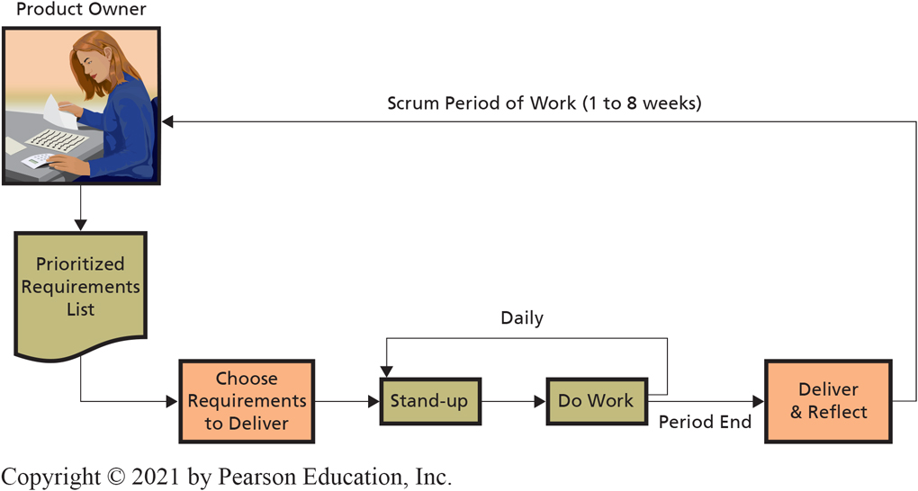
Scrum Process
CE 17-3 What is the scrum process?
Figure C E 17-5 Scrum Process
Notes:
Scrum team members are programmers, systems analysts, business analysts, database designers, cloud-engineers, PQA testing personnel, and any other staff needed to build the work product.

Slide 10
Key Roles
CE 17-3 What is the scrum process?
Product owner (user, business professional)
Provides requirements, clarification, testing
Scrum master
Expert in scrum processes, keeps process organized and working
Coach or referee, guardian of team members’ time
Team members
5–9 on team
Programmers, systems analysts, business analysts, database designers, cloud engineers, P Q A testing personnel, others as needed

Slide 11
Stand-Up Meetings
CE 17-3 What is the scrum process?
15-minute meetings where each team member states:
What he or she has done in past day
What he or she will do in coming day
Any factors blocking progress
Purpose
Accountability for progress and give public forum for blocking factors
Notes:
Often one team member has expertise to help another, blocked team member resolve the blocking issue.

Slide 12
Paired Programming
CE 17-3 What is the scrum process?
Two programmers share a computer and write a program together
One provides a test, other demonstrates code passes test or changes code
Minimal documentation created
Team’s job to create working version of the requirements selected at start of scrum period

Slide 13
When Are We Done?
CE 17-3 What is the scrum process?
Customer satisfied with product created and accepts it, even if some requirements left unfinished
Project runs out of time
Money runs out

Slide 14
How Do Requirements Drive the Scrum Process?
CE 17-4 How do requirements drive the scrum process?
Scrum is unique from other Agile methods
Scrum uses requirements to drive planning and scheduling
Express requirements in terms of “Who does what and why?”
Product owner creates requirements and prioritizes them
Notes:
Scrum is distinguished from other agile development methodologies by using requirements to drive planning and scheduling.

Slide 15
Example of “Who Does What and Why?” Using the P R I D E System
CE 17-4 How do requirements drive the scrum process?
A requirement could be expressed as:
“As a personal trainer, I want to view the client’s exercise records so I can make sure he is not doing too much.” Or
“As a personal trainer, I want to view the client’s exercise records so I can make sure she is still actively involved in her exercise program.”
What different things do the two statements above tell us about the system to be built?

Slide 16
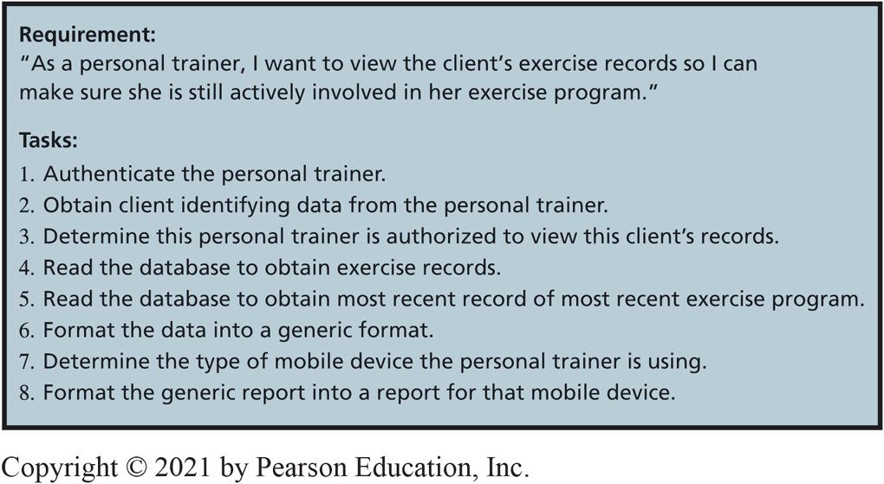
Example Requirement and Tasks
CE 17-4 How do requirements drive the scrum process?
Figure C E 17-6 Example Requirement and Tasks
Notes:
Tasks for additional requirements that might be implemented in this scrum period are created also.
Tasks are created as a group, in a team meeting where the team can give feedback to one another. One team member will think of a task to be done that other members may not be aware. Or, a member may realize a particular task is incomplete, or is doable in some other way.

Slide 17
Scheduling Tasks
CE 17-4 How do requirements drive the scrum process?
Way tasks are scheduled makes scrum innovative
Developers terrible at determining how long a task will take, good at how long something will take in comparison to something else
Assign each task a difficulty score, called points
Points form a Fibonacci sequence: {1, 2, 3, 5, 8, 13, 21, 34, 55, ...}
Points summed to total for requirement
Team estimation and planning poker
Notes:
Points form a Fibonacci sequence: {1, 2, 3, 5, 8, 13, 21, 34, 55, 89, 144, and ?}. Any number larger than 144 is meaningless. Most likely 89 and 144 are meaningless as well, and should be subdivided into multiple requirements.
When all tasks have received points, points are summed to a total for the requirement.

Slide 18
Techniques for Assigning Points
CE 17-4 How do requirements drive the scrum process?
Team estimation and planning poker
Iterative, feedback-generating process to obtain team scores
Learn more at The Elements of Scrum.

Slide 19
Committing to Finish Tasks
CE 17-4 How do requirements drive the scrum process?
Team velocity
Total number of work points team can accomplish in each scrum period
Determines how many requirements team can commit to in next scrum period
Notes:
Suppose five requirements on prioritized requirements list total 125 points. If a team knows its velocity is 100 points per scrum period, they know they cannot do all five. However, if the top four total, say 80 points, they can commit to doing those four, plus something else.
In this case, the team would go back to product owner and ask if there is a requirement lower on the priority list that can be done for the available 20 points of capacity.

Slide 20
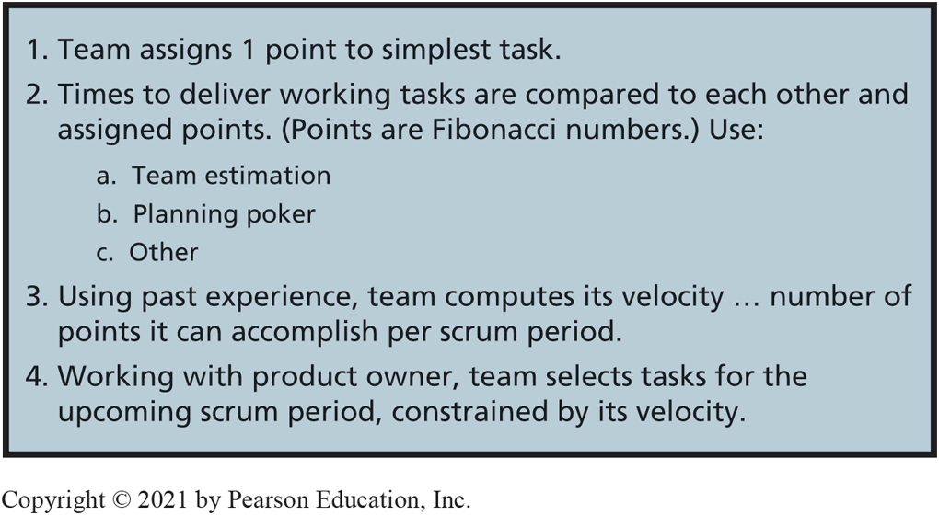
Summary of Scrum Estimation Technique
CE 17-4 How do requirements drive the scrum process?
Figure C E 17-7 Summary of Scrum Estimation Technique

Slide 21
Hocus-Pocus?
CE 17-4 How do requirements drive the scrum process?
Incorporates team iteration and feedback for scheduling and tasking
Team creates something that far exceeds what each member can do individually
Team learns to assign points more accurately, and knows its true velocity
Scrum a good technique, but not magic
Scrum helps limit potential financial losses and help produce substantial results quickly
Notes:
Second, it provides a framework for process learning.
As a team works more scrum periods together, it learns how to assign points more accurately, and increasingly learns what its true velocity is.

Slide 22
Active Review
CE 17-1 Why is the S D L C losing credibility?
CE 17-2 What are the principles of agile development methodologies?
CE 17-3 What is the scrum process?
CE 17-4 How do requirements drive the scrum process?

Slide 23

Copyright

