Slide 1

Experiencing M I S
Ninth Edition
Chapter Extension 18
Business Process Management
Copyright © 2021, 2019, 2017 Pearson Education, Inc. All Rights Reserved
Notes:
If this PowerPoint presentation contains mathematical equations, you may need to check that your computer has the following installed:
1) MathType Plugin
2) Math Player (free versions available)
3) NVDA Reader (free versions available)

Slide 2
Study Questions
CE 18-1 Why do organizations need to manage business processes?
CE 18-2 What are the stages of business process management (B P M)?
CE 18-3 How do business processes and information systems relate?
CE 18-4 Which comes first: business processes or information systems?
CE 18-5 How is B P M practiced in the real world?

Slide 3
Review of Chapter 2
CE 18-1 Why do organizations need to manage business processes?
Activities: something actors perform as part of a business function
Actors: people, computer programs, or both
Roles: job titles
Repositories: collections of something of value (e.g., data)
Data flows: movement of data among activities and repositories
Logical flow: sequence of flows from one activity to another

Slide 4
Managing Business Processes
CE 18-1 Why do organizations need to manage business processes?
Assume you work in sales, selling equipment and supplies to hotel industry
Products include hotel furniture, cleaning equipment, and supplies (towels, linens, and staff uniforms)
You are the customer’s representative within the firm
Processing an order involves five steps

Slide 5
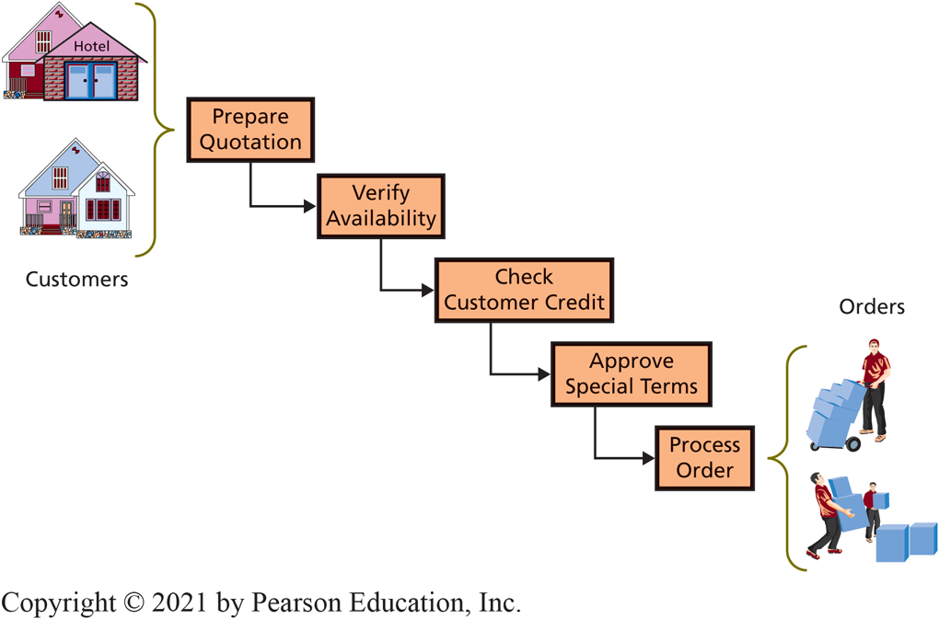
Steps in Processing an Order
CE 18-1 Why do organizations need to manage business processes?
Figure C E 18-1 Steps in Processing an Order
Notes:
Steps in Processing an Order
Ensure operations department verifies product is available and can be delivered on requested schedule.
Check with Accounting to verify credit required to process the order.
Check with your boss, a sales manager, to approve any special terms the customer might request (discounts, free shipping, extended return policy, and so forth).

Slide 6
Why Does This Process Need Management?
CE 18-1 Why do organizations need to manage business processes?
Processes dynamic and need changing to:
Improve process quality
Process uses resources inefficiently
Adapt to new technology
Adapt business fundamentals
Notes:
Need to monitor process quality and adjust process design, as appropriate.

Slide 7
Examples of Change in Business Fundamentals
CE 18-1 Why do organizations need to manage business processes?
Market (e.g., new customer category, characteristics)
Product lines
Supply chain
Company policy
Company organization (e.g., mergers, acquisitions)
Internationalization
Business environment

Slide 8
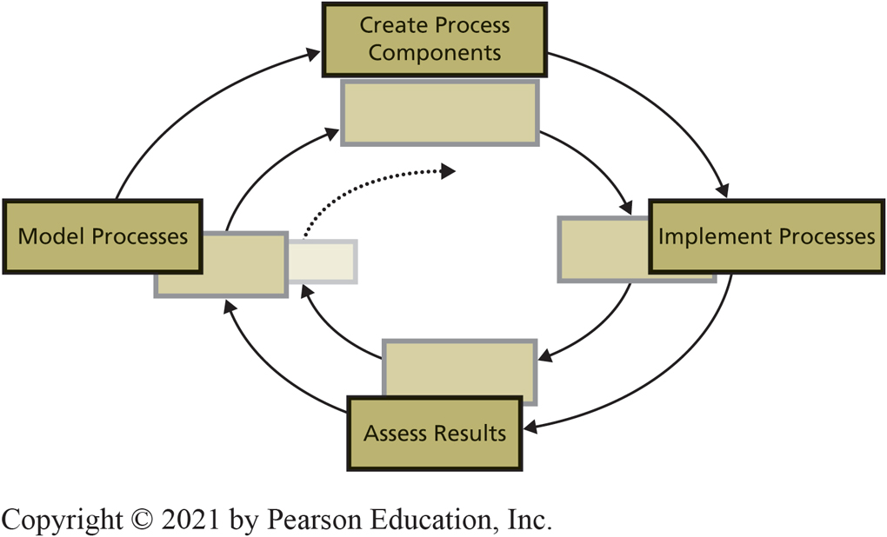
Stages in the B P M Cycle
CE 18-2 What are the stages of business process management (B P M)?
Figure C E 18-2 Stages in the B P M Cycle
Notes:
Business process management (BPM) is a cyclical process for systematically creating, assessing, and altering business processes.
Cycle begins by creating models of business processes.
Usually teams build an as-is model that documents the current situation.
See www.isaca.org/cobit/ for more information.

Slide 9
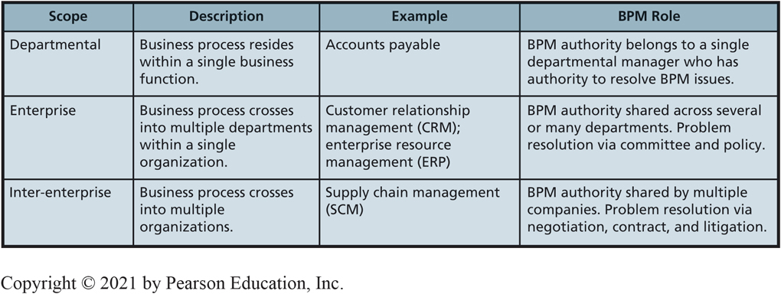
Scope of Business Process Management
CE 18-2 What are the stages of business process management (B P M)?
Figure C E 18-3 Scope of Business Process Management
Notes:
Nonprofit and government organizations have all three types of processes shown in Figure CE18-3, but most of these processes are service-oriented rather than revenue-oriented.

Slide 10
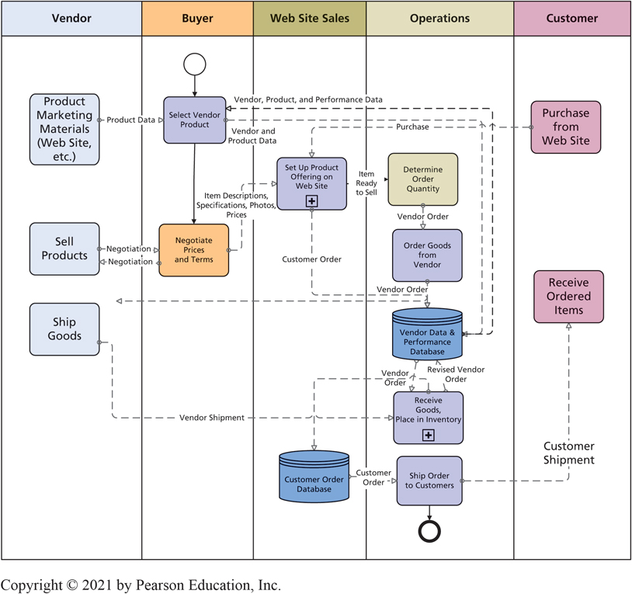
Best Bikes Ordering Process
CE 18-3 How do business processes and information systems relate?
Figure C E 18-4 Best Bikes Ordering Process
Notes:
We can deduce three important principles from this figure.
Information system elements are embedded within business processes, but some activities in business processes are not part of any information system.
This business process uses two separate information systems, and, in general, a business process can utilize zero, one, or more information systems.
The information system that processes Customer Database will be used by other business processes.

Slide 11
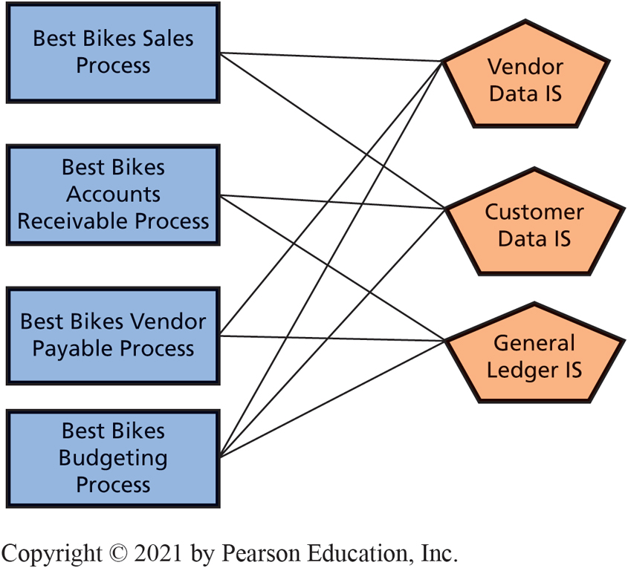
Many-to-Many Relationship of Business Processes and Information Systems
CE 18-3 How do business processes and information systems relate?
Figure C E 18-5 Many-to-Many Relationship of Business Processes and Information Systems
Notes:
Recalling the cardinality principles from Chapter Extension 6, we can say that the relationship of business processes and information systems is many-to-many. Best Bikes sales process uses two information systems (many), and, at the same time, the General Ledger IS used by three different processes (also many).

Slide 12
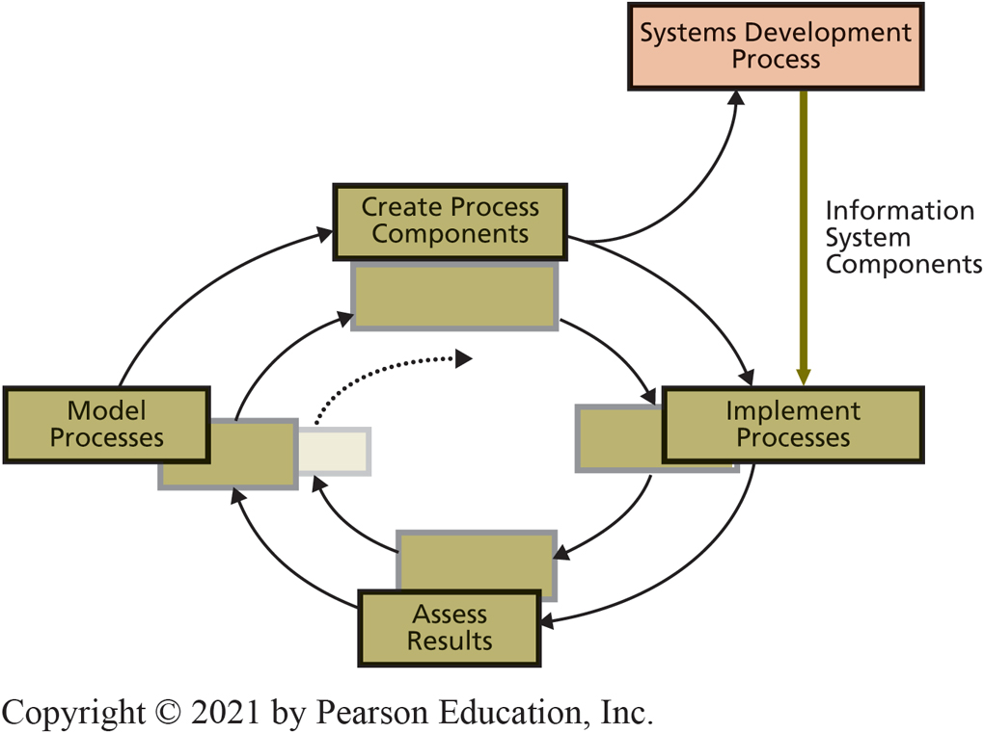
B P M and Systems Development
CE 18-4 Which comes first, business processes or information systems?
Figure C E 18-6 B P M and Systems Development
Notes:
The organization will engage in business process management and construct system components in the create process components stage of the BPM cycle.
Starting from processes and working toward information systems is likely to work well for business processes under consideration but will cause problems later for other processes that use the same information systems.

Slide 13
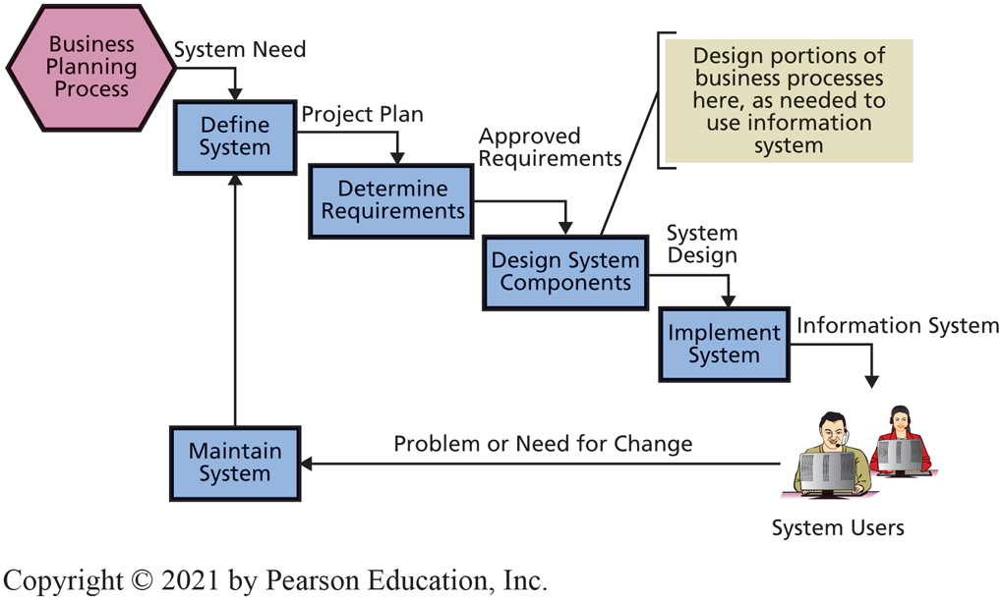
Five-Step System Development Life Cycle
CE 18-4 Which comes first, business processes or information systems?
Figure C E 18-7 Classic Five-Step System Development Life Cycle
Notes:
The processes that use this system are designed as part of Design System Components. This development process makes business processes a poor stepchild of the information systems development process.
Some aspects of business processes will be constructed as part of system implementation, which makes business processes a poor stepchild of the information systems development process.

Slide 14
Another Factor: Off-The-Shelf Software
CE 18-4 Which comes first, business processes or information systems?
Start with business processes first:
Likely to choose package that works well for processes being developed, but not work for processes that come later
Start with I S and collect all requirements:
May find package works better for all users, but business processes receive short shrift

Slide 15
And the Answer is…
CE 18-4 Which comes first, business processes or information systems?
In theory, better to start with business processes
More likely to result in processes and systems aligned with organization’s strategy and direction
In practice, no clear answer
Organizations today take both approaches
Notes:
Develop IS in-house because the procedures and employees that use that application are in-house.
Even if the vendor of application includes business processes as part of package, as ERP vendors do, those business processes are not yours until you have integrated them into your business and trained your employees.

Slide 16
Not Possible to Buy Processes or Systems Off-the-Shelf
CE 18-4 Which comes first, business processes or information systems?
Neither information systems nor business processes can be purchased off-the-shelf
Entire business processes unlikely to be part of vendor’s package
If likely to use license application, better to begin with processes (This rule is not ironclad)
Allow time for integration and training
Expect mistakes and problems as new application first put into use
Notes:
Develop IS in-house because the procedures and employees that use that application are in-house.
Even if the vendor of application includes business processes as part of package, as ERP vendors do, those business processes are not yours until you have integrated them into your business and trained your employees.

Slide 17
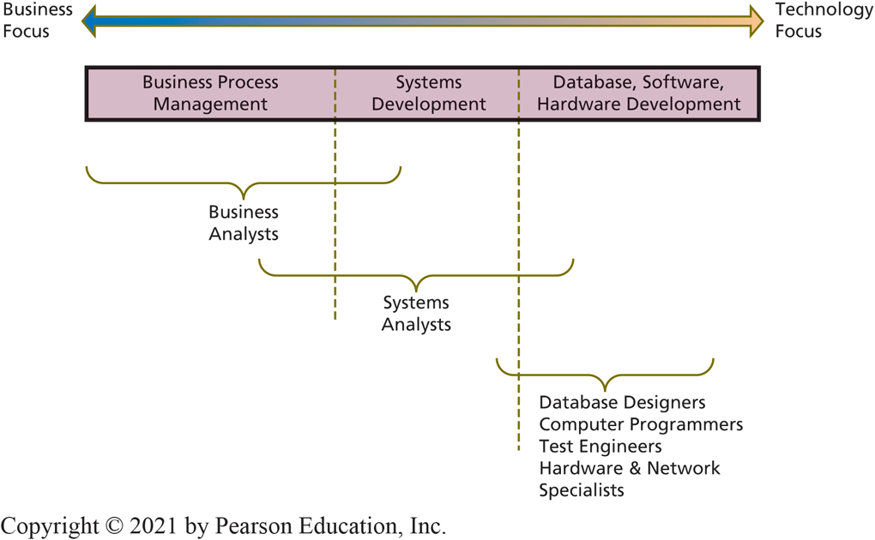
Focus of Personnel Involved in B P M and Systems Development
CE 18-5 How is B P M practiced in the real world?
Figure C E 18-8 Focus of Personnel Involved in B P M and Systems Development
Notes:
Assume processes are to be created first, with systems developed during process creation.
This figure implies an organization has a group of business professionals who perpetually assess processes and wait to pounce on any process judged to need improvement.
If the process problem involves information systems, BPM team is augmented with systems analysts and technical personnel as they are needed. Figure CE18-8 shows the focus of these job categories.

Slide 18
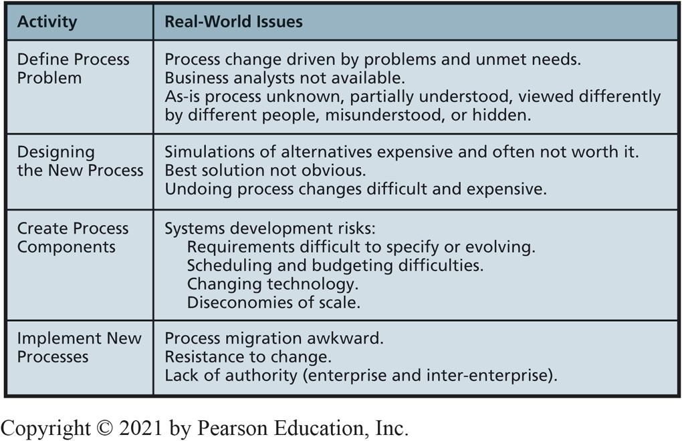
Real-World B P M Issues
CE 18-5 How is B P M practiced in the real world?
Figure C E 18-9 Real-World B P M Issues
Notes:
Most companies form a team to develop and evaluate alternatives. Most promising alternative is chosen for implementation by discussion among the team members.
Four dimensions of feasibility used in SDLC (cost, technical, schedule, and organizational) can help to eliminate some alternatives.

Slide 19
Defining the Process Problem
CE 18-5 How is B P M practiced in the real world?
Business analysts well versed in Porter’s models, organizational strategy, and systems alignment theory like C O B I T
Assess existing processes by creating an “as-is” model
Specify alternatives for fixing the problem
Adjust role resources
Change process structure
Do both

Slide 20
Designing the New Process
CE 18-5 How is B P M practiced in the real world?
Fundamental actions are possible:
Adjust role resources
Adjust number of employees performing a role, give employees additional training, to change employee management, and so forth
Change process structure
Both can be done at the same time.

Slide 21
In the Real World
CE 18-5 How is B P M practiced in the real world?
Most companies form a team to develop and evaluate alternatives
Most promising alternative chosen for implementation by discussion among the team members
Four dimensions of feasibility eliminate some alternatives
Cost
Technical
Schedule
Organizational

Slide 22
Implement New Processes
CE 18-5 How is B P M practiced in the real world?
Problems of implementing new or changed process similar, possibly greater, to those for implementing a new I S
Employees unsure exactly what to do
Old habits die hard
Some employees actively resist change, or comply viciously
Authority uncertainty problem with inter-enterprise processes

Slide 23
Active Review
CE 18-1 Why do organizations need to manage business processes?
CE 18-2 What are the stages of business process management (B P M)?
CE 18-3 How do business processes and information systems relate?
CE 18-4 Which comes first: business processes or information systems?
CE 18-5 How is B P M practiced in the real world?

Slide 24

Copyright

