Slide 1

Experiencing M I S
Ninth Edition
Chapter 1
The Importance of M I S
Notes:
If this PowerPoint presentation contains mathematical equations, you may need to check that your computer has the following installed:
1) MathType Plugin
2) Math Player (free versions available)
3) NVDA Reader (free versions available)

Slide 2
“But today, they’re not enough.”
Amanda Lacks Skills eHermes Needs:
Abstract Reasoning Skills.
Systems Thinking Skills.
Collaboration Skills.
Experimentation Skills.
Notes:
What's not good enough?
What should Amanda have done differently?
To what extent are the four skills required in your education so far.
How do you feel about working with ambiguity?

Slide 3
What Do Employers Want?
Self starter, Don’t wait to be told what to do.
Team worker
Develops ideas with others.
Ask questions.
Pulls more than their own weight.

Slide 4
Study Questions
1-1 Why is Introduction to M I S the most important class in the business school?
1-2 How will M I S affect me?
1-3 Why are M I S–related jobs in high demand?
1-4 What is M I S?
1-5 What is information?
1-6 What data characteristics are necessary for quality information?
Notes:
Chapter Preview
It begins by discussing the key skills that students need and explains why this course is the best course for teaching those key skills. The discussion of how important this class will be to your career, is followed by discussions of fundamental concepts. The chapter wraps up with some practice on one of the key skills students need to learn.
Optional: CE1: Collaboration Information Systems for Decision Making, Problem Solving, and Project Management

Slide 5
The Digital Revolution
1-1 Why is Introduction to M I S the most important class in the business school?
Technology fundamentally changing business.
Information Age
Production, distribution, control of information primary economic drivers.
Digital Revolution
From mechanical/analog devices to digital devices.
Notes:
What happens when those costs are essentially zero?

Slide 6
Understanding the Forces Pushing the Evolution of New Digital Devices
1-1 Why is Introduction to M I S the most important class in the business school?
Bell’s Law
New class of computers establishes a new industry each decade.
New platforms, programming environments, industries, networks, and information systems.
Understand how next digital evolution will affect businesses.
What an industry does and how does it will change.
Notes:
Change is a given factor.

Slide 7
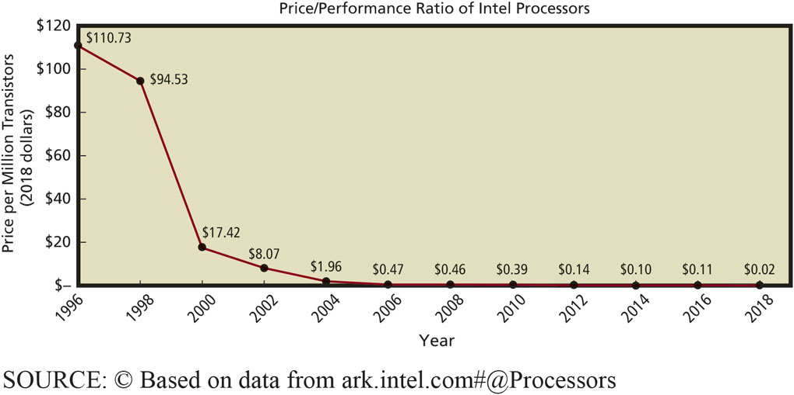
Computer Price/Performance Ratio Historical Trend
1-1 Why is Introduction to M I S the most important class in the business school?
Figure 1-1 Computer Price/Performance Ratio Decreases
Notes:
Moore’s Law: “The number of transistors per square inch on an integrated chip doubles every 18 months.”
You needn’t care how fast of a computer your company can buy for $100.

Slide 8
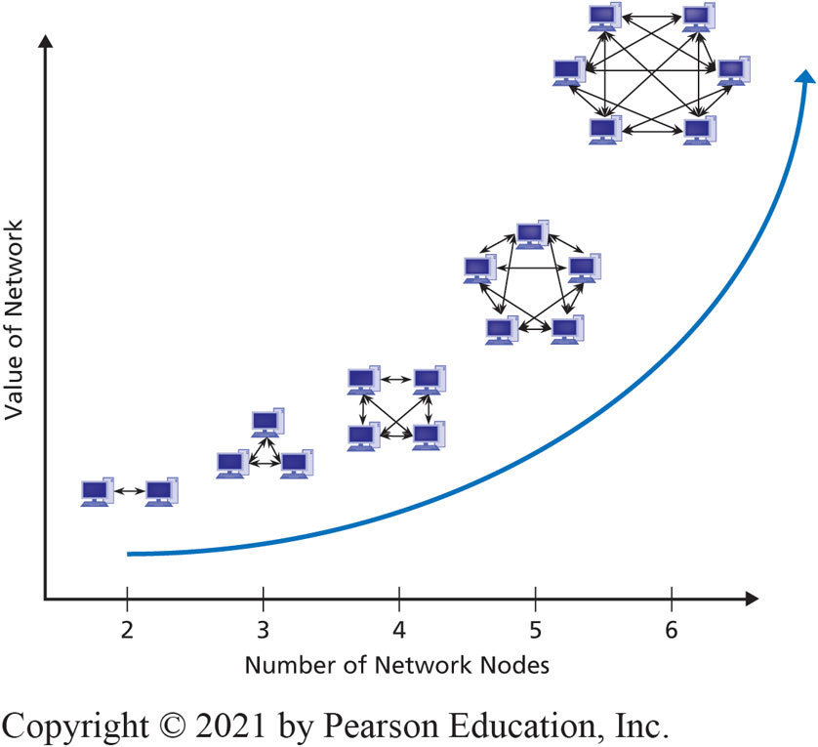
Metcalfe’s Law
1-1 Why is Introduction to M I S the most important class in the business school?
Network value equal to square of number of users connected to it.
Figure 1-2 Increasing Value of Networks
Google, Amazon, eBay exist due to large numbers of Internet users.
Notes:
Will these be the biggest companies in 2027? Or will new ones emerge?

Slide 9
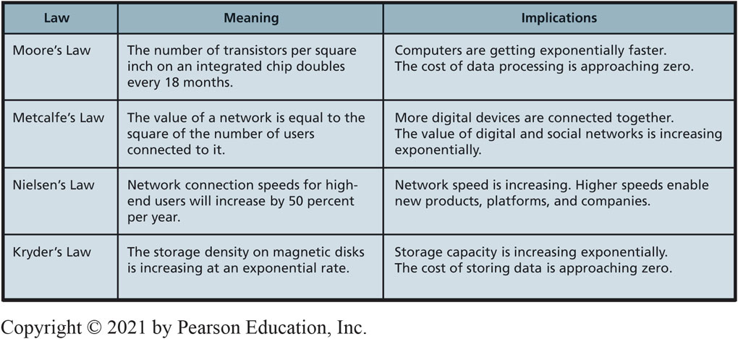
Fundamental Forces Changing Technology
1-1 Why is Introduction to M I S the most important class in the business school?
Figure 1-3 Fundamental Forces Changing Technology
Notes:
Test their connection speed here. http://www.geeksquad.com/do-it-yourself/tools/test-your-broadband-speed.aspx
Zipf’s Law is a more accurate, though less easily understood, way of explaining how the value of a network increases as additional network nodes are added. See Briscoe, Odlyzko, and Tilly’s 2006 article “Metcalfe’s Law Is Wrong” for a better explanation. http://spectrum.ieee.org/computing/networks/metcalfes-law-is-wrong.

Slide 10
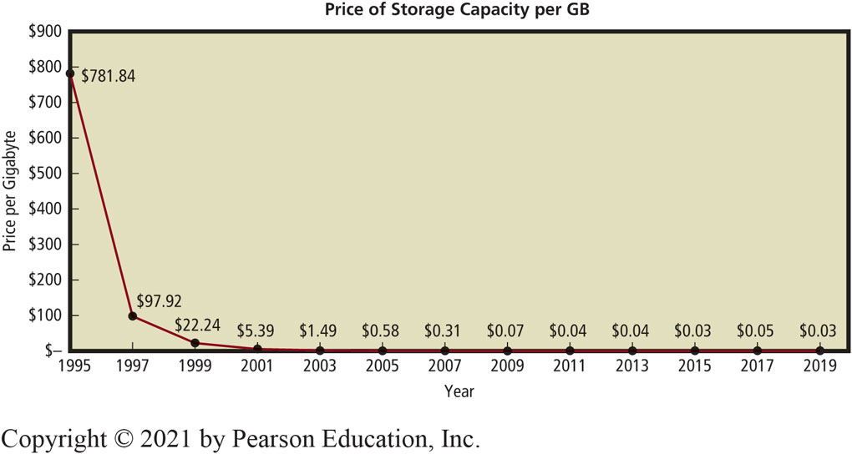
Price of Storage Capacity per G B
1-1 Why is Introduction to M I S the most important class in the business school?
Figure 1-4 Price of Storage Capacity per G B
Notes:
Moore’s Law: “The number of transistors per square inch on an integrated chip doubles every 18 months.”
You needn’t care how fast of a computer your company can buy for $100.

Slide 11
This is the Most Important Class in the School of Business Because You Will Learn
1-1 Why is Introduction to M I S the most important class in the business school?
How technology fundamentally changes businesses.
Why executives try to find ways to use new technology to create a sustainable competitive advantage.
Assess, evaluate, apply emerging information technology to business.
Help you attain knowledge needed by future business professionals.

Slide 12
Technological Change is Accelerating
1-2 How will M I S affect me?
Bell’s Law
Today’s highly successful business could be bankrupt quickly because technology changed and it didn’t.
Example: Blockbuster
In 2004, Blockbuster had $5.9B in revenues
In 2010, Blockbuster filed for bankruptcy
High-speed network connections and streaming video changed the competitive landscape
Notes:
Changes in technology will threaten your job security and provide opportunities, if you have the skills and desire to use them.

Slide 13
How Can I Attain Job Security?
1-2 How will M I S affect me?
Moore’s Law, Metcalfe’s Law, and Kryder’s Law
Driving data processing, storage, communications costs to essentially zero.
Any routine skill can, and will, be outsourced to lowest bidder.
Notes:
Can today's non-routine skills become routine in a few years? Identify some non-routine job skills. How could they be threatened?

Slide 14
What Skills Will be Marketable during Your Career?
1-2 How will M I S affect me?
Rapid technological change and increased international competition:
Requires skills and ability to adapt.
Favors people with strong non-routine cognitive skills.
Message: Develop strong non-routine cognitive skills.

Slide 15
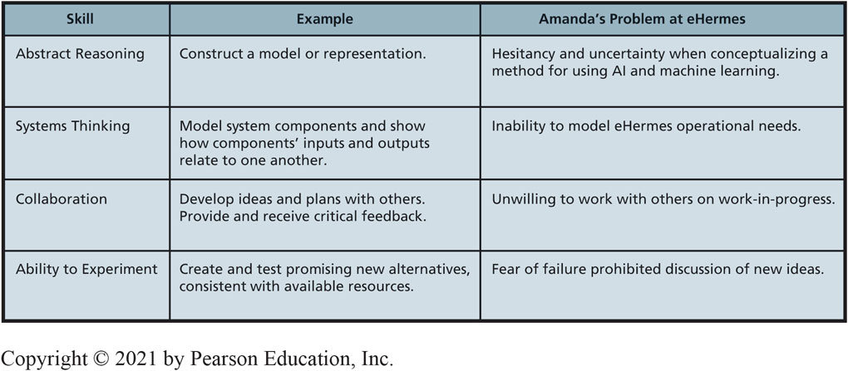
What is a Marketable Skill?
1-2 How will M I S affect me?
Figure 1-5 Examples of Critical Skills for Nonroutine Cognition
Notes:
Rapid technological change and increased international competition place spotlight on workforce skills and preparation, particularly ability to adapt to changing technology and shifting demand.
How are abstract thinking and system thinking related?

Slide 16
How Can Intro to M I S Help You Learn Non-Routine Skills? (1 of 4)
1-2 How will M I S affect me?
Abstract Reasoning
Ability to make and manipulate models.
Learn to use and construct abstract models.
Ch. 1: Five components of an I S model.
Ch. 5: How to create data models.
Ch. 12: How to make process models.
Notes:
Abstract thinking involves using models. One or more models in every course topic and book chapter.
The model example is from Wikipedia.org https://en.wikipedia.org/wiki/Data_model#/media/File:Data_modeling_context.svg.

Slide 17
How Can Intro to M I S Help You Learn Non-Routine Skills? (2 of 4)
1-2 How will M I S affect me?
Systems Thinking
Ability to model system components, connect inputs and outputs among components to reflect structure and dynamics.
Ability to discuss, illustrate, critique systems; compare alternative systems; apply different systems to different situations.
Notes:
These skills are essential for business professionals.

Slide 18
How Can Intro to M I S Help You Learn Non-Routine Skills? (3 of 4)
1-2 How will M I S affect me?
Collaboration
People working together to achieve a common goal, result, or work product.
Chapter 7 and Chapter Extension10 discuss collaboration skills and illustrate several collaboration information systems.
Notes:
Every chapter of this book includes collaboration exercises that may be assigned in class or as homework.

Slide 19
How Can Intro to M I S Help You Learn Non-Routine Skills? (4 of 4)
1-2 How will M I S affect me?
Ability to Experiment
Make reasoned analysis of an opportunity; develop and evaluate possible solutions.
“I’ve never done this before.”
“I don’t know how to do it.”
“But will it work?”
“Is it too weird for the market?”
Fear of failure paralyzes many good people and ideas
Notes:
Use features and functions of Microsoft Excel, Access not used before. Collaborate using Microsoft SharePoint, Google Docs, and Spreadsheets, or other collaboration tools.
Think about Falcon Security's 3D printing problem. What are risks? Should they proceed?

Slide 20
Jobs
1-3 Why are M I S-related jobs in high demand?
74 percent of CEOs plan to use artificial intelligence (AI) to automate tasks to a large or very large extent over the next 3 years.
Those same CEOs believe just 26 percent of their workers are prepared to collaborate with their AI coworkers.
Just 3 percent of CEOs plan to increase investments toward training and reskilling employees to prepare them for these new tech-centric jobs.
Understanding technology and having a willingness to learn new tech skills will be increasingly important for future job security.
Notes:
One in two recent college graduates either unemployed or underemployed, but, not in all job categories.
Will these trends change over the next 20 years?

Slide 21
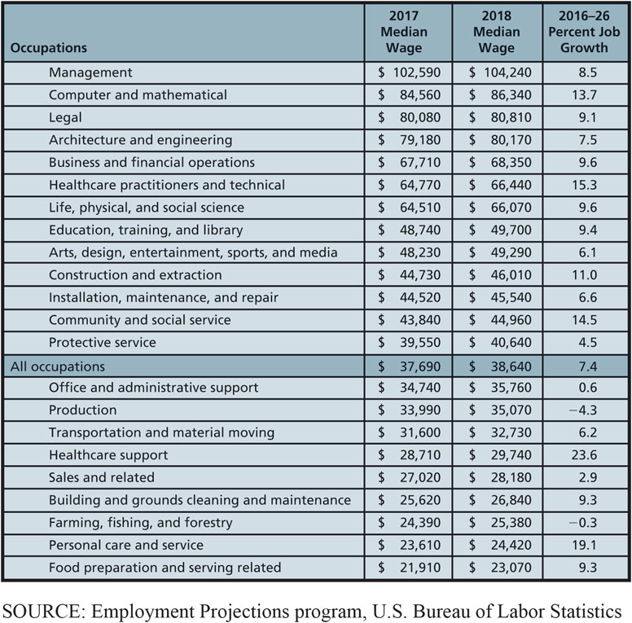
Median Wages and Job Growth by Sector
1-3 Why are M I S-related jobs in high demand?
Figure 1-6 Median Wage and Percent Job Growth by Sector
Notes:
Notice the rapid growth projected in Computer and mathematical from 2016-2026.

Slide 22
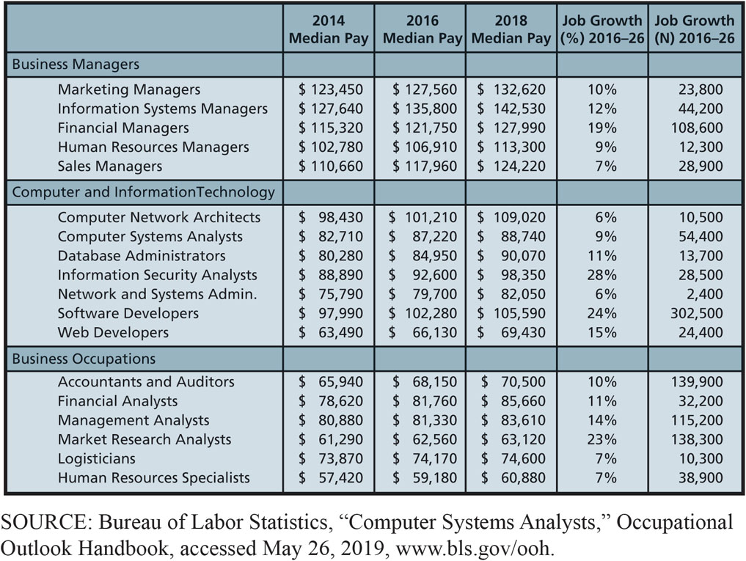
B L S Occupational Outlook 2016-2026
1-3 Why are M I S-related jobs in high demand?
Figure 1-7 Bureau of Labor Statistics Occupational Outlook 2016–2026
Notes:
U.S. Bureau of Labor Statistics recent job projections for business managers, computer and information technology, and other business occupations for the years 2014 to 2024. Growth rates of all information systems–related jobs are above the average for all occupations.

Slide 23
Bottom Line of M I S Course
1-3 Why are M I S-related jobs in high demand?
Most important course in business school because:
Gives background needed to assess, evaluate, and apply emerging information systems technology to business.
Gives marketable skills by helping you learn abstraction, systems thinking, collaboration, and experimentation.
Makes you aware of well-paying, high demand M I S-related jobs.

Slide 24
A is for Alphabet (1 of 2)
So What?
The Internet has enabled innovation and changed our lives.
Google is one of the largest publicly traded companies in the world with a diverse portfolio of projects.
As of August 10, 2015, it was a subsidiary of an overarching company named Alphabet Inc.
Page and Brin manage the overall strategy, but not daily operations of each company.

Slide 25
A is for Alphabet (2 of 2)
So What?
The company was restructured to:
Retain top talent in a highly competitive industry.
Decrease bureaucratic climate.
Improve internal career trajectories of industry superstars.
Make individual companies more nimble, efficient, and autonomous.

Slide 26
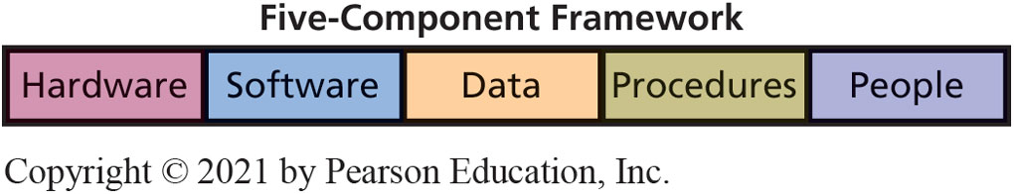
Components of an Information System?
1-4 What is M I S?
Figure 1-8 Five Components of an Information System
Notes:
Identify IS components of your university's online registration system.
This framework appears throughout the textbook.

Slide 27
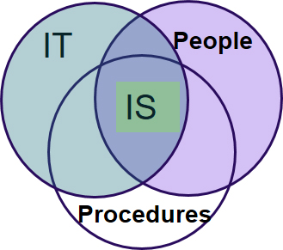
Difference between I T and I S
1-4 What is M I S?
Information technology (I T)
Products
Methods
Inventions
Standards
I T drives development of new I S.
I T components = Hardware + Software + Data
I S = I T + Procedures + People

Slide 28
Management Information Systems (1 of 2)
1-4 What is M I S?
Key elements
Management and use
Information systems
Strategies
Goal of M I S:
Managing I S to achieve business strategies.

Slide 29
Management Information Systems (2 of 2)
1-4 What is M I S?
Management and use to:
Develop, maintain, adapt by:
Creating an information system that meets your needs, take an active role in system’s development. Why?
Business professionals using cognitive skills to understand business needs and requirements.

Slide 30
Achieving Strategies
1-4 What is M I S?
Information systems exist to help people achieve business strategies.
“What is the purpose of our Facebook page?”
“What is it going to do for us?”
“What is our policy for employees’ contributions?”
“What should we do about critical customer reviews?”
“Are the costs of maintaining the page sufficiently offset by the benefits?”
Notes:
Chapter 3 addresses the relationship between information systems and strategy in more depth.
Chapter 8 addresses social media and strategy specifically.

Slide 31
Management and Use of Information Systems
1-4 What is M I S?
Business professionals need to:
Take active role to ensure systems meet their needs.
Understand how I S constructed.
Consider users’ needs during development.
Learn how to use I S.
Remember ancillary requirements (security, backups).

Slide 32
Defining Information
1-5 What is information?
Definitions vary:
Knowledge derived from data.
Data presented in a meaningful context.
Processed data, or data processed by summing, ordering, averaging, grouping, comparing, or similar operations.
“A difference that makes a difference.”

Slide 33
Where is Information?
1-5 What is information?
Graph is not, itself, information
Graph is data that you, and others, use to conceive information
Ability to conceive information from data determined by cognitive skills
People perceive different information from same data

Slide 34
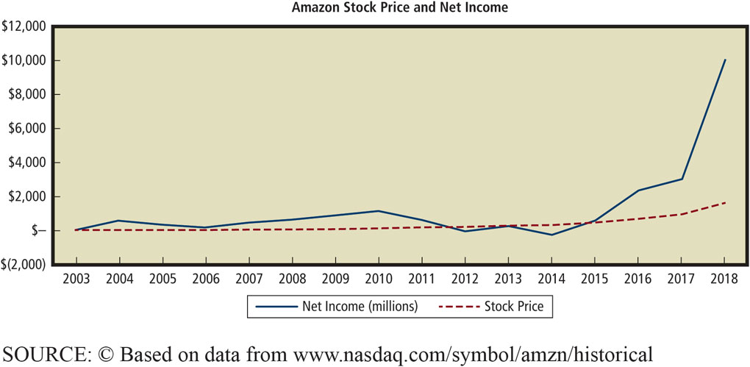
Amazon.com stock price and net income
1-5 What is information?
Figure 1-9 Amazon Stock Price and Net Income

Slide 35
Data Characteristics Needed for Quality Information
1-6 What data characteristics are necessary for quality information?
Accurate
Timely
Relevant
To context
To subject
Just barely sufficient
Worth its cost

Slide 36
How Does the Knowledge in This Chapter Help You?
Realize future belongs to those who creatively envision new applications of information systems and technology
Learn Reich’s four key skills
Learn I S components
Understand every business professional needs active role in new information systems development
Learn definitions of information
Understand the data characteristics of quality information
Notes:
What impact will these have on new products and services? Structure of organizations? Nature of work and education? Personal privacy? Personal relationships?

Slide 37
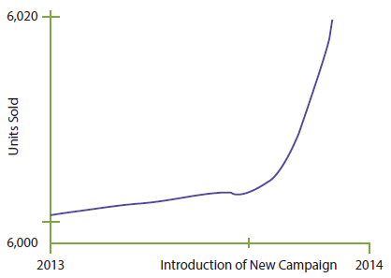
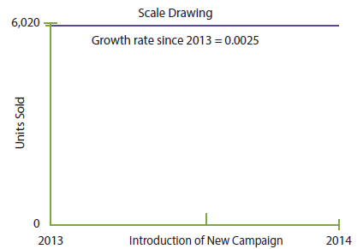
Ethics and Professional Responsibility (1 of 3)
Ethics Guide
Figures 1-3 Measuring Growth of Units Sold using Different Axis Values
Notes:
Use Kant’s categorical imperative, to explore ethical issues concerning deceptive data displays.
Practice applying the difference between data and information.
Note the graph on the left has no quantitative labels on the vertical axis; the vertical scale on the middle graph ranges only 20 units (20/6000=0.003%) which exaggerates insignificant variations; the scale of the last graph conceals variation in the data.

Slide 38
Ethics and Professional Responsibility (2 of 3)
Ethics Guide: Ethics and Professional Responsibility
Immanuel Kant
Categorical imperative
One should behave only in a way that one would want the behavior to be a universal law.
Are you willing to publish your behavior to the world?
Notes:
How do you want other people behave?

Slide 39
Ethics and Professional Responsibility (3 of 3)
Ethics Guide: Ethics and Professional Responsibility
Necessity to act in accordance with categorical imperative.
Perfect duty—behavior that must always be met.
Imperfect duty—a praiseworthy action, but not required.
Giving to charity, developing your business skills and abilities.
Notes:
Stealing cannot be a universal law. Lying is not consistent with the categorical imperative because if everyone lies, words are useless.

Slide 40
Imperfect Duty of Business Professionals
Ethics Guide: Ethics and Professional Responsibility
Imperfect duties
Cultivating your talent is a professional responsibility.
Obtaining skills necessary to accomplish your job.
Continuing to develop business skills and abilities throughout your career.

Slide 41
Five-Component Careers
Career Guide
 | Hardware | Software | Data | Procedures | People
Sales & Marketing | Vendors (I B M, Cisco, etc.) | Vendors (Microsoft, Oracle, etc.) | Vendors (Acxiom, Google, etc.) | Vendors (S A P, Infor, Oracle) | Recruiters (Robert Half, Lucas Group)
Support | Vendors Internal M I S | Vendors Internal M I S | Database administration Security | Vendors and internal customer support | Customer support Training
Development | Computer engineering Internal M I S | Application programmer Quality test Engineer | Data modeler Database design | Business process management Process reengineering | Training Internal M I S recruiting
Management | Internal M I S | Internal M I S | Data administration | Project management | Technical management
Consulting | Project management, development, pre- and postsale support
Notes:
GOALS
Motivate students for study in this course and in others by reminding them of the need to prepare for jobs now. Employment will not necessarily be easy.
Broaden students’ perspectives about MIS careers. Many exciting jobs other than programmer or hardware specialist exist.
Make students aware that a lot of interesting jobs that require MIS skills are not necessarily “computer” jobs. Professional sales is one, for example.
Reinforce the five-component model and show students another way they can use it to guide their thinking.

Slide 42
Active Review
1-1 Why is Introduction to M I S the most important class in the business school?
1-2 How will M I S affect me?
1-3 Why are M I S-related jobs in high demand?
1-4 What is MIS?
1-5 What is information?
1-6 What data characteristics are necessary for quality information?

Slide 43
Pluralsight
Case Study 1
Who is Pluralsight and what do they do?
Go online to pluralsight.com and search for a course you might be interested in taking:
What is attractive to you about online training?
What advice would you give executives at Pluralsight if they wanted to grow their business?
How could they increase their revenues?
Why would corporate clients be interested in online technology training for their employees?
Notes:
Point of case: You should learn to assess, evaluate, and apply emerging information technology to business.
Curated sales are items specifically selected and grouped by its shopping experts that are targeted at women.

Slide 44
Pluralsight (con’t)
Case Study 1
What is the technology skills gap and why does it exist?
How might a traditional university benefit from a partnership with Pluralsight?
Why might some universities see such a partnership as a threat?
Suppose you were considering buying stock in Pluralsight. What types of threats might Pluralsight face in the future?
Notes:
Point of case: You should learn to assess, evaluate, and apply emerging information technology to business.
Curated sales are items specifically selected and grouped by its shopping experts that are targeted at women.

Slide 45

Copyright

