Slide 1
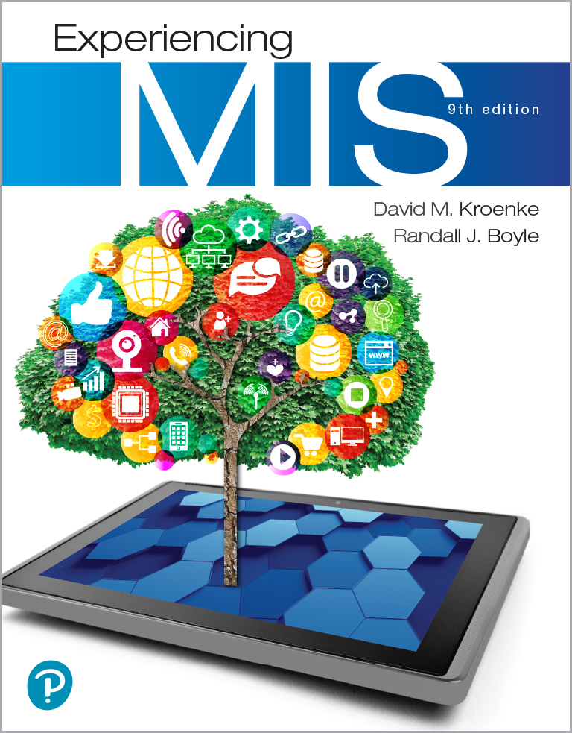
Experiencing M I S
Ninth Edition
Chapter 2
Organizational Strategy, Information Systems, and Competitive Advantage
Slides in this presentation contain hyperlinks. JAWS users should be able to get a list of links by using INSERT+F7
Copyright © 2019, 2017, 2016 Pearson Education, Inc. All Rights Reserved
Notes:
If this PowerPoint presentation contains mathematical equations, you may need to check that your computer has the following installed:
1) MathType Plugin
2) Math Player (free versions available)
3) NVDA Reader (free versions available)

Slide 2
“We can’t be everything to everybody.”
Reputation as a company that is essentially a mobile, door-to-door eBay
Current focus on selling products
Jessica wants to focus on partnering with local companies to sell new products too
Could expand to become a “shipping” company
Could drastically change the supply chain
Notes:
Use eHermes to:
Practice using Porter’s Five Forces Model.
Understand the application of competitive strategy.
Consider the risks of changes in the market to competitive strategy.
Understand major changes in company operations (selling new products, offering shipping service) create opportunity to change company mission.

Slide 3
Study Questions
2-1 How does organizational strategy determine information systems structure?
2-2 What five forces determine industry structure?
2-3 How does analysis of industry structure determine competitive strategy?
2-4 How does competitive strategy determine value chain structure?
2-5 How do business processes generate value?
2-6 How does competitive strategy determine business processes and the structure of information systems?
2-7 How do information systems provide competitive advantages?

Slide 4
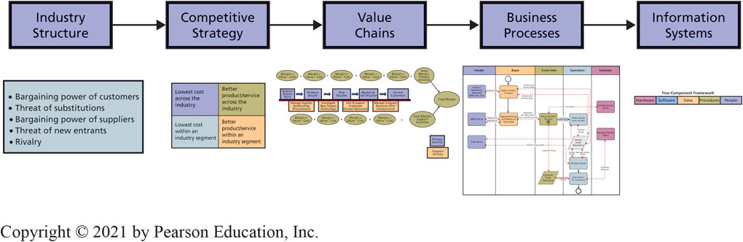
Strategy Determines Information Systems
2-1 How does organizational strategy determine information systems structure?
Figure 2-1 Organizational Strategy Determines Information Systems
Notes:
This figure summarizes a planning process used by many organizations.
Start with Porter’s Five Forces to analyze industry structure.
Organizations examine the industry structure and determine a competitive strategy. That strategy determines value chains, which determine business processes. The structure of business processes determines the design of supporting information systems.

Slide 5
Five Forces Determine Industry Structure
2-2 What five forces determine industry structure?
Competitive Forces
Competition from vendors who manufacture substitutes.
Competition from new competitors.
Competition from existing rivals.
Bargaining Power Forces
Bargaining power of suppliers.
Bargaining power of customers.
Notes:
Porter’s Five Forces.

Slide 6
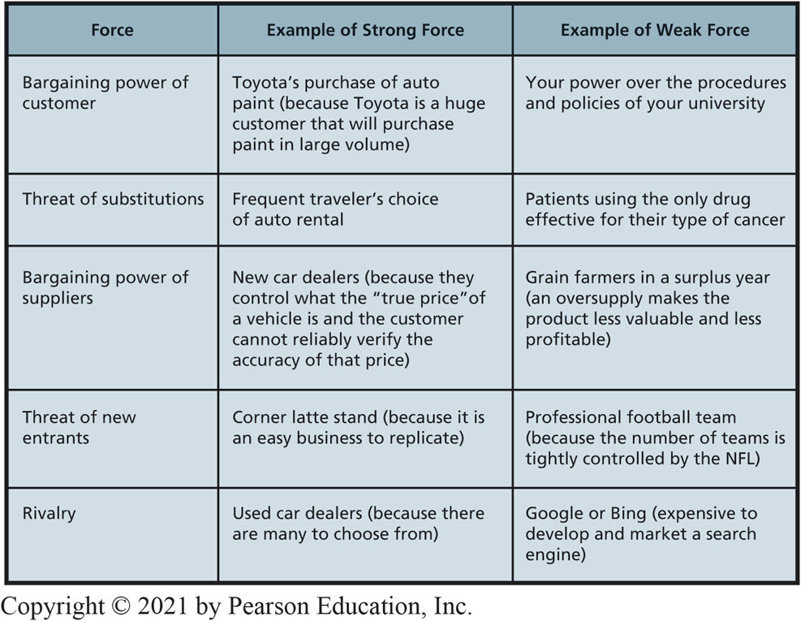
Five Forces Examples
2-2 What five forces determine industry structure?
Figure 2-3 Examples of Five Forces
Notes:
Each of the three competitive forces concerns the danger of customers taking their business elsewhere.

Slide 7
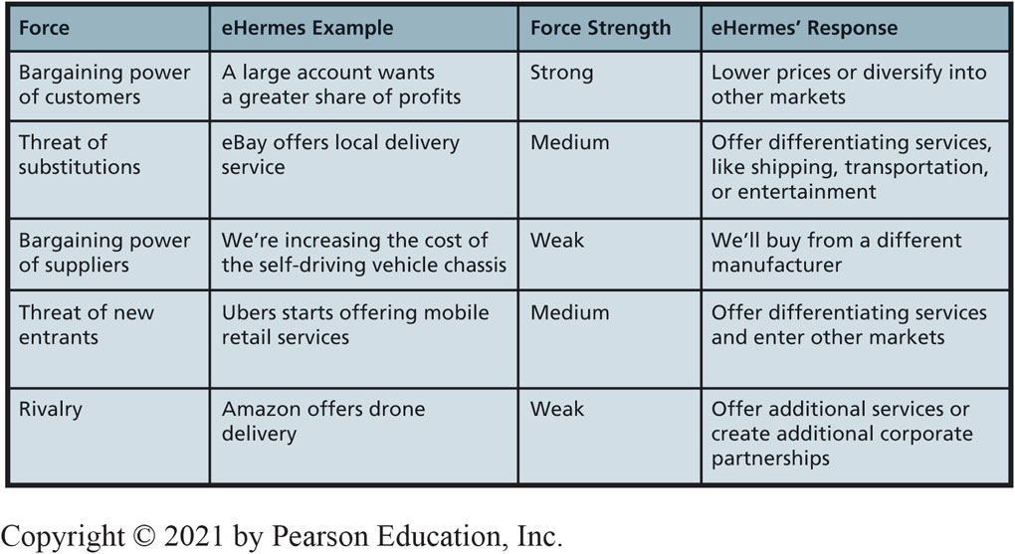
Five Forces Determine Industry Structure (con’t)
2-2 What five forces determine industry structure?
Figure 2-4 Five Forces at eHermes
Notes:
Each of the three competitive forces concerns the danger of customers taking their business elsewhere.
Have students examine table to see why eHermes is exploring possibility of offering shipping service.

Slide 8
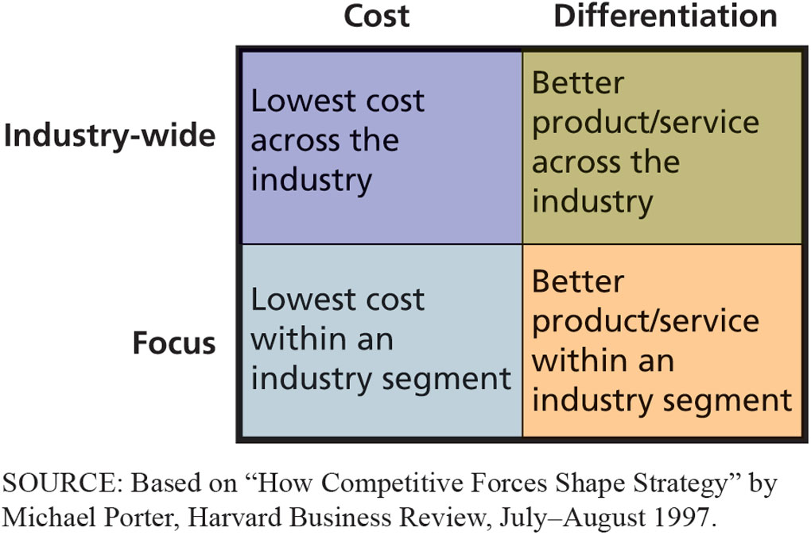
Industry Structure Analysis Determines Competitive Strategy
2-3 How does analysis of industry structure determine competitive strategy?
Figure 2-5 Porter’s Four Competitive Strategies
Notes:
To be effective, organization goals, objectives, culture, and activities must be consistent with the organization’s strategy.
This means, all information systems in organization must facilitate the organization’s competitive strategy.
Each of the three competitive forces concerns the danger of customers taking their business elsewhere.
Have students examine table to see why eHermes is exploring possibility of offering shipping service.

Slide 9
Value Chain Concepts (1 of 3)
2-4 How does competitive strategy determine value chain structure?
Industry analysis leads to determining competitive strategy.
Business activities must align with the chosen strategy
Cost leader strategy requires activities performed at lowest possible cost
Differentiation strategy requires activities that support distinction
Value: amount customers will pay for resource, product, or service
Margin: value of activity – cost of the activity
Notes:
Porter’s Five Forces.

Slide 10
Value Chain Concepts (2 of 3)
2-4 How does competitive strategy determine value chain structure?
Value chain: network of value-creating activities.
Primary activities: business functions directly related to product or service production
Inbound Logistics
Operations/Manufacturing
Outbound Logistics
Sales and Marketing
Customer Service
Notes:
Porter’s Five Forces.

Slide 11
Value Chain Concepts (3 of 3)
2-4 How does competitive strategy determine value chain structure?
Support activities: business functions that assist the primary activities
Procurement
Technology
Human Resources
Firm Infrastructure
Notes:
Porter’s Five Forces.

Slide 12
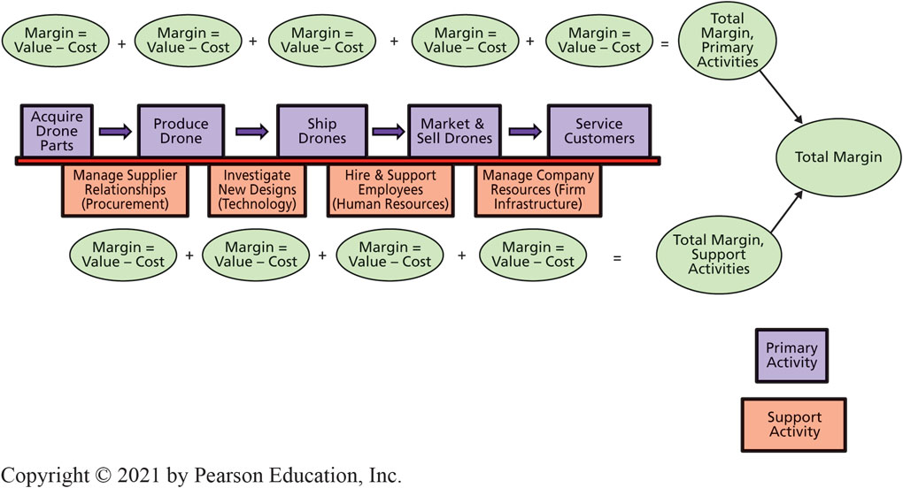
Drone Manufacturer’s Value Chain
2-4 How does competitive strategy determine value chain structure?
Figure 2-6 Drone Manufacturer’s Value Chain
Notes:
Medium-sized drone manufacturer’s value chain--network of value-creating activities
Difference between the value that an activity generates and its cost is called margin.
Linkages--interactions across value activities.

Slide 13
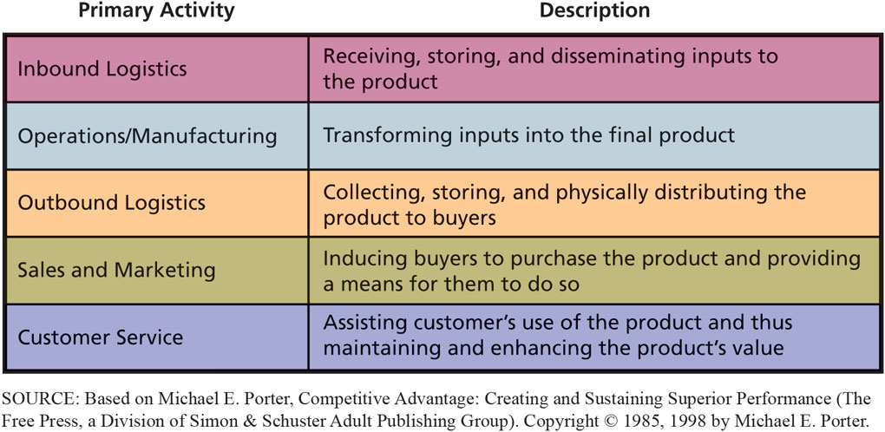
Value Chain Primary Activities
2-4 How does competitive strategy determine value chain structure?
Figure 2-7 Task Descriptions for Primary Activities of the Value Chain
Notes:
Summary of primary activities of a generic value chain.

Slide 14
Business Process Concepts
2-5 How do business processes generate value?
Business process: a network of activities that generate value by transforming inputs into outputs
Business processes vary in terms of costs and effectiveness
Streamlining business processes is a key to competitive advantage
Add value
Reduce costs
Add value and reduce costs
How something is done (the business process) is just as important as what is done.
Notes:
Porter’s Five Forces.

Slide 15
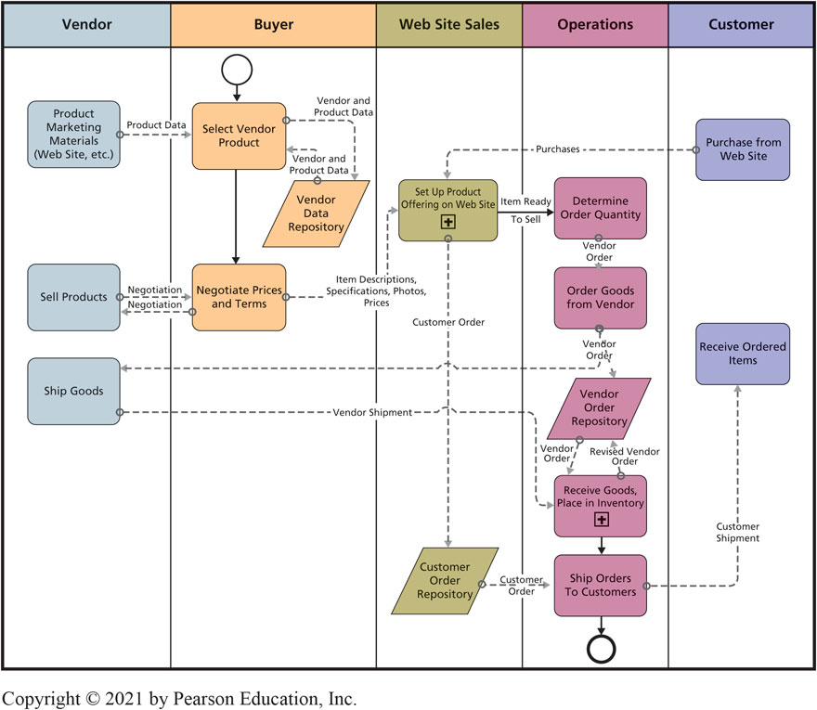
Depicting and Improving Business Processes (1 of 2)
2-5 How do business processes generate value?
Figure 2-8 Existing Best Bikes Business Process Using BPMN
Notes:
Best Bikes business process of selling products on its web site.

Slide 16
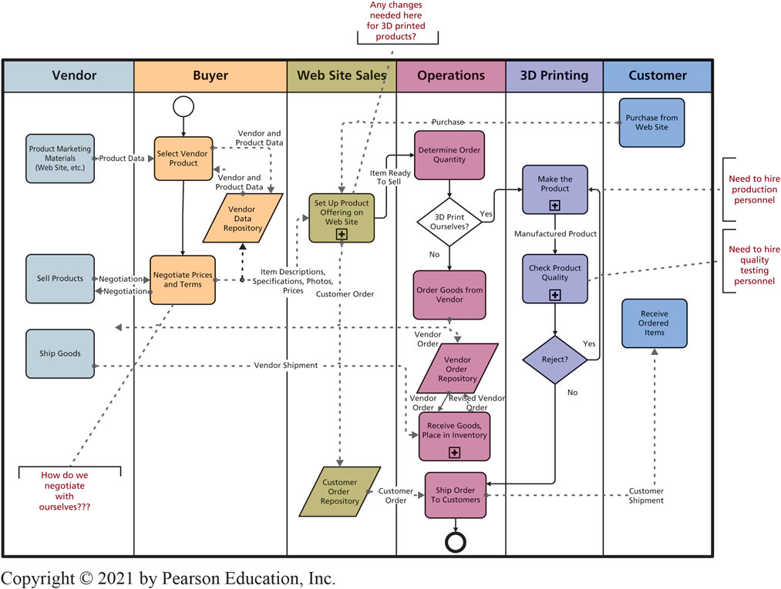
Depicting and Improving Business Processes (2 of 2)
2-5 How do business processes generate value?
Figure 2-10 Revised Best Bikes Business Process Using BPMN
Notes:
Summary of primary activities of a generic value chain.

Slide 17
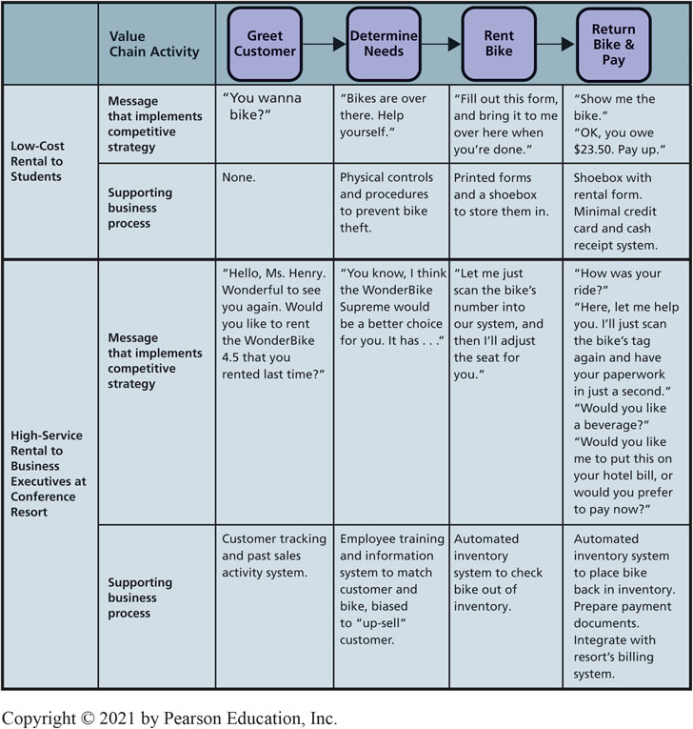
Operations Value Chain Options: Low-Cost vs High-Service
2-6 How does competitive strategy determine business processes and the structure of information systems?
Figure 2-11 Operations Value Chains for Bicycle Rental Companies
Notes:
Operations Value Chains for Bicycle Rental Companies

Slide 18
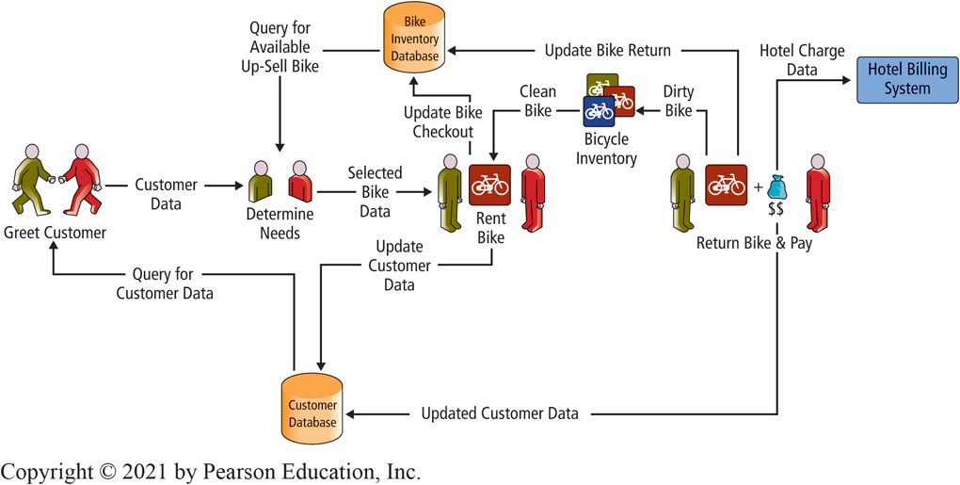
High-Service Rental Value Chain
2-7 How do information systems provide competitive advantages?
Figure 2-12 Business Process and Information Systems for High-Service Bike Rental
Notes:
Operationalized personalize customer service along with use of automation.

Slide 19
Principles of Competitive Advantage
2-7 How do information systems provide competitive advantages?
Product Implementations
Create a new product of service
Enhance products or services
Differentiate products or services
Process Implementations
Lock in customers and buyers
Lock in suppliers
Raise barriers to market entry
Establish alliances
Reduce costs
Notes:
Notice the personalize customer relationship.

Slide 20
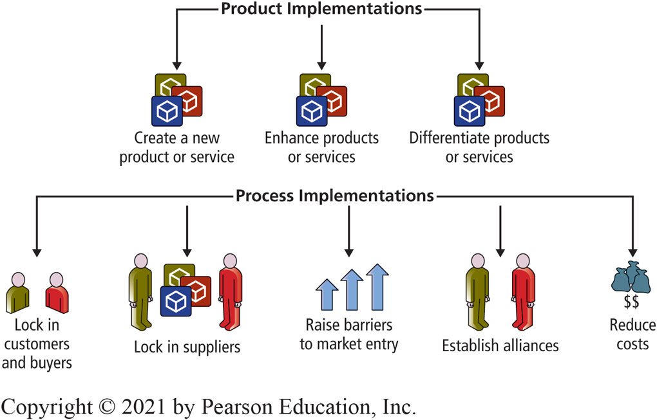
Competitive Advantages Via Products and Processes
2-7 How do information systems provide competitive advantages?
Figure 2-13 Principles of Competitive Advantage
Notes:
Operationalized personalize customer service along with use of automation.

Slide 21
Amazon Eats Whole Foods (1 of 2)
So What?
Amazon recently purchased the grocery retailer Whole Foods for more than $13 billion.
This move is perceived by many as a strategic move against Amazon’s major competitor—Walmart.
Walmart sells more groceries than any other company in the United States.
Whole Foods will help Amazon increase its grocery business.
Notes:
Consider how Amazon’s other products and services could be combined with Whole Foods.

Slide 22
Amazon Eats Whole Foods (2 of 2)
So What?
Amazon Go has as no checkout lines or point-of-sale terminals.
Do you think other grocery chains are concerned about this move by Amazon?
Do you see any downsides of the Amazon Go model?
Can you identify any other industries that Amazon may choose to enter in the next 5 years?

Slide 23
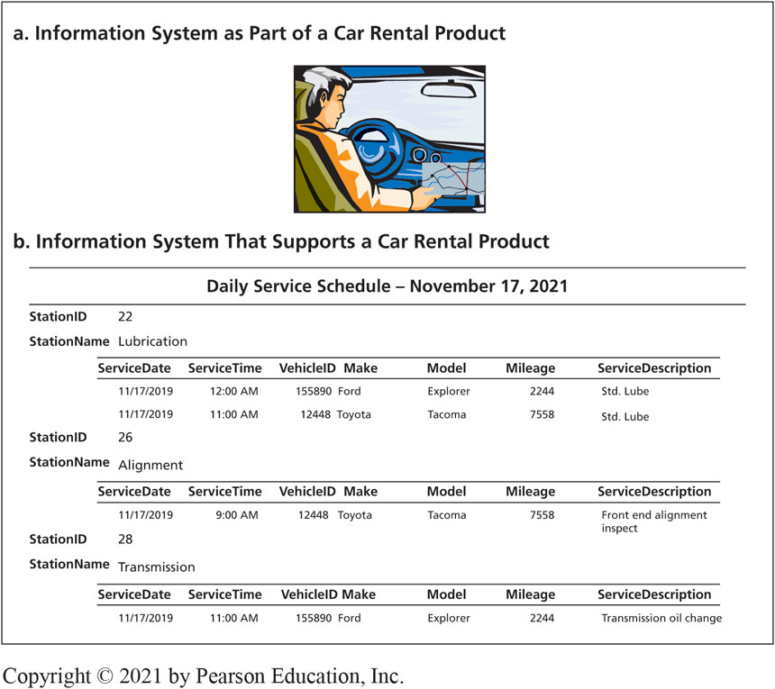
Competitive Advantages Via Products
2-7 How do information systems provide competitive advantages?
Figure 2-14 Two Roles for Information Systems Regarding Products
Notes:
Operationalized personalize customer service along with use of automation.

Slide 24
Using I S to Create Competitive Advantages
2-7 How do information systems provide competitive advantages?
ABC Shipping Company Example:
Enhances existing products
Differentiates products
Locks in customers
Raises barriers to market entry
Increases profit margins by decreasing costs and decreasing errors

Slide 25
How Does the Knowledge in This Chapter Help You?
Identify key points eHermes must address in deciding whether to diversify the types of services the company provides.
Develop guidance for yourself about relationship between competitive strategy and information systems requirements
Summarize what you have learned from this example in a statement that you could make in a job interview

Slide 26
The Lure of Love Bots
Ethics Guide
The problem: 15 percent of the total subscribers were female, while 85 percent were male
“The key to maintaining subscribers on this type of site is keeping them interested”
To keep subscribers paying, “all we have to do is send them some messages from a dummy account”
All interactions can be handled with A I bots
Are the owner’s actions illegal? Unethical?
Notes:
GOALS
Sensitize students to the fact that a competitive strategy is not just an academic topic. Changing competitive strategy has dramatic impacts on personnel and company culture.
Understand practical applications of business reports.
Explore ethical questions concerning communication about sensitive topics.
This guide illustrates the uncomfortable position many managers face when they possess knowledge that cannot be communicated to others in the company.
As a manager, you will sometimes have information that you are not supposed to communicate to employees. If an employee asks you directly about that information, you can either divulge it or lie. Which would you choose? What are the consequences of either choice?
Is there an alternative between inappropriately divulging information and lying? What is it? What disadvantages does that alternative have?
In general, what are the consequences on the organization’s culture of moving from a differentiation strategy to a low-cost strategy?
In general, what are the consequences on the organization’s culture of moving from a low-cost strategy to a differentiation strategy?

Slide 27
Senior Learning and Development Specialist
Career Guide
Christin Dunlop in Learning and Development
Q. What attracted you to this field?
A. “As I started taking computer courses in college, I quickly discovered that was how my brain worked. …Learning how things work and the ‘magic’ behind the scenes really excites me.”
Q. What advice would you give to someone who is considering working in your field?
A. “The biggest key to success within technology is a sense of adventure, confidence in yourself, and a willingness to try something new and step outside your comfort zone. My advice is be confident you can learn something and go for it!”

Slide 28
Active Review
2-1 How does organizational strategy determine information systems structure?
2-2 What five forces determine industry structure?
2-3 How does analysis of industry structure determine competitive strategy?
2-4 How does competitive strategy determine value chain structure?
2-5 How do business processes generate value?
2-6 How does competitive strategy determine business processes and the structure of information systems?
2-7 How do information systems provide competitive advantages?

Slide 29
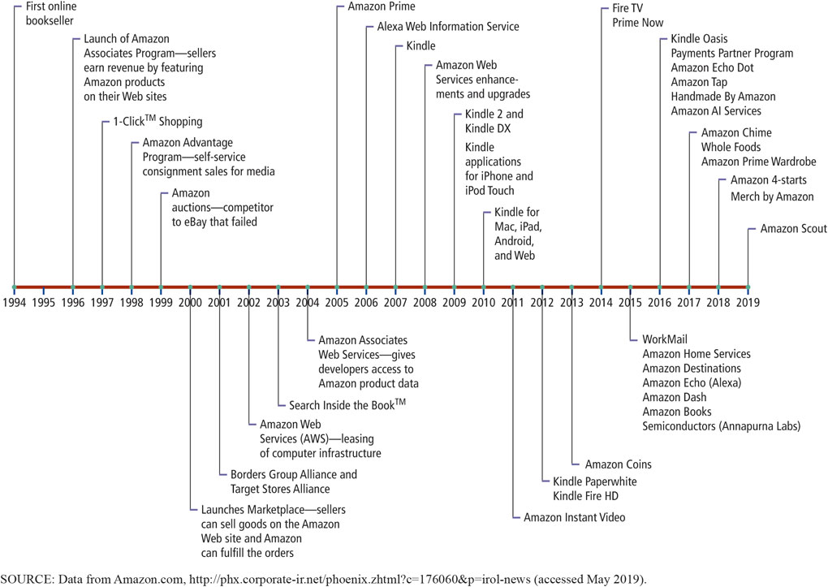
The Amazon of Innovation (1 of 2)
Case Study 2
Figure 2-15 Innovation at Amazon
Notes:
Figure shows list of business innovations created by Amazon for online retailing. Began as an online bookstore in 1994 and added new product categories. In 2016, Amazon sold goods in dozens of product categories.

Slide 30
The Amazon of Innovation (2 of 2)
Case Study 2
Amazon’s business lines three categories:
Online retailing
Own inventory
Associates program
Consignment
Order fulfillment
Cloud services
Notes:
Amazon built an enormous supporting infrastructure to ship 9 million items a day during the busy holiday season. Most of the year, Amazon.com has excess infrastructure capacity. Starting in 2000, Amazon began to lease some of that capacity to other companies and that led to the creation of cloud services.
You can ship your inventory to an Amazon warehouse and access Amazon’s information systems just as if they were yours.
Amazon Web Services allows organizations to lease time on computer equipment in very flexible ways. Organizations can expand and contract their computer resources within minutes.

Slide 31
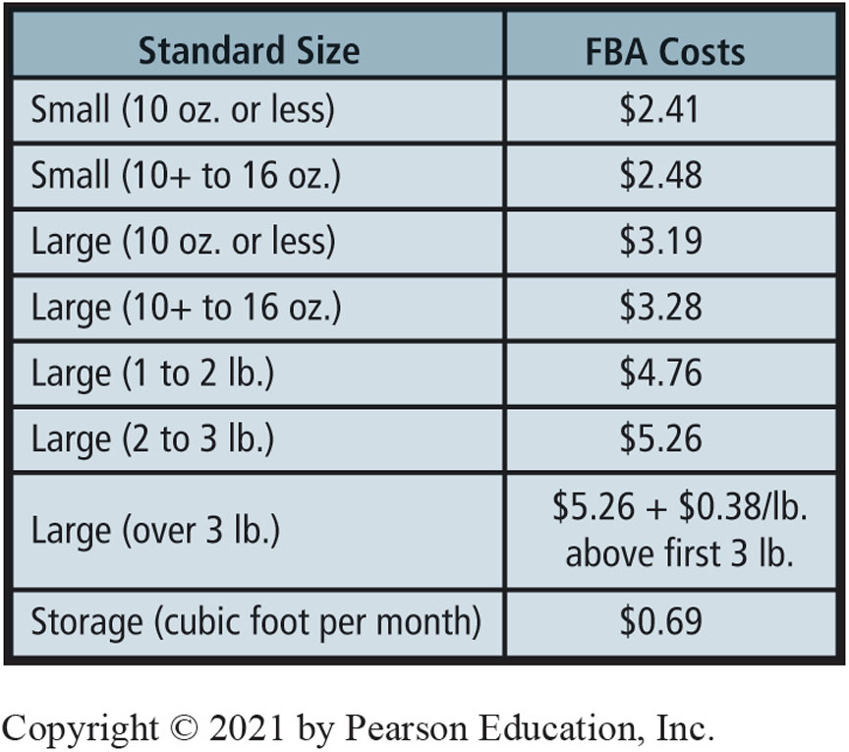
Fulfillment Fees for Standard-Sized Products (as of May 2019)
Case Study 2

Slide 32
Impact of F B A
Case Study 2
Amazon provides customer service for order processing (handling returns, fixing erroneously packed orders, answering customer order queries, etc.).
Using Web-standard technology, F B A customers’ order and payment data directly linked to Amazon’s information systems.
Enables companies to outsource order fulfillment to Amazon, thus avoiding the cost of developing their own processes, facilities, and information systems for this purpose.

Slide 33

Copyright

