Slide 1

Experiencing M I S
Ninth Edition
Chapter 3
Business Intelligence Systems
Slides in this presentation contain hyperlinks. JAWS users should be able to get a list of links by using INSERT+F7
Copyright © 2021, 2019, 2017 Pearson Education, Inc. All Rights Reserved
Notes:
If this PowerPoint presentation contains mathematical equations, you may need to check that your computer has the following installed:
1) MathType Plugin
2) Math Player (free versions available)
3) NVDA Reader (free versions available)
This chapter considers business intelligence (BI) systems: information systems that can produce patterns, relationships, and other information from organizational structured and unstructured social data as well as from external, purchased data.

Slide 2
“Data analysis, where you don’t know the second question to ask until you see the answer to the first one.”
Having great success with grocery stores wanting to compete with online retailers like Walmart and Amazon
Grocery stores are hesitant to share customer data
Worried about customer privacy
Use anonymized data with public data to identify customers? Data triangulation?
Get data in spreadsheet to start
Will need a data mart to combine all of the data
Notes:
Goals: Use the eHermes system to:
Illustrate a practical application for business intelligence systems, specifically reporting.
Provide a setting to teach standard reporting terminology.
Illustrate advantages of storing data in the cloud.

Slide 3
Study Questions
3-1 How do organizations use business intelligence (B I) systems?
3-2 What are the three primary activities in the B I process?
3-3 How do organizations use data warehouses and data marts to acquire data?
3-4 What are three techniques for processing B I data?
3-5 What are the alternatives for publishing B I?
Notes:
This chapter considers BI systems to identify patterns, relationships, and other information in organizational structured and unstructured social data, as well as purchased external data. In addition to this data, another rich source of knowledge is employees themselves.
Vast amounts of collective knowledge exist in every organization’s employees. How can that knowledge be shared?
As you will learn, business intelligence is the key technology supporting such marketing technology.

Slide 4
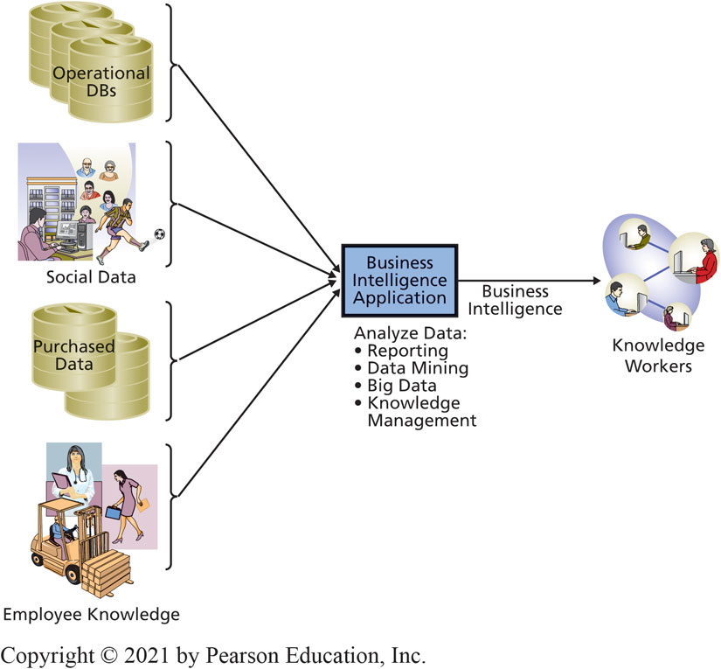
Components of Business Intelligence (B I) Systems
3-1 How do organizations use business intelligence (B I) systems?
Figure 3-1 Structure of a Business Intelligence System
Notes:
BI systems are information systems that process operational and other data to identify patterns, relationships, and trends for use by business professionals and other knowledge workers.
Five standard IS components are present in BI systems: hardware, software, data, procedures, and people.
The boundaries of BI systems are blurry.

Slide 5
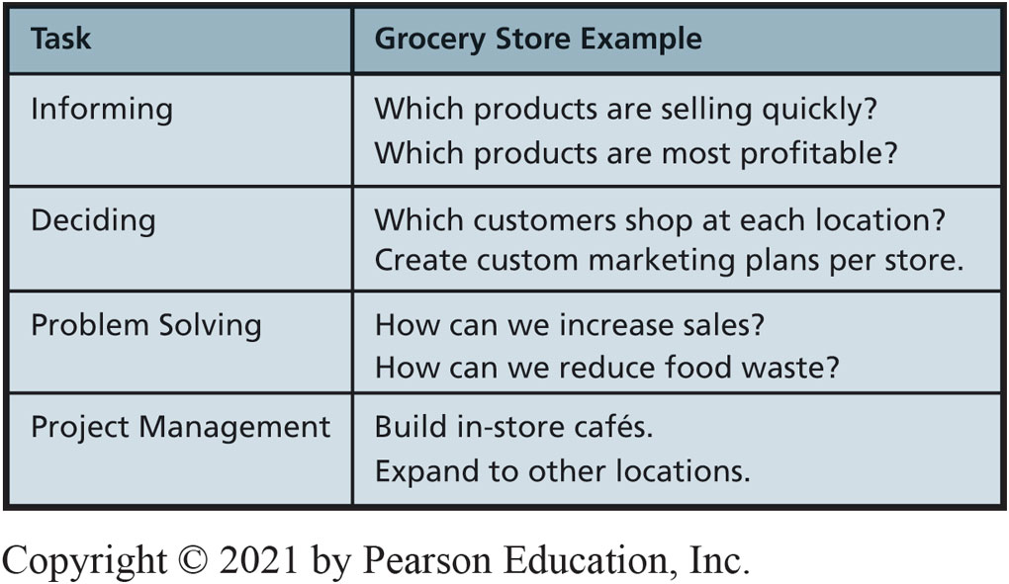
How Do Organizations Use B I?
3-1 How do organizations use business intelligence (B I) systems?
Figure 3-2 Example Uses of Business Intelligence
Notes:
Use BI for all of the collaborative tasks described in Chapter 2.
Falcon Security could use BI to determine whether it could save costs by rerouting its drone flights.

Slide 6
What are Typical Uses for B I?
3-1 How do organizations use business intelligence (B I) systems?
Identifying changes in purchasing patterns
Important life events change what customers buy.
Entertainment
Netflix has data on watching, listening, and rental habits.
Classify customers by viewing patterns.
Notes:
Typical uses involve classification or prediction.

Slide 7
Just-In-Time Medical Reporting
3-1 How do organizations use business intelligence (B I) systems?
Example of real time data mining and reporting.
Injection notification services
Software analyzes patient’s records, if injections needed, recommends as exam progresses.
Blurry edge of medical ethics.

Slide 8
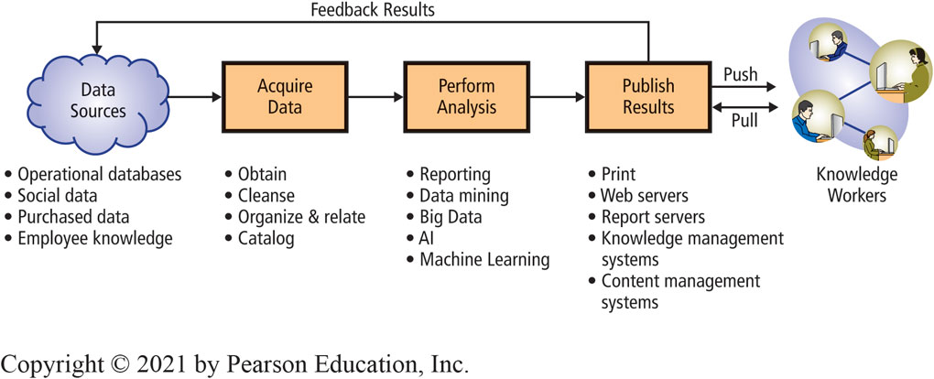
Three Primary Activities in the B I Process
3-2 What are the three primary activities in the B I process?
Figure 3-3 Three Primary Activities in the B I Process
Notes:
These activities directly correspond to the BI elements in Figure 3-1.
The four fundamental categories of BI analysis are reporting, data mining, Big Data, and knowledge management.
Push publishing delivers business intelligence to users without any request from the users; the BI results are delivered according to a schedule or as a result of an event or particular data condition. Pull publishing requires the user to request BI results.

Slide 9
Using Business Intelligence to Find Candidate Parts
3-2 What are the three primary activities in the B I process?
Identify parts that might qualify.
Provided by vendors who make part design files available for sale.
Purchased by larger customers.
Frequently ordered parts.
Ordered in small quantities.
Used part weight and price surrogates for simplicity.
Notes:
Obtained an extract of sales data from its IS department and stored it in Microsoft Access.

Slide 10
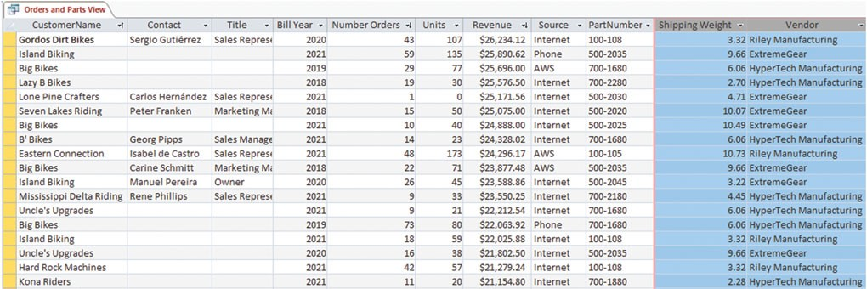
Acquire Data: Extracted Order Data
3-2 What are the three primary activities in the B I process?
Query
Sales (CustomerName, Contact, Title, Bill Year, Number Orders, Units, Revenue, Source, PartNumber)
Part (PartNumber, Shipping Weight, Vendor)
Figure 3-4 Sample Extracted Data: Order Extract Table and Part Data Table
Source: Microsoft Corporation
Notes:
IS department extracted the data.
Actually wouldn’t need all of the data columns in the Sales table.
Data was divided into different billing years, which wouldn’t affect analysis.

Slide 11
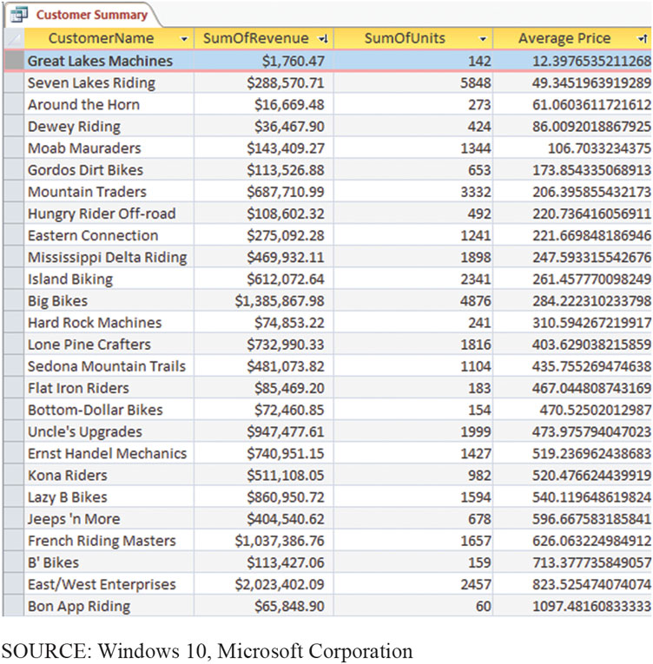
Sample Extracted Data: Part Data Table
3-2 What are the three primary activities in the B I process?
Figure 3-5 Customer Summary
Source: Microsoft Corporation
Notes:
Actually wouldn’t need all of the data columns in the Sales table.
Data was divided into different billing years, that division wouldn’t affect analysis.

Slide 12
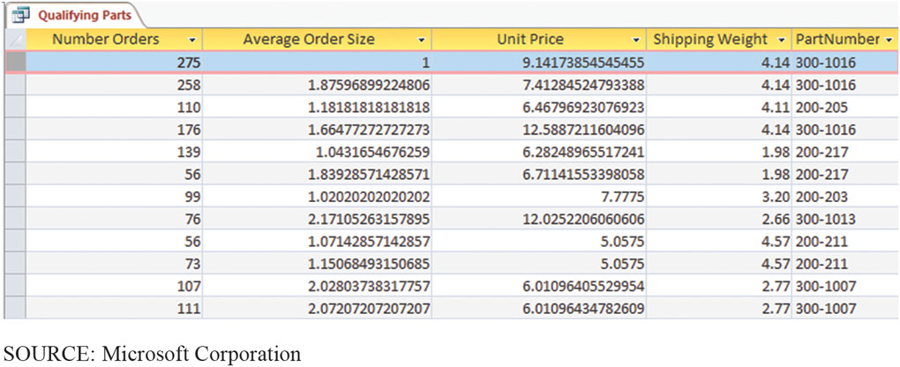
Analyze Data
3-2 What are the three primary activities in the B I process?
Figure 3-6 Qualifying Parts Query Results
Notes:
First step was to combine the data in the two tables into a single table that contained both the sales and part data.

Slide 13
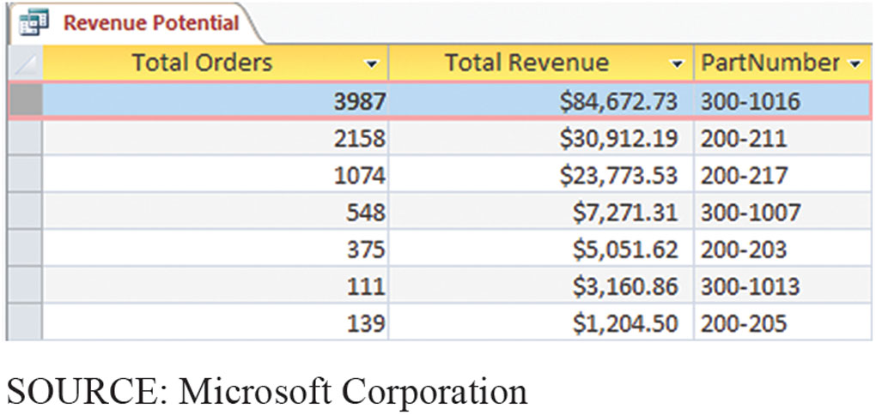
Sample Orders and Parts View Data
3-2 What are the three primary activities in the B I process?
Figure 3-7 Sales History for Selected Parts
Notes:
Data in Figure 3-7 connects selected parts with their past sales data.

Slide 14
Using Data Warehouses and Data Marts to Acquire Data
3-3 How do organizations use data warehouses and data marts to acquire data?
Functions of a data warehouse
Obtain data from operational, internal, and external databases.
Cleanse data.
Organize and relate data.
Catalog data using metadata.
Notes:
For a small organization, the extraction may be as simple as an Access database. Larger organizations, however, typically create and staff a group of people who manage and run a data warehouse, which is a facility for managing an organization’s BI data.

Slide 15
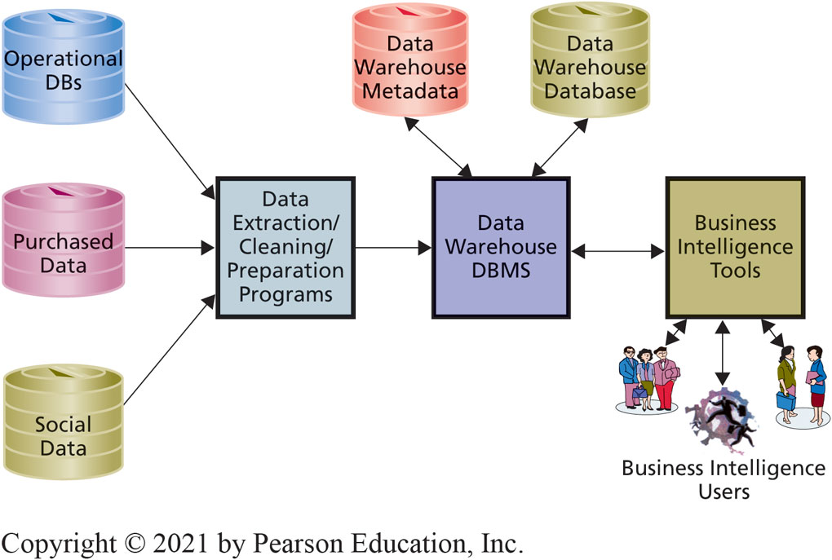
Components of a Data Warehouse
3-3 How do organizations use data warehouses and data marts to acquire data?
Figure 3-8 Components of a Data Warehouse
Notes:
This figure shows the components of a data warehouse. Programs read operational and other data and extract, clean, and prepare that data for BI processing.
An organization might use Oracle for its operational processing, but use SQL Server for its data warehouse. Other organizations use SQL Server for operational processing, but use DBMSs from statistical package vendors such as SAS or SPSS in the data warehouse.

Slide 16
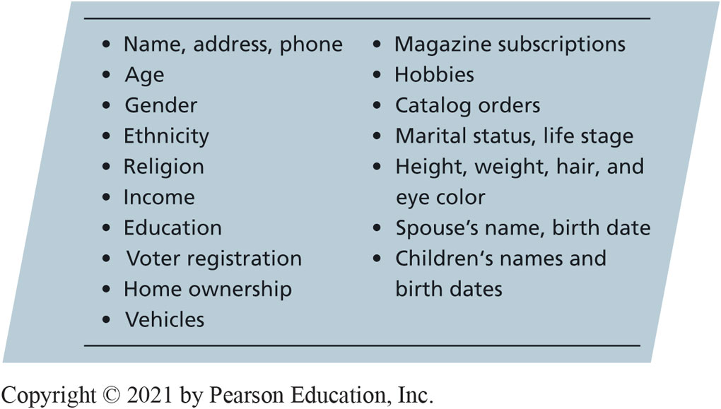
Examples of Consumer Data That Can Be Purchased
3-3 How do organizations use data warehouses and data marts to acquire data?
Figure 3-9 Examples of Consumer Data That Can Be Purchased
Notes:
Purchase of data about other organizations is not unusual or particularly concerning from a privacy standpoint.
However, some companies choose to buy personal, consumer data (like marital status) from data vendors like Acxiom Corporation.

Slide 17
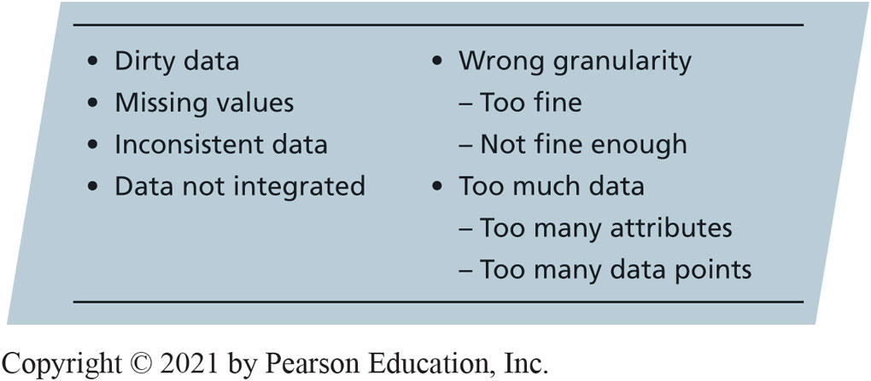
Possible Problems with Operational Data
3-3 How do organizations use data warehouses and data marts to acquire data?
Figure 3-10 Possible Problems with Source Data
Notes:
Most operational and purchased data have problems that inhibit their usefulness for BI analysis.
Problematic data is termed dirty data. Examples are a value of B for customer gender and of 213 for customer age. Other examples are a value of 999–999–9999 for a U.S. phone number, a part color of “gren,” and an email address of WhyMe@GuessWhoIAM.org.

Slide 18
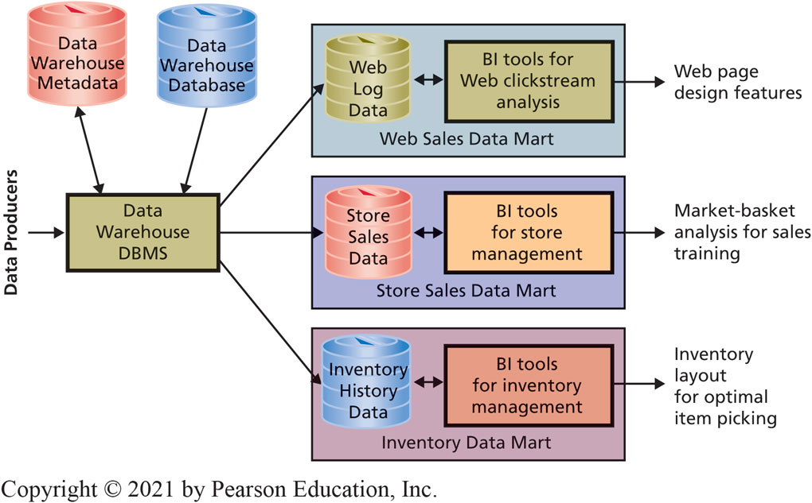
Data Warehouses Versus Data Marts
3-3 How do organizations use data warehouses and data marts to acquire data?
Figure 3-11 Data Mart Examples
Notes:
The data analysts who work with a data warehouse are experts at data management, data cleaning, data transformation, data relationships, and the like. However, they are not usually experts in a given business function.
A data mart is a subset of a data warehouse. A date mart addresses a particular component or functional area of the business.

Slide 19
Reporting Analysis
3-4 What are three techniques for processing B I data?
Process of sorting, grouping, summing, filtering, and formatting structured data
Structured data
Data in rows and columns like tables
Exception reports
Produced when something out of predefined bounds occurs
Printed and dynamic reports
Notes:
Reporting analysis is the process of sorting, grouping, summing, filtering, and formatting structured data. Structured data is data in the form of rows and columns. Most of the time structured data means tables in a relational database, but it can refer to spreadsheet data as well. The parts analysis you read in 3-2 is an example of a reporting analysis. Another type of report, exception reports are reports produced when something out of predefined bounds occurs.

Slide 20
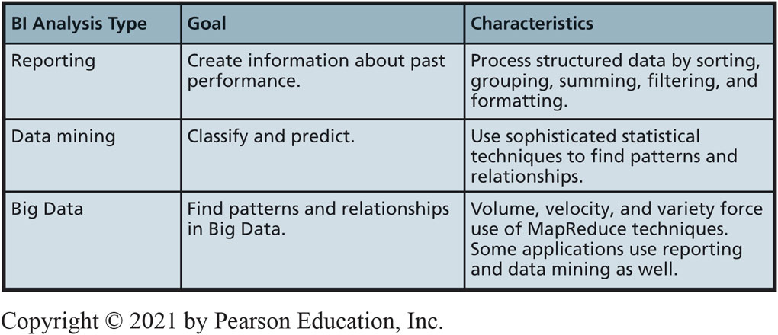
Types of B I Analysis
3-4 What are three techniques for processing B I data?
Figure 3-12 Three Types of B I Analysis
Notes:
In general, reporting analyses are used to create information about past performance, whereas data mining is used primarily for classifying and predicting. There are exceptions, but these statements are reasonable rules of thumb.
The goal of Big Data analysis is to find patterns and relationships in the enormous amounts of data generated from sources like social media sites or Web server logs. As indicated, Big Data data techniques can include reporting and data mining as well.

Slide 21
Data Mining
3-4 What are three techniques for processing B I data?
Application of statistical techniques to find patterns and relationships among data for classification and prediction
Combined discipline of statistics, mathematics, artificial intelligence, and machine learning

Slide 22
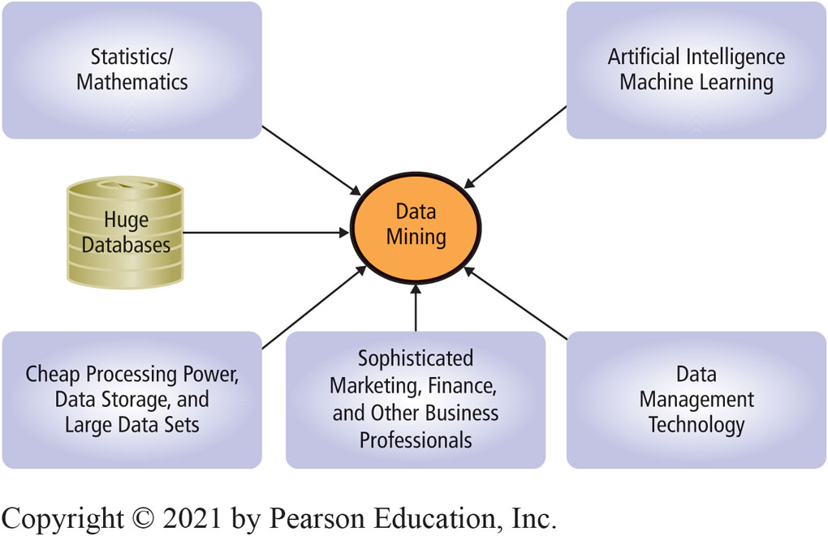
Source of Disciplines of Data Mining
3-4 What are three techniques for processing B I data?
Figure 3-13 Disciplines of Data Mining

Slide 23
Two Broad Categories of Data Mining
3-4 What are three techniques for processing B I data?
Unsupervised procedures
Does not start with a priori hypothesis or model
Hypothesized model created afterward based on analytical results to explain patterns found
Example: Cluster analysis
Notes:
Cluster analysis: Statistical technique to identify groups of entities with similar characteristics; used to find groups of similar customers from customer order and demographic data.

Slide 24
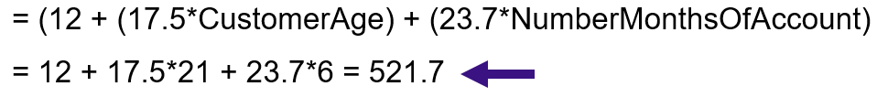
Supervised Data Mining
3-4 What are three techniques for processing B I data?
Supervised data mining uses a priori model to compute outcome of model
Prediction, such as multiple linear regression
Ex: CellPhoneWeekendMinutes
Notes:
Predict number of minutes of weekend cell phone use.

Slide 25
Big Data
3-4 What are three techniques for processing B I data?
Huge volume
Petabyte and larger
Rapid velocity
Generated rapidly
Great variety
Structured data, free-form text, log files, graphics, audio, and video
Notes:
Big Data analysis can involve both reporting and data mining techniques. The chief difference is, however, that Big Data has volume, velocity, and variation characteristics that far exceed those of traditional reporting and data mining.

Slide 26
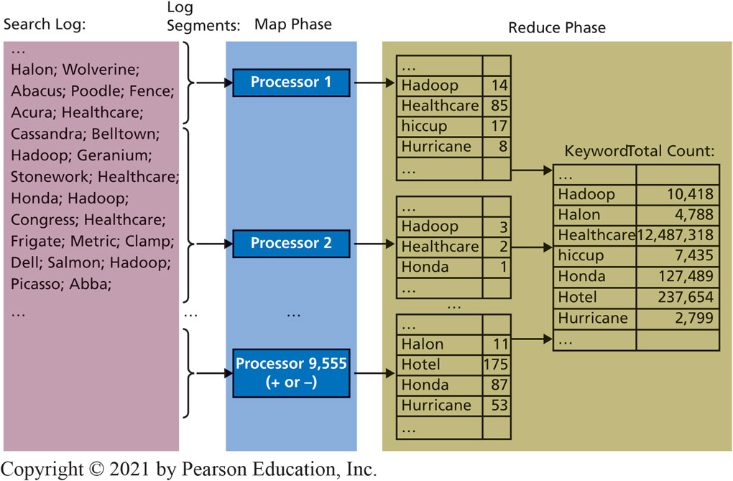
MapReduce Processing Summary
3-4 What are three techniques for processing B I data?
Figure 3-14 MapReduce Processing Summary
Notes:
Technique for harnessing power of thousands of computers working in parallel.

Slide 27
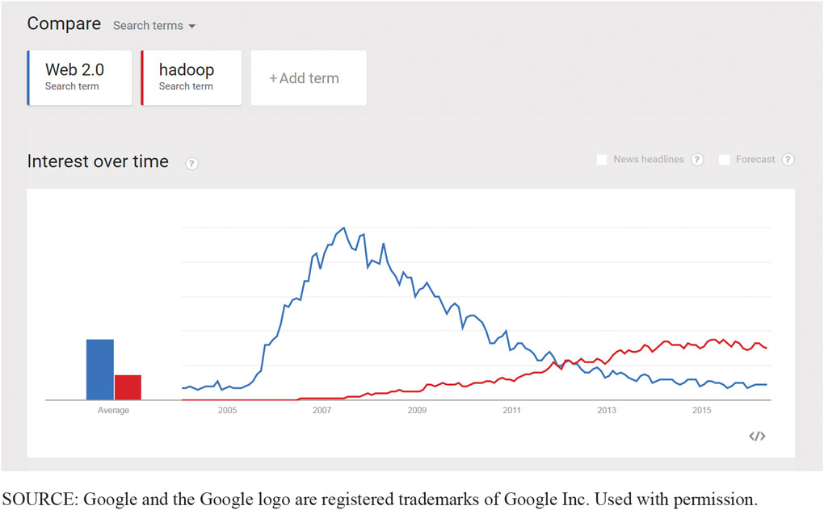
Google Trends on the Term Web 2.0
3-4 What are three techniques for processing B I data?
Figure 3-15 Google Trends on the Terms Web 2.0 and Hadoop
Notes:
This trend line supports contention that “Web 2.0” is fading from use.

Slide 28
Hadoop
3-4 What are three techniques for processing B I data?
Open-source program supported by Apache Foundation
Manages thousands of computers
Implements MapReduce (written in Java)
Amazon.com supports Hadoop as part of E C3 cloud offering
Pig query language platform for large dataset analysis
Easy to master, extensible, and automatically optimizes queries on map-reduce level

Slide 29
Geofencing for businesses?
So What?
Geofencing is a location service that allows applications to know when a user has crossed a virtual fence (specific location)
Crossing a fence can trigger an automated action
Determine her location and identify local sales
Supported by more than 90% of smartphones
Used to send recruiting ads to qualified nurses who live in or frequent certain geofenced zones

Slide 30
Geofencing for businesses? (con’t)
So What?
Is it becoming invasive and too much of a privacy concern?
80% of people surveyed want to receive location-based alerts from businesses
Could geofencing be integrated with IoT devices to create an even more efficient smart home? How?
How could a university leverage the benefits of geofencing on campus to improve student life and safety?

Slide 31
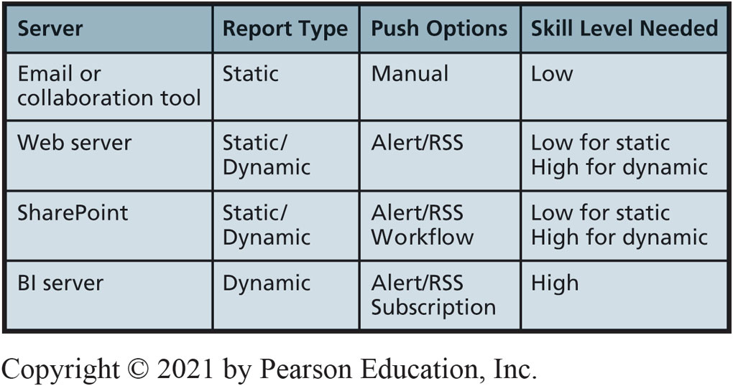
B I Publishing Alternatives
3-5 What are the alternatives for publishing B I?
Figure 3-16 B I Publishing Alternatives
Notes:
In the BI context, most static reports are published as PDF documents. Dynamic reports are BI documents that are updated at the time they are requested. A sales report that is current at the time the user accessed it on a Web server is a dynamic report.

Slide 32
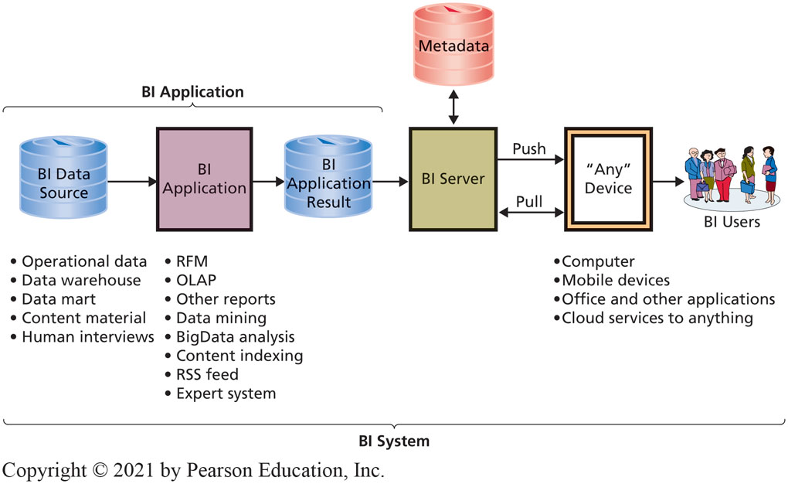
What are the Two Functions of a B I Server?
3-5 What are the alternatives for publishing B I?
Management and delivery
Figure 3-17 Components of a Generic Business Intelligence System
Notes:
A BI server extends alert/RSS functionality to support user subscriptions, which are user requests for particular BI results on a particular schedule or in response to particular events. For example, a user can subscribe to a daily sales report, requesting that it be delivered each morning.
Management and delivery. The management function maintains metadata about the authorized allocation of BI results to users. The BI server tracks what results are available, what users are authorized to view those results, and the schedule upon which the results are provided to the authorized users. It adjusts allocations as available results change and users come and go.

Slide 33
How Does the Knowledge in This Chapter Help You?
Business intelligence a critical skill for future business professionals
Business leaders prioritize the digital transformation of their businesses
Business intelligence is a key technology supporting such digital transformation
You now have a basic understanding of this increasingly important business discipline
You can contribute by imagining possible uses of the data your organization generates
Notes:
GOAL
Sensitize students to the use of data generated and processed about them.
Illustrate some of the uses of frequent-buyer data.

Slide 34
M I S-Diagnosis (1 of 2)
Ethics Guide
Doctors are relying more and more on artificial intelligence (A I)-driven expert systems to select the most appropriate medications and treatments.
Ordered to improve the system’s “perception” of the company’s drugs.
Minor modifications to the drug’s profile made a big difference.
But some of the numbers he used to modify the profile were not accurate.
The changes would warrant a regulatory review.
Notes:
GOAL
Sensitize students to the use of data generated and processed about them.
Illustrate some of the uses of frequent-buyer data.

Slide 35
M I S-Diagnosis (2 of 2)
Ethics Guide
Suppose the company alters the drug profile.
Would the company be liable if something happened to a patient who took the drug based on altered information?
Do you think that manipulating the recommendation of an A I system even though the new recommendation may be for the better drug is ethical according to the categorical imperative, and utilitarian perspective?
Notes:
Help students understand the importance not just of what data is being gathered about them, but what analyses and conclusions are being made from that data, behind their back.

Slide 36
Manager, Data and Analytics
Career Guide
Lindsey Tsuya at Nike Inc.
Q. What attracted you to this field?
A. “As a college student, I worked in the service industry. When I was selecting my degree, I knew I wanted two things. First, I wanted a degree that made money. Second, I wanted a job that did not involve direct provision of service to the public. By choosing information systems, I knew I would be doing more of a behind-the-scenes job.”
Q. What advice would you give to someone who is considering working in your field?
A. “No matter what field you choose, make sure it is something you are passionate about because if you are not passionate about it, work will feel like…work.”

Slide 37
Active Review
3-1 How do organizations use business intelligence (B I) systems?
3-2 What are the three primary activities in the B I process?
3-3 How do organizations use data warehouses and data marts to acquire data?
3-4 What are three techniques for processing B I data?
3-5 What are the alternatives for publishing B I?

Slide 38
Hadoop the Cookie Cutter (1 of 2)
Case Study 3
Third-party cookie created by site other than one you visited.
Most commonly occurs when a Web page includes content from multiple sources.
DoubleClick
I P address where content was delivered.
DoubleClick instructs your browser to store a DoubleClick cookie.
Records data in cookie log on DoubleClick’s server.

Slide 39
Hadoop the Cookie Cutter (2 of 2)
Case Study 3
Third-party cookie owner has history of what was shown, what ads you clicked, and intervals between interactions.
Cookie log shows how you respond to ads and your pattern of visiting various Web sites where ads placed.
Firefox Lightbeam tracks and graphs cookies on your computer.

Slide 40
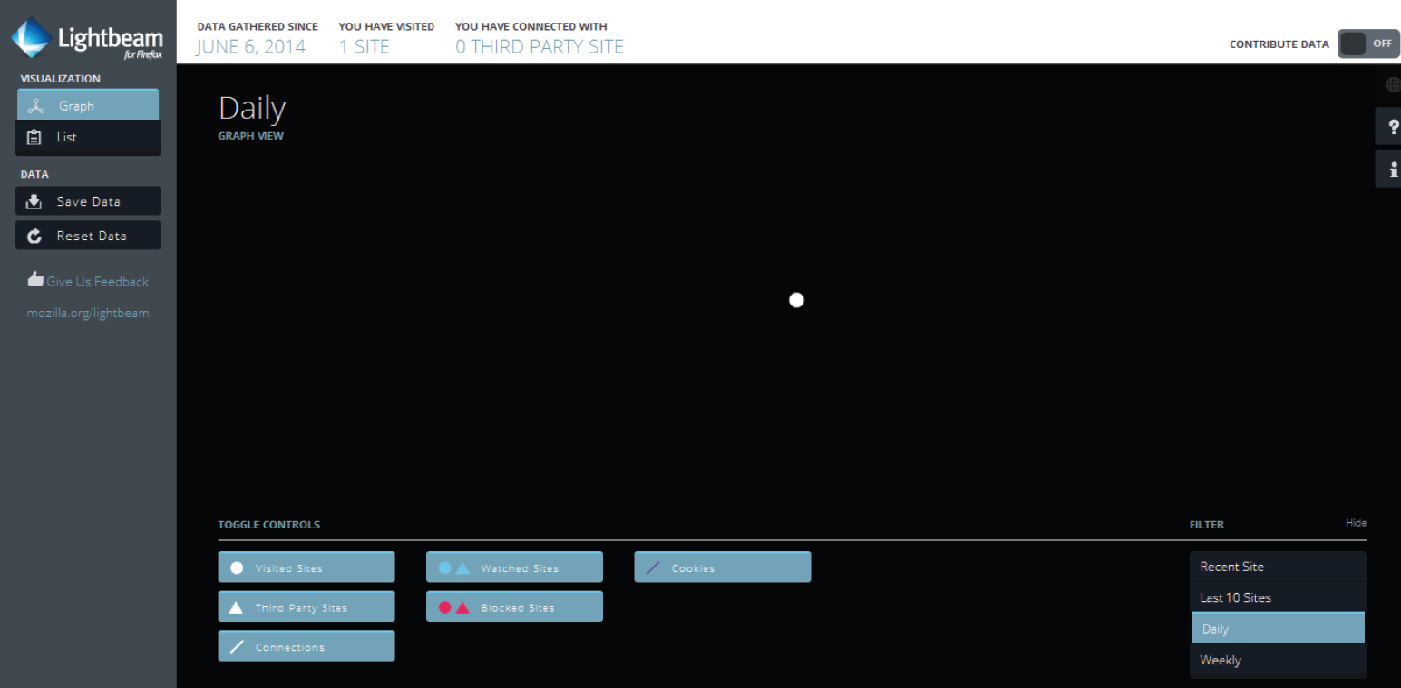
Firefox Lightbeam: Display on Start up
Case Study 3
No cookies on startup.
Figure 3-18a Third-Party Cookie Growth
Source: © Mozilla Corporation
Notes:
FireFox has an optional feature that tracks and graphs all the cookies on your computer.

Slide 41
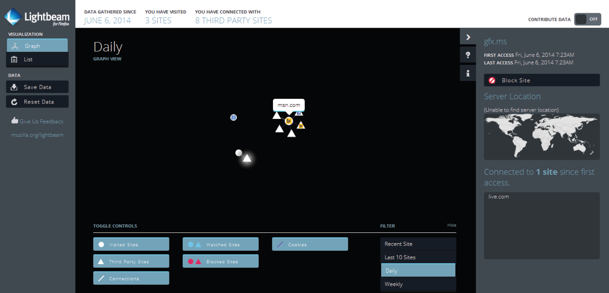
After Visiting M S N.com
Case Study 3
After M S N.com and Gmail.
Figure 3-18b Third-Party Cookie Growth
Source: © Mozilla Corporation
Notes:
Who are these companies that are gathering my browser behavior data? If you hold your mouse over one of the cookies, it will highlight the data and source location.

Slide 42
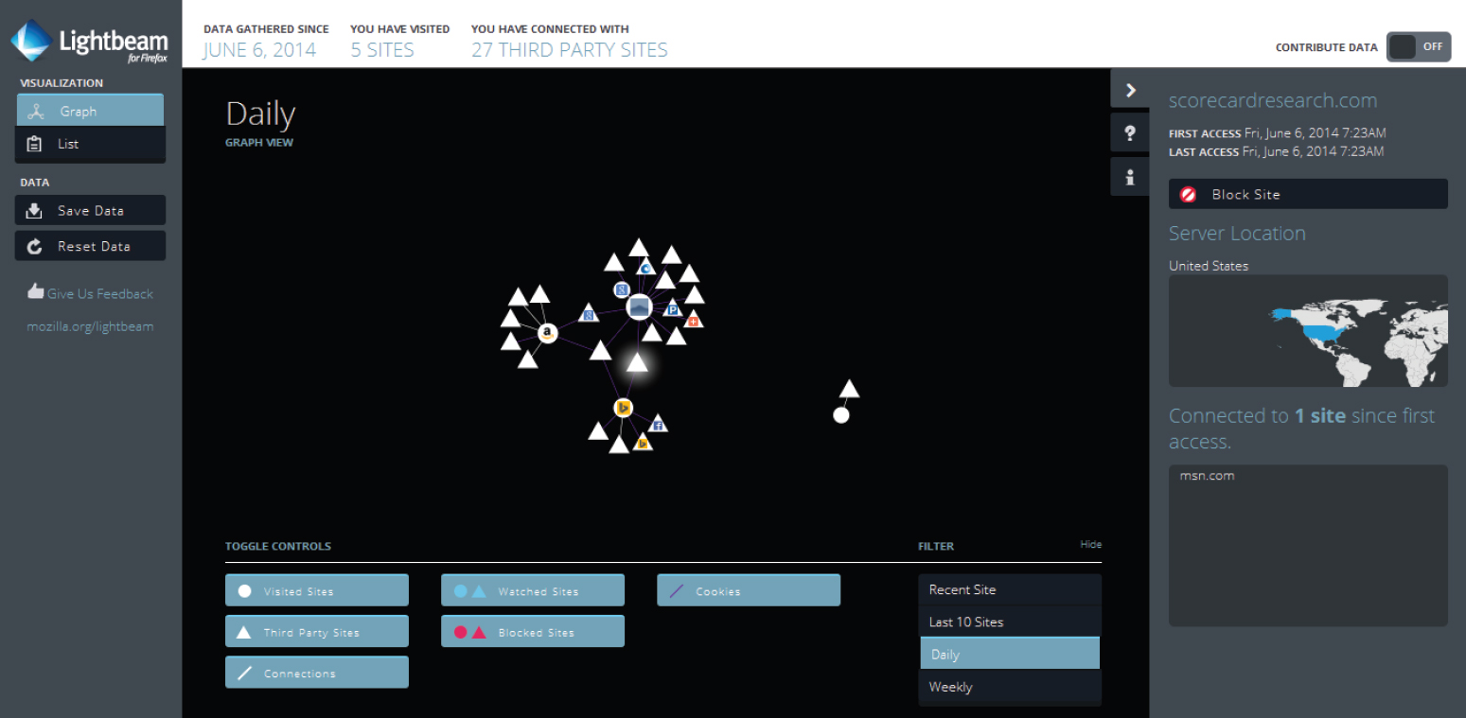
5 Sites Visited Yields 27 Third Parties
Case Study 3
Five sites visited yield 27 third parties.
Figure 3-18c Third-Party Cookie Growth
Source: © Mozilla Corporation

Slide 43
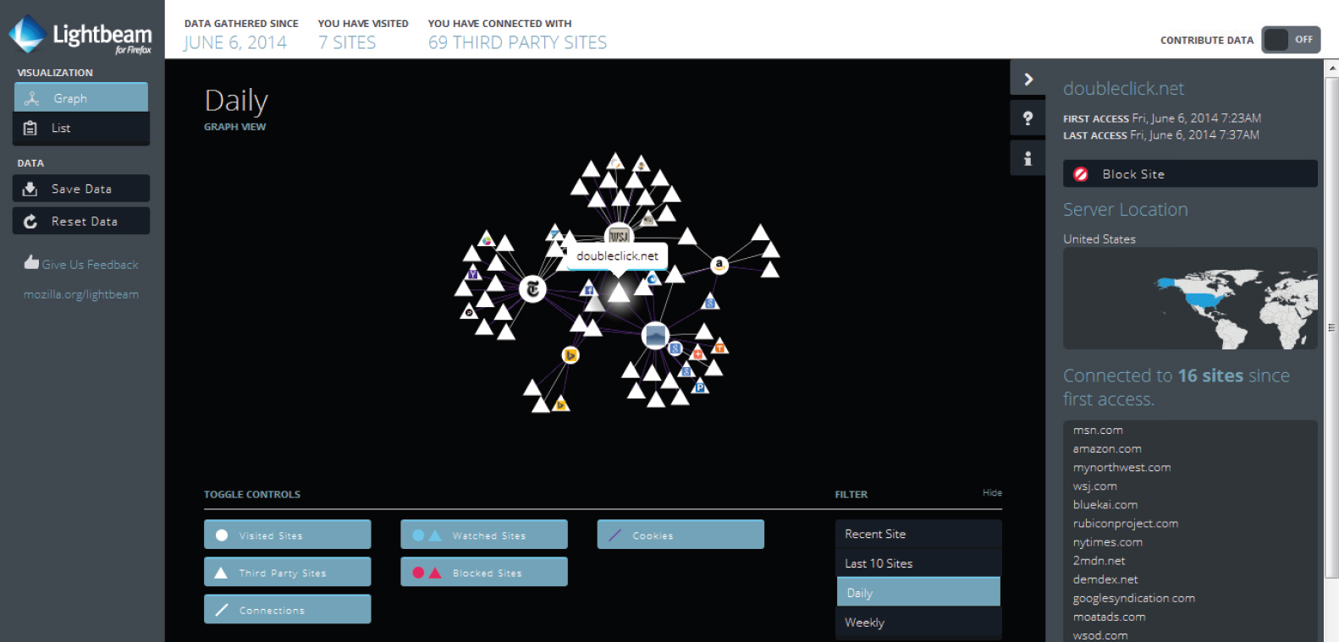
Sites Connected to Doubleclick
Case Study 3
Sites connected to DoubleClick.
Figure 3-18d Third-Party Cookie Growth
Source: © Mozilla Corporation

Slide 44

Copyright

