Slide 1

Experiencing M I S
Ninth Edition
Chapter 7
Collaboration Information Systems for Decision Making, Problem Solving, and Project Management
Copyright © 2021, 2019, 2017 Pearson Education, Inc. All Rights Reserved
Notes:
If this PowerPoint presentation contains mathematical equations, you may need to check that your computer has the following installed:
1) MathType Plugin
2) Math Player (free versions available)
3) NVDA Reader (free versions available)

Slide 2
“We could also sell virtual spinning classes...”
How is ARES going to make money?
Selling an app to consumers
Revenue sharing with instructors
In-app advertising revenue
Celebrity rides
Corporate wellness programs?
Healthy employees might have fewer health issues, be more energetic, and have fewer sick days.
Notes:
These questions get to the issue of how to monetize the ARES system.
Provide a setting for students “to assess, evaluate, and apply emerging information technology to business.” (One of the major goals of the text from Chapter 1.)
Connect applications of IS to the fundamentals presented in Chapters 1–6.
Show a realistic application of digital reality + cloud technology.
Demonstrate the need for, the creation of, and some of the issues involving an inter-enterprise IS.
Illustrate one realistic outcome for a startup… the originator, here Dr. Flores, cannot make a go of it, so investors buy it for pennies on the dollar and change the strategy. Will there be success?

Slide 3
Study Questions
7-1 What are the two key characteristics of collaboration?
7-2 What are three criteria for successful collaboration?
7-3 What are the four primary purposes of collaboration?
7-4 What are the components and functions of a collaboration information system?
Notes:
This chapter investigates ways information systems can support collaboration. It defines collaboration; discusses collaborative activities and criteria for successful collaboration; discusses kinds of work collaborative teams do, requirements for collaborative information systems; and discusses important collaborative tools for improving communicating content.

Slide 4
Successful Collaboration
7-1 What are the two key characteristics of collaboration?
People working together to achieve a common goal.
Feedback and iteration
Cooperation lacks feedback and iteration loop.
Notes:
Cooperation occurs when people divide the project into separate tasks, and work independently without consultation with the other group members.
Members of a collaborative group work together to achieve a common goal via a process of feedback and iteration to communicate, share information and knowledge, combine skills, and share time.

Slide 5
Importance of Effective Critical Feedback
7-1 What are the two key characteristics of collaboration?
Members learn from each other.
Provide constructive criticism—both positive and negative advice given to improve an outcome.
Be willing to express different, even unpopular, ideas. (Important)
Avoid groupthink—the desire for group cohesion.
Collaborator business experience not important.
Being popular or well organized not important.

Slide 6
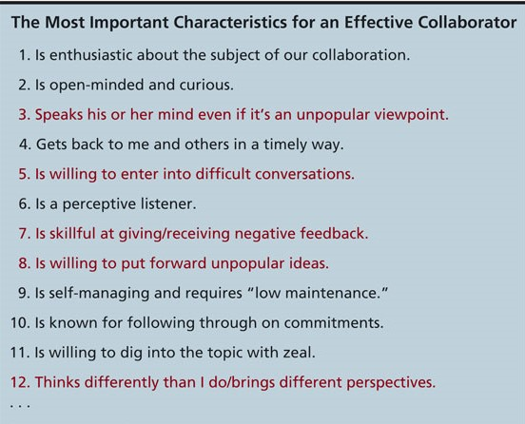
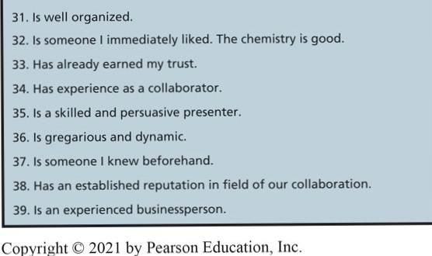
Important Characteristics of a Collaborator
7-1 What are the two key characteristics of collaboration?
Figure 7-1 Important Characteristics of a Collaborator
Notes:
Qualities, attitudes and skills of a good collaborator are shown here. Most students are surprised to learn that 5 of the top 12 characteristics involve disagreement.
Most students think avoiding conflict and having similar ideas and opinions makes a group better. While social ability is important, research indicates the importance of having different ideas and opinions expressed.

Slide 7
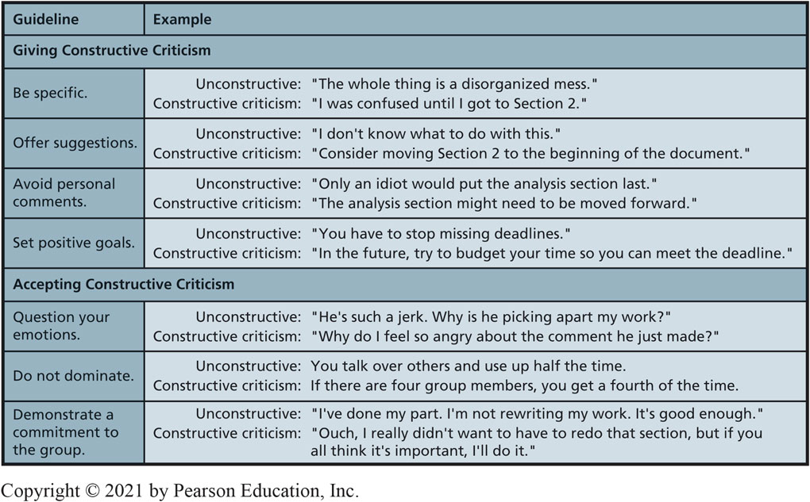
Guidelines for Giving and Receiving Constructive Criticism
7-1 What are the two key characteristics of collaboration?
Figure 7-2 Guidelines for Giving and Receiving Constructive Criticism
Notes:
When forming a collaborative group, it’s useful to begin with a discussion of how to give constructive criticism.

Slide 8
Successful Collaboration
7-2 What are three criteria for successful collaboration?
Criteria for judging team success:
Successful outcome. (Achieved objectives)
Growth in team capability over time.
Meaningful and satisfying experience.
Notes:
Hackman's three criteria for judging team success.
“Did we do it within the time and budget allowed?”
“Did the team get better?” As a team gets better, it becomes more efficient; thus, provides more service for a given cost or the same service for less cost. Better work processes, coordination, knowledge, task skills, communication.
The nature of team goals is a major factor in making work meaningful, rewards and credit, develop camaraderie.

Slide 9
Why Collaborate?
7-3 What are the four primary purposes of collaboration?
Become informed.
Share data & communicate interpretations.
Develop & document shared understandings.
Make decisions.
Solve problems.
Manage projects.
Notes:
These four purposes build on each other.
Importance of project management increases as group size, project scope, and complexity increase.
Use the hierarchy of these four purposes to build your professional skills.

Slide 10
Understanding Decision Making
7-3 What are the four primary purposes of collaboration?
Decision Levels
Operational Decisions—support day-to-day activities
Managerial Decisions—support resource allocation
Strategic Decisions—support broad organizational decisions
Decision Processes
Structured—solution method is understood and agreed upon
Unstructured—no understood and accepted solution method

Slide 11
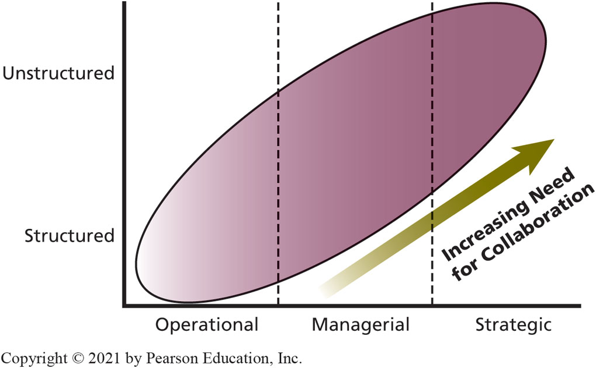
Collaboration Needs for Decision Making
7-3 What are the four primary purposes of collaboration?
Figure 7-3 Collaboration Needs for Decision Making
Notes:
There are three levels of decisions in an organization: operational, managerial, and strategic.
This figure depicts the relationships among problem structure, management levels, and degree of collaboration.
Note that “problem structure” refers to the method or process by which the decision is to be made, but not to the nature of the underlying problem.

Slide 12
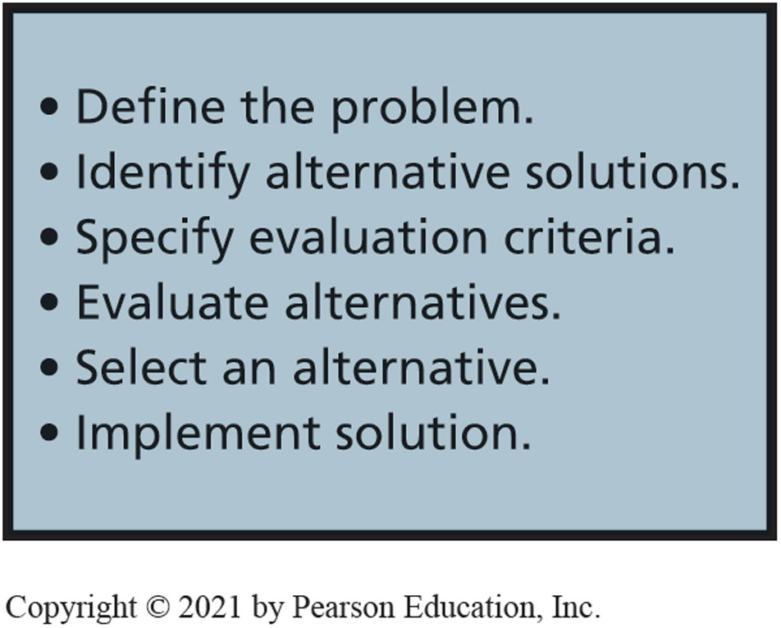
Solving Problems (Tasks)
7-3 What are the four primary purposes of collaboration?
Figure 7-4 Problem-Solving Tasks
Notes:
People confronting the same problem can define it differently due to experience, education, training, personal goals, or job responsibilities. A problem-solving group needs to develop a shared definition of the problem through research, discussion and compromise.
Identifying possible solutions may involve investigative research, and brainstorming.
Evaluating alternatives involves comparing test results to identify and eliminate infeasible, substandard, or unacceptable solutions and to identify feasible, superior or acceptable solutions.
Selecting a solution may be based on majority vote, consensus, or compromise.
Implementing selected solution includes monitoring and modifying the chosen solution as needed.

Slide 13
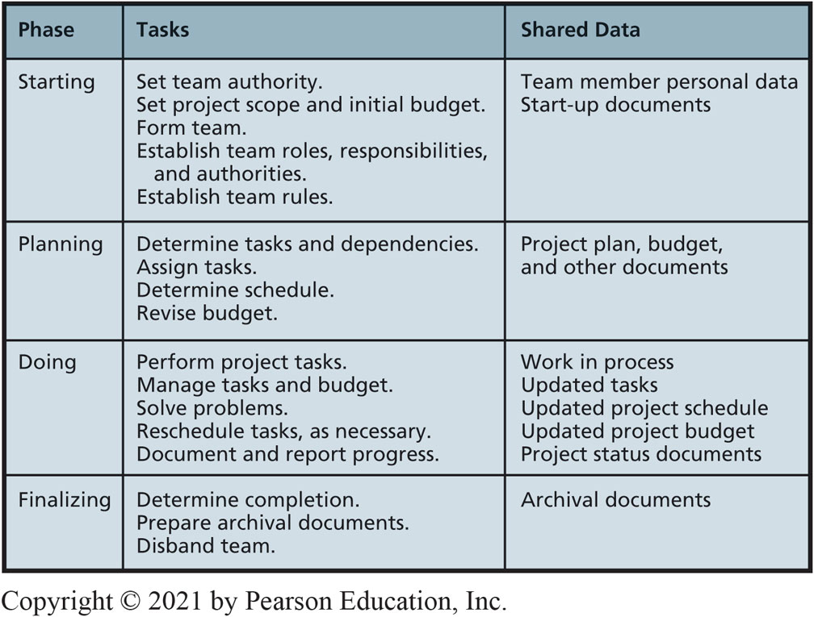
Managing Projects
7-3 What are the four primary purposes of collaboration?
Figure 7-5 Project Management Tasks and Data
Notes:
This table shows the four phases of project management, major tasks of each, and the kind of data collaborative teams need to share.

Slide 14
Future of the Gig Economy
So What?
The gig economy is where businesses hire many people as independent contractors for a short period of time.
Short-term employees can work remotely over high-speed Internet connections.
Businesses don’t have to pay for expensive office space, retirement, and benefits.
Employees can work as much or as little as they want and get paid well to do so.

Slide 15
Future of the Gig Economy (con’t)
So What?
Workers participating in the gig-economy model could surpass 40% of the workforce by 2020.
What are some of the downsides of being a worker in the gig economy?
Are there any technologies that may help gig workers feel more integrated with the clients for which they work?
Should gig workers receive benefits and be considered “employees”? Why?

Slide 16
Collaboration Information Systems
7-4 What are the components and functions of a collaboration information system?
Hardware
Software
Data and metadata
Procedures
People
Know when and how to use.
Notes:
This is based on the five IS components model. Project metadata is data used to manage the project.
Hardware—including mobile devices
Software—email, text messaging, collaborative support tools.
Data—Google Drive, Microsoft OneDrive, project data and metadata.
Procedures for using—Microsoft Office Online (Lync).
People—know when and how to use.

Slide 17
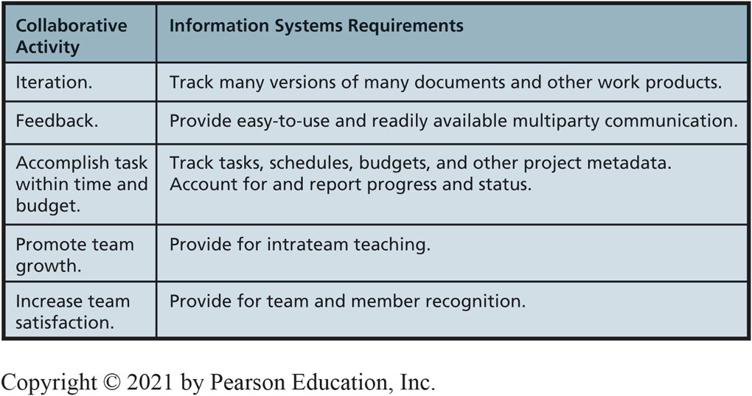
Collaboration System Requirements
7-4 What are the components and functions of a collaboration information system?
Figure 7-6 Collaboration System Requirements
Notes:
Figure 7-6 shows requirements for growth in team capability, and for creating a meaningful and satisfying experience.

Slide 18
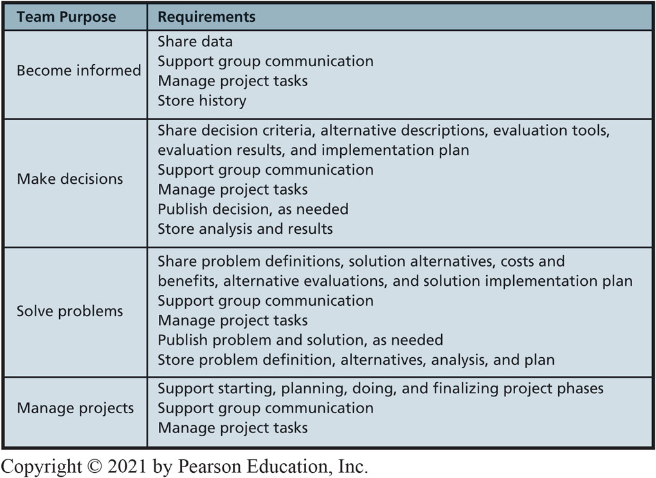
Requirements for Different Collaboration Purposes
7-4 What are the components and functions of a collaboration information system?
Figure 7-7 IS Requirements for Different Collaboration Purposes
Notes:
Figure 7-7 lists the four purposes of collaboration activities and summarizes IS requirements for collaboration systems for each purpose. When you construct a collaboration IS, first determine the type of effort you are engaged in, then determine your requirements.

Slide 19
How Does the Knowledge in this Chapter Help You?
Business professionals need to know how collaboration IS can improve team performance
You understand how to collaborate effectively with your future co-workers
Giving and receiving critical feedback
Avoiding groupthink
Understanding what and how IS can support teamwork

Slide 20
Big Brother Wearables (1 of 3)
Ethics Guide
Richie agrees to wear a biological profiling and health tracking device.
Paid a $150 bonus as part of an incentive program at work to help employees be healthier.
Sal, his boss, tells him his performance is unacceptable.
Richie is over-fatigued from too much cycling.

Slide 21
Big Brother Wearables (2 of 3)
Ethics Guide
How would you feel if your employer began monitoring your computer activity and physiological state?
Is monitoring the physiology and computer behavior of employees ethical?
Categorical imperative—What you ought to do, independent of your own wants.
Utilitarianism—The morality of an act is determined by its outcome.

Slide 22
Big Brother Wearables (3 of 3)
Ethics Guide
Would this type of monitoring change your behavior both inside and outside of work?
Would you consider this an invasion of your privacy?
Patient data collected by healthcare providers is one of the most sensitive types of data.
What are some of the risks and liabilities facing companies if they decide to use wearable technologies to monitor employees?

Slide 23
Senior Product Manager
Career Guide
Christi Wruck at Instructure
Q. What attracted you to this field?
A. “I was working in a different field but was regularly considered the resident techie. I built Web sites and databases and set up networks and systems for the nonprofits that employed me. I was good at it, and I enjoyed it. So I decided to move into this field.”
Q. What advice would you give to someone who is considering working in your field?
A. “Study Agile, UX/UI design, project management, and SCRUM, and learn how to write at least a little bit of code.”

Slide 24
Active Review
7-1 What are the two key characteristics of collaboration?
7-2 What are three criteria for successful collaboration?
7-3 What are the four primary purposes of collaboration?
7-4 What are the components and functions of a collaboration information system?
Notes:
This chapter investigates ways information systems can support collaboration. It defines collaboration; discusses collaborative activities and criteria for successful collaboration; discusses kinds of work collaborative teams do, requirements for collaborative information systems; and discusses important collaborative tools for improving communicating content.

Slide 25
Airbnb
Case Study 7
Airbnb is a business based on sharing referred to as collaborative consumption.
Consumers can temporarily share their assets with other consumers via renting or lending, Airbnb charges a fee for this service.
Airbnb doesn’t own any hotels, yet it is the largest accommodation provider in the world.
A big part of collaborative consumption is feedback.
Notes:
Airbnb is the largest hotel chain in the world. It’s even bigger than the next five largest hotel brands combined. And it doesn’t own a single hotel property. Airbnb is a $35 billion company.

Slide 26
Airbnb (con’t)
Case Study 7
Why did it take 13 years for someone to start a company like Airbnb?
What other markets might benefit from collaborative consumption?
Would companies like Airbnb and Uber help economies or hurt them? Why?
Why would reviews be more important to a smaller host compared to a large 200-room hotel?
Notes:
Airbnb logs more than 100 million stays per year in spaces that would have otherwise remained unused. Thanks to Airbnb, consumers are now able to generate income from their previously unused spaces by temporarily renting to other consumers.

Slide 27

Copyright

