Slide 1

Experiencing M I S
Ninth Edition
Chapter 8
Processes, Organizations, and Information Systems
Copyright © 2021, 2019, 2017 Pearson Education, Inc. All Rights Reserved
Notes:
If this PowerPoint presentation contains mathematical equations, you may need to check that your computer has the following installed:
1) MathType Plugin
2) Math Player (free versions available)
3) NVDA Reader (free versions available)
This chapter explores processes and their supporting information systems within levels of an organization.
Investigate three types of processes and the scope of information systems that they use; investigate the concept of process quality and explain how information systems can be used to increase it; discuss how the use of information systems at one level of organization leads to information silos, explain the problems of such silos, and show how those problems can be solved by information systems at the next level of organization; discuss how enterprise systems such as CRM, ERP, and EAI can help eliminate information silos; wrap up by showing how interenterprise IS can solve problems of enterprise-level silos.

Slide 2
“I Got the Email, but I Couldn’t Download the Attachment.”
Difficult for everyone to attend meetings
Wastes time covering old ground
Cell phone calls interrupt meeting
Felix not reading meeting minutes
“I got the email, but I couldn’t download the attachment.”
Poor communication
Interpersonal conflicts
Notes:
Group needs better communication.
Illustrates a dysfunctional meeting.
Show some of the disadvantages of face-to-face meetings.
Show some of the disadvantages of a group’s use of email.
Look at the statement and behaviors of Felix. It appears he is disassociated from the group. Have the class identify those clues. Downloading an attached Word or pdf isn’t complicated. So, did Felix really try? If he had a problem downloading the file, why didn’t he try to solve it?

Slide 3
Study Questions
8-1 What are the basic types of processes?
8-2 How can information systems improve process quality?
8-3 How do enterprise systems solve the problems of departmental silos?
8-4 How do CRM, ERP, and EAI support enterprise processes?
8-5 What are the challenges of implementing and upgrading enterprise information systems?
8-6 How do inter-enterprise IS solve the problems of enterprise silos?

Slide 4
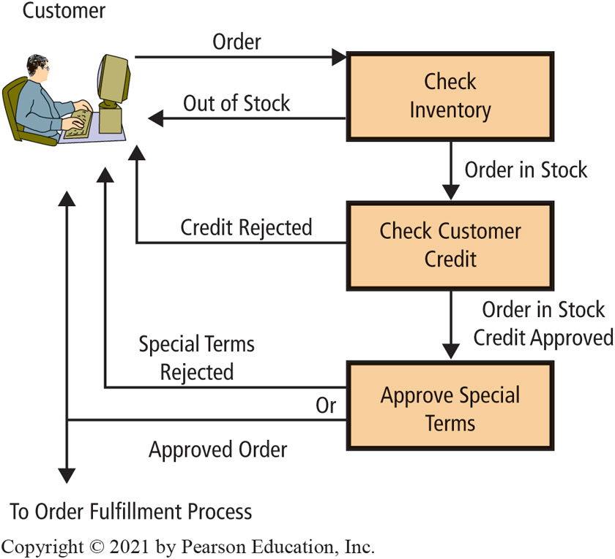
Figure 8-1 Business Process with Three Activities
8-1 What are the basic types of processes?
Figure 8-1 Business Process with Three Activities
Notes:
This is a simplified view of a three-activity process for approving customer orders.

Slide 5
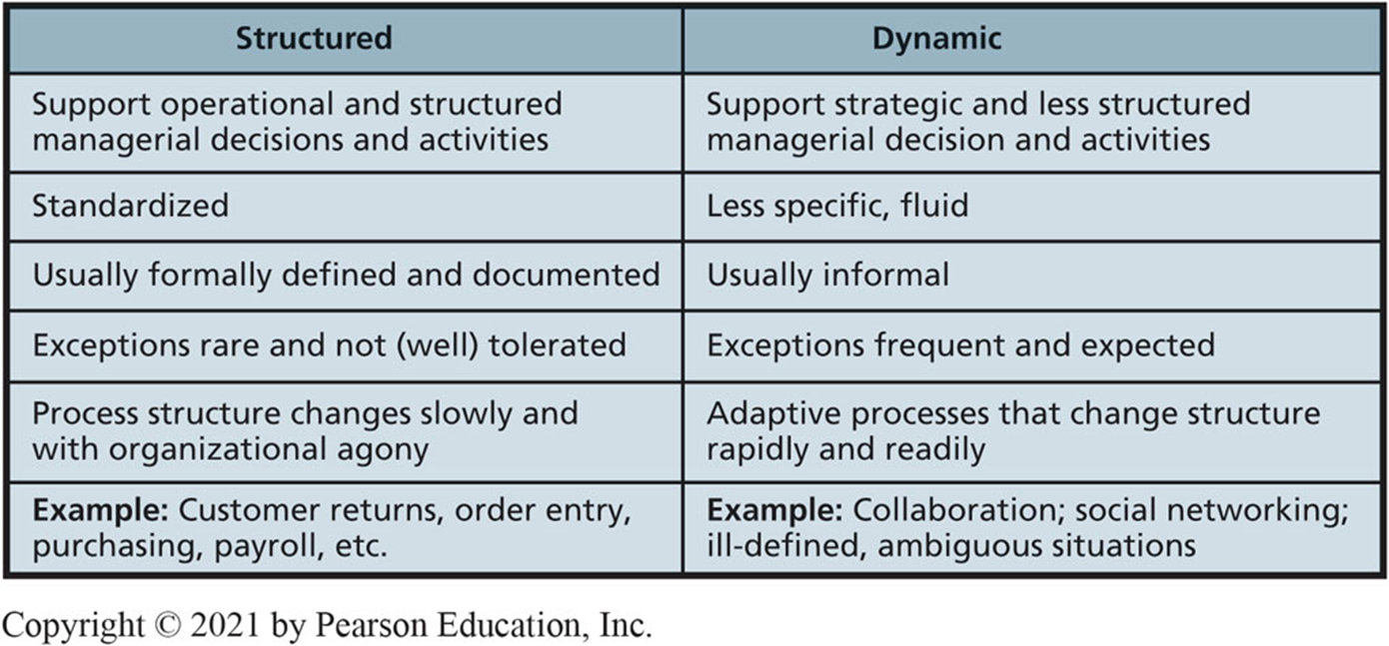
Figure 8-2 Structured Versus Dynamic Processes
8-1 What are the basic types of processes?

Slide 6
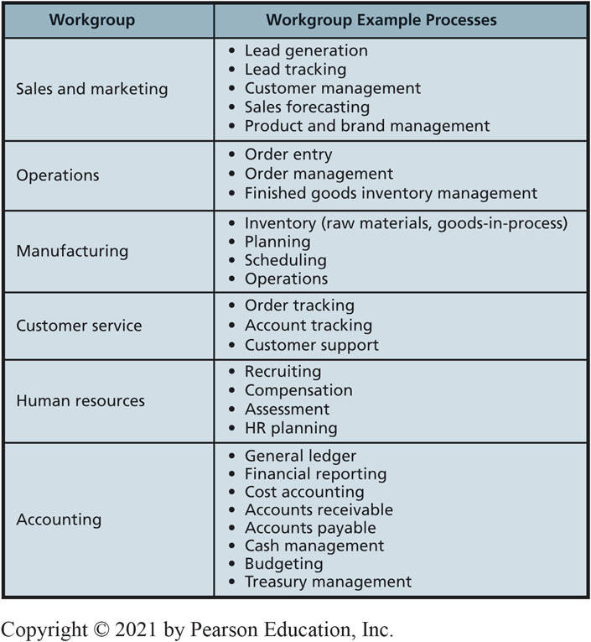
Figure 8-3 Common Workgroup Processes
8-1 What are the basic types of processes?

Slide 7
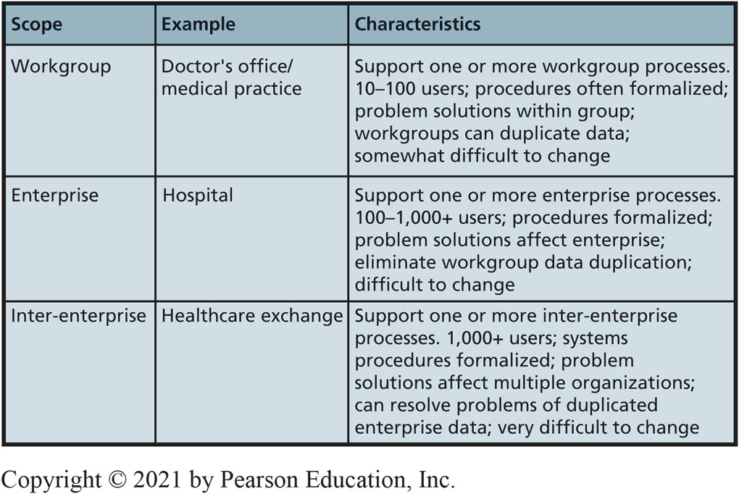
Figure 8-4 Characteristics of Information Systems
8-1 What are the basic types of processes?

Slide 8
Improving Process Quality
8-2 How can information systems improve process quality?
Process efficiency
Ratio of outputs to inputs
Process effectiveness
How well a process achieves organizational strategy
How can processes be improved?
Change process structure
Change process resources
Change both

Slide 9
Improving Process Quality (con’t)
8-2 How can information systems improve process quality?
Performing an activity
Partially automated, completely automated
Augmenting human performing activity
Ex: Common reservation system
Controlling data quality
Ensure data complete and correct before continuing process activities

Slide 10
Eliminating Information Silos
8-3 How do enterprise systems solve the problems of departmental silos?
What are the problems of information silos?
Data duplicated.
Data inconsistency.
Data isolated.
Disjointed processes.
Lack of integrated enterprise information.
Inefficiency: decisions made in isolation.
Increased cost for organization.
Notes:
An information silo exists when data are isolated in separated information systems.
Information system silos arise when:
IS supports departmental processes rather than enterprise-level processes.
Personal and workgroup support applications are created over time.
Organizations grow, especially by merger and acquisitions.

Slide 11
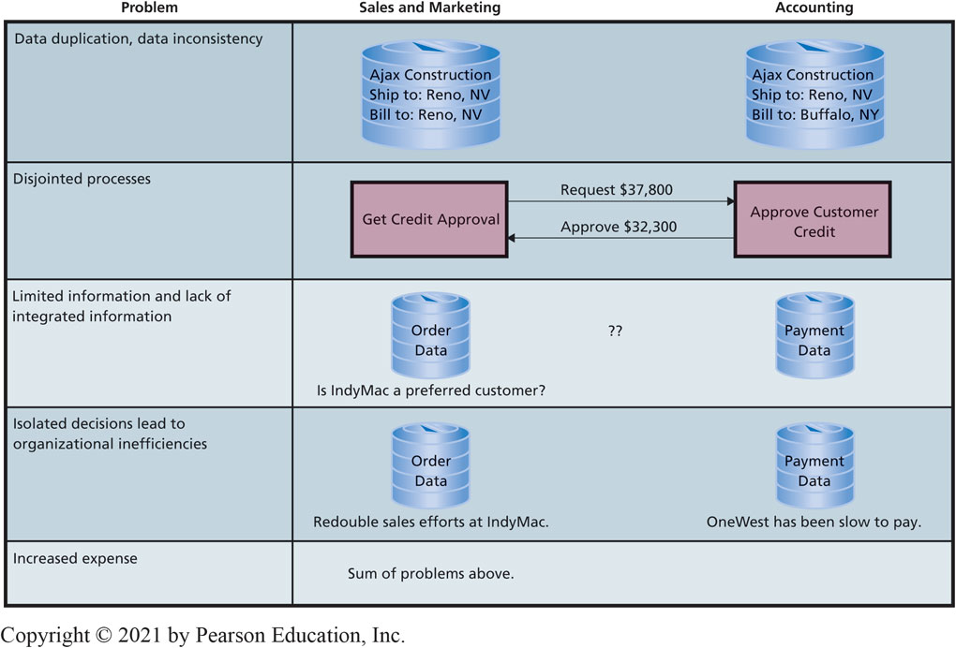
Problems Created by Information Silos
8-3 How do enterprise systems solve the problems of departmental silos?
Figure 8-5 Problems Created by Information Silos
Notes:
This table summarizes problems of information silos.
Duplicated and inconsistent data
Separated supporting applications; difficult for two activities to reconcile their data, getting approvals will be slow and possibly erroneous
Lack of integrated enterprise data as a consequence of disjointed systems
Inefficiency results from making decisions in isolation
Information silos increase costs—duplicated data, disjointed systems, limited information, and inefficiencies all mean higher costs

Slide 12
Solving the Problems of Information Silos (1 of 2)
8-3 How do enterprise systems solve the problems of departmental silos?
Integrate into single database.
Revise applications.
Allow isolation, manage to avoid problems.

Slide 13
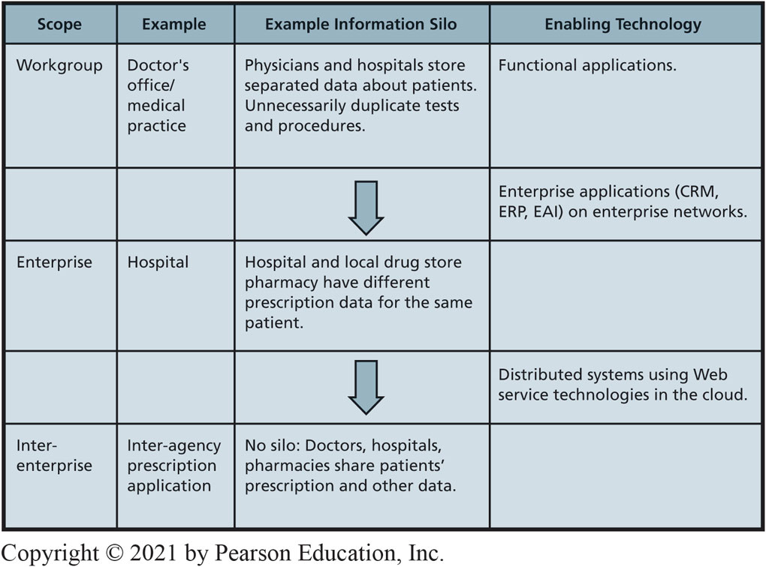
Solving the Problems of Information Silos (2 of 2)
8-3 How do enterprise systems solve the problems of departmental silos?
Figure 8-6 Information Silos as Drivers
Notes:
The arrows in Figure 8-6 show this resolution at two levels of organization.
First, isolated data created by workgroup information systems are integrated using enterprise-wide applications.
Second, today, isolated data created by information systems at the enterprise level are integrated into inter-enterprise systems using distributed applications.

Slide 14
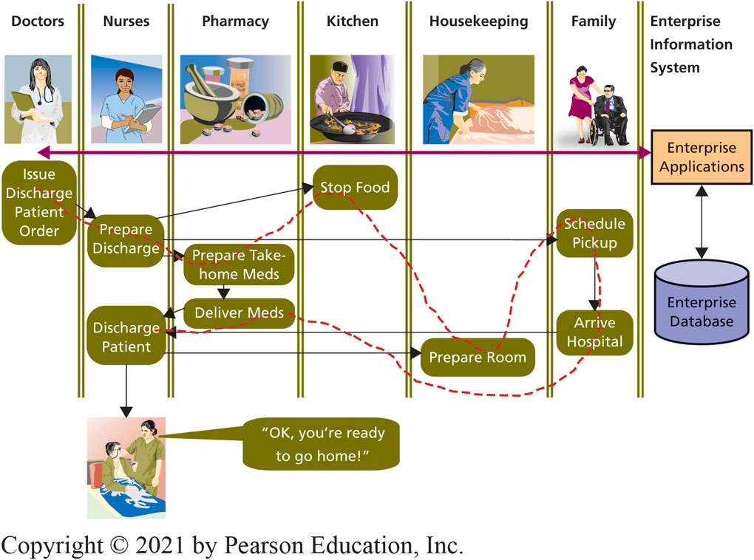
An Enterprise System for Patient Discharge
8-3 How do enterprise systems solve the problems of departmental silos?
Figure 8-7 Example Enterprise Process and Information System
Notes:
Hospital uses an enterprise-wide information system to support this process. IS provides data entry forms, reports, and notifications to human actors in this process. It also controls the flow of process activity as shown by dotted arrow.
To use new system, staff needs to transition from a paper-based system to computer-based one.

Slide 15
Business Process Reengineering
8-4 How do CRM, ERP, and EAI support enterprise processes?
Business Process Reengineering (B P R)
Integrated data, enterprise systems create stronger, faster, more effective linkages in value chains.
Difficult, slow, exceedingly expensive.
Key personnel determine how best to use new technology.
Requires high-level and expensive skills and considerable time.

Slide 16
Emergence of Enterprise Application Solutions
8-4 How do CRM, ERP, and EAI support enterprise processes?
Inherent processes
Predesigned processes for using application.
“Industry best practices.”
Customer relationship management (C R M).
Enterprise resource planning (E R P).
Enterprise application integration (E A I).
Notes:
Organizations can license software and obtain prebuilt procedures. Over time, three categories of enterprise applications have emerged: customer relationship management, enterprise resource planning, and enterprise application integration.

Slide 17
Customer Relationship Management (C R M)
8-4 How do CRM, ERP, and EAI support enterprise processes?
Suite of applications, database, set of inherent processes.
Manage all interactions with customer through four phases of customer life cycle.
Marketing, customer acquisition, relationship management, loss/churn.
Supports customer-centric organization.

Slide 18
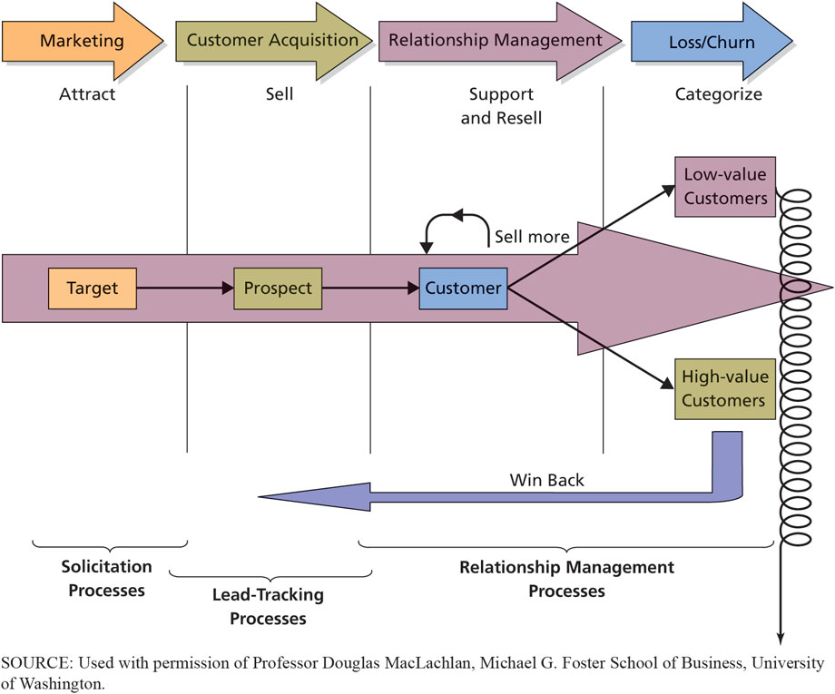
Customer Life Cycle
8-4 How do CRM, ERP, and EAI support enterprise processes?
Figure 8-8 The Customer Life Cycle
Notes:
Notice that components exist for each stage of the customer life cycle. As shown, all applications process a common customer database. This design eliminates duplicated customer data and removes the possibility of inconsistent data.
Marketing sends messages to target market to attract customer prospects. When prospects order, they become customers who need to be supported. Additionally, relationship management processes increase the value of existing customers by selling them more products.
Over time, organization loses some customers. When this occurs, win-back processes categorize customers according to their value and attempt to win back and turn them into high-value customers.

Slide 19
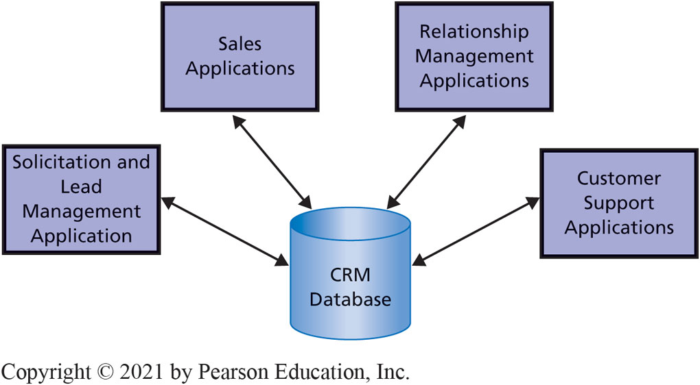
C R M Applications
8-4 How do CRM, ERP, and EAI support enterprise processes?
Figure 8-9 C R M Applications
Notes:
CRM components exist for each stage of the customer life cycle. As shown, all applications process a common customer database. This design eliminates duplicated customer data and removes the possibility of inconsistent data. It also means that each department knows what has been happening with the customer at other departments.

Slide 20
Digital Dining?
So What?
CaliBurger started testing a burger-flipping robot named Flippy in its Pasadena restaurant
Cooks about 150 burgers per hour
Plans to deploy Flippy robots in 50 of its locations
Payback in a few years:
Run around the clock
No personal/vacation days
No onboarding, training, or management
Notes:
To do this well, you need to know IS and something: IS and marketing, IS and operations, IS and finance.

Slide 21
Digital Dining? (con’t)
So What?
The robotic barista from Café X costs $25,000
Makes 150 cups of custom coffee per hour
Doesn’t need to be tipped
Payback period is about 2 years
Will major chains adopt robotic workers?
Can they remain competitive with human workers?
The company selling these robots will employ a lot of well-paid people to make, sell, maintain, and replace these machines increasing human jobs
Notes:
To do this well, you need to know IS and something: IS and marketing, IS and operations, IS and finance.

Slide 22
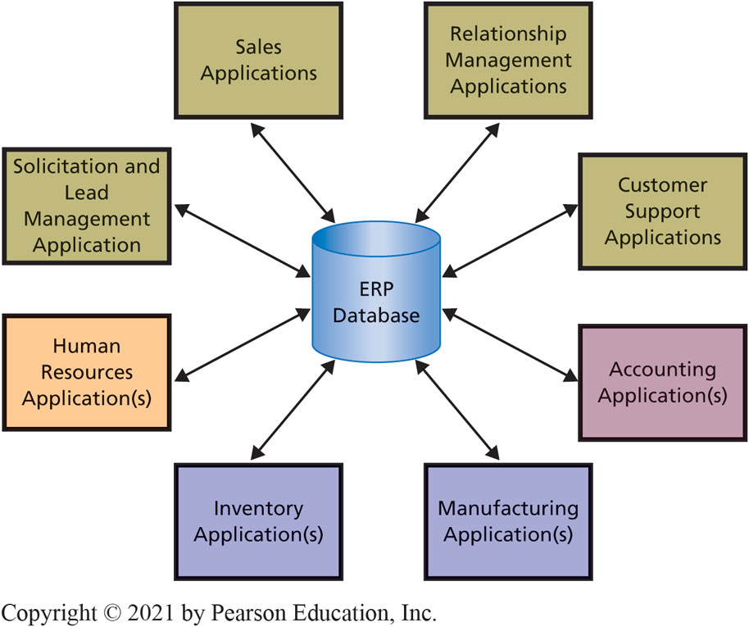
E R P Applications
8-4 How do CRM, ERP, and EAI support enterprise processes?
E R P is a suite of applications
The primary purpose of an E R P system is integration
Integration allows real-time updates
Figure 8-10 E R P Applications
Notes:
ERP is a suite of applications (modules), a database and a set of inherent processes for consolidating business operations into a single, consistent, computing platform. ERP systems are an IS based on ERP technology.

Slide 23
Purpose of E R P Systems
8-4 How do CRM, ERP, and EAI support enterprise processes?
Suite of applications, database, and inherent processes
Consolidates business operations into a single, consistent computing platform
C R M plus accounting, manufacturing, inventory, and human resources applications
S A P offers industry-specific customize packages
Notes:
ERP — Suite of modules, a database, and set of inherent processes for consolidating business operations into a single, consistent computing platform.

Slide 24
Enterprise Application Integration (E A I)
8-4 How do CRM, ERP, and EAI support enterprise processes?
Connects system “islands”
Enables communicating and sharing data
Provides integrated information
Provides integrated layer on top of existing systems while leaving functional applications “as is”
Enables less expensive, gradual move to E R P
Notes:
EAI is a suite of software applications that integrates existing systems by providing layers of software that connect applications.

Slide 25
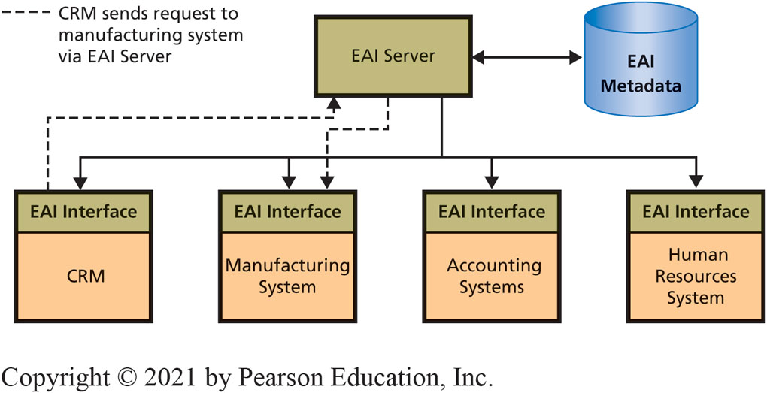
Design and Implementation for the Five Components
8-4 How do CRM, ERP, and EAI support enterprise processes?
Figure 8-11 Enterprise Application Integration (E A I) Architecture
Notes:
EAI enables organizations to use existing silo applications while eliminating many serious problems of isolated systems.

Slide 26
Factors that Make Implementing ERP Challenging
8-5 What are the challenges of implementing and upgrading enterprise information systems
Collaborative Management
Requirements Gaps
Transition Problems
Employee Resistance
New Technology

Slide 27
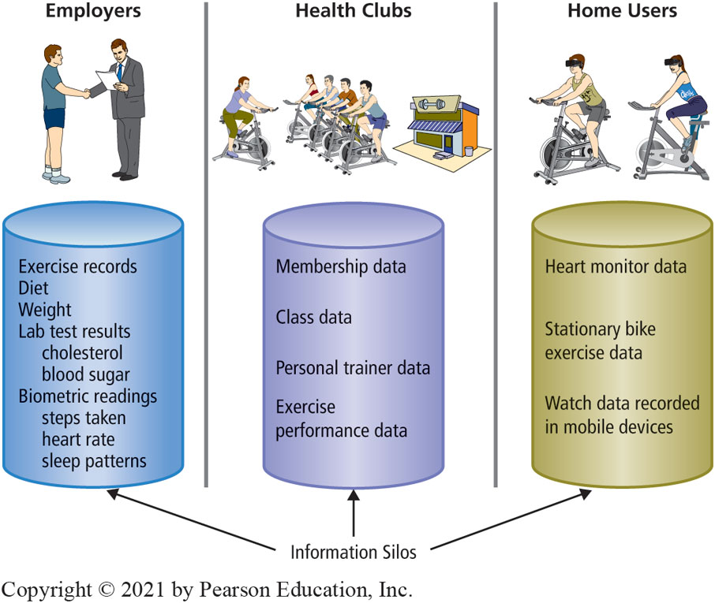
Enterprise I S Solve the Problems of Information Silos
8-6 How do inter-enterprise I S solve the problems of enterprise silos?
Figure 8-12 Information Silos Without A R E S
Notes:
Figure 8-12 shows the information silos that exist among employers, health clubs, and home users, the principal ARES users.
Isolation of data causes problems. Employers want reports on exercise data stored on user devices in health clubs. Users want data from their employers as well as exercise data from their health clubs. Health clubs want lab readings and biometric readings from employers, and home workout data to integrate with data they have.

Slide 28
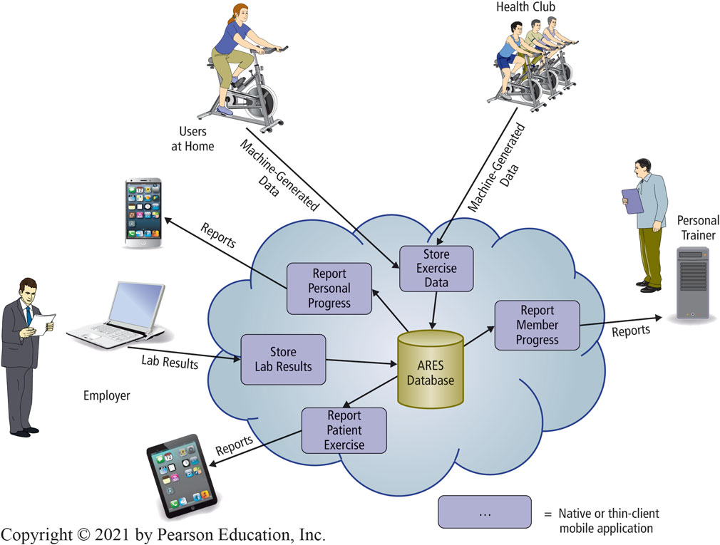
Inter-enterprise A R E S System
8-6 How do inter-enterprise I S solve the problems of enterprise silos?
Figure 8-13 Inter-enterprise A R E S System
Notes:
ARES is a distributed system because processing is distributed across multiple computing devices. Standards such as http, https, html5, css3, JavaScript, and others enable programs on varied and disparate devices to flexibly communicate with cloud servers and database, and indirectly communicate with each other.

Slide 29
How Does the Knowledge in this Chapter Help You?
You understand the basic types of processes found in business and how information systems can support those processes and improve process quality
You are aware of the problems posed by departmental silos and the types of solutions made possible by CRM, ERP, and EAI
You learned how best to implement and upgrade enterprise information systems
You are able to apply these concepts to inter-enterprise systems

Slide 30
Paid Deletion (1 of 2)
Ethics Guide
A company experiences negative press.
Manufacturing company dealing with environmental protection violations.
A popular chain of restaurants had a long list of healthcode violations.
Companies offer Eric money to tweak the results of Web searches using key terms relevant to these negative incidents.
Eric buries or deletes negative results without his employer knowing.
Notes:
Goals
Understand how business pressures motivate people to act unethically and sometimes illegally.
Discuss ethical principles about employee behavior harming his/her employer.

Slide 31
Paid Deletion (2 of 2)
Ethics Guide
What happens if someone finds out search results are being manipulated?
Eric could be fired
Company could be severely harmed
Robin could lose her job too
How might have Eric rationalized his fraudulent behavior?
Even if Eric were caught, would he be guilty of a crime?
Notes:
Do you think that removing content on the Internet and manipulating search engine results for money is ethical according to:
The categorical imperative?
The utilitarian perspective?

Slide 32
Software/Platform Engineer
Career Guide
Ben Peters at Anaconda, Inc.
Q. What attracted you to this field?
A. “I love working to solve the challenges the industry faces and having the potential to change the world. When I was exploring majors in college, I looked at factors like job demand outlook and salary potential, too. I wanted to be a part of a growing industry with lots of potential.”
Q. What advice would you give to someone who is considering working in your field?
A. “Practice, practice, and more practice! Try to get as much hands-on experience as you can while you are in school so you will stand out to future employers. Focus on grasping the fundamentals of software development, design, and architecture, and you will have a great career.”

Slide 33
Active Review
8-1 What are the basic types of processes?
8-2 How can information systems improve process quality?
8-3 How do enterprise systems solve the problems of departmental silos?
8-4 How do CRM, ERP, and EAI support enterprise processes?
8-5 What are the challenges of implementing and upgrading enterprise information systems?
8-6 How do inter-enterprise IS solve the problems of enterprise silos?

Slide 34
A Tale of Two Interorganizational I S
Case Study 8
Access C T
Enrolled 208,301 and model for state-run exchanges.
Cover Oregon
Spent $250 million for system clearly inoperable.
Exchange’s board of directors decided to stop development and utilize the federal exchange.
Notes:
Goal
Have students understand the difficulties of creating an interorganizational information system.
See the questions at the end of the case for exercises to assign to students

Slide 35
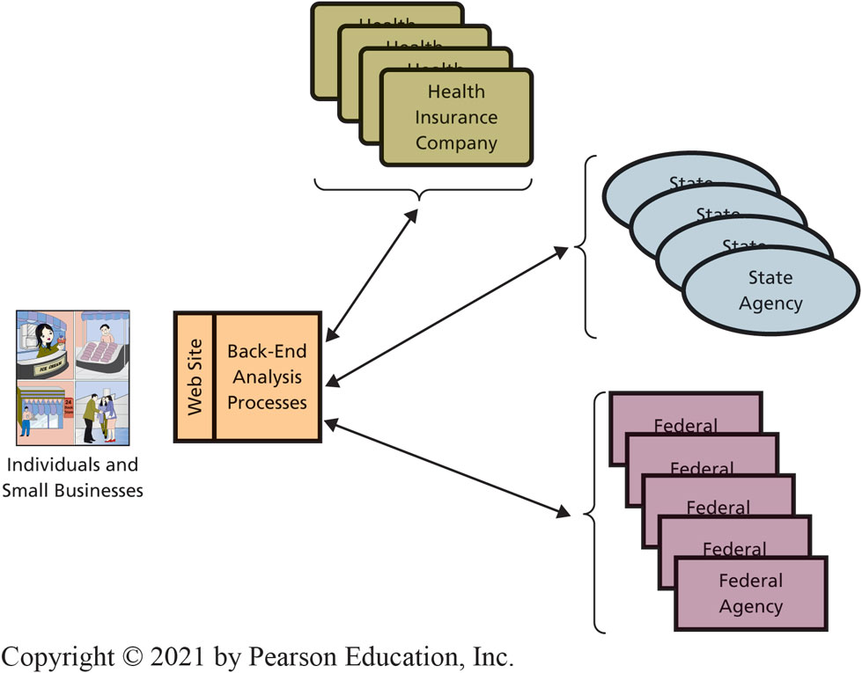
Healthcare Exchange Interorganizational IS
Case Study 8
Figure 8-16 Healthcare Exchange Interorganizational I S

Slide 36
Access C T (1 of 2)
Case Study 8
Exchange went live in only 12 months.
Counihan
More than 30 years of experience working in insurance industry.
Key player in development of Massachusetts healthcare system.
Hired senior staff with deep experience in insurance.
Notes:
Discuss IS development success factors and common failure factors.

Slide 37
Access C T (2 of 2)
Case Study 8
Wadleigh director of application development for C I G N A, a health services organization.
Primary assignment
Hire and manage an outside contractor to develop exchange website and support back-end code and to manage implementation of exchange information system.
Created project plan and began search for contractor to develop the site.

Slide 38
Cover Oregon (1 of 3)
Case Study 8
Did not hire a supervising contractor for project, instead took an active role in software’s development.
Agency suffered high employee turnover, and had difficulty hiring and keeping qualified personnel.

Slide 39
Cover Oregon (2 of 3)
Case Study 8
O H A hired software development company to create major software components.
Two of three finalists dropped out at last minute, leaving Oracle Corporation a sole source vendor.
Oracle negotiated time and materials contracts instead of contract for specific deliverables at specific prices.
When problems developed, Oracle was paid tens of millions of additional money for change orders on same time and materials basis.
Notes:
Explain problem of time-and-materials contract problems using home construction example.

Slide 40
Cover Oregon (3 of 3)
Case Study 8
Oregon legislature required state to hire a quality assurance contractor, Maximus Corporation, to oversee project.
Maximus reported significant problems involving divided control, lack of clear requirements, inappropriate contracting methodology, lack of project planning, and lack of progress.
Unclear who got those reports or what was done with them.
Head of O H A project threatened to withhold Maximus’ payment.
End result: Exchange development failed.

Slide 41

Copyright

