Slide 1
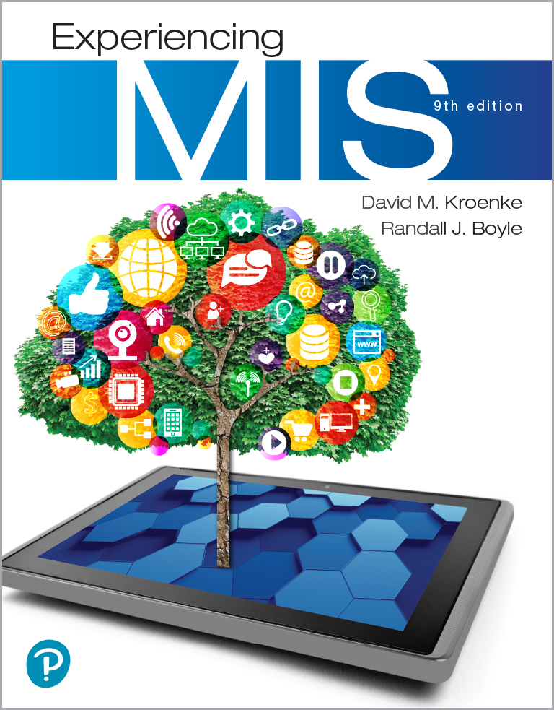
Experiencing M I S
Ninth Edition
Chapter 9
Social Media Information Systems
Slides in this presentation contain hyperlinks. JAWS users should be able to get a list of links by using INSERT+F7
Copyright © 2021, 2019, 2017 Pearson Education, Inc. All Rights Reserved
Notes:
If this PowerPoint presentation contains mathematical equations, you may need to check that your computer has the following installed:
1) MathType Plugin
2) Math Player (free versions available)
3) NVDA Reader (free versions available)

Slide 2
“In a mixed-reality environment, we can create anything, replace anything, and alter anything.”
Find ways to make A R E S profitable.
Traditionally banner ads, pop-ups, and short videos generate ad revenue.
Mixed-reality apps allows developers to create anything, replace anything, and alter anything.
Virtual 60-foot prehistoric megalodon shark.
Virtual 40-foot power bar.
Overlay virtual objects over reality.
Notes:
GOALS
Illustrate the unique opportunities possible in digital reality environments.
Illustrate how social applications can generate revenue.
Consider a unique application of social networking for fitness.
Show the difficulties inherent in the systems development process.
Show how cloud-based infrastructure can support social applications.

Slide 3
A R E S Application Prototype
Users can cycle with friends virtually.
Unsure how many users it can support.
Think about details of how system will function before estimating development costs or project timeline.
Generating revenue from social media applications difficult.
Think about ways to apply new, emerging technology to accomplish business organizational strategies.
Notes:
Technological shift creates new opportunities, but also substantial risks for developers.

Slide 4
Study Questions
9-1 What is a social media information system (S M I S)?
9-2 How do S M I S advance organizational strategy?
9-3 How do S M I S increase social capital?
9-4 How do (some) companies earn revenue from social media?
9-5 How can organizations address S M I S security concerns?
9-6 Where is social media taking us?

Slide 5
Social Media Information System (S M I S)
9-1 What is a social media information system (S M I S)?
Social media (S M)
I T for sharing content among networks of users.
Enables communities of practice.
People related by a common interest.
Social media information system (S M I S)
Sharing content among networks of users.

Slide 6
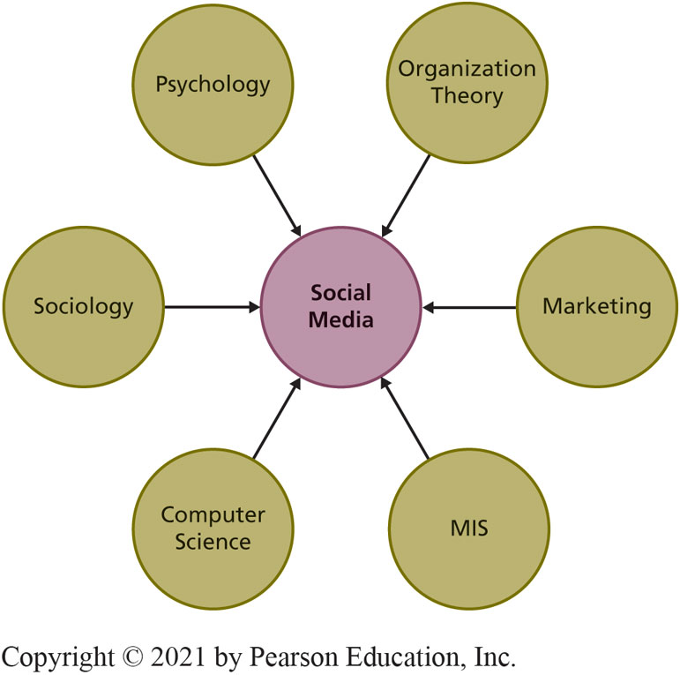
Convergence of Many Disciplines
9-1 What is a social media information system (S M I S)?
Figure 9-1 Social Media is a Convergence of Disciplines
Notes:
Focus on MIS portion of diagram by discussing SMIS and how they contribute to organizational strategy.
Social media is a convergence of many disciplines.

Slide 7
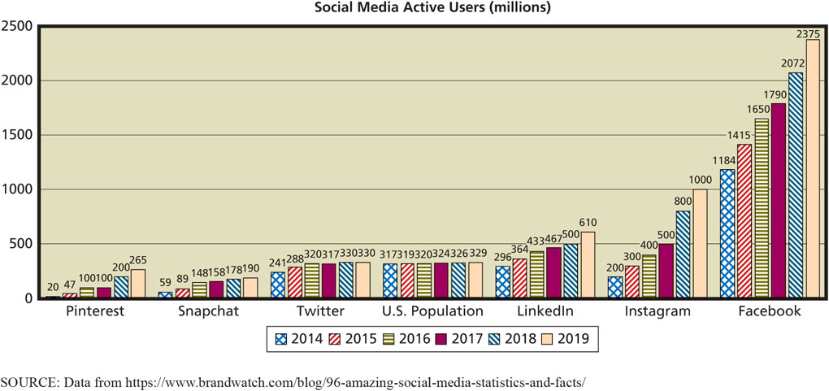
Number of Social Media Active Users
9-1 What is a social media information system (S M I S)?
Figure 9-2 Number of Social Media Active Users
Notes:
More than 72 percent of American adults use SM.
An estimated 91 percent of Fortune 500 companies maintain active Twitter accounts, 89 percent have Facebook pages, and 77 percent have YouTube accounts.

Slide 8
Three S M I S Roles
9-1 What is a social media information system (S M I S)?
Social Media Providers
Facebook, Snapchat, LinkedIn, Twitter, Instagram, and Pinterest platforms.
Attracting, targeting demographic groups.
Users
Individuals and organizations.
Communities
Mutual interests that transcend familial, geographic, and organizational boundaries.
Notes:
About 81 percent of Pinterest users are female. On LinkedIn, 61 percent of users are 30 or older.
Companies hire staff to maintain their SM presence, promote their products, build relationships, and manage their image. Depending on how organizations want to use SM, they can be users, providers, or both.

Slide 9
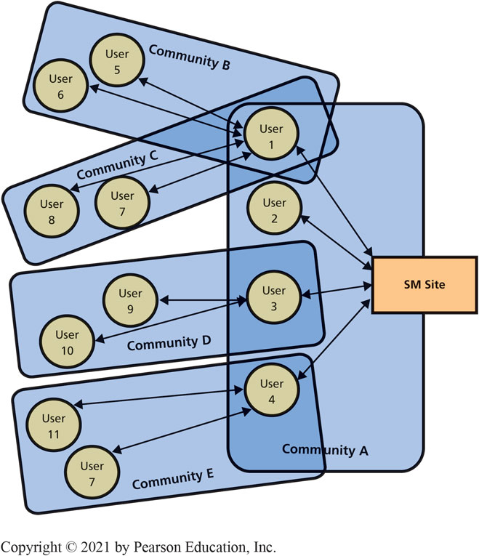
S M User Communities
9-1 What is a social media information system (S M I S)?
Figure 9-3 S M Communities
Notes:
Community A—first-tier community of users with direct relationship to the site. User 1 belongs to three communities — A, B, and C.
Communities B–E—second-tier communities intermediated by a first-tier user.
Number of second and higher tier community members grows exponentially.
Exponential nature of relationships offers sponsoring organizations both a blessing and a curse.
If social media site wants pure publicity, will need viral hook to relate to as many communities as possible.

Slide 10
Social Media Application Providers
9-1 What is a social media information system (S M I S)?
Facebook, Twitter, LinkedIn, Google…
May charge fee, depending on application and purpose.
Free company page on Facebook, but…
Fee to advertise to communities that “Like” that page.
Internal S M using SharePoint for wikis, discussion board, photo sharing.
Notes:
Larger organizations are big enough to create and manage their own internal social media platforms such as wikis, blogs, and discussion boards. Thus, becoming a social media provider.

Slide 11
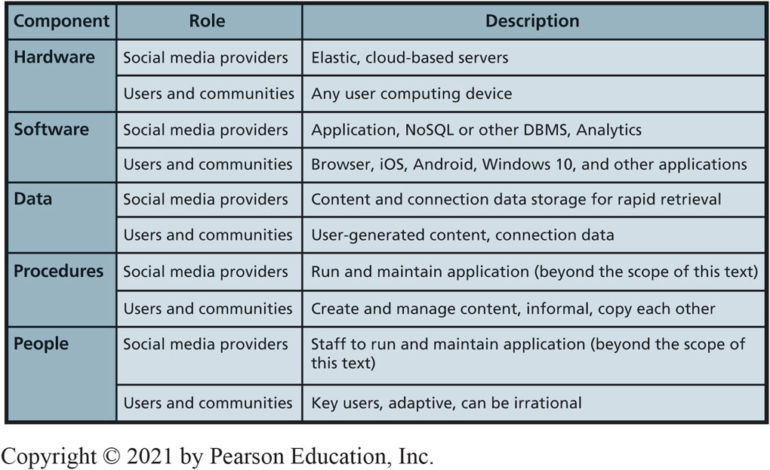
Five Components of S M I S
9-1 What is a social media information system (S M I S)?
Figure 9-4 Five Components of S M I S
Notes:
SM application providers host SM presence using elastic servers in the cloud.
Develop and operate custom, proprietary, social networking application software.
Content data—data and responses to data contributed by users and SM sponsors.
Connection data—data about relationships.
Must have procedures for creating content, managing user responses, removing obsolete or objectionable content, and extracting value from content.
Social media creates new job titles, new responsibilities, and need for new types of training.

Slide 12
S M I S and Organizational Strategy
9-2 How do S M I S advance organizational strategy?
Strategy determines value chains
Value chains determine business processes.
Processes determine S M I S requirements.
How do value chains determine dynamic processes?
Dynamic process flows cannot be designed or diagrammed.
S M fundamentally changes balance of power among users, communities, and organizations.
Notes:
In Chapter 3, Figure 3-1 (page 57), you learned the relationship of information systems to organizational strategy.

Slide 13
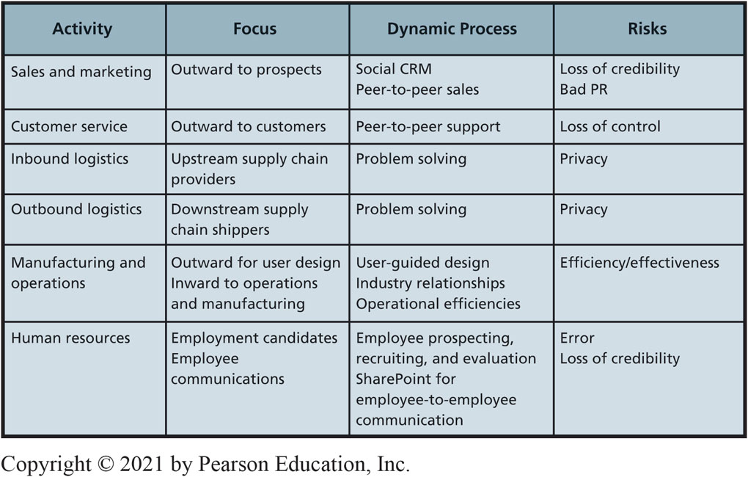
S M in Value Chain Activities
9-2 How do S M I S advance organizational strategy?
Figure 9-5 S M in Value Chain Activities
Notes:
This figure summarizes how social media contributes to five primary value chain activities and to human resources support activity.
General framework by which organizations can accomplish their strategy via a dynamic process supported by SMIS.

Slide 14
Social Media and the Sales and Marketing Activity
9-2 How do S M I S advance organizational strategy?
Dynamic, S M-based C R M process.
Social C R M
Customers craft own relationship.
Wikis, blogs, discussion lists, frequently asked questions, sites for user reviews and commentary, other dynamic content.
Customers search content, contribute reviews and commentary, ask questions, create user groups, etc.
Not centered on customer lifetime value.
Notes:
In the past, organizations controlled their relationships with customers using structured processes and related information systems. In fact, the primary purpose of traditional CRM was to manage customer touches.

Slide 15
Social Media and Customer Service
9-2 How do S M I S advance organizational strategy?
Relationships emerge from joint activity; customers have as much control as companies.
Product users freely help each other solve problems.
Selling to or through developer networks most successful.
Microsoft’s M V P program.
Peer-to-peer support risks loss of control.
Notes:
Amazon's Vine customers provide pre-release and new product reviews to the buyer community.
Many organizations struggle to make the transition from controlled, structured, traditional CRM processes to wide-open, adaptive, dynamic social CRM processes.

Slide 16
Social Media and Inbound and Outbound Logistics
9-2 How do S M I S advance organizational strategy?
Benefits
Numerous solution ideas and rapid evaluation of them.
Better solutions to complex supply chain problems.
Facilitates user created content and feedback among networks needed for problem solving.
Loss of privacy
Open discussion of problem definitions, causes, and solution constraints.
Problem solving in front of your competitors.
Notes:
The Japanese earthquake in the spring of 2011 created havoc in the automotive supply chain when major Japanese manufacturers lacked power and, in some cases, facilities to operate. Social media was used to dispense news, allay fears of radioactive products, and address ever-changing needs and problems.

Slide 17
Social Media and Manufacturing and Operations
9-2 How do S M I S advance organizational strategy?
Improves communication channels within organization and externally with consumers, design products, develop supplier relationships, and operational efficiencies.
Crowdsourcing.
Business-to-consumer (B2C) and Business-to-business (B2B).
YouTube for posting videos of product reviews and testing, factory walk-throughs.
Yammer—enterprise social networking service.

Slide 18
Social Media and Human Resources
9-2 How do S M I S advance organizational strategy?
Employee communications using internal personnel sites.
Ex: MySite and MyProfile in SharePoint.
Finding prospective employees, recruiting and evaluating candidates.
Place for employees to post their expertise.
Risks:
Forming erroneous conclusions about employees.
Pushing unpopular management message.

Slide 19
Enhanced Golf Fan
So What?
Advances in technology have changed the way we consume entertainment.
In 2017, 59% of people would rather watch a game at home than watch it live (32%).
The P G A has started providing data visualizations, advanced statistics, real-time updates, and live feeds to improve the viewing experience.
How could other sports use data analytics to enhance the viewing experience?

Slide 20
9-3 How Do S M I S Increase Social Capital?
9-3 How do S M I S increase social capital?
Capital
Investment of resources for future profit.
Types of business capital
Physical capital: produce goods and services (factories, machines, manufacturing equipment).
Human capital: human knowledge and skills investments.
Social capital: social relations with expectation of marketplace returns.

Slide 21
What is the Value of Social Capital?
9-3 How do S M I S increase social capital?
Value of social capital
Number of relationships, strength of relationships, resources controlled.
Adds value in four ways
Information
Influence
Social credentials
Personal reinforcement
Notes:
Relationships in social networks can:
Provide information about opportunities, alternatives, problems, and other factors important to business professionals.
Provide an opportunity to influence decision makers who are critical to your success.
Be a form of social credentials.
Reinforce a professional’s image and position in an organization or industry.

Slide 22
How Do Social Networks Add Value to Businesses?
9-3 How do S M I S increase social capital?
Progressive organizations:
Have Facebook, LinkedIn, Twitter, other S N sites.
Encourage customers and interested parties to leave comments.

Slide 23
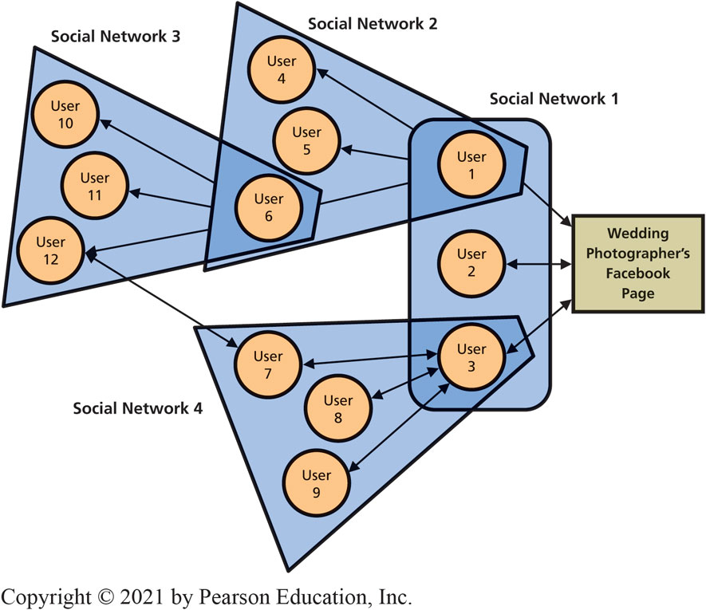
Using Social Networking to Increase the Number of Relationships
9-3 How do S M I S increase social capital?
Figure 9-6 Growing Social Networks
Notes:
Growing Social Networks.
Organizations have social capital just as humans do.
Discuss how a photographer could use SM to communicate a wedding experience using text, pictures, and video instantly to everyone in your social network,

Slide 24
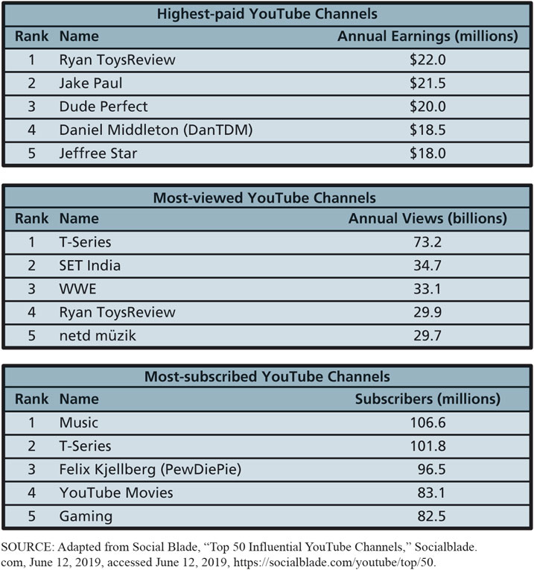
Top YouTube Channels
9-3 How do S M I S increase social capital?
Figure 9-7 Top YouTube Channels
Notes:
In general, the more views a channel gets, the more the content creator gets paid. However, the food and cooking channels have higher earnings than the beauty and style channels. The number of views is not the only factor influencing earnings. The resources (i.e., money) controlled by the viewers of the food and cooking channels may be higher than the viewers of the beauty and style channels.

Slide 25
Using Social Networks to Increase the Strength of Relationships
9-3 How do S M I S increase social capital?
Strength of a relationship
Likelihood other entity will do something that benefits your organization.
Positive reviews, post pictures using organization’s products or services, tweet about upcoming product releases, and so on.
Strengthen relationships by asking someone to do you a favor.
Frequent interactions strengthen relationships.
Notes:
You weaken the strength of social relationships by continually freeloading, declining requests for help, and failing to spend time with friends.

Slide 26
Using Social Networks to Connect to Those with More Resources
9-3 How do S M I S increase social capital?
Social Capital = Number of Relationships × Relationship Strength × Entity Resources.
Huge network of people with few resources less valuable than a smaller network of people with substantial resources.
Resources must be relevant.
Most organizations ignore value of entity assets.

Slide 27
Earning Revenue from Social Media
9-4 How do (some) companies earn revenue from social media?
Hyper-social organization
Transform interactions with customers, employees, and partners into mutually satisfying relationships with them and their communities.
You Are the Product
“If you’re not paying, you’re the product.”
Renting your eyeballs to an advertiser.
Monetize
Notes:
As a business student, you know that nothing is free. Processing time, data communication, and data storage may be cheap, but they still cost something.

Slide 28
Revenue Models for Social Media
9-4 How do (some) companies earn revenue from social media?
Advertising
Pay-per-click.
Use increases value.
Freemium
Offers users a basic service for free, and then charges a premium for upgrades or advanced features.
Sales—apps and virtual goods, affiliate commissions, donations.
Notes:
The two most common ways SM companies generate revenue are advertising and charging for premium services.

Slide 29
Does Mobility Reduce Online Ad Revenue? (1 of 2)
9-4 How do (some) companies earn revenue from social media?
By 2022, number of mobile devices to reach 12.3 billion.
Mobile ad spending should reach $141B, and account for 75 percent of total digital ad spending.
Conversion rate
Frequency someone clicks on ad makes a purchase, “likes” a site, or takes some other action desired by advertiser.
Conversion rate on smartphones is 2.25%, but 4.84% on P C s.
Notes:
Facebook made 99% of its 2019 first quarter earnings ($15.1B) from advertising. About 86% of Twitter’s $787M.

Slide 30
Does Mobility Reduce Online Ad Revenue? (2 of 2)
9-4 How do (some) companies earn revenue from social media?
Mobile devices are not likely to spell the death of the Web/social media revenue model.
How best to configure mobile experience to obtain legitimate clicks and conversions?
Geofencing—a location service that allows applications to know when a user has crossed a virtual fence (specific location) and then triggers an automated action.
Consumers receive specific ads/coupons based on location

Slide 31
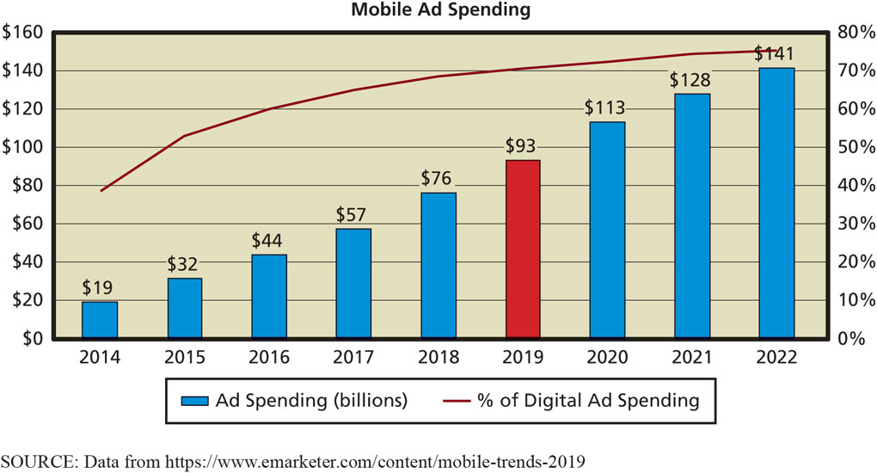
Mobile Ad Spending
9-4 How do (some) companies earn revenue from social media?
Figure 9-8 Mobile Ad Spending
Notes:
Mobile users click ads more often and generate more revenue.
Design problem: How best to configure mobile experience to obtain legitimate clicks and conversions?

Slide 32
Social Media Policy
9-5 How can organizations address S M I S security concerns?
Develop and publicize social media policy.
Delineate employees’ rights and responsibilities.
Index to 100 different policies at Social Media Today.
Intel’s Three Pillars of S M Policies.
Disclose
Protect
Use Common Sense
Notes:
Organizations and executives no longer plan and control organizational messaging. Such messaging emerges via a dynamic, SM-based process. Ask students what they think about that.

Slide 33
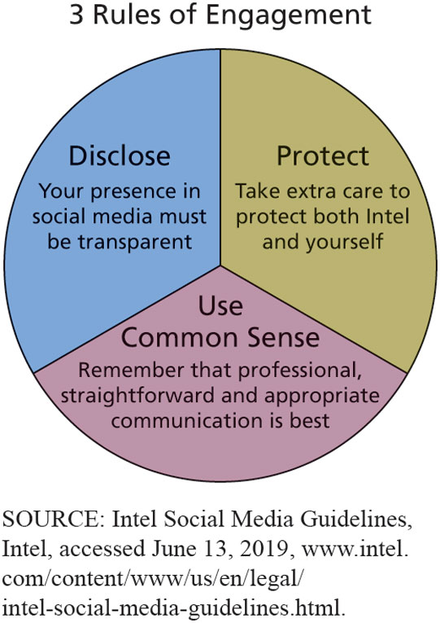
Intel’s Rules of Social Media Engagement
9-5 How can organizations address S M I S security concerns?
Figure 9-9 Intel’s Rules of Social Media Engagement
Notes:
Managing the Risk of Employee Communication.

Slide 34
Managing the Risk of Inappropriate Content
9-5 How can organizations address S M I S security concerns?
User-generated content (U G C)
Problems from external sources
Junk and crackpot contributions
Inappropriate content
Unfavorable reviews
Mutinous movements
Monitor by employees or use outsource service such as Bazaarvoice
Notes:
Organizations should regularly monitor the site and remove objectionable material.
Monitoring can be done by employees or by companies such as Bazaarvoice, which offer services not only to collect and manage ratings and reviews, but also to monitor sites for irrelevant content.

Slide 35
Responding to Social Networking Problems
9-5 How can organizations address S M I S security concerns?
Leave it.
“Never wrestle with a pig; you’ll get dirty and the pig will enjoy it.”
Respond to it.
If it yields positive result.
Delete it.
Comments by crackpots, have nothing to do with the site, or contains obscene or otherwise inappropriate content.
Notes:
Responses are best reserved for when the problematic content has caused the organization to do something positive as a result.

Slide 36
Internal Risks from Social Media (1 of 2)
9-5 How can organizations address S M I S security concerns?
Threats to information security, increased organizational liability, decreased employee productivity.
Seemingly innocuous comments inadvertently leak information used to secure access to organizational resources.
Bad idea to tell everyone it’s your birthday because your date of birth (D O B) can be used to steal your identity.

Slide 37
Internal Risks from Social Media (2 of 2)
9-5 How can organizations address S M I S security concerns?
Employees may inadvertently increase corporate liability when they use social media.
Sexual harassment liability.
Leak confidential information.
Reduced employee productivity.
Many employees visit non-work-related Web sites each day.
Facebook (65%), Twitter (7%), Instagram (9%), and Snapchat (7%).
Notes:
Smart managers know SM comes with both benefits and costs.

Slide 38
The Future of Social Media
9-6 Where is social media taking us?
New mobile devices with innovative mobile-device U X, coupled with dynamic and agile information systems based on cloud computing and dynamic virtualization.
B Y O D policy
Organization the endoskeleton, supporting the work of people on the exterior.
Employees craft own relationships with their employers.
Non-routine cognitive skills more important.
Notes:
Social media means customers use all the vendor’s touch points they can find to craft their own relationships.

Slide 39
How Does the Knowledge in This Chapter Help You? (1 of 2)
How to apply some of your knowledge to help organizations
Learned components of a social media I S and commitment organization makes when it places a Facebook or Twitter icon on its Web page
Learned how organizations use S M I S to achieve strategies across the five primary value chain activities and how S M I S can increase social capital

Slide 40
How Does the Knowledge in This Chapter Help You? (2 of 2)
Learned how revenue can be earned from social media
Learned about need to manage risks of social media, and how social media will challenge you in the future

Slide 41
Synthetic Friends
Ethics Guide
Army of bots for company S M.
Inflates follower count.
“Click farms”
Form of click fraud.
Large group of low-paid workers hired to click on paid advertising links for the click fraudster.
Attracts annoying spam accounts.
Then comes the purge.
Notes:
Goals.
Explore ethical questions about deception on business social networking sites.
Formulate ethical principles when creating or using social networks for business.

Slide 42
Social Media/Online Reputation Manager
Career Guide
Adam Young at RC Willey
Q. What attracted you to this field?
A. “While looking for career opportunities, I saw that technology was always going to be important and was constantly evolving. I’ve always liked new challenges, and this looked like a good starting point.”
Q. What advice would you give to someone who is considering working in your field?
A. “Do as much as you can to gain as much experience as you can before you graduate. A lot of companies are looking for experience. The more that you do now to develop those skill sets, the better you will stand out.”

Slide 43
Active Review
9-1 What is a social media information system (S M I S)?
9-2 How do S M I S advance organizational strategy?
9-3 How do S M I S increase social capital?
9-4 How do (some) companies earn revenue from social media?
9-5 How can organizations address S M I S security concerns?
9-6 Where is social media taking us?

Slide 44
LinkedIn
Case Study 9
In 2006, LinkedIn boasted more than 5 million members
In 2010, LinkedIn saw membership climb to 90 million
More than 1,000 employees in 10 offices around the world
In 2011, LinkedIn became publicly traded and was valued at more than $4.5 billion
Earned more than $150 million per year in advertising revenue
Notes:
GOAL:
Use case questions to get student to think of ways to use social media.

Slide 45
LinkedIn (con’t)
Case Study 9
In 2016, LinkedIn was acquired by Microsoft for $26 billion
More than 9,000 employees and more than half a billion members in more than 200 countries worldwide
Would the two companies be worth more together than apart?
Can it be successfully integrated across all Windows products?
Notes:
GOAL:
Use case questions to get student to think of ways to use social media.

Slide 46

Copyright

