Slide 1

Experiencing M I S
Ninth Edition
Chapter 11
Information Systems Management
Slides in this presentation contain hyperlinks. JAWS users should be able to get a list of links by using INSERT+F7
Copyright © 2021, 2019, 2017 Pearson Education, Inc. All Rights Reserved
Notes:
If this PowerPoint presentation contains mathematical equations, you may need to check that your computer has the following installed:
1) MathType Plugin
2) Math Player (free versions available)
3) NVDA Reader (free versions available)

Slide 2
“Outsourcing the Development of a Strategic Application Seems Risky.”
Team discuss outsourcing A R E S development to India.
Raj’s friend in India (Sandeep) is a developer.
Successfully developed
app for him.
Risks: What if he doesn’t finish? Takes code? Loses interest?
Will cost 4 to 6 times as much to develop in U.S.
Bite the bullet and hire own programmers.
Notes:
Goals
Use ARES to:
Illustrate some technical issues dilemma of offshore outsourcing:
– It can be considerably cheaper than domestic development.
– It is replete with problems and risks.
Have students make a list of all the problems they identify in scenario.

Slide 3
Study Questions
11-1 What are the functions and organization of the I S department?
11-2 How do organizations plan the use of I S?
11-3 What are the advantages and disadvantages of outsourcing?
11-4 What are your user rights and responsibilities?
Notes:
Information systems are critical to organizational success and need to be managed responsibly. The chapter surveys the management of IS and IT resources. It first discusses the major functions and the organization of the IS department. Then, it discusses planning the use of IT/IS.
Outsourcing is the process of hiring outside vendors to provide business services and related products. For our purposes, outsourcing refers to hiring outside vendors to provide information systems, products, and applications. The pros and cons, and risks of outsourcing discussed.
The chapter next discusses the relationship between users to the IS department, such as user and IS department’s rights and responsibilities.
The chapter concludes with a discussion of possible challenges that we will face in 2027, such as mobile devices at work.

Slide 4
The Major Functions of the I S Department
11-1 What are the functions and organization of the I S department?
Plan use of I S to accomplish organizational goals and strategy.
Manage outsourcing relationships.
Protect information assets.
Develop, operate, maintain computing infrastructure.
Develop, operate, maintain applications.
Notes:
Protection function is topic of Chapter 10.
Develop functions important for IS majors, but less so for other business professionals and not considered in this text.
To set stage, consider the organization of IS Department.

Slide 5
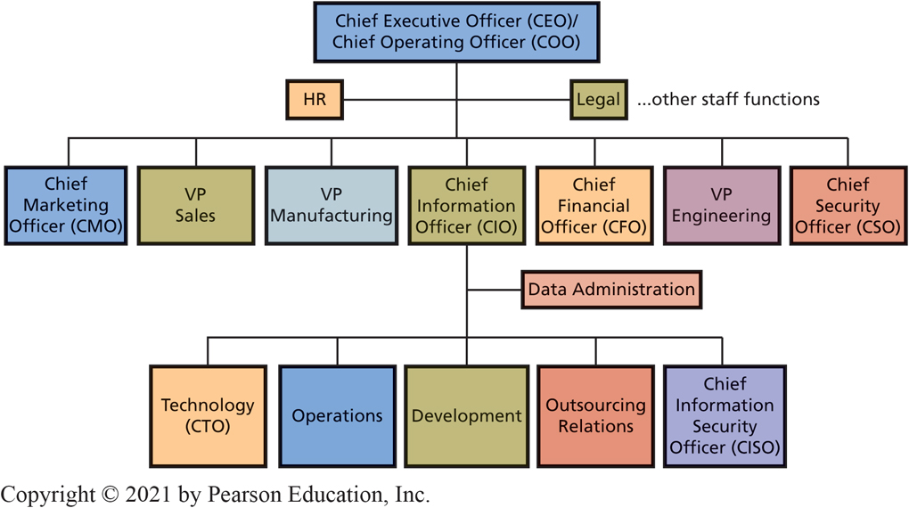
How is the I S Department Organized?
11-1 What are the functions and organization of the I S department?
Figure 11-1 Typical Senior-Level Reporting Relationships
Notes:
This figure shows a typical top-level structure and reporting relationships of a large organization.
The organizational structure varies depending on the organization’s size, culture, competitive environment, industry, and other factors.
Other common titles are vice president of information services, director of information services, and, less commonly, director of computer services.
The size and structure of the development group depend on whether programs are developed in-house.
The Data Administration staff function is to protect data and information assets by establishing data standards and data management practices and policies.

Slide 6
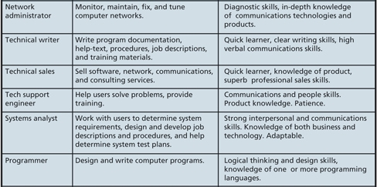
What I S-Related Job Positions Exist? (1 of 3)
11-1 What are the functions and organization of the I S department?
Figure 11-2 Job Positions in the Information Systems Industry (continues on next two slides)
Notes:
Job Positions in the Information Systems Industry
Relate to five components of an information system.
With exception of computer technician, and possibly test QA engineer, all these positions require a 4-year degree and business knowledge or business degree, and good verbal communications and writing skills.

Slide 7
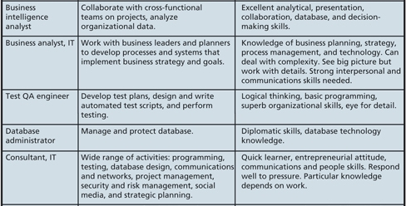
What I S-Related Job Positions Exist? (2 of 3)
11-1 What are the functions and organization of the I S department?
Figure 11-2 Job Positions in the Information Systems Industry (con’t.)
Notes:
Salaries for information systems jobs have a wide range. Higher salaries are for professionals with more experience, working for larger companies, and living in larger cities.

Slide 8
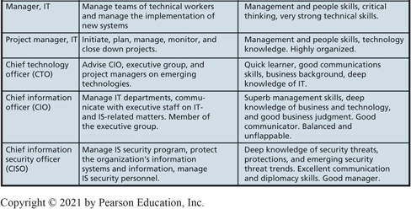
What I S-Related Job Positions Exist? (3 of 3)
11-1 What are the functions and organization of the I S department?
Figure 11-2 Job Positions in the Information Systems Industry (con’t.)

Slide 9
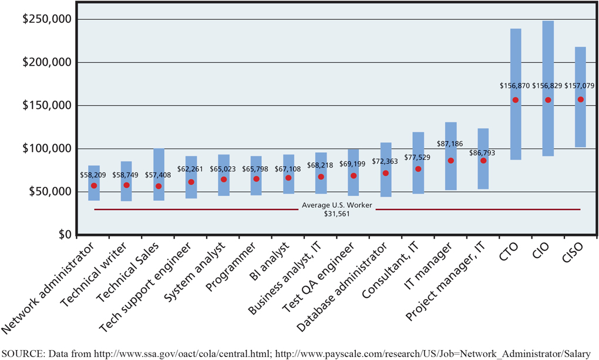
Salaries for Information Systems Jobs
11-1 What are the functions and organization of the I S department?
Figure 11-3 Salaries for Information Systems Jobs

Slide 10
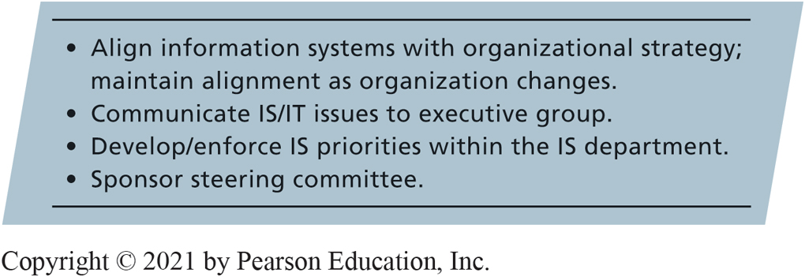
Planning the Use of I S/I T
11-2 How do organizations plan the use of I S?
Figure 11-4 Planning the Use of I S/I T
Notes:
All information systems must be aligned with the organization’s competitive strategy.
Maintaining alignment between IS capabilities and organizational strategy is a continual process. Without a strong CIO, IS may be perceived as a drag on organization’s opportunities.
A steering committee is a group of senior managers from the major business functions that works with CIO to set IS priorities and decide among major IS projects and alternatives. IS department sets up the steering committee’s schedule, agenda, and conducts meetings.

Slide 11
What is Outsourcing?
11-3 What are the advantages and disadvantages of outsourcing?
Process of hiring another organization to perform services.
Save costs, gain expertise.
Save direct/indirect management time and attention.
Any value chain business activity can be outsourced.
“Your back room is someone else’s front room.” (Drucker)
Notes:
At ARES Systems, building a large development and test team may be more than the company needs and require management skills that they don’t have. Outsourcing the development function saves them from needing this expertise.

Slide 12
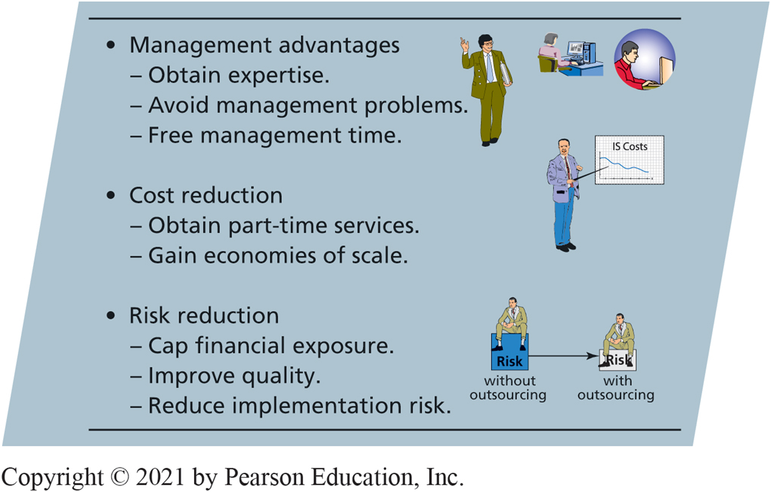
Popular Reasons for Outsourcing I S Services
11-3 What are the advantages and disadvantages of outsourcing?
Figure 11-5 Popular Reasons for Outsourcing I S Services
Notes:
Many companies outsource portions of information systems activities. This figure lists popular reasons for doing so.

Slide 13
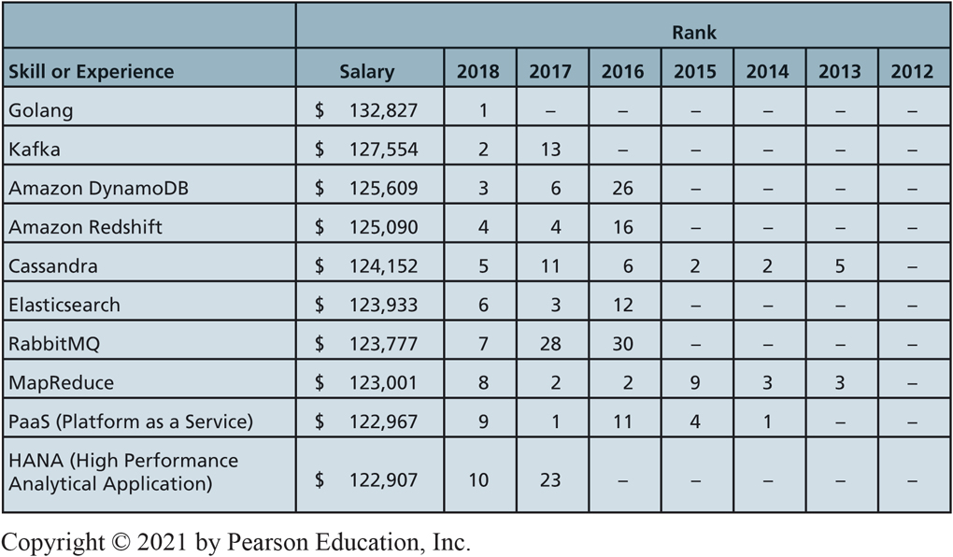
Top-10 Highest-Paid Tech Skills
11-3 What are the advantages and disadvantages of outsourcing?
Figure 11-6 Top-10 Tech Skills

Slide 14
Poor Data Management at Facebook
So What?
Over 2 billion active users
Open model that allowed integration of a variety of other platforms and services
Users could log into 3rd party sites with Facebook login
Open model enabled 3rd party to siphon off 80 million Facebook users’ data
Data management practices damaged reputation
Notes:
Questions
1. To what extent are social media platforms an important part of your daily interactions? Do you use a certain social media platform because your family or friends use it? Why do you think this is the case?
2. Are you one of the 87 million Facebook users who had their data shared with Cambridge Analytica? If so, did this situation bother you? Why or why not?
3. During Mark Zuckerberg’s hearings on Capitol Hill, it became clear that many politicians have minimal knowledge about how Facebook operates as a business. How does this present challenges for the creation of regulations that may be put in place to ensure that Facebook and other tech companies properly manage user data?
4. Why would Facebook offer a pay option? Would it be worth it to you to pay a monthly fee to access Facebook and know that your personal data would be protected? Why or why not?

Slide 15
Risk Reduction
11-3 What are the advantages and disadvantages of outsourcing?
Caps financial risk.
Ensures quality or avoids substandard quality.
Less likely to pick wrong hardware, software, network protocol, or implementing tax law changes incorrectly.
Vendor’s responsible for managing risks.
Notes:
Outsourcing reduces some types of risk.

Slide 16
International Outsourcing
11-3 What are the advantages and disadvantages of outsourcing?
India
Large, well-educated, English-speaking; labor cost is 20-30% of the U.S. labor cost
China and other countries, too.
Modern telephone technology and Internet-enabled service databases.
Customer support and other functions operational 24/7.
Notes:
With modern telephone technology and Internet-enabled service databases, a single customer service call can be initiated in United States, partially processed in India, then Singapore, and finalized in Ireland.
Amazon.com operates customer service centers in the United States, India, and Ireland.

Slide 17
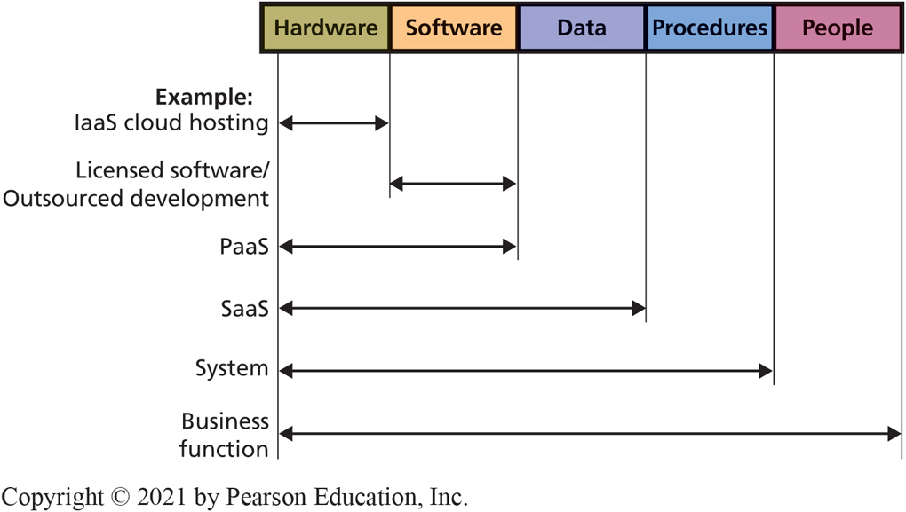
I S/I T Outsourcing Alternatives
11-3 What are the advantages and disadvantages of outsourcing?
Figure 11-7 I S/I T Outsourcing Alternatives
Notes:
Categories of alternatives according to information systems components and outsourcing of hardware to the cloud.
Electronic Data Systems (EDS) successful for more than 30 years as outsource vendor of hardware infrastructure.
Software as a service (SaaS) an outsourcing alternative that provides hosted applications and data storage. Salesforce.com is a typical example of a SaaS provider.
Outsource an entire system: Oracle provides entire payroll function as an outsourced service. Client company only provides employee and work information, while payroll outsource vendor does the rest.
Web storefront is a form of application outsourcing. Amazon.com provides a Web storefront for product vendors and distributors who choose not to develop their own Web presence.
Some organizations choose to outsource an entire business function. Many companies outsource to travel agencies the function of arranging for employee travel. Some outsource vendors operate offices within other company’s facilities.

Slide 18
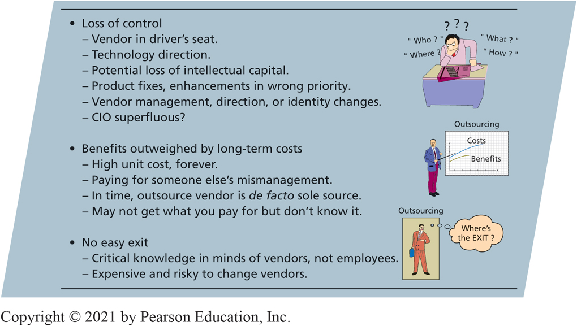
What are the Risks of Outsourcing?
11-3 What are the advantages and disadvantages of outsourcing?
Figure 11-8 Outsourcing Risks
Notes:
Outsourcing presents significant risks.
Loss of control over important business functions, loss of human capital, and important management resources.
Difficulty in identifying or realizing benefits.
Difficulty in ending outsourcing dependencies.

Slide 19
Benefits Outweighed by Long-Term Costs
11-3 What are the advantages and disadvantages of outsourcing?
Dangers
Unit fixed cost contract prevents economies of scale.
Vendor de facto sole source.
Changing pricing strategy.
No easy exit (tightly integrated vendor).
Difficult to know if vendor well managed.
Notes:
Vendor becomes defacto sole source and might increase its prices.
Vendor becomes tightly integrated such that parting company can be exceedingly risky.
Outsource vendor’s employees have gained significant knowledge of the company.
Vendor knows the server requirements in customer support, patterns of usage, and best procedures for downloading operational data into the data warehouse. Consequently, your lack of knowledge make it difficult to bring outsourced service back in-house.
Company must invest considerable work, duplication of effort, management time, and expense to change to another vendor.

Slide 20
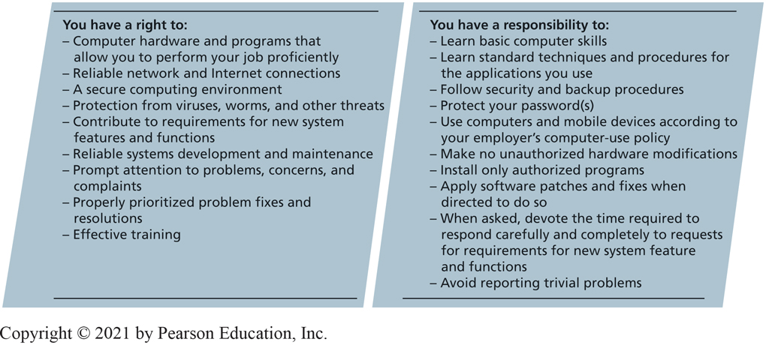
Your I S Rights and Responsibilities
11-4 What are your user rights and responsibilities?
Figure 11-9 User Information Systems Rights and Responsibilities
Notes:
If you process huge files for data-mining applications, you have a right to the huge disks and fast processor that you need. However, if you merely receive email and access corporate Web portal, then your right is for more modest requirements.
Reliable means you can process without problems.
Organization should protect your computer and files, and you should not normally need to think about security.
Participate in requirements meetings for new applications you will use and for major changes to applications currently used.
Receive prompt attention to your problems, concerns, and complaints about information services. Right to have means to report problems, and to know your problem has been received and registered with IS department. Right to have your problem resolved, consistent with established priorities.
Training convenient to you, easy to understand, and enables you to use systems to perform your job.
Your responsibilities toward IS department and organization.
Do not expect hand-holding for basic operations. Nor expect to receive repetitive training and support for same issue.
Responsible for protecting your password(s), computer, your organization’s networks and databases.
Unauthorized modifications could interfere with automated maintenance programs for upgrading your computer and cause problems the IS department will have to fix.
Responsibility to treat information systems professionals professionally. One form of professional behavior is to learn basic computer skills to avoid reporting trivial problems.

Slide 21
How Does the Knowledge in This Chapter Help You? (1 of 2)
Know primary responsibilities of I S department and can understand why department may implement standards and policies it does
Know planning functions of I S and how they relate to rest of organization
Know reasons for outsourcing I S services, most common and popular outsource alternatives, and outsourcing risks
Know how to be a better consumer of I S department services

Slide 22
How Does the Knowledge in This Chapter Help You? (2 of 2)
Know kinds of work that must be done and the advantages, disadvantages, and choices for outsourcing work
Know the advantages and disadvantages of outsourcing software development
Knowing your rights and responsibilities will enable you to be a more effective business professional by setting reasonable expectations as to what you can expect from the I S department
Knowing what the IS department expects of you

Slide 23
Training Your Replacement (1 of 2)
Ethics Guide
Scott must cut his team of software developers by 75 percent.
They are going to be replaced with new outsourced employees—working on the other side of the planet.
Employees who are being released will train the new outsourced employees.
Training the replacements will be a condition of departing employees’ severance package.
Notes:
GOALS
Evaluate ethics of employee activities in terms of a particular computer-use policy.
Forewarn students that employers have right to monitor computer usage, and many do.
Develop techniques for managing employees’ computer use.
Guide focuses on the student’s role as a manager rather than as a computer user.

Slide 24
Training Your Replacement (2 of 2)
Ethics Guide
How is it fair to ask someone to train the person taking his or her job?
Scott wondered how long it would be before he was training his own replacement.
Do you think that forcing an employee to train his or her replacement is ethical according to the categorical imperative? The utilitarian perspective?

Slide 25
Data Governance Officer
Career Guide
Susan M. Jones at Utah State University
Q. What attracted you to this field?
A. “Honestly, what isn’t attractive about this field? The information
technology (IT) field is exciting, innovative, and
dynamic. IT connects every division in an organization...”
Q. What advice would you give to someone who is considering working in your field?
A. “Data governance requires the coordination of many roles
and organizational areas. Therefore, my advice is to take
time to analyze the big picture and make connections,
whether working for yourself or for a large company…”

Slide 26
Active Review
11-1 What are the functions and organization of the I S department?
11-2 How do organizations plan the use of I S?
11-3 What are the advantages and disadvantages of outsourcing?
11-4 What are your user rights and responsibilities?
How does the knowledge in this chapter help you?

Slide 27
Automating Labor (1 of 3)
Case Study 11
McDonald’s former C E O Ed Rensi stated that a single $35,000 robotic worker would cost less and be more productive than a $15-an-hour human worker.
The hamburger-making robot can make 400 burgers per hour, every hour, without a break.
It can completely replace three human fast-food workers.

Slide 28
Automating Labor (2 of 3)
Case Study 11
In 2016, Foxconn (supplier to Apple) replaced 60,000 factory workers with robots.
Airbus is going to use H R P-2 and H R P-4 humanoid robots to assemble its airplanes.
Amazon.com is using 200,000 Kiva robots at its fulfillment centers to help process customer orders.

Slide 29
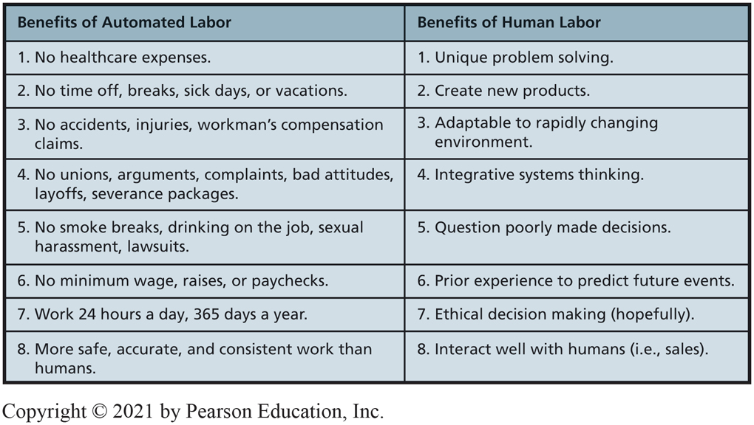
Automated Versus Human Labor
Case Study 11
Figure 11.10 Automated Versus Human Labor

Slide 30
Automating Labor (3 of 3)
Case Study 11
By 2030, nearly 800 million workers may be taken out of the current worldwide labor force.
Robots will have I Qs higher than 90 percent of the U.S. population.
They will likely take jobs that involve routine physical and mental tasks.
How might the automation of labor provide a competitive advantage for forward-looking companies?

Slide 31

Copyright

