Slide 1

Experiencing M I S
Ninth Edition
Chapter 12
Information Systems Development
Slides in this presentation contain hyperlinks. JAWS users should be able to get a list of links by using INSERT+F7
Copyright © 2021, 2019, 2017 Pearson Education, Inc. All Rights Reserved
Notes:
If this PowerPoint presentation contains mathematical equations, you may need to check that your computer has the following installed:
1) MathType Plugin
2) Math Player (free versions available)
3) NVDA Reader (free versions available)
As a future business professional, you will be involved in the development of new technology applications to your business. You may take the lead in developing an IS project, or you might be an office manager who implements procedures and trains people in the use of systems. Or, you might become a business analyst and work as a liaison between users and technical staff.
If nothing else, you may be asked to provide requirements and to test the system to ensure those requirements have been met. Whatever your role, it is important that you understand how processes and systems are developed and managed.

Slide 2
“Augmented Reality is a Dream Come True.”
Example of decision making in small company.
Zev, owner and source of investment funds.
Team presents options, he listens and makes a decision.
Team is nervous, not really sure what will happen.
“The ad possibilities are huge. We could sell new kinds of ads that people have never seen before.”
Will focus on building a HoloLens prototype.
Notes:
GOALS
Use the ARES system to:
Demonstrate a typical software development meeting in a small startup.
Show the wide range in development options and costs that can exist.
Illustrate the use of a prototype for reducing risk.
Provide a setting for a discussion of scrum.

Slide 3
Bottom Line
Startups are fun and interesting places to work.
Time and budgets limited.
Decisions made more quickly, but risky if not well managed.
Prototypes used to reduce front-end risk.
Scrum ideal process for creating prototypes.

Slide 4
Study Questions
12-1 What is systems development?
12-2 Why is systems development difficult and risky?
12-3 What are the five phases of the S D L C?
12-4 How is system definition accomplished?
12-5 What is the users’ role in the requirements phase?
12-6 How are the five components designed?
12-7 How is an information system implemented?
12-8 What are the tasks for system maintenance?
12-9 What are some of the problems with the S D L C?
Notes:
As a business professional, you will be involved in the development of new technology applications for their business and may take the lead in developing an application.

Slide 5
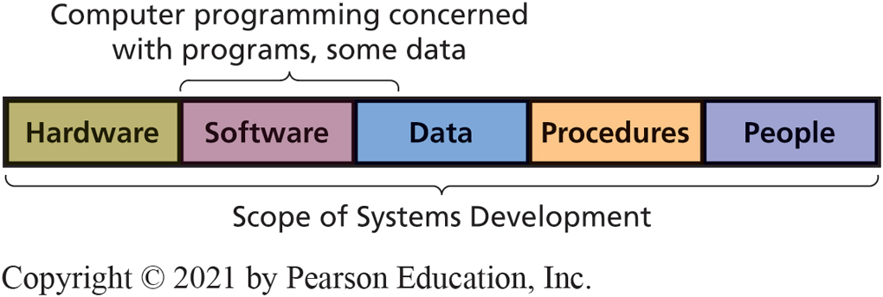
Information Systems Development
12-1 What is systems development?
Process of creating and maintaining information systems
Involves all five components of I S model
Figure 12-1 Systems Development Versus Program Development

Slide 6
Requirements of Information Systems Development
12-1 What is systems development?
Requires
Establishing system goals
Setting up the project
Determining requirements
Business knowledge and management skill
Coordinated teamwork of both specialists and non-specialists with business knowledge

Slide 7
Why So Risky?
12-2 Why is systems development difficult and risky?
Many projects never finish
Often 200–300% over budget
Some don’t accomplish goals
High risk of failure
Even with competent people following appropriate methodology

Slide 8
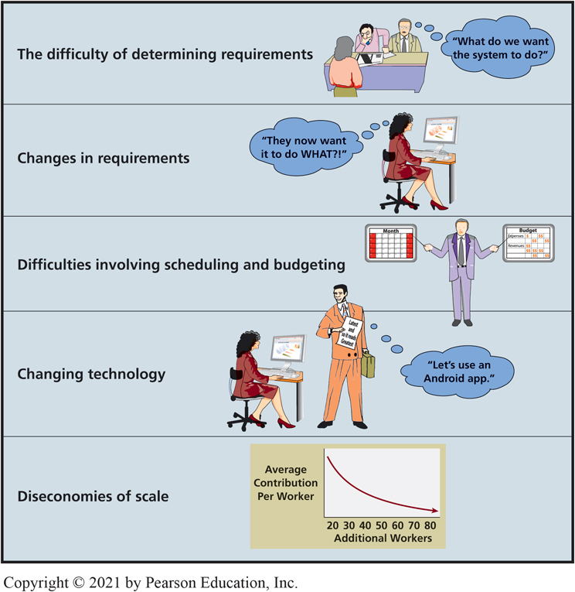
Major Challenges to System Development
12-2 Why is systems development difficult and risky?
Figure 12-3 Major Challenges to Systems Development
Notes:
Before system can be finalized, detailed requirements need to be specified.

Slide 9
Difficulty of Requirements Determination
12-2 Why is systems development difficult and risky?
What specifically is system to do?
What should the holographic displays look like?
What sort of feedback should competitors receive?
How do users join spinning classes?
How much cloud resource needed?
Must create environment where difficult questions are asked and answered.
Notes:
The ARES system started with a prototype. As they think about operational system, what are the true requirements?
What does privacy mean for the ARES system, in details? Who sets the privacy policy? Who can change it? What granularity of permission is needed? As any experienced systems analyst knows, there will undoubtedly be important questions that no one knows to ask.

Slide 10
Changes in Requirements
12-2 Why is systems development difficult and risky?
Aims at moving target
Bigger system, longer project, more requirements will change
What should development team do?
Incorporate changes along the way or make changes in maintenance phase?
Notes:
Midway through the development process, a major health club chain approaches Ashley with a lucrative contract proposal. But that proposal necessitates major changes in planned HoloLens requirements.

Slide 11
Scheduling and Budgeting Difficulties
12-2 Why is systems development difficult and risky?
How long to build it?
How long to create data model?
How long to build database applications?
How long to do testing?
How long to develop and document procedures?
How long for training?
How many labor hours? Labor cost?
What’s the rate of return on investment?
Notes:
If you cannot estimate how much a system costs, then how do you perform a financial analysis to determine if system generates an appropriate rate of return?

Slide 12
Changing Technology
12-2 Why is systems development difficult and risky?
Stop development to switch to new technology?
Finish developing according to existing plan?
Why build an out-of-date system?
Can you afford to keep changing the project?
Notes:
Example: While you are developing the ARES application for Microsoft’s HoloLens, Apple and Google both release new holographic mixed-reality devices. These new devices have improved graphics, battery life, and user interfaces. You know that with these new devices you can create better applications more rapidly than the platform you’re currently using.

Slide 13
Diseconomies of Scale
12-2 Why is systems development difficult and risky?
Brooks’ Law
“Adding more people to a late project makes the project later”
Veteran members train new staff and lose productivity while training
Schedules can be compressed only so far
Once a project is late and over budget, no good choices exist
Notes:
“Nine women cannot make a baby in one month.”

Slide 14
Is it Really So Bleak?
12-2 Why is systems development difficult and risky?
Yes and No
Successful methodologies exist
When supported and managed properly
Systems development life cycle (S D L C), still most common methodology

Slide 15
What are the Five Phases of the S D L C?
12-3 What are the five phases of the S D L C?
System definition
Requirements analysis
Component design
Implementation
System maintenance
Notes:
SDLC is the traditional process used to develop information systems and applications. The IT industry developed the SDLC in the “school of hard knocks.” Many early projects met with disaster, and companies and systems developers sifted through the ashes of those disasters to determine what went wrong.
Different authors and organizations package the tasks into different numbers of phases, such as 5, 7, or 8. Here is a 5-phase SDLC.

Slide 16
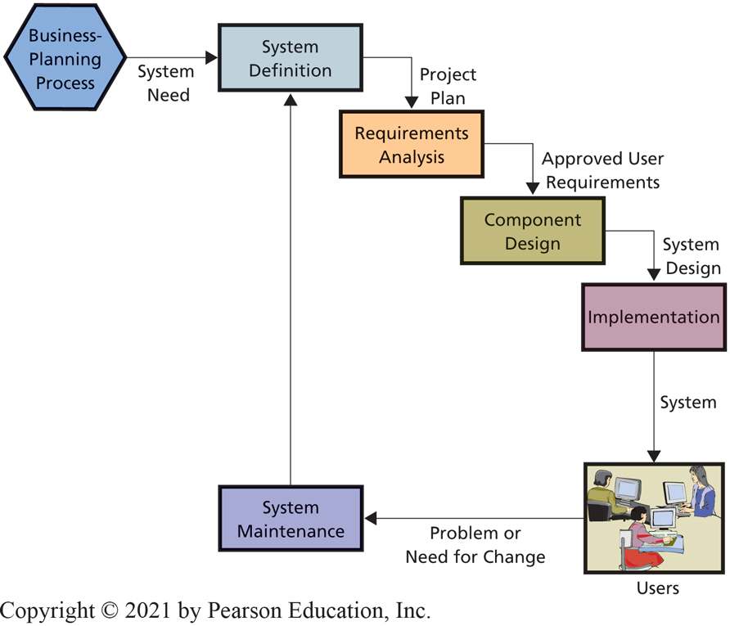
Systems Development Life Cycle (S D L C)
12-3 What are the five phases of the S D L C?
Figure 12-3 Phases in the S D L C
Notes:
SDLC is the traditional process used to develop information systems and applications. The IT industry developed the SDLC in the “school of hard knocks.” Many early projects met with disaster, and companies and systems developers sifted through the ashes of those disasters to determine what went wrong.
Different authors and organizations package the tasks into different numbers of phases, such as 5, 7, or 8. Here is a 5-phase SDLC.

Slide 17
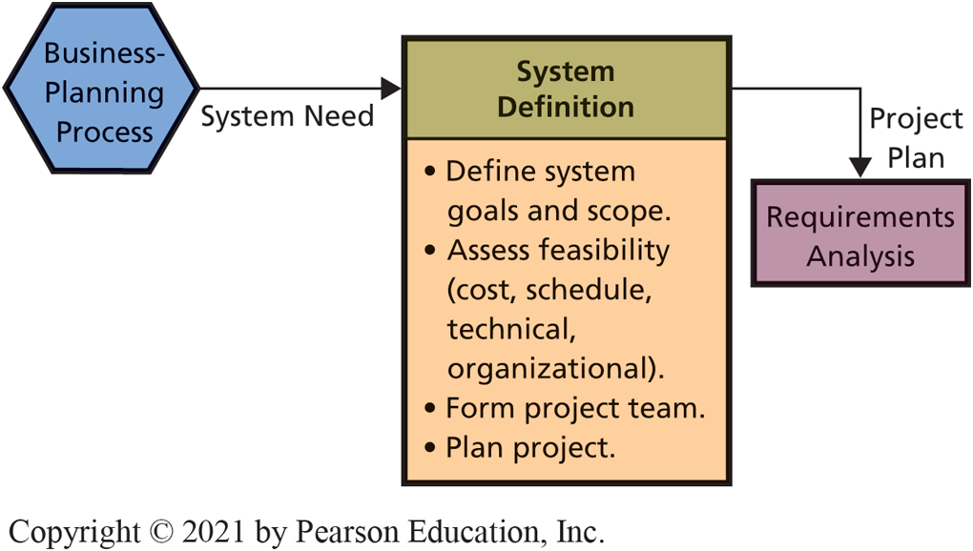
S D L C Definition Phase
12-4 How is system definition accomplished?
Figure 12-4 S D L C: System Definition Phase
Notes:
At the start, cost and schedule feasibility are only an approximation or back-of-the-envelope analysis.
Eliminate any obviously infeasible ideas as soon as possible.
The scope might be defined by specifying the users, or the business processes, or the plants, offices, and factories that will be involved.

Slide 18
Systems Definition
12-4 How is system definition accomplished?
Assign a few employees, possibly on a part-time basis, to define new system, assess its feasibility, and plan project
Members include users, managers, and I S professionals

Slide 19
Define System Goals and Scope (Example)
12-4 How is system definition accomplished?
Define goal and purpose in terms of organization’s competitive strategy
A R E S team wants a 3D augmented reality application for Microsoft HoloLens.
Will it attract new clients?
What major features of application need to be implemented?
Define specific business activities, users, business processes, plants, offices, and factories involved

Slide 20
Assess Feasibility
12-4 How is system definition accomplished?
Four types of feasibility to include
Cost Feasibility—assess whether benefits justify the estimated development and operational costs
Schedule Feasibility — assess whether project can be completed in a given time
Technical Feasibility — assess whether existing technology is able to meet the needs of the new system
Organizational Feasibility — assess whether new system fits within current organizations culture
Assess initially and update throughout the project

Slide 21
Form a Project Team and Plan the Project
12-4 How is system definition accomplished?
Both IS professionals and user representatives
Managers, business analysts, systems analysts, programmers, software testers, and users
Team composition changes over time
User Involvement critical throughout entire process
Plan the project
Tasks, personnel, dependencies, schedules
Notes:
Normally, consists of both IS professionals and user representatives. Project manager and IS professionals can be in-house personnel or outside contractors.
Business analysts specialize in understanding business needs, strategies, and goals and helping businesses implement systems to accomplish competitive strategies.
Systems analysts are IT professionals who understand both business and technology.

Slide 22
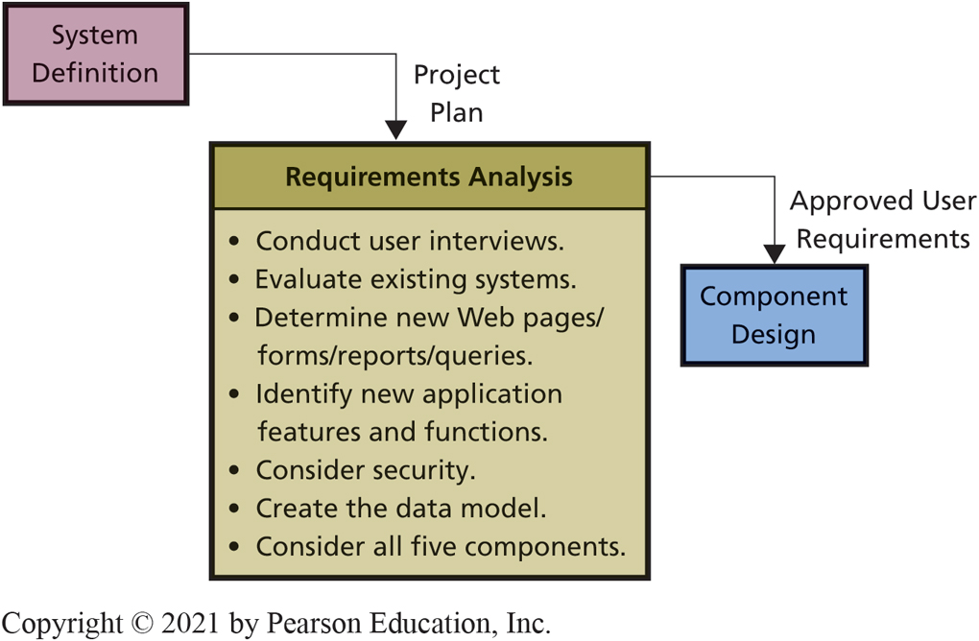
S D L C: Requirements Analysis Phase
12-5 What is the users’ role in the requirements phase?
Figure 12-5 S D L C: Requirements Analysis Phase
Notes:
This is the most important phase in the systems development. If the requirements are wrong, the system will be wrong. If the requirements are determined completely and correctly, then design and implementation will be easier and more likely to result in system success.

Slide 23
Role of a Prototype
12-5 What is the users’ role in the requirements phase?
Direct user experience.
Assess technical and organizational feasibility.
Define requirements and functions.
Parts often reused.
Code for A R E S prototype reused in other digital reality devices?
Prototype-funding dilemma. Which comes first?
Notes:
Expense is often justified for greater clarity and completeness of requirements, and because parts of prototype can be reused in operational system.
Will we obtain sufficient return to justify these estimated costs? At ARES, Zev most likely asked for a prototype because he didn’t like the price tag for developing the multiple applications for multiple systems.

Slide 24
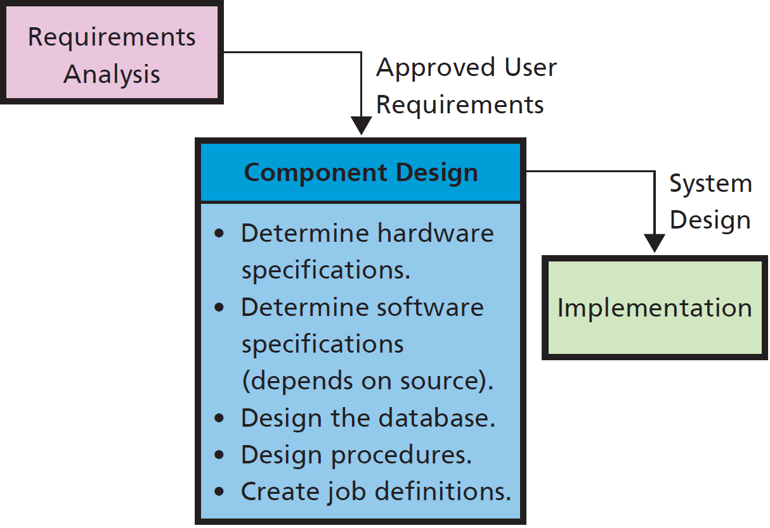
S D L C Component Design Phase
12-6 How are the five components designed?
Figure 12-6 S D L C: Component Design Phase
Notes:
Team determines hardware specifications required for the application.
Program design depends on the source of the programs. For off-the-shelf software, team must determine candidate products and evaluate them against the requirements. For off-the-shelf with alteration programs, team identifies products to be acquired off-the-shelf, then determines alterations required. For custom-developed programs, team produces design documentation for writing program code.
The prototype can be useful in this phase also.
Design involves developing job descriptions for the various roles. These descriptions detail responsibilities, skills needed, training required, and so forth.

Slide 25
Designing Components
12-6 How are the five components designed?
Determine hardware specifications
Determine software specifications
Design database
Design procedures
Normal, backup, and failure recovery procedures
Design job descriptions
Create and define new tasks and responsibilities
Notes:
Team designs each component by developing alternatives, evaluating each alternative against requirements, and selecting among those alternatives.
Accurate requirements are critical; if they are incomplete or wrong, then they will be poor guides for evaluation.

Slide 26
Hardware, Database, and Procedure Design
12-6 How are the five components designed?
Hardware design
Determine specifications and source of hardware
Purchase, lease, or lease time from a hosting service in the cloud
Database design
Convert data model to database design
Notes:
For ARES, data will be stored in the cloud and perhaps some application processing done there.
Hardware design decision involves interaction with software design.
Which mixed-reality devices will they want to support in addition to HoloLens?
If ARES uses a Web application, the project can afford to support more devices than if it must create native applications for every device type.

Slide 27
Software Design
12-6 How are the five components designed?
Software design depends on source of programs
Off-the-shelf software
Off-the-shelf-with-alteration software
Custom-developed programs
Decide where application processing will occur
Mobile devices
Processing can occur on cloud-servers, or a mixture
Thin-client or native application?

Slide 28
Database Design
12-6 How are the five components designed?
Convert data model to database design using techniques like those described in Chapter 5
If using off-the-shelf programs, then little database design needed; the programs will handle their own database processing

Slide 29
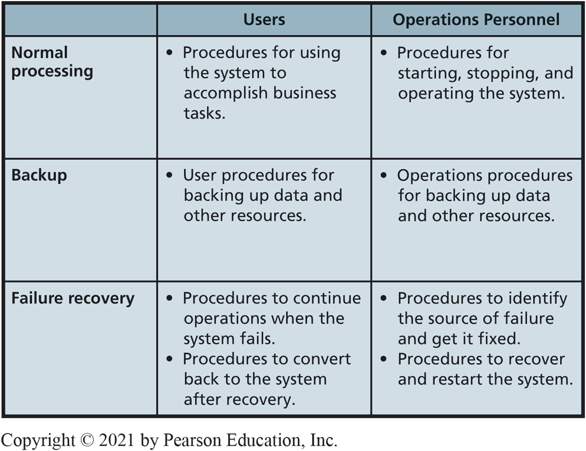
Procedure Design
12-6 How are the five components designed?
Figure 12-7 Procedures to Be Designed
Notes:
Usually, teams of systems analysts and key users design procedures.
Procedures for both users and operations personnel.
Procedures need to be developed for normal, backup, and failure recovery operations, as summarized in Figure 12-7. Procedures for both users and operations personnel. Procedures need to be developed for normal, backup, and failure recovery operations, as summarized in Figure 12-7. Usually, teams of systems analysts and key users design the procedures.

Slide 30
Design of Job Descriptions
12-6 How are the five components designed?
Teams of systems analysts and users determine job descriptions, functions for users, and operations personnel
New information systems may require creating new jobs
Duties and responsibilities need to be defined in accordance with human resources policies
Usually, new duties and responsibilities added to existing jobs

Slide 31
Banking on I o T (1 of 2)
So What?
Immediate access to analytics allows for
Better strategic decision making
New strategic competitive opportunities
Sensor technologies and the ability to rapidly transmit, store, and analyze large data sets have redefined operations and industries.
As more smart devices (I o T) are connected to the Internet, increasing amounts of data are captured and transmitted by these devices.
Notes:
In-class exercise. Identify any potential drawbacks or complications that may arise from this connectivity?

Slide 32
Banking on I o T (2 of 2)
So What?
I o T is generally defined as the proliferation of Internet-connected devices.
By 2030 there will be roughly 500 billion Internet-connected devices.
Banks want to manage automated transactions conducted by I o T devices.
Huge potential for loyalty programs paired with these transactions.
Debit card charged several times a day when your refrigerator orders groceries for you.
Notes:
What are the potential pitfalls of drastically increasing the number of financial transactions you or a company is responsible for in a given period of time (e.g., buying groceries or raw materials in very small quantities)?

Slide 33
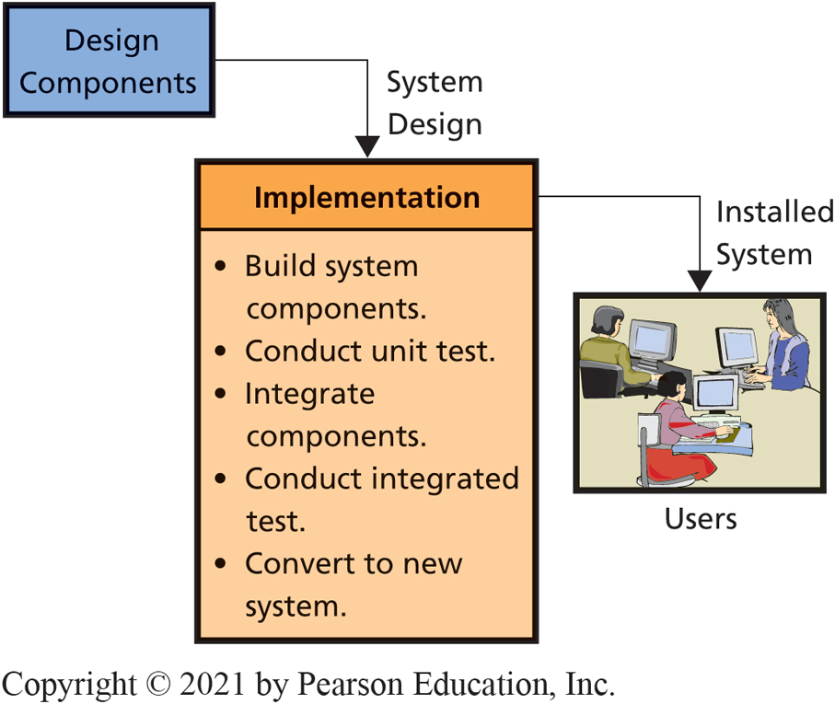
S D L C System Implementation Phase
12-7 How is an information system implemented?
Figure 12-8 S D L C: Implementation Phase
Notes:
Implementation has two meanings. It could mean to implement the information systems components only, or it could mean to implement the information system and the business processes that use the system.
A test plan, which is a formal description of the system’s response to use and misuse scenarios, is written. Professional test engineers, called product quality assurance (PQA) test engineers, are hired for this task. Teams of these engineers are augmented by users as well.

Slide 34
System Testing
12-7 How is an information system implemented?
Test plan
Product quality assurance (P Q A)
User testing
Develop test plans and test cases.
Beta testing
Users final say on whether system “production ready”
Notes:
A test plan consists of sequences of actions that users will take when using the new system. Test plans include not only the normal actions that users will take, but also incorrect actions. A comprehensive test plan should cause every line of program code to be executed.
Test plan should cause every error message to be displayed. Testing, retesting, and re-retesting consume huge amounts of labor. Often, developers can reduce the labor cost of testing by writing programs that invoke system features automatically.
PQA personnel usually construct the test plan with the advice and assistance of users. PQA test engineers perform testing, and supervise user test activity. Many PQA professionals are programmers who write automated test programs.

Slide 35
System Conversion Approaches
12-7 How is an information system implemented?
Four Ways of Implementing an Information System.
Pilot | • Implement entire system in limited portion of business • Limits exposure to business if system fails
Phased | • System installed in phases or modules • Each piece installed and tested
Parallel | • Complete new and old systems run simultaneously • Very safe, but expensive
Plunge | • High risk if new system fails • Only used if new system not vital to company operations
Notes:
IS professionals recommend any of first three, depending on circumstances. In most cases, avoid “taking the plunge!”

Slide 36
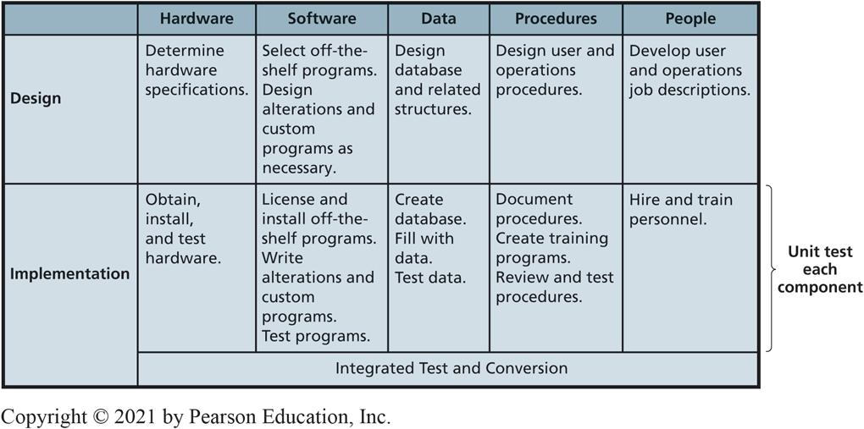
Design and Implementation for the Five Components
12-7 How is an information system implemented?
Figure 12-9 Design and Implementation for the Five Components
Notes:
Figure 12-9 shows design and implementation for the Five Components.
This table summarizes the tasks for five IS components during the design and implementation phases.

Slide 37
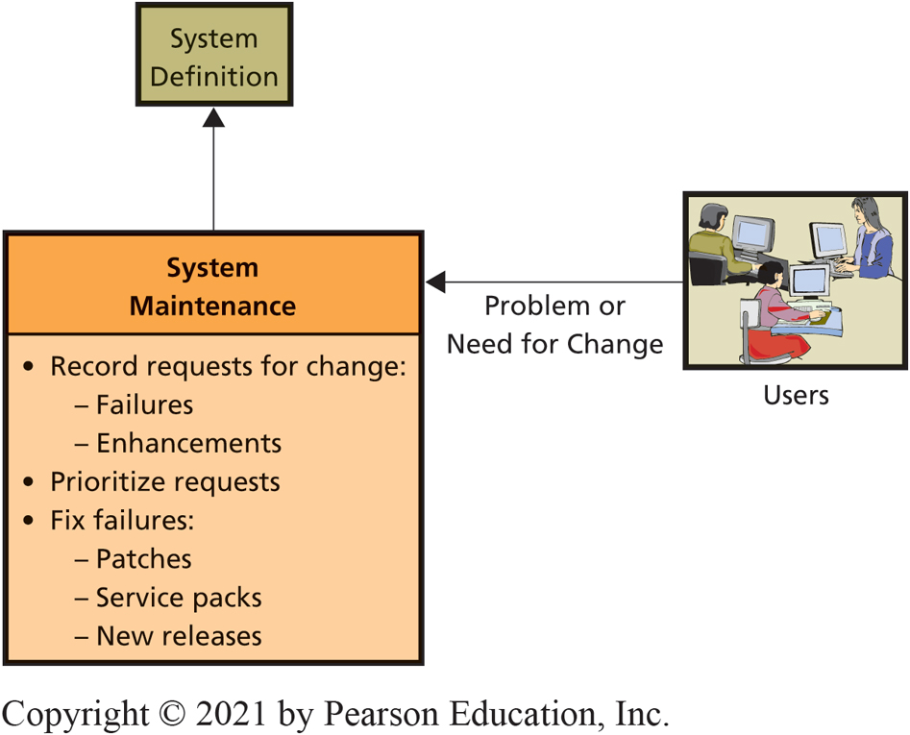
S D L C System Maintenance Phase
12-8 What are the tasks for system maintenance?
Figure 12-10 S D L C: System Maintenance Phase
Notes:
There needs to be a means for tracking both failures and requests for enhancements to meet new requirements. Many organizations find it necessary to develop a tracking database. This database contains a description of failures and enhancements, who reported them, who made the fix or enhancement, status of that work, and whether the fix or enhancement was tested and verified by the originator.
IS personnel prioritize system problems according to their severity.

Slide 38
Problems with the S D L C
12-9 What are some of the problems with the S D L C?
S D L C Waterfall Method
Requirements documentation difficult
Business requirements change
“Analysis paralysis”—Spend so much time on documentation, it hampers progress
Scheduling and budgeting difficulties
Time and cost estimates for large project way off
People who make initial estimates know little about how much time it will take or cost
Notes:
The process is supposed to operate in a sequence of non-repetitive phases. For example, the team completes the requirements phase and goes over the waterfall into the design phase and on through the process.
Waterfall rarely works smoothly, causing development team to go back and forth, raising costs and delaying project.

Slide 39
How Does the Knowledge in This Chapter Help You?
You will be involved in development projects as a business professional
Given robots, drones, driverless cars, and 3D printing, how will anyone in manufacturing, operations, marketing, accounting, finance not be involved in systems development?
All business grads will play strong roles in developing new systems strategies and priorities as well as managing projects

Slide 40
Engineered Slowdown
Ethics Guide
Faulty batteries installed in first batch of tablets
Company wants to intentionally slow down the processing capacity of the tablet as it ages
Will ensure that the tablets will last at least until customer warranty expires
Won’t have the money to replace batteries once they start failing
Apple has done same thing to iPhones
Notes:
GOALS
According to the definitions of the ethical principles previously defined in this book:
Do you think intentionally slowing down a device without customers knowing is ethical according to the categorical imperative?
Do you think intentionally slowing down a device without customers knowing is ethical according to the utilitarian perspective?
2. How would you feel if you were asked to write software that intentionally slowed down a product over time without customers knowing about it? Do you think other types of companies may be engaged in similar tactics? How would this benefit those companies?
3. Suppose the company producing the leading operating system slowly adds in more “features” that progressively increase processing power requirements (i.e., slows down the device). This would cause users to have to purchase a new device (laptop, desktop, tablet, or phone) every couple of years. How might hardware and software companies benefit from an increasingly inefficient operating system? Can you think of any other industry where something similar might be happening?
4. How could Mike justify introducing the intentional slowdown in processing power? Would you be OK calling this intentional slowdown a “feature” that increases battery life, knowing full well that it shortens the life of the device? Why?

Slide 41
Developing Your Personal Brand (1 of 2)
Career Guide
Professionals use social media, such as LinkedIn, to build their personal brand.
Personal brand is the means by which you conduct authentic relationships with the market for your talents and abilities.
That market might be your professional colleagues, your employer, your fellow employees, your competition, or anyone who cares about what you care about.

Slide 42
Developing Your Personal Brand (2 of 2)
Career Guide
What is your personal competitive advantage?
Why would someone choose you, your expertise, or your work products over others?
How could you use social media (like LinkedIn) to make an existing professional contact more personal in nature while still maintaining your privacy?

Slide 43
Active Review
12-1 What is systems development?
12-2 Why is systems development difficult and risky?
12-3 What are the five phases of the S D L C?
12-4 How is system definition accomplished?
12-5 What is the users’ role in the requirements phase?
12-6 How are the five components designed?
12-7 How is an information system implemented?
12-8 What are the tasks for system maintenance?
12-9 What are some of the problems with the S D L C?
Notes:
Remind students that as a business professional, they will be involved in the development of new technology applications for their business and may take the lead in developing an application.

Slide 44
When Will We Learn? (1 of 2)
Case Study 12
1974: Cause of failure
Lack of user involvement in creating and managing system requirements.
Access C T project (2013) successful.
If schedule fixed, funding fixed, what factors can be traded-off to reduce project difficulty and risk?
Requirements. Reduce to bare minimum, get system running, add to it.
Notes:
GOALS
Illustrate difference between application development and systems development.
Motivate need for the SDLC or other development process.
Illustrate some difficulties in creating and managing an interenterprise system.

Slide 45
When Will We Learn? (2 of 2)
Case Study 12
Failure: State of Oregon wasted $248+ million attempting to develop an information system to support healthcare exchange.
Very early in project, consulting firm hired to provide quality assurance, warned requirements were vague, changing, and inconsistent.
Warnings made no difference. Why?
Software and systems made of “pure thought-stuff.”

Slide 46

Copyright

