Slide 1
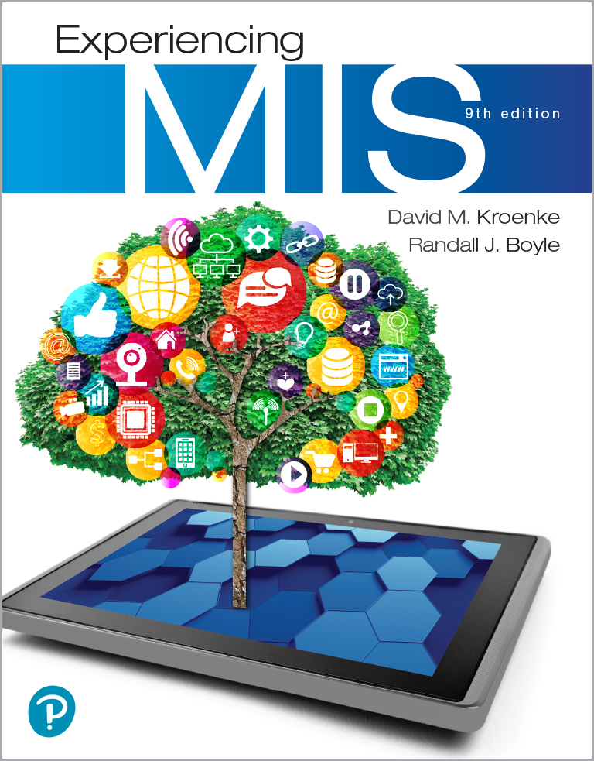
Experiencing M I S
Ninth Edition
Chapter Extension 2
Artificial Intelligence and Automation
Copyright © 2021, 2019, 2017 Pearson Education, Inc. All Rights Reserved
Notes:
If this PowerPoint presentation contains mathematical equations, you may need to check that your computer has the following installed:
1) MathType Plugin
2) Math Player (free versions available)
3) NVDA Reader (free versions available)
This chapter discusses the potential implications of artificial intelligence and automation on organizations. Artificial Intelligence (AI) is the ability of a machine to simulate human abilities such as vision, communication, recognition, learning, and decision making in order to achieve a goal. Organizations hope to use AI to increase the automation, or the process of making systems operate without human intervention, of mundane tasks typically done by humans.

Slide 2
Study Questions
CE 2-1 Why is artificial intelligence important?
CE 2-2 How will A I and automation affect organizations?
CE 2-3 How will A I affect me?
CE 2-4 What is the goal of A I?
CE 2-5 How does A I work?

Slide 3
Artificial Intelligence and Automation
CE 2-1 Why is artificial intelligence important?
Organizations hope to use artificial intelligence (A I) to increase the automation of mundane tasks typically done by humans
A I could be used in a number of different autonomous systems including:
Self-driving cars, robots, commercial drones, agricultural systems, military platforms, surgical systems, and other smart devices.
Efficiency gains and cost reductions over 10 years could be as large as $14 to $33 trillion

Slide 4
Advances in A I
CE 2-1 Why is artificial intelligence important?
Researchers estimate the impact of A I:
There’s a 50 percent chance A I will outperform humans in all tasks in 45 years
There’s an 83 percent chance A I will take over all jobs paying less than $20 an hour within a few years
Historically, no, they haven’t been right
A I is now starting to be commercially successful

Slide 5
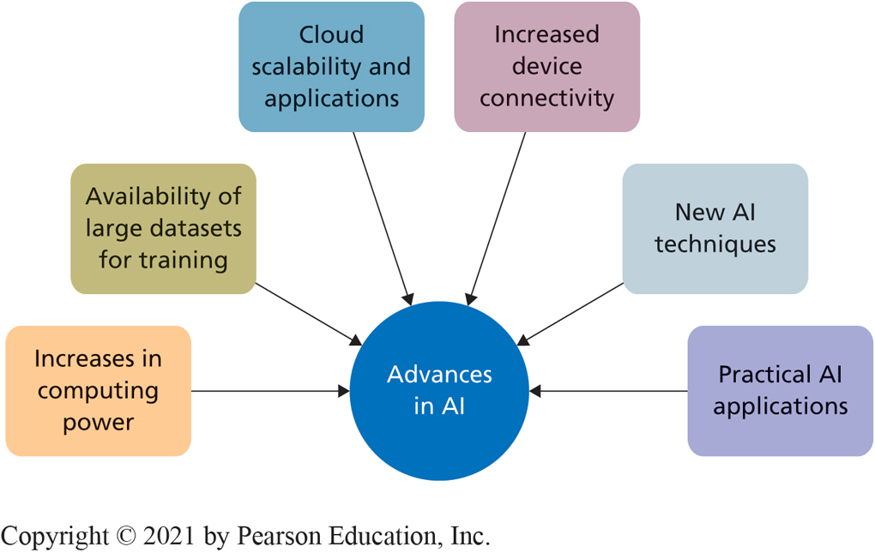
Forces Driving A I Innovation
CE 2-1 Why is artificial intelligence important?
Figure C E 2-1 Forces Driving A I Innovation
Notes:
Significant innovations in the past couple of decades have advanced AI to the point that it’s now starting to be successful. These forces are driving AI innovations.

Slide 6
Examples of the Six Forces Advancing A I
CE 2-1 Why is artificial intelligence important?
I B M’s Watson operates at about 80 teraflops per second
I B M’s Watson can read 800 million pages per second
I B M offers access to a variety of online A I applications including including Conversation, Discovery, Document Conversion, Language Translator, Tone Analyzer, Speech to Text, and Visual Recognition
In 2006, A I researcher Geoffrey Hinton developed a way to simulate multiple layers of artificial neural networks, rather than just a single layer
Google has over 1,000 working A I projects

Slide 7
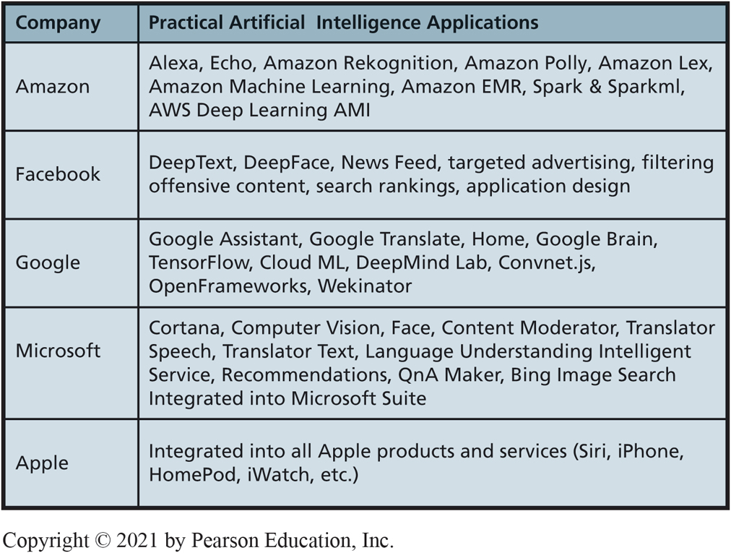
Practical A I Applications
CE 2-1 Why is artificial intelligence important?
Figure C E 2-2 Examples of Practical A I Applications

Slide 8
Impact of A I (1 of 2)
CE 2-2 How will A I and automation affect organizations?
A I is going to
reduce costs
increase productivity
create new services
find unique solutions to age-old problems
enable an army of smart devices with new capabilities
How will A I-powered machines save you money?
How much?

Slide 9
Impact of A I (2 of 2)
CE 2-2 How will A I and automation affect organizations?
U.S. Bureau of Labor Statistics the average employee in the U.S. makes $24.91 per hour
The true cost of an employee is 46 percent ($11.41) more
You won’t have to pay for overtime, paid leave, insurance, retirement contributions, etc.

Slide 10
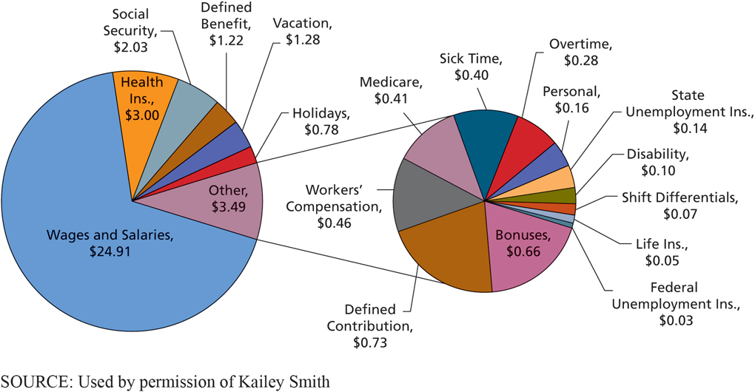
Employee Costs per Hour
CE 2-2 How will A I and automation affect organizations?
Figure C E 2-3 Employee Costs per Hour (U.S.)
Notes:
If you buy an automated system, you won’t have to pay for any of the additional benefits that you normally do with human labor. You won’t have to pay for overtime, paid leave, insurance, retirement contributions, etc.

Slide 11
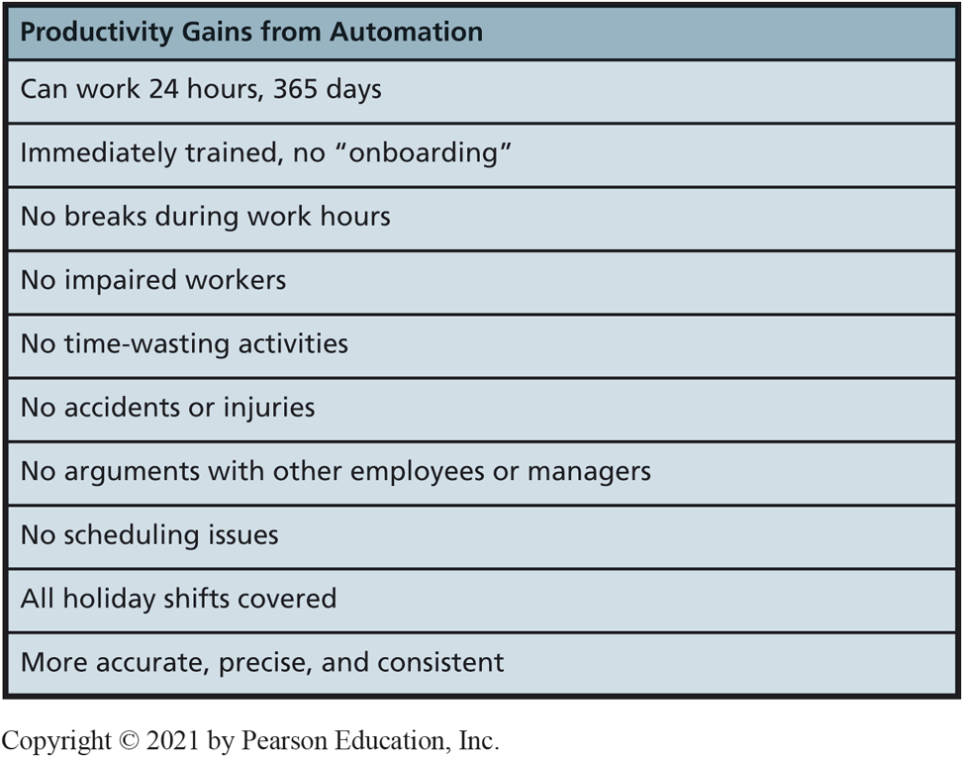
Productivity Gains from Automation
CE 2-2 How will A I and automation affect organizations?
Figure C E 2-4 Productivity Gains from Automation
Notes:
You could quantify each of these productivity gains, but the gains would vary substantially depending on your specific circumstances. For example, if your restaurants are open 24 hours a day, you would realize sizable productivity gains from an automated hamburger machine. But if they were only open 8 hours a day, the gains might be less.

Slide 12
Other Benefits—Reduced Fraud
CE 2-2 How will A I and automation affect organizations?
A I-powered machines don’t want to steal
A C F E estimates that a typical organization loses 5 percent of their annual revenue to employee fraud
Median loss for employee fraud is $130,000 per incident
Estimated amount of employee fraud losses would be $900 billion per year in the U.S.

Slide 13
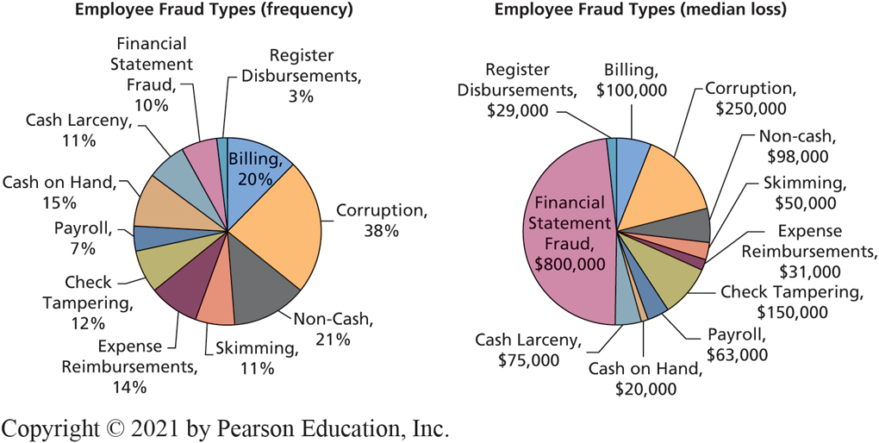
Employee Fraud Frequency and Median Loss
CE 2-2 How will A I and automation affect organizations?
Figure C E 2-5 Employee Fraud Frequency and Median Loss
Notes:
Not all types of fraud are the same. Some types of fraud, like financial statement fraud, don’t occur that often but have large median losses. The ACFE estimates that a typical organization loses 5 percent of their annual revenue to employee fraud.

Slide 14
How Will This Impact Me? (1 of 2)
CE 2-3 How will A I affect me?
Some people see A I as an incredible opportunity
Others see it as a serious threat to their jobs
What happens if you get replaced by a machine, or A I bot?
Would years of education and training become worthless?
Will you have to change careers?

Slide 15
How Will This Impact Me? (2 of 2)
CE 2-3 How will A I affect me?
Jobs requiring routine physical and mental tasks are prime candidates for automation
A I Experts estimate that by 2025, nearly 100 million workers could be taken out of the current U.S. labor force
They will be replaced by robots with I Q s higher than 90% of the U.S. population
You need to understand the economic implications of these historic changes

Slide 16
Impact on Workers
CE 2-3 How will A I affect me?
A I and automation could do jobs that humans don’t really want to do (dirty, stinky, boring, and even dangerous jobs)
Home repairs, house cleaning, car washing, auto repairs, gardening, and cooking could all be done autonomously
Retooling of the existing workforce will be necessary
There will be new types of jobs for humans to do

Slide 17
A Shifting Workplace
CE 2-3 How will A I affect me?
Human workers need to develop skills that machines aren’t good at
These include abstract reasoning, systems thinking, collaboration, experimentation, creativity, adaptability, and new undefined problem solving.
Even the best A I’s need training
Machines need humans to survive
They need humans to push them to improve

Slide 18
The Goal of A I
CE 2-4 What is the goal of A I?
The goal of A I research is to create artificial general intelligence, or strong A I that can complete all of the same tasks a human can
Currently we have weak A I that is focused on completing a single specific task
Potential for superintelligence capable of intelligence more advanced than human intelligence

Slide 19
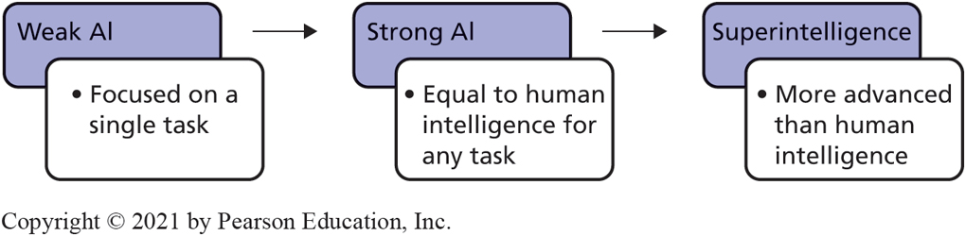
Evolution of A I Abilities
CE 2-4 What is the goal of A I?
Figure C E 2-6 Evolution of A I Abilities
Notes:
Currently, we have weak AI, which is focused on completing a single specific task. There is speculation that someday we may be able to create an AI that moves beyond strong AI to create a superintelligence capable of intelligence more advanced than human intelligence. Some researchers see superintelligence as a potential threat to humans. Others disagree and argue that this level of AI is hundreds of years away.

Slide 20
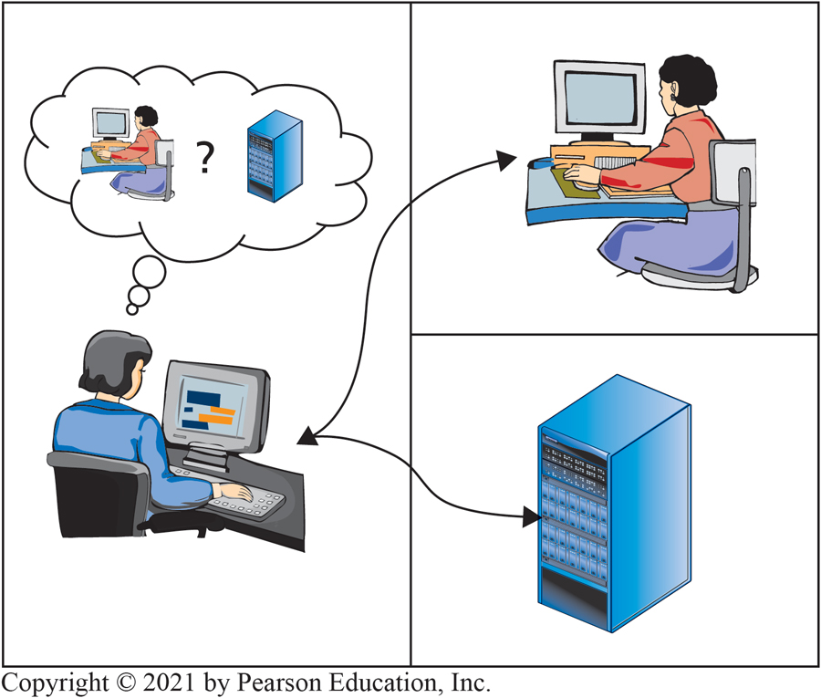
Am I Talking to a Human or a Computer?
CE 2-4 What is the goal of A I?
Figure C E 2-7 Turing Test
Notes:
Currently, we have weak AI, which is focused on completing a single specific task. There is speculation that someday we may be able to create an AI that moves beyond strong AI to create a superintelligence capable of intelligence more advanced than human intelligence. Some researchers see superintelligence as a potential threat to humans. Others disagree and argue that this level of AI is hundreds of years away.

Slide 21
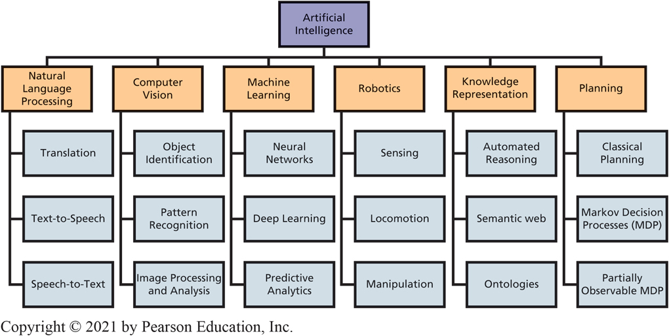
Major A I Research Areas
CE 2-4 What is the goal of A I?
Figure C E 2-8 Major A I Research Areas
Notes:
These major areas focus on different aspects of human abilities. In fact, AI as a research area is much broader than can be shown here. AI is a general term that means different things to different people depending upon their area of interest. However, the implementation of AI into real-world technology usually involves combining multiple different areas together.

Slide 22
A I is an Enabler of Other Technology
CE 2-4 What is the goal of A I?
An AI-powered self-driving car would have:
Multiple computer vision systems (LIDAR, RADAR, cameras, night-vision capability, etc.)
A robotics component that governs locomotion, sensing, and navigation
The ability to automatically learn from your past transportation needs and environmental preferences (machine learning)
The ability to preplan future routes (planning)
The ability to give your car instructions by talking with it normally (natural language processing)

Slide 23
How Does A I Really Work?
CE 2-5 How does A I work?
You need to understand how A I works so you can see how it could be applied to organizational problems
The following example looks at how A I can be used to solve a real-world problem—spam filtering
Use machine learning to classify spam vs legitimate emails

Slide 24
Machine Learning for Spam Detection
CE 2-5 How does A I work?
Naïve Bayes Classifier that predicts the probability of a certain outcome based on prior occurrences of related events
Collect a large number of previous emails already classified as either spam or legitimate
Search all of the emails for the word “promotion”
88 percent of prior emails containing the word “promotion” were spam
If a new email comes in containing the word “promotion,” we will say there is an 88 percent chance it’s spam

Slide 25
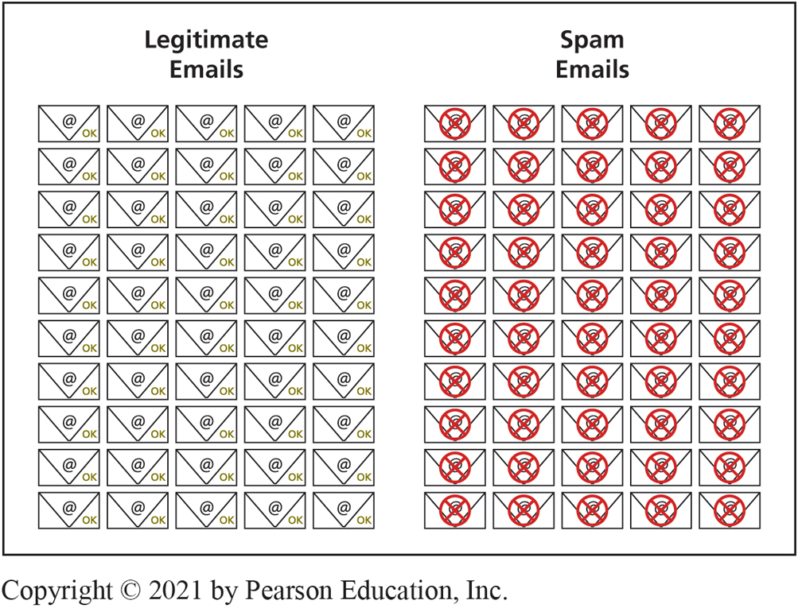
Classifying Prior Emails
CE 2-5 How does A I work?
Figure C E 2-9a Classifying Emails as Spam or Legitimate
Notes:
First, we collect a large number of previous emails. Then we classify each email as either “spam” or “legitimate.” Next, we search all of the emails for the word “promotion” and see how many matches we get.

Slide 26
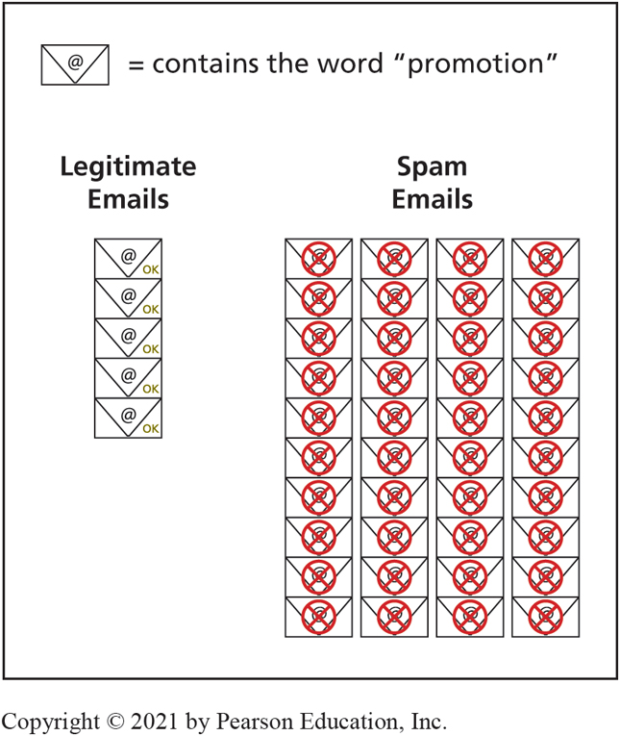
Emails Containing the Word “Promotion”
CE 2-5 How does A I work?
Figure C E 2-9b Emails Containing the Word “Promotion.”
Notes:
Some of the legitimate emails may have used the word “promotion” in the context of an advancement in your job. On the other hand, the spam emails likely used the word “promotion” in terms of a special sale. In this case, 88 percent of prior emails containing the word “promotion” were spam. So, in the future, if a new email comes in containing the word “promotion” we will say there is an 88 percent chance it’s spam. That doesn’t mean the word “promotion” can be used to perfectly identify all spam, but it’s a strong indicator.

Slide 27
I B M’s Watson
CE 2-5 How does A I work?
I B M’s Watson uses natural language processing (N L P), or the ability of a computer system to understand spoken human language, to answer questions
Watson can provide evidence-based answers for questions in fields like healthcare, transportation, education, social media, customer service, security, etc.

Slide 28
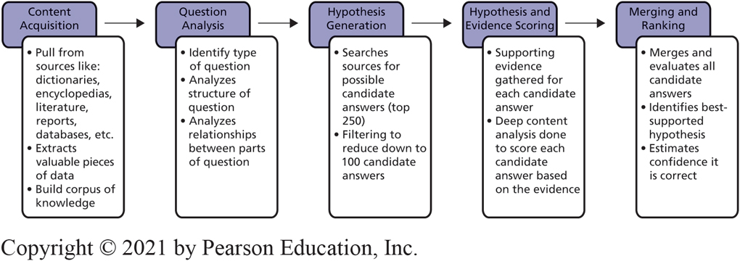
I B M’s Question and Answering Process
CE 2-5 How does A I work?
Figure C E 2-10 I B M’s Question Answering Process
Notes:
First, Watson acquires content from sources like dictionaries, encyclopedias, literature, reports, databases, etc. It extracts valuable pieces of data from structured and semi-structured data sources. It then takes these extracted pieces of data and adds them to a corpus of knowledge, or a large set of related data and texts. Watson can read hundreds of millions of pages per second, can interact with people all over the world at the same time, and speaks 9 languages.

Slide 29
Active Review
CE 2-1 Why is artificial intelligence important?
CE 2-2 How will A I and automation affect organizations?
CE 2-3 How will A I affect me?
CE 2-4 What is the goal of A I?
CE 2-5 How does A I work?

Slide 30

Copyright

