Slide 1

Chapter 7
Wireless and Mobile Networks
Computer Networking: A Top-Down Approach
9th edition
Jim Kurose, Keith Ross
Pearson, 2025
All material copyright 1996-2025
J.F Kurose and K.W. Ross, All Rights Reserved
Notes:
Version History
V9.0. July 2025 (completely redone from scratch, not a revision of 8.*)

Slide 2
Wireless and mobile networks: overview
Chapter goals:
understand principles of wireless networks:
  physical layer: radio, influence on higher layers
  access network: link-layer challenges/solutions in any wireless networks
  core network: the “network” layer in a wireless network
  user/device mobility: among access networks
  application-specific wireless networks: Bluetooth, satellite, IoT
wireless networks in practice:
  WiFi
  5G (with a bit of 4G)
  Bluetooth, satellite, IoT
For a more extensive treatment of wireless and mobile networks visit: https://gaia.cs.umass.edu/wireless_and_mobile_networks

Slide 3

Chapter 7 outline
introduction
radio: the physical layer
the wireless access network
  principles, WiFi, 5G
the wireless core network
  principles, 5G
mobility
Bluetooth, satellite, IoT wireless networks

Slide 4
Wireless and Mobile Networks: context
more mobile-broadband-connected (cellular) devices than fixed-broadband-connected devices devices (5-1 in 2019)!
  wireless connectivity even great when WiFi users considered (80% of broadband homes use WiFi)
  60% of Internet traffic from major web sites destinated to mobile device
8000
7000
6000
5000
Mobile broadband subscribers (M)
4000
Broadband subscribers (M)
3000
2000
Fixed (wired) broadband subscribers (M)
1000
2007
2008
2009
2010
2011
2012
2013
2014
2015
2016
2017
2018
2019
2020
2021
2022
2023
Data source: www.statista.com (1/25)

Slide 5
Wireless applications their needs
Six application areas :
Application needs:
Wide-area Mobile Wireless Internet Access
Local-area Mobile Wireless Internet Access
Fixed Wireless Internet Access
Satellite Networks for Internet Access and Sensing
Cable replacement
Internet of Things (IoT)
high importance
user data rate
mobility
user data rate
mobility
medium
low
energy efficiency
area traffic capacity
energy
efficiency
area traffic capacity
latency
device density
latency
device density

Slide 6



















Elements of a wireless network
wired network
infrastructure

Slide 7





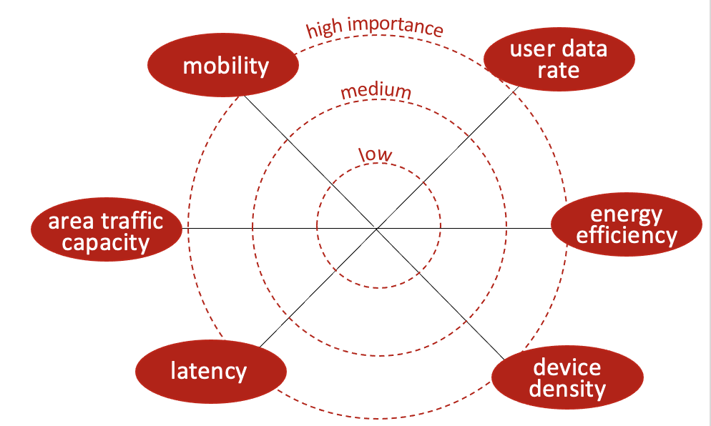
Elements of a wireless network
wireless hosts
laptop, smartphone, IoT
run applications
may be stationary (non-mobile) or mobile
  wireless does not always mean mobility!
wired network
infrastructure

Slide 8

Elements of a wireless network
base station
typically connected to wired network
relay - responsible for sending packets between wired network and wireless host(s) in its “area”
  e.g., 4G/5G cell towers, 802.11 (WiFi) access points (APs)
wired network
infrastructure

Slide 9

Elements of a wireless network
wireless link
typically used to connect device(s) to base station, also used as backbone link
multiple access protocol coordinates link access (random access, FDMA, TDMA, CDMA, polling)
various transmission rates and distances, frequency bands
wired network
infrastructure
Ad hoc networks: not all wireless networks are connected into a larger network

Slide 10
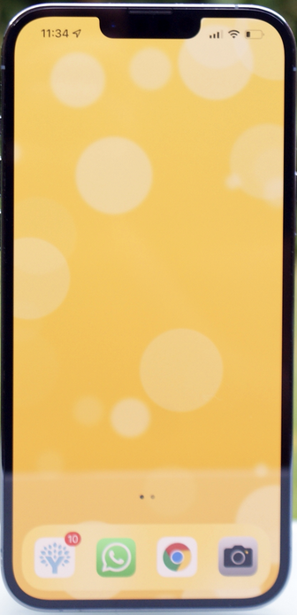
Elements of a wireless network
wireless device radio
wireless device has different radios for different networks
iPhone16: has ~11 different radios, many antennae
  5 different cellular radios, WiFi, Bluetooth, UWB, satellite NFC, GPS
wired network
infrastructure
Ad hoc networks: not all wireless networks are connected into a larger network

Slide 11
Characteristics of selected wireless links
14 Gbps
802.11ax
10 Gbps
5G
3.5 Gbps
802.11ac
802.11 af,ah
600 Mbps
802.11n
4G LTE, 5G eMBB
54 Mbps
802.11g
LEOS
11 Mbps
802.11b
2 Mbps
Bluetooth
Indoor
Outdoor
Midrange
outdoor
Long range
outdoor
Space (100’s of Km)
10-30m
50-200m
200m-4Km
4Km-15Km

Slide 12
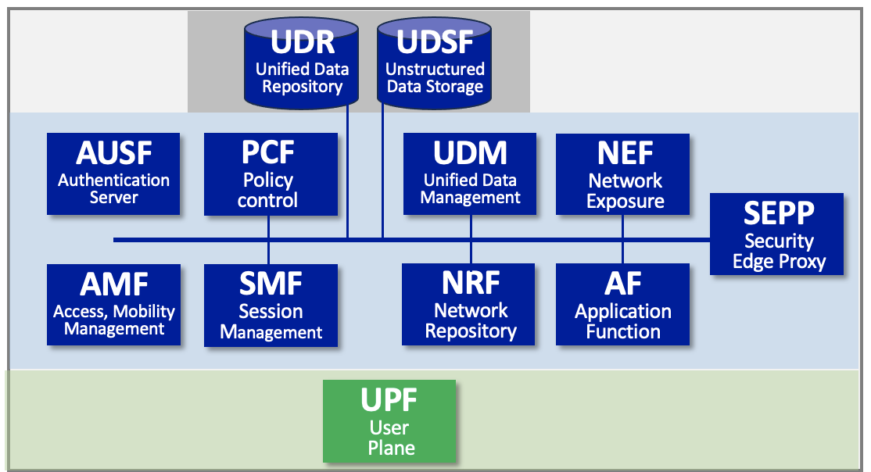












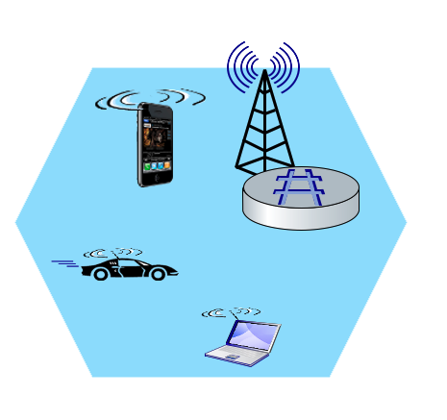
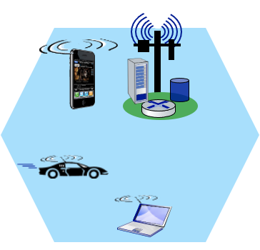
Wireless networks: edge and core networks
WiFi:
5G:
=
Mobile device
Mobile device
(UE)
Base station
(gNode-B)
Mobility Management Entity (MME)
Institutional wired network
Internet
Base station
(eNode-B)
WLAN 1
Internet
WLAN 2
…
…
edge
core
edge
core

Slide 13
Chapter 7 outline
introduction
radio: the physical layer
  radio principles
  radio channels
  antennas: MIMO
  radio spectrum
  coding and modulation
the wireless access network
the wireless core network
mobility
Bluetooth, satellite, IoT wireless networks

Slide 14
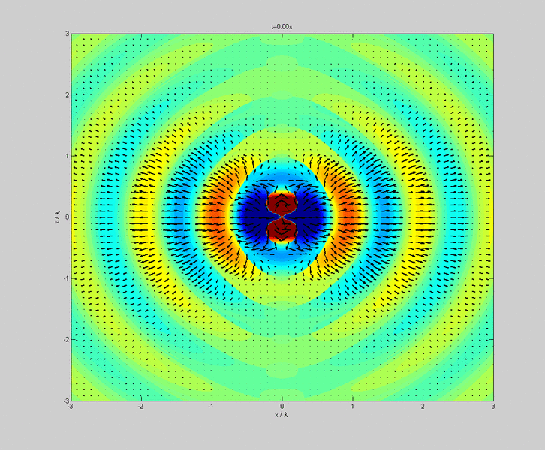
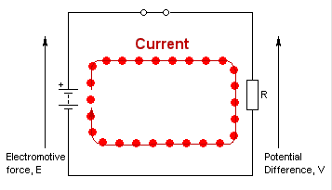
Electromagnetics: enabling communication
receiver
transmitter
(1) current at one location (transmitter) ....
(2) creates an EM field in space ....
(3) induces a current at remote location (receiver)....
slide concept: S. Rangan (NYU)

Slide 15
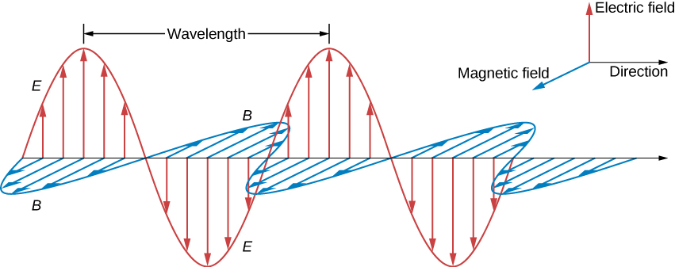
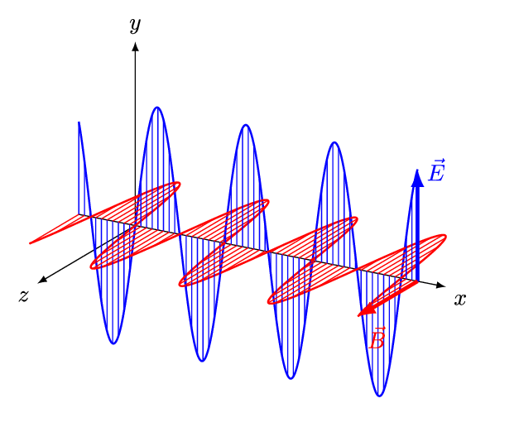
Radio basics: electromagnetic waves
λ: wavelength
amplitude
wave propagation:
Electromagnetic wave has:
wavelength (λ)
frequency: speed of light / wavelength = c/λ
directionality (of propagation)
time-varying amplitude
slide concept: S. Rangan (NYU)

Slide 16
Radio basics: phase
The phase of a periodic signal, represents the fraction of the period covered up until time t
often measured in angular units (0 to 360)
time
0
90
180
270
360
degrees
we can code information into signal by changing signal’s phase (keeping frequency the same!)
bit value
0
0
1
0
1
1
signal
time

Slide 17
Radio signal characteristics
Power: antenna receive/transmit energy per unit time
linear: measured in watts (or milliwatts)
logarithmic: measured in decibels (db)
Power spectral density:
power present in signal as a function of frequency
P_{mW}
(
(
P_{dBm} = 10 . log₁₀
1mW
example:
P_{mW} = 250 mW (typical max
mobile transmit power)
power spectral density
.9975
1.00
1.0025
frequency (GHz)
(
250mW
P_{dBm} = 10 . log₁₀
(
1mW
carrier (center) frequency
= 24 dBm
Notes:
License

Slide 18

Radio signal characteristics
Bandwidth: width (measured in Hz) of range of frequencies use by radio signal
radio frequency usage characterized by power spectral density (psd of zero means no signal power at that frequency)
bandwidth = “band” + “width” (width of frequency band used)
22 MHz
bandwidth
power spectral density (psd)
frequency (GHz)
2.427
2.438
2.449
two meanings/usage of “bandwidth”
carrier (center) frequency
Radio signal “bandwidth” different from link “bandwidth” (maximum transmission rate) term used by network engineers!
Radio signal with 22 MHz bandwidth, evenly spread between 2.427, 2.429 GHz. This 22 MHz bandwidth channel corresponds to channel 6 in WiFi network)
Notes:
License

Slide 19
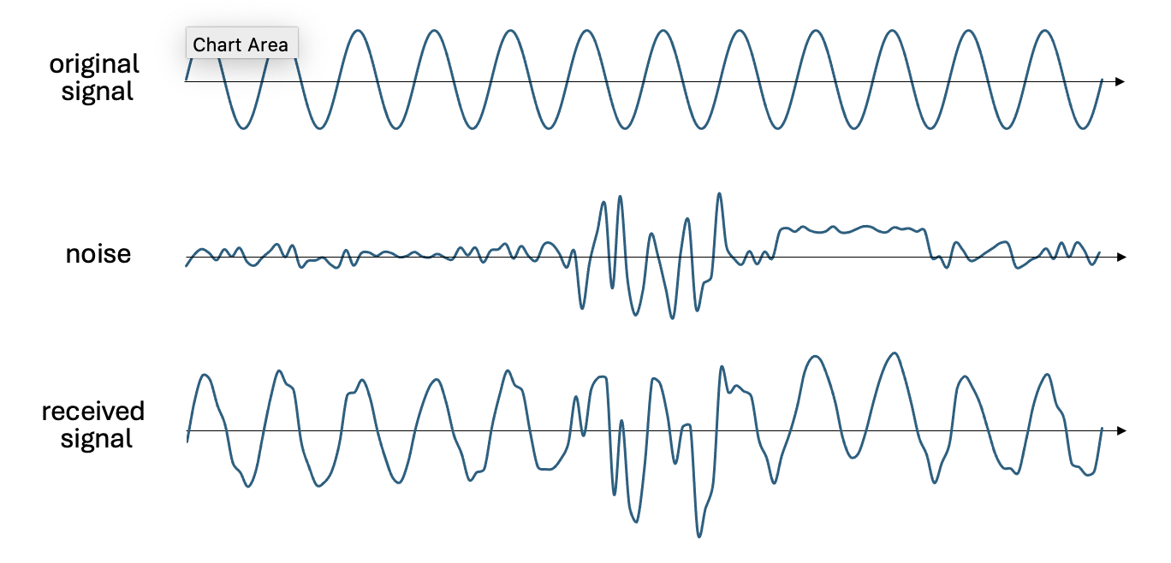
Signals and Noise
interference: other transmitters/EM radiaters in same frequency band
  hundreds of consumer devices operate in unlicensed 2.4 GHz band (aka: Industrial, Scientific, and Medical band): WiFi, Bluetooth, Zigbee, satellite TV, microwave ovens, garage-door openers, baby monitors, cordless phones, wireless mics/speakers, radio-controlled drones and toys, amateur radio, ...
thermal and electronic noise in receiver:
    natural thermal variations, imperfections in electronics
Original signal, noise, and noisy received signal
Notes:
License

Slide 20
Signal to Noise Ratio (SNR)
SNR: ratio of signal power to noise power (often measured in dB)
fundamental measure of channel “quality”
(
received signal power
SNR (dB) = 10 . log₁₀
(
noise power
SNR of 0 implies equal signal and noise
high (or low) SNR: easy (or hard) to extract signal from signal+noise
Typical ranges for current radios:
  lower limit for cellular: -10 to -6 dB
  lower limit for WiFi: 20dB
Original signal, noise, and noisy received signal
Notes:
License

Slide 21
Channel Capacity
Shannon capacity (of a communication channel): maximum rate at which data can be transmitted, given bandwidth, SNR constraints
(
received signal power
C = B . log₂
1+
(
noise power
where:
  C is capacity (bits/sec)
  B is bandwidth (in Hz)
  power measured linearly (e.g., in mW)
Observations:
  C scales linearly with B (for constant SNR)
  high SNR: C scales logarithmically: little value in increasing SNR beyond a certain point
  Shannon: classic 1948 paper
Notes:
License

Slide 22
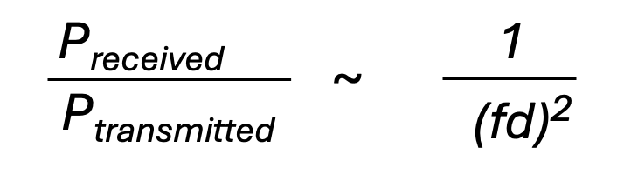
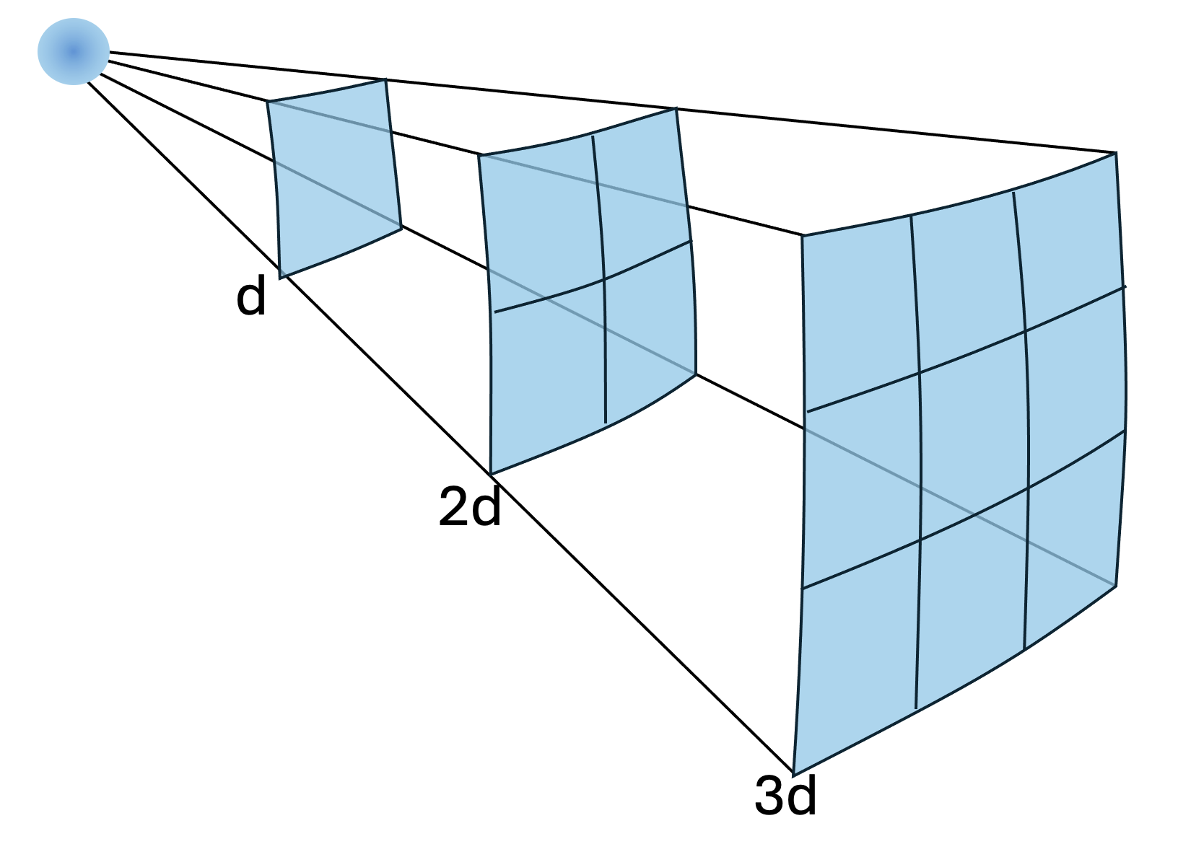
Wireless link characteristics: path loss
  Wireless radio signal attenuates (loses power) as it propagates
path loss
(aka fading) reduction in power density (attenuation) of an electromagnetic wave as it propagates from transmitter to receiver
f: frequency
d: distance
Generalized path loss ~ (fd)^{n} :
n=2 (free space), n=(2.7,3.5) urban, n= (3,6) in building
Notes:
Wikipedia figure
Put dot on the left if I change anything.
Use pointer to show that further it goes, reduction in power density.
As a wireless signal travels over a longer distance, it spreads out and covers a larger area, but its power density (or signal strength) decreases.

Slide 23

“Hidden terminal problem” recalling ~ (fd)² path loss
  Signal fading with~ (d)² path loss, causes a “hidden terminal” problem:
A
B
C
Signal strength
(log scale)
signal detection
threshold
space
hidden terminals: A and B can hear each other, B and C can hear each other, but A and C can not hear each other
complicates wireless channel sharing among A, B, C
Notes:
WiGig tri-band-enabled devices, which operate in the 2.4, 5 and 60 GHz bands, deliver data transfer rates up to 7 Gbit/s (for 11ad), about as fast as an 8-band 802.11ac transmission, and more than eleven times as fast than the highest 802.11n rate, while maintaining compatibility with existing Wi-Fi devices. The 60 GHz millimeter wave signal cannot typically penetrate walls but can propagate by reflection from walls, ceilings, floors and objects using beamforming built into the WiGig system.

Slide 24
Wireless link characteristics: hidden terminals
Path loss causes “hidden terminals”
B, A hear each other
B, C hear each other
A, C can not hear each other interfering at B
Objects cause ”hidden terminals”
B, A hear each other
B, C hear each other
A, C can not hear each other means A, C unaware of their interference at B
A
B
C
C
B
A
Signal strength
(log scale)
signal detection
threshold
space

Slide 25


Wireless link characteristics: multipath
  multipath propagation: radio signal reflects off objects ground, built environment, arriving at destination at slightly different times
reflected path
line of sight
(LOS) path
reflected path

Slide 26
Wireless link characteristics: multipath
  multipath propagation: radio signal reflects off objects ground, built environment, arriving at destination at slightly different times
Coherence time:
amount of time bit is present in channel to be received
influences maximum possible transmission rate, since coherence times can not overlap
inversely proportional to
  frequency
  receiver velocity
transmitted
pulses
time
received
LOS pulse
received
multipath
pulses
received
multipath
pulses
received
LOS pulse
received
pulse
time
T_{c}: coherence time

Slide 27
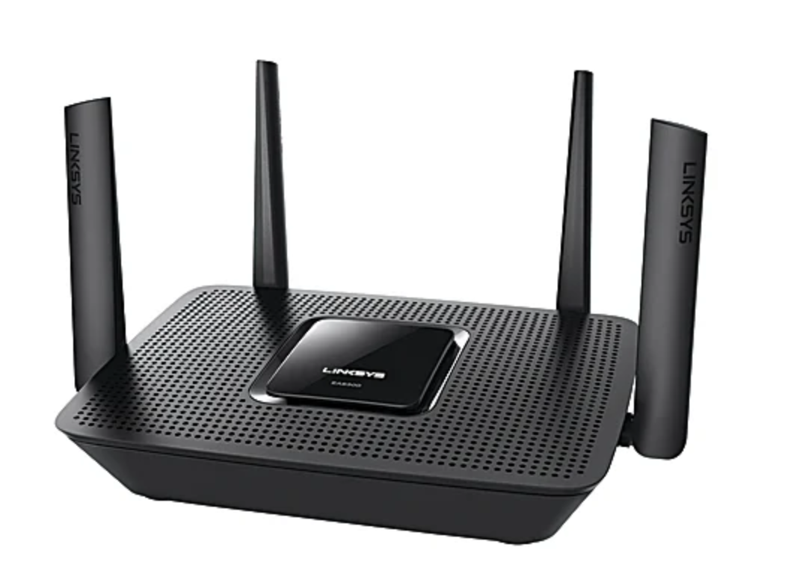
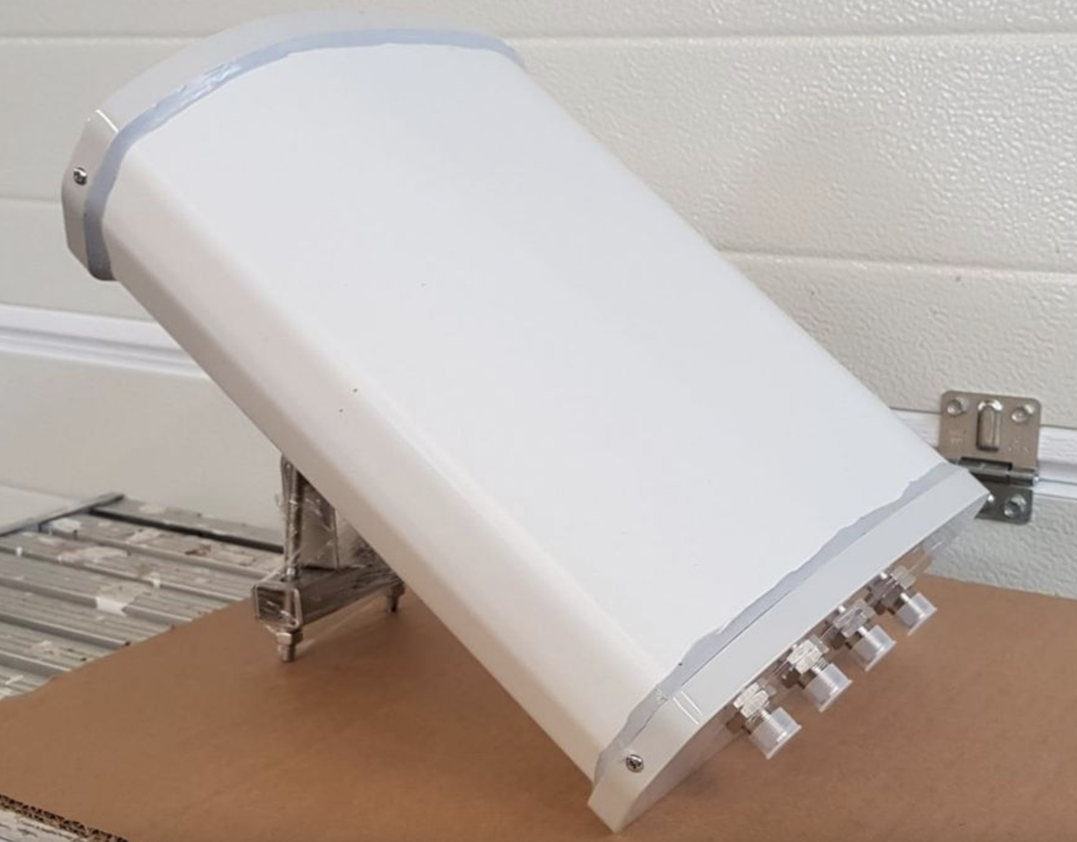
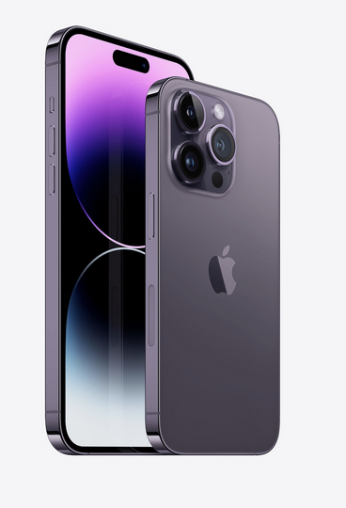
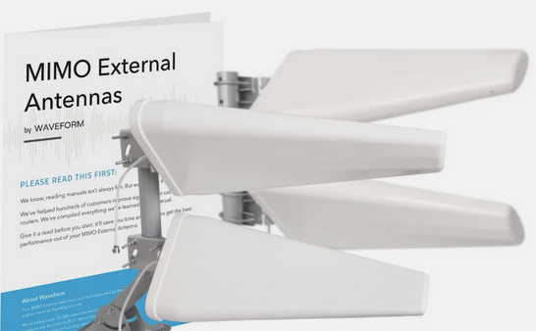
Antennas
MIMO: Multiple input
multiple output
antenna
  Antennas both transmit and receive radio waves
single antenna: old school
multiple antenna: common now in wireless networks
Gigabit LTE with 4x4 MIMO
Wi‑Fi 6 (802.11ax) with 2x2 MIMO

Slide 28

MIMO transmission: single user
Single User MIMO: spatial diversity
multiple transmit/receive antenna to/at one user at same time
exploit multipath: use multiple antennas to increase number of paths for transmitted signal between transmitter and receiver
multipath: signals arriving at receiver not the same (e.g., some at higher quality)
antenna gain: increase SNR by combining multiple signals
sender
receiver
12 signal paths from one sender (with two antennae) to one receiver (with two antennae)

Slide 29
MIMO: spatial diversity
  increase reliability, range by sending / receiving redundant streams of information in parallel along different spatial paths between transmit and receive antennas
sender
receiver
improved reliability: unlikely that all paths degraded at same time
improved range: multiple antennas gather more signal at receiver

Slide 30
MIMO: spatial diversity
H_{1,1}(x)
  x: signal transmitted
  y_{j}: signal received at antenna j
  H_{i,j}(x): transformation of signal x from transmitter antenna i to receiver antenna j
  estimated by receiver (perhaps with sender’s help)
H_{2,1}(x)
x
y₁= H_{1,1}(x)
+ H_{2,1}(x)
x
receiver
x
y₂= H_{1,2}(x)
+ H_{2,2}(x)
transmitter
H_{1,1}()
y₁= H_{1,1}(x) + H_{2,1}(x)
  Signal processing at receiver?
  don’t want to just add y1, y2
  take stronger or smaller SNR of y1, y2?
  re-align phases, coherently add?
x
x
H_{1,2}()
Transmitter
Receiver
x
x
H_{2,1}()
H_{2,2}()
y₂= H_{1,2}(x) + H_{2,2}(x)

Slide 31
MIMO: spatial multiplexing
H_{1,1}(x₁)
  send two different streams of information, x₁ and x₂ in parallel along different spatial paths from transmitter to receiver
  spatial multiplexing differs from spatial diversity
H_{2,1}(x₂)
x₁
y₁= H_{1,1}(x₁)
+ H_{2,1}(x₂)
receiver
x₂
y₂= H_{1,2}(x₁)
+ H_{2,2}(x₂)
transmitter
H_{1,1}()
y₁= H_{1,1}(x₁) + H_{2,1}(x₂)
x₁
x₁
H_{1,2}()
Transmitter
Receiver
x₂
x₂
H_{2,1}()
H_{2,2}()
y₂= H_{1,2}(x₁) + H_{2,2}(x₂)

Slide 32
MIMO: spatial multiplexing
H_{1,1}(x₁)
H_{2,1}(x₂)
x₁
y₁= H_{1,1}(x₁)
+ H_{2,1}(x₂)
receiver
x₂
y₁= H_{1,1}(x₁) + H_{2,1}(x₂)
y₂= H_{1,2}(x₁) + H_{2,2}(x₂)
y₂= H_{1,2}(x₁)
+ H_{2,2}(x₂)
transmitter
  Two equations in two unknowns
  but H_{i,j}(x_{i}) are time-varying stochastic quantities
H_{1,1}()
y₁= H_{1,1}(x₁) + H_{2,1}(x₂)
x₁
x₁
H_{1,2}()
Transmitter
Receiver
x₂
x₂
H_{2,1}()
H_{2,2}()
y₂= H_{1,2}(x₁) + H_{2,2}(x₂)

Slide 33

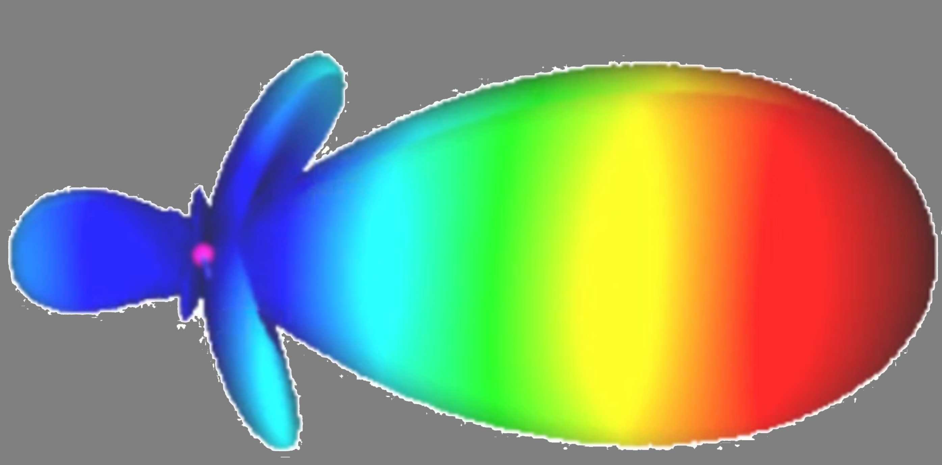
Multi-user MIMO
multiple transmit antenna send to different users at same time
  “spatial multiplexing”
exploit directional antenna: send to geographically separated users at same time via beamforming
single user MIMO
multi-user MIMO

Slide 34
Wireless radio spectrum:
radio spectrum: national asset, owned by the nation
national government determine how spectrum is used “locally”
different spectrum use types:
licensed:
dedicated use, typically by one “owner” (e.g., cellular carrier such as AT&T, Verizon)
often allocated by spectrum auction
shared:
spectrum dynamically shared among users
“incumbent” may get preferential access, others “back off”
unlicensed:
open (free) for anyone to use, conforming to rules (e.g., power transmission levels)
2.4GHz and 5 Ghz WiFi
3.5GHz “Private 5G” (aka CBRS)
Notes:
License

Slide 35

WiFi spectrum bands
6 GHz range
most recently added
more than 250 configurable/selectable WiFi channels of different transmission rates
802.11
ax/be
5 GHz range
more than 150(configurable/selectable WiFi channels) of different transmission rates
802.11
a/h/n/ac/ax
2.4 GHz
Divided into 11-14 channels, depending on country
802.11
b/g/n/ax
other 802.11 WiFi spectrum bands, but not in widespread use
Notes:
https://en.wikipedia.org/wiki/List_of_WLAN_channels

Slide 36
5G spectrum: three spectrum bands*
* No single, well-accepted ranges for “low”, “mid” and “high”
High band frequencies: 25–66 GHz range (aka mmwave)
26 GHz, 40 GHz, 50 GHz, 66 GHz bands popular
short distances (< mile), high speeds (<3 Gbps)
line of sight transmission: poor penetration of trees, buildings, ...
5G
3.4 - 6 GHz
Mid-band frequencies: 1 - 6 GHz ranges
balance distances (~5 miles ?) and transmission rates (100–900 Mbps)
1.8, 3.3 GHz to 3.8 GHz, 6 GHz bands popular
5G
4G
5G
4G
3G
2G
1-2.6 GHz
Low band frequencies: (< 1 GHz range)
covers longer distances (10’s of miles), but at lower speeds (50–250 Mbps)
5G
4G
3G
2G

Slide 37
Chapter 7 outline
introduction
radio: the physical layer
  radio principles
  radio channels
  antennas: MIMO
  radio spectrum
  coding and modulation
the wireless access network
the wireless core network
mobility
Bluetooth, satellite, IoT wireless networks

Slide 38
Physical Layer: coding and modulation
Coding
Modulation
1010001011100110101
Coding
Digital Modulation
Pulse Shaping
RF Modulation
d: original data
Add error detection, correction bits at physical layer
We won’t cover this
(look at ECE for courses)
match transmission bandwidth to channel bandwidth using pulse shaping
Choose digital modulation technique that maximizes number of reliably transmitted bits/sec based on observed channel impairments
e.g., in family of Quadrature amplitude modulation (QAM)
transmit signal as an electromagnetic wave over assigned carrier frequency
Carrier: waveform at a given frequency, f_{c} (carrier frequency), modified (modulated) with an information-bearing signal
Notes:
https://en.wikipedia.org/wiki/Carrier_wave

Slide 39
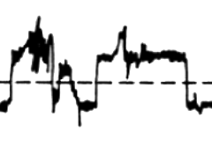
Physical Layer: Error detection, correction coding
noisy channel
Coding
01101
101000100110101
01101
101001100110101
EDC’ d’
error-free
?
Y
101000100110101
EDC
d: original data
EDC’
d’: received data
EDC: error detection, correction bits
additionally transmitted bits (in addition to d)
added so receiver can detect and possibly correct errors in d bits
example: parity bits, redundancy bits
received EDC’ and received d’ bits may contain errors
N
errors
correctable
?
Y
N
EDC used at many layers: channel (physical), link, network, transport, application layers
Notes:
https://en.wikipedia.org/wiki/Carrier_wave

Slide 40
Physical Layer: Error detection, correction coding
Wireless physical layer may add EDC bits, into addition to:
application
transport
network
link
physical
application-layer EDC bits
adding physical-layer EDC makes sense!
detect/recover locally, rather than wait for end-end
physical layer techniques adapted to local radio error characteristics
M
transport-layer EDC bits
H_{t}
M
H_{n}
H_{t}
M
link-layer EDC bits
H_{l}
H_{n}
H_{t}
M
101000100110101
original bits
01101
101000100110101
EDC+original bits
Notes:
https://en.wikipedia.org/wiki/Carrier_wave

Slide 41
Physical Layer: EDC shuffling example
A burst of noise in this interval causing 3 bits to be unintelligible , with no shuffling, would mean receiver can not determine d₄
Link
physical
d₁ d₂ d₃ d₄ d₅ d₆ d₇ d₈
original bits from link layer, including EDC
d₁ d₁’ d₂ d₂’ d₃ d₃’ d₄ d₄’ d₅ d₅’ d₆ d₆’ d₇ d₇’ d₈ d₈’
add EDC duplicate bits in PHY
coding
d₁ d₅’ d₂ d₆’ d₃ d₇’ d₄ d₈’ d₅ d₁’ d₆ d₂’ d₇ d₃’ d₈ d₄’
shuffle for resistance to burst errors
modulation
modulation: from bits to symbols to waveforms
A burst of noise in this interval, causing 3 bits to be unintelligible still allows receiver to determine all original bits
Notes:
https://en.wikipedia.org/wiki/Carrier_wave

Slide 42
Modulation
Coding
Modulation
1010001011100110101
Coding
Digital Modulation
Pulse Shaping
RF Modulation
d: original data
digital modulation
bit value
0
0
1
0
1
1
time
encoding bits (1’s, 0’s) into analog RF carrier signal by changing (“modulating”) a characteristic of the RF carrier signal: amplitude, frequency, or phase.
amplitude
modulation
time
frequency
modulation
time
phase
modulation
time
Notes:
https://en.wikipedia.org/wiki/Carrier_wave

Slide 43
Modulation schemes: ASK, PSK
Amplitude shift keying (ASK): signal’s amplitude encodes bits
bit value
0
0
1
0
1
1
time
0:
1:
signal
time
Binary Phase shift keying (BPSK): signal’s phase encode bits
0:
signal
1:
time
PSK: 0 and 1 signals out of phase by 180º, but at same carrier frequency

Slide 44
Modulation schemes: QPSK
Why stop at just two phases?
two bits grouped to become one “symbol” (2 bits -> 4 symbols)
QPSK: Quadrature Phase Shift Keying: 4 symbols encoded using 4 phases
symbol
signal
∂
0
0
0
1
1
0
0
1
1
1
1
1
QPSK frequency same as BPSK, but twice the data rate!
“00”
∂
∂
“00”
“01”
“10”
“01”
“11”
“11”
“01”
∂
“10”
signal
∂
time
∂
“11”
∂
Fun interactive QPSK tool: https://www.geogebra.org/m/enkymjtg

Slide 45
Constellation diagrams
graphical characterization of modulation: amplitude, phase of symbols
point in constellation diagram depicts symbol’s phase (degrees counterclockwise from east) and amplitude (distance from origin)
QPSK constellation diagram: four symbols represented by four signal waveforms:
  four different phases
  identical amplitude
amplitude
135º
45º
225º
315º
V
p
e
h
s
a
QPSK constellation diagram

Slide 46
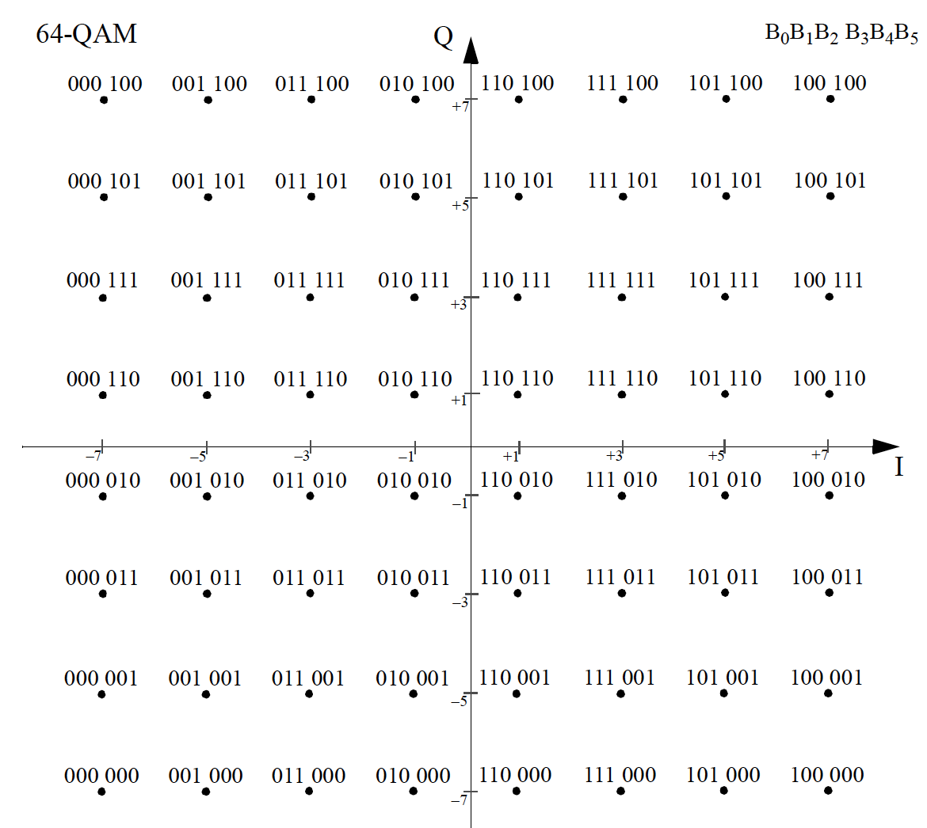
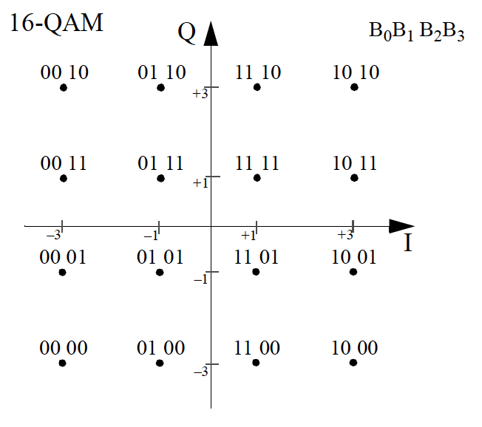
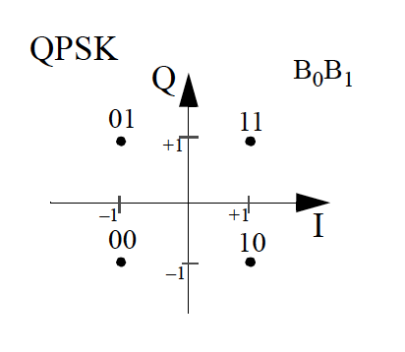
QAM: Quadrature Amplitude Modulation
generalizing QPSK
m-QAM: using m different amplitude/phase values to encode log2(m) bits
64-QAM
b₀b₁b₂b₃b₄b₅
16-QAM
b₀b₁b₂b₃
4-QAM
b₀b₁
bit encodings for 4-QAM, 16-QAM, 64-QAM (for WiFi)

Slide 47
Constellation diagrams: how bit errors occur
Transmitter transmits waveforms for 12 1111 symbols, sequentially
16-QAM
b₀b₁b₂b₃
phase/amplitude of transmitted signal
phase/amplitude of received signals
receiver measures amplitude, phase of received signal
receiver classifies symbol as bit pattern with amplitude, phase closest to received signal amplitude, phase
This received signal, is misclassified as 1011 since its amplitude, phases are closer to 1011 than 1111
These received signals correctly classified as 1111 (received amplitude, phases closest to 1111)

Slide 48
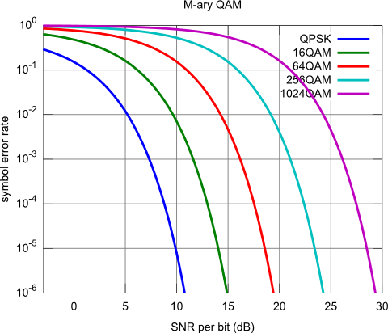

Adaptive modulation
given modulation scheme :
has nominal data rate (assuming no errors)
SNR can increase/decrease:
  changing interference
  sender transmitter power
  move along SNR vs BER tradeoff curve
Idea: change modulation scheme, power on the fly, getting highest data rate possible (at acceptable BER, acceptable energy expenditure), as SNR changes
Max data rate:
16 QAM: 11.5 Mbps
64 QAM: 26.9 Mbps
Notes:
Direct Relationship: As SNR increases, BER generally decreases. A higher SNR means that the signal is more distinct from the noise, making it easier for the receiver to correctly interpret the transmitted bits.
Design Considerations: Achieving a high SNR often requires more power or more advanced technology (like better antennas or receivers), which can be more expensive or consume more energy.

Slide 49
Chapter 7 outline
introduction
radio: the physical layer
the wireless access network
  sharing a wireless access channel: OFDMA, CSMA/CA
  WiFi wireless LAN
  5G radio access network
the wireless core network
  principles, 5G
mobility
Bluetooth, satellite, IoT wireless networks

Slide 50
Recall: MAC protocols
multiple access protocols
type of MAC
channel partitioning
random access
taking turns
TDMA
FDMA
Aloha
CSMA/CA
CSMA
polling
type of protocol
OFDMA
slotted Aloha
CSMA/CD
(Ethernet)
system
OFDMA: 4/5G, WiFi6; Bluetooth; satellite
  WiFi; satellite; control plane: 4/5G, Bluetooth
  (and many wired technologies)
  Bluetooth, satellite
  (and many wired technologies)
Notes:
Control plane: coordination about how to share the data plane requires used of the channel.

Slide 51
FDM: Frequency Division Multiplexing
rather than one fat “wideband” channel:
Narrowband channels:
each subchannel has lower bit transmission rate than wideband channel:
  making multipath easier to accommodate
  lower rate implementations easier
transmissions can happen on different subchannels at same time (in parallel)
divide into multiple thin “narrowband” subchannels
separated by “guard bands” to avoid interference
- 0.50
- 0.25
0.00
0.25
0.50
frequency (Hz)
Notes:
Within each Wi-Fi channel, OFDM splits the channel's bandwidth into many subcarriers.

Slide 52
OFDM: Orthogonal FDM
envelope of spectrum
subcarriers: again close together
slightly overlapping, but no guard bands
∂
∂
orthogonal: carefully designed, modulated so crosstalk among subcarriers cancels at center of each subcarrier frequency
- 0.50
- 0.25
0.00
0.25
0.50
frequency (Hz)

Slide 53

OFDM: Subcarriers
Wireless Jargon:
“carrier” ~ “channel”
“subcarrier” ~ “subchannel”
Channel bandwidth
(MHz)
Number of subcarriers
1.25
2.5
5
10
15
20
76
150
300
600
900
1200
∂
# subcarriers in an 4G / 5G channel depends on channel’s bandwidth
- 0.50
- 0.25
0.00
0.25
0.50
frequency (Hz)
Notes:
This example shows 12 subcarriers, in “real life”

Slide 54
OFDMA: subcarriers, time
15 kHz
frequency
180 kHz
Time

Slide 55
OFDMA: symbols
0.5 msec slot
66.6 umsec
one “symbol” can be transmitted per 66.6 usec (4G) at given subcarrier frequency
number of bits (between 2-8) in symbol depends on modulation technique chosen (which depends on channel quality)
frequency
time

Slide 56
OFDMA: resource blocks
0.5 msec slot
66.6 umsec
resource block (RB):
symbols grouped into resource blocks
84 symbols (7 symbols/slot over 12 subcarriers) in 4G
smallest unit of data that can be sent to (assigned to) a user
frequency
time

Slide 57
OFDMA: resource blocks
.
.
.
.
.
.
.
.
.
.
.
.
.
.
.
.
.
.
.
.
.
.
.
.
.
.
.
.
.
.
.
.
.
.
.
.
.
.
.
.
.
.
Base station decides which RBs get assigned (over all frequencies) to which devices at 1 msec intervals
frequencies
.
.
.
.
.
.
.
.
.
.
.
.
.
.
.
.
.
.
.
.
.
.
.
.
.
.
.
.
.
.
.
.
.
.
.
.
.
.
.
.
.
.
1 msec
4G / 5G scheduling interval

Slide 58
From 4G LTE to 5G New Radio (NR)
Commonalities, differences:
4G, 5G: resource blocks (RB)
smallest scheduling unit of transmission to device
4G, 5G both use OFDMA
Subcarrier bandwidths:
  4G: 15 kHz
  5G: 15, 30, 60, 120 kHz
Max carrier bandwidth:
  4G: 20 MHz
  5G: 100 MHz
4G
5G
.
.
.
.
.
.
.
.
.
.
.
.
.
.
.
.
.
.
.
.
.
.
.
.
.
.
.
.
.
.
.
.
.
.
.
.
.
.
.
.
.
.
configurable bandwidth
per sub carrier
12 (or configurable) number of subcarriers per carrier
7 symbols/subcarrier
0.5 msec
1 LTE PRB
.
.
.
.
.
.
.
.
.
.
.
.
.
.
.
.
.
.
.
.
.
.
.
.
.
.
.
.
.
.
.
.
.
.
.
.
.
.
.
.
.
.
14 symbols/subcarrier
1 msec
1 5G NR PRB

Slide 59
CSMA/CA: addressing the “hidden terminals” problem
Path loss causes “hidden terminals”
B, A hear each other
B, C hear each other
A, C can not hear each other interfering at B
Objects cause ”hidden terminals”
B, A hear each other
B, C hear each other
A, C can not hear each other means A, C unaware of their interference at B
A
B
C
C
B
A
Signal strength
(log scale)
signal detection
threshold
space

Slide 60
CSMA/CA: collisions happen
A
B
A senses channel empty, transmits
DIFS
DIFS
B senses channel empty (A’s’ transmission has not reached B yet), transmits
data
collision
data
A senses channel empty, transmits
data
DIFS
B senses channel empty (does not hear A’s transmission due to fading), transmits
collision
data

Slide 61
IEEE 802.11 MAC Protocol: CSMA/CA
802.11 sender
1 if sense channel idle for DIFS then
  transmit entire frame (no collision detection)
sender
receiver
DIFS
2 if sense channel busy then
  start random backoff time
  timer counts down while channel idle
  transmit when timer expires
  3. if no ACK, increase random backoff interval, repeat 2 (see next slide)
data
SIFS
ACK
802.11 receiver
if frame received OK
return ACK after SIFS (ACK needed due to hidden terminal problem)

Slide 62
CSMA/CA: randomization after collision
A
B
A senses channel empty, transmits
DIFS
DIFS
Channel sensed idle for DIFS time
data
collision
data
NO ACK, loss or collision detected
No ACK: loss or collision detected
Wait DIFS time
DIFS
DIFS
Wait DIFS time
random
backoff
Wait randomized backoff
Wait randomized backoff [0, ~200 μsec], depending on PHY. Backoff interval doubles after each collision
random
backoff
Transmit (successfully)
data
data

Slide 63
Avoiding collisions: using RTS/CTS
idea: sender “reserves” channel use for data frames using small reservation packets
sender first transmits small request-to-send (RTS) packet to BS using CSMA
  RTSs may still collide with each other (but they’re short)
  contains duration for following data transmission
BS broadcasts clear-to-send (CTS) packet in response to RTS
  contains duration for following data transmission
RTS and/or CTS heard by all nodes
  All nodes except transmitter defer transmissions
  transmits data frame
Notes:
Ready to send and clear to send

Slide 64

Collision Avoidance: RTS-CTS exchange
A
B
AP
RTS(A)
RTS(B)
reservation collision
RTS(A)
CTS(A)
CTS(A)
time
DATA (A)
defer
ACK(A)
ACK(A)

Slide 65
Backwards compatibility: challenging
IEEE standard | WiFi gen | Year | Max data rate (theoretical) | Frequency (GHz) | Bandwidth | PHY
802.11b |  | 1999 | 11 Mbps | 2.4 | 22 | spread spectrum
802.11g |  | 2003 | 54 Mbps | 2.4 | 20 | OFDM
802.11n | WiFi 4 | 2009 | 600 Mbps | 2.4, 5 | 20, 40 | OFDM
802.11ac | WiFi 5 | 2013 | 6.9 Gbps | 5 | 20, 40, 80,160 | OFDM, MIMO
802.11ax | WiFi 6 | 2020 | 9.5 Gbps | 2.4, 5 | 20, 40, 80,160 | OFDM, OFDMA, MIMO
802.11be | WiFi 7 | 2024 | 30+ Gbps | 2.4, 5, 6 | 20, 40, 80,160, 320 | OFDM, OFDMA, MIMO
Challenge: WiFi 6/7 APs support OFDM (FDMA) and OFDMA (FDMA+TDMA)
How can a WiFi 6/7 AP do both FDMA and TDMA at the same time?
How can WiFi 6/7 AP support user device radios that only do FDMA?

Slide 66
Extending RTS/CTS: Multiuser RTS
idea: create new type of RTS message Multiuser RTS (MU-RTS)
transmitter must use MU-RTS before OFDMA transmissions
transmit MU-RTS using full FDMA channel, with duration info (as usual )
  heard by all 802.11* devices (both OFDM- and OFDMA-capable)
  contains additional OFDMA assignment info for receivers (so receivers will know which OFDMA RUs to listen to)
receivers respond with CTS, sent on assigned OFDMA subchannel
transmitter sends resource blocks to OFDMA receivers, according to assignment
Notes:
Ready to send and clear to send

Slide 67
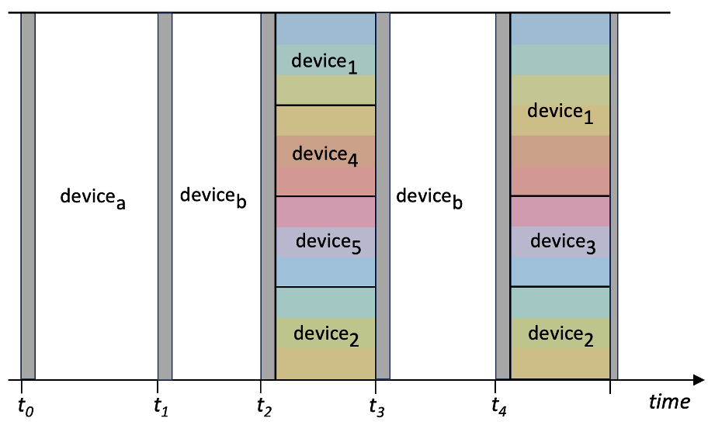
Extending RTS/CTS: Multiuser RTS
Example scenario:
AP wants to send to seven devices
two legacy devices a, b (OFDM only)
five OFDMA-capable devices 1, ... 5
RTS
(business-as-usual for devices a,b)
MU-RTS
(for OFDMA devices 1 ... 5)
Notes:
Ready to send and clear to send

Slide 68
Chapter 7 outline
introduction
radio: the physical layer
the wireless access network
  sharing a wireless access channel: OFDMA, CSMA/CA
  WiFi wireless LAN
  5G radio access network
the wireless core network
  principles, 5G
mobility
Bluetooth, satellite, IoT wireless networks

Slide 69
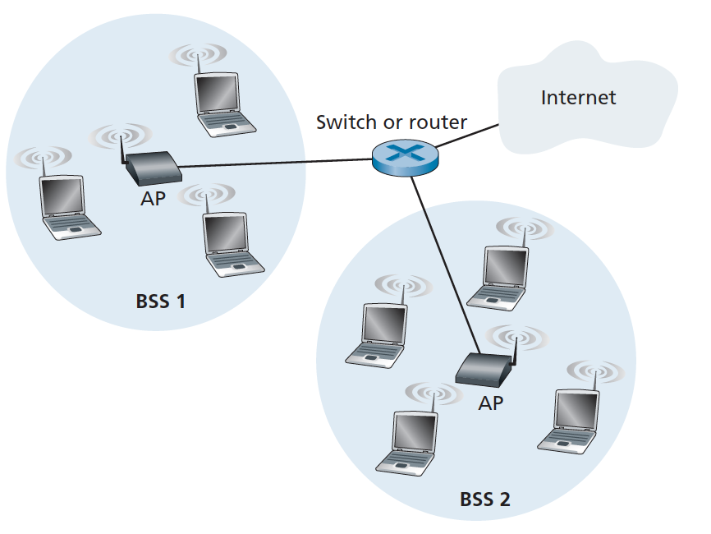

802.11 wireless link layer
802.11
802.3
data plane
Application
Transport
control plane
Network
control plane
data plane
WLAN
Link layer
802.11 MAC
802.11 MAC
802.3 MAC
802.3 MAC
Physical
PHY
PHY
PHY

Slide 70
802.11 downlink (AP-to-device) frame flow
IP datagram
data frames: containing IP datagrams
Control, management frames
IP datagram
IP datagram
...
reliable
data transfer
data frame
control frame
data frame
mngmnt frame
energy
management
data frame
...
mngmnt frame
...
channel
measurement
control frame
discovery,
attachment
queue of frames awaiting transmission
(MAC scheduling)
...
UEs
to/from institutional
network, Internet
RTS/CTS
data plane
control plane
AP
PHY

Slide 71
802.11 frame: addressing
2
2
6
6
6
2
6
0 - 2312
4
frame
control
duration
address
1
address
2
address
3
seq
control
address
4
payload
CRC
Address 1: MAC address of wireless host or AP to receive this frame
Address 4: used only in ad hoc mode
Address 3: MAC address of router interface to which AP is attached
Address 2: MAC address
of wireless host or AP
transmitting this frame

Slide 72
802.11 frame: addressing
Internet
H1
R1
802.3 Ethernet frame
R1 MAC addr
H2 MAC addr
MAC dest addr
MAC source addr
AP MAC addr
H1 MAC addr
R1 MAC addr
address 1
address 2
address 3
802.11 WiFi frame

Slide 73
802.11 frame
duration of reserved
transmission time (RTS/CTS)
frame sequence # (for reliable data transfer)
IP datagram, link-layer control or management message
2
2
6
6
6
2
6
0 - 2312
4
frame
control
duration
address
1
address
2
address
3
seq
control
address
4
payload
CRC
2
2
4
1
1
1
1
1
1
1
1
protocol
version
type
subtype
to
AP
from
AP
more
frag
retry
power
mgt
more
data
WEP
rsvd
type of management, control, or data frame
0: management
1: control
2: data
Notes:
https://howiwifi.com/2020/07/13/802-11-frame-types-and-formats/

Slide 74
Retrospective: “A day in the life”* (WiFi)
data plane
1
HTTP/3 request in UDP segment, in IP datagram, into 802.11 frame. Enter, wait, MAC frame scheduling queue
1
Application
HTTP
Transport
control plane
data plane
2
Device sends RTS control frame (using CSMA/CA); AP responds with CTS.
Network
3
RTS
2
CTS
4
802.11 MAC
ACK
802.11 MAC
Physical
Physical
3
Device sends DATA frame to AP. Buffers DATA frame
control plane
4
AP responds with ACK, device removes transmitted frame
AP can now forward frame to router
*https://gaia.cs.umass.edu/kurose_ross/videos/6/

Slide 75
Chapter 7 outline
introduction
radio: the physical layer
the wireless access network
  sharing a wireless access channel: OFDMA, CSMA/CA
  WiFi wireless LAN
  5G radio access network (RAN)
the wireless core network
  principles, 5G
mobility
Bluetooth, satellite, IoT wireless networks

Slide 76
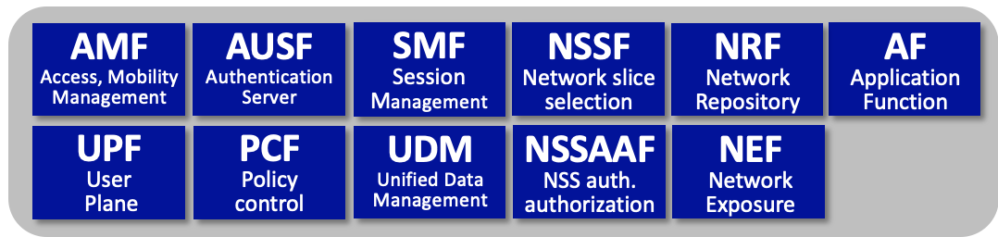
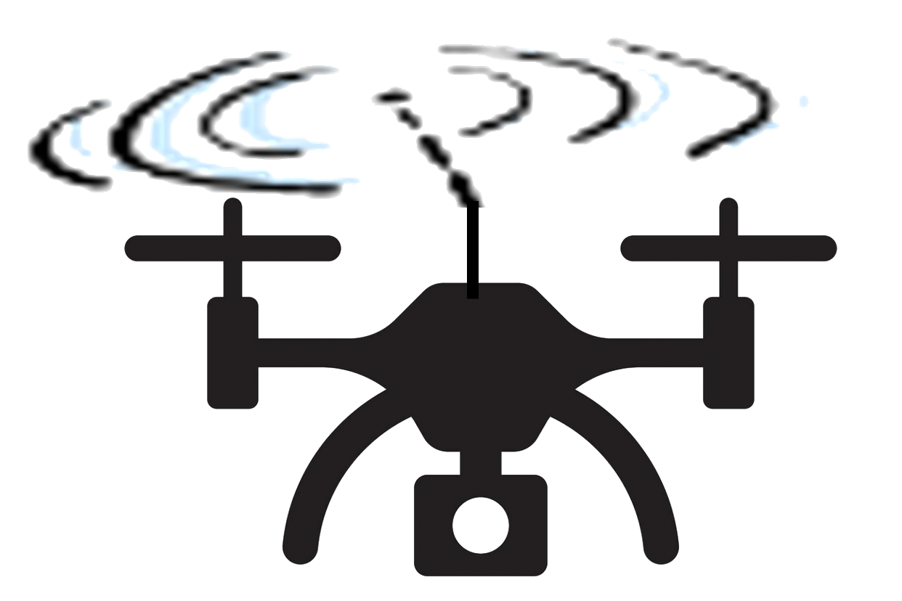
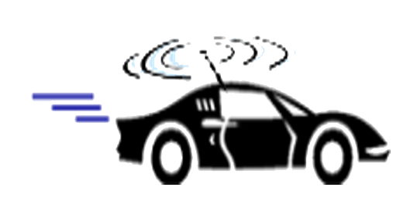
Architectural Elements of 5G
Core Network Functions
User device
gNodeB
to
Internet
radio access
Network (RAN)
5G core network

Slide 77
5G Radio Access Network (RAN)
5G RAN: edge network connecting devices to base station
provides link-layer service, as first hop between devices and larger network
limited geographic scope
under control of a single service provider
somewhat analogous to WiFi LAN
RAN components:
  many devices (User Equipment: UE)
  radio channel (New Radio: NR)
  one base station (Next Generation Node B: gNodeB, gNB)
User equipment
(UEs)
gNodeB

Slide 78
5G Core Network
Core situated between RAN and other endpoints (Core, larger Internet)
  single Core; multiple RANs
consist of links, routers, servers, providing services to devices and base stations
  “all IP” Core, but very different services than traditional Internet apps
clear logical separation between control-plane, user plane:
  CUPS: Control-Plane and User-Plane Separation
Core Network Functions
to
Internet

Slide 79

Resource Blocks (RB)
  Resource Element (RE): holds one transmitted OFDMA symbol, in one time minislot on one subcarrier frequency
  Resource Block (RB): bundle of neighboring (time, frequency) Resource Elements
    4G: 84 symbols (12 neighboring subcarriers, 7 consecutive minislots)
    5G: multiple bundlings possible
    RB is smallest unit of transmission scheduling: all symbols in RB have same source, destination
180
kHz
10 MHz channel with 50 RBs.
each RB spanning 180 kHz subchannel
.
.
.
.
.
.
.
.
.
.
.
.
.
.
.
.
.
.
.
.
.
.
.
.
.
.
.
.
.
.
1 ms
time
4G Resource Block (RB): 84 Resource Elements (REs), each carrying one symbol.

Slide 80
5G Bands, Channels, Subchannels: it confusing!
180
kHz
channel 1
...
...
...
10 MHz channel with 50 RBs.
each RB spanning 180 kHz subchannel
.
.
.
.
.
.
.
.
.
.
.
.
.
.
.
.
.
.
.
.
.
.
.
.
.
.
.
.
.
.
channel N
...
1 ms
one band
multiple channels
multiple subchannels
per channel
time
  ... and it’s about to get more confusing

Slide 81


Downlink physical channels
Physical channel
set of Resource Blocks (RBs) carrying similar type of data (channel information RBs, user and control RBs, RB allocation information)
base station
...
downlink RBs transmitted from base station to devices
three 5G downlink physical channels:
  Physical Downlink Shared Channel (PDSCH)
  Physical Downlink Control Channel (PDCCH)
  Physical Broadcast Channel (PBCH)

Slide 82
Uplink physical channels
Physical channel
set of Resource Blocks (RBs) carrying similar type of data (radio channel information RBs, user and control RBs, RB allocation information)
base station
uplink RBs transmitted from devices to base station
three 5G uplink physical channels:
  Physical Uplink Shared Channel (PUSCH)
  Physical Random-Access Channel (PRACH)
  Physical Uplink Control Channel (PUCCH)
...

Slide 83
Uplink/downlink logical channels
logical channel
base station
Set of Resource Blocks (RBs) carrying similar type of data. Logical channels are mapped onto physical channels, with one or more logical channel mapped to same physical channel
individual, per-device logical channels, as well as shared logical channels among devices
...
many logical channels
6 physical channels
...

Slide 84
RAN protocol stack (at device, base station)
user plane
Application
user plane
Transport
control
plane
control
plane
Network
Network
SDAP
RRC
RRC
SDAP
RAN
link
layer
PDCP
PDCP
RAN
link
layer
RLC
RLC
MAC
MAC
Physical
Physical
base station
device

Slide 85
Retrospective: “A day in the life”* (5G RAN)
user plane
1
Application
1
HTTP/3 request in UDP segment, in IP datagram, into 5G frame. Enter, wait, 5G MAC frame scheduling queue
HTTP
user plane
Transport
control
plane
control
plane
Network
Network
SDAP
RRC
2
3
RRC
SDAP
SR
DCI
2
device’s control plane sends SR Scheduling Req) on Physical Uplink Control Channel (PUCCH) to base station
PDCP
PDCP
RLC
RLC
3
base station control plane send DCI message Physical Downlink Control Channel (PDCCH) granting upstream RBs
MAC
MAC
Physical
Physical
4
device sends frame in allocated RBs
device
base station

Slide 86
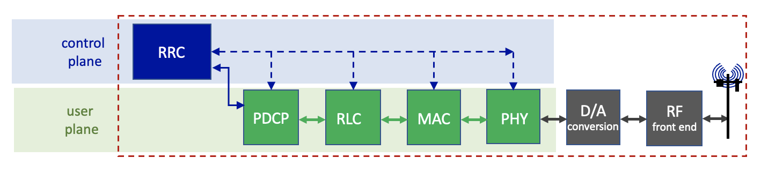
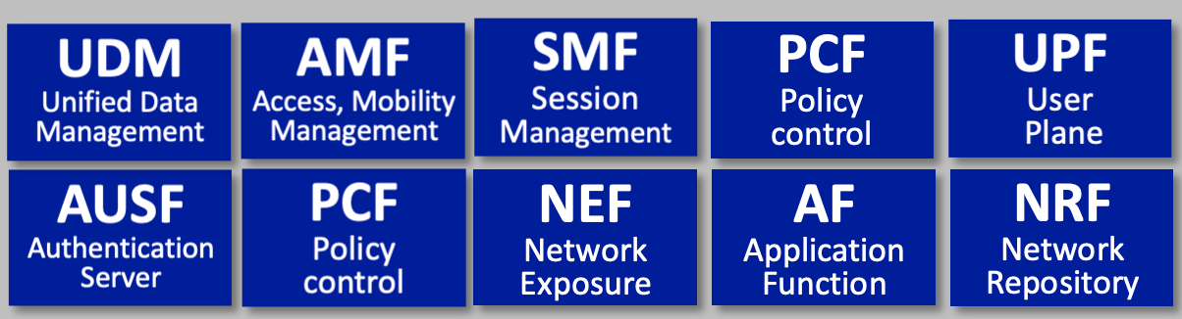
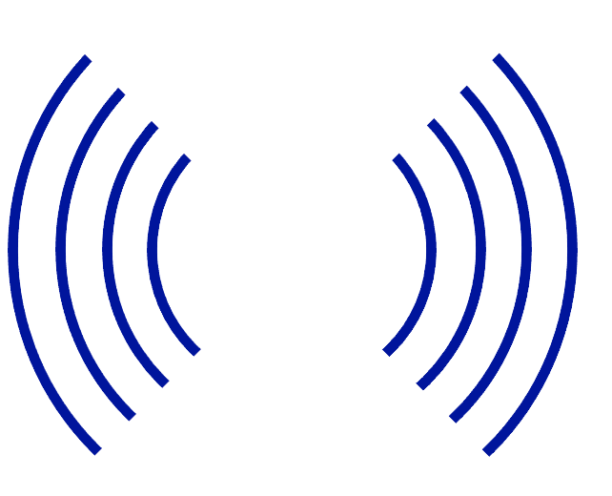
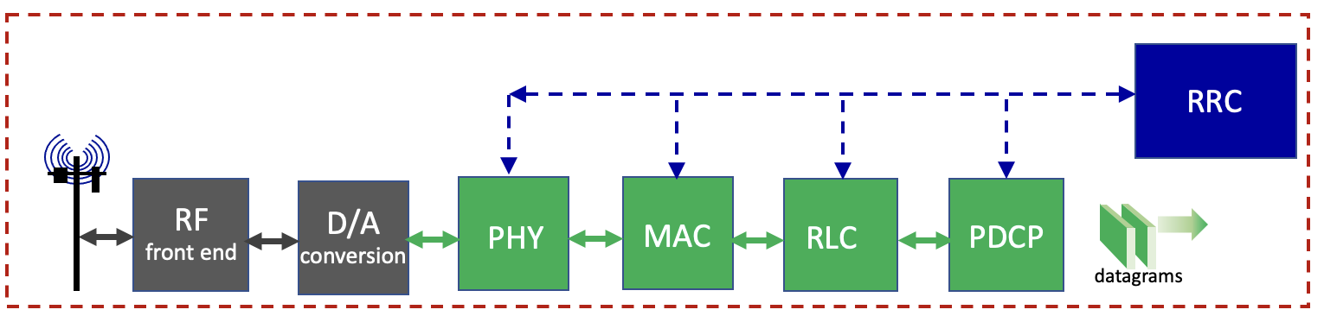
RAN packet processing pipeline: context
RAN: transfers datagrams between mobile core and devices
datagrams
IP datagrams
Base station
(gNode-B)
device
protocol processing pipeline in UE

Slide 87
RAN packet processing pipeline
base station
control
plane
RRC
mobile
core
user
plane
PDCP
RLC
MAC
PHY
D/A
conversion
RF
front end
datagrams
traditional 3GPP view
RRC (Radio Resource Control)
configures coarse-grained, policy-related aspects of pipeline (e.g., scheduling prioritization, security)
this implements the RAN’s control plane
does not process user plane packets

Slide 88
RAN packet processing pipeline
base station
control
plane
RRC
mobile
core
user
plane
PDCP
RLC
MAC
PHY
D/A
conversion
RF
front end
datagrams
PDCP (Packet Data Convergence Protocol)
compress/decompress IP headers
ciphering, integrity protection

Slide 89
RAN packet processing pipeline
base station
control
plane
RRC
mobile
core
user
plane
PDCP
RLC
MAC
PHY
D/A
conversion
RF
front end
datagrams
RLC (radio link control)
link-layer frame segmentation/reassembly
reliable data transfer (ARQ)

Slide 90
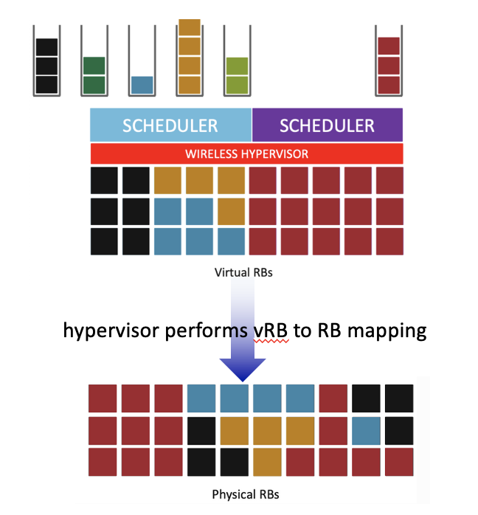
RAN packet processing pipeline
base station
control
plane
RRC
I msec scheduling control loop
mobile
core
user
plane
PDCP
RLC
MAC
PHY
D/A
conversion
RF
front end
datagrams
MAC (Media Access Control)
buffering, multiplexing/demultiplexing frames
scheduling: real-time scheduling frame decisions

Slide 91
RAN packet processing pipeline
base station
control
plane
RRC
mobile
core
user
plane
PDCP
RLC
MAC
PHY
D/A
conversion
RF
front end
datagrams
PHY (Physical Layer)
modulation, coding

Slide 92
Split RAN
  Q: how is RAN functionality partitioned between physical elements (i.e.,., “split” across centralized and distributed locations)?
    historically: no split - implemented in base station
Monolithic base station
control
plane
RRC
user
plane
PDCP
RLC
MAC
PHY
D/A
conversion
RF
front end
datagrams

Slide 93
Split RAN
  Q: how is RAN functionality partitioned between physical elements (i.e,., “split” across centralized and distributed locations)?
    historically: no split - implemented in base station
    O-RAN: three “units” - where units are implemented is an implementation choice
Central Unit (CU)
Distributed Unit (DU)
Radio Unit (RU)
control
plane
RRC
user
plane
PDCP
RLC
MAC
PHY
D/A
conversion
RF
front end
datagrams

Slide 94
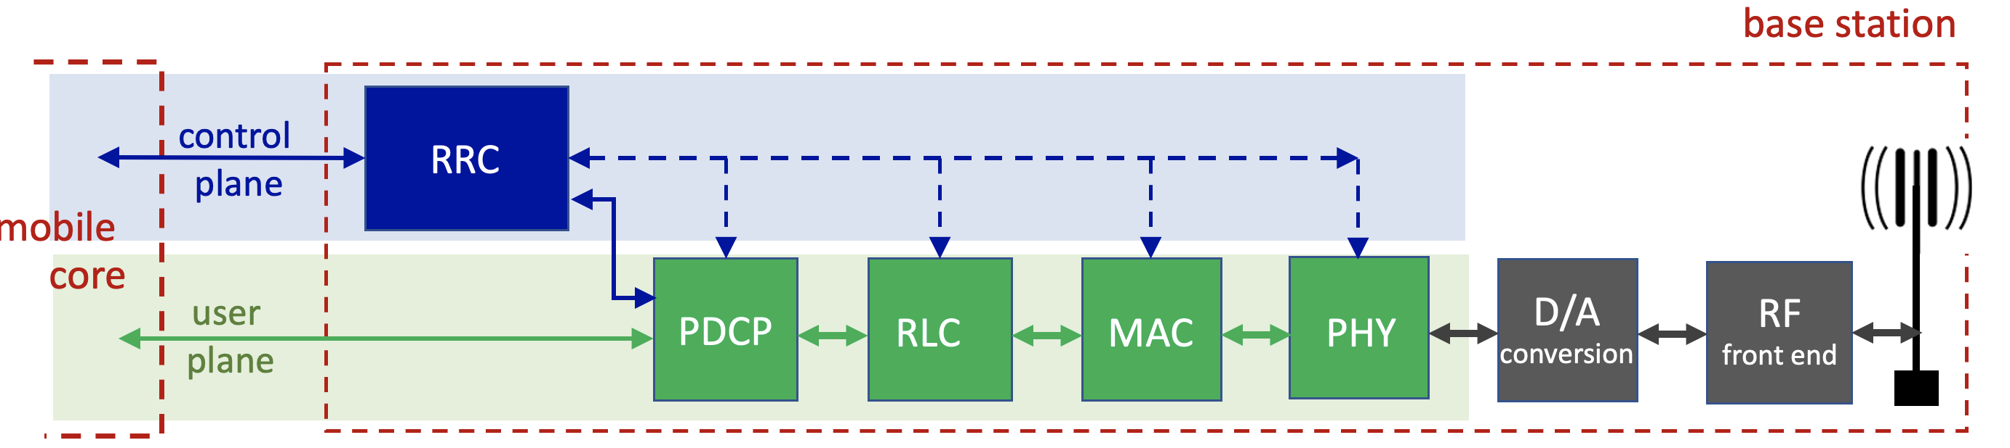
Software-defined RAN
Recall our earlier description of traditional RAN base station (below)
tightly coupled control and data planes
let’s focus on control / management: RRC implementation

Slide 95

Software-defined RAN
  SD-RAN: implementing RAN using SDN approach
3GPP-compliant interface between RAN and Mobile Core control plane
New programmatic API for exerting software-based control over pipeline that implements RAN user plane
control
plane
Control plane proxy
Real-Time Intelligent Controller (RIC)
Re-factored RRC
user
plane
PDCP
RLC
MAC
PHY
D/A
conversion
RF
front end
SDN-controlled switches

Slide 96
Software-defined RAN
  SD-RAN: implementing RAN using SDN approach
Near-real time network control applications implemented as “xApps”
RAN Network Information Base (R-NIB)
common set of information consumed by numerous control apps, e.g., longer time-scale CQI (channel Quality Indicator) values, other per-session state
load
balancing
…
…
handover
QoS
control
plane
Control plane proxy
Real-Time Intelligent Controller (RIC)
R-NIB
Re-factored RRC
user
plane
PDCP
RLC
MAC
PHY
D/A
conversion
RF
front end
SDN-controlled switches

Slide 97
RAN: operator’s “secret sauce”
    combination of standardized specifications + implementation strategies:
      interfaces, high-level functions standardized
      implementation of some functions, e.g., RB assignment to channels, frame scheduling, not standardized – up to the network operator.
      implementation choices are the technical “secret sauces”

Slide 98
Chapter 7 outline
introduction
radio: the physical layer
the wireless access network
  sharing a wireless access channel
  WiFi wireless LAN
  5G radio access network
  common challenges: network discovery, frame scheduling, energy
the wireless core network
  principles, 5G
mobility
Bluetooth, satellite, IoT wireless networks

Slide 99


Joining the edge wireless network
arriving device: must establish initial connection with node (WiFi AP, 4G/5G base station) at wireless edge of network
  initial connection then used for authentication, DHCP, gain full network access
  “bootstrapping” connectivity: initial connection is just with edge node
WiFi
institution’s
wired network
Internet
WiFi AP
association
5G
Mobile packet core
Internet
gNode-B

Slide 100
Association: two approaches
Beaconing: mobile listens to wireless channels for “beacons” advertising existence of wireless network node(s)
Probing: mobile actively transmits probe messages, waits for wireless network node(s) to reply
Edge network 1
Edge network 2
Edge network 1
Edge network 2
beacon
beacon
probe request
base
station
base
station
base
station
base
station
reply
reply
user device
user device
Either (or both) approaches used in practice in an edge network

Slide 101

802.11: beaconing and probing
Beaconing:
Probing:
arriving client device
WiFi AP
1
AP 2
2
2
AP 1
2
2
3
4
802.11 beacon frame (broadcast)
1
H1
2
802.11 Association request
802.11 Association response
3
1
Probe Request frame broadcast from H1
Probe Response frames sent from APs
Association Request frame sent: H1 to selected AP
Association Response frame sent from selected AP to H1
2
... device will next authenticate to network
3
4
No exchange of identity, credentials (yet)! Just “Can we talk?”

Slide 102
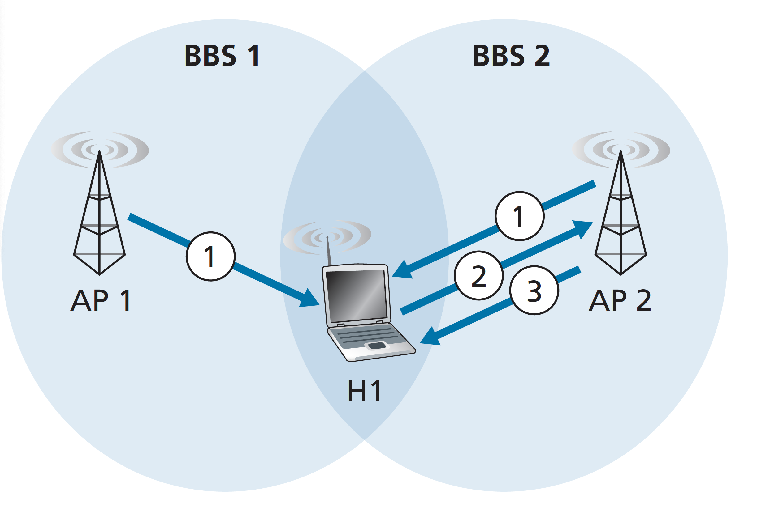
Connecting to the 5G edge
5G network
(network 1)
5G network
(network 2)
network 2’s SSB, SIBs
network 1’s SSB, SIBs
1
1
RRC connection setup request
Base station 1
2
Base station 2
H1
3
RRC connection setup response

Slide 103
RAN/WLAN scheduling: the “big picture”
All packets to/from all devices in edge network must pass through base station
4G/5G and WiFi 6/7: OFDMA RB scheduling
downlink MAC scheduler: which frames to send from base station to which devices in which order in which RBs (if OFDMA)?
uplink MAC scheduler: which devices send which frames in which order in which RBs to base station (if OFDMA)
5G RAN
devices
MAC
gNodeB
PHY
Wi-Fi
devices
MAC
AP
PHY

Slide 104

Wireless MAC scheduling: considerations
Channel aware or channel unaware?
does scheduler consider quality of channel between base station and device?
QoS aware or QoS unaware?
does scheduler consider QoS (quality of service) needed by (or guaranteed to) device?
Priorities, Fair scheduling?
Does scheduler provide priority among different types of traffic (user, control, real-time)?
does scheduler consider fairness among UEs?
fairness: no standard definition
good
voice
poor
WWW browsing
“We are all equally important”

Slide 105
MAC scheduling considerations
Channel aware or channel unaware?
does scheduler consider quality of channel between base station and device?
QoS aware or QoS unaware?
does scheduler consider QoS (quality of service) needed by (or guaranteed to) device?
Priorities, Fair scheduling?
Does scheduler provide priority among different types of traffic (user, control, real-time)?
does scheduler consider fairness among UEs?
fairness: no standard definition
Standards do not dictate answers to these questions!
Scheduling algorithms, parameters up to network implementers, operators: their “secret sauce”
good
voice
poor
WWW browsing
“We are all equally important”

Slide 106
RAN scheduling: Resource Blocks
Scheduling:
Base station decides which frames/packets get assigned to which RBs for transmission to user
scheduling interval: 1 msec
scheduling complexity:
  50 subchannels per 10MHz channel
  100’s (?) active user
1 ms
180
kHz
A 10 MHz channel with
50 RBs, each RB spanning 180 kHz
.
.
.
.
.
.
.
.
.
.
.
.
.
.
.
.
.
.
.
.
.
.
.
.
.
.
.
.
.
.
.
.
.
.
.
.
.
.
.
time
Resource Block: 84 symbols
one user gets to transmit 84 symbols on one subchannel in 0.5 sec time interval
50 subchannels per 10MHz channel

Slide 107
RAN scheduling: Channel Quality Indicator
IP datagrams
Channel Quality Indicator (CQI):
user measures quality of received reference signals (embedded in RBs), reports quality back to base station
4-bit CQI value maps to modulation scheme to use (e.g., which QAM?) and expected throughput
PDCP
RLC
control plane (RRC)
MAC
scheduler
CQI
PHY
RAN packet-processing stack (3GPP)
“We are all equally important”

Slide 108
RAN scheduling: QoS Class Indicator
IP datagrams
QCI: QoS Class Indicator
QoS network wants to provide to a particular device (e.g., delay, guaranteed bit rate QoS guarantees)
scheduler determines allocation of available radio spectrum to ensure all UEs meet their QoS requirements
PDCP
(RRC)
RLC
QCI
MAC
scheduler
CQI
PHY
Priority | QCI | Max delay | Max loss | Application
2 | 1 | 100ms | .01 | Voice
3 | 4 | 50 ms | .001 | Real-time gaming
6 | 7 | 300 ms | .000001 | Streaming video
8 | 8 | 600 | .000001 | Web browsing, TCP
RAN packet-processing stack (3GPP)

Slide 109
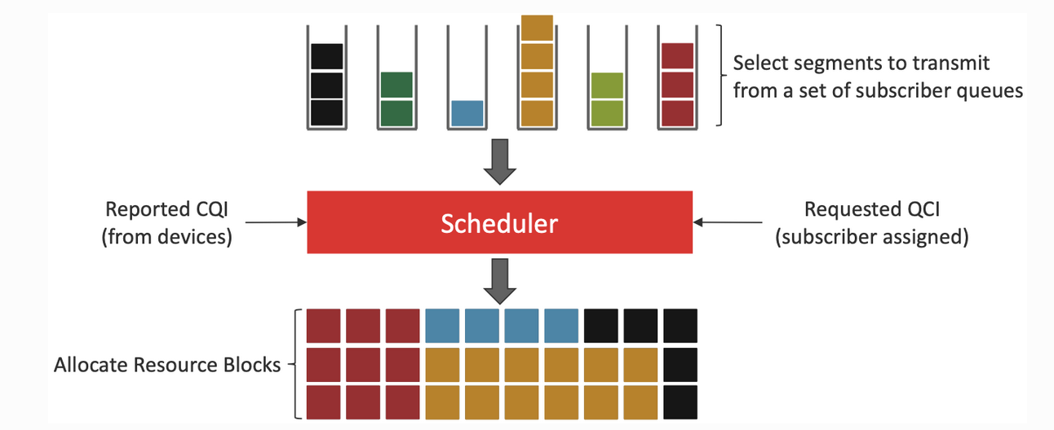
4G/5G scheduling: abstraction

Slide 110
Scheduling policies: priority
Priority scheduling:
arriving traffic classified, queued by class
  any header fields can be used for classification, e.g., control versus user data
high priority queue
arrivals
classify
link
departures
low priority queue
2
send packet from highest priority queue that has buffered packets
  scheduling within priority class could be another scheduling discipline
1
3
4
5
arrivals
packet in service
1
3
2
4
5
departures
1
3
2
4
5

Slide 111
Round Robin scheduling (per UE)
scheduler cyclically scans device queues, mapping packets/frame from each device (if available) to an RB in turn
channel unaware, QoS unaware
fair (by turns) but not necessarily throughput-fair since different devices may have different channel quality
Each device has its own queue

Slide 112
Maximum Throughput (MT) scheduling
find device (UE) i, with highest quality channel over all RBs, k:
    d^{i}_{k}(t): expected data rate for UE^{i} using kth RB at time t (e.g., based on CQI)
    at t: select max_{i,k} {d^{i}_{k}(t)}, assign UE^{i} frame to RB_{k}
maximizes overall immediate throughput
channel aware, QoS unaware, throughput unfair

Slide 113
Blind Equal Throughput (BET) scheduling (per device)
scheduler maintains exponentially-weighted-moving-average of data rate received at each UE^{i} at time t, R^{i(}t):
R^{i}(t) = (1-β) . r^{i}(t) + β . R^{i}(t-1)
  where r^{i}(t) is data rate achieved in scheduling interval t
at t: select min_{i} {R^{i}(t-1)}: assign UE^{i} frame blindly (not know channel conditions) to (any) RB
  assign RB to device with smallest data rate last round
channel somewhat-aware, QoS unaware, blind throughput fair

Slide 114
Proportional Fairness (PF) scheduling
combine Blind Equal Throughput (BET) and Maximum Throughput (MT) scheduling
    d^{i}_{k}(t): expected data rate for UE^{i} using kth RB at time t
    R^{i}(t-1): data rate achieved by UE^{i} at t
at t: select max_{i,k} {d^{i}_{k}(t) / R^{i}(t-1)}: assign UE^{i}
balances high data rate with a measure of fairness
channel aware, QoS unaware, fairness aware

Slide 115
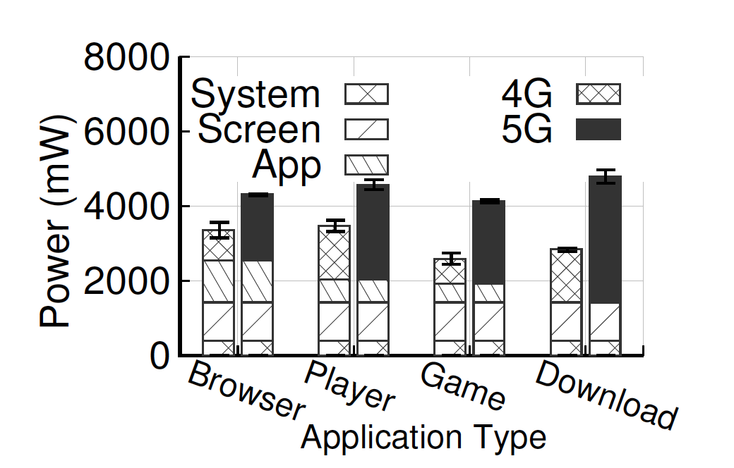
Energy consumption in wireless devices
battery/energy: a critical resource in wireless devices (phones, IoT)
energy use by LTE radios¹:
  on: transmitting or receiving/waiting to receive: 1000 — 3500mW
  off: < 15mW (~1% – 2 % of on-state energy use)
significant amount of device energy expended on communication, across applications
5G implementations currently expending more energy than 4G
Power use in mobile phones: app vs screen vs system vs network
Sources: 1: ATT, 2: “Understanding Operational 5G,” ACM SIGCOMM 2020

Slide 116

Cycles of sleep/activity: sleep
4G/5G, WiFi, Bluetooth radios turned off when not in use: conserve energy
Going to sleep is easier:
device-driven: go to sleep if nothing to send, nothing being received
sleep may (or may not) be coordinated with base station (4/5G), AP (WiFi) , controller (BT)
may have deep-sleep (longer, more “turned off”) versus light sleep (shorter, less “turned off”)

Slide 117
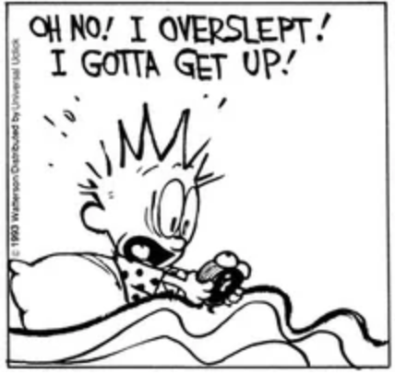
Cycles of sleep/activity: awake
4G/5G, WiFi, Bluetooth radios turned off when not in use: conserve energy
Waking up is harder:
base station (4/5G), AP (WiFi) , controller (BT) needs to signal to “wake up” device when there are packets to be sent to it
  network context (4/5G) may need to be re-created
  data frames containing IP datagram (e.g., from remote hosts) need to be buffered at base station until device is awake

Slide 118
Cycles of sleep/activity: tradeoff/challenges
How long to sleep?
longer: save more energy but greater latency
  effects on high-layer protocols: e.g., TCP
shorter: less energy savings, and more signaling overhead with short sleep cycles
How long to stay awake?
time since last activity (before going to sleep)
  data transmission typically “bursty”
  burst should be over before going to sleep: how long to wait?

Slide 119

Coordinated wake/sleep in 5G
short DRX cycles
long DRX cycles
device active
device active
t₀
t₁
t₂
t₃
t₄
t₅
time
inactivity timer timeout, enter short DRX cycle
still nothing to send or receive, enter long DRX cycle
incoming transmission to device buffered at base station until end of current DRX cycle
transmission received at device
transmission received at device, start inactivity timer
periodic wakeup in short DRX cycles, nothing to send/receive, return to short DRX sleep
Device awakes from long DRX sleep, accepts channel scheduling assignment, ends sleep

Slide 120
Chapter 7 outline
introduction
radio: the physical layer
the wireless access network
  principles, WiFi, 5G
the wireless core network
  principles, 5G
mobility
Bluetooth, satellite, IoT wireless networks

Slide 121
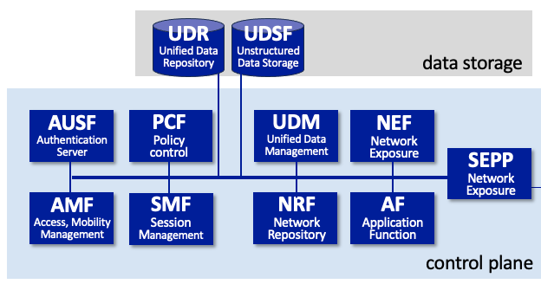

5G Core Functional Components
5G Core is all (mostly) about control plane services
UDR
Unified Data Repository
UDSF
Unstructured Data Storage
data
storage
AUSF
Authentication
Server
PCF
Policy control
UDM
Unified Data Management
NEF
Network Exposure
3rd party apps
SEPP
Security Edge Proxy
AMF
Access, Mobility
Management
SMF
Session
Management
NRF
Network Repository
AF
Application Function
N1
control planes in other cellular providers
N2
control plane
N3
UPF
User
Plane
user plane
Internet
base station

Slide 122
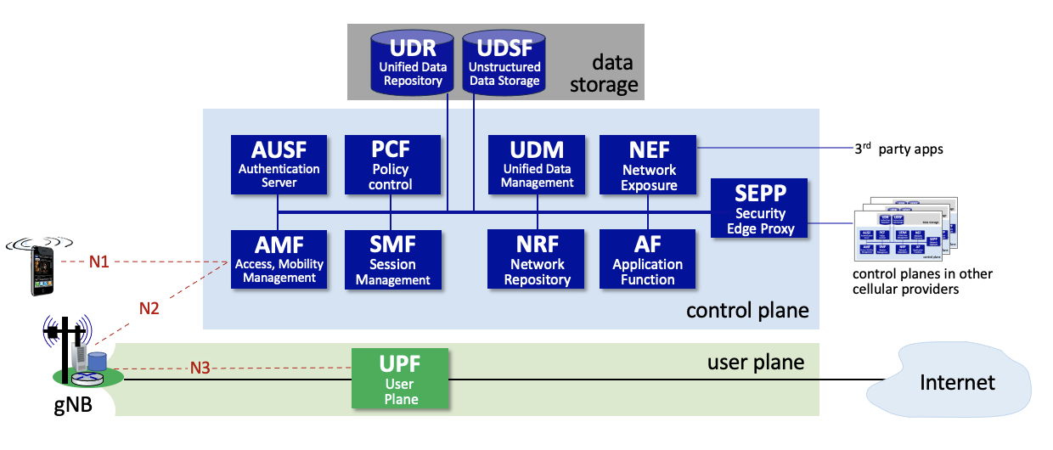
5G Core Functional Components
UPF (User Plane Function)
each device is assigned to a UPF, which acts as relay, forwarding traffic between UE, Internet
UPF responsible for policy enforcement, lawful intercept, traffic usage measurement, QoS policing
responsible for tunneling (i.e., encapsulating, decapsulating) traffic to/from base station over N3 interface

Slide 123
5G Core Functional Components
AMF (Access, Mobility Management Function)
connection, reachability management; mobility management; access authorization; and location services
SMF (Session Management Function)
manages each UE session, including IP address allocation, selection of associated UP function, QoS control, control aspects of UP routing

Slide 124
5G Core Functional Components
AUSF (Authentication Server Function): Authenticates devices.
UDM (Unified Data Management): Manages user identity, including the generation of authentication credentials.
UDR (Unified Data Repository): Manages user static subscriber-related information.
UDSF (Unstructured Data Storage Network Function): Used to store unstructured data, and so is similar to a Key/Value Store.

Slide 125
5G interfaces*, control/user -plane separation (CUPS)
AUSF
Authentication
Server
UDM
Unified Data Management
AF
Application Function
control plane
emphasis on functions and services
well-defined interfaces defines between services
N13
N12
N8
N10
N5
N1
AMF
Access, Mobility
Management
SMF
Session
Management
PCF
Policy control
N11
N7
N2
N3
N4
base station
UPF
User
Plane
* not all 3GPP defined interface shown
N3
N6
N6
data plane
5-layer Internet data plane
base station
IP datagrams
extensive use of tunneling
S-GW
IP tunnel

Slide 126
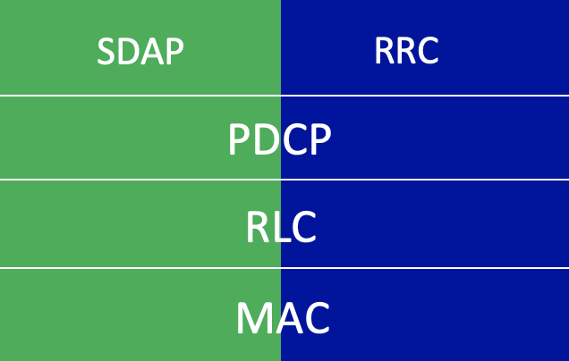
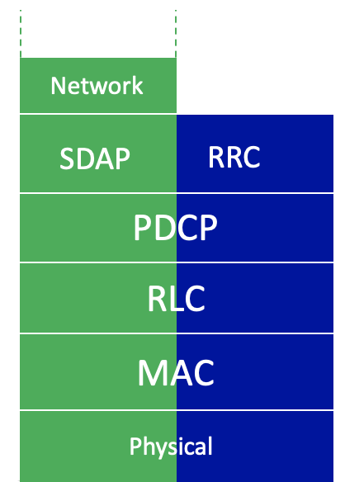
5G Core: User plane tunnels
GTP-U
GTP-U
UDP
UDP
IP
IP
IP
IP
Packet Data
Convergence
Radio Link
link
link
link
Medium Access
Physical
Physical
Physical
Physical
UPF for device z
UPF address: x
from Internet,
sender has IP address w
user device,
address z
base station
address y
backhaul network
Source
addr: w
Dest
addr: z
user payload
Source
addr: w
Dest
addr: z
user payload
Source
addr: x
Dest
addr: y
Source
addr: w
Dest
addr: z
UE payload

Slide 127
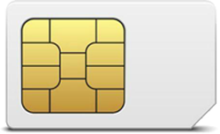
Identity: who are you?
  4G/5G:
  You’re a customer to a wireless service provider, with a home cellular network (who you pay)
  you have a SIM (Subscriber Identity Module) card or vSIM
    identifies you, your home network to all cellular networks globally
    has cryptographic key info also known to your home network
  Internet approaches:
  You’re a name, password
    different names, password for different applications, services
  You’re a name, public key certificate
    servers often have public keys, users not so much (yet)
Notes:
Section 4.6.1 (pg 247) in Sauter 4th edition

Slide 128
Joining a 5G network
Two major phases:
  Registration: device identifies, authenticates itself to network, and vice versa
  PDU Session establishment: Core network functions allocate IP address to device, create data-plane path between device and device’s UPF
    PDU: protocol data unit, aka, “packet”
Access and Mobility Management Function (AMF) plays key role in joining arriving device into network

Slide 129
Joining a 5G network: steps
AMF
Access, Mobility
Management
UDM
Unified Data Management
RRC connection setup
request, response
Registration request
AUSF
Authentication
Server
Identity request, response
remote/home
5G Core
authentication, security
authentication, security
AUSF
Authentication
Server
registration
registration accept
update device’s connection data
PDU session establishment request
session creation request, response
SMF
Session
Management
device subscription retrieval, update
UPF
User Plane Function
session
establishment
session
establishment req./resp.
Device, base station, RAN data plane configuration
session req. (with SMF info)
session info (e.g., device IPv4 address, tunnel)
session response
1st uplink datagram in data plane

Slide 130
Chapter 7 outline
introduction
radio: the physical layer
the wireless access network
  principles, WiFi, 5G
the wireless core network
  principles, 5G
mobility
Bluetooth, satellite, IoT wireless networks

Slide 131
What is mobility?
spectrum of mobility, from the network perspective:
no mobility
high mobility
device moves
between networks, but
powers down
while moving
device moves within same WLAN/RAN in
one provider
network
device moves among WLANs/ RANs in
one provider
network
device moves
among multiple
provider networks,
while maintaining
ongoing connections
We’re interested in these!

Slide 132
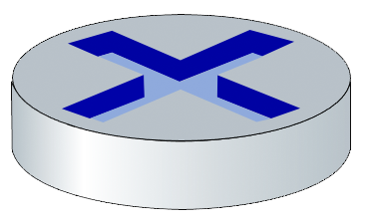

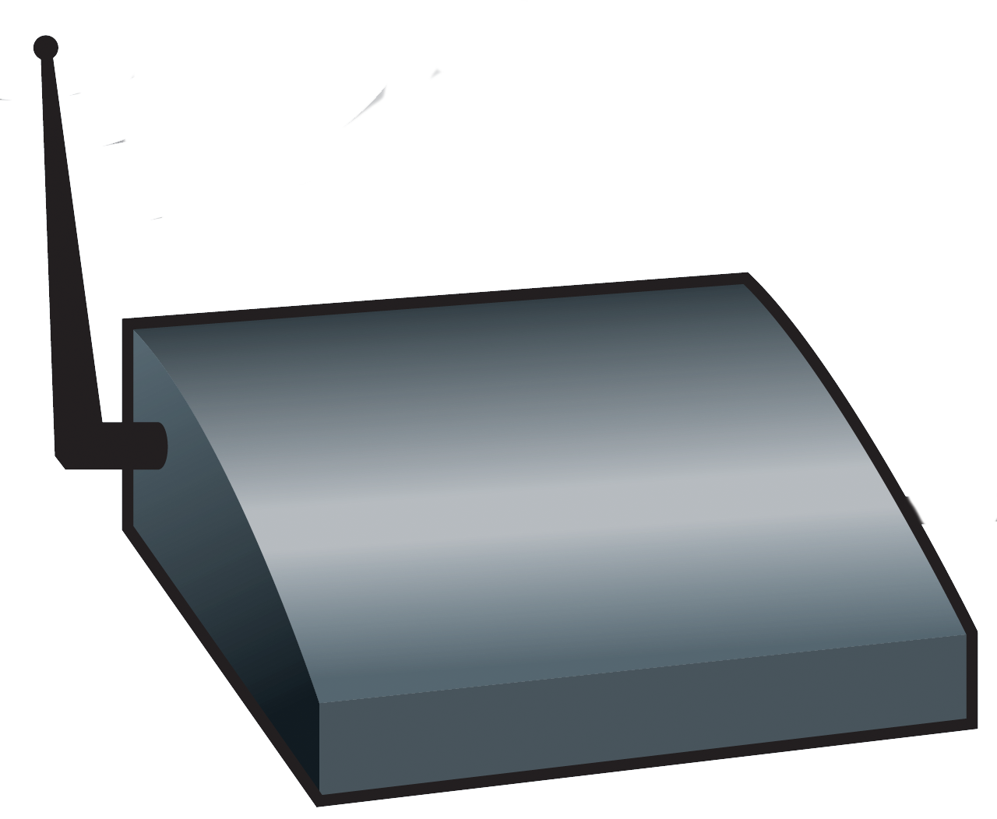

Mobility in a WiFi network
802.11: a link-layer standard, takes a link-layer approach towards mobility
Extended Service Set (ESS): multiple BSS’s, in same layer-3 subnet, each with same SSID
router R₁
BSS₁
switch S₁
Internet
AP₁
switch S₂
AP₃
mobility between BSSs in same ESS
  Fast re-authentication
  AP can suggest new APs to device
AP₂
BSS₃
BSS₂
Extended Service Set (ESS)
proprietary (vendor) solutions for enhanced mobility

Slide 133
Mobility in 5G networks: handover
Handover:
mobile device changes is point of attachment to the network
data flow to device changes from source base station to target base station
before
handover
AMF
Access, Mobility
Management
SMF
Session
Management
UPF
User Plane Function
after
handover
Why perform handover?
stronger signal from target base station
target base station has less devices, less traffic

Slide 134
Mobility in 5G networks: handover
source BS
1
current (source) BS selects target BS, sends Handover Request message to target BS
data path before handover
3
1
4
UPF
User Plane Function
2
2
target BS pre-allocates radio time slots, responds with HR ACK with info for mobile
data path after
handover
target BS
3
source BS informs mobile of new BS
mobile can now send via new BS - handover looks complete to mobile
4
source BS stops sending datagrams to mobile, instead forwards to new BS (who forwards to mobile over radio channel)

Slide 135
Mobility in 5G networks: handover
5
target BS informs AMF, SMF that it is new BS for mobile
SMF instructs UPF to change tunnel endpoint to be (new) target BS
source BS
6
UPF
User Plane Function
UPF
User Plane Function
5
AMF
Access, Mobility
Management
6
target BS ACKs back to source BS: handover complete, source BS can release resources
SMF
Session
Management
5
target BS
7
mobile’s datagrams now flow through new tunnel from target BS to UPF

Slide 136
Handover: timeline, signaling
device
source base station
target base station
AMF
Access, Mobility
Management
SMF
Session
Management
UPF
User Plane Function
device data
device data
measurement
making
handover
decision
handover
request
accept?
handover
request ACK
RRC
reconfig.
transfer
status
detach from source base station, attach to target base station
device data
handover
in the
RAN
buffer device data from source base station
RRC reconfig.
complete
handover
success
transfer
status
PDU session
update
path switch req.
session mod.
req/response
handover
in the
Core
data end marker
device data
device data
PDU session
update resp.
time
device context
release
path switch req. ACK

Slide 137
Chapter 7 outline
introduction
radio: the physical layer
the wireless access network
  principles, WiFi, 5G
the wireless core network
  principles, 5G
mobility
Bluetooth, satellite, IoT wireless networks

Slide 138
Bluetooth (BT) overview
example of wireless ad hoc network: devices have no “infrastructure” (e.g., access point, base station) to connect to
BT devices must find other BT devices, organize themselves into a network from scratch!
  connect devices at link layer, providing channel allocation
  addressing assignment
  service discovery
  application-to-application communication over Bluetooth network
  security
An entirely new architecture and protocol stack (different from Internet) is needed!
Notes:
So stress that this is interesting and new!

Slide 139
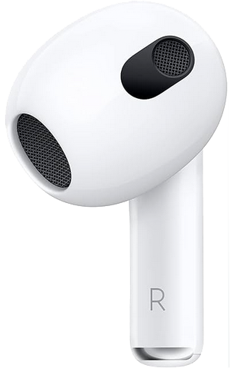
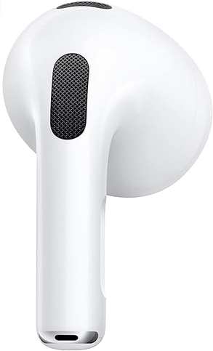


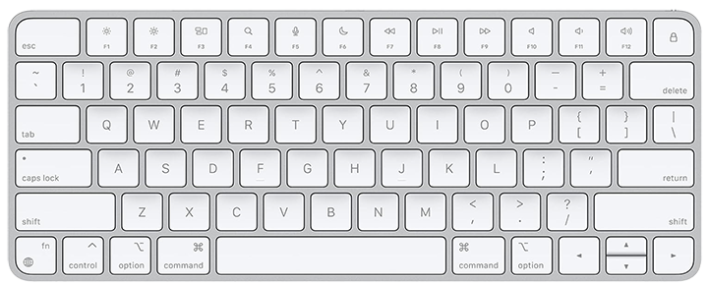
Bluetooth: overview
Bluetooth network: piconet
coverage: generally <10 m diameter
no more than 8 devices per piconet
  device initially forming network: central role
  up to 7 more devices: peripheral role
communication only between central and peripheral node
  no direct peripheral-to-peripheral communication
BT device has unique 48-bit address
Operate in unlicensed ISM band: 2.4 GHz
P
C
diameter of
coverage
P
P
C
device with central role
device with peripheral role
P

Slide 140
Bluetooth basics: wireless channel
operates in 2.4-2.5 GHz ISM radio band
  Classic BT: 1 MHz bandwidth/channel, 79 channels, 2.1 Mbit network max rate
  BLE: 2 MHz bandwidth/channel, 40 channels. 3 advertising, 37 data channels
BT channel: TDM, 625 μsec slot length
channel access via polling: central device advertises, grants channel access to peripherals in its BT network
uses frequency hopping (form of “spread spectrum”) transmissions
P
C
diameter of
coverage
P
P
C
device with central role
device with peripheral role
P

Slide 141
Bluetooth channel: frequency hopping
senders in BT network “hop” among 79 frequencies/channels
  transmit on different frequency after each slot
  hopping pattern known by all BT devices in same piconet
different BT piconets (with different hop patterns) can exist in same space
Hopping pattern used by BT network 1
slot
1
625 μsec
2
3
4
channel #
.
.
.
.
.
.
.
.
.
.
.
.
.
.
.
.
.
.
.
.
.
.
.
.
.
.
.
.
.
.
76
77
78
Q: Why hop?
A: minimize effects of interference:
potentially many interfering transmitters in ISM
If interfering device uses channel x, x occurs only occasionally in sequence
BT frame sent on x (not received at receive due to interference), retransmitted on different frequency in next slot
79
time
Hopping pattern used by BT network 2
Notes:
Top half of slide is about what hopping is, but why hop in the first place?

Slide 142
Bluetooth architecture, protocol stack (simplified)
Bluetooth stack completely different from Internet stack!
  differences reflect BT’s special purpose
no “network,” “transport” layer!
  no routing in Classic BT (BLE adds managed flooding)
layers not as conceptually well-defined as in Internet, 5G
Host (OS)
Applications,
E2E services
Logical Link Control and Adaptation (L2CAP)
Host-Controller
Interface (HCI)
link
Classic
BLE
physical
Controller
(firmware)
separate controllers for classic, BLE
host, controller structure deeply embedded in architecture
Notes:
Probably the best picture in the Bluetooth Spec is Figure 2.1 in 5.0 specification (“Figure 2.1: Bluetooth core system architecture”). But it’s really complicated and there isn’t really clear layering.

Slide 143
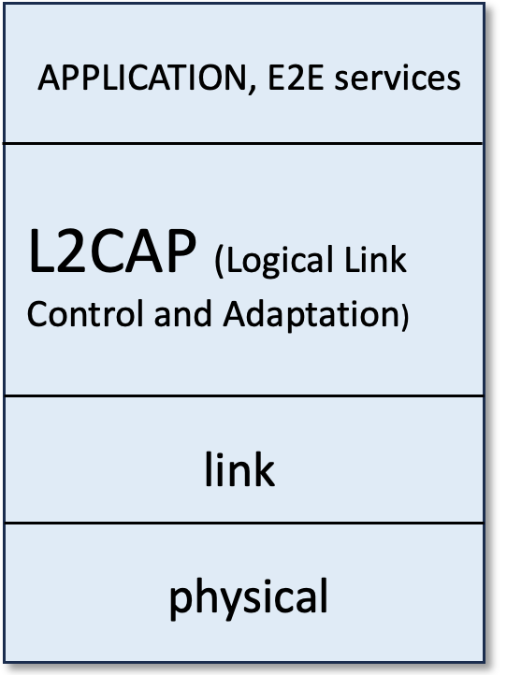

Logical Link Control, Adaptation (L2CAP) layer
creation, management of end-end L2CAP channels between two devices
  channels for E2E application/user data, or higher-level services
  reliability, flow control, segmentation
L2CAP channels types:
  connection-oriented, asynchronous (ACL)
  connectionless, asynchronous (ACL)
  synchronous (eSCO), e.g., for periodic audio app)
Notes:
Note that description/layer of link controller (which is really the lower sublayer) and link manager in Sauter’s book is incorrect.

Slide 144
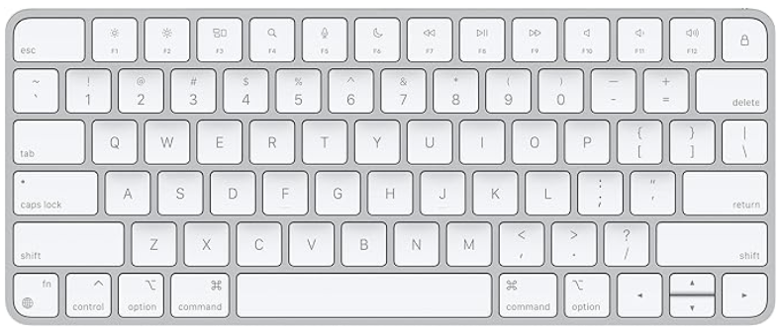
Bluetooth piconet and L2CAP connections
MP3
music
Service
discovery
end-to-end L2CAP connections
MP3
music
Remote
keyboard
L2CAP
Service
discovery
link
L2CAP
physical
Bluetooth peripheral
link
physical
Bluetooth piconet wireless
channel (frequency hopping)
Remote
keyboard
Service
discovery
Bluetooth central role
L2CAP
link
physical
Bluetooth peripheral
Notes:
Note that description/layer of link controller (which is really the lower sublayer) and link manager in Sauter’s book is incorrect.

Slide 145
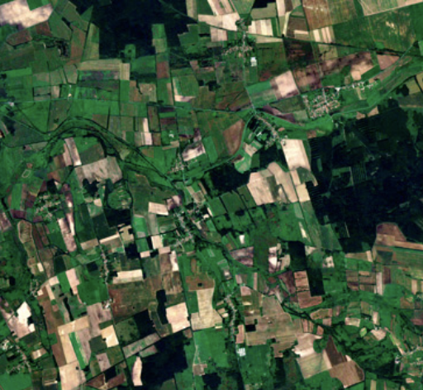







Satellite applications
Sensing:
environment: weather, land use, various human activity
resolution: ~m/pixel
Broadcast:
Internet:
connectivity to unserved regions, alternative to wired Internet
low latency over long distances
access in airplanes
consumer: Direct to Home TV/video, radio (Dish, SiriusXM)
business: content to many cable head ends
GPS
leverage broadcast: one send reaches many users

Slide 146



GEO and LEO satellites
GEO:
geosynchonous: stationary with respect to ground
35,768 km above earth
~800 msec RTT
wide area coverage / satellite
LEO:
Low Earth Orbit: satellite moves with respect to ground: 27,000 km/hour
  within line of sight (LOS) of ground station for 5-15 mins
550 - 1200 km above earth
~30 msec RTT in practice
smaller area coverage / satellite
  constellation (network) of multiple LEO satellites to cover wide area
  inter-satellite links (ISL)

Slide 147


Satellites: why all the fuss?
Lots of (LEOS) satellites being launched
LEOS constellations
 | # deployed (2025) | # planned | ISL planned?
Starlink | 7,239 | 12,000 - 42,000 | Yes
EutelSat Oneweb | 648 | 716 – 6,372 | No
Kuipers (Amazon) | 27 | 3,236 | ?
Telesat | 1 | 298 - 1671 | Yes
Sources: A. Raman, LEO Satellite Mega Constellations, networkingchannel.eu;
N.Pachler et al., An Updated Comparison of Four Low Earth Orbit Satellite Constellation Systems to Provide Global Broadband; company literature
Notes:
Source: A. Raman, LEO Satellite Mega, networkingchannel.eu

Slide 148










Components of a LEO satellite network
intersatellite links (ISL)
LEO satellites in motion
satellite channel
Broadcast (multicast) down
unicast up
rural,
remote
communications
airborne,
maritime
vehicles
ground
stations
Internet
“footprint”
Starlink satellite dish: “Dishy McFlatface”
mobile user terminals

Slide 149

Satellite networking: a link or a network?
links in the sky
network in the sky:
single satellite hop between base stations
AKA “bent pipe” architecture
multiple satellite hops between base stations
routing among satellites

Slide 150

Starlink
April 2025: ~7,239 operational LEO satellites (planned: 12K, requesetd:30K)
  first launches: 2019
  three low-Earth-orbit orbital shells, at 525, 530, 535 km
  satellites: 500 – 2700 lbs
services:
  Internet service: 4M subscribers in Sept 2024 (residential US: $120/mo)
  service in Ukraine (terrestrial networks damaged)
  2024: testing direct-to-smartphone tests would use cellular spectrum from SpaceX’s U.S. mobile partner T-Mobile

Slide 151






IoT: many, many use cases!
Monitoring: pressure, vibration, 3D tilt, temperature, humidity, switches, openings, battery charge, voltage, leaks, cracks, strain gauges, fill levels ...
Asset geolocation, tracking warehouse security, monitoring transport conditions, e.g., for food safety ...
Monitoring: sound, air, water, weather, lighting, traffic, crowds, infrastrcuture; sharing (bikes) ...
.... and there’s many more!
Smart metering, service (de)activation , efficiency monitoring, remote diagnosis, asset surveillance, quality monitoring ...
rainfall, temperature, wind, humidity, animal tracking and health, soil condition, infrastructure monitoring ...
Security, enviro conditions (temp., air, lights, power), predictive infrastructure monitoring, ...
Notes:
Summarized from https://www.sigfox.com/

Slide 152

Lots of connected IoT devices, and more soon!
60
50
40
number of devices (in billions)
30
IoT
20
10
PC, laptops,
tablets, phones
2014
2028
https://www.statista.com/statistics/512650/worldwide-connected-devices-amount/

Slide 153
IoT communication requirements
wireless
distance: from meters to kilometers
data rate: 100’s bps when active (metering) to ~1 Mbps (video surveillance)
energy: always a consideration
  up ~10 years without external power
  local energy harvesting
short
range: WiFi,
BLE, Zigbee
low energy consumption
high data rate
low power
wide area:
LoRaWAN,
LTE-M
traditional
Cellular:
4/5G
wide area coverage
IoT technical tradeoffs
Notes:
So stress that this is interesting and new!

Slide 154
Wireless and mobile networks: Summary
The physical layer: radio
The wireless access network
  principles, WiFi, 5G
The wireless core network
  principles, 5G
Mobility
Bluetooth, satellite, IoT wireless networks
For a more extensive treatment of wireless and mobile networks visit: https://gaia.cs.umass.edu/wireless_and_mobile_networks

