Slide 1
Bird call classification:
Systematic classification experiments
Dominik Siric

Slide 2
Data split
First step was to perform random shuffling on the data – ensure that splits are not biased and that the order of the samples does not impact the results
Next we perform k-fold cross-validation to evaluate the performance of the classifier
The classifier is trained on k-1 of the folds and tested on the remaining fold
The process is done k times
We evaluated our classifiers with 5 fold and 10 fold cross-validation

Slide 3
Features
-Initial number of features for each species – 548
-The goal is to reduce this number while preserving as much information as possible
-Since the features are on different scale we need to standardize the data before performing PCA
-Standardizing - subtracting the mean of each feature from the data, and then dividing by the standard deviation of each feature

Slide 4
Features
-Use PCA on the standardized with 99% variance preserved
-Doing this reduces the number of features to 254 – more than 50% reduction
-The number of rows I still huge and computationally expensive – 20000 for each species

Slide 5
Features
We can use the information that when combining all instances, in about 70% of them the no bird was heard (i.e. the label was 0)
Using stratified sampling we reduced the number of rows - ensures that the subset of instances is still representative of the original dataset and is less likely to introduce bias
The final dimension of each species – 10000x254 for features and 10000x1 for labels
Reduced the dimensionality for about 50% in total while keeping the most important information for classification

Slide 6
Evaluation
The first evaluation criterion was accuracy – measures how good a model classifies the labels of the test data
But, since the data is not balanced, we also used F1 score
F1 score – takes into account both precision and recall which could give us more meaningful result for our multi-class classification task
For every algorithm both F1 score and accuracy were reported for both the training and test set to detect overfitting
Baseline accuracy – randomly guessing one of the 7 options would mean that baseline accuracy would be 1/7 or 14.3%
Best we can expect – depends heavily on the algorithm we use, but since the data is large and has a lot of features we believe we can achieve high accuracy if we avoid overitting

Slide 7
EXPERIMENTS
We used the following algorithms for classification:
Random Forest – ensemble learning method that has ability to handle high-dimensional data and imbalanced datasets
Support Vector Classification – also works well in high-dimensional spaces
Multi-layer Perceptron Classifier – neural networks are powerful algorithms that learn complex patterns with large datasets
Gaussian Naive Bayes – Simple and effective algorithm

Slide 8
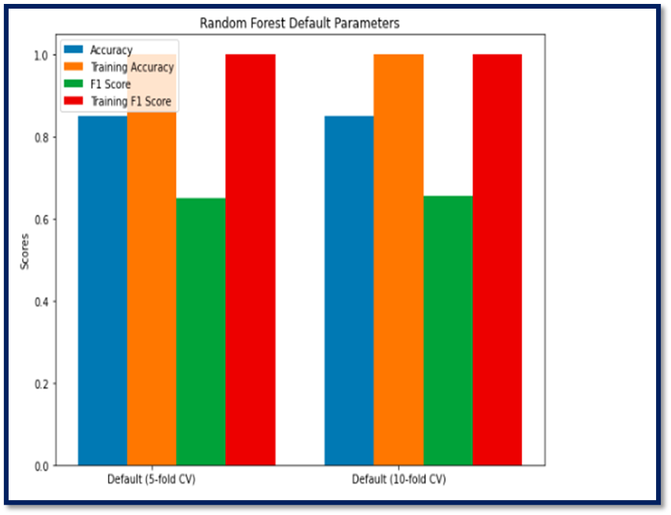
Random Forest
The difference between 5- and 10-fold cross validation is basically non-existent
With default parameters the model massively overfits to training data
While the f1 score and accuracy are solid for the test, we will explore if changing the parameters can reduce the overfitting and improve the classifier
RANDOM FOREST 5 FOLD VS 10 FOLD CROSS VALIDATION
 | 5-FOLD | 10-FOLD
ACCURACY | 0.849 | 0.852
F1 SCORE | 0.651 | 0.656
TRAINING ACCURACY | 0.999 | 0.999
TRAINING F1 SCORE | 0.999 | 0.999

Slide 9
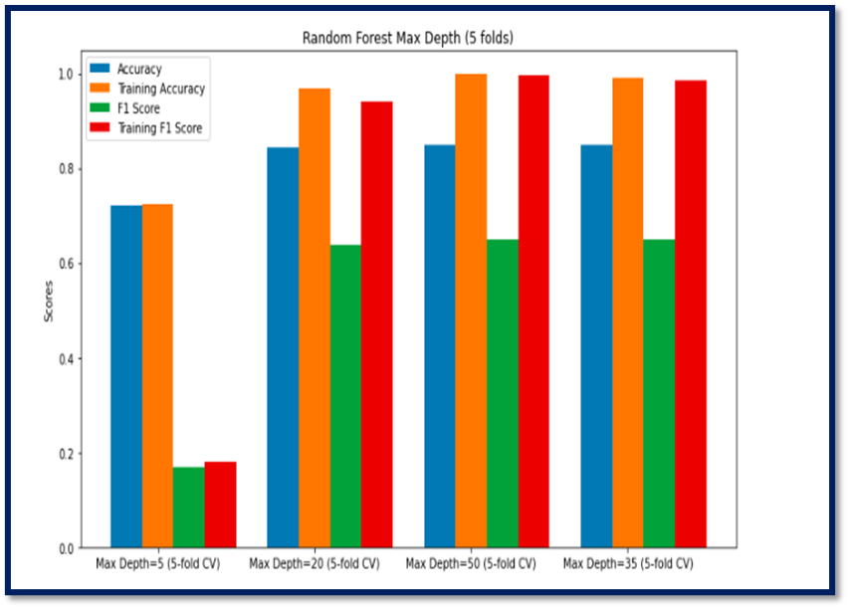
Random Forest
Overfitting increases for higher max_depth parameter, with lover values leading to underfitting
For value max_depth 20 we get similar accuracy and f1 score to higher max_depth values but a bit less overfitting
RANDOM FOREST DIFFERENT MAX_DEPTH PARAMETER PERFORMANCE
MAX_DEPTH NUM. | 5 | 20 | 35 | 50
ACCURACY | 0.721 | 0.845 | 0.849 | 0.845
F1 SCORE | 0.168 | 0.638 | 0.648 | 0.649
TRAINING ACCURACY | 0.722 | 0.968 | 0.991 | 0.998
TRAINING F1 SCORE | 0.179 | 0.941 | 0.984 | 0.996

Slide 10
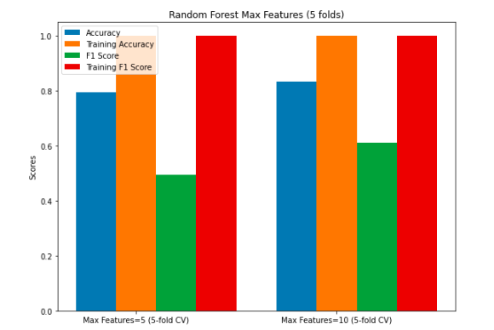
Random Forest
Accuracy and F1 score improve for higher values of max_features parameters but for both values it overfitts to the training data
RANDOM FOREST WITH DIFFERENT MAX_FEATURES PARAMETER PERFORMANCE
MAX_FEATURES NUM. | 5 | 10
ACCURACY | 0.796 | 0.835
F1 SCORE | 0.495 | 0.613
TRAINING ACCURACY | 0.999 | 0.999
TRAINING F1 SCORE | 0.999 | 0.999

Slide 11
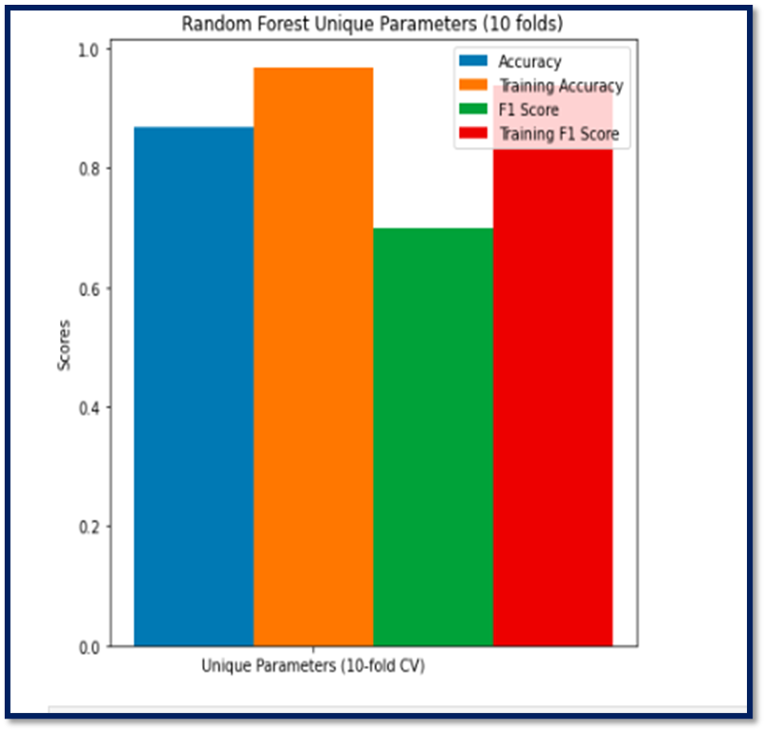
Random Forest
Using the knowledge we got from testing different parameters we try to create a model that overfits the least and has the highest accuracy and f1 score
The parameters were: n_estimators=200, max_depth=20, min_samples_split=5, min_samples_leaf=2, max_features=50
As visible from the bar chart accuracy was 0.87 and the f1 score 0.70, on the training set about 0.97 and 0.0.94 respectively
The results on the test set were better with these parameters than any other

Slide 12
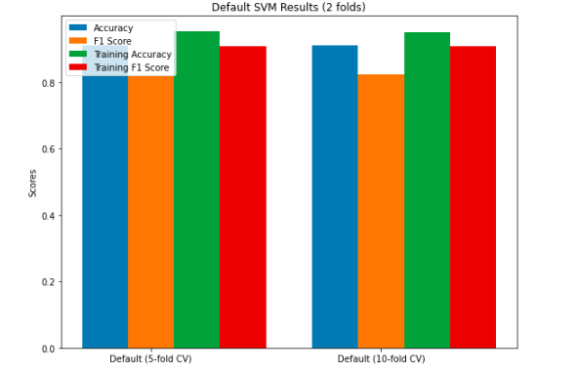
Support Vector Classification
The accuracy and F1 score without changing any parameters for 5- and 10-fold cross validation are already very promising
Overfitting occurs but its not as significant as it was in the previous algorithm, especially because the difference between test and training set metric are not as high
SVC 5 FOLD VS 10 FOLD CROSS VALIDATION
 | 5-FOLD | 10-FOLD
ACCURACY | 0.910 | 0.911
F1 SCORE | 0.817 | 0.822
TRAINING ACCURACY | 0.952 | 0.952
TRAINING F1 SCORE | 0.907 | 0.908

Slide 13
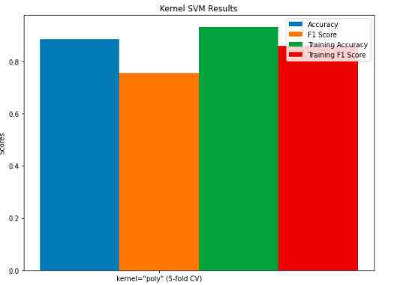
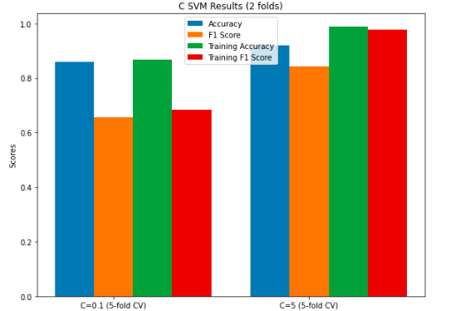
Support Vector Classification
Increasing the regularization parameter C increases accuracy and F1 score, but also leads to overfitting
Using the polynomial kernel instead of the default (‘rbf’) yields a bit worse results
SVC WITH DIFFERENT PARAMETER SETTINGS
PARAMETER | C=0.1 | C=5 | Kernel='poly'
ACCURACY | 0.859 | 0.919 | 0.885
F1 SCORE | 0.657 | 0.844 | 0.756
TRAINING ACCURACY | 0.869 | 0.988 | 0.931
TRAINING F1 SCORE | 0.683 | 0.978 | 0.859

Slide 14
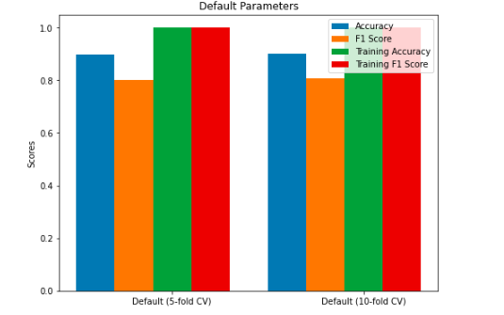
Multi-layer Perceptron Classifier
Accuracy for both folds is about 0.90 and F1 score about 0.80
Overfitting occurs with training accuracy and f1 score, being basically 100%
MLP 5 FOLD VS 10 FOLD CROSS VALIDATION
 | 5-FOLD | 10-FOLD
ACCURACY | 0.897 | 0.901
F1 SCORE | 0.801 | 0.808
TRAINING ACCURACY | 0.999 | 0.999
TRAINING F1 SCORE | 0.999 | 0.999

Slide 15
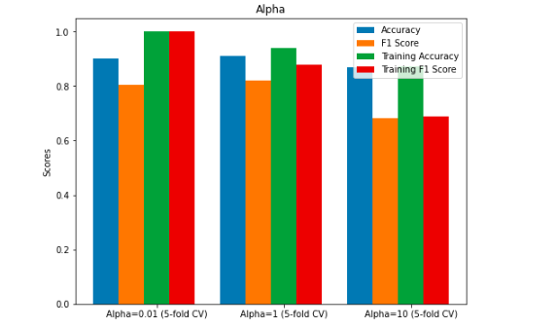
Multi-layer Perceptron Classifier
The accuracy and f1 score is optimal at alpha = 1, also there is less overfitting
Increasing the alpha parameter further gives us worse results and underfitting
SVC WITH DIFFERENT ALPHA PAREMETER
ALPHA | 0.01 | 1 | 10
ACCURACY | 0.899 | 0.911 | 0.868
F1 SCORE | 0.804 | 0.820 | 0.682
TRAINING ACCURACY | 0.999 | 0.939 | 0.871
TRAINING F1 SCORE | 0.999 | 0.878 | 0.688

Slide 16
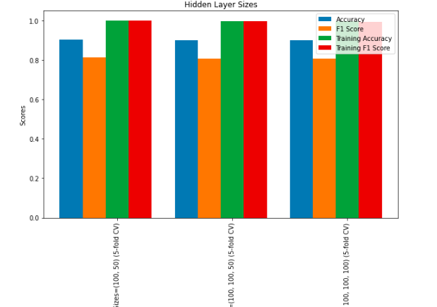
Multi-layer Perceptron Classifier
Adding more hidden layers doesn’t necessarily improve the results for either evaluations
SVC WITH DIFFERENT HIDDEN LAYER SIZES
HIDDEN LAYER SIZE | (100, 50) | (100, 100, 50) | (100, 100, 100, 100)
ACCURACY | 0.902 | 0.899 | 0.899
F1 SCORE | 0.812 | 0.805 | 0.807
TRAINING ACCURACY | 0.999 | 0.997 | 0.998
TRAINING F1 SCORE | 0.999 | 0.995 | 0.997

Slide 17
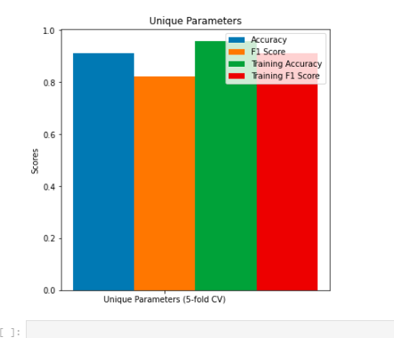
Multi-layer Perceptron Classifier
Combining different parameters with values: hidden_layer_sizes=(100, 50), alpha=1, solver='adam', activation='relu', learning_rate='adaptive', max_iter=200
We got values for accuracy 0.91 and for f1 score 0.82.
The results on the training set were 0.96 and 0.91 respectively, which is still high but lower than with other parameters, especially when considering that the evaluation has improved

Slide 18
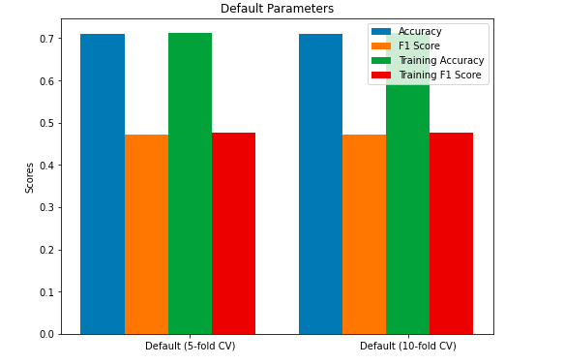
Gaussian Naive Bayes
Bad performance on both training and test set
By far the worst results of all algorithms
NAIVE BAYES 5 FOLD VS 10 FOLD CROSS VALIDATION
 | 5-FOLD | 10-FOLD
ACCURACY | 0.711 | 0.711
F1 SCORE | 0.472 | 0.472
TRAINING ACCURACY | 0.712 | 0.712
TRAINING F1 SCORE | 0.476 | 0.476

Slide 19
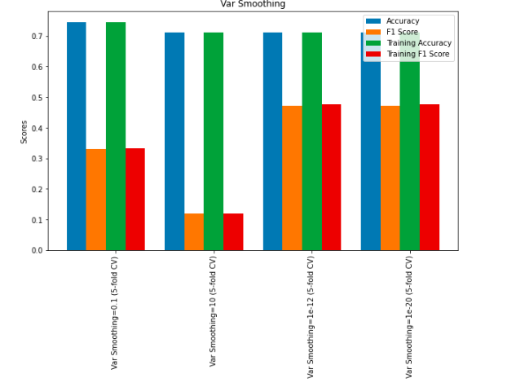
Gaussian Naive Bayes
This algorithm doesn’t have a lot of parameters so we are restricted with trying to improve it
F1 score generally gets better if we decrease var_smoothing, but the accuracy gets worse
This algorithm doesn’t do well on the data, no matter the parameters
NAIVE BAYES WITH DIFFERENT VAR_SMOOTHING PARAMETERS
VAR SMOOTHING | 0.1 | 1 | 1e-12 | 1e-20
ACCURACY | 0.745 | 0.711 | 0.711 | 0.711
F1 SCORE | 0.331 | 0.119 | 0.472 | 0.472
TRAINING ACCURACY | 0.745 | 0.711 | 0.712 | 0.712
TRAINING F1 SCORE | 0.332 | 0.119 | 0.476 | 0.476

