Slide 1

Dominion protector

Slide 2
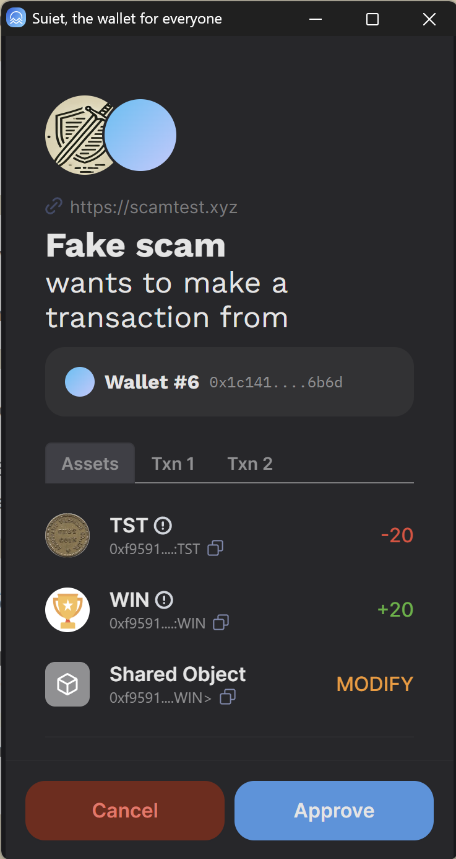
Today’s security
Transaction simulation

Slide 3

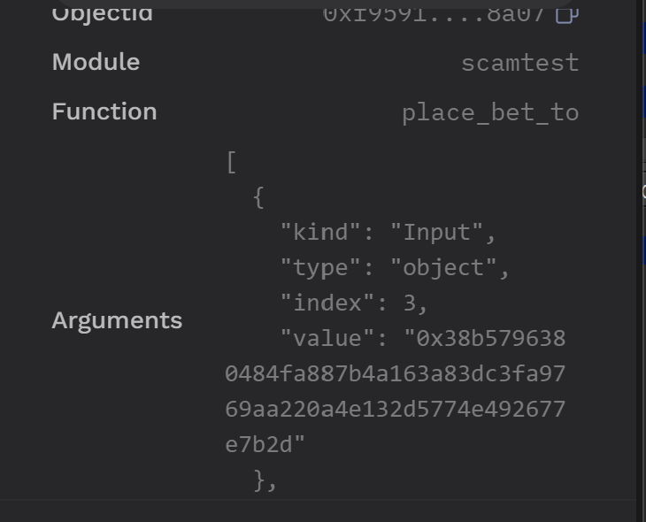
Simulation problems
Hard to read

Slide 4
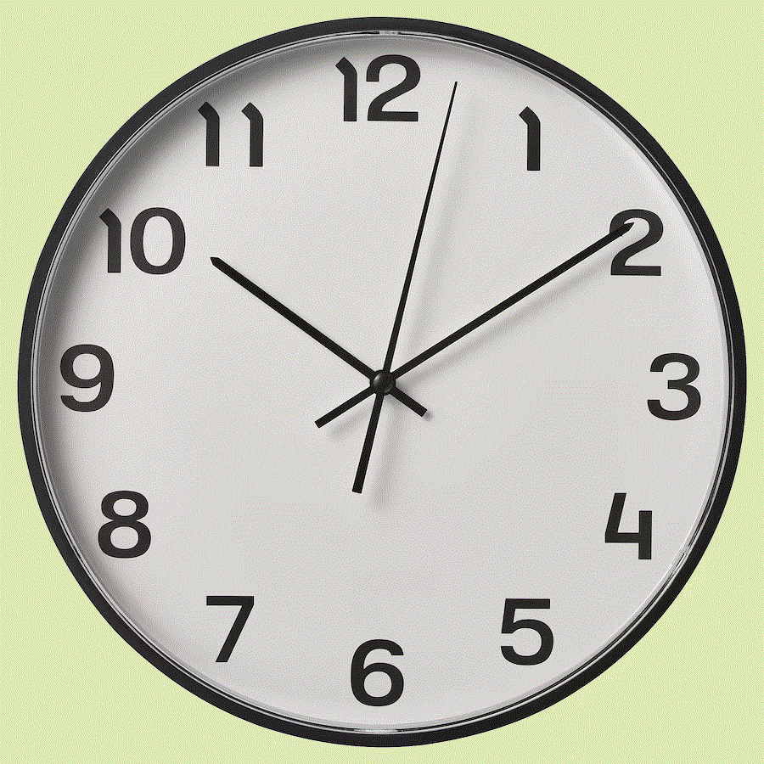
Simulation problems
Simulation
Execution
May be inaccurate

Slide 5
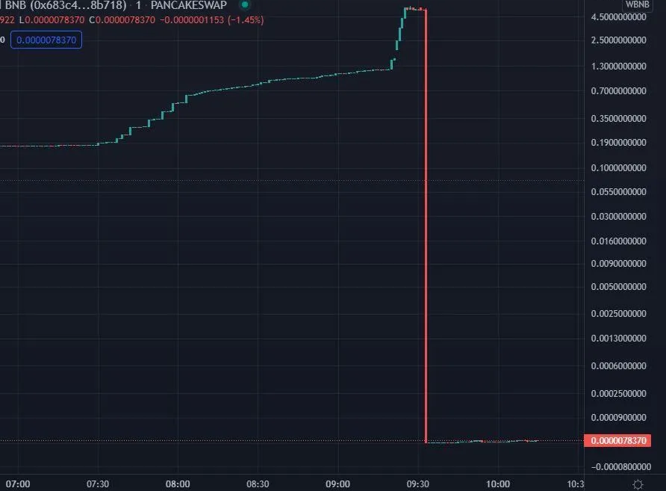
Simulation problems
Unpredictable future

Slide 6
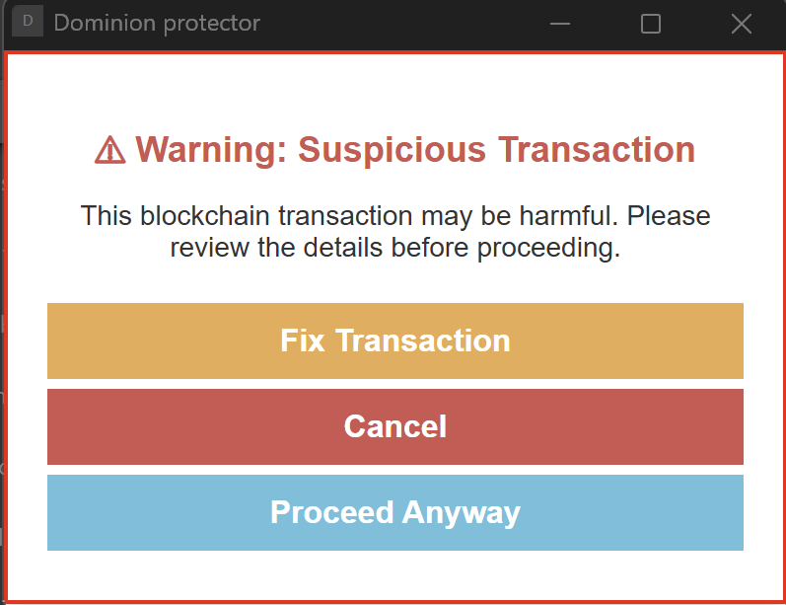
Wallet protector

Slide 7
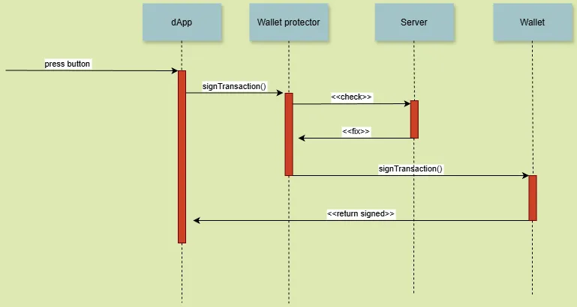
Wallet protector
Additional security layer

Slide 8

But
WHAT IS LOSS

Slide 9

A question for AI

Slide 10

AI problems
Accuracy and speed

Slide 11
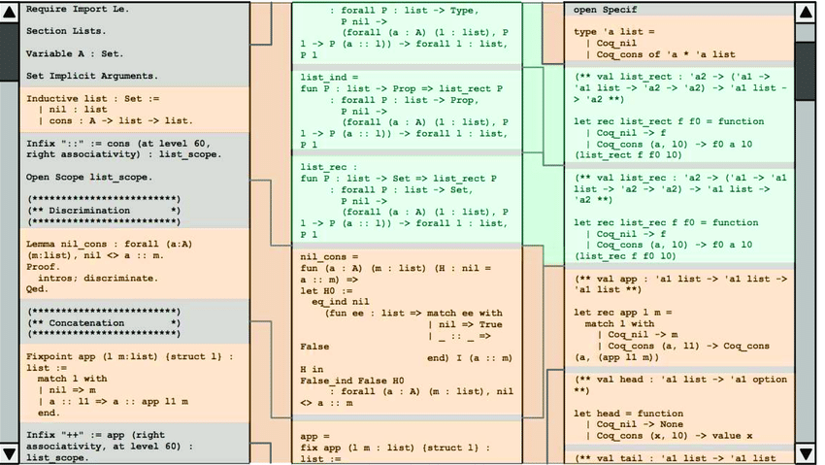
Security
Formal verification

Slide 12

Invariants
Formal verification requires intelligence

Slide 13


Speed up
Analyzing contracts on deploy

