Slide 1


The basics of file systems

Slide 2
The basics of file systems
What a file system must do:
store our data

Slide 3

The basics of file systems
What a file system must do:
store our data
This organisation becomes inconvenient if we have thousands of files.

Slide 4
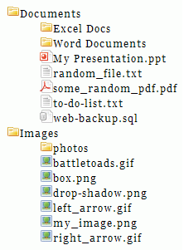
The basics of file systems
What a file system must do:
store our data, organise data into a hierarchy of files and directories

Slide 5
The basics of file systems
What a file system must do:
store our data, organise data into a hierarchy of files and directories, provide and limit the access to stored files.

Slide 6
The basics of file systems
Today we will limit ourselves to file systems that store data in a single computer and provide access only to local users.

Slide 7
The basics of file systems
The desired interface to a file system:
f = open(“./pstorage-fes/src/fes.c"); read(f, buffer, size); ..... write(f, buffer, size); ..... close(f);

Slide 8
The basics of file systems
The desired interface to a file system: | The interface of a storage device:
f = open(“./pstorage-fes/src/fes.c"); read(f, buffer, size); ..... write(f, buffer, size); ..... close(f); | * read a sector* nr. N, * write a sector nr. M. * a sector is a contiguous piece of a storage device that is 512 bytes or 4096 bytes long; the start of a sector is a multiple of the sector size

Slide 9
The basics of file systems
The desired interface to a file system: | The interface of a storage device:
f = open(“./pstorage-fes/src/fes.c"); read(f, buffer, size); ..... write(f, buffer, size); ..... close(f); | * read a sector* nr. N, * write a sector nr. M. * a sector is a contiguous piece of a storage device that is 512 bytes or 4096 bytes long; the start offset of a sector is multiple of the sector size
This restriction is not always true. Chips are getting denser, and nowadays a single PCI-e card can host a computer with 16 ARM cores, 32G RAM, 4x400Gbit ethernet, and dedicated accelerators for NVMe-oF, compression and erasure coding. For example, see Mellanox (Nvidia) BlueField. Such devices can provide a much more sophisticated API.

Slide 10
The basics of file systems
The desired interface to a file system: |  | The interface of a storage device:
f = open(“./pstorage-fes/src/fes.c"); read(f, buffer, size); ..... write(f, buffer, size); ..... close(f); |  | * read a sector* nr. N, * write a sector nr. M. * a sector is a contiguous piece of a storage device that is 512 bytes or 4096 bytes long; the start of a sector is a multiple of the sector size
The task of a file system:
 | Atop of a block device, provide an API that enables users to create files and directories, find files and directories by their name, write and read files at arbitrary offsets (not necessarily sector-aligned), do these operations quickly and reliably.

Slide 11
The basics of file systems
A problem that a file system must solve: how does one store a list of files*?
An array with file names, unsorted:
file15, file1,
file2, file3,
file4, file9,
file6, file8,
file7, file5,
file12, file11,
file10, file13,
file14, file0
* boxes in diagrams depict contiguous areas of a disk; different boxes are assumed not to be adjacent

Slide 12
The basics of file systems
A problem that a file system must solve: how does one store a list of files*?
An array with file names, unsorted:
We need up to 16 string comparisons to find a file.
file15, file1,
file2, file3,
file4, file9,
file6, file8,
file7, file5,
file12, file11,
file10, file13,
file14, file0
* boxes in diagrams depict contiguous areas of a disk; different boxes are assumed not to be adjacent

Slide 13
The basics of file systems
A problem that a file system must solve: how does one store a list of files*?
An array with file names, unsorted: | A balanced binary search tree:
We need up to 16 string comparisons to find a file. | We need at most 4 comparisons to find a file. Win?
file15, file1,
file2, file3,
file4, file9,
file6, file8,
file7, file5,
file12, file11,
file10, file13,
file14, file0
file7
file3
file11
file1
file5
file0
file2
file4
file6
* boxes in diagrams depict contiguous areas of a disk; different boxes are assumed not to be adjacent

Slide 14

The basics of file systems
A problem that a file system must solve: how does one store a list of files*?
An array with file names, unsorted: | A balanced binary search tree:
We need up to 16 string comparisons to find a file. | We need at most 4 comparisons to find a file. Win?
file15, file1,
file2, file3,
file4, file9,
file6, file8,
file7, file5,
file12, file11,
file10, file13,
file14, file0
file7
file3
file11
file1
file5
file0
file2
file4
file6
* boxes in diagrams depict contiguous areas of a disk; different boxes are assumed not to be adjacent

Slide 15
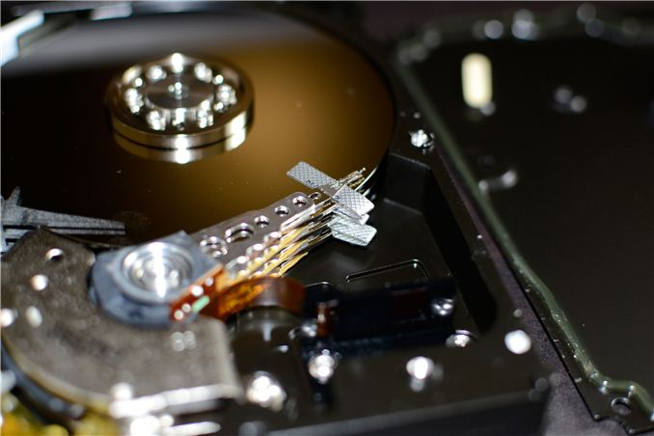
The basics of file systems
The reader head needs to be positioned very precisely. It takes much time to reposition it which makes random reads from HDD very slow. For reference:
the speed of sequential reads from an HDD is ≈100 MB/sec, which is ≈10 ms per 1 MB,
time to reposition the reader head is also ≈10 ms.
Modern HDDs are more performant. For example, Seagate Exos 16T does sequential reads at the rate of up to 250MB/sec and has a 6ms latency of random accesses.
The values of 100 MB/sec and 10ms are much handier for estimates.

Slide 16
The basics of file systems
The reader head needs to be positioned very precisely. It takes much time to reposition it which makes random reads from HDD very slow. For reference:
the speed of sequential reads from an HDD is ≈100 MB/sec, which is ≈10 ms per 1 MB,
time to reposition the reader head is also ≈10 ms.
Let us change the scale and have durations that we see in the everyday life:
1ns ---> 1s
L1 latency (Zen 4, 5.7Ghz) | 0.7s
L2 latency | 2.5s
L3 latency | 10s
RAM latency | ≈84s

Slide 17
The basics of file systems
The reader head needs to be positioned very precisely. It takes much time to reposition it which makes random reads from HDD very slow. For reference:
the speed of sequential reads from an HDD is ≈100 MB/sec, which is ≈10 ms per 1 MB,
time to reposition the reader head is also ≈10 ms.
Let us change the scale and have durations that we see in the everyday life:
1ns ---> 1s
L1 latency (Zen 4, 5.7Ghz) | 0.7s
L2 latency | 2.5s
L3 latency | 10s
RAM latency | ≈84s
A read from an HDD | 116 days only to position the reader head

Slide 18
The basics of file systems
A problem that a file system must solve: how does one store a list of files*?
An array with file names, unsorted: |  | A balanced binary search tree:
Jump to the start of the list: Read the whole list: Scan the array in RAM: | ≈10msec <1msec (<100K) <1msec | Most files need 4 or 3 random accesses which translates to latencies above 30 msec.
file15, file1,
file2, file3,
file4, file9,
file6, file8,
file7, file5,
file12, file11,
file10, file13,
file14, file0
file7
file3
file11
file1
file5
file0
file2
file4
file6
* boxes in diagrams depict contiguous areas of a disk; different boxes are assumed not to be adjacent

Slide 19
The basics of file systems
Kinds of storage devices:
HDD (Hard Disk Drive, a.k.a. Rotating drive, a.k.a. Spinning rust) | + sequential access is reasonably fast (≈250 MB/sec) - random access is very slow (≈100 IOPS*)
* IOPS stands for “Input/output Operations Per Second”. * As per the spec of Intel SSD DC S3700, D7-P5600 and D7-PS1030.

Slide 20
The basics of file systems
Kinds of storage devices:
HDD (Hard Disk Drive, a.k.a. Rotating drive, a.k.a. Spinning rust) | + sequential access is reasonably fast (≈250 MB/sec) - random access is very slow (≈100 IOPS*)
Flash memory | + fast sequential reads + no mechanical reader heads to reposition - no random writes; it is only possible to rewrite whole “rewrite blocks” that are several MB long - low number of rewrite cycles due to physical degradation of memory cells
* IOPS stands for “Input/output Operations Per Second”. * As per the spec of Intel SSD DC S3700, D7-P5600 and D7-PS1030.

Slide 21
The basics of file systems
Kinds of storage devices:
HDD (Hard Disk Drive, a.k.a. Rotating drive, a.k.a. Spinning rust) | + sequential access is reasonably fast (≈250 MB/sec) - random access is very slow (≈100 IOPS*)
Flash memory | + fast sequential reads + no mechanical reader heads to reposition - no random writes; it is only possible to rewrite whole “rewrite blocks” that are several MB long - low number of rewrite cycles due to physical degradation of memory cells
SSD (Solid State Drive), SATA | Flash + a computer that hides the complexity of managing “rewrite blocks”. + fast sequential access (≈500 MB/sec sequential read*) + fast random access (≈75.000 IOPS)
* IOPS stands for “Input/output Operations Per Second”. * As per the spec of Intel SSD DC S3700, D7-P5600 and D7-PS1030.

Slide 22
The basics of file systems
Kinds of storage devices:
HDD (Hard Disk Drive, a.k.a. Rotating drive, a.k.a. Spinning rust) | + sequential access is reasonably fast (≈250 MB/sec) - random access is very slow (≈100 IOPS*)
Flash memory | + fast sequential reads + no mechanical reader heads to reposition - no random writes; it is only possible to rewrite whole “rewrite blocks” that are several MB long - low number of rewrite cycles due to physical degradation of memory cells
SSD (Solid State Drive), SATA | Flash + a computer that hides the complexity of managing “rewrite blocks”. + fast sequential access (≈500 MB/sec sequential read*) + fast random access (≈75.000 IOPS)
SSD, NVMe | SSD with a faster interface: ≈5 GB/sec sequential read, ≈1M IOPS* (PCIe3-era devices). PCIe5 devices are faster yet: ≈15 GB/sec sequential read, ≈2.3M IOPS.
* IOPS stands for “Input/output Operations Per Second”. * As per the spec of Intel SSD DC S3700, D7-P5600 and D7-PS1030.

Slide 23
The basics of file systems
Kinds of storage devices:
HDD (Hard Disk Drive, a.k.a. Rotating drive, a.k.a. Spinning rust) | + sequential access is reasonably fast (≈250 MB/sec) - random access is very slow (≈100 IOPS*)
Flash memory | + fast sequential reads + no mechanical reader heads to reposition - no random writes; it is only possible to rewrite whole “rewrite blocks” that are several MB long - low number of rewrite cycles due to physical degradation of memory cells
SSD (Solid State Drive), SATA | Flash + a computer that hides the complexity of managing “rewrite blocks”. + fast sequential access (≈500 MB/sec sequential read*) + fast random access (≈75.000 IOPS)
SSD, NVMe | SSD with a faster interface: ≈5 GB/sec sequential read, ≈1M IOPS* (PCIe3-era devices). PCIe5 devices are faster yet: ≈15 GB/sec sequential read, ≈2.3M IOPS.
See also:
https://lwn.net/Articles/931668/
https://lwn.net/Articles/1022718/
https://nabstreamingsummit.com/wp-content/uploads/2022/05/2022-Streaming-Summit-Netflix.pdf
* IOPS stands for “Input/output Operations Per Second”. * As per the spec of Intel SSD DC S3700, D7-P5600 and D7-PS1030.

Slide 24
The basics of file systems
Kinds of storage devices:
HDD (Hard Disk Drive, a.k.a. Rotating drive, a.k.a. Spinning rust) | + sequential access is reasonably fast (≈250 MB/sec) - random access is very slow (≈100 IOPS*)
Flash memory | + fast sequential reads + no mechanical reader heads to reposition - no random writes; it is only possible to rewrite whole “rewrite blocks” that are several MB long - low number of rewrite cycles due to physical degradation of memory cells
SSD (Solid State Drive), SATA | Flash + a computer that hides the complexity of managing “rewrite blocks”. + fast sequential access (≈500 MB/sec sequential read*) + fast random access (≈75.000 IOPS)
SSD, NVMe | SSD with a faster interface: ≈5 GB/sec sequential read, ≈1M IOPS* (PCIe3-era devices). PCIe5 devices are faster yet: ≈15 GB/sec sequential read, ≈2.3M IOPS.
Storage-class memory (3D cross-point memory, etc.) | Byte-addressable non-volatile random-access memory that connects to PCI-e or DRAM busses. “Non-volatile” means “does not lose data when powered off”. + the bandwidth and latency is comparable to DRAM, + the size is up to single-digit terabytes.
* IOPS stands for “Input/output Operations Per Second”. * As per the spec of Intel SSD DC S3700, D7-P5600 and D7-PS1030.

Slide 25
The basics of file systems
APIs for working with file systems:
An operating system must hide hardware details from applications and provide a single API that can be used with different underlying storages.
POSIX (Portable Operating System Interface),
Windows API.

Slide 26
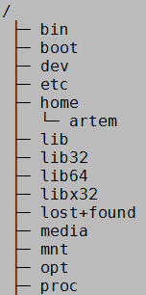
The basics of file systems
POSIX file system API
A file system is a tree of directories and files:

Slide 27
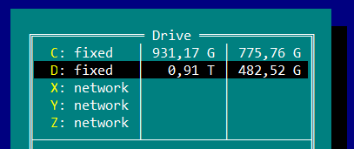
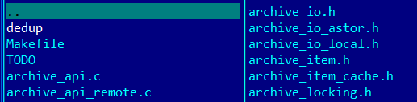
The basics of file systems
POSIX file system API | Windows file system API
A file system is a tree of directories and files: | In Windows, a file system is a collection of trees that Windows calls “drives”:

Slide 28
The basics of file systems
POSIX file system API | Windows file system API
A file system is a tree of directories and files: | In Windows, a file system is a collection of trees that Windows calls “drives”:
Filesystem Hierarchy Standard: Linux: http://refspecs.linuxfoundation.org/FHS_2.3/fhs-2.3.pdf FreeBSD: https://www.freebsd.org/doc/handbook/dirstructure.html

Slide 29
The basics of file systems
POSIX file system API | Windows file system API
A file system is a tree of directories and files: | In Windows, a file system is a collection of trees that Windows calls “drives”:
Filesystem Hierarchy Standard: Linux: http://refspecs.linuxfoundation.org/FHS_2.3/fhs-2.3.pdf FreeBSD: https://www.freebsd.org/doc/handbook/dirstructure.html | \Global??\C:\foo\bar.txt

Slide 30
The basics of file systems
An ambiguity in the terminology
A file system is a hierarchy of directories and files presented to a user | A file system is a mechanism of storing files and directories on a storage device.

Slide 31
The basics of file systems
A refresher on the POSIX Filesystem API
1. open(path, flags, mode) / close(fd)

Slide 32
The basics of file systems
A refresher on the POSIX Filesystem API
1. open(path, flags, mode) / close(fd)
O_CREAT, O_EXCL, O_NOATIME, O_CLOEXEC.

Slide 33
The basics of file systems
A refresher on the POSIX Filesystem API
1. open(path, flags, mode) / close(fd)
2. mkdir(path, flags) / rmdir(path)

Slide 34
The basics of file systems
A refresher on the POSIX Filesystem API
1. open(path, flags, mode) / close(fd)
2. mkdir(path, flags) / rmdir(path)
3. chdir(path), chroot(path)

Slide 35
The basics of file systems
A refresher on the POSIX Filesystem API
1. open(path, flags, mode) / close(fd)
2. mkdir(path, flags) / rmdir(path)
3. chdir(path), chroot(path)
4. openat(dirfd, path, flags) / mkdirat() / rmdirat() / etc dirfd replaces the “current working directory” for openat(). This gives multiple improvements: ???

Slide 36
The basics of file systems
A refresher on the POSIX Filesystem API
1. open(path, flags, mode) / close(fd)
2. mkdir(path, flags) / rmdir(path)
3. chdir(path), chroot(path)
4. openat(dirfd, path, flags) / mkdirat() / rmdirat() / etc dirfd replaces the “current working directory” for openat(). This gives multiple improvements: no races with chdir(), per-thread working directories instead of a process-global one, fewer steps to traverse the file system.

Slide 37
The basics of file systems
A refresher on the POSIX Filesystem API
1. open(path, flags, mode) / close(fd)
2. mkdir(path, flags) / rmdir(path)
3. chdir(path), chroot(path)
4. openat(dirfd, path, flags) / mkdirat() / rmdirat() / etc
5. symlink() / readlink()

Slide 38
The basics of file systems
A refresher on the POSIX Filesystem API
1. open(path, flags, mode) / close(fd)
2. mkdir(path, flags) / rmdir(path)
3. chdir(path), chroot(path)
4. openat(dirfd, path, flags) / mkdirat() / rmdirat() / etc
5. symlink() / readlink()
6. link() / unlink() In POSIX, files and their names exist separately. The following situations are allowed: files with multiple names, files with no names.

Slide 39
The basics of file systems
A refresher on the POSIX Filesystem API
1. open(path, flags, mode) / close(fd)
2. mkdir(path, flags) / rmdir(path)
3. chdir(path), chroot(path)
4. openat(dirfd, path, flags) / mkdirat() / rmdirat() / etc
5. symlink() / readlink()
6. link() / unlink() In POSIX, files and their names exist separately. The following situations are allowed: files with multiple names, files with no names. open(O_TMPFILE) creates a file that has no name from the outset.

Slide 40
The basics of file systems
A refresher on the POSIX Filesystem API
1. open(path, flags, mode) / close(fd)
2. mkdir(path, flags) / rmdir(path)
3. chdir(path), chroot(path)
4. openat(dirfd, path, flags) / mkdirat() / rmdirat() / etc
5. symlink() / readlink()
6. link() / unlink()
7. Special files: directory, character devices, block devices, pipes, unix domain sockets.

Slide 41
The basics of file systems
A refresher on the POSIX Filesystem API
1. open(path, flags, mode) / close(fd)
2. mkdir(path, flags) / rmdir(path)
3. chdir(path), chroot(path)
4. openat(dirfd, path, flags) / mkdirat() / rmdirat() / etc
5. symlink() / readlink()
6. link() / unlink()
7. Special files
8. mmap() / munmap()

