Slide 1


The basics of file systems

Slide 2
The basics of file systems
Backblaze report on HDD failures in 2023
Among the most often used disks there has been the following number of failures: https://www.backblaze.com/blog/backblaze-drive-stats-for-2023/
Model | # of disks | % of failed disks
HGST HMS5C4040BLE640 | 10260 | 0.38%
HGST HUH721212ALE604 | 13144 | 0.95%
HGST HUH721212ALN604 | 10532 | 3.69%
WDC WUH721816ALE6L4 | 21607 | 0.30%
Toshiba MG07ACA14TA | 37913 | 1.12%
Toshiba MGO8ACA16TA | 33750 | 1.09%
Seagate ST4000DM000 | 11391 | 3.32%
Seagate ST8000NM0055 | 13914 | 3.85%
Seagate ST12000NM0008 | 19449 | 2.93%
Seagate ST12000NM001G | 13108 | 1.19%
Seagate ST14000NM001G | 10693 | 1.80%
Seagate ST16000NMO01G | 27433 | 0.70%

Slide 3
The basics of file systems
A CERN experiment to measure the reliability of disks
An application writes 1Gb to a disk this way: Choose 1k random locations on the disk, each 1Mb long, Write 1Mb to the first location, Wait 1s, Repeat to fill remaining locations. The application was run on a cluster that had approx. 3000 hosts. Each host had a HW RAID. Wait 3 weeks. Read blocks that were written at step 1.

Slide 4
The basics of file systems
A CERN experiment to measure the reliability of disks
An application writes 1Gb to a disk this way: Choose 1k random locations on the disk, each 1Mb long, Write 1Mb to the first location, Wait 1s, Repeat to fill remaining locations. The application was run on a cluster that had approx. 3000 hosts. Each host had a HW RAID. Wait 3 weeks. Read blocks that were written at step 1. CERN have found approx. 0.005% blocks that would read back data that differed from data originally written to them. Yet, all reads were reported as successful both by the hardware and by the OS.

Slide 5
The basics of file systems
A CERN experiment to measure the reliability of disks
Conclusions: Data may not be stored without redundancy. Applications and file systems must implement checksumming and consistency checks. Storage systems need to run proactive background consistency checks. | Data replication or Reed-Solomon coding. ZFS and btrfs store cryptographic hashes of all blocks (ext4 has only CRC). Online scrubbing & repair в ZFS and XFS and in HW RAID controllers.

Slide 6
The basics of file systems
A CERN experiment to measure the reliability of disks
Conclusions: Data may not be stored without redundancy. Applications and file systems must implement checksumming and consistency checks. Storage systems need to run proactive background consistency checks. | Data replication or Reed-Solomon coding. ZFS and btrfs store cryptographic hashes of all blocks (ext4 has only CRC). Online scrubbing & repair в ZFS and XFS and in HW RAID controllers.
Note: hard drives are not the only component prone to data corruption. PCI-e relies heavily on error correction: https://pcisig.com/pcie%C2%AE-60-specification-webinar-qa-error-detection-and-correction-fec. The same is true for ethernet, for RAM, etc.

Slide 7
The basics of file systems
Wrong ways to handle FS corruption
The paper [1] ran an experiment where the data of the following applications was located on a file system that would randomly corrupt the content of blocks: Redis, ZooKeeper, Cassandra, Kafka, RethinkDB, LogCabin. [1] https://www.usenix.org/system/files/conference/fast17/fast17-ganesan.pdf [2] https://www.usenix.org/system/files/conference/fast18/fast18-alagappan.pdf

Slide 8
The basics of file systems
Wrong ways to handle FS corruption
The paper [1] ran an experiment where the data of the following applications was located on a file system that would randomly corrupt the content of blocks: Redis, Does not validate checksums of user data, Replicates corrupted data across nodes of a cluster, Corruptions of a FS are “handled” with assert()s. ZooKeeper, Cassandra, Kafka, RethinkDB, LogCabin. [1] https://www.usenix.org/system/files/conference/fast17/fast17-ganesan.pdf [2] https://www.usenix.org/system/files/conference/fast18/fast18-alagappan.pdf

Slide 9
The basics of file systems
Wrong ways to handle FS corruption
The paper [1] ran an experiment where the data of the following applications was located on a file system that would randomly corrupt the content of blocks: Redis, ZooKeeper, Validates checksums in all data, but does it inside assert()s, Uses Adler32 as the checksum, Cassandra, Kafka, RethinkDB, LogCabin. [1] https://www.usenix.org/system/files/conference/fast17/fast17-ganesan.pdf [2] https://www.usenix.org/system/files/conference/fast18/fast18-alagappan.pdf

Slide 10
The basics of file systems
Wrong ways to handle FS corruption
The paper [1] ran an experiment where the data of the following applications was located on a file system that would randomly corrupt the content of blocks: Redis, ZooKeeper, Cassandra, Has no checksums for uncompressed data, When the checksum does not match, Cassandra chooses the last write as “the correct one”. This way it can replicate corrupted data to other cluster nodes. Kafka, RethinkDB, LogCabin. [1] https://www.usenix.org/system/files/conference/fast17/fast17-ganesan.pdf [2] https://www.usenix.org/system/files/conference/fast18/fast18-alagappan.pdf

Slide 11
The basics of file systems
Ways to check the data integrity
So far, we’ve mentioned two mechanism of integrity checks: Cyclic redundancy checks, Cryptographic hash sums. Let us consider them in more detail.

Slide 12
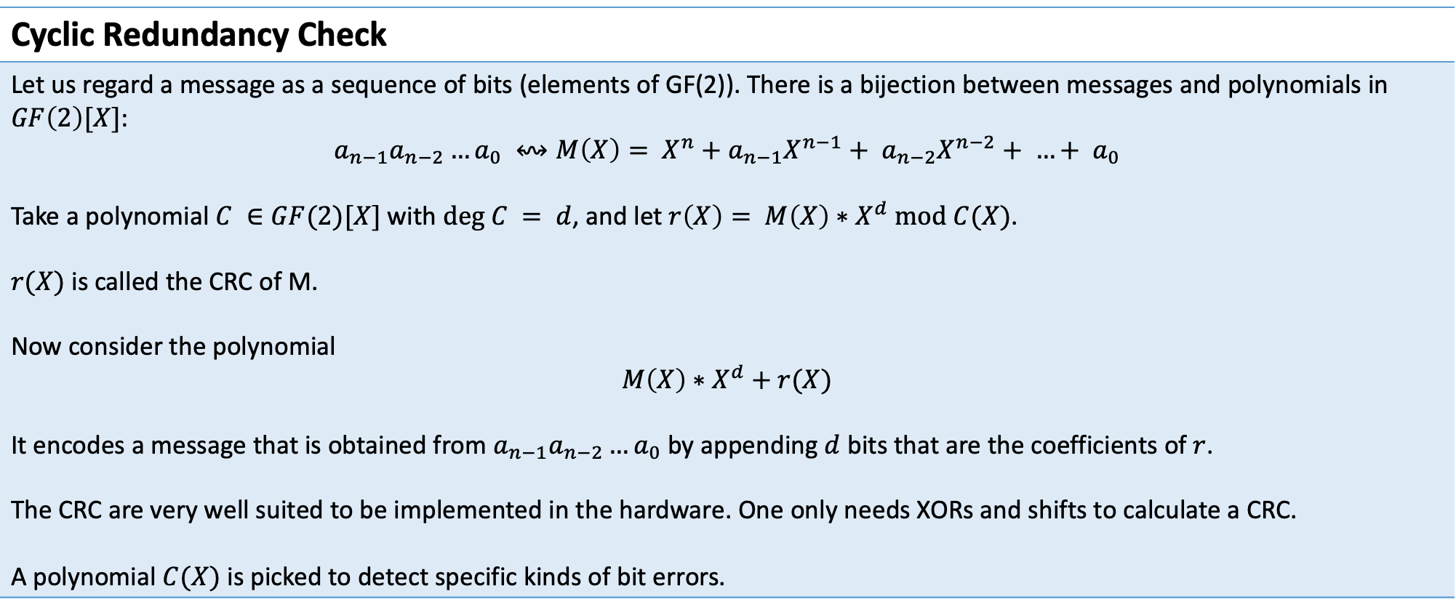
The basics of file systems
Cyclic Redundancy Check
Let us regard a message as a sequence of bits (elements of GF(2)). There is a bijection between messages and polynomials in $GF\left(2\right)[X]$: $$a_{n−1}a_{n−2}…a_{0} ↭M\left(X\right)= X^{n}+a_{n−1}X^{n−1}+ a_{n−2}X^{n−2}+ …+ a_{0}$$ Take a polynomial $C ∈GF(2)[X]$ with $deg C = d$, and let $r\left(X\right)= M\left(X\right)∗X^{d} mod C(X)$. $r(X)$ is called the CRC of M. Now consider the polynomial $$M\left(X\right)∗X^{d}+r(X)$$ It encodes a message that is obtained from $a_{n−1}a_{n−2}…a_{0}$ by appending $d$ bits that are the coefficients of $r$. The CRC are very well suited to be implemented in the hardware. One only needs XORs and shifts to calculate a CRC. A polynomial $C(X)$ is picked to detect specific kinds of bit errors.

Slide 13
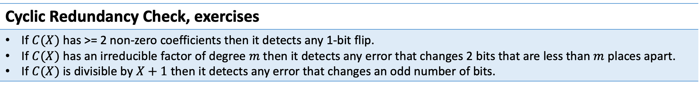
The basics of file systems
Cyclic Redundancy Check, exercises
If $C(X)$ has >= 2 non-zero coefficients then it detects any 1-bit flip. If $C(X)$ has an irreducible factor of degree $m$ then it detects any error that changes 2 bits that are less than $m$ places apart. If $C(X)$ is divisible by $X+1$ then it detects any error that changes an odd number of bits.

Slide 14
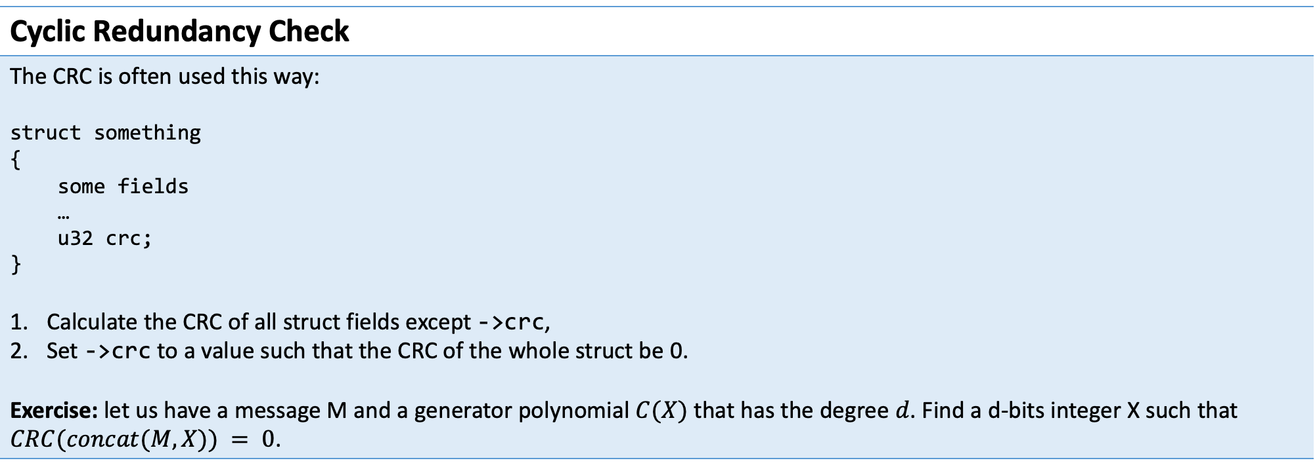
The basics of file systems
Cyclic Redundancy Check
The CRC is often used this way: struct something { some fields … u32 crc; } Calculate the CRC of all struct fields except ->crc, Set ->crc to a value such that the CRC of the whole struct be 0. Exercise: let us have a message M and a generator polynomial $C(X)$ that has the degree $d$. Find a d-bits integer X such that $CRC(concat(M, X)) = 0$.

Slide 15
The basics of file systems
Examples of CRC
Name | Applications | The generator polynomial*
CRC-16-CCITT | Bluetooth | 0x1021
CRC-16-IBM | USB | 0x8005
CRC-32 | Ethernet, SATA, MPEG-2, gzip, bzip2, PNG | 0x04C11DB7
CRC-32C (Castagnoli)** | iSCSI, SCTP, ext4, btrfs, Ceph | 0x1EDC6F41
* Bits in these numbers are used as the coefficients of the generator polynomial.
** SSE4.2 has dedicated instructions to calculate this CRC.

Slide 16
The basics of file systems
Cryptographic hashes
CRCs are very fast to calculate and detect some most frequent corruptions. However, they are easily fooled by deliberately introduced errors. Redis, ZooKeeper, Validates checksums in all data, but does it inside assert()s, Uses Adler32 as the checksum, Cassandra, Kafka, RethinkDB, LogCabin. Adler32 was designed to detect typical corruptions in data compressors. It is good only for short bit strings. It cannot reliably detect corruptions in longer blocks. That is why ZooKeeper may believe corrupted blocks to be valid.

Slide 17
The basics of file systems
Cryptographic hashes
CRCs are very fast to calculate and detect some most frequent corruptions. However, they are easily fooled by deliberately introduced errors. To verify reliably that data was not tampered with or corrupted, we use cryptographic hashes: MD5, SHA1, SHA-256, SHA-384, SHA-512. These algorithms may be relied upon because we know no algorithm for finding hash collisions except brute-force search. However, The search for collisions in MD5 is no longer “too computationally expensive”, For SHA1, a collision was found and there is a way to construct more collisions using that one, SHA-256 and more modern hashes still need a full brute-force search to find a collision.

Slide 18
The basics of file systems
An example of consistency checks: Merkle trees
Remark: + means string concatenation.
Root HASH(hash0 + hash1)
hash0 HASH(hash0-0 + hash0-1)
hash0 HASH(hash1-0 + hash1-1)
hash0-0 HASH(user_data 0-0)
hash0-1 HASH(user_data 0-1)
hash0-0 HASH(user_data 0-0)
hash0-1 HASH(user_data 0-1)

Slide 19
The basics of file systems
An example of consistency checks: Merkle trees
Applications: ZFS organises the whole FS as a Merkle tree so it can check the consistency when walking a path and when looking for file extents, p2p networks use Merkle trees to ensure that the data is tamper-free, DynamoDB uses Merkle trees to quickly find parts of the DB that differ between cluster nodes and need to be resynced.
Remark: + means string concatenation.
Root HASH(hash0 + hash1)
hash0 HASH(hash0-0 + hash0-1)
hash0 HASH(hash1-0 + hash1-1)
hash0-0 HASH(user_data 0-0)
hash0-1 HASH(user_data 0-1)
hash0-0 HASH(user_data 0-0)
hash0-1 HASH(user_data 0-1)

Slide 20
The basics of file systems
RAID – Redundant Array of Independent (Inexpensive) Disks
What can it achieve: Be more reliable than individual disks, Have bigger capacity than individual disks.

Slide 21
The basics of file systems
RAID levels
RAID0 (stipe) | This RAID level splits data into parts that have N * B bytes, then splits each part into N blocks, and writes blocks to individual disks:
........
........
........
Disk 0 Disk 1 …… Disk N-1

Slide 22
The basics of file systems
RAID levels
RAID1 (mirror) | Every disk contains the same data:
........
==
........
==
==
........
==
==
==
==
==
==
Disk 0 Disk 1 …… Disk N-1

Slide 23
The basics of file systems
RAID levels
RAID4 | This RAID level uses N+1 disks. The first N disks are organised as a RAID0 array. Blocks on first N disks are XORed and the result is stored to the last disk. This RAID array may lose any disk and still retain all data.
........
b10
b00
........
b11
b01
........
b10 + b11 + …
b00 + b01 + …
Disk 0 Disk 1 …… Disk N-1

Slide 24
The basics of file systems
RAID levels
RAID4 | This RAID level uses N+1 disks. The first N disks are organised as a RAID0 array. Blocks on first N disks are XORed and the result is stored to the last disk. This RAID array may lose any disk and still retain all data. Such array has a disadvantage. The parity disk needs more IOPS than other member disks.
........
b10
b00
........
b11
b01
........
b10 + b11 + …
b00 + b01 + …
Disk 0 Disk 1 …… Disk N-1

Slide 25
The basics of file systems
RAID levels
RAID5 | This RAID level works like RAID4, but places parity blocks on different disks in a round-robin manner:
........
b20
b10 + b11
b00
........
b20 + b21
b10
b01
........
b21
b11
b00 + b01

Slide 26
The basics of file systems
Write holes
Writes to different blocks in the same RAID stripe will happen at different moments. Consider the following scenario: a write to RAID1 starts, member disk #0 processed the write, the power failed, member disk #1 has not processed the write.

Slide 27
The basics of file systems
Write holes
There is a hardware solution to write holes: BBU (Battery Backup Unit) in RAID controllers. And there are software solutions: write intent bitmap (linux md), checksumming + COW (ZFS). Write intent bitmap is useful in other ways. It both fixes write holes, and provides a way to decrease the time it takes to rebuild a RAID array.

Slide 28
The basics of file systems
One more fatal flaw of RAID5
Rebuilding a RAID5 array after a disk failure takes a long time*. Moreover, during that period the remaining disks are put under unusually large load. This increases the probability of a second disk failing during a rebuild. As disks grew larger, this scenario went from theoretical to frequent. That is why we no longer use RAID5 and prefer RAID6 instead. RAID6 protects against failure of any 2 disks in an array.
* It takes approx. 1.5 day to overwrite a 10Tb disk at 100Mb/sec.

Slide 29
The basics of file systems
RAID6 and Reed-Solomon codes

Slide 30
The basics of file systems
RAID6 and Reed-Solomon codes
A message that has $n$ bytes may be regarded as a vector in the $n$-dimensional vector space over the field $k=GF(256)$.

Slide 31
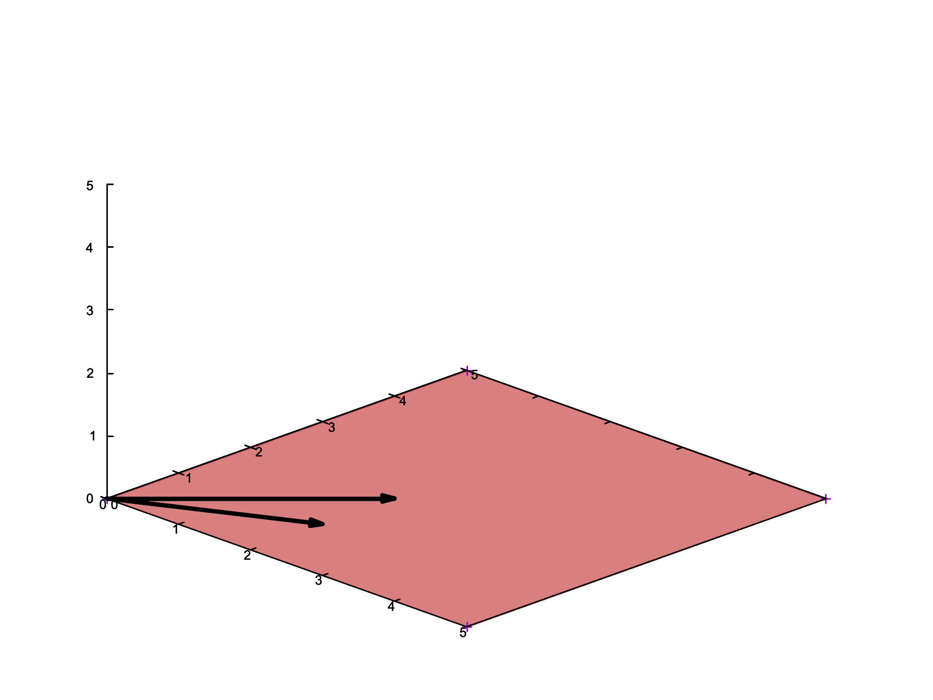
The basics of file systems
RAID6 and Reed-Solomon codes
A message that has $n$ bytes may be regarded as a vector in the $n$-dimensional vector space over the field $k=GF(256)$.

Slide 32
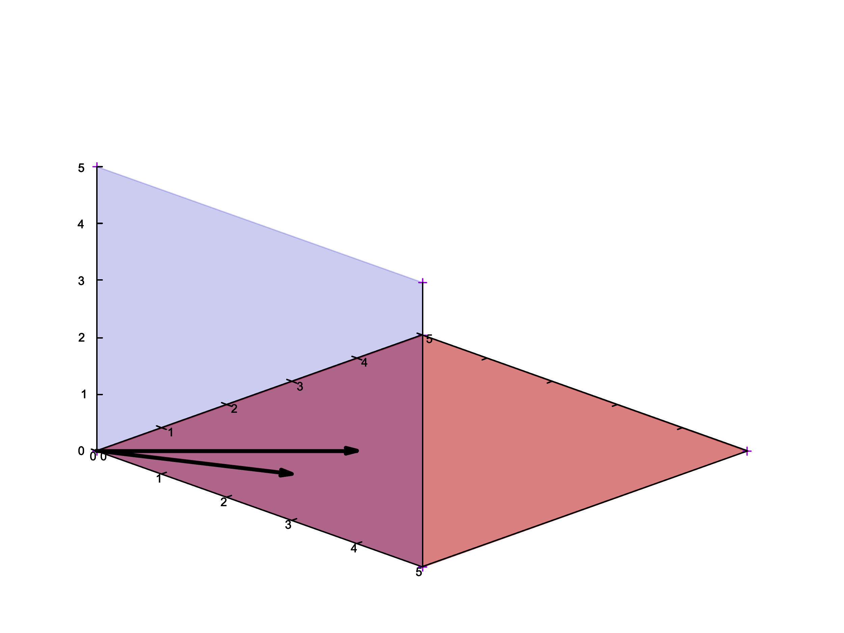
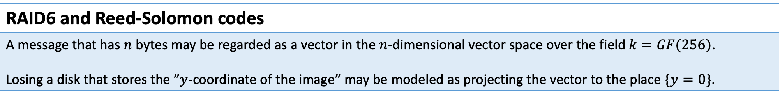
The basics of file systems
RAID6 and Reed-Solomon codes
A message that has $n$ bytes may be regarded as a vector in the $n$-dimensional vector space over the field $k=GF(256)$. Losing a disk that stores the ”$y$-coordinate of the image” may be modeled as projecting the vector to the place $\{y=0\}$.

Slide 33

The basics of file systems
RAID6 and Reed-Solomon codes
A message that has $n$ bytes may be regarded as a vector in the $n$-dimensional vector space over the field $k=GF(256)$. Losing a disk that stores the ”$y$-coordinate of the image” may be modeled as projecting the vector to the place $\{y=0\}$.

Slide 34
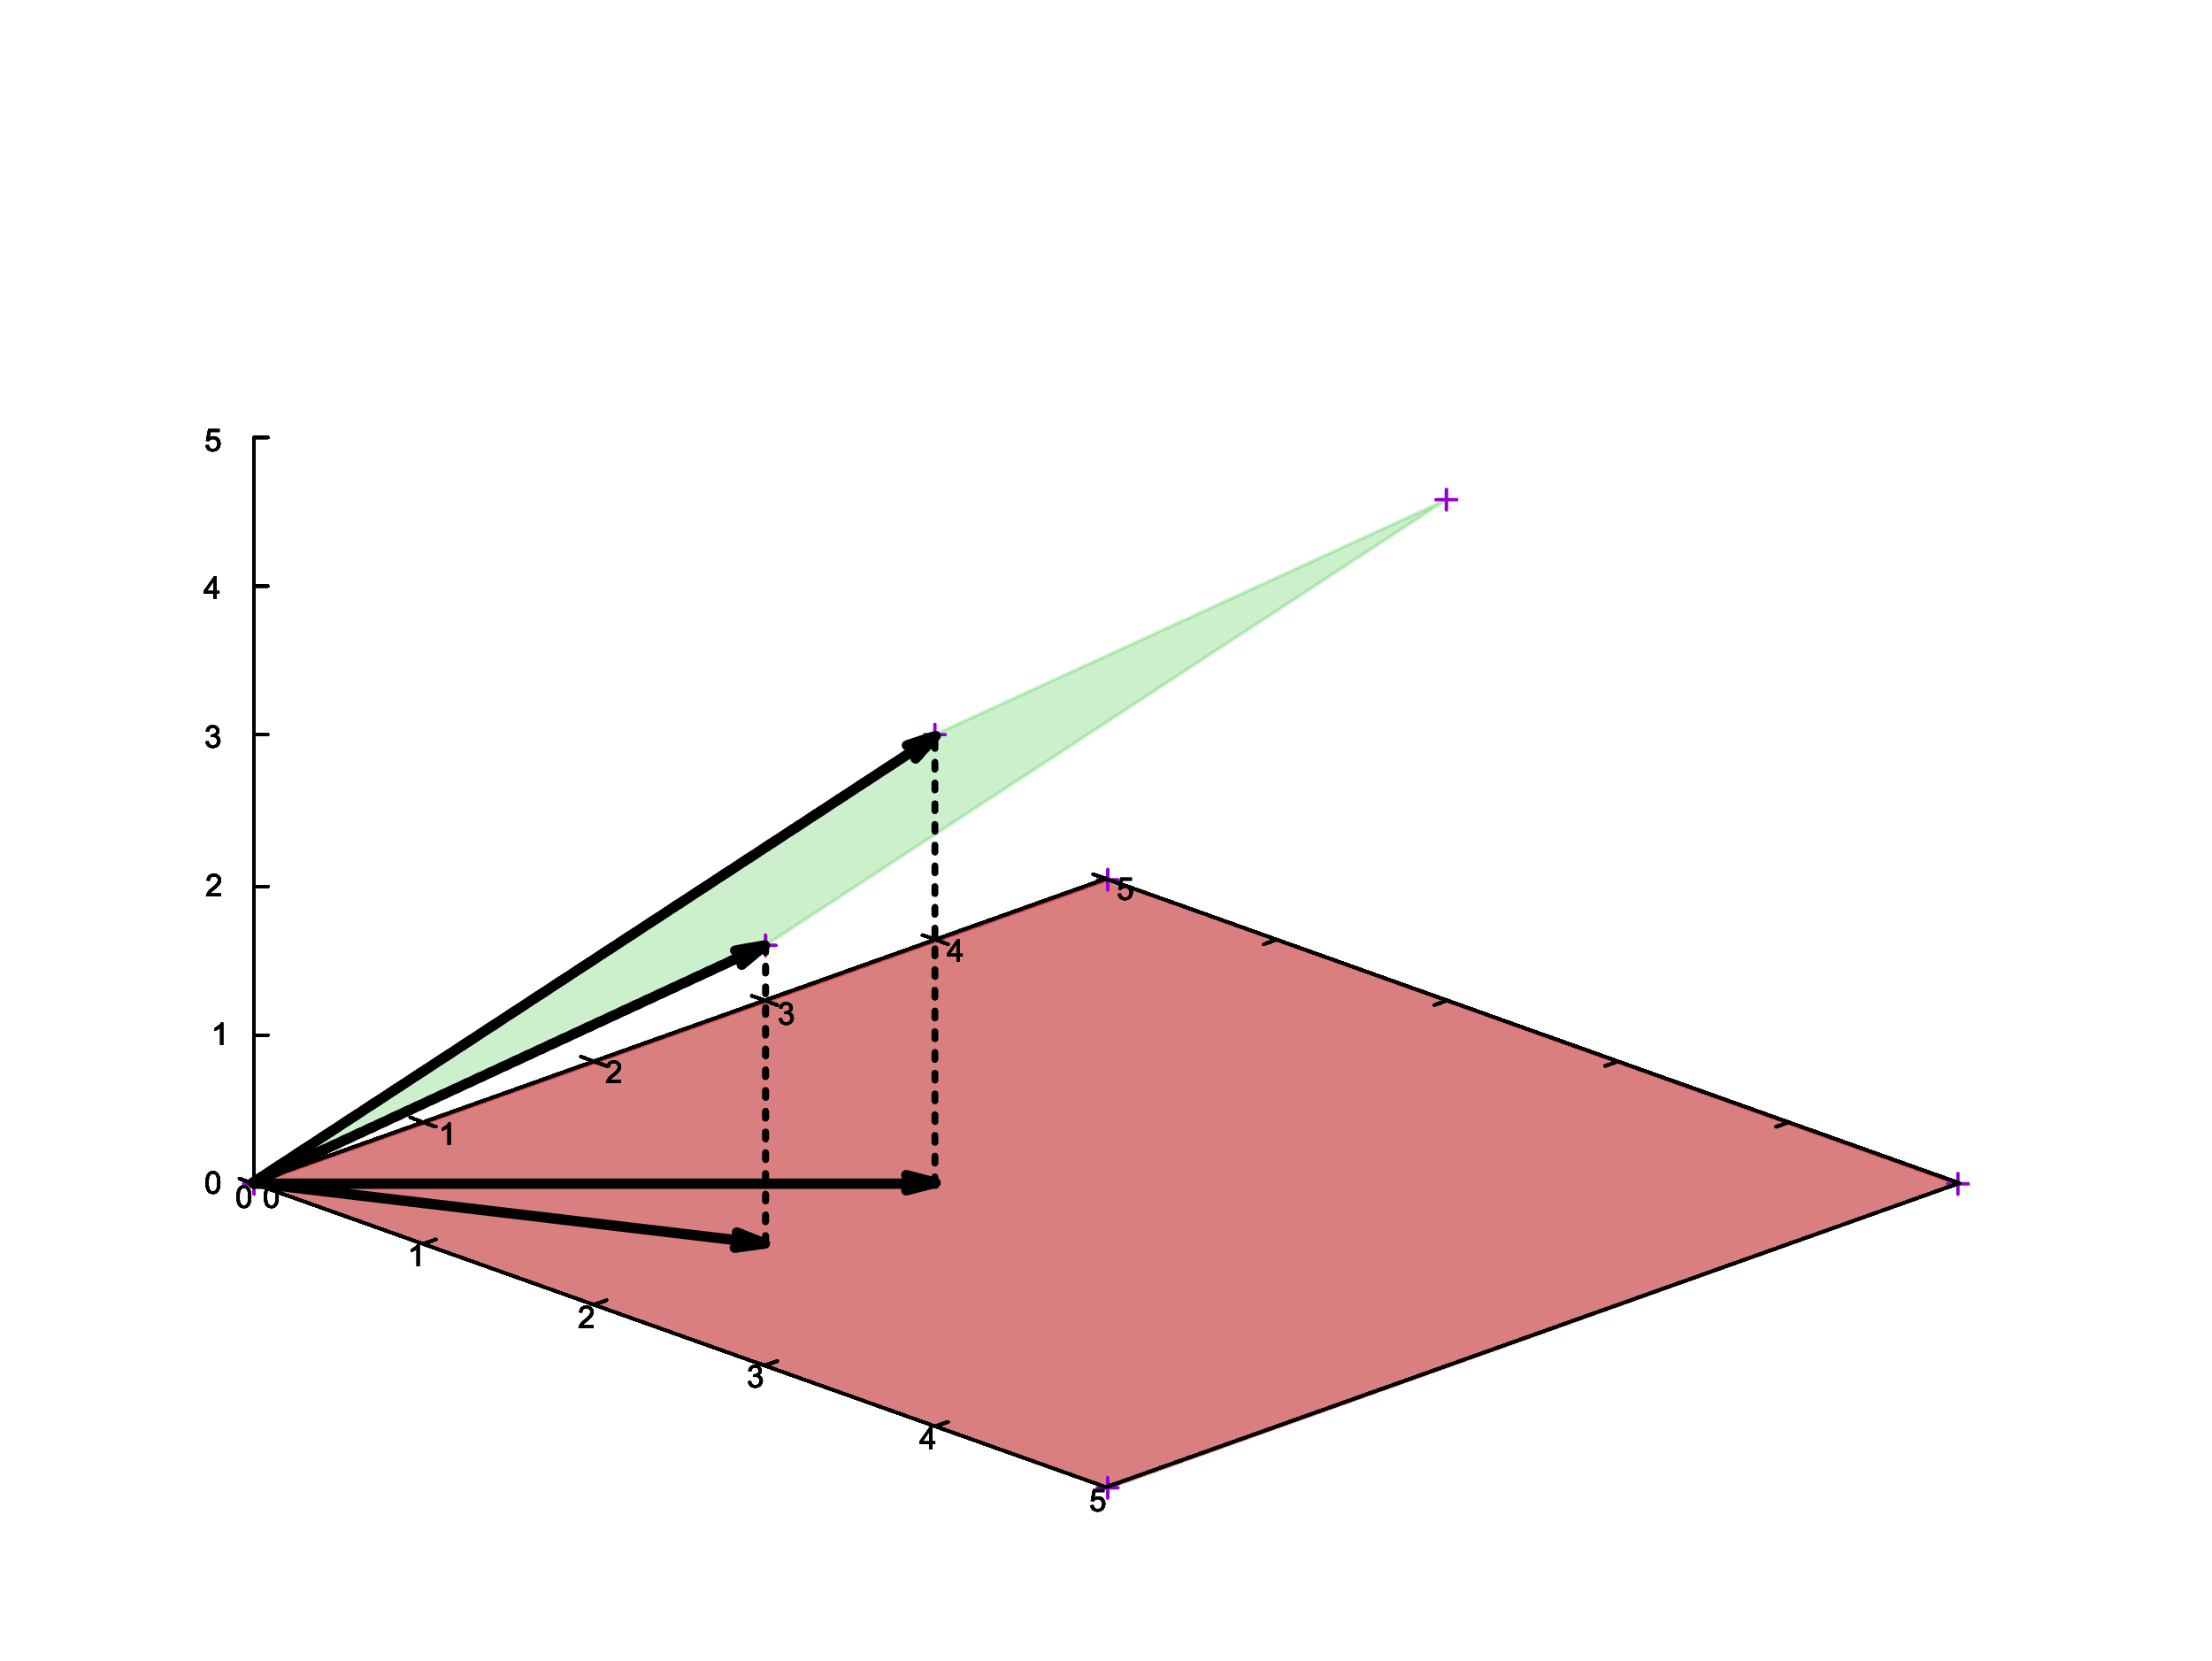
The basics of file systems
RAID6 and Reed-Solomon codes
A message that has $n$ bytes may be regarded as a vector in the $n$-dimensional vector space over the field $k=GF(256)$.

Slide 35
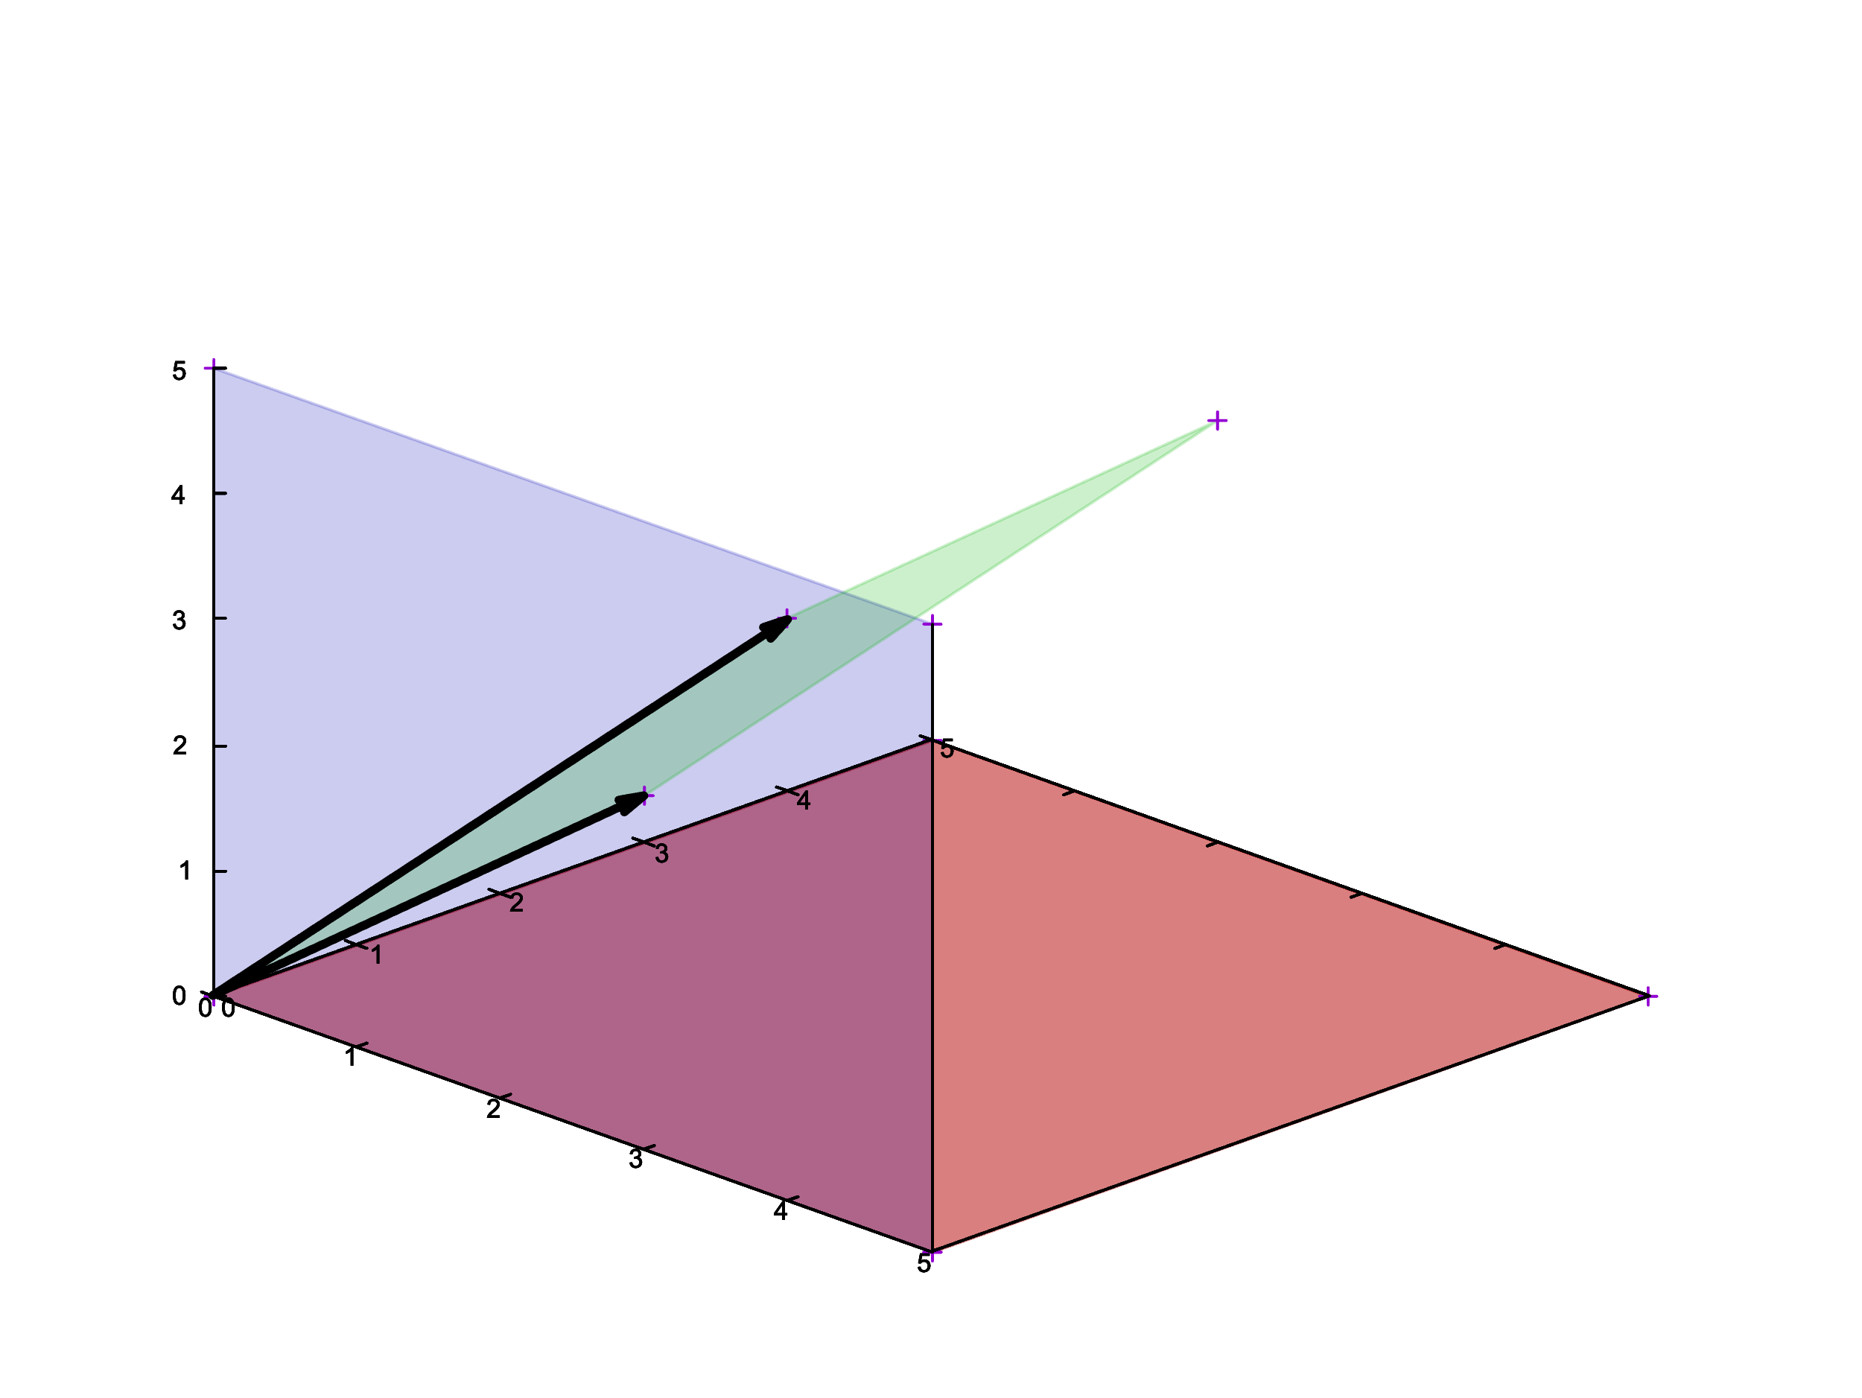
The basics of file systems
RAID6 and Reed-Solomon codes
A message that has $n$ bytes may be regarded as a vector in the $n$-dimensional vector space over the field $k=GF(256)$.

Slide 36
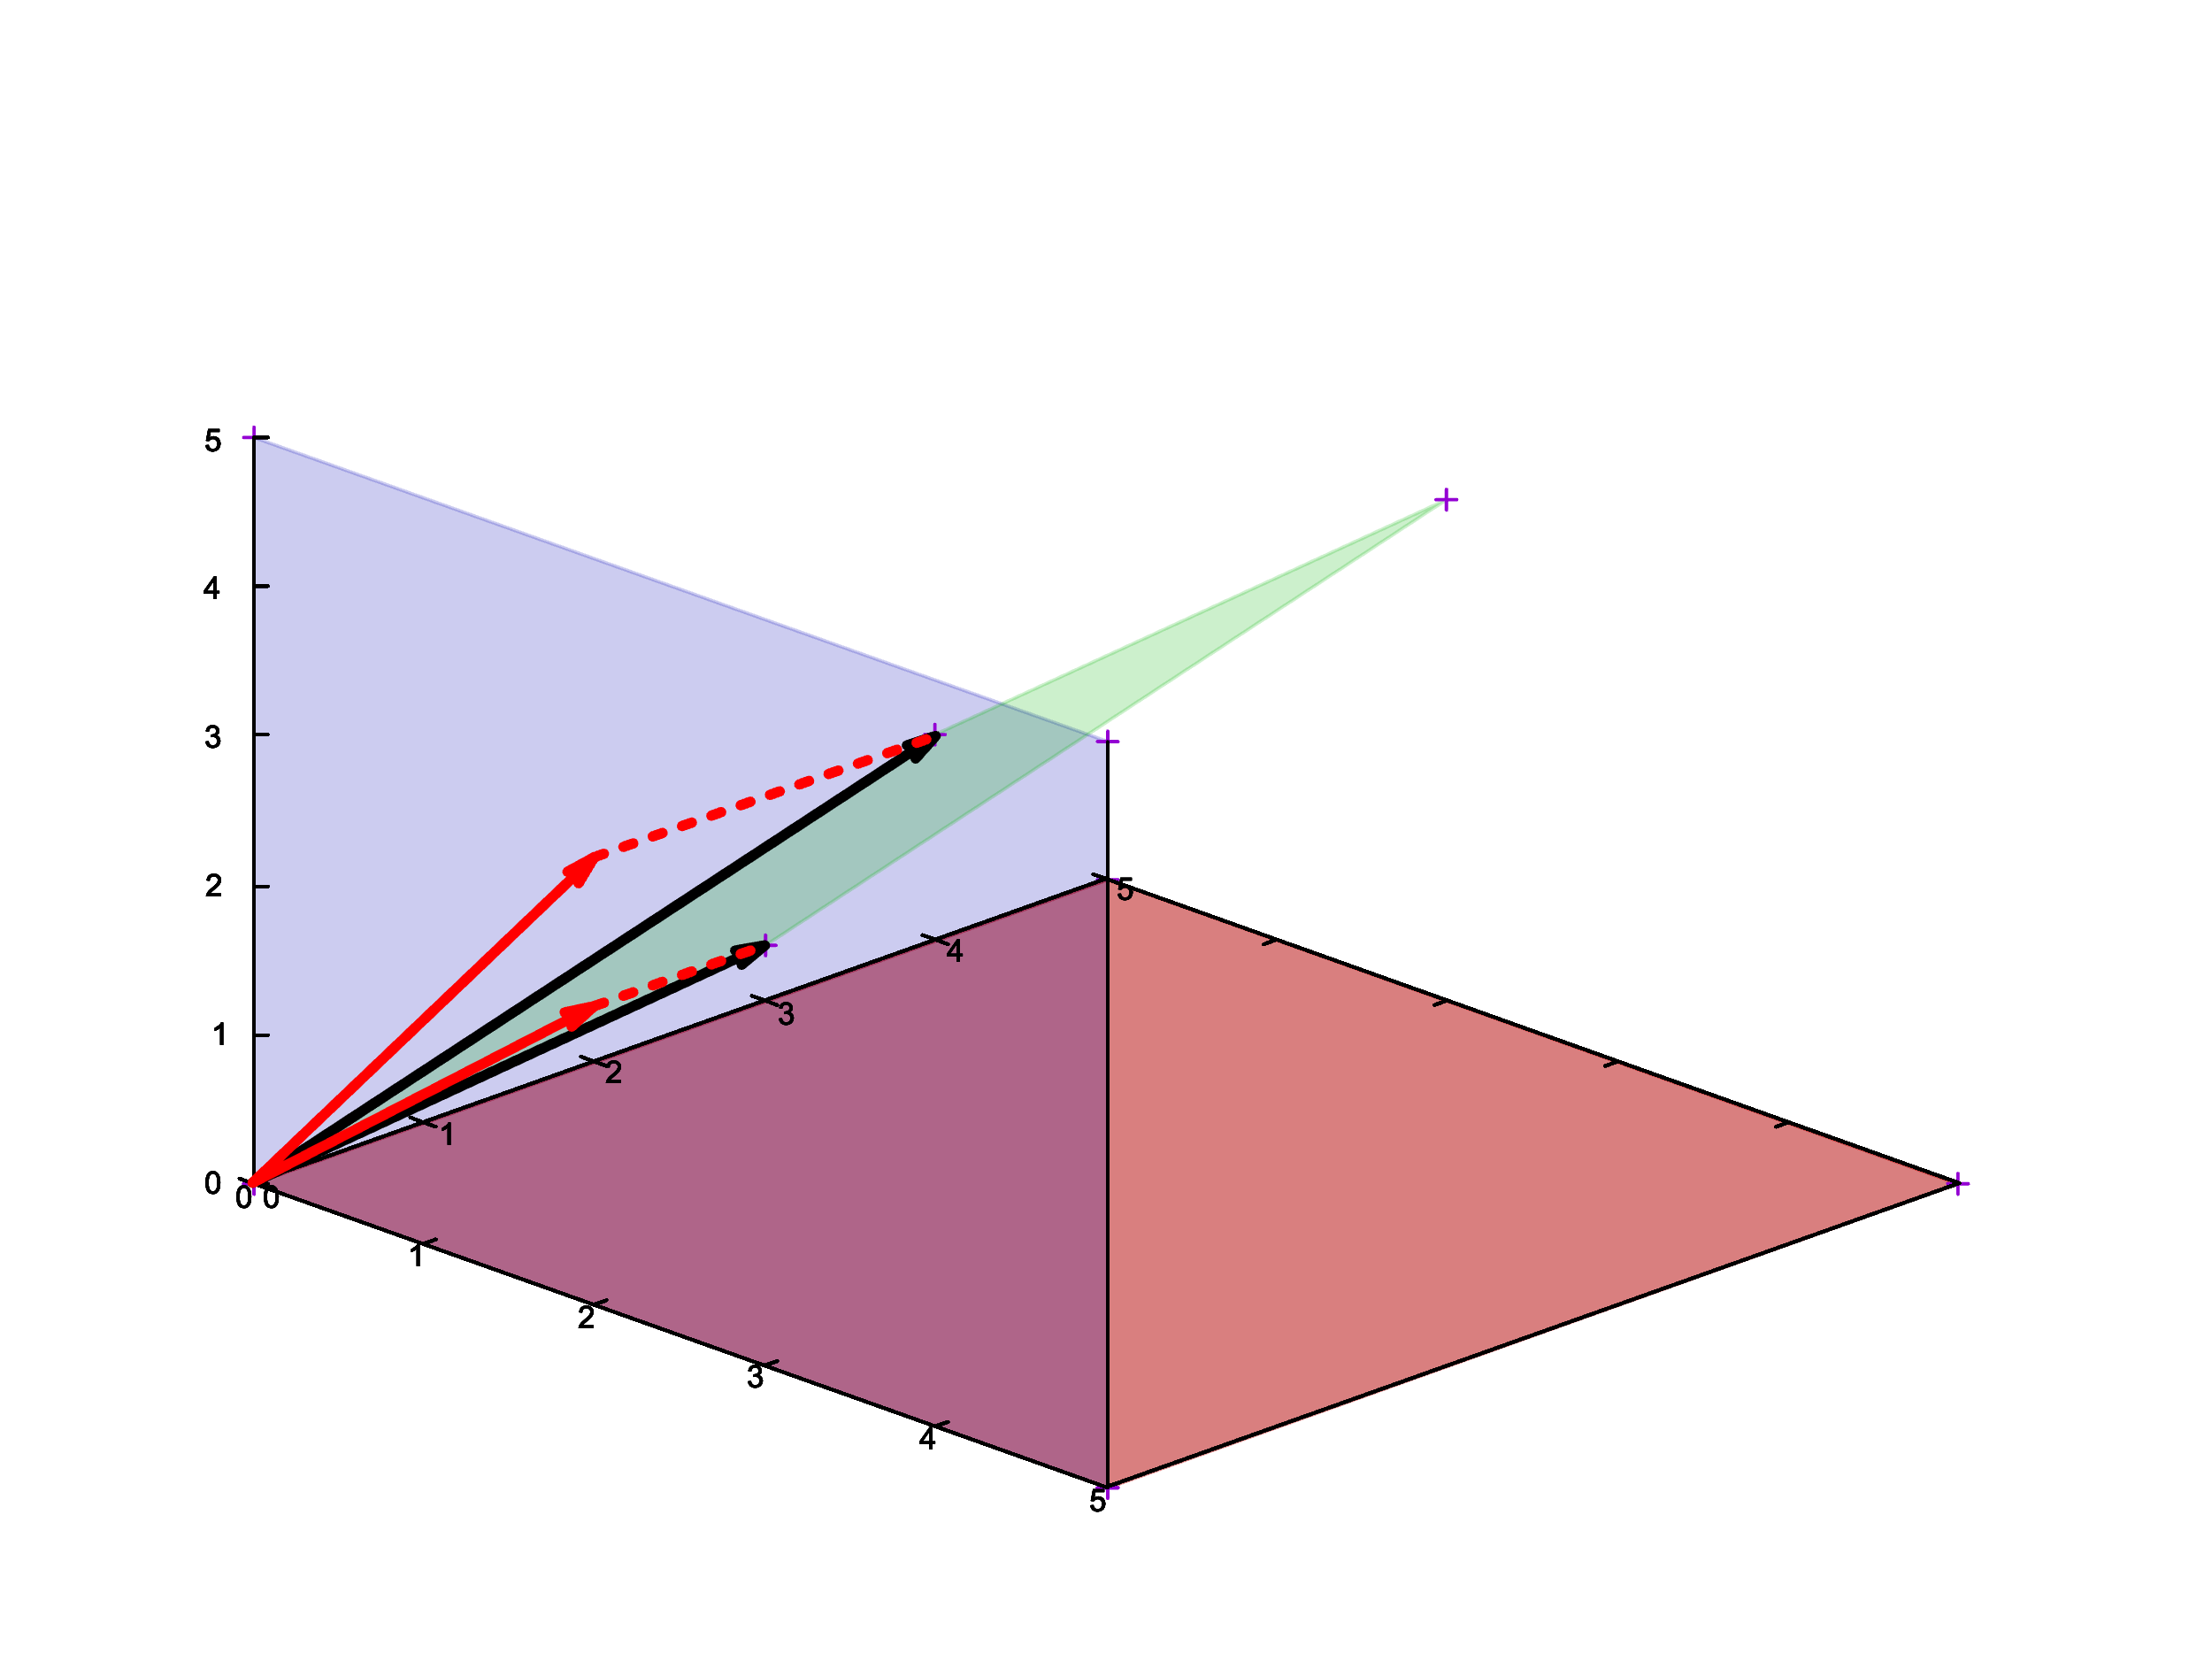
The basics of file systems
RAID6 and Reed-Solomon codes
A message that has $n$ bytes may be regarded as a vector in the $n$-dimensional vector space over the field $k=GF(256)$.

Slide 37
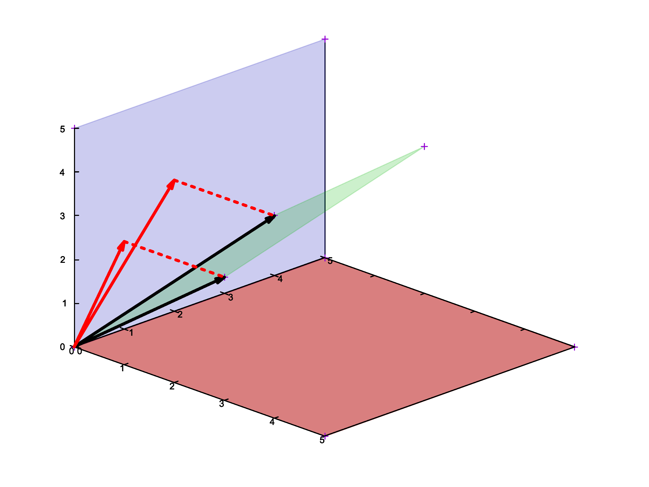
The basics of file systems
RAID6 and Reed-Solomon codes
A message that has $n$ bytes may be regarded as a vector in the $n$-dimensional vector space over the field $k=GF(256)$.

Slide 38
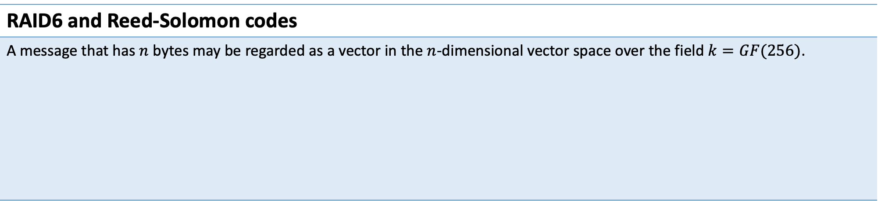
The basics of file systems
RAID6 and Reed-Solomon codes
A message that has $n$ bytes may be regarded as a vector in the $n$-dimensional vector space over the field $k=GF(256)$.

Slide 39
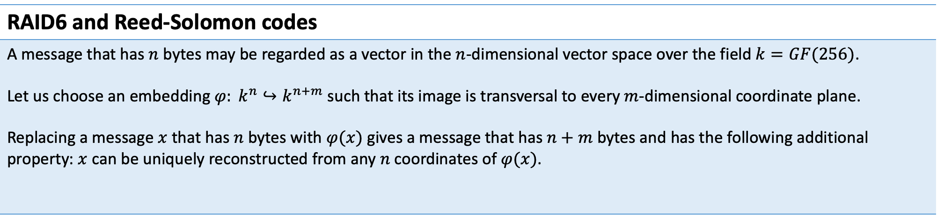
The basics of file systems
RAID6 and Reed-Solomon codes
A message that has $n$ bytes may be regarded as a vector in the $n$-dimensional vector space over the field $k=GF(256)$. Let us choose an embedding $φ: k^{n}↪k^{n+m}$ such that its image is transversal to every $m$-dimensional coordinate plane. Replacing a message $x$ that has $n$ bytes with $φ(x)$ gives a message that has $n+m$ bytes and has the following additional property: $x$ can be uniquely reconstructed from any $n$ coordinates of $φ(x)$.

Slide 40
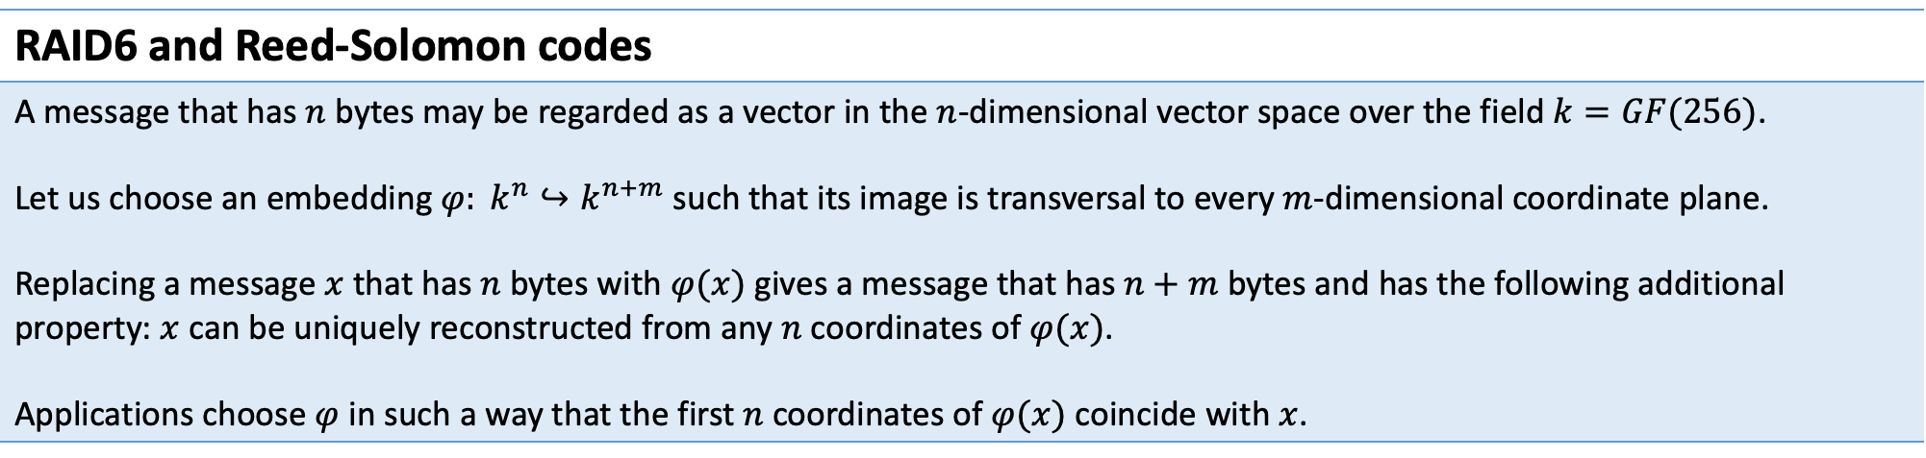
The basics of file systems
RAID6 and Reed-Solomon codes
A message that has $n$ bytes may be regarded as a vector in the $n$-dimensional vector space over the field $k=GF(256)$. Let us choose an embedding $φ: k^{n}↪k^{n+m}$ such that its image is transversal to every $m$-dimensional coordinate plane. Replacing a message $x$ that has $n$ bytes with $φ(x)$ gives a message that has $n+m$ bytes and has the following additional property: $x$ can be uniquely reconstructed from any $n$ coordinates of $φ(x)$. Applications choose $φ$ in such a way that the first $n$ coordinates of $φ(x)$ coincide with $x$.

Slide 41
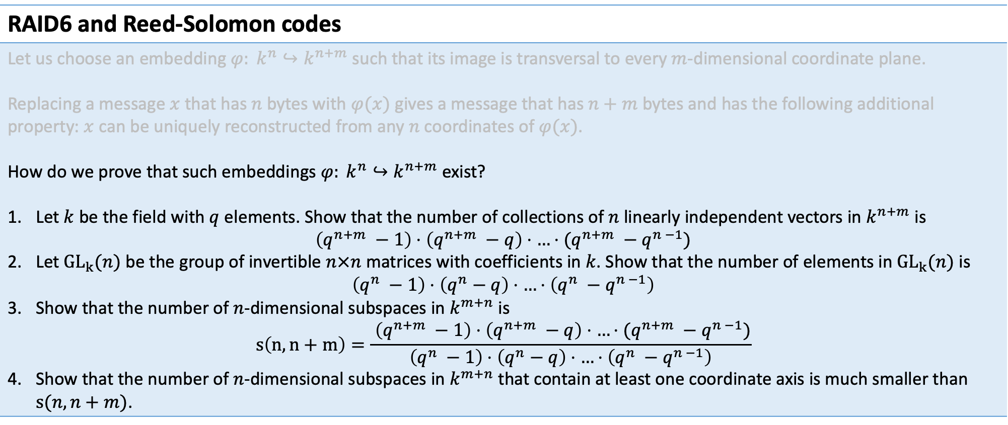
The basics of file systems
RAID6 and Reed-Solomon codes
Let us choose an embedding $φ: k^{n}↪k^{n+m}$ such that its image is transversal to every $m$-dimensional coordinate plane. Replacing a message $x$ that has $n$ bytes with $φ(x)$ gives a message that has $n+m$ bytes and has the following additional property: $x$ can be uniquely reconstructed from any $n$ coordinates of $φ(x)$. How do we prove that such embeddings $φ: k^{n}↪k^{n+m}$ exist? Let $k$ be the field with $q$ elements. Show that the number of collections of $n$ linearly independent vectors in $k^{n+m}$ is $\left(q^{n+m} −1\right)⋅\left(q^{n+m} −q\right)⋅…⋅(q^{n+m} −q^{n −1})$ Let ${GL}_{k}{(n)}$ be the group of invertible $n×n$ matrices with coefficients in $k$. Show that the number of elements in ${GL}_{k}{(n)}$ is $\left(q^{n} −1\right)⋅\left(q^{n}−q\right)⋅…⋅\left(q^{n} −q^{n −1}\right)$ Show that the number of $n$-dimensional subspaces in $k^{m+n}$ is $s\left(n, n+m\right)=\frac{ \left(q^{n+m} −1\right)⋅\left(q^{n+m} −q\right)⋅…⋅(q^{n+m} −q^{n −1})}{\left(q^{n} −1\right)⋅\left(q^{n}−q\right)⋅…⋅\left(q^{n} −q^{n −1}\right)}$ Show that the number of $n$-dimensional subspaces in $k^{m+n}$ that contain at least one coordinate axis is much smaller than $s{(n, n+m)}$.

Slide 42
The basics of file systems
Problems of RAID6
Let us use Reed-Solomon coding with parameters (n, n + m). This means that we store m redundant pages for every n pages of user data.

Slide 43
The basics of file systems
Problems of RAID6
Let us use Reed-Solomon coding with parameters (n, n + m). This means that we store m redundant pages for every n pages of user data. Tail latency: In order to read n consecutive data pages, we need to make requests to n disks or n cluster nodes.

Slide 44
The basics of file systems
Problems of RAID6
Let us use Reed-Solomon coding with parameters (n, n + m). This means that we store m redundant pages for every n pages of user data. Tail latency: In order to read n consecutive data pages, we need to make requests to n disks or n cluster nodes. | We can use longer pages. This way a bigger share of requests may be satisfied by reading only one disk. We can read redundant disks as well and treat slow disks as if they failed.

Slide 45
The basics of file systems
Problems of RAID6
Let us use Reed-Solomon coding with parameters (n, n + m). This means that we store m redundant pages for every n pages of user data. Tail latency: In order to read n consecutive data pages, we need to make requests to n disks or n cluster nodes. A single write to an array requires writes to n + m disks.

Slide 46
The basics of file systems
Problems of RAID6
Let us use Reed-Solomon coding with parameters (n, n + m). This means that we store m redundant pages for every n pages of user data. Tail latency: In order to read n consecutive data pages, we need to make requests to n disks or n cluster nodes. A single write to an array requires writes to n + m disks. | We can use Reed-Solomon with parameters (n, n + m + k) and wait only for n + m disks to confirm writes. Remaining disks may be assumed failed.

Slide 47
The basics of file systems
Problems of RAID6
Let us use Reed-Solomon coding with parameters (n, n + m). This means that we store m redundant pages for every n pages of user data. Tail latency: In order to read n consecutive data pages, we need to make requests to n disks or n cluster nodes. A single write to an array requires writes to n + m disks. Read amplification during a rebuild: In order to rebuild 1 page, we must read n pages.

Slide 48
The basics of file systems
Problems of RAID6
Let us use Reed-Solomon coding with parameters (n, n + m). This means that we store m redundant pages for every n pages of user data. Tail latency: In order to read n consecutive data pages, we need to make requests to n disks or n cluster nodes. A single write to an array requires writes to n + m disks. Read amplification during a rebuild: In order to rebuild 1 page, we must read n pages. | There is a class of erasure codes that minimises the replication traffic: Minimum Storage Regenerating codes. See: Clay Codes: Moulding MDS Codes to Yield an MSR Code https://www.usenix.org/system/files/conference/fast18/fast18-vajha.pdf

Slide 49
The basics of file systems
The model of errors in RAID6
Reminder: RAID6, just like RAID5 assumes that a failed disk is reported as missing. RAID6 provides no protection against the bit rot. It does not detect situations when a failed disk reads garbage and reports success. If we use RAID6 we still need data integrity checks.

