Slide 1


The basics of file systems

Slide 2
The basics of file systems
Today we are going to introduce NFS
NFS (Network File System) is a mechanism to make a local FS accessible over the network.

Slide 3
The basics of file systems
Design requirements
Accessing a FS over the network must work the same way as accessing a local FS, even from the point of view of the OS kernel.

Slide 4
The basics of file systems
Design requirements
Accessing a FS over the network must work the same way as accessing a local FS, even from the point of view of the OS kernel.
User space
app | app | app | ... | …
Pagecache
VFS
Sun UFS | ext2 | ISO 9660 | ...
Block IO layer (requests submission & scheduling)
...
Kernel Space

Slide 5
The basics of file systems
Design requirements
Accessing a FS over the network must work the same way as accessing a local FS, even from the point of view of the OS kernel. NFS must be accessed with the same VFS callbacks as a local file system.
User space
app | app | app | ... | …
Pagecache
VFS
Sun UFS | ext2 | ISO 9660 | NFS | ...
Block IO layer (requests submission & scheduling)
...
Kernel Space

Slide 6
The basics of file systems
POSIX API and VFS callbacks
POSIX API | VFS
Calls that take a file path handle the whole path: open(“./dev/pstorage-fes/main.c”, O_RDONLY)

Slide 7
The basics of file systems
POSIX API and VFS callbacks
POSIX API | VFS
Calls that take a file path handle the whole path: open(“./dev/pstorage-fes/main.c”, O_RDONLY) | The kernel walks the path one component at a time: t0 = openat(AT_FDCWD, “.”), t1 = openat(t0, “dev”), t2 = openat(t1, “pstorage-fes”), t3 = openat(t2, “main.c”). Why do we need this?

Slide 8
The basics of file systems
POSIX API and VFS callbacks
POSIX API | VFS
Calls that take a file path handle the whole path: open(“./dev/pstorage-fes/main.c”, O_RDONLY) | The kernel walks the path one component at a time: t0 = openat(AT_FDCWD, “.”), t1 = openat(t0, “dev”), t2 = openat(t1, “pstorage-fes”), t3 = openat(t2, “main.c”). Why do we need this? At every step, the kernel needs to verify the type of the next component and handle the following cases: a subdirectory, a symbolic link, a mount point.

Slide 9
The basics of file systems
POSIX API and VFS callbacks
POSIX API | VFS
Calls that take a file path handle the whole path: open(“./dev/pstorage-fes/main.c”, O_RDONLY) | The kernel walks the path one component at a time: t0 = openat(AT_FDCWD, “.”), t1 = openat(t0, “dev”), t2 = openat(t1, “pstorage-fes”), t3 = openat(t2, “main.c”). Why do we need this? At every step, the kernel needs to verify the type of the next component and handle the following cases: a subdirectory, a symbolic link, a mount point.
Quiz: what directory does a call open(“./dev/pstorage-fes/..”) open in the following two cases: both “dev” and “pstorage-fes” are directories, “dev” is a directory and “pstorage-fes” is a symbolic link?

Slide 10
The basics of file systems
POSIX API and VFS callbacks
Client | Server
/ |- /home | | | |- /artem | | | |- hello.txt | |- /mnt <--- the mount point for /exports | / |- /home | | | |- /artem | | | |- hello.txt | |- /exports <--- mounted to /mnt on the client | |- /home | |- /artem | |- hello.txt |- symlink <-- points to “/home/artem/hello.txt”
Which of files named “hello.txt” does the following command read when run on the client machine: # cat /mnt/home/artem/symlink

Slide 11
The basics of file systems
The protocol of NFSv2
Walking a path: lookup(dirfh, name) -> (fh, attr) getattr(dirfh) -> attr readdir(dirfh, cookie, count) -> [direntry] | Arguments named fh (File Handle) may be regarded as file descriptors. Attr is similar to struct stat. It describes properties of a file or a directory like the type, the size, the access permissions, etc.

Slide 12
The basics of file systems
The protocol of NFSv2
Walking a path: lookup(dirfh, name) -> (fh, attr) getattr(dirfh) -> attr readdir(dirfh, cookie, count) -> [direntry] Working with directories and symlinks: mkdir(dirfh, name, attr) -> (fh, newattr) rmdir(dirfh, name) -> status symlink(dirfh, name, string) -> status readlink(fh) -> string link(dirfh, name, tofh, toname) -> status rename(dirfh, name, tofh, toname) -> status

Slide 13
The basics of file systems
The protocol of NFSv2
Walking a path: lookup(dirfh, name) -> (fh, attr) getattr(dirfh) -> attr readdir(dirfh, cookie, count) -> [direntry] Working with directories and symlinks: mkdir(dirfh, name, attr) -> (fh, newattr) rmdir(dirfh, name) -> status symlink(dirfh, name, string) -> status readlink(fh) -> string link(dirfh, name, tofh, toname) -> status rename(dirfh, name, tofh, toname) -> status Creating and removing files: create(dirfh, name, attr, flags) -> (newfh, attr) remove(dirfh, name) -> status

Slide 14
The basics of file systems
The protocol of NFSv2
Walking a path: lookup(dirfh, name) -> (fh, attr) getattr(dirfh) -> attr readdir(dirfh, cookie, count) -> [direntry] Working with directories and symlinks: mkdir(dirfh, name, attr) -> (fh, newattr) rmdir(dirfh, name) -> status symlink(dirfh, name, string) -> status readlink(fh) -> string link(dirfh, name, tofh, toname) -> status rename(dirfh, name, tofh, toname) -> status Creating and removing files: create(dirfh, name, attr, flags) -> (newfh, attr) remove(dirfh, name) -> status Reading and writing files: read(fh, offset, count) -> (attr, data) write(fh, offset, count, data) -> attr

Slide 15
The basics of file systems
Design requirements
Accessing a FS over the network must work the same way as accessing a local FS, even from the point of view of the OS kernel. NFS must be accessed with the same VFS callbacks as a local file system.
User space
app | app | app | ... | …
Pagecache
VFS
Sun UFS | ext2 | ISO 9660 | NFS | ...
Block IO layer (requests submission & scheduling)
...
Kernel Space

Slide 16
The basics of file systems
Design requirements and networking-related issues
Accessing a FS over the network must work the same way as accessing a local FS, even from the point of view of the OS kernel. NFS must be accessed with the same VFS callbacks as a local file system.
An NFS server may reboot at any moment, but clients must be able to proceed with file handles that they already have.
t0 = openat(AT_FDCWD, “.”),
t1 = openat(t0, “dev”),
t2 = openat(t1, “pstorage-fes”),
t3 = openat(t2, “main.c”).
The server restarted here, but t2 must remain valid.

Slide 17
The basics of file systems
Design requirements and networking-related issues
Accessing a FS over the network must work the same way as accessing a local FS, even from the point of view of the OS kernel. NFS must be accessed with the same VFS callbacks as a local file system.
An NFS server may reboot at any moment, but clients must be able to proceed with file handles that they already have. File handles must persist across reboots of NFS servers. Many operations like create() may be confirmed by a server only after a syncfs().
t0 = openat(AT_FDCWD, “.”),
t1 = openat(t0, “dev”),
t2 = openat(t1, “pstorage-fes”),
t3 = openat(t2, “main.c”).
The server restarted here, but t2 must remain valid.

Slide 18
The basics of file systems
Stateless server
File handles must persist across reboots of a NFS server. One way to have the state persist across reboots is to have no state at all.

Slide 19
The basics of file systems
Stateless server
File handles must persist across reboots of a NFS server. One way to have the state persist across reboots is to have no state at all. In the Unix File System files can be accessed by their inode number. One can use inode numbers as file handles*.
* How do we deal with deleted files? In this scenario an inode may be reused for a different file.

Slide 20
The basics of file systems
Stateless server
File handles must persist across reboots of a NFS server. One way to have the state persist across reboots is to have no state at all. In the Unix File System files can be accessed by their inode number. One can use inode numbers as file handles.
Problem: inodes are visible to the kernel only. There are no APIs in POSIX to open a file by its inode number. Is it possible to implement a NFS server in the user space?

Slide 21
The basics of file systems
Stateless server
File handles must persist across reboots of a NFS server. One way to have the state persist across reboots is to have no state at all. In the Unix File System files can be accessed by their inode number. One can use inode numbers as file handles.
Problem: inodes are visible to the kernel only. There are no APIs in POSIX to open a file by its inode number. Is it possible to implement a NFS server in the user space? man 2 name_to_handle_at man 2 open_by_handle_at

Slide 22
The basics of file systems
Stateless server
Many requests like create() may be confirmed only after a syncfs(). It is ok-ish for infrequent requests. However, write()s need a fsync() which makes all of them synchronous. That is too slow.

Slide 23
The basics of file systems
Stateless server
Many requests like create() may be confirmed only after a syncfs(). It is ok-ish for infrequent requests. However, write()s need a fsync() which makes all of them synchronous. That is too slow. NFSv3 proposed a way to implement asynchronous writes: Upon startup, a NFS server generates a random number. Responses to write()s communicate this number to the client. When the client wants to persist the data, it calls commit() and passes a number received from write()s. By looking at this number the NFS server can understand whether it was restarted between write()s and commit(), or not. If it was, the client must resend all write()s.

Slide 24
The basics of file systems
Stateless server and issues with POSIX FS behaviours
There may be files without a name. They exist as long as they have an open file descriptor.

Slide 25
The basics of file systems
Stateless server and issues with POSIX FS behaviours
There may be files without a name. They exist as long as they have an open file descriptor. Problem: if a NFS server exits, its open file descriptors are closed, and all unnamed files are deleted automatically. Unnamed files cannot persist across NFS server restarts.

Slide 26
The basics of file systems
Stateless server and issues with POSIX FS behaviours
There may be files without a name. They exist as long as they have an open file descriptor. Problem: if a NFS server exits, its open file descriptors are closed, and all unnamed files are deleted automatically. Unnamed files cannot persist across NFS server restarts.
This issue is solved by NFS clients (silly rename): when an open file is unlink()ed, a NFS client renames that file to “.nfs_random_suffix”, the client removes those files when they no longer have open file descriptors. If a client crashes or abruptly disconnects from the network, these files remain as garbage.

Slide 27
The basics of file systems
Issues related to non-idempotency of requests
Client | Network | Server
req
rmdir(“/path/to/dir”) ---->
time

Slide 28
The basics of file systems
Issues related to non-idempotency of requests
Client | Network | Server
req
rmdir(“/path/to/dir”) ---->
rmdir(“/prefix/path/to/dir”)
<----
resp(ok)
time

Slide 29
The basics of file systems
Issues related to non-idempotency of requests
Client | Network | Server
req
rmdir(“/path/to/dir”) ---->
rmdir(“/prefix/path/to/dir”)
<----
resp(ok)
connection lost
time

Slide 30
The basics of file systems
Issues related to non-idempotency of requests
Client | Network | Server
req
rmdir(“/path/to/dir”) ---->
rmdir(“/prefix/path/to/dir”)
<----
resp(ok)
connection lost
timeout
time

Slide 31
The basics of file systems
Issues related to non-idempotency of requests
Client | Network | Server
req
rmdir(“/path/to/dir”) ---->
rmdir(“/prefix/path/to/dir”)
<----
resp(ok)
connection lost
timeout
retry rmdir(“/path/to/dir”) ---->
rmdir(“/prefix/path/to/dir”)
time

Slide 32
The basics of file systems
Issues related to non-idempotency of requests
Client | Network | Server
req
rmdir(“/path/to/dir”) ---->
rmdir(“/prefix/path/to/dir”)
<----
resp(ok)
connection lost
timeout
retry rmdir(“/path/to/dir”) ---->
rmdir(“/prefix/path/to/dir”)
<----
resp(not found)
time

Slide 33
The basics of file systems
More networking-related issues
How much time does a lookup() take locally and in NFS?

Slide 34
The basics of file systems
More networking-related issues
How much time does a lookup() take locally and in NFS? | lookup() in NFS cannot take less time than 1 RTT between the client and the server.

Slide 35
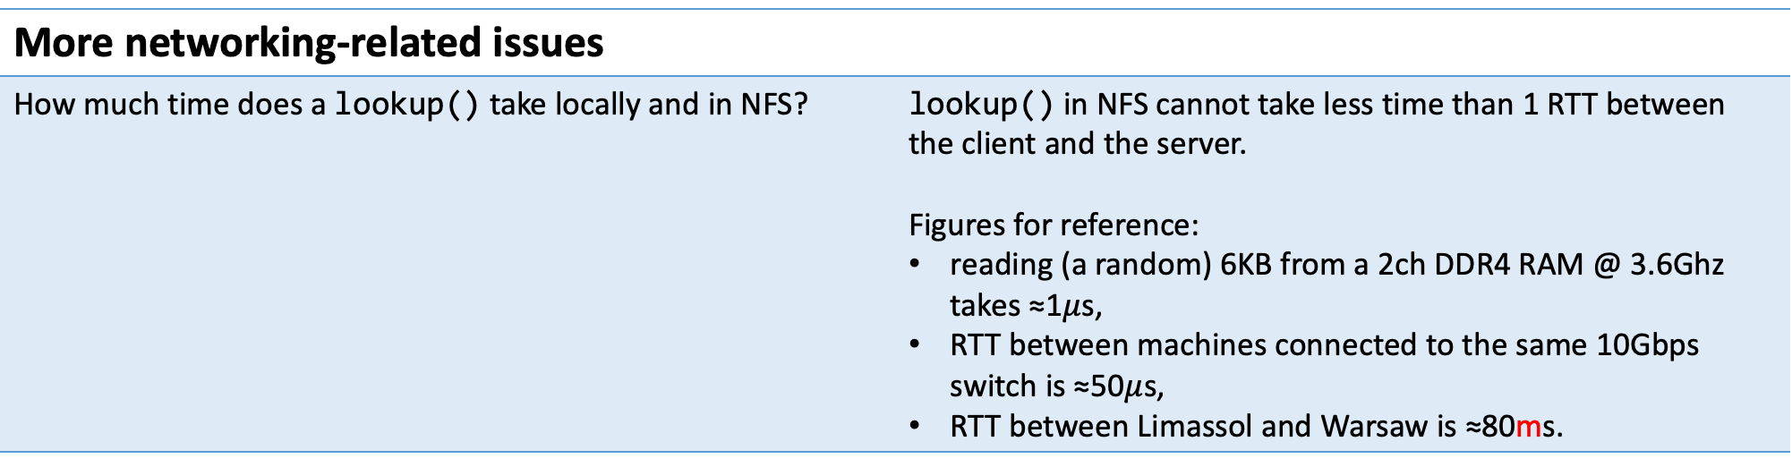
The basics of file systems
More networking-related issues
How much time does a lookup() take locally and in NFS? | lookup() in NFS cannot take less time than 1 RTT between the client and the server. Figures for reference: reading (a random) 6KB from a 2ch DDR4 RAM @ 3.6Ghz takes ≈1$μ$s, RTT between machines connected to the same 10Gbps switch is ≈50$μ$s, RTT between Limassol and Warsaw is ≈80ms.

Slide 36
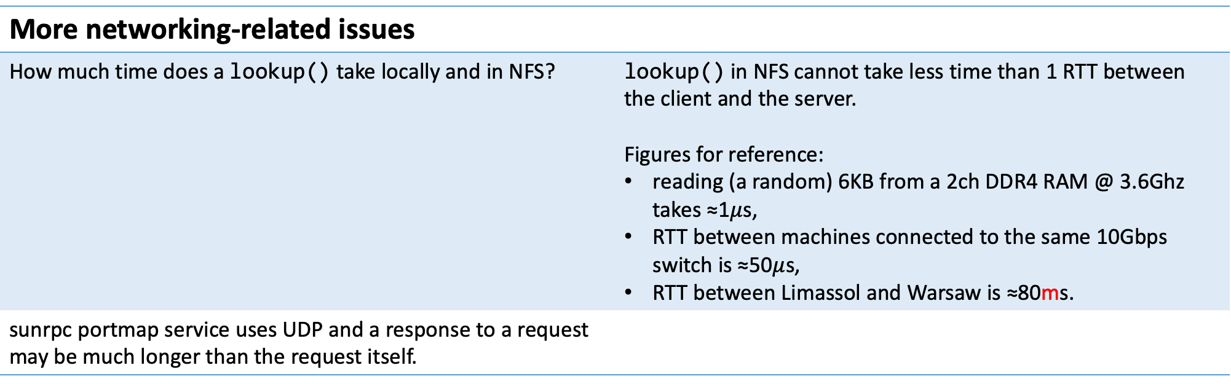
The basics of file systems
More networking-related issues
How much time does a lookup() take locally and in NFS? | lookup() in NFS cannot take less time than 1 RTT between the client and the server. Figures for reference: reading (a random) 6KB from a 2ch DDR4 RAM @ 3.6Ghz takes ≈1$μ$s, RTT between machines connected to the same 10Gbps switch is ≈50$μ$s, RTT between Limassol and Warsaw is ≈80ms.
sunrpc portmap service uses UDP and a response to a request may be much longer than the request itself.

Slide 37
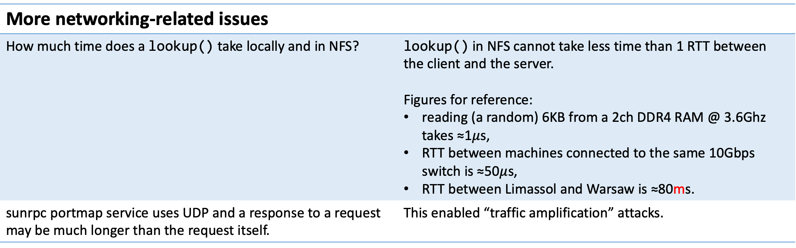
The basics of file systems
More networking-related issues
How much time does a lookup() take locally and in NFS? | lookup() in NFS cannot take less time than 1 RTT between the client and the server. Figures for reference: reading (a random) 6KB from a 2ch DDR4 RAM @ 3.6Ghz takes ≈1$μ$s, RTT between machines connected to the same 10Gbps switch is ≈50$μ$s, RTT between Limassol and Warsaw is ≈80ms.
sunrpc portmap service uses UDP and a response to a request may be much longer than the request itself. | This enabled “traffic amplification” attacks.

Slide 38
The basics of file systems
More networking-related issues: NFS over UDP
Reads from NFS files transfer data in datagrams that are >=4K long which forces UDP to fragment them. The client must reassemble those fragments.

Slide 39
The basics of file systems
More networking-related issues: NFS over UDP
Reads from NFS files transfer data in datagrams that are >=4K long which forces UDP to fragment them. The client must reassemble those fragments. UDP reassembly uses a 16-bit field IP ID in packets. Packets that have the same IP ID are candidates for the reassembly.

Slide 40
The basics of file systems
More networking-related issues: NFS over UDP
Reads from NFS files transfer data in datagrams that are >=4K long which forces UDP to fragment them. The client must reassemble those fragments. UDP reassembly uses a 16-bit field IP ID in packets. Packets that have the same IP ID are candidates for the reassembly. In a fast network, a 16-bit counter may wrap around very quickly. For example, in a 1Gbps network it takes 1.5 seconds to send 64K packets, each 1.5Kbytes long. The default UDP reassembly timeout is 30 seconds so it is possible to have replies to different requests with the same IP ID. The UDP stack may reassemble them mistakenly. Some of mistaken reassemblies may be detected by the UDP checksum, but the checksum has only 16 bits. When mistaken reassemblies are frequent, it becomes very probable for them to come undetected by the checksum.

Slide 41
The basics of file systems
Single point of failure
A NFS server is both a single point of failure, and a bottleneck because its resources need to be shared between multiple clients.

Slide 42
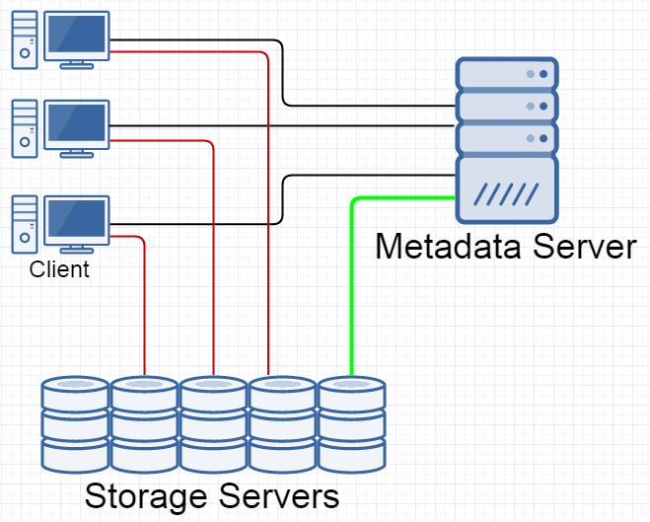
The basics of file systems
Single point of failure
A NFS server is both a single point of failure, and a bottleneck because its resources need to be shared between multiple clients.
Parallel NFS в NFSv4.1:

Slide 43
The basics of file systems
Single point of failure
A NFS server is both a single point of failure, and a bottleneck because its resources need to be shared between multiple clients.
Parallel NFS в NFSv4.1: It introduces interesting failure modes of its own: What happens if a client loses a connection to the metadata server, but retains connections to storage servers?

Slide 44
The basics of file systems
The Fallacies of Networked Computing
The network delivers messages reliably. Messages are delivered instantly. The bandwidth is unlimited. The network is secure.

Slide 45
The basics of file systems
The Fallacies of Networked Computing
The network delivers messages reliably. Messages are delivered instantly. The bandwidth is unlimited. The network is secure. | A function in the same process may succeed or fail. The caller does not care about that function crashing because in that case the caller is killed, too. The network introduces a new failure mode: a function call did something, but the caller was not notified about that. Network protocols must account for requests never being delivered and being delivered multiple times due to retries. A broken connection is a norm, not an exception.

Slide 46
The basics of file systems
The Fallacies of Networked Computing
The network delivers messages reliably. Messages are delivered instantly. The bandwidth is unlimited. The network is secure. | The speeds of function calls and RPC calls are qualitatively different. Spilling some registers to the stack and jumping to a function is measured with 1 or 2 digits of nanoseconds. An RPC call in a 10Gbps ethernet network spends dozens of microseconds on the network RTT alone. As we move from local networks to the Internet, that becomes milliseconds.

Slide 47
The basics of file systems
The Fallacies of Networked Computing
Consider a naïve routine to copy a file: while (!done) { r = read(fd_in, buf, sizeof(buf)); r0 = write(fd_out, buf, r); ... }
It took approx. 1.4 seconds to download 976 bytes.
This is not a log of a transatlantic communication. Both the client and the server were in the UK.
21-02-18 23:40:38.936 s#1412709.r#6998305: readfile = {offset = 0x4c44d78350, length = 16}
21-02-18 23:40:39.191 s#1412709.r#6998305: send 16 at offset 0x4c44d78350
21-02-18 23:40:39.191 s#1412709.r#6998305: completed
21-02-18 23:40:39.757 s#1412709.r#6998344: readfile = {offset = 0x4c44d78360, length = 944}
21-02-18 23:40:39.757 s#1412709.r#6998344: send 944 at offset 0x4c44d78360
21-02-18 23:40:39.757 s#1412709.r#6998344: completed
21-02-18 23:40:40.242 s#1412709.r#6998358: readfile = {offset = 0x4c44d7e360, length = 16}
21-02-18 23:40:40.361 s#1412709.r#6998358: send 16 at offset 0x4c44d7e360
21-02-18 23:40:40.361 s#1412709.r#6998358: completed

Slide 48
The basics of file systems
The Fallacies of Networked Computing
The network delivers messages reliably. Messages are delivered instantly. The bandwidth is unlimited. The network is secure. | Returning huge objects from a function call is cheap. It suffices to return 1 pointer. A RPC call must transfer the whole response, and the speed of a 10Gbps network connection is much smaller than that of the RAM. In many cases one must also factor in the CPU time needed to serialise and deserialise JSONs, protobufs, XMLs and other transport formats.

Slide 49
The basics of file systems
More networking-related issues
Typically, a server divides a user request into smaller sub-requests and sends them to servers that are deeper down the system:

Slide 50

The basics of file systems
More networking-related issues
Typically, a server divides a user request into smaller sub-requests and sends them to servers that are deeper down the system:
HTTP GET
proxy / lb
static content server
application server
application server
…
database server

Slide 51
The basics of file systems
More networking-related issues
Typically, a server divides a user request into smaller sub-requests and sends them to servers that are deeper down the system:
 | Suppose that every request spawns 10 sub-requests. Suppose also that the 99th pct. of the sub-request latency is 1ms, but the rest of sub-requests take 1s. What is the distribution of latencies of top-level requests? How to bound the tail latencies of top-level requests?
HTTP GET
proxy / lb
static content server
application server
application server
…
database server

Slide 52
The basics of file systems
More networking-related issues
Typically, a server divides a user request into smaller sub-requests and sends them to servers that are deeper down the system:
 | Suppose that every request spawns 10 sub-requests. Suppose also that the 99th pct. of the sub-request latency is 1ms, but the rest of sub-requests take 1s. What is the distribution of latencies of top-level requests? How to bound the tail latencies of top-level requests? How collect logs of all sub-requests together? How to analyse the execution trace of a top-level request? How to find reasons for requests getting blocked?
HTTP GET
proxy / lb
static content server
application server
application server
…
database server

Slide 53
The basics of file systems
Logging in a distributed system and the birthdays problem
How to match logs from multiple services in a distributed system?

Slide 54
The basics of file systems
Logging in a distributed system and the birthdays problem
How to match logs from multiple services in a distributed system? Let us assign a unique ID to each top-level request and propagate it into every sub-request. Now every log message related to a sub-request contains the ID of the top-level request. One can now scan logs of all services and filter those that contain a needed top-level request ID.

Slide 55
The basics of file systems
Logging in a distributed system and the birthdays problem
How to match logs from multiple services in a distributed system? Let us assign a unique ID to each top-level request and propagate it into every sub-request. Now every log message related to a sub-request contains the ID of the top-level request. One can now scan logs of all services and filter those that contain a needed top-level request ID.
How can we generate globally unique IDs? We must do this without incurring any synchronisation between nodes of our system.

Slide 56
The basics of file systems
Logging in a distributed system and the birthdays problem
How to match logs from multiple services in a distributed system? Let us assign a unique ID to each top-level request and propagate it into every sub-request. Now every log message related to a sub-request contains the ID of the top-level request. One can now scan logs of all services and filter those that contain a needed top-level request ID.
How can we generate globally unique IDs? We must do this without incurring any synchronisation between nodes of our system. Can choose globally unique IDs randomly?

Slide 57
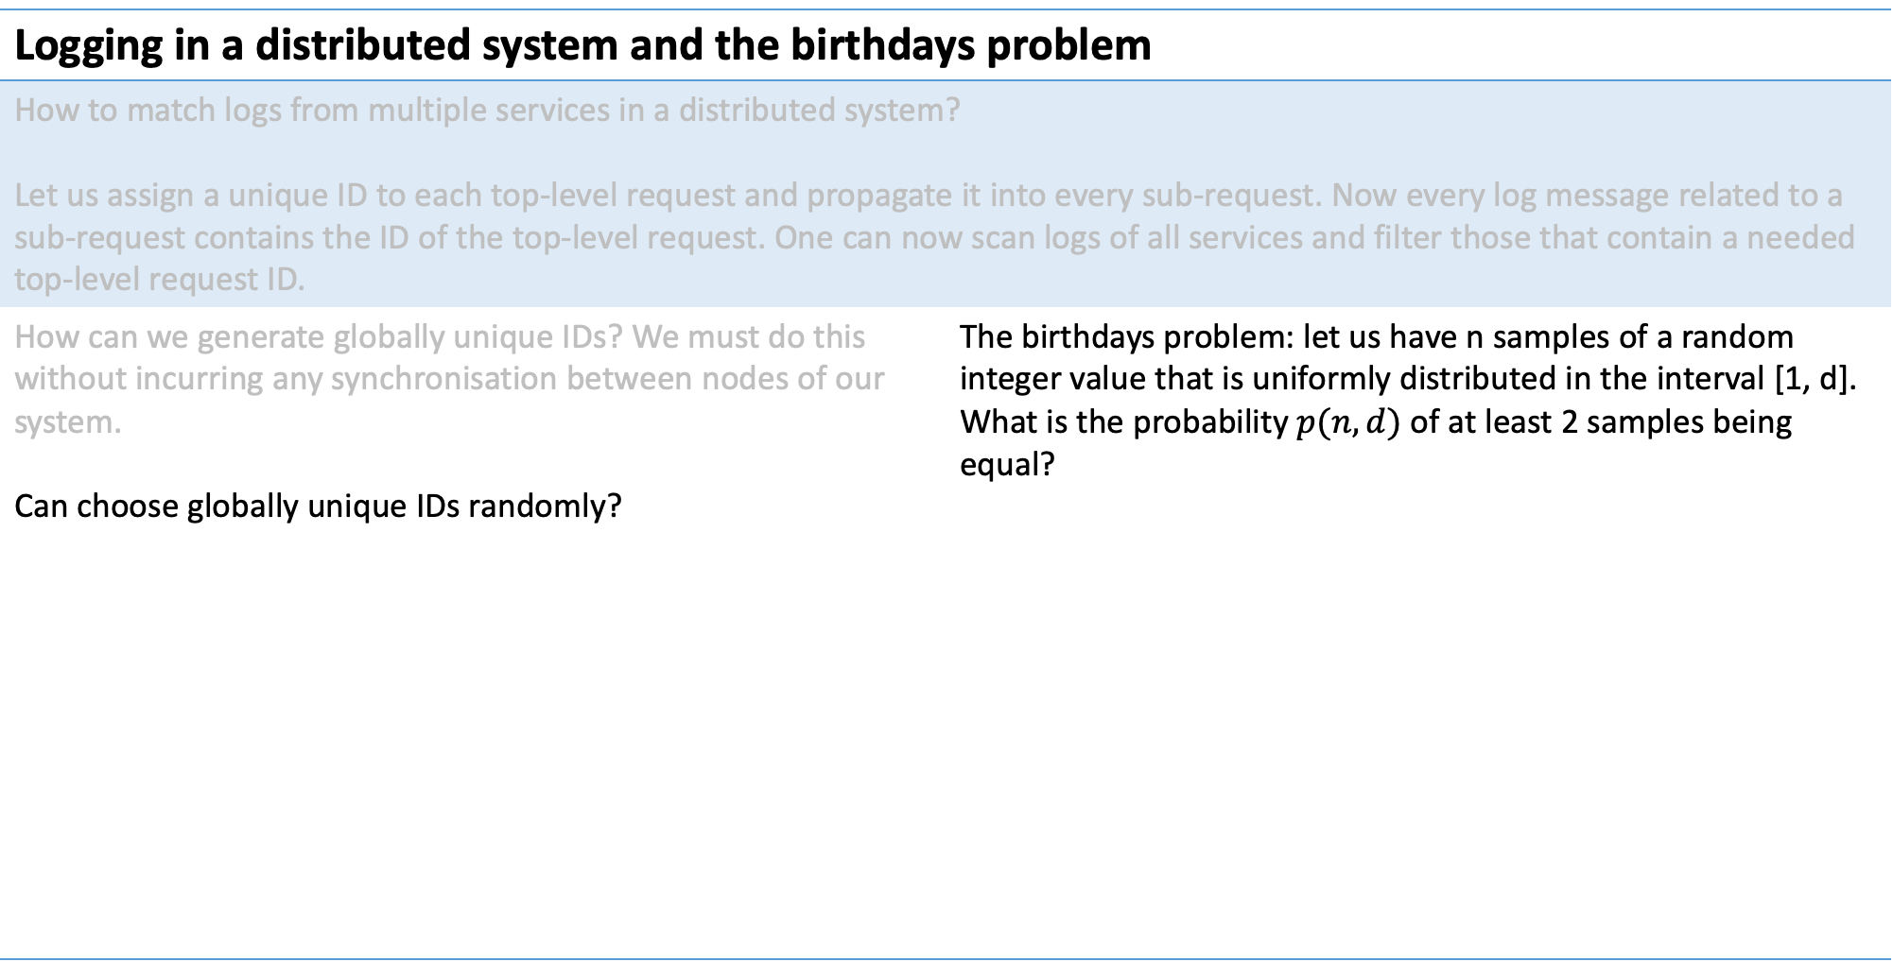
The basics of file systems
Logging in a distributed system and the birthdays problem
How to match logs from multiple services in a distributed system? Let us assign a unique ID to each top-level request and propagate it into every sub-request. Now every log message related to a sub-request contains the ID of the top-level request. One can now scan logs of all services and filter those that contain a needed top-level request ID.
How can we generate globally unique IDs? We must do this without incurring any synchronisation between nodes of our system. Can choose globally unique IDs randomly? | The birthdays problem: let us have n samples of a random integer value that is uniformly distributed in the interval [1, d]. What is the probability $p(n, d)$ of at least 2 samples being equal?

Slide 58
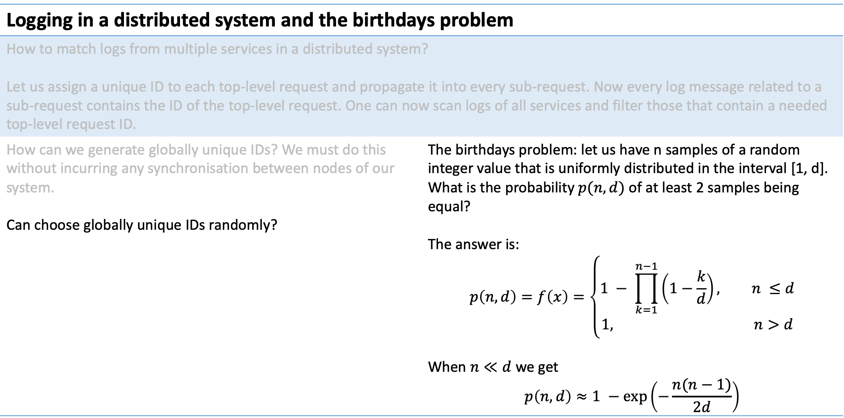
The basics of file systems
Logging in a distributed system and the birthdays problem
How to match logs from multiple services in a distributed system? Let us assign a unique ID to each top-level request and propagate it into every sub-request. Now every log message related to a sub-request contains the ID of the top-level request. One can now scan logs of all services and filter those that contain a needed top-level request ID.
How can we generate globally unique IDs? We must do this without incurring any synchronisation between nodes of our system. Can choose globally unique IDs randomly? | The birthdays problem: let us have n samples of a random integer value that is uniformly distributed in the interval [1, d]. What is the probability $p(n, d)$ of at least 2 samples being equal? The answer is: $$p\left(n, d\right)=f\left(x\right)=\left\{\begin{aligned}1 − \prod_{k=1}^{n−1}{\left(1−\frac{k}{d}\right)}, n ≤d \\ &1, n>d\end{aligned}\right.$$ When $n≪d$ we get $$p\left(n,d\right)≈1 −\exp\left(−\frac{n(n−1)}{2d}\right)$$

Slide 59
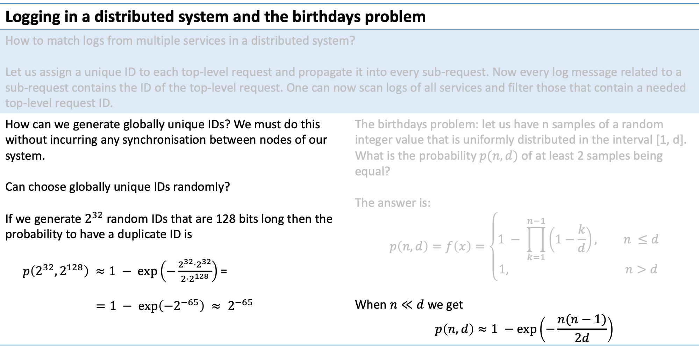
The basics of file systems
Logging in a distributed system and the birthdays problem
How to match logs from multiple services in a distributed system? Let us assign a unique ID to each top-level request and propagate it into every sub-request. Now every log message related to a sub-request contains the ID of the top-level request. One can now scan logs of all services and filter those that contain a needed top-level request ID.
How can we generate globally unique IDs? We must do this without incurring any synchronisation between nodes of our system. Can choose globally unique IDs randomly? If we generate $2^{32}$ random IDs that are 128 bits long then the probability to have a duplicate ID is $p\left(2^{32},2^{128}\right) ≈1 − \exp\left(−\frac{2^{32}⋅2^{32}}{2⋅2^{128}}\right)$ = $$=1 − \exp\left(−2^{−65}\right) ≈ 2^{−65}$$ | The birthdays problem: let us have n samples of a random integer value that is uniformly distributed in the interval [1, d]. What is the probability $p(n, d)$ of at least 2 samples being equal? The answer is: $$p\left(n, d\right)=f\left(x\right)=\left\{\begin{aligned}1 − \prod_{k=1}^{n−1}{\left(1−\frac{k}{d}\right)}, n ≤d \\ &1, n>d\end{aligned}\right.$$ When $n≪d$ we get $$p\left(n,d\right)≈1 −\exp\left(−\frac{n(n−1)}{2d}\right)$$

Slide 60
The basics of file systems
Logging in a distributed system and the birthdays problem
How to match logs from multiple services in a distributed system? Let us assign a unique ID to each top-level request and propagate it into every sub-request. Now every log message related to a sub-request contains the ID of the top-level request. One can now scan logs of all services and filter those that contain a needed top-level request ID.
How can we generate globally unique IDs? We must do this without incurring any synchronisation between nodes of our system. Can choose globally unique IDs randomly? Another useful trick is to have IDs that have 6 bytes of the timestamp and 10 random bytes. They are equally unlikely to have collisions, but they are also sortable and include the timestamp.

Slide 61
The basics of file systems
To do at home
Write a gRPC server (https://grpc.io) with a single request handler that generates 128 random bytes. Add random sleeps so that 99% of requests run very fast, and 1% of requests take 1s. Write a gRPC server with a single request handler that does 16 sub-requests to different instances of a service from exercise #1 and concatenates their responses. Sub-requests must be processed in parallel. Install Prometheus (https://prometheus.io). Instrument solutions of #1 and #2 to report request latencies to Prometheus. Install Grafana (https://grafana.com) and make a dashboard with plots of the 90th, 95th and 99th percentiles of latencies of service №2 and each of 16 instances of service #1. Install Jaeger (https://www.jaegertracing.io). Instrument solutions of #1 and #2 with opentracing (https://opentracing.io) have them report request traces to Jaeger.

