Slide 1

Wasserstein Style Transfer
Youseff Mroueh
Presented by:
Dominique McDonald

Slide 2
Image Style Transfer
Processing an image in such a way that it retains its original content while taking on the style of another image
Difficult to define a loss function that captures constraint
Gaussian optimal transport in Encoder/Decoder framework

Slide 3
Paper Structure
Intro to Image Style Transfer Problem
Universal Style Transfer
Wasserstein Universal Style Transfer
Wasserstein Style/Content Interpolation
Experiments and Conclusions

Slide 4
Advancements that Paved the Way
Neural Style Transfer (Gayts et al)
Defined a style loss function by matching spatial statistics of an image in the feature space of a deep CNN
Slow and requires an optimization per content and style image
Feedforward Networks
Produced stylizations in single forward pass
Approach is limited to only one style image
Instance Normalization
Improved quality and diversity of stylization
Still limited to one style image
Conditional Instance Normalization
Enabled multiple styles neural transfer
Adaptive Instance Normalization
Whitening Coloring Transform
Enabled Arbitrary style transfer
Enabled arbitrary style transfer framework based on encoder/decoder framework and employed a normalization in encoder feature space

Slide 5
Universal Style Transfer
via Optimal Transport lens

Slide 6
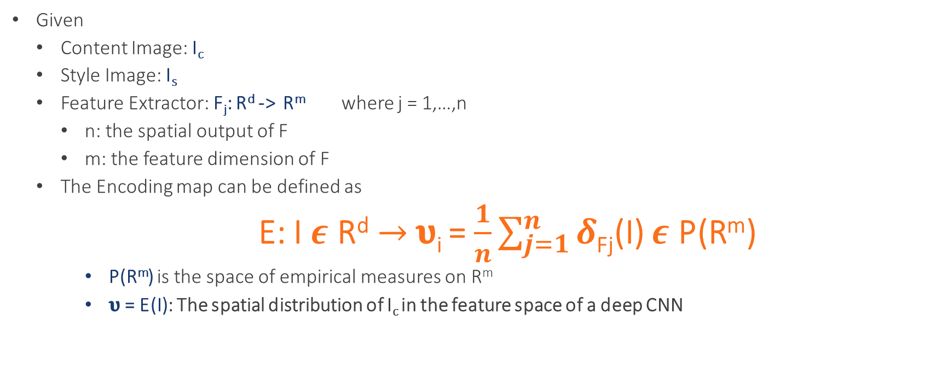
Encoding Map
Given
Content Image: I_{c}
Style Image: I_{s}
Feature Extractor: F_{j}: R^{d} -> R^{m} where j = 1,…,n
n: the spatial output of F
m: the feature dimension of F
The Encoding map can be defined as
E: I $ε$ R^{d}$→$𝛖_{i} = $\frac{1}{n}\sum_{j=1}^{n}{δ}$_{Fj}(I) $ε$ P(R^{m})
P(R^{m}) is the space of empirical measures on R^{m}
𝛖 = E(I): The spatial distribution of I_{c} in the feature space of a deep CNN

Slide 7

Decoding Map
D: 𝛖 $ε$ P(R^{m}) $→D\left(υ\right) ε$R^{d}
s.th D(E(I)) = I

Slide 8
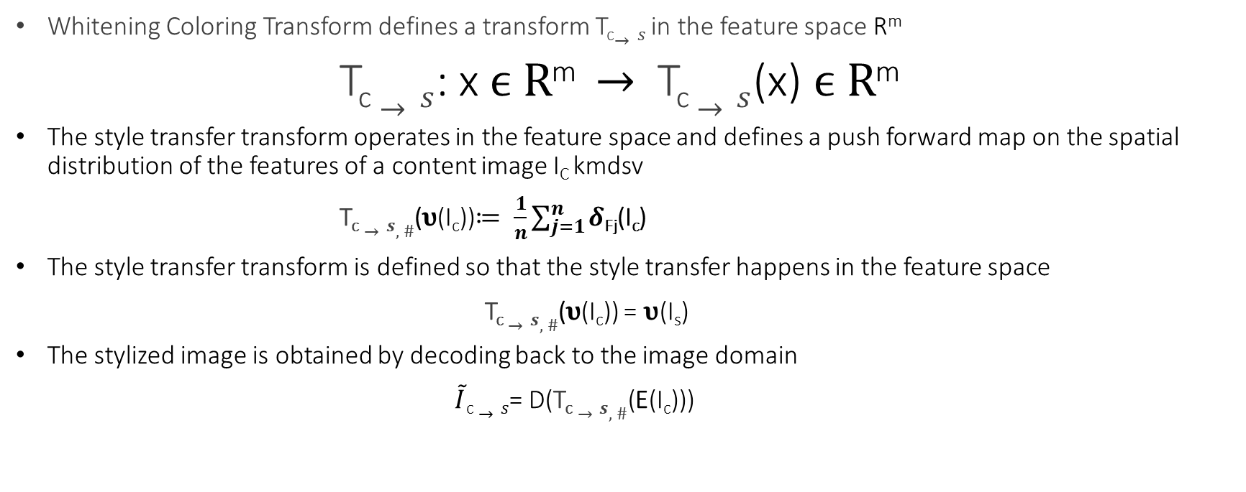
Universal Style Transfer in Feature Space
Whitening Coloring Transform defines a transform T_{c}$→s$ in the feature space R^{m}
T_{c} $→s$: x $ϵ R$^{m} $→$ T_{c}$→s$(x) $ϵ R$^{m}
The style transfer transform operates in the feature space and defines a push forward map on the spatial distribution of the features of a content image I_{C} kmdsv
T_{c}$→s,\#$(𝛖(I_{c}))$≔ \frac{1}{n}\sum_{j=1}^{n}{δ}$_{Fj}(I_{c})
The style transfer transform is defined so that the style transfer happens in the feature space
T_{c}$→s,\#$(𝛖(I_{c})) = 𝛖(I_{s})
The stylized image is obtained by decoding back to the image domain
$\tilde{I}$_{c} $→s$= D(T_{c}$→s,\#$(E(I_{c})))

Slide 9

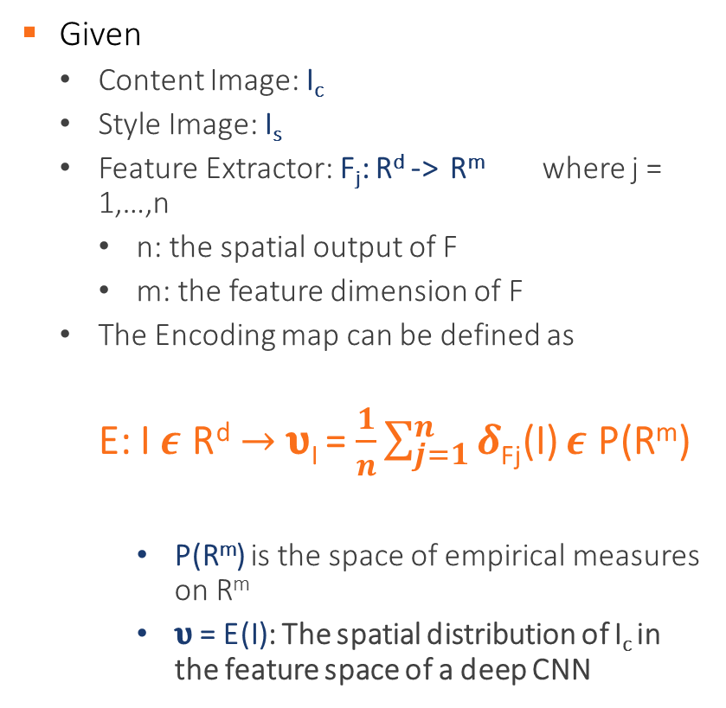
Encoder/Decoder Framework
Encoder
Decoder
Given
Content Image: I_{c}
Style Image: I_{s}
Feature Extractor: F_{j}: R^{d} -> R^{m} where j = 1,…,n
n: the spatial output of F
m: the feature dimension of F
The Encoding map can be defined as
E: I $ε$ R^{d}$→$𝛖_{I} = $\frac{1}{n}\sum_{j=1}^{n}{δ}$_{Fj}(I) $ε$ P(R^{m})
P(R^{m}) is the space of empirical measures on R^{m}
𝛖 = E(I): The spatial distribution of I_{c} in the feature space of a deep CNN
Assuming encoding map is invertible
D: 𝛖 $ε$ P(R^{m}) $→D\left(υ\right) ε$R^{d}
s.th D(E(I)) = I

Slide 10
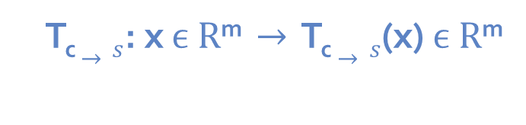

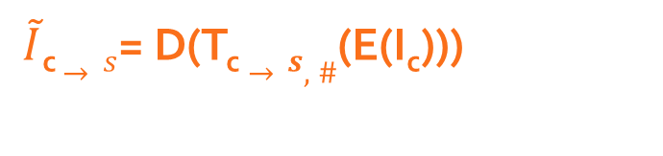
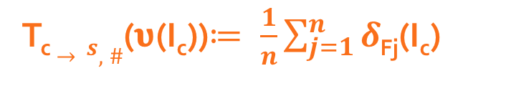
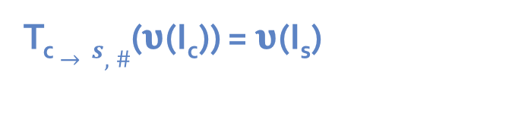
Universal Style Transfer in Feature Space
Whitening Coloring Transform defines a transform T_{c}$→s$ in the feature space R^{m}
T_{c} $→s$: x $ϵ R$^{m} $→$ T_{c}$→s$(x) $ϵ R$^{m}
The style transfer transform operates in the feature space and defines a push forward map on the spatial distribution of the features of a content image I_{C}
T_{c}$→s,\#$(𝛖(I_{c}))$≔ \frac{1}{n}\sum_{j=1}^{n}{δ}$_{Fj}(I_{c})
The style transfer transform is defined so that the style transfer happens in the feature space
T_{c}$→s,\#$(𝛖(I_{c})) = 𝛖(I_{s})
The stylized image is obtained by decoding back to the image domain
$\tilde{I}$_{c} $→s$= D(T_{c}$→s,\#$(E(I_{c})))

Slide 11
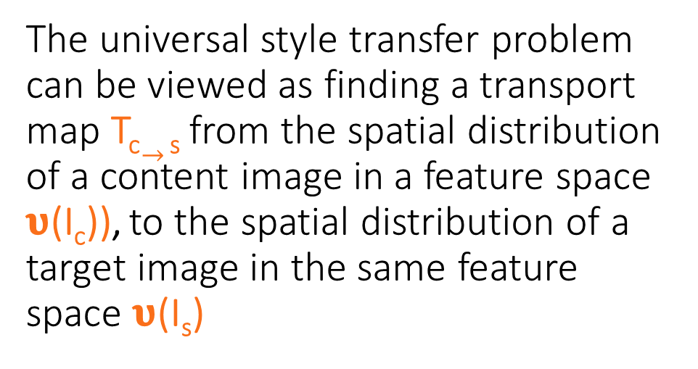
The universal style transfer problem can be viewed as finding a transport map T_{c}$→$ _{s} from the spatial distribution of a content image in a feature space 𝛖(I_{c})), to the spatial distribution of a target image in the same feature space 𝛖(I_{s})
KEY IDEA

Slide 12
Wasserstein Universal Style Transfer

Slide 13
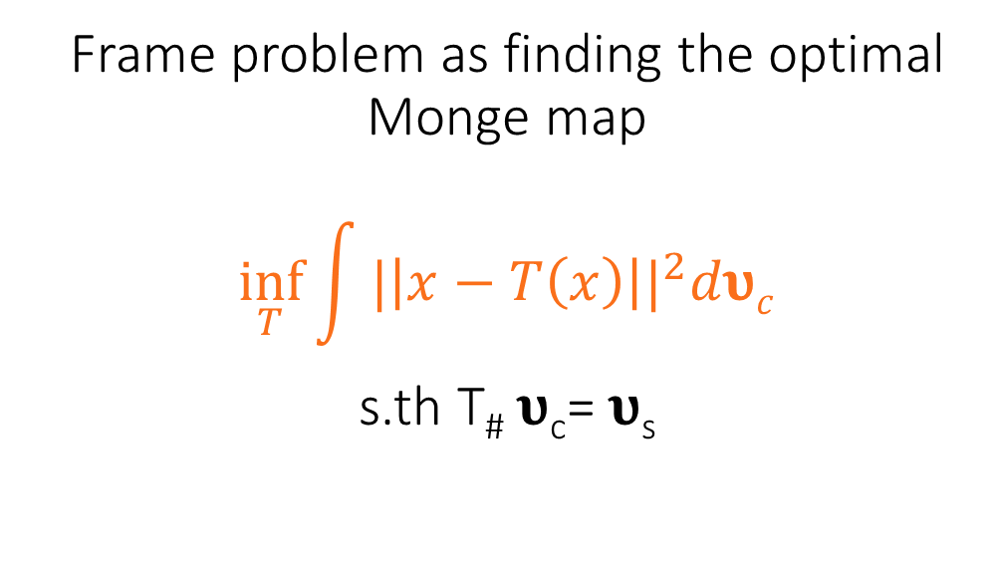
Frame problem as finding the optimal Monge map $$\inf_{T}{\int{{|\left|x−T\left(x\right)\right||}^{2}d\text{υ}c}}$$ s.th T# 𝛖_{c}= 𝛖_{s}
Optimal Transport Formulation

Slide 14
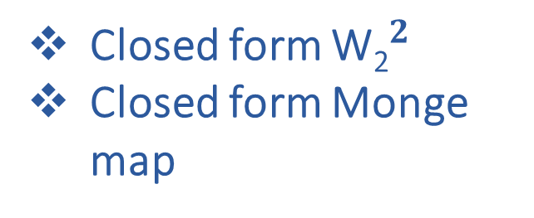
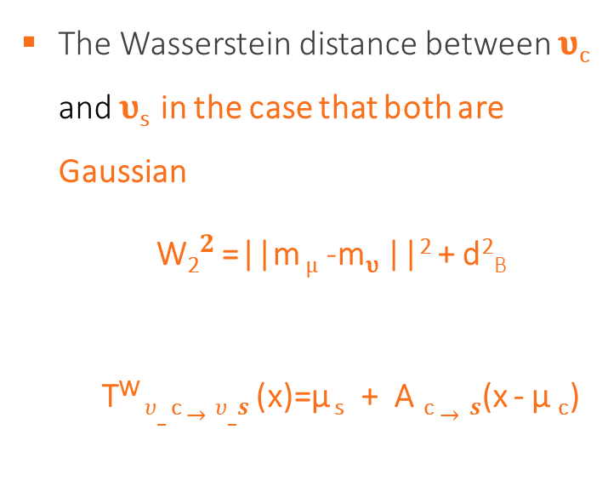
The Solution
Why Wasserstein?
The Wasserstein distance between 𝛖_{c} and 𝛖_{s} in the case that both are Gaussian
${\text{W}\text{2}}^{2}$ =||m _{µ} -m_{𝛖} ||² + d²_{B}
T^{W} $υ_$_{c}$→υ_s$ (x)=µ _{s} + A _{c}$→s$(x - µ _{c})
Closed form ${\text{W}\text{2}}^{2}$
Closed form Monge map

Slide 15
Style/Content Interpolation
Using McCann Interpolates

Slide 16
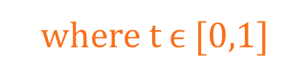

Balancing Style Content Preservation
McCann Interpolate b/w 𝛖_{c} and 𝛖_{s}
$$\min_{\text{υ}}{{\text{ (1-}\text{t}\text{)}\text{W}\text{2}}^{2}\text{(}\text{υ}\text{,}d\text{υ}c}{)+ \text{t}\text{W}\text{2}}^{2}\text{(}\text{υ}\text{,}\text{υ}\text{s}\text{)}$$
where t $ϵ$ [0,1]
Content Loss
Style Loss

Slide 17
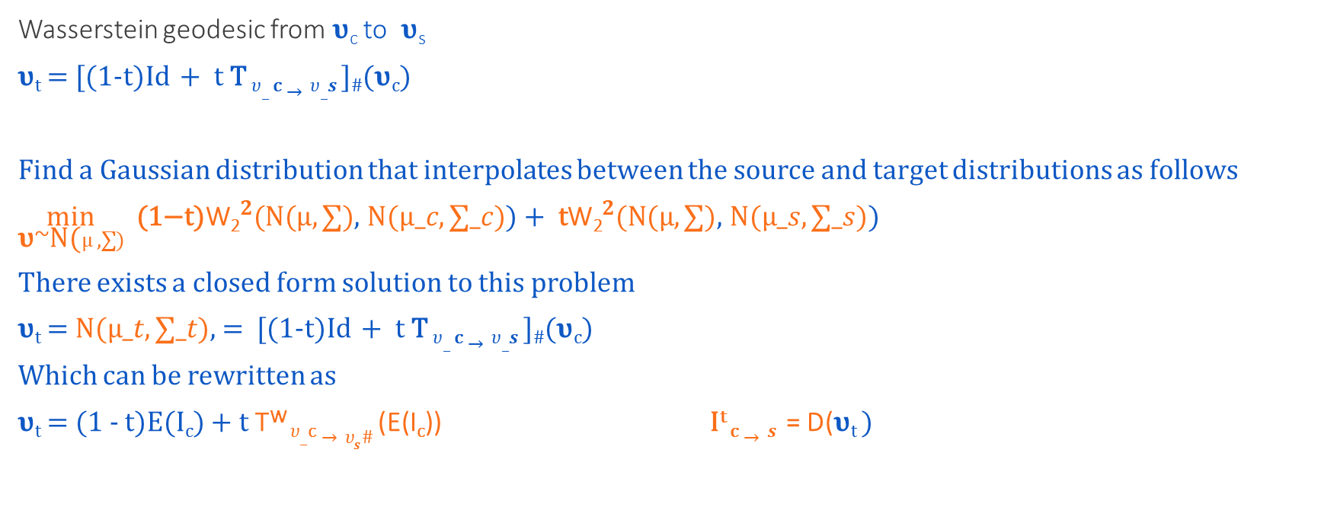
Solution
Wasserstein geodesic from 𝛖_{c} to 𝛖_{s}
𝛖_{t} = [(1-t)Id + t T $υ_$_{c}$→υ_s$ ]#(𝛖_{c})
Find a Gaussian distribution that interpolates between the source and target distributions as follows
$\min_{\text{υ}\text{\sim }\text{N}\text{(}µ,∑)}$ ${\text{ (1−}\text{t}\text{)}\text{W}\text{2}}^{2}\text{(}\text{N}\text{(}µ,∑)$, $\text{N}\text{(}µ_c,∑_c)$) + ${ \text{t}\text{W}\text{2}}^{2}\text{(}\text{N}\text{(}µ,∑)$, $\text{N}\text{(}µ_s,∑_s)$)
There exists a closed form solution to this problem
𝛖_{t} = $\text{N}\text{(}µ_t,∑_t)$, = [(1-t)Id + t T $υ_$_{c}$→υ_s$ ]#(𝛖_{c})
Which can be rewritten as
𝛖_{t} = (1 - t)E(I_{c}) + t T^{W} $υ_$_{c}$→υ_{s}\#$ (E(I_{c})) I^{t} _{c}$→s$ = D(𝛖_{t} )

Slide 18
With Wasserstein style interpolation we now have a way to balance style content preservation which will also allow us to generalize to multiple style interpolation using Gaussian Wasserstein barycenters.
KEY IDEA

