Slide 1
Rule Checking Tool Evaluation
Simon Schneider
Institute of Software Security – TU Hamburg – Germany
Simon.schneider@tuhh.de

Slide 2
Timetable
1300 - 1330 Introduction to our tool, DFDs, and evaluation process; questions
1330 - 1400 Discovery phase
Break
1415 - 1515 Analysis phase 1
Break
1530 – 1630 Analysis phase 2
1630 - 1700 Buffer, off-boarding

Slide 3
Dataflow Diagrams
As we use them

Slide 4
Components
Nodes: (micro)services, databases, external entities
Edges: information flows between two nodes
Annotations: enrich model components with system properties (e.g. security mechanisms)

Slide 5
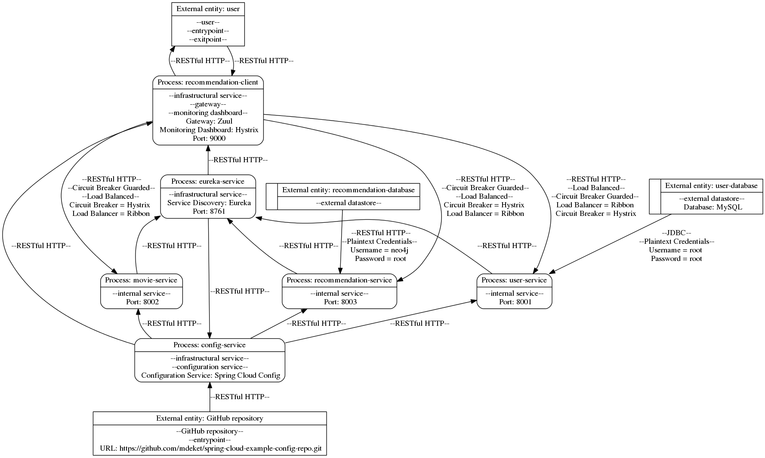
Example DFD
External Entity
Annotations e.g. “load_balanced” or “encrypted”
Data Store
Information Flow
Services
internal (business logic) and infrastructural

Slide 6
(Automatic) Extraction of DFDs
Manually creating DFDs is tedious and error-prone
We employ static, textual analysis approach to automatically extract DFDs from source code
Basic idea: keywords in the code indicate existence of system components
(e.g. Java annotations: @EnableEurekaServer → stands up service discovery server)

Slide 7
Traceability
Benefit of textual analysis: proving why model items were extracted is often trivial
Simply showing “where you looked” in the code to conclude existence of model item
Traceability = linking model items to code snippets

Slide 8


Example Traceability
Line 19 in file recommendation-client/src/main/java/com/example/service/UserService.java :
Show Traceability
Show Traceability
Line 7 in file eureka-service/src/main/java/com/example/EurekaServiceApplication.java:
Line 3 in file config-service/src/main/resources/application.properties :
Lines [1:2] in file (in external config repository) mdeket/spring-cloud-example-config-repo/blob/master/eureka-service-default.yml :
Show Traceability

Slide 9
Rule Checking tool

Slide 10
Tool overview
Tool for automatically checking architectural security rules on DFDs
Users can formulate rules as model queries with tool language or use pre-defined rules
Pre-defined rules based on best-practices for microservices published by CS, NIST, and OWASP
Generated output contains evidence for the verdicts

Slide 11
Tool output
Plain verdict (rule is adhered to or violated)
Evidence for verdict in terms of model items (property check fails because item x does not have annotation y)
Traceability of model items (node x is in defined scope because of annotation y as seen at place z in code)

Slide 12
Language components
Three groups of components to formulate rules:
Scope transformations: define the set of nodes or edges to be checked
Property checks: mostly based on annotations of model items
Logical operators: to create more complex queries

Slide 13
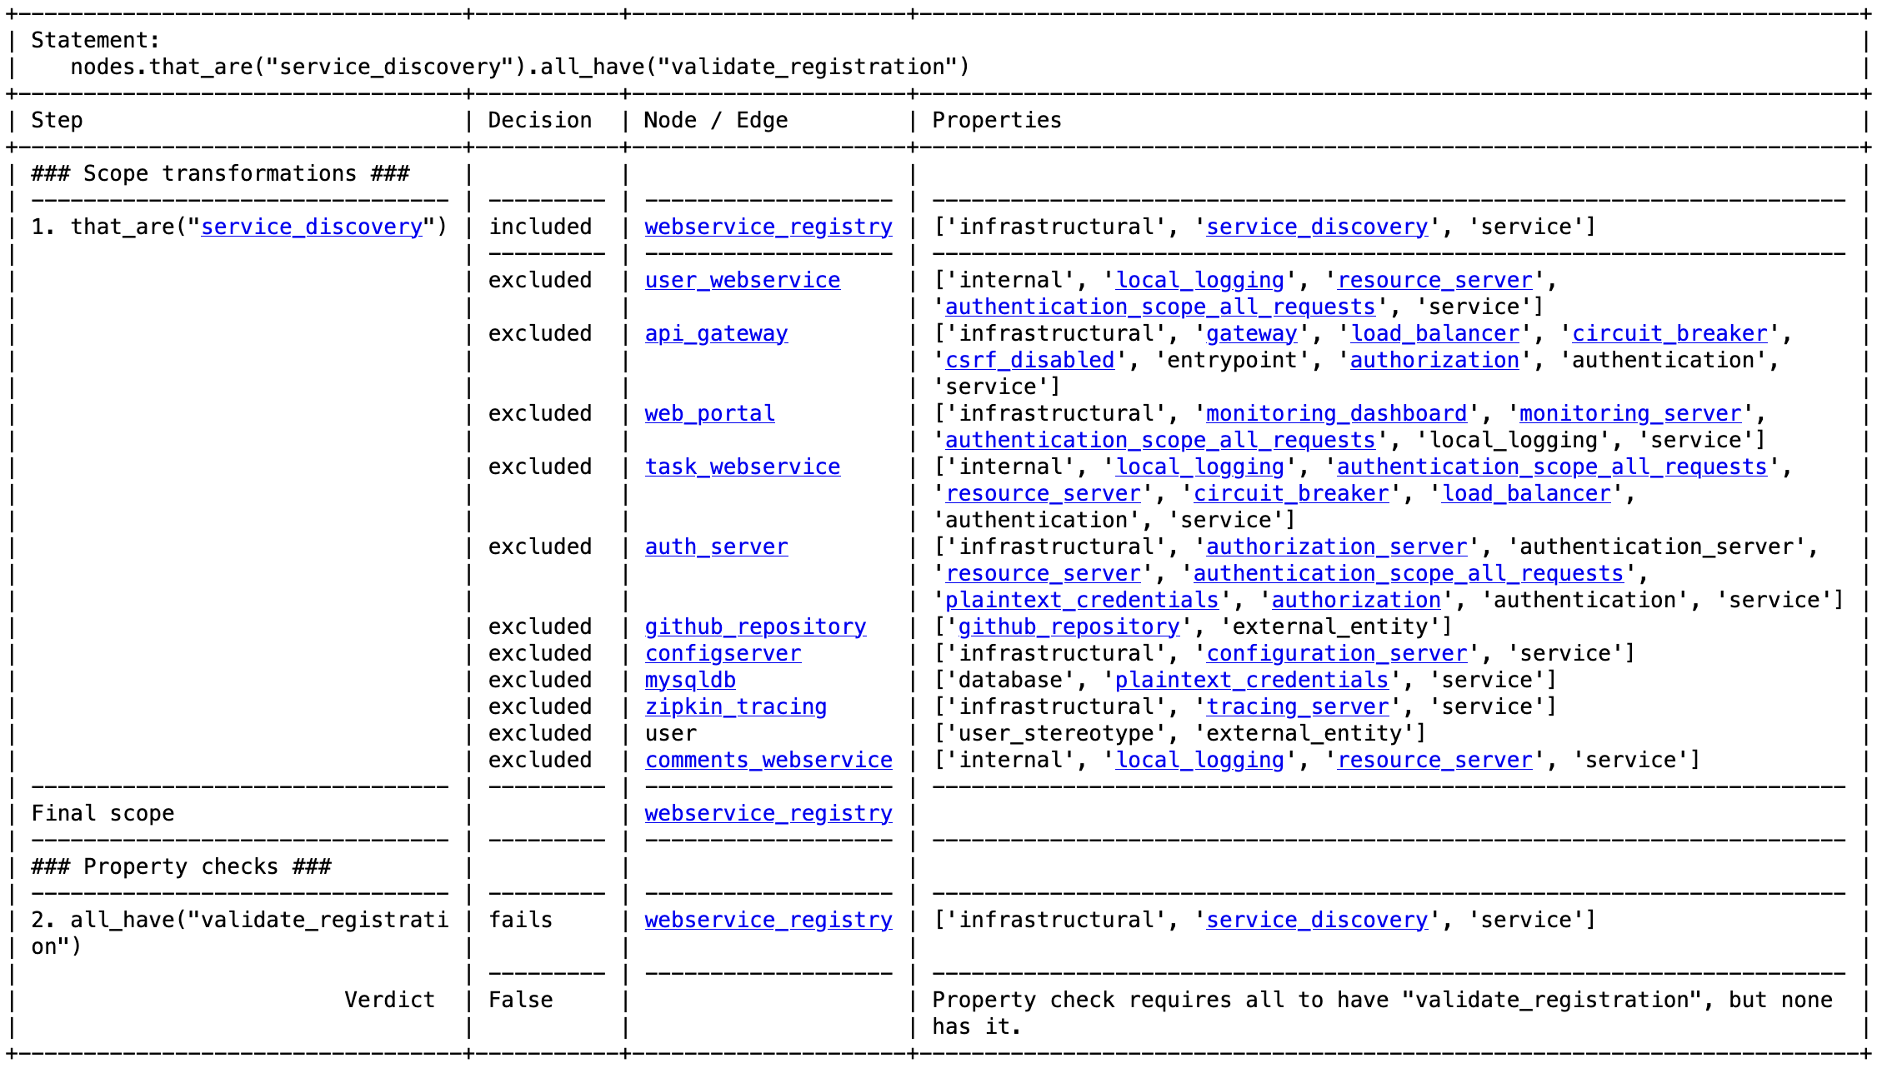
Example Output

Slide 14
process for today

Slide 15
Evaluation process
Discovery Phase: for you to get familiar with the application
Analysis Phase 1:
Manually perform a code analysis task on a given application (check if a security rule is true or false and show why)
Then, receive our tool’s output for that rule and check if you agree with it and if the given evidence supports the verdict
Receive tool output for a second rule, directly check if you agree and if evidence supports verdict
Analysis phase 2: same as phase 1 with two new rules
Interviews (coming days): tell me your feedback

Slide 16
Timetable
1300 - 1330 Introduction to our tool, DFDs, and evaluation process; questions
1330 - 1400 Discovery phase
Break
1415 - 1515 Analysis phase 1
Break
1530 – 1630 Analysis phase 2
1630 - 1700 Buffer, off-boarding

Slide 17
Paper Example
edges.sender_is("internal").receiver_is("internal").all_are("authenticated")

Slide 18
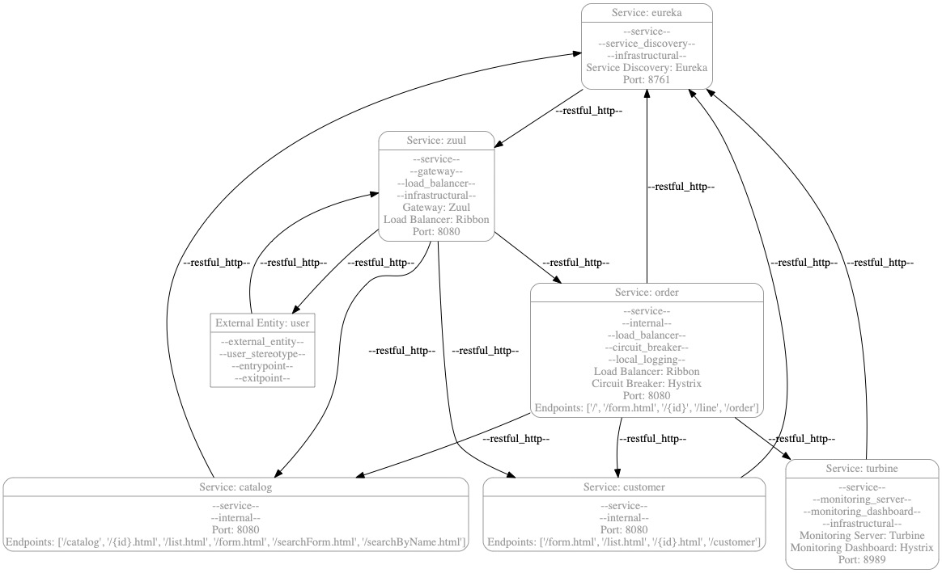
Paper Example
edges

Slide 19
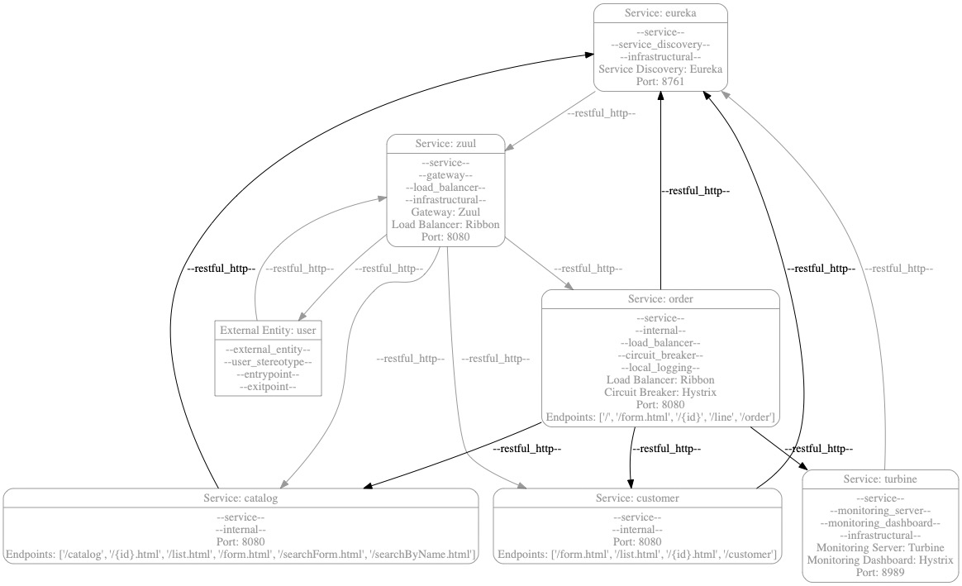
Paper Example
edges.sender_is("internal")

Slide 20
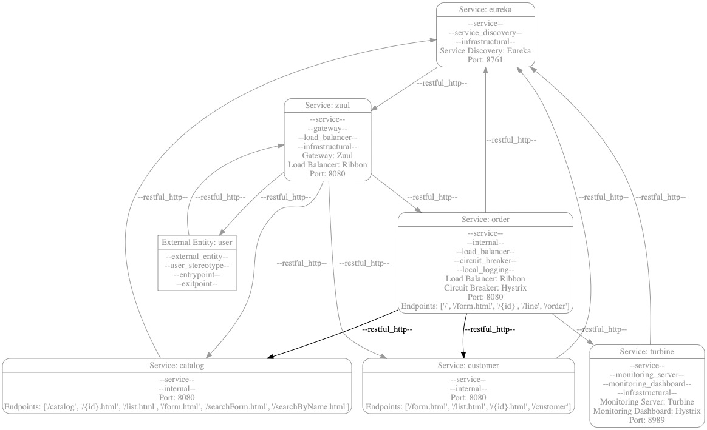
Paper Example
edges.sender_is("internal").receiver_is("internal")

Slide 21
Paper Example
edges.sender_is("internal").receiver_is("internal").all_are("authenticated")
→ False (both edges in the scope are not authenticated)

Slide 22
DFD Extraction implementation
We implemented our approach by combining different keyword search techniques
from direct parsing to more complex combination of found keywords across codebase
Performance: precision 0.93, recall 0.85 on dataset of 17 apps
Implementation supports Java, mainly Spring technologies

Slide 23
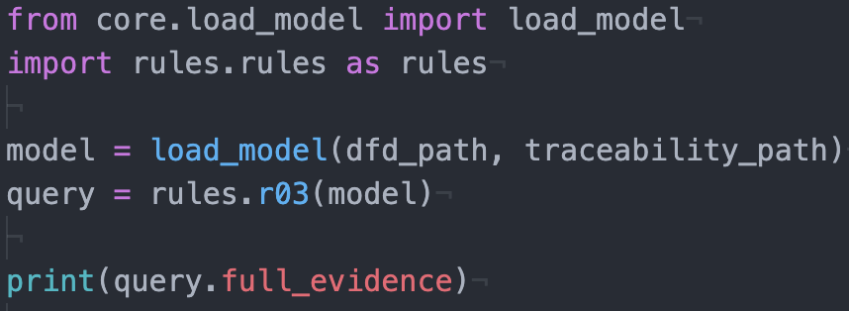
How to run (you won’t have to)
Everything is plain Python
Minimal example:
Import model parser + rules
Load model by giving file location
Execute rules on model
Print evidence, whichever format is desired
Instead of loading rule, own query can be formulated

Slide 24
Evidence
Core point of the framework
Query verdict is proven step-by-step with evidence for each query component
Evidence: linking verdict to model items
for each model item in scope, show reason why it is in-/excluded or fulfils/fails a property check

Slide 25
Model parsing
DFDs do not always look the same (annotations, trust boundaries, node types…)
Also, different file types (.py, .json, .txt…)
Framework supports different parsers for different formats

Slide 26
Overview
Application:
https://github.com/anilallewar/microservices-basics-spring-boot
4000+ LoC
README contains explanation of all components + architecture diagram
Rules:
R1: All entry points should perform authorization.
R2: All connections between a service and an external entity should be encrypted.
R3: All connections between services should be authorized.
R4: All entry points should have a load balancer
Output provided, participants do not actually run framework

Slide 27
Process
Phase 1:
R1 manually first, then framework
R2 framework first, then manually
Phase 2:
R3 manually first, then framework
R4 framework first, then manually

Slide 28
Discovery phase
Please get familiar with the application as you always do. All your usual tools and resources are fine. For example:
Download the code and load it into your preferred code analysis tool
Read the README file or other documentation there is about the project
Browse the source code to get familiar with the location of functionalities and how the application is structured

Slide 29
Analysis phase
Manual first:
Please answer the code analysis tasks.
Afterwards: here is the tools output. Can you verify that this is correct. Did you reach the same conclusion and would give the same evidence as the tool does?
Framework first:
This is the tool’s output for the analysis task. Can you verify that this is correct. Did you reach the same conclusion and would give the same evidence as the tool does?

