Slide 1
PROJECT HOTEL RESERVATIONS
An Analysis of Hotel Reservation trends

Slide 2
CONTRIBUTORS
Dominique Villacis
Bernardino Echeverria
Sausana Abraham
Sugandha Singh

Slide 3
Introduction
A lot has changed in the hotel industry post pandemic. Among other factors like new cleaning protocols and health screenings, the elements that have been especially volatile and difficult to track are prices and cancellations.
The cost of booking a hotel room plummeted in the early stages of the pandemic when nobody was traveling. We decided to analyse a hotel reservation dataset to look at the booking trends pre-covid. This analysis will help hoteliers set fair expectations for hotel industry recovery post-covid.

Slide 4
Motivation
With this pre-covid dataset, we as a group wondered if we could help produce better forecasts and reduce uncertainty in business decisions taken by hotels in future. By using Machine Learning we can predict the chances of a guest cancelling their reservation. Using Exploratory data we can get insights into prices and other factors that may impact pricing and cancellations.

Slide 5
Description of our dataset
The dataset has been taken from Kaggle.
The dataset contains records of hotel reservations. There are -
36,275 data points
19 features.
Most of the data is numerical with 3 columns being categorical.
The columns of the raw data are the following:
Booking_ID, no_of_adults, no_of_children, no_of_weekend_nights, no_of_week_nights, type_of_meal_plan, required_car_parking_space, room_type_reserved, lead_time, arrival_year, arrival_month, arrival_date, market_segment_type, repeated_guest, no_of_previous_cancellations, no_of_previous_bookings_not_canceled, avg_price_per_room, no_of_special_requests, booking_status

Slide 6
Explanatory Analysis
To get more in-depth insight into our data we analysed following questions using python.
What’s the average price -
- Per day
-Per month
Do longer total stays have lower average prices?
What is the busiest month?
Which time of the year has the longest reservations?
Which months have more reservations with children?
Which months include more reservations with weekends?
From which segment do reservations come the most?
Does the longer lead time leads to more cancellations?

Slide 7
Data Cleaning
To make sure we have a clean dataset to work with so our results are not skewed we took following steps -
Checked for null values
Checked for duplicate values
Dropped the column - type_of_meal_plan
Combined the Weekend nights and weeknight booking columns to create a total nights column.

Slide 8
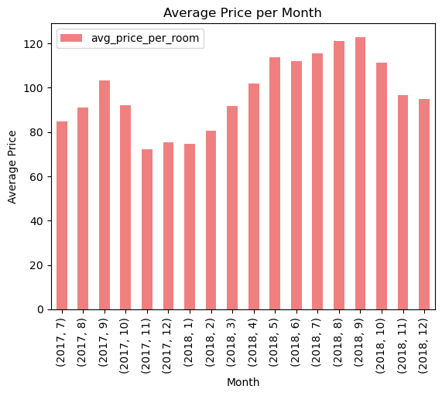
Results of Explanatory Analysis -
What’s the average price?
Average price per day - $103.4

Slide 9
Do longer total stays have lower average prices?
Based on our analysis the correlation value between longer stays and average prices came out to be
0.015768370115224067
This signifies a weak correlation. That means that longer reservations have none to minimum impact on average room prices.

Slide 10
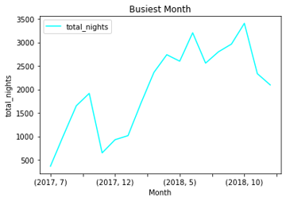
What is the busiest month?
October is the busiest month.

Slide 11
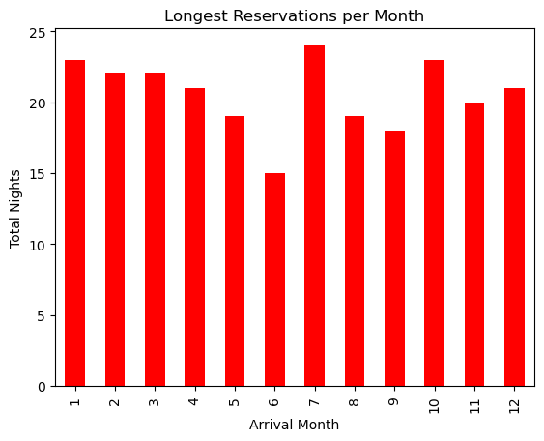
Which time of the year has the longest reservations?
Based on the chart we created the
month of July has the longest
reservations.

Slide 12
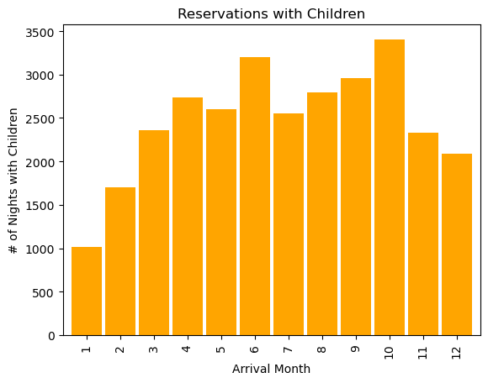
Which months have more reservations with children?
The month of October seems to
have more reservations with kids.

Slide 13
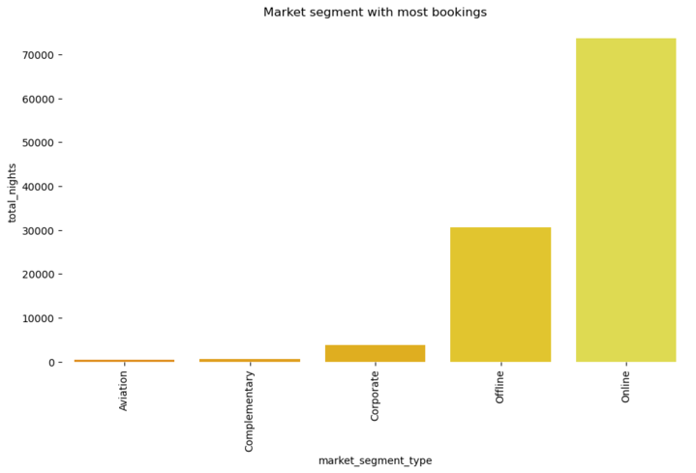
From which segment do reservations come the most?
Most reservations are made online.

Slide 14
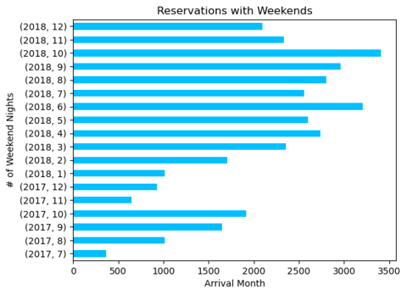
Which months include more reservations with weekends?
From Jan, 2018 to Dec, 2018
October has the most reservations
with weekends.

Slide 15
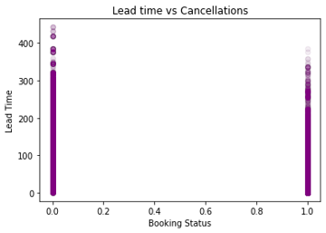
Does the longer lead time lead to more cancellations?
There is a negative correlation
-0.4385379185883181
Based on the dataset,
longer lead time does lead to
more cancellations.

Slide 16
Database creation
Postgres was used to create and store data . The database was named hotel_Reservattions_db.The database consists of 4 tables named customers,bookings,customer_bookings and clean_hotel_dataset and joined by using primary key named Booking_ID.

Slide 17
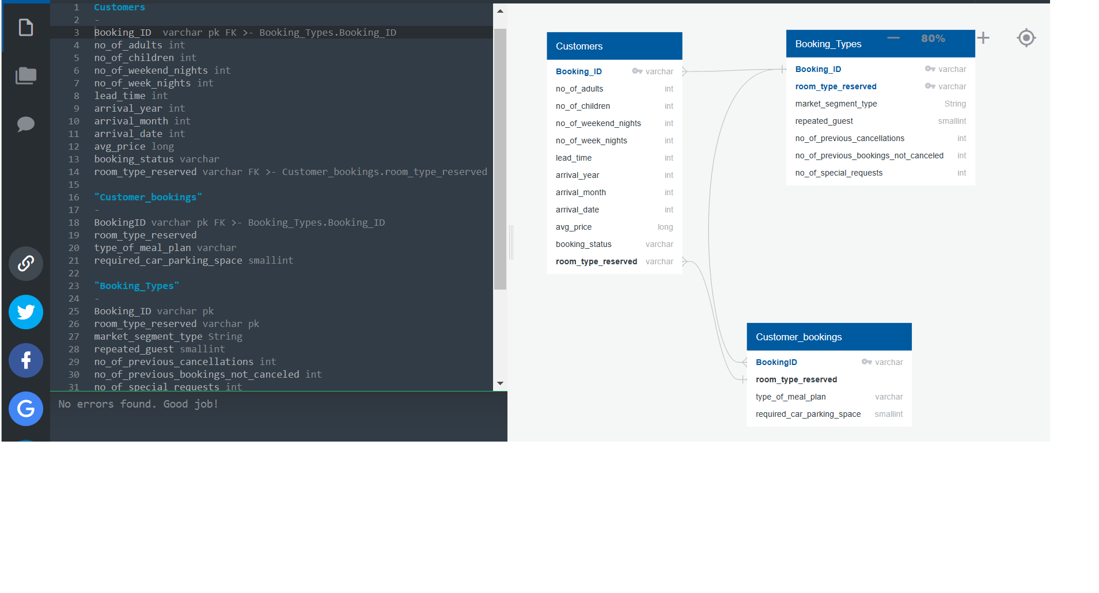
Below is the ERD of the database
Postgres ERD:

Slide 18
Decision Tree model
The dataset was split into features (or inputs) and target (or outputs). The features set, X, is copy of the booking dataset without the booking_status . The target Y is the booking status, to predict whether it will be cancelled or not.The data was then split into training and testing sets Below is the classification report for training set of 80/20 and then 75/25.The Confusion matrix shows an accuracy of 84.5% which we are happy about.

Slide 19
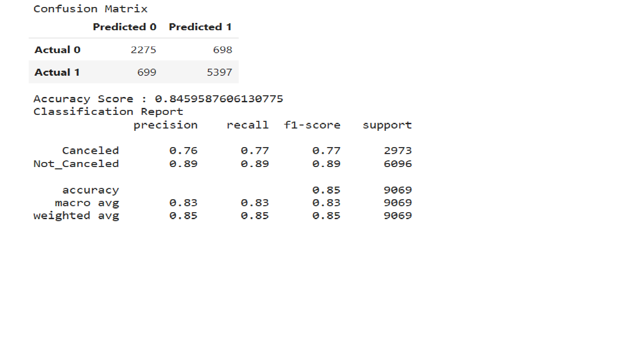

Slide 20
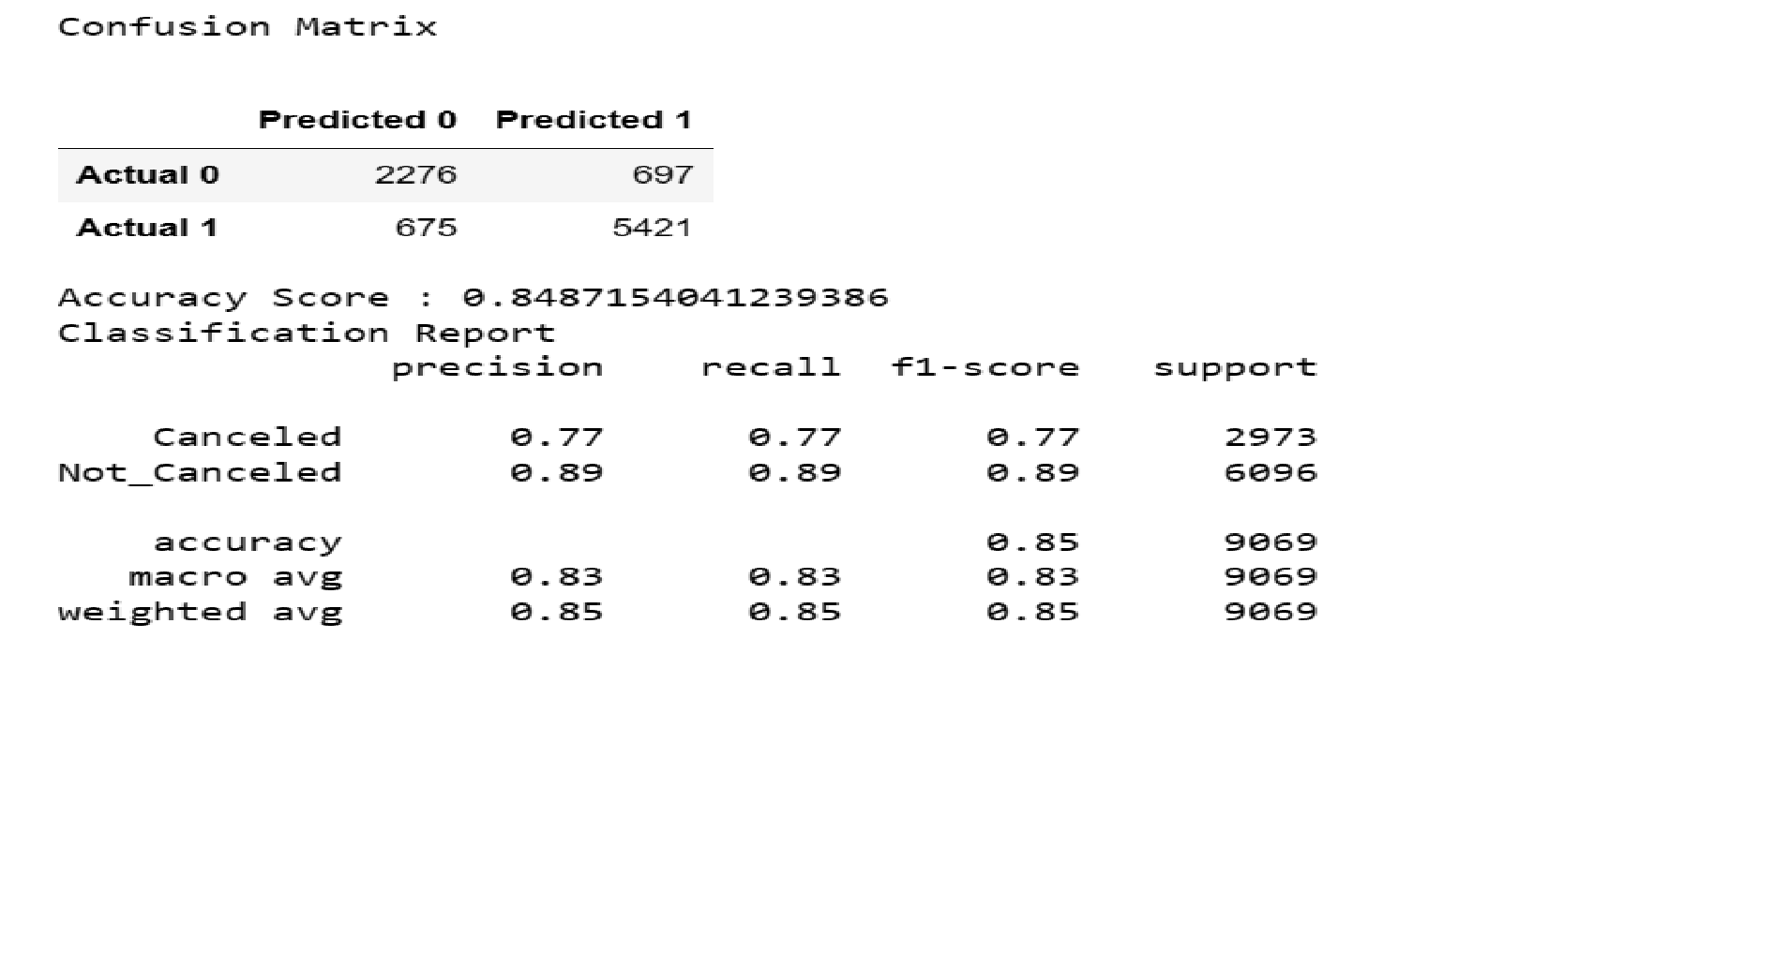

Slide 21
Support Vector Machine Model
We use the Support Vector Machine model as it is a binary classifier. This means that the possible outcomes are either cancelled or not cancelled.
During the process of creating the model we encoded three of the columns, market segment type, room type reserved and booking status.
The purpose of encoding this data was to use it in the SVM model. The data was transform from categorical into integers.
0 and 1 for booking status, 0 for Cancelled and 1 for Not Cancelled.

Slide 22
Support Vector Machine Model
After encoding the data, the next step was to remove unwanted columns from the data.
We use the encoded booking data as our y variable and for our x variable we removed Booking ID, and the uncoded room type reserved, market segment type and booking status, as well as the encoded booking which is our y variable.
The model was created using the lineal kernel, as data was 0 or 1.
With this model we got an accuracy score of 80.23%

Slide 23
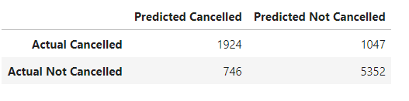
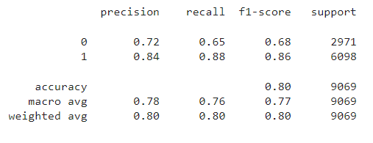
Support Vector Machine Model
Even though the accuracy of the model is 80%, we believe that for this model we needed more cancelled reservation in order to make a better prediction as precision and recall are 72% and 65% respectively.

Slide 24
Tableau

Slide 25
Brief Overview of Random Forest Machine Learning Algorithm
Popular supervised machine learning algorithm.
It implements both Classification and Regression problems in ML.
It is a classifier that includes several decision trees instead of relying on one.
It takes predictions from each tree and based on the majority votes of predictions, it predicts the final output.
The greater number of trees in the forest leads to higher accuracy and prevents the problem of overfitting.

Slide 26
Sources:
•https://www.kaggle.com/datasets/ahsan81/hotel-reservations-classification-dataset
•https://www.statista.com/statistics/1186201/hotel-and-resort-industry-market-size-global/

