Slide 1
HOTEL RESERVATIONS
An Analysis of Hotel Reservation Trends

Slide 2
Introduction

Slide 3
The Data Hotel
A lot has changed in the hospitality industry post pandemic and the elements that have been especially volatile and difficult to track are prices and cancellations. The cost of booking a hotel room plummeted in the early stages of the pandemic when nobody was traveling.
Analyse the trends of hotel reservations.
What market segment make the most reservations.
Costs.
Possible special requests from customers or any other interesting find.

Slide 4
Hotel Reservation data set. Why?
We as a group wondered if we could help produce better forecasts and reduce uncertainty in business decisions taken by hotel management in the future.
Exploratory Data Analysis: factors that may impact pricing and cancellations.
Machine Learning: predict guest cancellation.

Slide 5
Description
The dataset has been taken from Kaggle.
It contains records of hotel reservations:
36,275 data points
19 features.
16 numerical columns and 3 categorical columns.

Slide 6


Slide 7
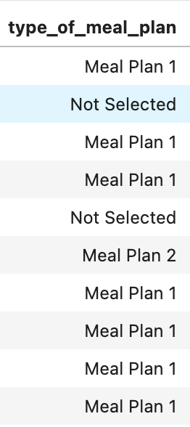
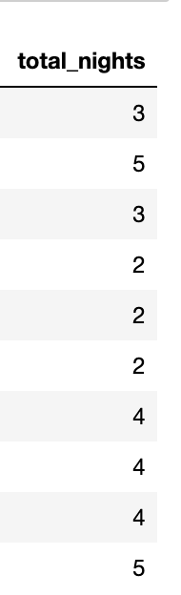
Data Cleaning
To make sure we have a clean dataset, so our results are not skewed, we took the following steps:
Checked null values
Checked duplicate values
Dropped column “type_of_meal_plan”
Created a new column “total_nights” by adding “n_of_weekend nights” with “n_of_week_nights”

Slide 8
Exploratory Data Analysis
“Action is one, two is coincidence, three of them forms a trend and suggests a pattern.”
Thomas Vato

Slide 9
Exploratory Data Analysis
To get more in-depth insight into our data we analysed the following questions using python:
What’s the average price? (Per day, per month)
Do longer total stays have lower average prices?
What is the busiest month?
Which time of the year has the longest reservations?
Which months have more reservations with children?
Which months include more reservations with weekends?
From which segment do reservations come the most?
Does a longer lead time result in less cancellations?

Slide 10
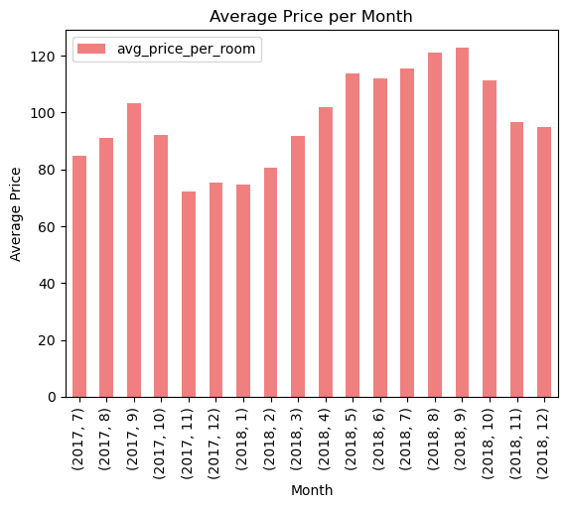
What’s the average price?
Average price per month - $103.4

Slide 11
Do longer total stays have lower average prices?
Based on our analysis the correlation value between longer stays and average prices, is:
0.02 (approx.)
This shows a weak correlation. That means longer reservations have no minimal impact on average room prices.

Slide 12
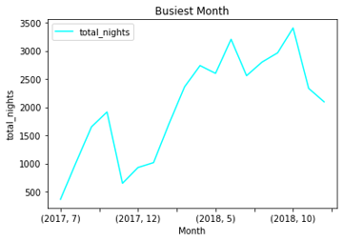
What is the busiest month?
October is the busiest month.

Slide 13
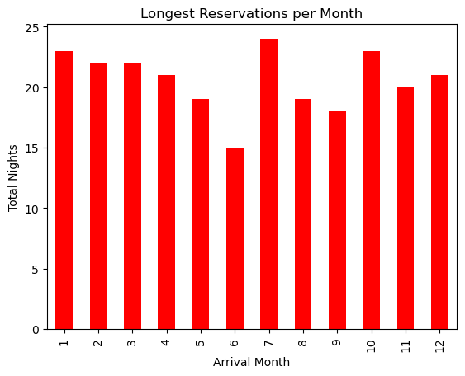
Which time of the year has the longest reservations?
Based on the chart we created, July
has the longest reservations.

Slide 14
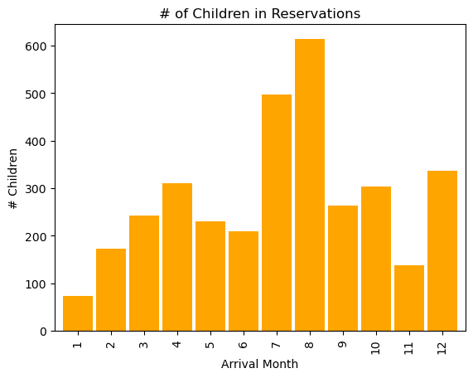
Which months have more reservations with children?
The month of August seems to
have more reservations with kids.

Slide 15
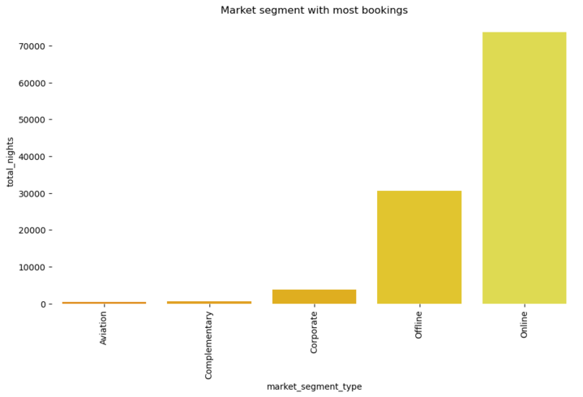
From which segment do reservations come the most?
Most reservations come from the
Online market segment.

Slide 16
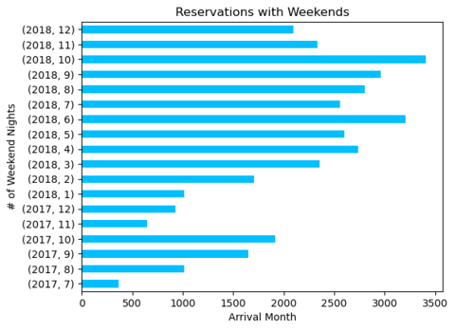
Which months include more reservations with weekends?
From Jan, 2018 to Dec, 2018
October has the most reservations
with weekends.

Slide 17
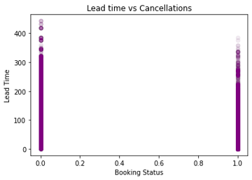
Does a long lead time result in less cancellations?
There is a negative correlation
-0.44 (approx.)
Which means, a longer lead time
result in more cancellations.

Slide 18
Dashboard

Slide 19
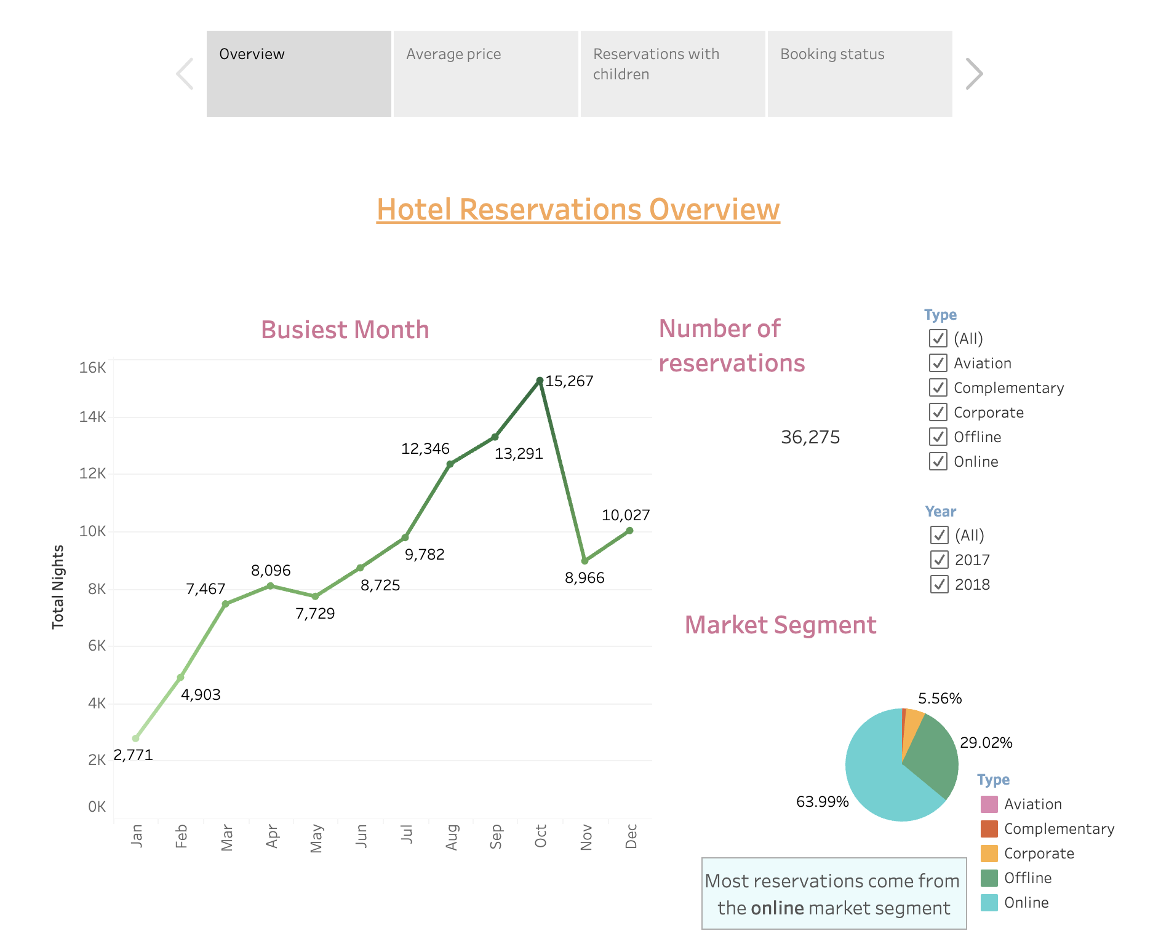
https://public.tableau.com/app/profile/dominique.villacis/viz/Hotel_reservations/Analysis

Slide 20
Database

Slide 21
Database creation and design process
Purpose of the database
We wanted to create a database so we could organize and store the data in a structured form and access it easily for our in-depth analysis.
Organizing the information
We cleaned the data by checking nulls and duplicate values.
We dropped the column named “Meal_plan”, as it did not have relevant information to our analysis.
We combined columns to create a new column named “total_nights”
Finally, we used the clean data to create our database

Slide 22
Database creation and design process
Dividing the information into tables
The database consists of 4 tables named :
Customers
Bookings
customer_bookings
Clean_hotel_dataset
The tables were joined by using primary key named: Booking_ID.

Slide 23
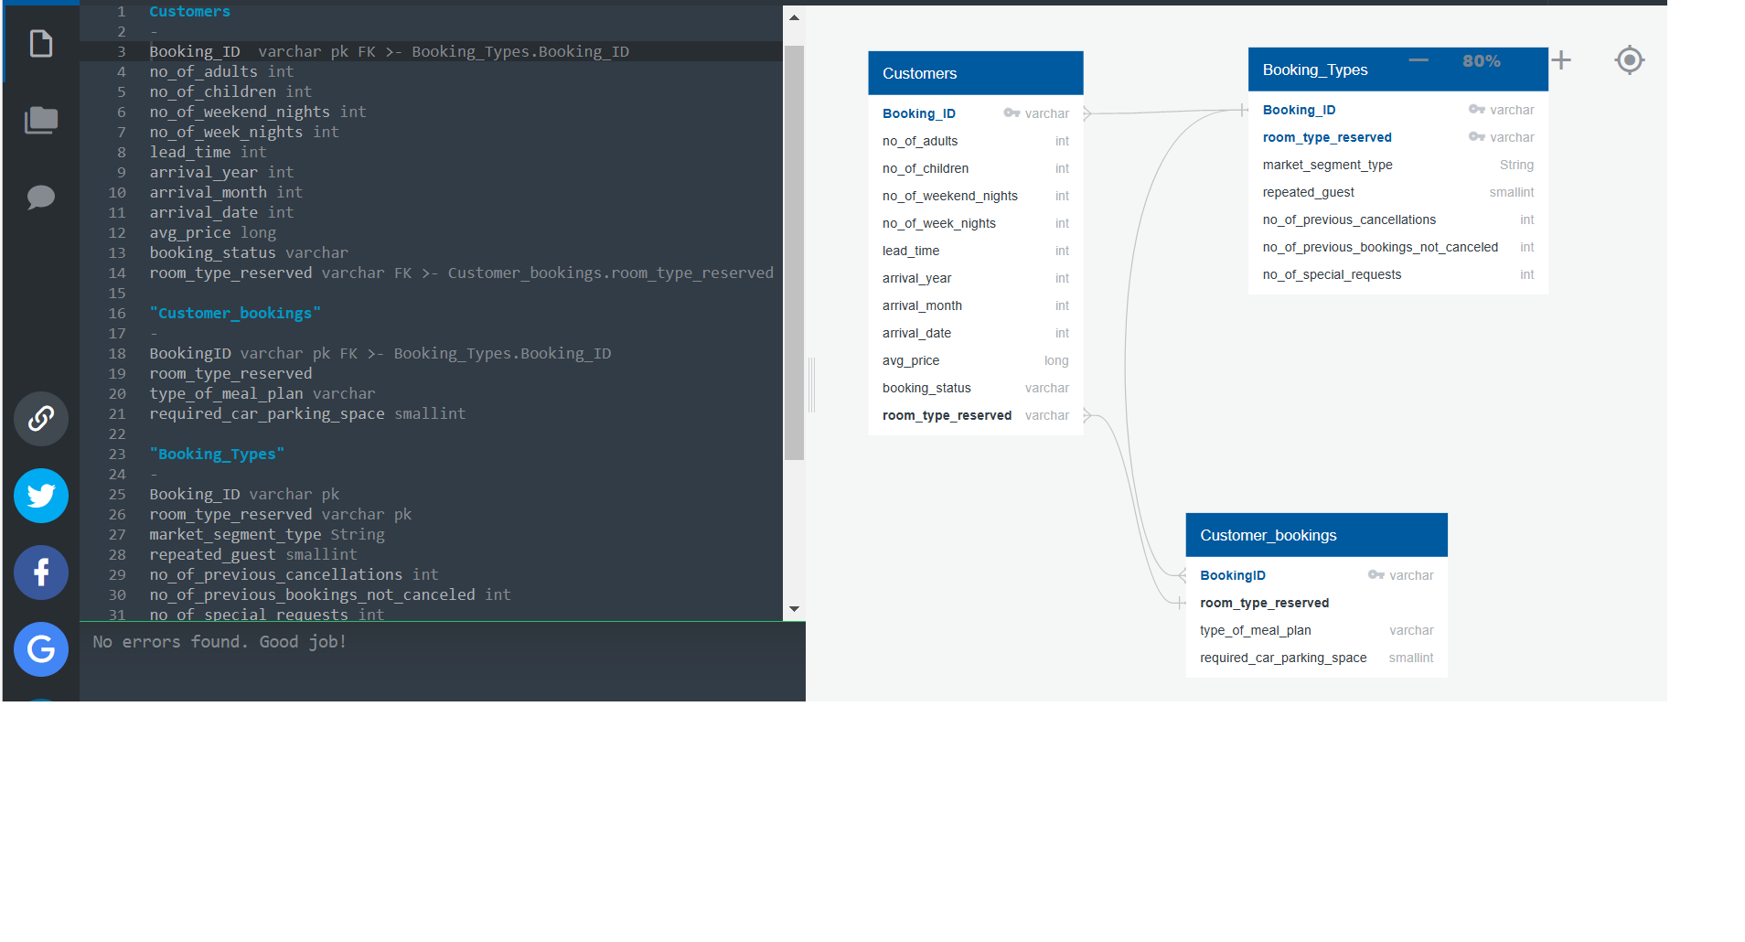
Database ERD
Below is the database ERD with the different dataypes and primary key

Slide 24
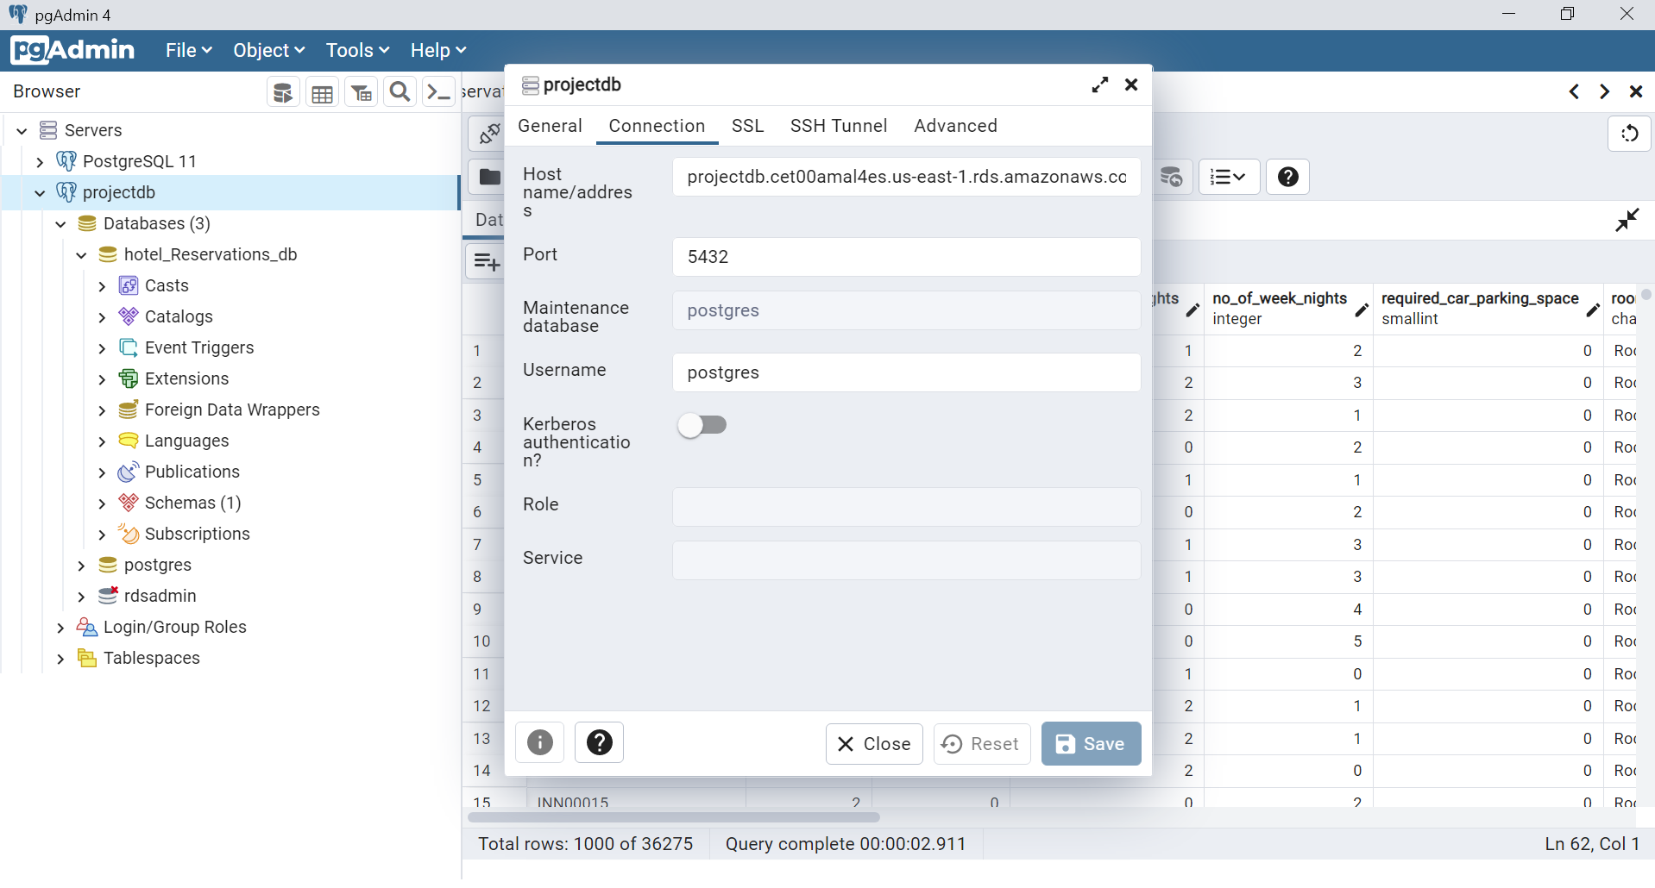
Database AWS link
Postgres database was set up and hosted on AWS RDS services and then connected to local pgAdmin using the url of the endpoint from AWS ,the resulting new server was named projectdb .

Slide 25
Machine Learning

Slide 26
Models
Logistic Regression Model: predicts binary outcomes, meaning that there are only two possible outcomes.
Support Vector Machine Model: like logistic regression, is a binary classifier: It can categorize samples into one of two categories
Decision Tree: encodes a series of true/false questions that are represented by a series of if/else statements
Random Forest: sample the data and build several smaller, simpler decision trees

Slide 27
Logistic Regression Model
Logistic regression is a classification algorithm, and is used when the classification problem is binary.
The objective of this model is to predict if reservations made by customers are going to be cancelled or not cancelled.
We first preprocessed the data to make sure we don’t have null or duplicated values.
Logistic regression just accepts numeric values as input; we did an integer encoding to the target variable “booking_status” (cancelled: 0, not cancelled: 1).
We proceeded to remove categorical columns and noisy features to prepare our model for the train and test set.

Slide 28
Train and test the model
We followed these steps:
1. Split data into training and testing, to learn and assess the performance of the model.
2. Create a Logistic Regression model
3. Fit the model using the training data
4. Make predictions (to create predictions for y-values we used the X_test set)
5. Validate the model with accuracy score, confusion matrix and classification report

Slide 29
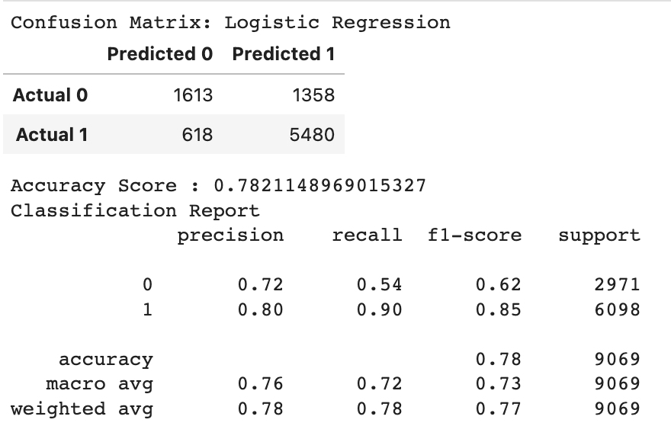
Results
Accuracy score: 78%
Precision: 72%
Sensitivity/Recall: 54%
Although accuracy is quite high,
it is important to evaluate the recall method as well and a 54% result is low for the analysis, which means that the logistics regression model did not perform well in this case.

Slide 30
Support Vector Machine Model
We use the Support Vector Machine model as it is a binary classifier. This means that the possible outcomes are either cancelled or not cancelled.
During the process of creating the model we encoded three of the columns, market segment type, room type reserved and booking status.
The purpose of encoding this data was to use it in the SVM model. The data was transform from categorical into integers.
0 and 1 for booking status, 0 for Cancelled and 1 for Not Cancelled.

Slide 31
Support Vector Machine Model
After encoding the data, the next step was to remove unwanted columns from the data.
We use the encoded booking data as our y variable and for our x variable we removed Booking ID, and the uncoded room type reserved, market segment type and booking status, as well as the encoded booking which is our y variable.
The model was created using the linear kernel, as data was 0 or 1.
With this model we got an accuracy score of 80.23%

Slide 32
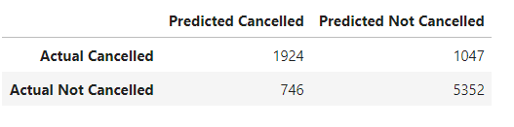
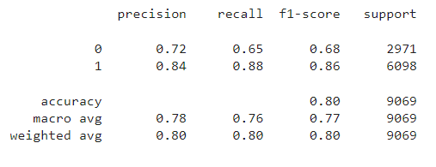
Support Vector Machine Model
Even though the accuracy of the model is 80%, we believe that for this model we need more cancelled reservations in order to make a better prediction, as precision and recall are 72% and 65%, respectively.

Slide 33
Decision Tree Model
Decision tree was chosen as it's easier to understand and require less time and fewer resources to create and because the dataset has a feature named " booking status” that is really important to a decision be taken.
The dataset was split into features (or inputs) and target (or outputs).
The features set, X, is copy of the booking dataset without the booking_status . The target Y is the booking status, to predict whether it will be cancelled or not.
The data was then split into training and testing sets. Below is the Confusion matrix.
The Confusion matrix shows an accuracy of 84.5% and the precision and recall is not too low either.

Slide 34
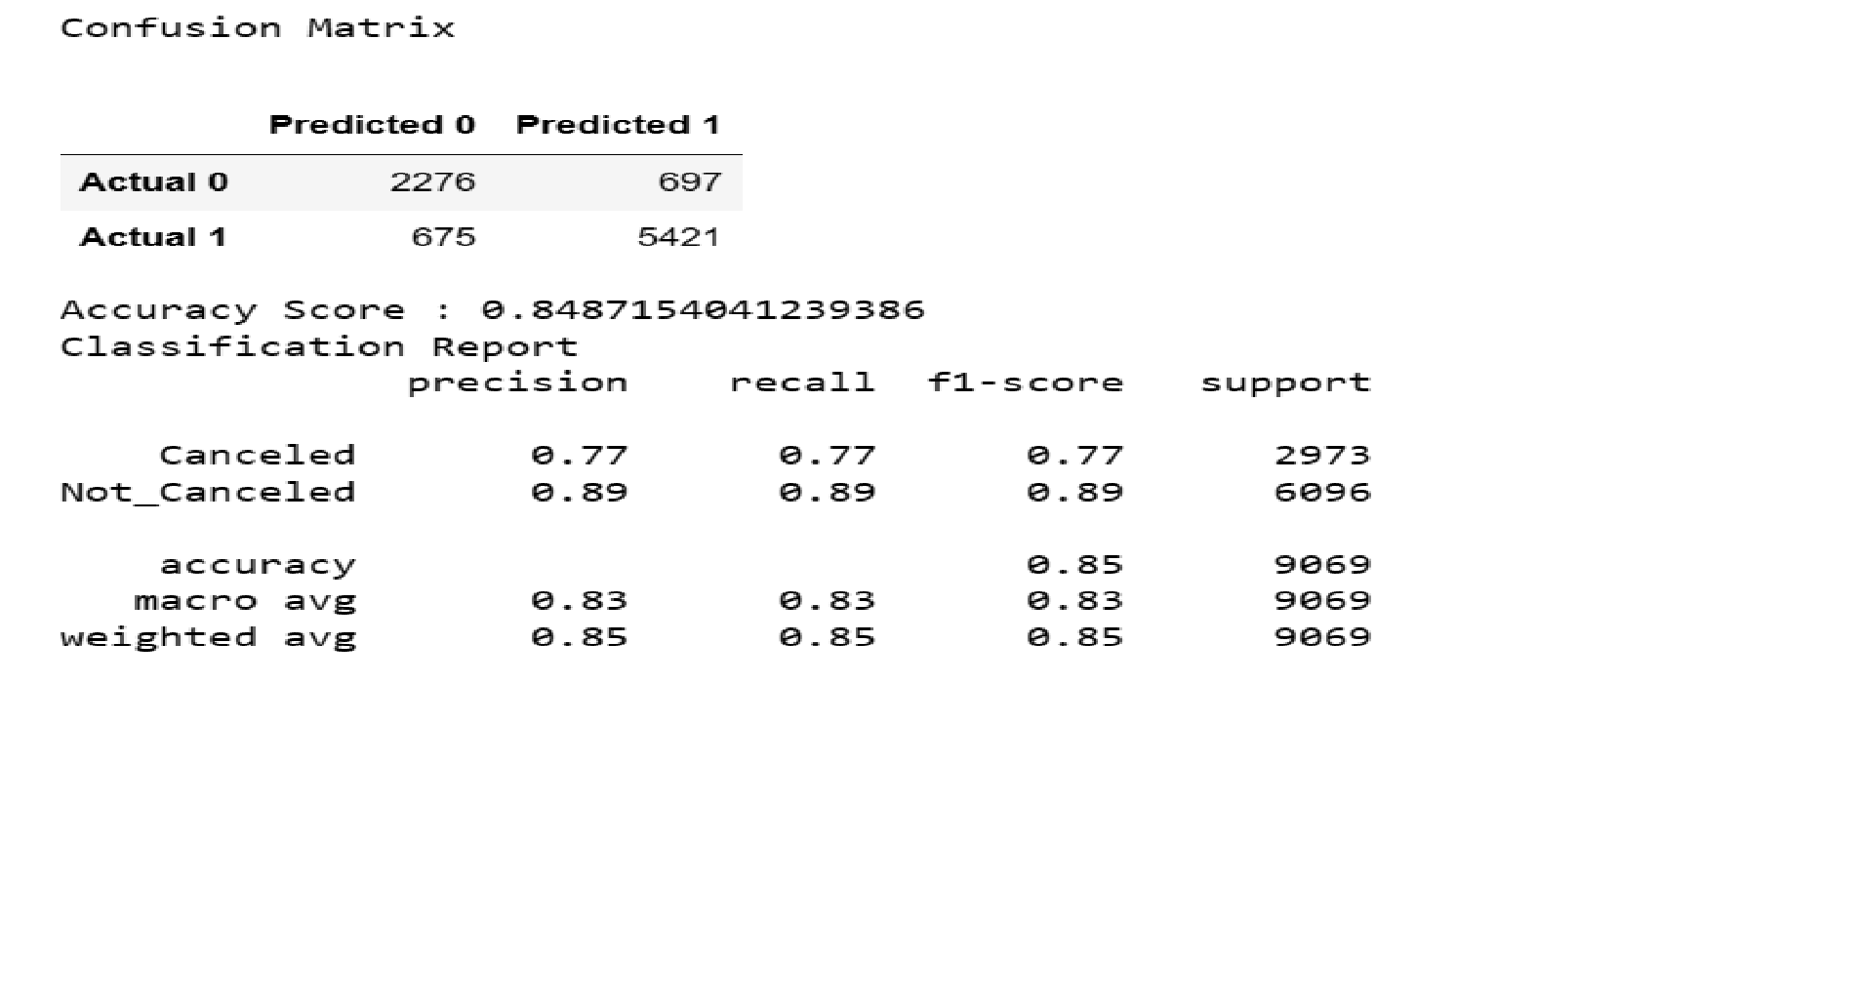

Slide 35
Brief Overview of Random Forest Machine Learning Algorithm
Popular supervised machine learning algorithm.
It implements both Classification and Regression problems in ML.
It is a classifier that includes several decision trees instead of relying on one.
It takes predictions from each tree and based on the majority votes of predictions, it predicts the final output.
The greater number of trees in the forest leads to higher accuracy and prevents the problem of overfitting.

Slide 36
Why choosing Random Forest Algorithm?
It provides a relatively higher accuracy rate.
Our data is 36,275 data points. It’s not a huge dataset but, Random forest handles big data well.
For this dataset we wanted to predict if a hotel reservation made by a customer will be canceled or not. Here, we are trying to predict a label i.e canceled or not canceled. So, using a random forest classification model can be useful.

Slide 37
Creating Random Forest Algorithm
First, we define the features set and named it model_df. We dropped categorical columns "Booking_ID","room_type_reserved" and "market_segment_type"
Next, we define the target set. Here, we used the ravel() method, which performs the same procedure on our target set data as the values attribute. The target set here is “booking_status”
Then, we split it into the training and testing sets.
Lastly, we created the StandardScaler instance, fit the scaler with the training set, and scale the data.
We created a random forest instance using the random forest classifier, RandomForestClassifier().
Finally, we fit the model with our training sets.
Then, made predictions using the scaled testing data.

Slide 38
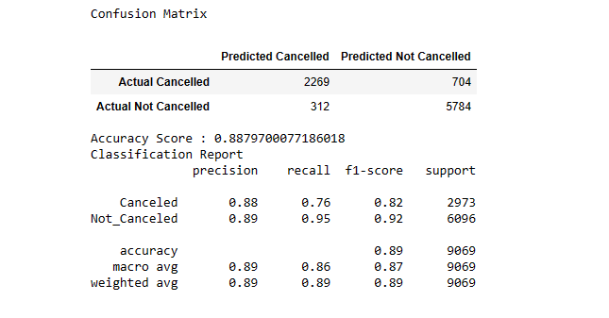
Evaluating the Model
After making predictions on the scaled testing data, we analyzed how well our random forest model classifies loan applications by using the confusion_matrix.
The accuracy of this model is 89%

Slide 39
Results
 | Logistic Regression | SVM | Decision Tree | Random Forest
Accuracy | 78% | 80% | 85% | 89%
Precision | 72% | 72% | 77% | 88%
Recall | 54% | 65% | 77% | 76%

Slide 40
Recommendations

Slide 41
Since October is the busiest month, our recommendation is to increase the average room price for that month to increase hotel profits.
Increase marketing efforts for offline, corporate and aviation segments, as they are significantly lower than online sales.
In order to reduce cancellations with longer lead time and to avoid unoccupied rooms, the hotel should implement a stricter cancellation policy.
We recommend creating packages for families to stay over the weekend on non-peak travel times.
We recommend promoting the winter months by partnering with trade shows and hosting corporate events to increase hotel bookings.

Slide 42
Tools - Technologies
Python/Pandas/Sklearn
PostgreSQL/AWS
Tableau
Microsoft Powerpoint
Google Slides

Slide 43
Sources
UM Data Analytics Modules
https://www.kaggle.com/datasets/ahsan81/hotel-reservations-classification-dataset
https://www.statista.com/statistics/1186201/hotel-and-resort-industry-market-size-global/

Slide 44
Contributors
Dominique Villacis
Bernardino Echeverria
Sausana Abraham
Sugandha Singh

