Slide 1
HOTEL RESERVATIONS
An Analysis of Hotel Reservation trends

Slide 2
Introduction
A lot has changed in the hotel industry post pandemic. Among other factors like new cleaning protocols and health screenings, the elements that have been especially volatile and difficult to track are prices and cancellations.
The cost of booking a hotel room plummeted in the early stages of the pandemic when nobody was traveling. We decided to analyse a hotel reservation dataset to look at the booking trends pre-covid. This analysis will help hoteliers set fair expectations for hotel industry recovery post-covid.

Slide 3
Why we chose Hotel Reservation data set?
With this pre-covid dataset, we as a group wondered if we could help produce better forecasts and reduce uncertainty in business decisions taken by hotels in the future. By using Machine Learning we can predict the chances of a guest cancelling their reservation.
By using Exploratory Data we can get insights into prices and other factors that may impact pricing and cancellations.

Slide 4
Description of our dataset
The dataset has been taken from Kaggle.
The dataset contains records of hotel reservations. There are:
36,275 data points
19 features.
Most of the data is numerical with 3 columns being categorical.
The columns of the raw data are the following:
Booking_ID, no_of_adults, no_of_children, no_of_weekend_nights, no_of_week_nights, type_of_meal_plan, required_car_parking_space, room_type_reserved, lead_time, arrival_year, arrival_month, arrival_date, market_segment_type, repeated_guest, no_of_previous_cancellations, no_of_previous_bookings_not_canceled, avg_price_per_room, no_of_special_requests, booking_status

Slide 5
Exploratory Data Analysis
To get more in-depth insight into our data we analysed the following questions using python:
What’s the average price? (Per day, per month)
Do longer total stays have lower average prices?
What is the busiest month?
Which time of the year has the longest reservations?
Which months have more reservations with children?
Which months include more reservations with weekends?
From which segment do reservations come the most?
Does a longer lead time result in less cancellations?

Slide 6
Data Cleaning
To make sure we have a clean dataset, so our results are not skewed, we took the following steps:
Checked null values
Checked duplicate values
Dropped column “type_of_meal_plan”
Combined Weekend nights and weeknights booking columns to create a “total_nights” column.

Slide 7
Exploratory Data Analysis

Slide 8
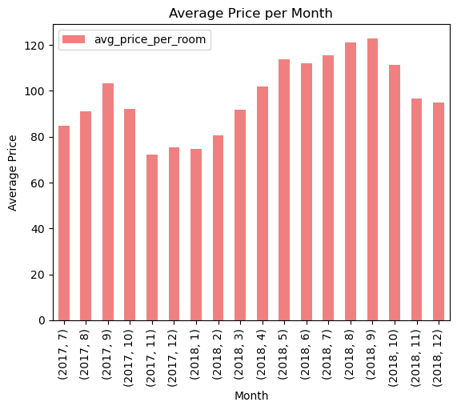
What’s the average price?
Average price per day - $103.4

Slide 9
Do longer total stays have lower average prices?
Based on our analysis the correlation value between longer stays and average prices, is:
0.015768370115224067
This shows a weak correlation. That means longer reservations have no minimal impact on average room prices.

Slide 10
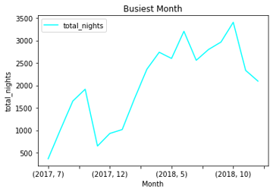
What is the busiest month?
October is the busiest month.

Slide 11
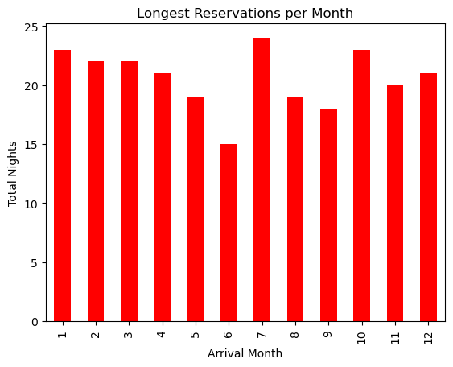
Which time of the year has the longest reservations?
Based on the chart we created, July
has the longest reservations.

Slide 12
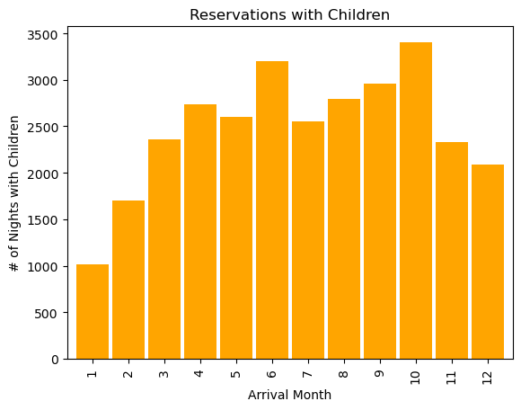
Which months have more reservations with children?
The month of October seems to
have more reservations with kids.

Slide 13
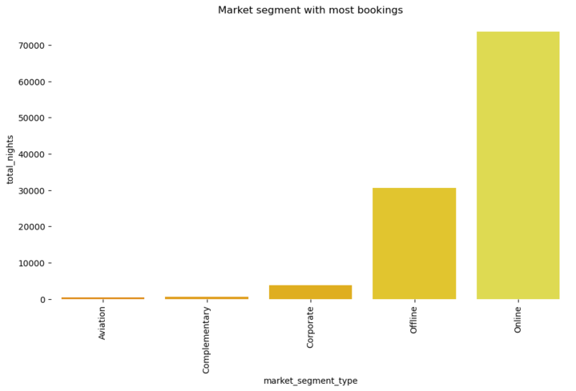
From which segment do reservations come the most?
Most reservations come from the
Online market segment.

Slide 14
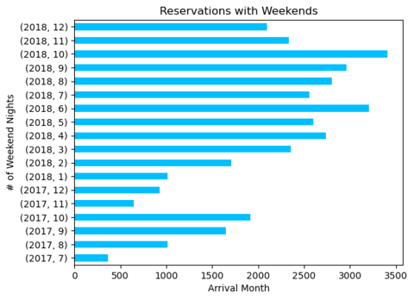
Which months include more reservations with weekends?
From Jan, 2018 to Dec, 2018
October has the most reservations
with weekends.

Slide 15
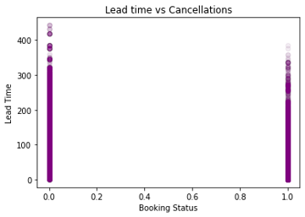
Does the longer lead time lead to more cancellations?
There is a negative correlation
-0.4385379185883181
Which means, a longer lead time
result in more cancellations.

Slide 16
Database

Slide 17
Database creation and design process
Purpose of the database
We wanted to create a database so we could organize and store the data in a structured form and access it easily for our in-depth analysis.
Organizing the information
We cleaned the data by checking null and duplicate values.
We dropped the column “Meal_plan”, as it did not have relevant information to our analysis.
We combined columns to create a new column “total_nights”
Finally, we used the cleaned data to create our database

Slide 18
Database creation and design process
Dividing the information into tables
We used postgres.
The database consists of 4 tables:
Customers
Bookings
customer_bookings
Clean_hotel_dataset
The tables were joined by using primary key: Booking_ID.

Slide 19
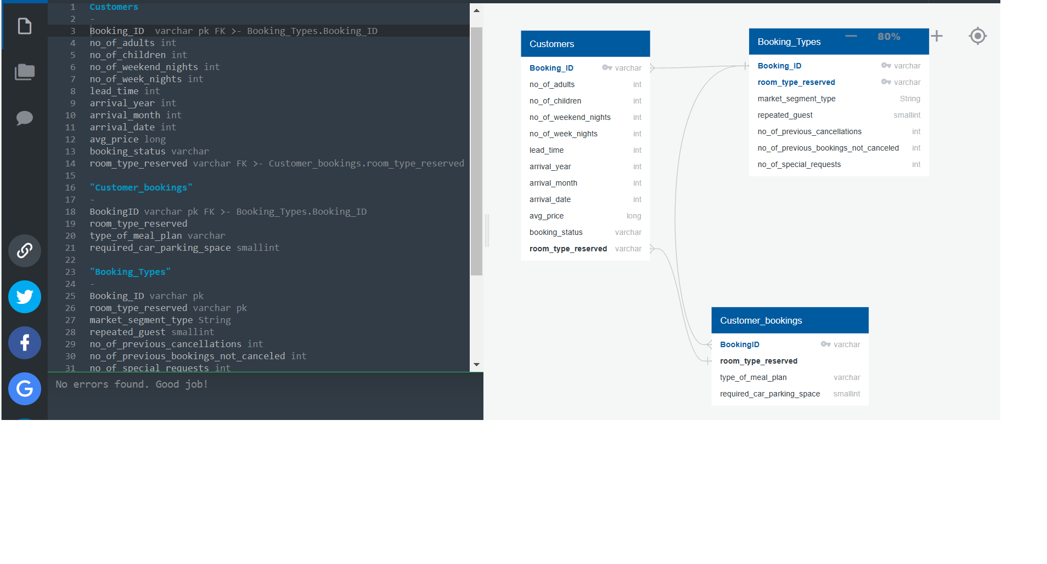
Database ERD
Specify primary keys and set up table relationships

Slide 20
Machine Learning

Slide 21
Logistic Regression Model
Logistic regression is a classification algorithm, and is used when the classification problem is binary.
The objective of this model is to predict if reservations made by customers are going to be cancelled or not cancelled.
We first preprocessed the data to make sure we don’t have null or duplicated values.
Logistic regression just accepts numeric values as input; we did an integer encoding to the target variable “booking_status” (cancelled: 0, not cancelled: 1).
We proceeded to remove categorical columns and noisy features to prepare our model for the train and test set.

Slide 22
Train and test the model
We followed these steps:
1. Split data into training and testing, to learn and assess the performance of the model.
2. Create a Logistic Regression model
3. Fit the model using the training data
4. Make predictions (to create predictions for y-values we used the X_test set)
5. Validate the model with accuracy score, confusion matrix and classification report

Slide 23
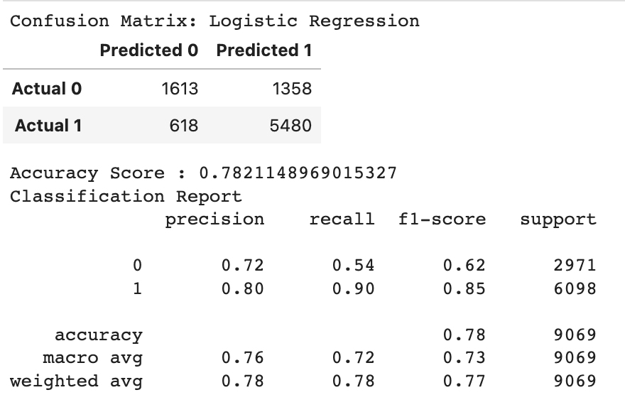
Results
Accuracy score: 78%
Precision: 72%
Sensitivity/Recall: 54%
Although accuracy is quite high,
it is important to evaluate the recall method as well and a 54% result is low for the analysis, which means that the logistics regression model did not perform well in this case.

Slide 24
Decision Tree Model
The dataset was split into features (or inputs) and target (or outputs).
The features set, X, is copy of the booking dataset without the booking_status . The target Y is the booking status, to predict whether it will be cancelled or not.
The data was then split into training and testing sets. Below is the classification report.
The Confusion matrix shows an accuracy of 84.5% which we are happy about.

Slide 25
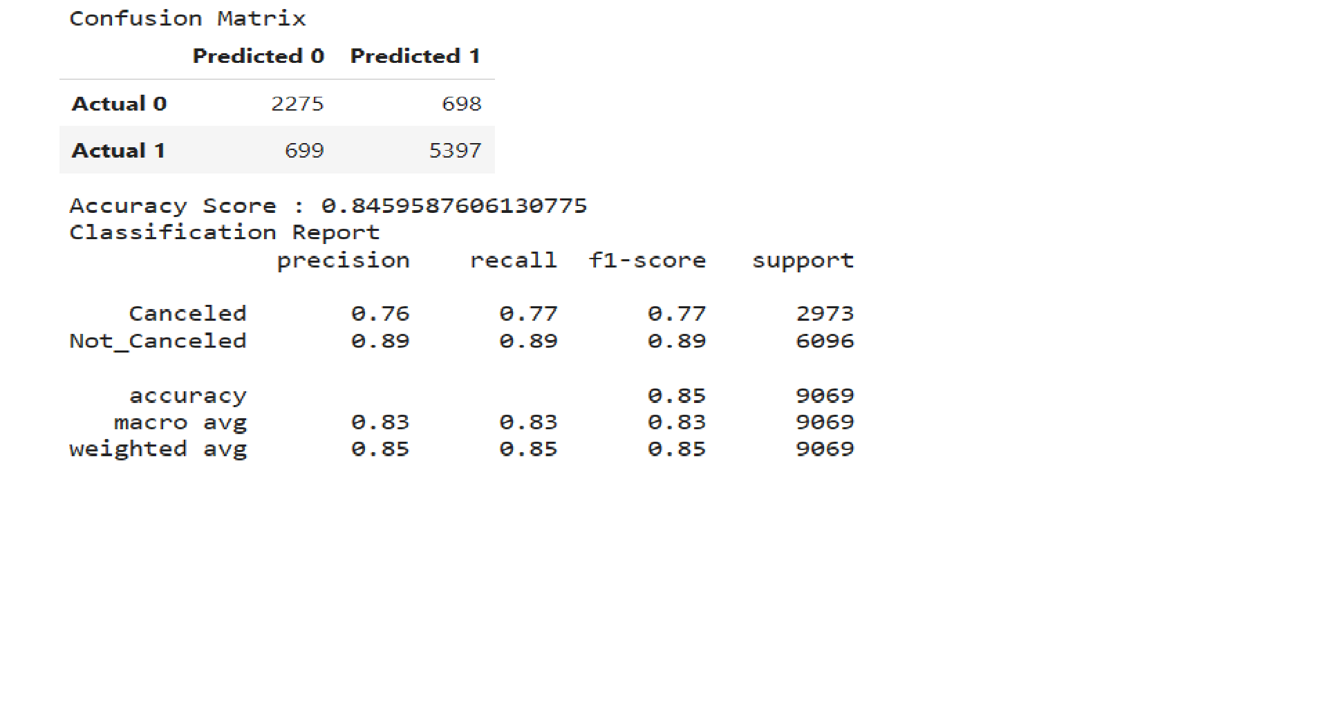

Slide 26
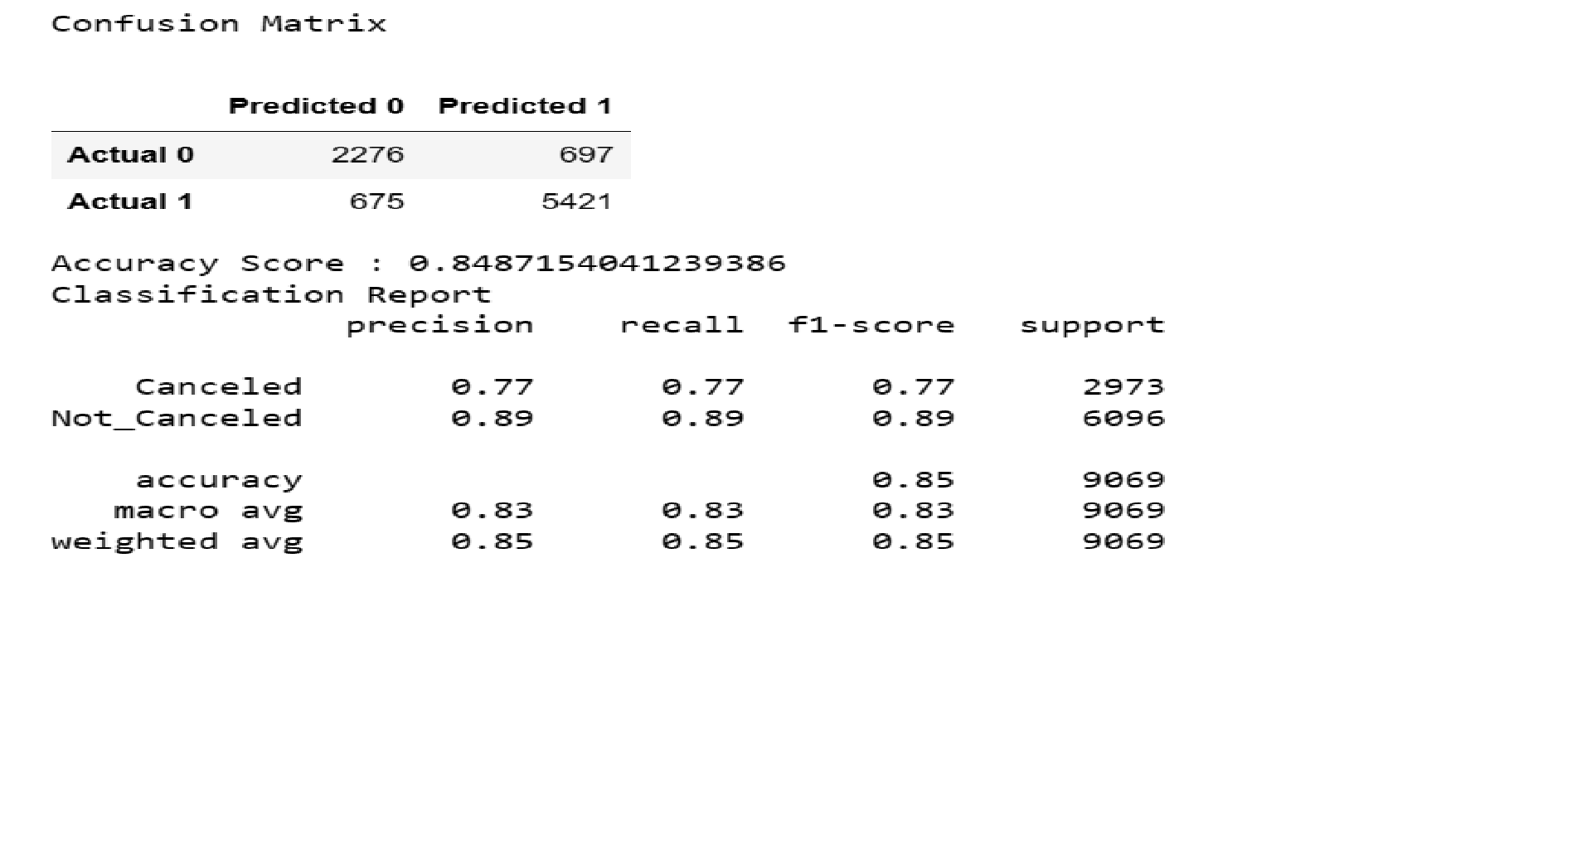

Slide 27
Support Vector Machine Model
We use the Support Vector Machine model as it is a binary classifier. This means that the possible outcomes are either cancelled or not cancelled.
During the process of creating the model we encoded three of the columns, market segment type, room type reserved and booking status.
The purpose of encoding this data was to use it in the SVM model. The data was transform from categorical into integers.
0 and 1 for booking status, 0 for Cancelled and 1 for Not Cancelled.

Slide 28
Support Vector Machine Model
After encoding the data, the next step was to remove unwanted columns from the data.
We use the encoded booking data as our y variable and for our x variable we removed Booking ID, and the uncoded room type reserved, market segment type and booking status, as well as the encoded booking which is our y variable.
The model was created using the linear kernel, as data was 0 or 1.
With this model we got an accuracy score of 80.23%

Slide 29
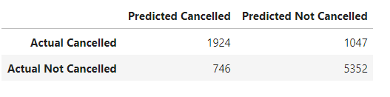
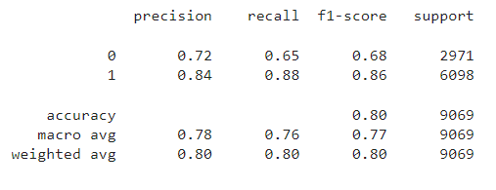
Support Vector Machine Model
Even though the accuracy of the model is 80%, we believe that for this model we need more cancelled reservations in order to make a better prediction, as precision and recall are 72% and 65%, respectively.

Slide 30
Brief Overview of Random Forest Machine Learning Algorithm
Popular supervised machine learning algorithm.
It implements both Classification and Regression problems in ML.
It is a classifier that includes several decision trees instead of relying on one.
It takes predictions from each tree and based on the majority votes of predictions, it predicts the final output.
The greater number of trees in the forest leads to higher accuracy and prevents the problem of overfitting.

Slide 31
Why choosing Random Forest Algorithm?
It provides a relatively higher accuracy rate.
Our data is 36,275 data points. It’s not a huge dataset but, Random forest handles big data well.
For this dataset we wanted to predict if a hotel reservation made by a customer will be canceled or not. Here, we are trying to predict a label i.e canceled or not canceled. So, using a random forest classification model can be useful.

Slide 32
Creating Random Forest Algorithm
First, we define the features set and named it model_df. We dropped categorical columns "Booking_ID","room_type_reserved" and "market_segment_type"
Next, we define the target set. Here, we used the ravel() method, which performs the same procedure on our target set data as the values attribute. The target set here is “booking_status”
Then, we split it into the training and testing sets.
Lastly, we created the StandardScaler instance, fit the scaler with the training set, and scale the data.
We created a random forest instance using the random forest classifier, RandomForestClassifier().
Finally, we fit the model with our training sets.
Then, made predictions using the scaled testing data.

Slide 33
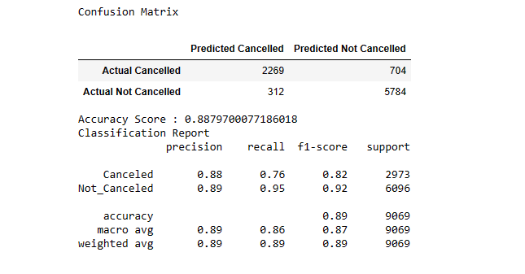
Evaluating the Model
After making predictions on the scaled testing data, we analyzed how well our random forest model classifies loan applications by using the confusion_matrix.
The accuracy of this model is 89%

Slide 34
Recommendations

Slide 35
Increase marketing efforts for offline, corporate and aviation segments, as they are significantly lower than online sales.
In order to reduce cancellations with longer lead time and to avoid unoccupied rooms, the hotel should implement a stricter cancellation policy by reducing the number of days for a full refund.
We recommend creating packages for families to stay over the weekend on non-peak travel times.
We recommend promoting the winter months by partnering with trade shows and hosting corporate events to increase hotel bookings.

Slide 36
Tools - Technologies
Python/Pandas/Sklearn
PostgreSQL/AWS
Tableau
Microsoft Powerpoint
Google Slides

Slide 37
Sources
UM Data Analytics Modules
https://www.kaggle.com/datasets/ahsan81/hotel-reservations-classification-dataset
https://www.statista.com/statistics/1186201/hotel-and-resort-industry-market-size-global/

Slide 38
Contributors
Dominique Villacis
Bernardino Echeverria
Sausana Abraham
Sugandha Singh

