Slide 1
PROJECT HOTEL RESERVATIONS
An Analysis of Hotel Reservations

Slide 2
CONTRIBUTORS
Dominique Villacis
Bernardino Echeverria
Sausana Abraham
Sugandha Singh

Slide 3
Introduction
A lot has changed in the hotel industry post pandemic. Among other factors like new cleaning protocols and health screenings, the elements that have been especially volatile and difficult to track are prices and cancellations.
The cost of booking a hotel room plummeted in the early stages of the pandemic when nobody was traveling. We decided to analyse a hotel reservation dataset to look at the booking trends pre-covid. This analysis will help hoteliers set fair expectations for hotel industry recovery post-covid.

Slide 4
Motivation
With this pre-covid dataset, we as a group wondered if we could help produce better forecasts and reduce uncertainty in business decisions taken by hotels in future. By using Machine Learning we can predict the chances of a guest cancelling their reservation. Using Exploratory data we can get insights into prices and other factors that may impact pricing and cancellations.

Slide 5
Description of our dataset
The dataset has been taken from Kaggle.
The dataset contains records of hotel reservations. There are -
36,275 data points
19 features.
Most of the data is numerical with 3 columns being categorical.
The columns of the raw data are the following:
Booking_ID, no_of_adults, no_of_children, no_of_weekend_nights, no_of_week_nights, type_of_meal_plan, required_car_parking_space, room_type_reserved, lead_time, arrival_year, arrival_month, arrival_date, market_segment_type, repeated_guest, no_of_previous_cancellations, no_of_previous_bookings_not_canceled, avg_price_per_room, no_of_special_requests, booking_status

Slide 6
Explanatory Analysis
To get more in-depth insight into our data we analysed following questions using python.
What’s the average price -
- Per day
-Per month
Do longer total stays have lower average prices?
What is the busiest month?
Which time of the year has the longest reservations?
Which months have more reservations with children?
Which months include more reservations with weekends?
From which segment do reservations come the most?
Does the longer lead time leads to more cancellations?

Slide 7
Data Cleaning
To make sure we have a clean dataset to work with so our results are not skewed we took following steps -
Checked for null values
Checked for duplicate values
Dropped the column - type_of_meal_plan
Combined the Weekend nights and weeknight booking columns to create a total nights column.

Slide 8
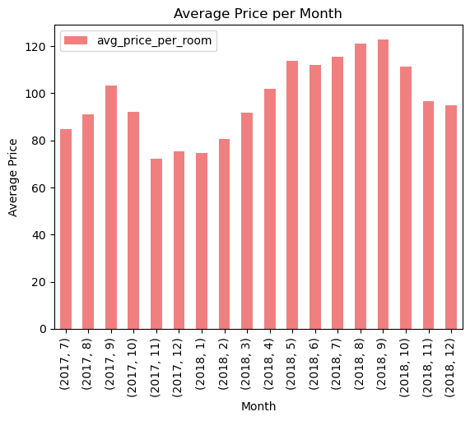
Results of Explanatory Analysis -
What’s the average price?
Average price per day - $103.4

Slide 9
Do longer total stays have lower average prices?
Based on our analysis the correlation value between longer stays and average prices came out to be
0.015768370115224067
This signifies a weak correlation. That means that longer reservations have none to minimum impact on average room prices.

Slide 10
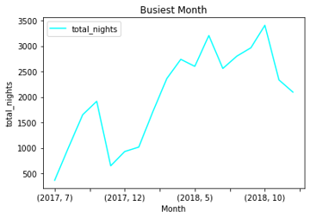
What is the busiest month?
October is the busiest month.

Slide 11
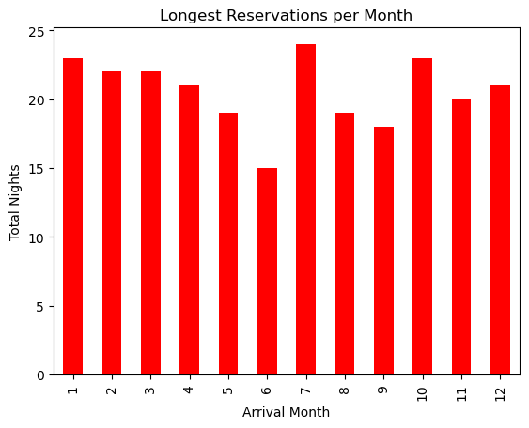
Which time of the year has the longest reservations?
Based on the chart we created the
month of July has the longest
reservations.

Slide 12
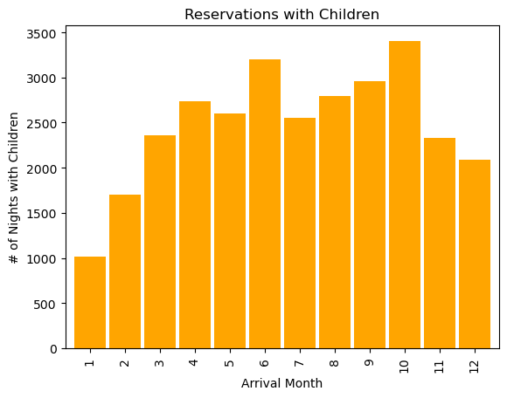
Which months have more reservations with children?
The month of October seems to
have more reservations with kids.

Slide 13
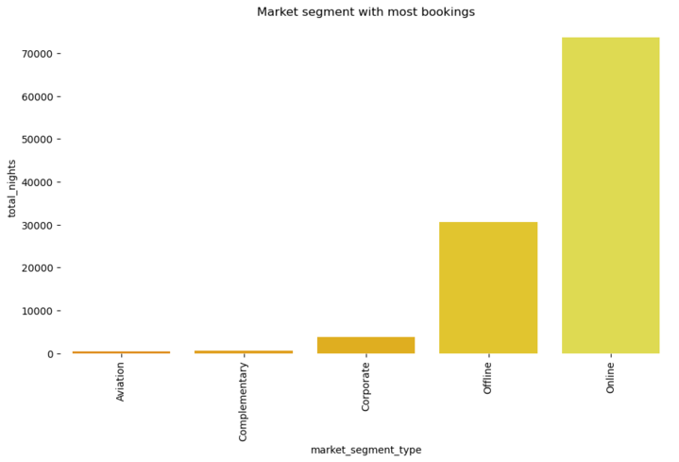
From which segment do reservations come the most?
Most reservations are made online.

Slide 14
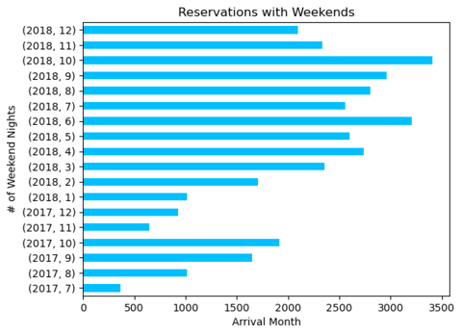
Which months include more reservations with weekends?
From Jan, 2018 to Dec, 2018
October has the most reservations
with weekends.

Slide 15
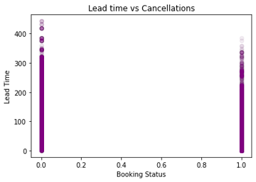
Does the longer lead time lead to more cancellations?
There is a negative correlation
-0.4385379185883181
Based on the dataset,
longer lead time does not lead to
more cancellations.

