Slide 1
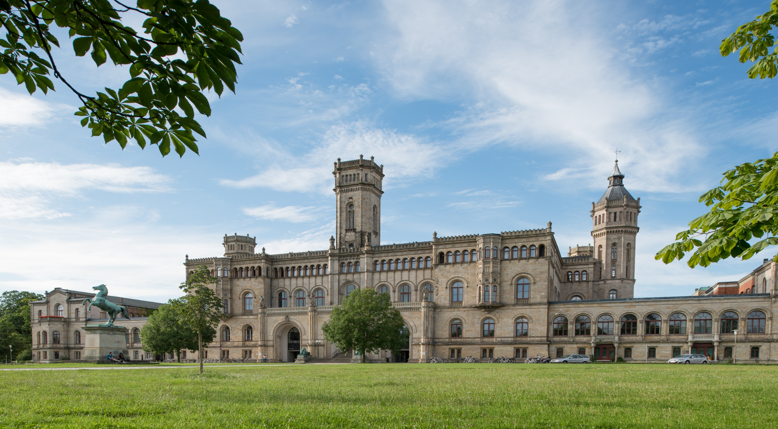

An Automatic Reproducibility Pipeline for the Learning Analytics Academic Community
Domenik Kern
Betreut von: Dr. Gábor Kismihók
© LUH

Slide 2
Structure
Introduction
  Research Objective
  Reproducibility
Implementation
  Reproducibility Checklist
  Development of Prototype and Workflow
  Human Evaluation Study
Results
  Study results
  Results for LAK’25
  Comparison to LAK’21/22
Discussion and Limitations
Conclusion

Slide 3
Introduction
Reproducibility crisis emerged over a decade ago [1]
Open Science (OS) to increase transparency and reproducibility [2]
Haim et al. [3] analyzed LAK’21/22 papers coherence to OS and reproducbility
→ Disappointing results in data sharing and reproducibility
No automated way to assess reproducibility at scale

Slide 4
Research Objective
Create a pipeline that automatically checks reproducibility criteria in a paper
Reproducibility Checklist combined with the LLM Gemma3
Pipeline applied to provide an overview of LAK

Slide 5
Reproducibility
Ability to draw the same conclusions from research by following the original documentation [4]
Improves quality and trust in science [2]
Possible by adopting OS practices, such as:
  Detailed documentation of Methods
  Open Data, Code
  Report results explicitly and transparently

Slide 6
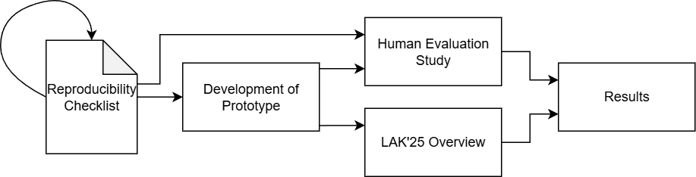
Approach for Implementation

Slide 7
Reproducibility Checklist
Open Methodology & Documentation | Clear explanation of methodology and a step-by-step description of the study or experiment.
Data Accessibility & Transparency | Datasets openly available, well documented, and collected through transparent methods.
Code & Software Availability | Code is shared in a public repository and includes scripts for data preparation and analysis.
Type of Analysis | Research and analytical methods are described clearly, including models, assumptions, and coding practices.
Results & Interpretation | Transparent reporting of outcomes and discussion of limitations and potential biases.
Preregistration | Checks whether the study was preregistered.

Slide 8
Development of Prototype
Paper as structured PDF file → Sections to be selected
Reproducibility Checklist read in as json
Sections and checklist put together as a prompt for LLM
Gemma 3 via Google Gemini API
Returns evaluated checklist with justification
Output parsed as json file

Slide 9
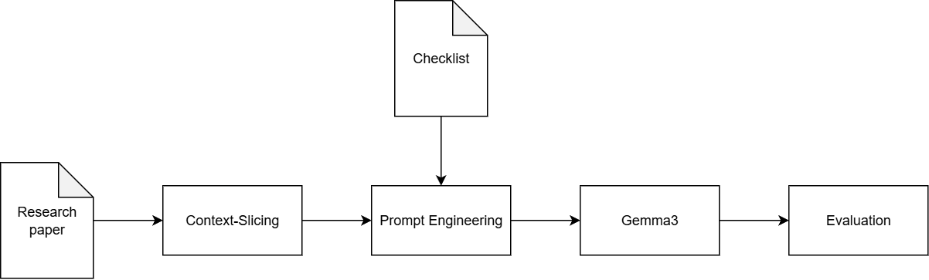
Pipeline Workflow

Slide 10
Human Evaluation Study
The checklist and the prototype got evaluated in a study
7 Participants, each participant gets 2 randomly selected papers from LAK’25 → 14 Papers evaluated
First manually evaluated, then with the help of prototype → comparison between results possible
Survey with questions to checklist and prototype
→ feedback for completeness of checklist and usabilty of prototype

Slide 11
Study Results
Few differences between manual and prototype evaluation
Main difference: detail quality of evaluation, like methods or interpretations → Prototype had no issue with that
As a result prototype evaluation always marked Open Methodology, Type of Analysis and Results as Met
Survey indicate a positive perception of checklist and prototype
Highlighting the prototype as a way to a fast and automated assessement, or atleast a help in creating framework

Slide 12
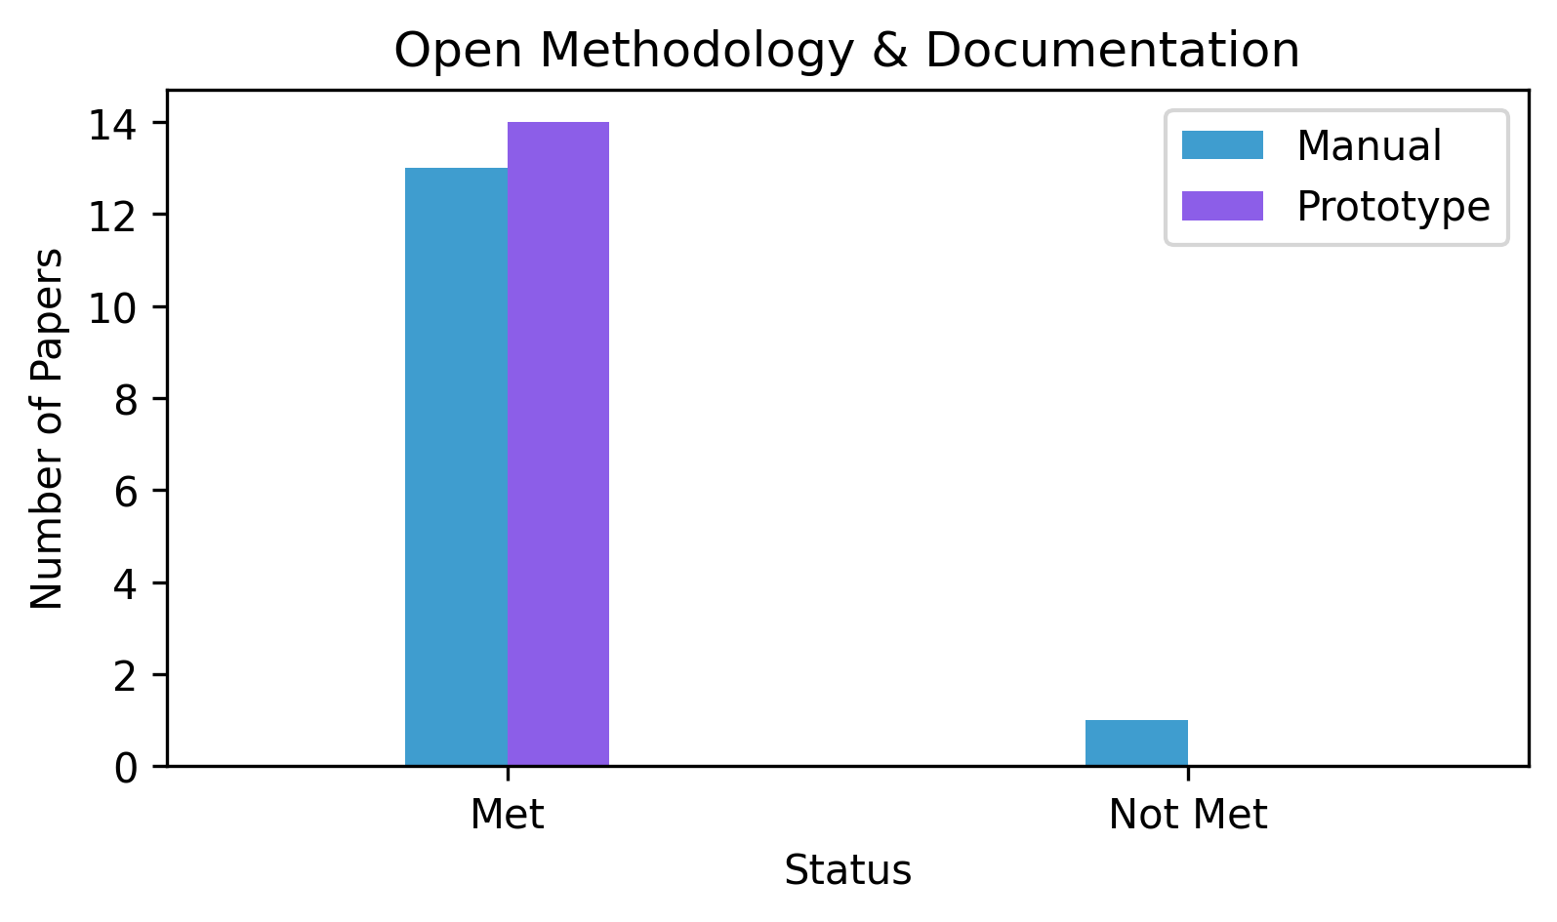
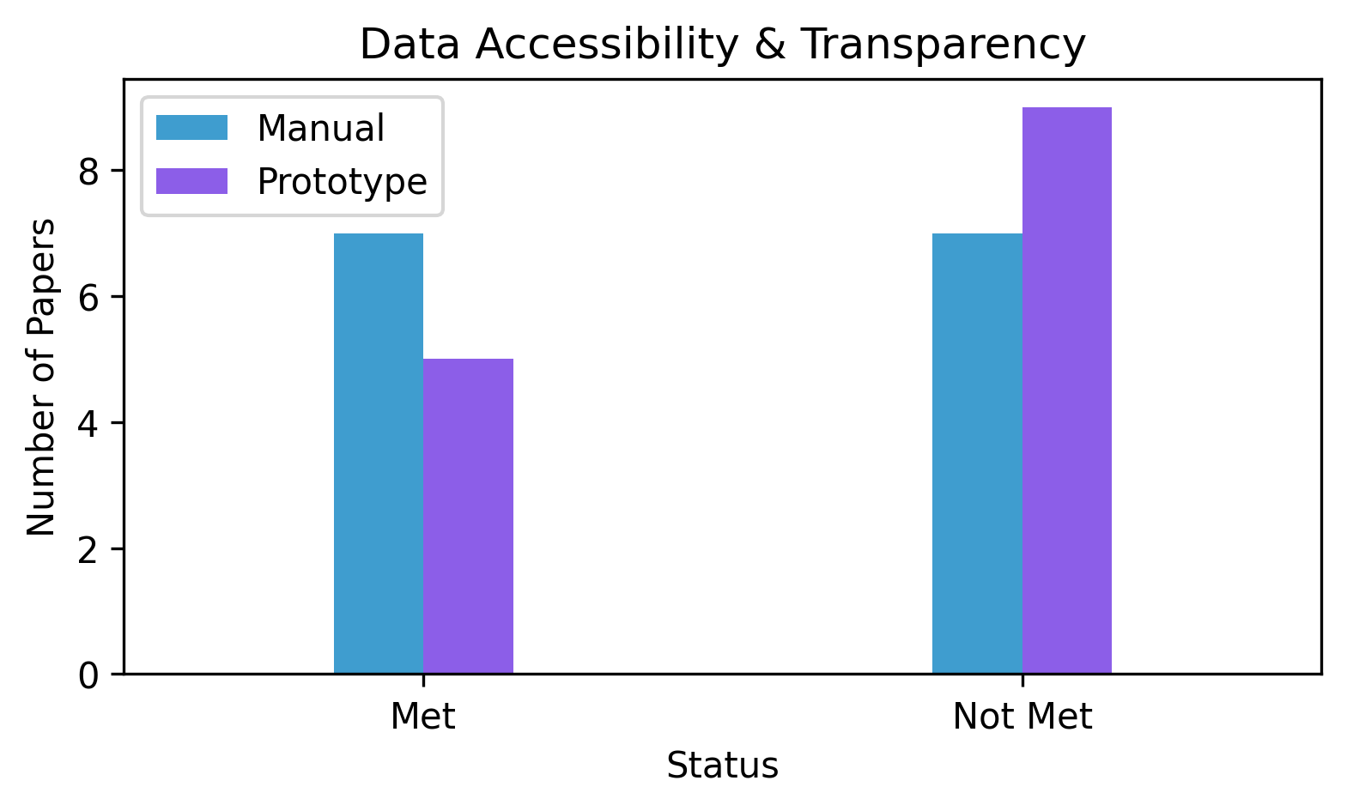
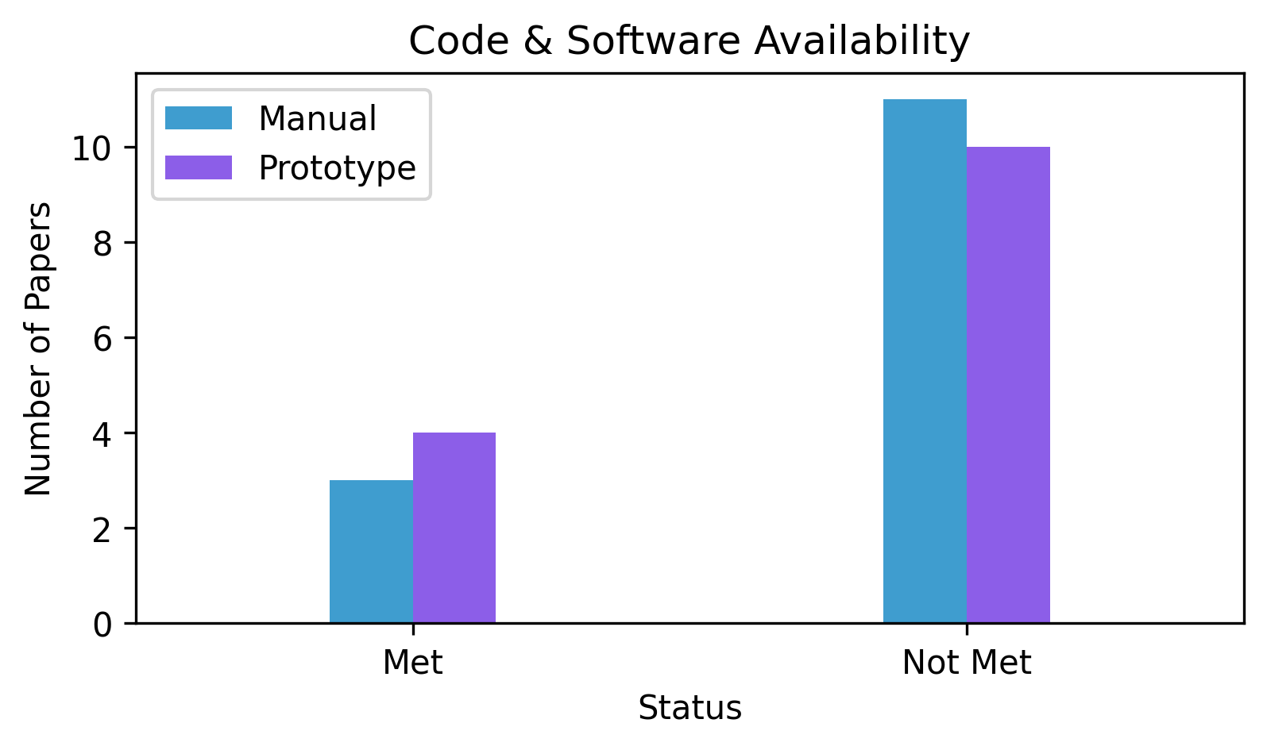
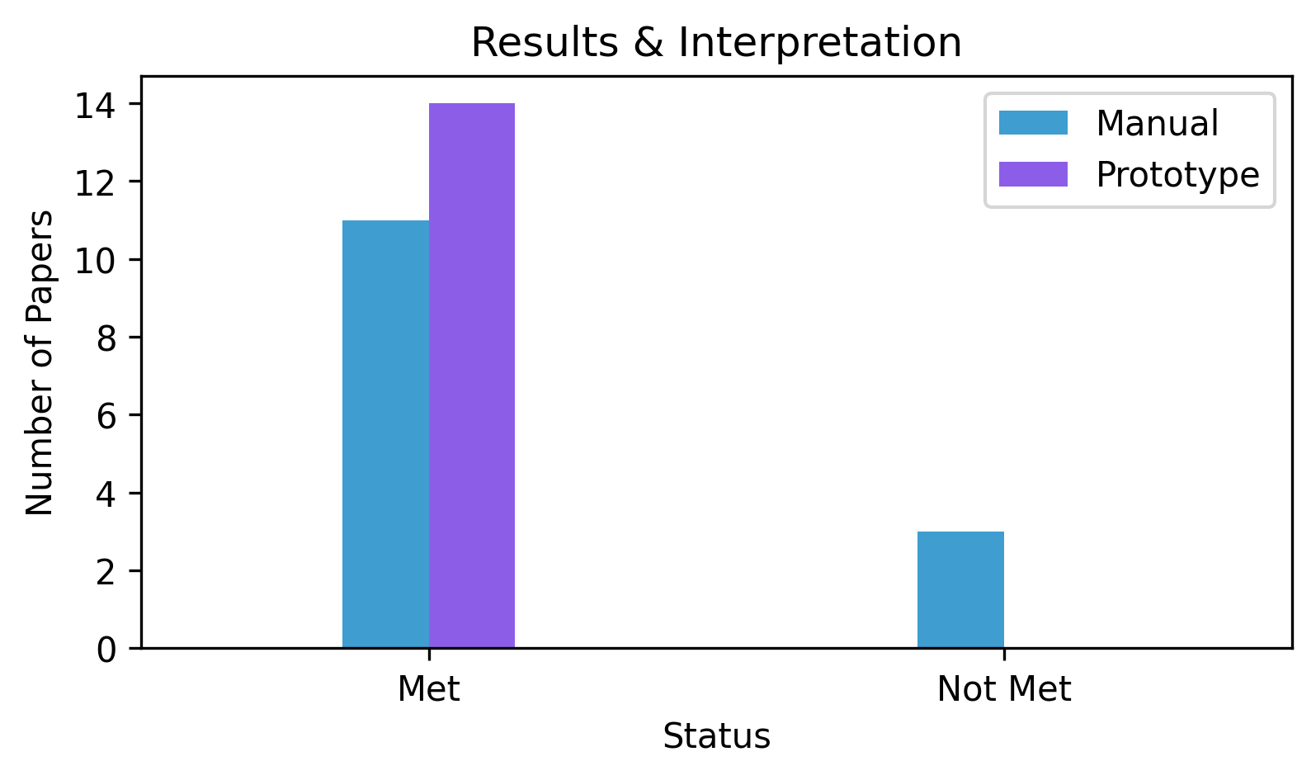
Comparison between manual and prototype evaluation

Slide 13
Results for LAK’25
All 70 research articles evaluated, from LAK’25
12 were deemed to be reproducible due to fully meeting the checklist
Every paper met criteria Open Methodology, Type of Analysis, Results & Interpretation
One third of papers shared Data and Code
One Paper was preregistered

Slide 14
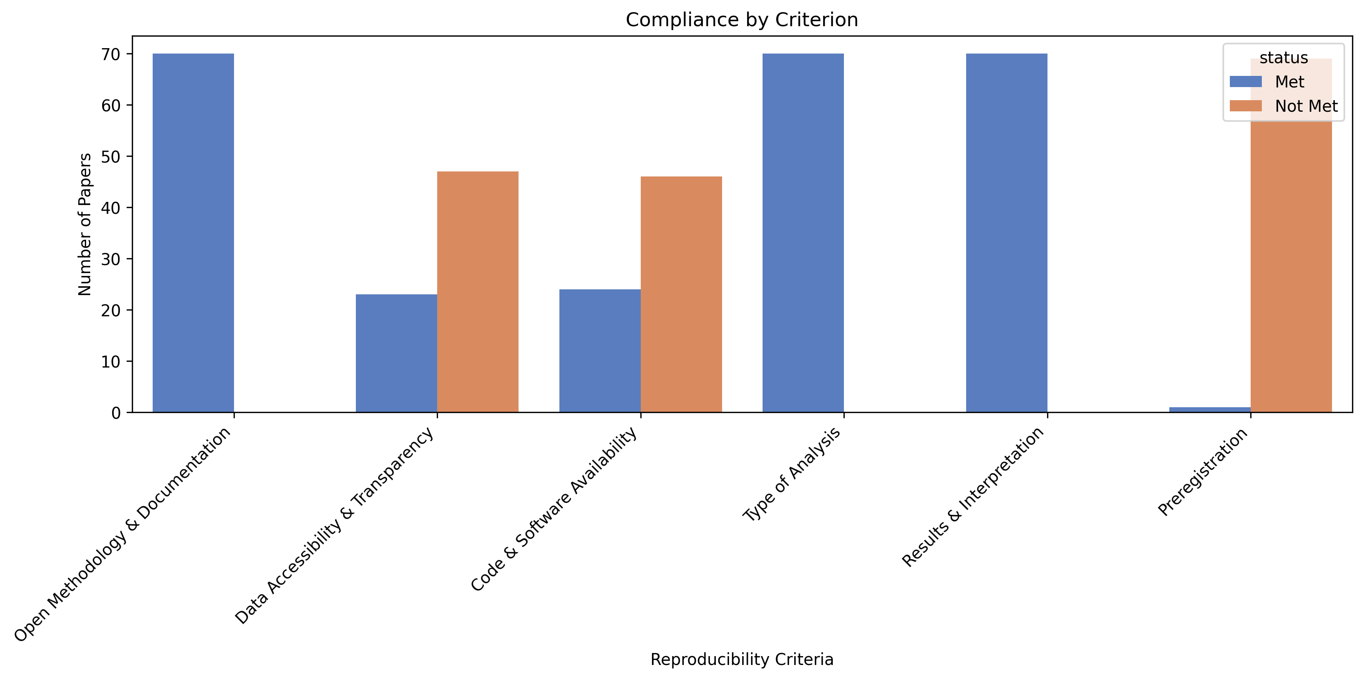
Overview of LAK’25 Criterion

Slide 15
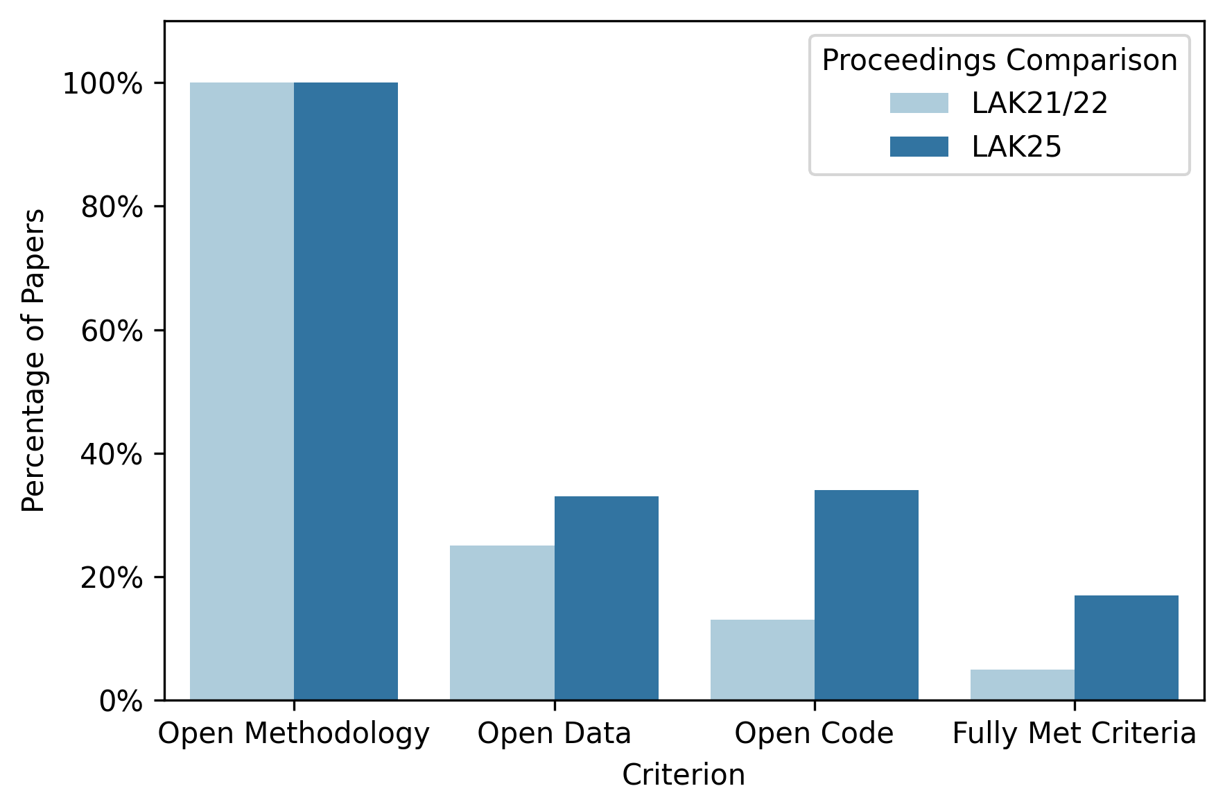
Comparison to LAK’21/22
Open Methodology
stayed at 100%
Open Data increased:
25% → 33%
Open Code also increased:
13% → 33%
Share of papers fully meeting criteria: 5% → 17%

Slide 16
Discussion & Limitations
Three Criteria always Met → might be lack of quality
→Criteria might need more granular questions
Sample size of study relatively small → maybe bigger difference between manual and prototype evaluation
Gemma 3 free, but limited rates and not as powerful
Still useful to create an overview and speed up manual work
No reproduction attempted → results should be seen as theoretical

Slide 17
Conclusion
Introduced an automated reproducibility checking pipeline
Pipeline evaluated in a study
Pipeline used to create an reproducibility overview of LAK’25 → seems to slowly improve
Pipeline not a perfect evaluater → results not 100% accurate, more like a baseline
More powerful LLM could improve it
Actual reproduction attempts could verify/discard findings

Slide 18
Sources
[1] F. Fidler and J. Wilcox. Reproducibility of scientific results. In E. N. Zalta, editor, The Stanford Encyclopedia of Philosophy. Metaphysics Research Lab, Stanford University, Summer 2021 edition, 2021.
[2]S. Bezjak et al. Open Science Training Handbook. Zenodo, 2018.
[3] A. Haim, S. Shaw, and N. Heffernan. How to open science: A principle and reproducibility review of the learning analytics and knowledge conference. In LAK2023: LAK23: 13th International Learning Analytics and Knowledge Conference, pages 156–164, 2023.
[4]O. E. Gundersen, “The fundamental principles of reproducibility,” Philosophical Transactions of the Royal Society A: Mathematical, Physical and Engineering Sciences, vol. 379, no. 2197, May 2021.

