Slide 1
Project Presentation
Performance Analysis and Modeling of Software Systems, Fall 2018
PAULA ANDREA CASTAÑEDA HOYOS , LUIS DOMÍNGUEZ LÓPEZ
PA.CASTANEDA@alumnos.upm.es , luis.dominguez.lopez@alumnos.upm.es

Slide 2
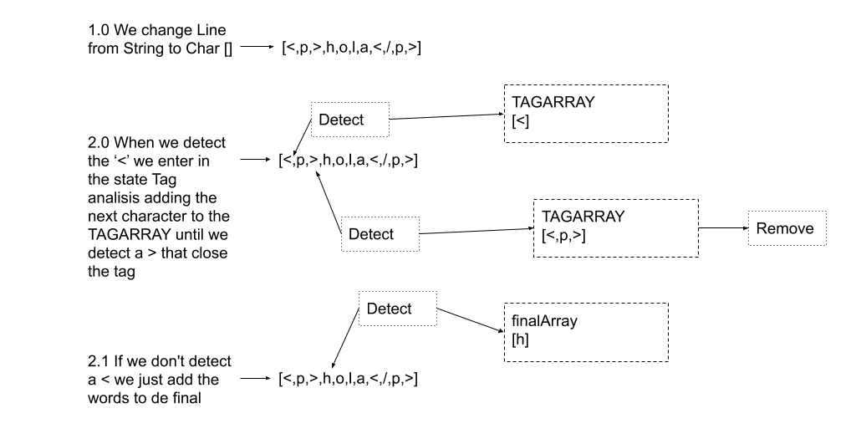
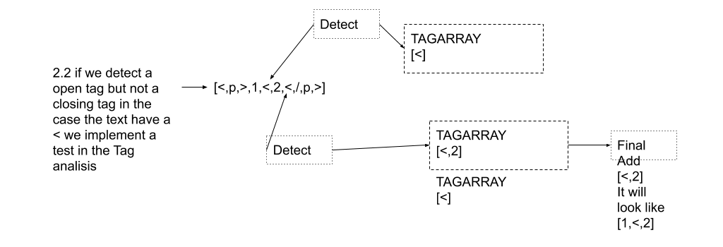
Implementation
Describe shortly how you implemented the HTML cleaning

Slide 3
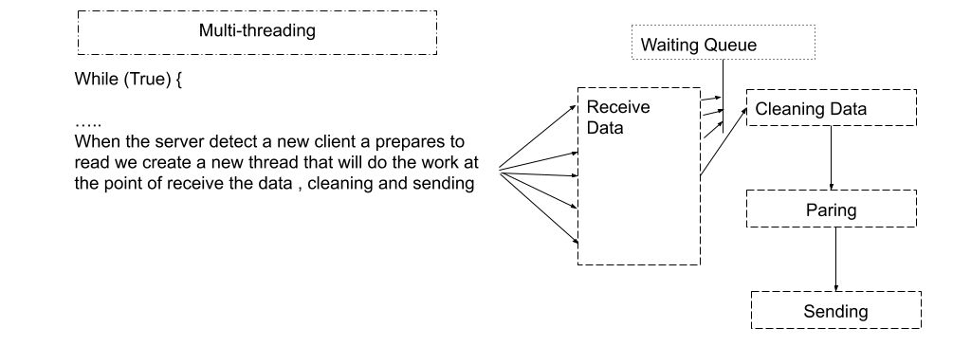
Implementation 2
Describe shortly how you implemented multi-threading

Slide 4
System Stability
State the default experiment length and replication factor
We extended the system with the features that were requested (1. Cleaning of document from special words, 2. Add fine-grained statistics gathering inside the server. 3. Extend the server into a multi-threaded implementation). We implemented those features in a progress way that means that we didn't implement all the features from the beginning because one of our purpose was evaluate the system with each improvement. The first phase one we just calculate the times that was requesting in each method of the system, in the second phase we implemented the cleaning method of the HTML files and in the last one, we implemented the multithreading to handle the calls on the server.

Slide 5
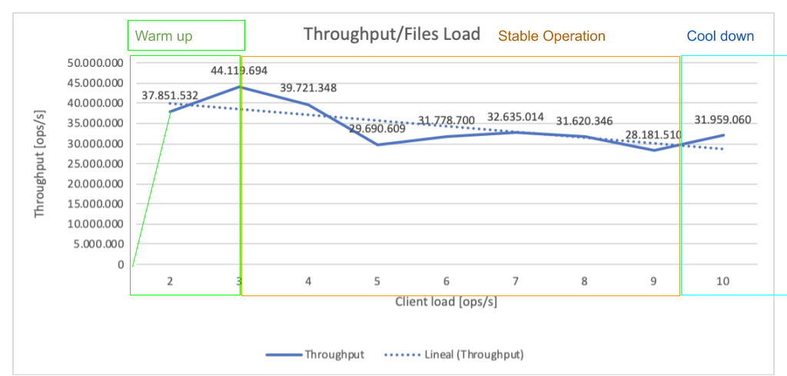
System Stability
Show an example graph with throughput over time (at least 1 minute) that motivates how you chose the warm-up and cool-down times

Slide 6
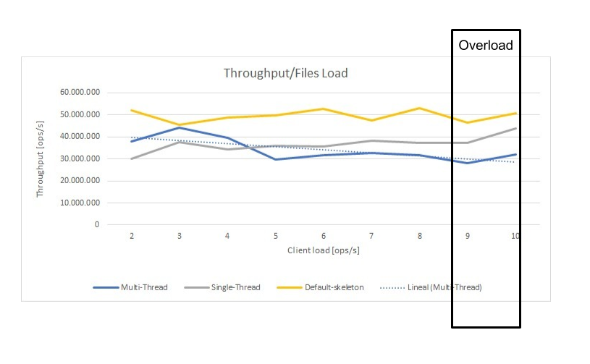
Baselines

Slide 7
Effect of Document Type

Slide 8
Conclusion
We learn how to interpretant the behave of a system that uses queues and how to measure that systems.
We learn a bit of aws, we practice a bit of java, and we learn a bit of queue theory and measurement of system.
The low time to develop the project, the connection with AWS and interpretant the results with sense.

